Slide 1
Information Visualization 2023 | Computer Science & iCompetence
Marco Soldati
March/April 2023
Spatial Geo Chart
05

Slide 2
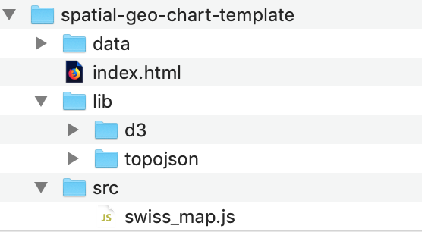
Template folder
Copy ‘template’ folder from Teams

Slide 3
Start HTTP Server
SimpleHTTPServer for Python
httpd for Ruby
http-server for Node
Or use your IDE (e.g. install Live Server on VS Code)

Slide 4
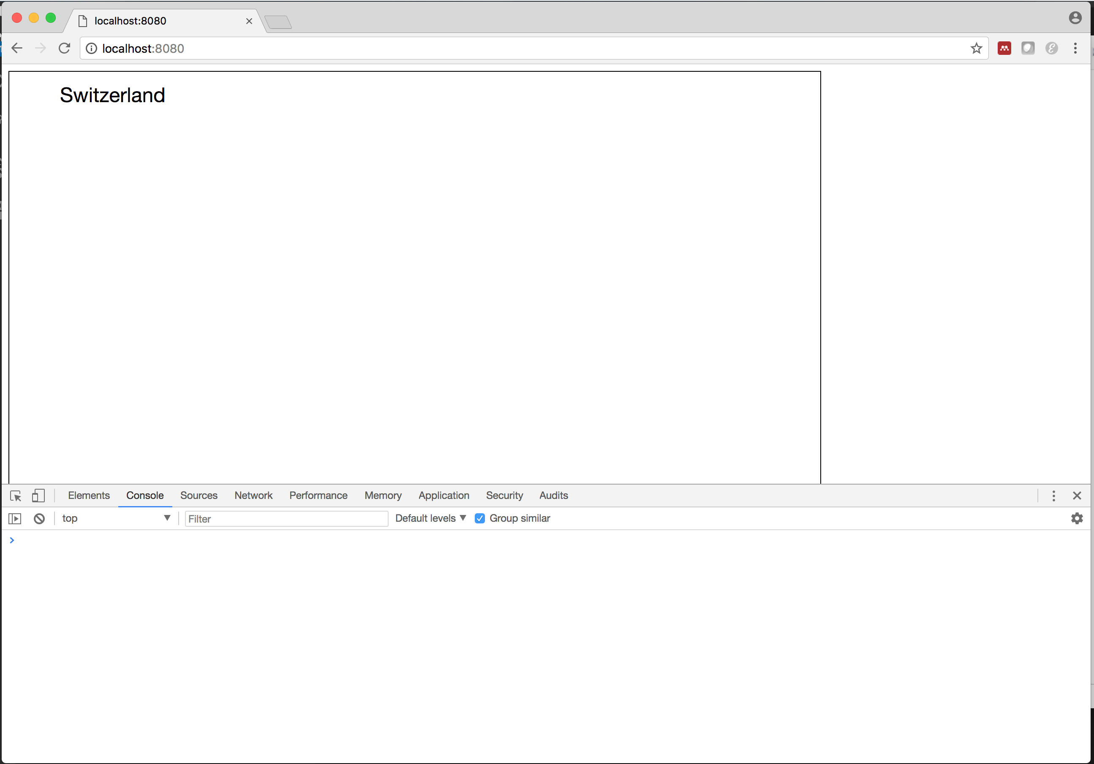
Step 1: Get Ready

Slide 5
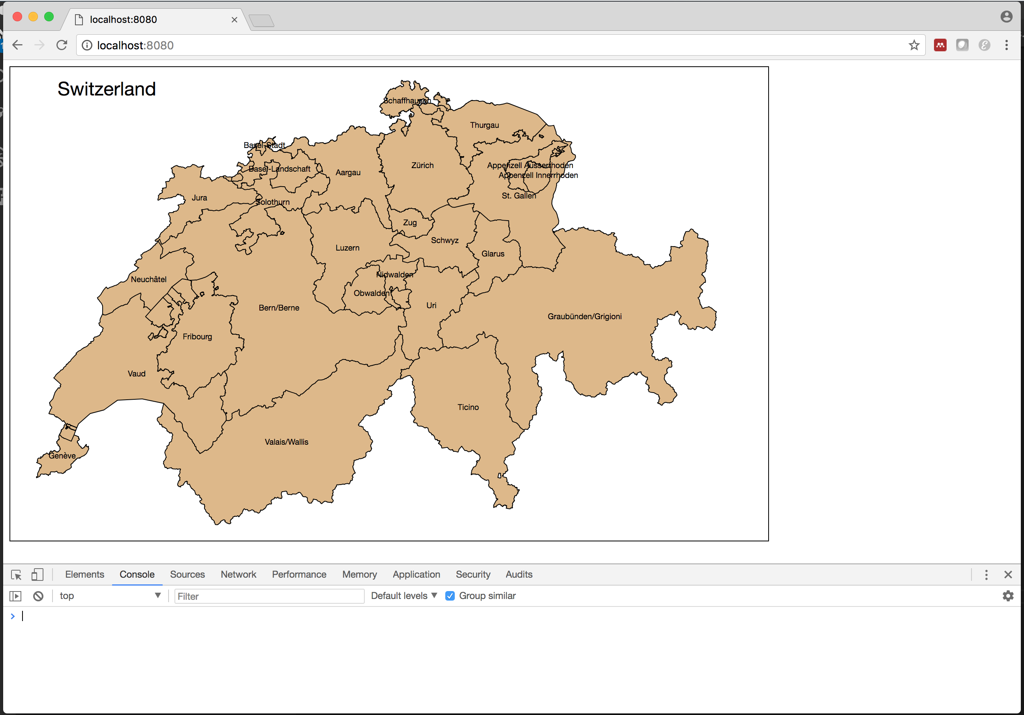
Step 2: Adapt Existing Code
https://bl.ocks.org/mbostock/4207744

Slide 6
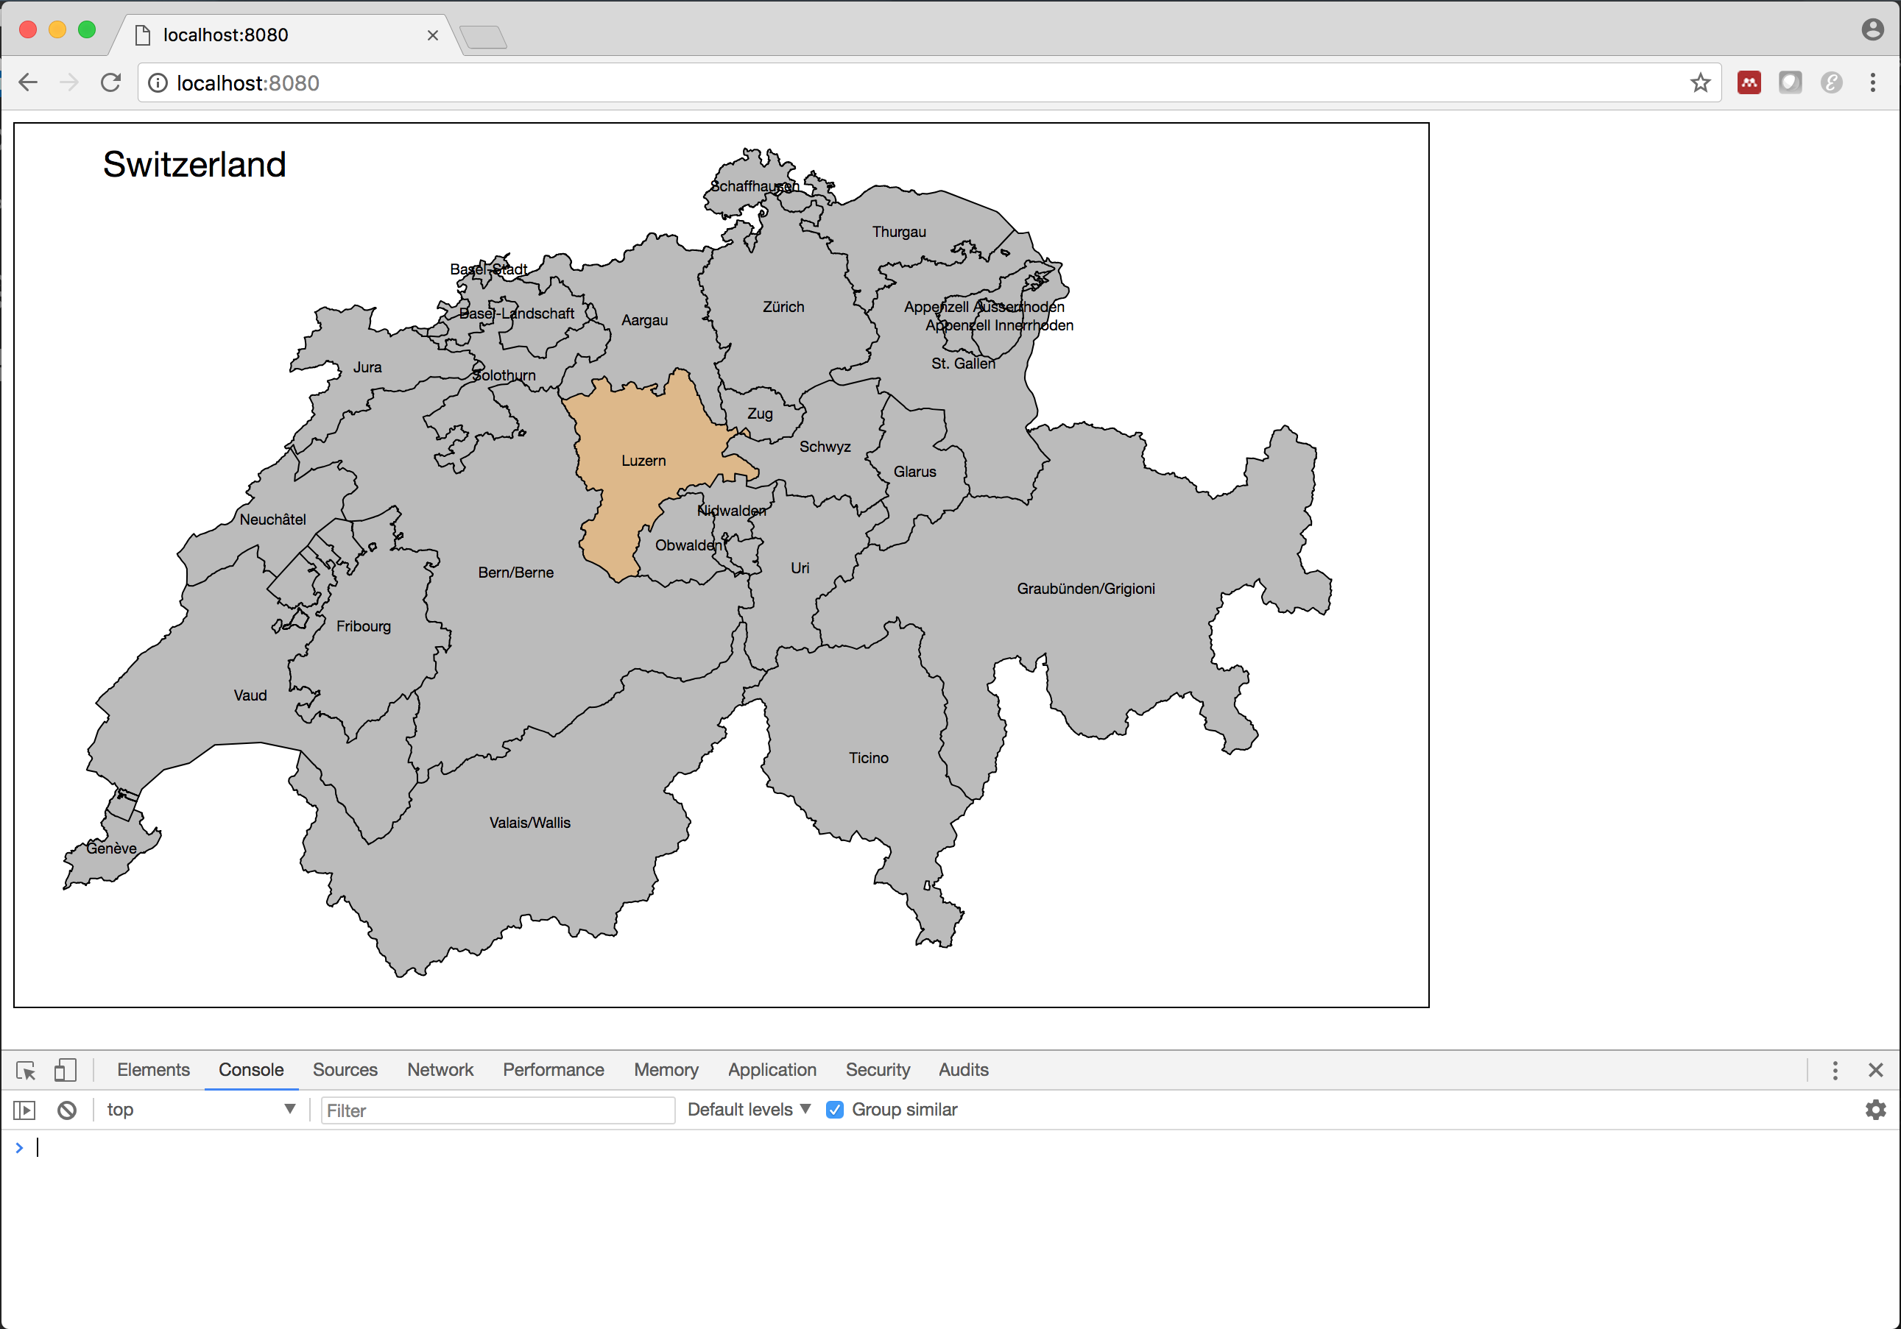
Step 3: Draw Each Canton

Slide 7
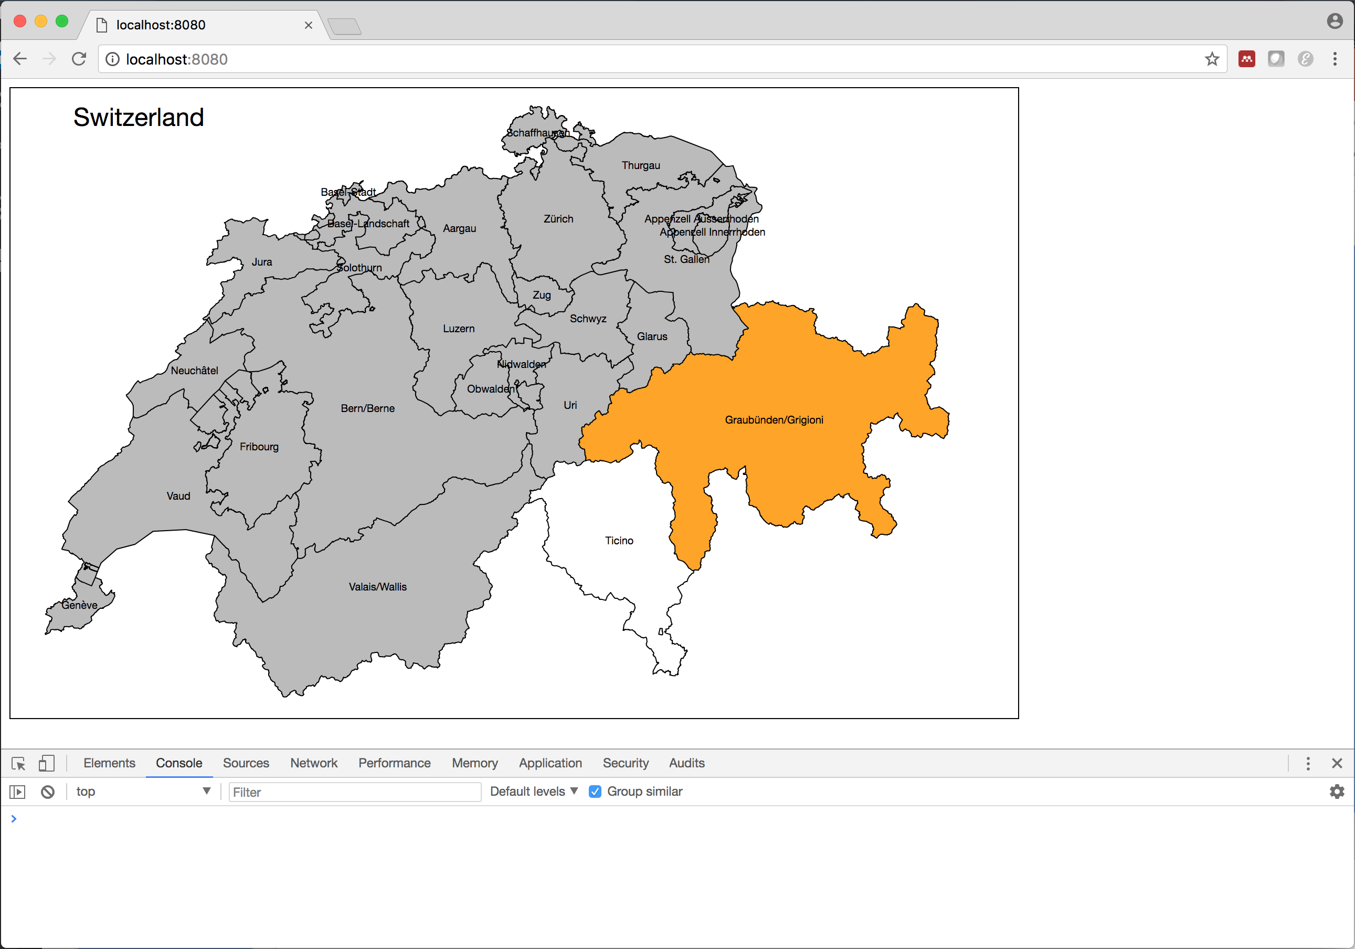
Step 4: Add Mouse Events

Slide 8

Step 5: Add Context

Slide 9
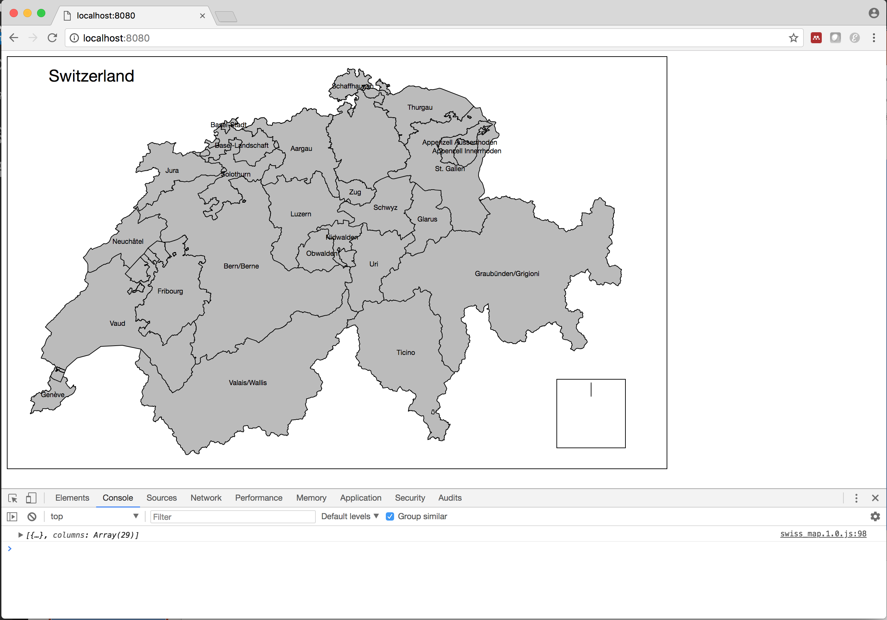
Step 6: Add Context Data

