Slide 1
Recordings
Recordings of this slide show are available in
German on SwitchTube
English on SwitchTube
Course material is available on Teams.

Slide 2

D3.js Tutorial (1/4)
SVG Introduction
marco.soldati@fhnw.ch
Computer scientist, researcher
Lecturer in information visualisation
February 2021

Slide 3
Basic Web Technologies
HTML/XML
<html>
<head>...
<body>
<h1>...</h1>
<h2>...</h2>
<p>...</p>
<ul id="mylist">
<li>...</li>
</ul>
</body>
</html>
CSS
<style>
body {
color: Silver
}
.mylist {
list-style: disc
}
</style>
JavaScript
function hello() {
alert('hello’);
}
hello();
JSON
[{
"name": "John",
"age": 30,
"city": "London"
},
{
"name": "Jane",
"age": 20,
"city": "Rome"
}]
Content & Structure
Presentation / Styling
Behaviour
Data

Slide 4
Scalable Vector Graphics (SVG)
XML-based vector image format
Supports interaction and animation
Uses CSS for styling and JavaScript for scripting
Usually created through drawing apps like Inkscape, Adobe Illustrator, etc
Natively supported by most browsers
SVG Visual Cheat Sheet
http://www.cheat-sheets.org/own/svg/index.xhtml
Adopted from: https://developer.mozilla.org/en-US/docs/Web/SVG/Tutorial/Introduction

Slide 5
Goals
Understand the basic concepts of SVG (the SVG specification is huge)
Understand how D3.js modifies SVG

Slide 6

<svg>
<svg version="1.1" baseProfile="full" width="300" height="200"
xmlns="http://www.w3.org/2000/svg">
<rect width="100%" height="100%" fill="yellow" />
<circle cx="150" cy="100" r="80" fill="blue" />
<text x="150" y="125" font-size="60" text-anchor="middle" fill="white">SVG</text> </svg>

Slide 7
Try it out
<svg version="1.1" baseProfile="full" width="300" height="200"
xmlns="http://www.w3.org/2000/svg">
<rect width="100%" height="100%" fill="yellow" />
<circle cx="150" cy="100" r="80" fill="blue" />
<text x="150" y="125" font-size="60" text-anchor="middle" fill="white">SVG</text> </svg>
1. Copy content into file sample1.svg and open in any browser
2. Swap <rect>, <circle> and <text>
3. Play with positions, size and color
http://www.cheat-sheets.org/own/svg/index.xhtml is your friend.

Slide 8
Embed SVG in HTML
①
<object data="image.svg" type="image/svg+xml" />
②
<iframe src="image.svg"></iframe>
③
<!DOCTYPE html>
<html>
<body>
<h1>My first SVG</h1>
<svg width="100" height="100">
<circle cx="50" cy="50" r="40" stroke="green” stroke-width="4" fill="yellow" />
</svg>
</body>
</html>

Slide 9
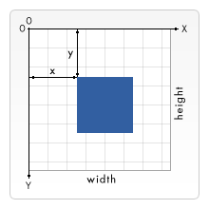
The SVG grid
Note: this is somewhat counter intuitive when drawing vertical bar charts with a baseline at the bottom

Slide 10
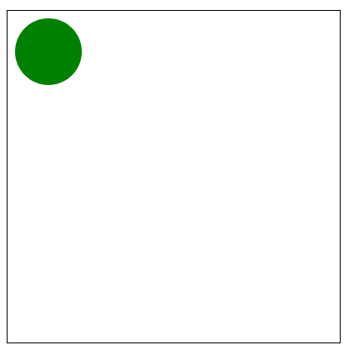
SVG is scalable
<svg width="200" height="200">
<rect width="100%" height="100%"
style="fill:white;stroke-width:1;stroke:rgb(0,0,0)" />
<circle cx="25" cy="25" r="20" fill="green"/>
</svg>

Slide 11
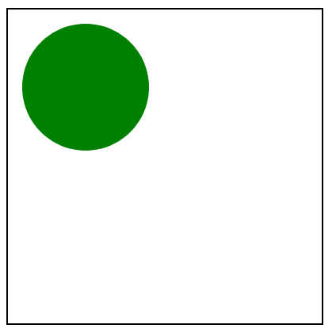
SVG is scalable
<svg width="200" height="200" viewBox="0 0 100 100">
<rect width="100%" height="100%"
style="fill:white;stroke-width:1;stroke:rgb(0,0,0)" />
<circle cx="25" cy="25" r="20" fill="green"/>
</svg>

Slide 12

Basic shapes 1/2
<svg width="400" height="125" version="1.1" xmlns="http://www.w3.org/2000/svg">
<rect x="10" y="10" width="30" height="30" stroke="black" fill="transparent" stroke-width="5"/>
<rect x="60" y="10" rx="10" ry="10" width="30" height="30" stroke="black" fill="transparent" stroke-width="5"/>
<circle cx="125" cy="25" r="20" stroke="red" fill="transparent" stroke-width="5"/>
<ellipse cx="180" cy="25" rx="20" ry="5" stroke="red" fill="transparent" stroke-width="5"/>
</svg>

Slide 13

Basic shapes 2/2
<svg width="400" height="250" version="1.1" xmlns="http://www.w3.org/2000/svg">
<line x1="10" y1="10" x2="50" y2="50" stroke="orange" stroke-width="5"/>
<polyline points="60 10 65 20 70 15 75 30 80 25 85 40 90 35 95 50 100 45" stroke="orange" fill="transparent" stroke-width="5"/>
<polygon points="150 10 155 30 170 30 160 40 165 55 150 45 135 55 140 40 130 30 145 30"
stroke="green" fill="transparent" stroke-width="5"/>
<path d="M200,30 Q220,05 230,30 T270,30" fill="none" stroke="blue" stroke-width="5"/>
</svg>

Slide 14
Path Tag <path>
<path d="M200,30 Q220,05 230,30 T270,30"/>
Mini language for SVG paths
https://gist.github.com/spoike/a524526aab5bb42ee229

Slide 15
SVG path mini language
M or m¹ | moveto | (x y)+
L or l | lineto | (x y)+
H or h | horizontal lineto | (x)+
V or v | vertical lineto | (y)+
Z or z | close path | none
Line commands
C or c | Bézier curveto | (x1 y1 x2 y2 x y)+
S or s | Shorthand Bézier curveto | (x2 y2 x y)+
Q or q | Quadratic Bézier curveto | (x1 y1 x y)+
T or t | Shorthand quadratic Bézier curveto | (x y)+
A or a | Elliptical arc | (rx ry rotation arc-flag sweep-flag x y)
Curve commands
¹ Capital letter: absolute position, small letter: relative position

Slide 16
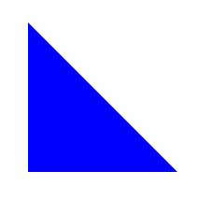
<path> - lines
<svg width="100" height="100" xmlns="http://www.w3.org/2000/svg">
<path d="M10 10 L 90 90 H 10 V 10 Z" style="fill:blue"/>
</svg>

Slide 17
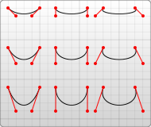
<path> - curves
<path d="M10 10 C 20 20, 40 20, 50 10" stroke="black" fill="transparent"/>
<path d="M70 10 C 70 20, 120 20, 120 10" stroke="black" fill="transparent"/>
<path d="M130 10 C 120 20, 180 20, 170 10" stroke="black" fill="transparent"/>
<path d="M10 60 C 20 80, 40 80, 50 60" stroke="black" fill="transparent"/>
<path d="M70 60 C 70 80, 110 80, 110 60" stroke="black" fill="transparent"/>
<path d="M130 60 C 120 80, 180 80, 170 60" stroke="black" fill="transparent"/>
<path d="M10 110 C 20 140, 40 140, 50 110" stroke="black" fill="transparent"/>
<path d="M70 110 C 70 140, 110 140, 110 110" stroke="black" fill="transparent"/>
<path d="M130 110 C 120 140, 180 140, 170 110" stroke="black" fill="transparent"/>

Slide 18

Try it out
<svg width= "320" height= "320" xmlns="http://www.w3.org/2000/svg">
<path d="" style="fill:white"/>
</svg>
Create the swiss flag with a path statement
If you want to be correct use the measures from here: https://en.wikipedia.org/wiki/Flag_of_Switzerland

Slide 19
Styles / CSS
Fill and stroke attributes
<rect x="10" y="10" width="100" height="100" stroke="blue" fill="purple” fill-opacity="0.5" stroke-opacity="0.8"/>
Style attribute
<rect x="10" height="180" y="10" width="180" style="stroke: black; fill: red;"/>
CSS
<?xml version="1.0" standalone="no"?>
<?xml-stylesheet type="text/css" href="style.css"?>
<svg width="200" height="150" >
<rect height="10" width="10" id="MyRect"/>
</svg>
Or use HTML CSS: https://www.w3schools.com/css/css_howto.asp

Slide 20
Styles / CSS
Embedded CSS
<svg width="200" height="200">
<defs>
<style type="text/css"><![CDATA[
#MyRect {
stroke: black;
fill: red;
}
]]></style>
</defs>
<rect x="10" height="180" y="10" width="180" id="MyRect"/>
</svg>

Slide 21

Group Tag <g>
<svg width="400" height="100">
<g fill="lightblue">
<rect x="20" y="20" width="60" height="60" />
<rect x="120" y="20" width="60" height="60" />
</g>
<g fill="purple">
<circle cx="50" cy="50" r="25"/>
<circle cx="150" cy="50"r="25"/>
</g>
</svg>

Slide 22

Transformation
<svg width="400" height="100">
<g fill="lightblue">
<rect x="20" y="20" width="60" height="60" />
<rect x="120" y="20" width="60" height="60" />
</g>
<g fill="purple" transform="translate(20, 20)">
<circle cx="50" cy="50" r="25"/>
<circle cx="150" cy="50"r="25"/>
</g>
</svg>

Slide 23

Transformation
<svg width="400" height="100">
<g fill="lightblue">
<rect x="20" y="20" width="60" height="60" transform="rotate(45 50 50)" />
<rect x="120" y="20" width="60" height="60" transform="translate(40 0) rotate(45 150 50)" />
</g>
<g fill="purple" transform="translate(20, 20)">
<circle cx="50" cy="50" r="25"/>
<circle cx="150" cy="50"r="25"/>
</g>
</svg>

Slide 24

Try it out
Create a pattern like this, use group tags

