Slide 1
Information Visualization 2021 | Computer Science & iCompetence
Marco Soldati
March 2021
D3 Introduction / Scale & Axis
02

Slide 2
Why D3.js
D3 is popular 80M Downloads, 90K Stars
D3 is flexible – as a developer you have full control
D3 is renowned for animation and interaction
D3 there is a huge community and lots of examples out there
Why not d3.js
There is quite a learning curve for d3.js → As a software engineer at bachelor level, it is achievable

Slide 3
Some comments
This tutorial is meant as a quick start for some of the important and slightly more complex features of d3.js
Thus, this tutorial does not cover all aspects of d3.js
Check the excellent online resources for more details
Best is to start your project from an existing drawing and adapt it towards your needs

Slide 4
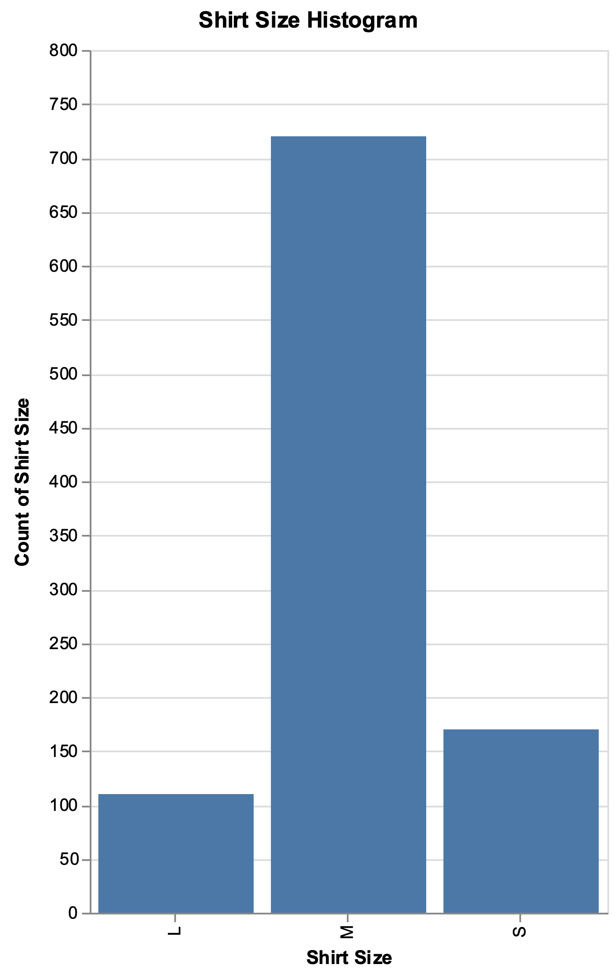
Goal – D3 Shirt Size Histogram
Vega-Lite

Slide 5
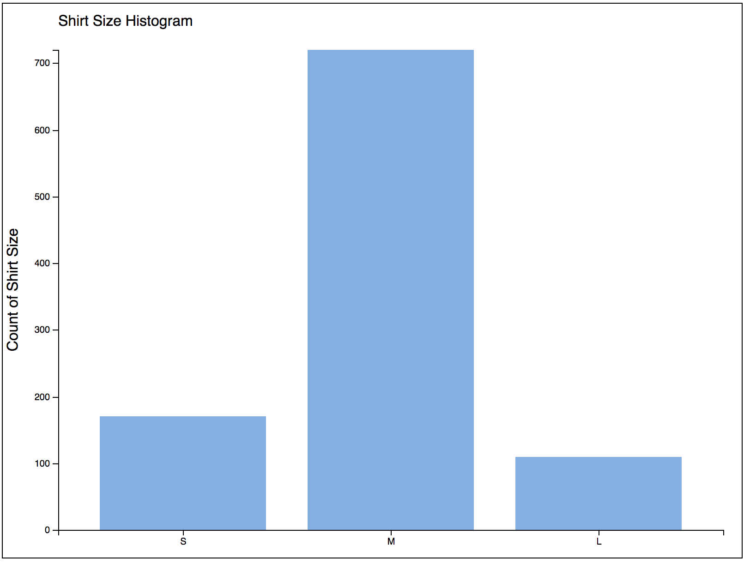
Goal – D3 Shirt Size Histogram
D3

Slide 6
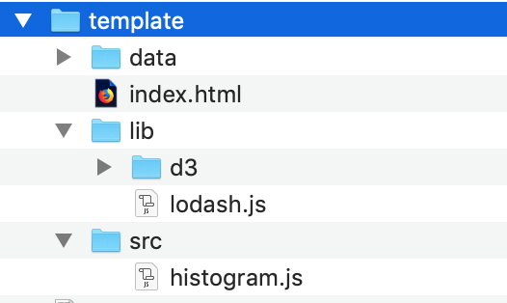
Template folder

Slide 7
Your turn
Copy template folder from active directory to your computer
Open Terminal and cd to your directory
Run a local server: # For Python version >3 python3 -m http.server # On windows try "python" # For Python version 2 python -m SimpleHTTPServer
Open index.html in Browser
Open index.html in your favourite Editor
Alternatively: use your web development IDE with an integrated server

Slide 8
HTML Template
<!doctype html>
<html>
<head>
<meta charset="utf-8"/>
</head>
<body>
<!-- put your html stuff here -->
<script src='lib/d3/d3.js'></script>
<script src='lib/lodash.js'></script>
<script src='src/histogram.js'></script>
</body>
</html>

Slide 9
histogram.js – sample data
var shirt_data = [
{"size": "S", "count" : 170},
{"size": "M", "count" : 720},
{"size": "L", "count" : 110}
];
Notes:
Simplified – Data aggregation is left out.

Slide 10
histogram.js – drawing area
// create svg canvas
const canvHeight = 600, canvWidth = 800;
const svg = d3.select("body").append("svg")
.attr("width", canvWidth)
.attr("height", canvHeight)
.style("border", "1px solid");
// calc the width and height depending on margins.
const margin = {top: 50, right: 20, bottom: 30, left: 60};
height = canvHeight - margin.top - margin.bottom;
width = canvWidth - margin.left - margin.right;
Notes:
Simplified – Data aggregation is left out.

Slide 11
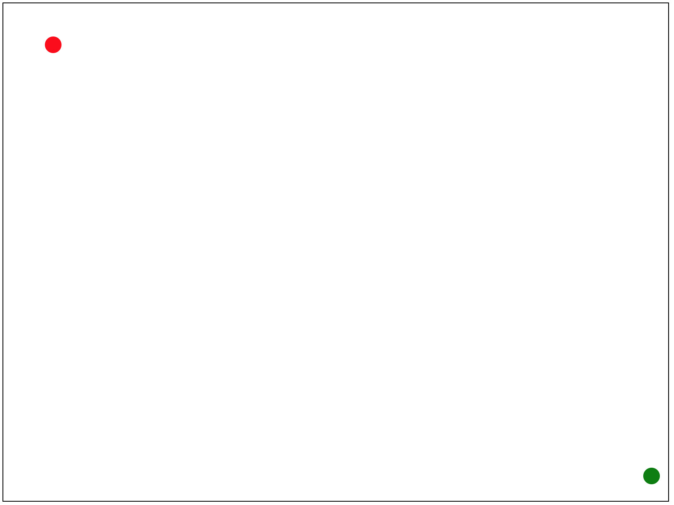
histogram.js – drawing area
svg.append("circle")
.attr("cx", margin.left)
.attr("cy", margin.top)
.attr("r", 10)
.style("fill", "red");
svg.append("circle")
.attr("cx", margin.left + width)
.attr("cy", margin.top + height)
.attr("r", 10)
.style("fill", "green");
Notes:
Simplified – Data aggregation is left out.

Slide 12
Your turn
Draw red and green point

Slide 13
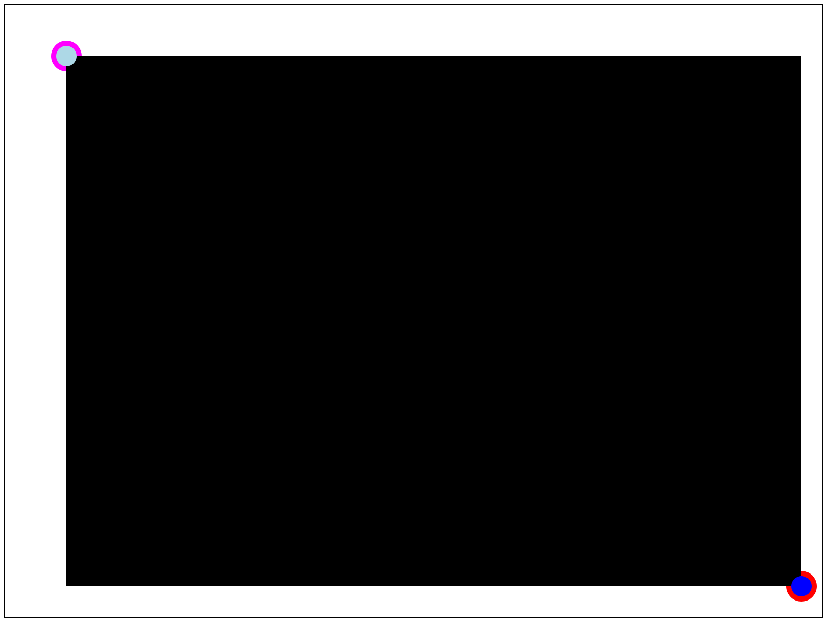
Your turn
Append a <g>-tag for the chart area, set its top/left point to the red dot (hint: use transform="translate(x,y)")
Append a <rect id="chart-area-box" ...> to mark the chart area

Slide 14
Cascading Style Sheets (CSS)
Describes the presentation of HTML and SVG elements
CSS
https://www.cheatography.com/davechild/cheat-sheets/css2/
CSS Selectors – exhaustively used by d3.select() and d3.selectAll()
https://www.cheatography.com/dimitrios/cheat-sheets/the-30-css-selectors-you-must-memorize/
https://wiki.selfhtml.org/wiki/CSS/Selektoren
Notes:
CSS selectors will be discussed later

Slide 15
CSS – index.html
<head>
<meta charset="utf-8"/>
<style>
#chart-area-box { }
.bar { fill: #82AEE5; }
</style>
</head>
<body>
...
Notes:
Simplified – Data aggregation is left out.

Slide 16
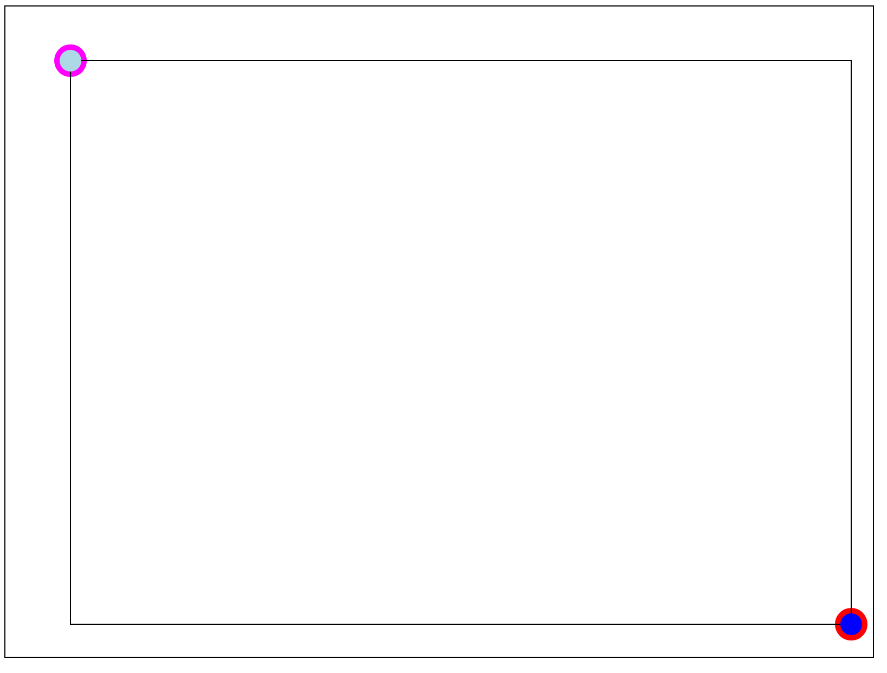
Your turn
Add CSS <style> section to index.html
Create a style for the outer box (fill: none; stroke: black)

Slide 17
D3.js
D3 modules
https://github.com/d3
D3 Gallery
https://github.com/d3/d3/wiki/Gallery
D3 API Reference
https://github.com/d3/d3/blob/master/API.md

Slide 18
Scale
A mapping from values to values ("Math")
Axis
A visual representation of a scale ("SVG Generator")

Slide 19
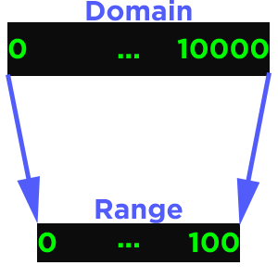
Scale
A mapping from values to values – aka a function:
var x = d3.scaleLinear()
.domain([0, 10000])
.range([0, 100]);
x(2000); // 20
x(32000); // 320

Slide 20
Scale
A mapping from values to values – aka a function:
Input ▶ Output
Domain ▶ Range Attribute ▶ Channel Data (Values) ▶ Screen (Pixels) Examples: Person Height ▶ Pixel Position Person Shirt Size ▶ Pixel Color

Slide 21
Linear Scales Continuous Input ▶ Continuous Output
≤ v3
d3.scale.linear();
≥ v4
d3.scaleLinear();

Slide 22
const scale = d3.scaleLinear();
Domain
0
1
1:1
Range
0
1
scale(0.5); // returns 0.5 scale(99); // returns 99

Slide 23
const scale = d3.scaleLinear()
.domain([100, 200]);
Domain
100
200
Normalization
Range
0
1
scale(100); // 0 scale(150); // 0.5
scale(200); // 1 scale(300); // 2

Slide 24
const scale = d3.scaleLinear()
.domain([100, 200])
.range([10, 90]);
Domain
100
200
Mapping
Range
10
90
scale(100); // 10 scale(150); // 50
scale(200); // 90 scale(250); // 130

Slide 25
Ordinal Scales Discrete Input ▶ Discrete Output
≤ v3
d3.scale.ordinal();
≥ v4
d3.scaleOrdinal();

Slide 26
const scale = d3.scaleOrdinal()
.domain(["I", "II", "III"])
.range(["Jan", "Feb", "Mar"]);
I
II
III
Jan
Feb
Mar
scale("II"); // "Feb"

Slide 27
const scale = d3.scaleOrdinal()
.domain(["I", "II", "III"])
.range(["Jan", "Feb", "Mar"]);
I
II
III
X
Jan
Feb
Mar
?
scale("X"); // ???

Slide 28
const scale = d3.scaleOrdinal()
.domain(["I", "II", "III"])
.range(["Jan", "Feb", "Mar"]);
I
II
III
X
Jan
Feb
Mar
Jan
Feb
Mar
Domain grows dynamically (cyclic)
scale("X"); // "Jan”
scale.domain(); // ["I", "II", "III", "X"]

Slide 29
const color = d3.scaleOrdinal()
.range(d3.schemeCategory10);
color("one"); // "#1f77b4" (Blue)
color("next"); // "#ff7f0e" (Orange)

Slide 30
const color = d3.scaleOrdinal()
.range(d3.schemeCategory10);
Equivalent Pass range to constructor
const color = d3.scaleOrdinal(d3.schemeCategory10);

Slide 31
Band Scales Discrete Input ▶ Continuous Output Bands
≤ v3
d3.scale.ordinal().rangeBands()
≥ v4
d3.scaleBand();

Slide 32
Full Padding Control Perfect for Bar Charts / Histograms / Grids

Slide 33
Axis A visual representation of a scale aka A function which generates SVG Scale ▶ SVG

Slide 34
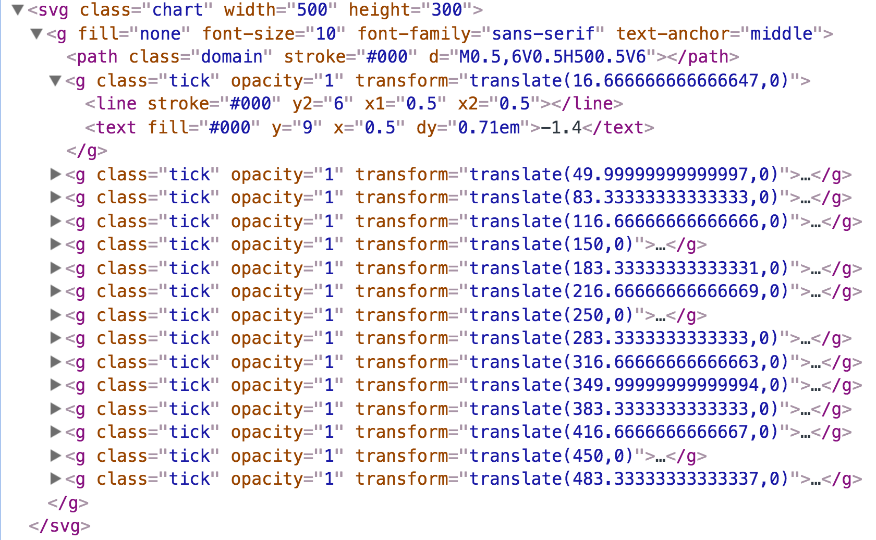
const xAxis = d3.axisBottom(xScale);
svg.call(xAxis);

Slide 35
Homework
Create the TShirt-Size Histogram
Create boxes
Create titles
Create scales for x- and y
Create axis for xScale and yScale
Use Chrome Console to check it.

