Slide 1
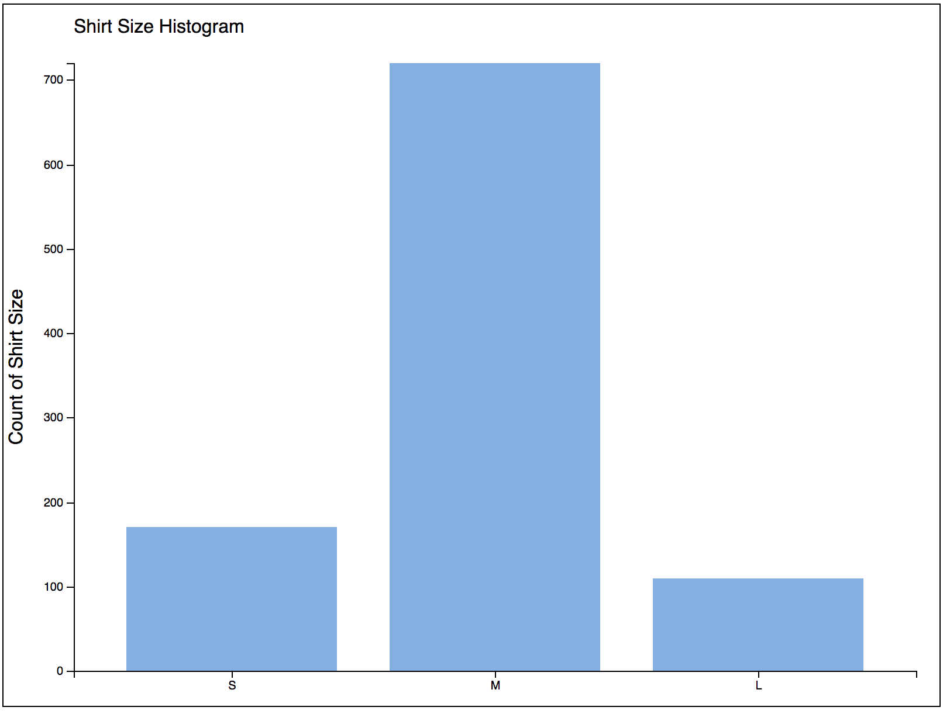
D3 Shirt Size Histogram
D3

Slide 2
Document Object Model
<html>
<head>
<title>
<body>
<svg>
<g> xAxis
<g> yAxis
<g> chart-area
<text>
y-title
<rect> bar_s
<rect> bar_m
<rect> bar_l
<text> chart-title

Slide 3
DOM Manipulation – append()
<g id="chart-area"></g>
append <rect>
g.append("rect")
.attr("width", "300")
.attr("height", "400");
<g id="chart-area">
<rect width="300"
height="400"/>
</g>

Slide 4
DOM Manipulation – attr()
<rect x="160" y="10" />
literal value
.attr("x", 42);
data item
.attr("x", function (d) { return d.weight; });
data item, index
.attr("x", function (d, i) { return i * 10; });

Slide 5
Arrow Functions
anonymous function
.attr("x", function (d) { return d.weight; });
arrow function
.attr("x", d => d.weight);
.attr("x", (d, i) => { return d.weight; }
concise/readable!

Slide 6
Arrow Functions
anonymous function
.attr("x", function (d) { return xScale(d); });
arrow function
.attr("x", d => xScale(d));
even simpler
.attr("x", xScale);

Slide 8
Information Visualization 2021 | Computer Science & iCompetence
Marco Soldati
March 2021
D3 Introduction
Selections,
Data Binding
and Events
03

Slide 9
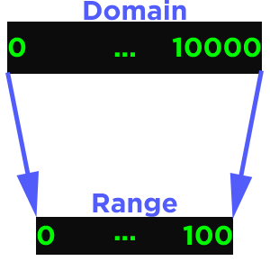
Recap – Scale
A mapping from values to values – aka a function:
var x = d3.scaleLinear()
.domain([0, 10000])
.range([0, 100]);
x(2000); // 20
x(32000); // 320

Slide 10
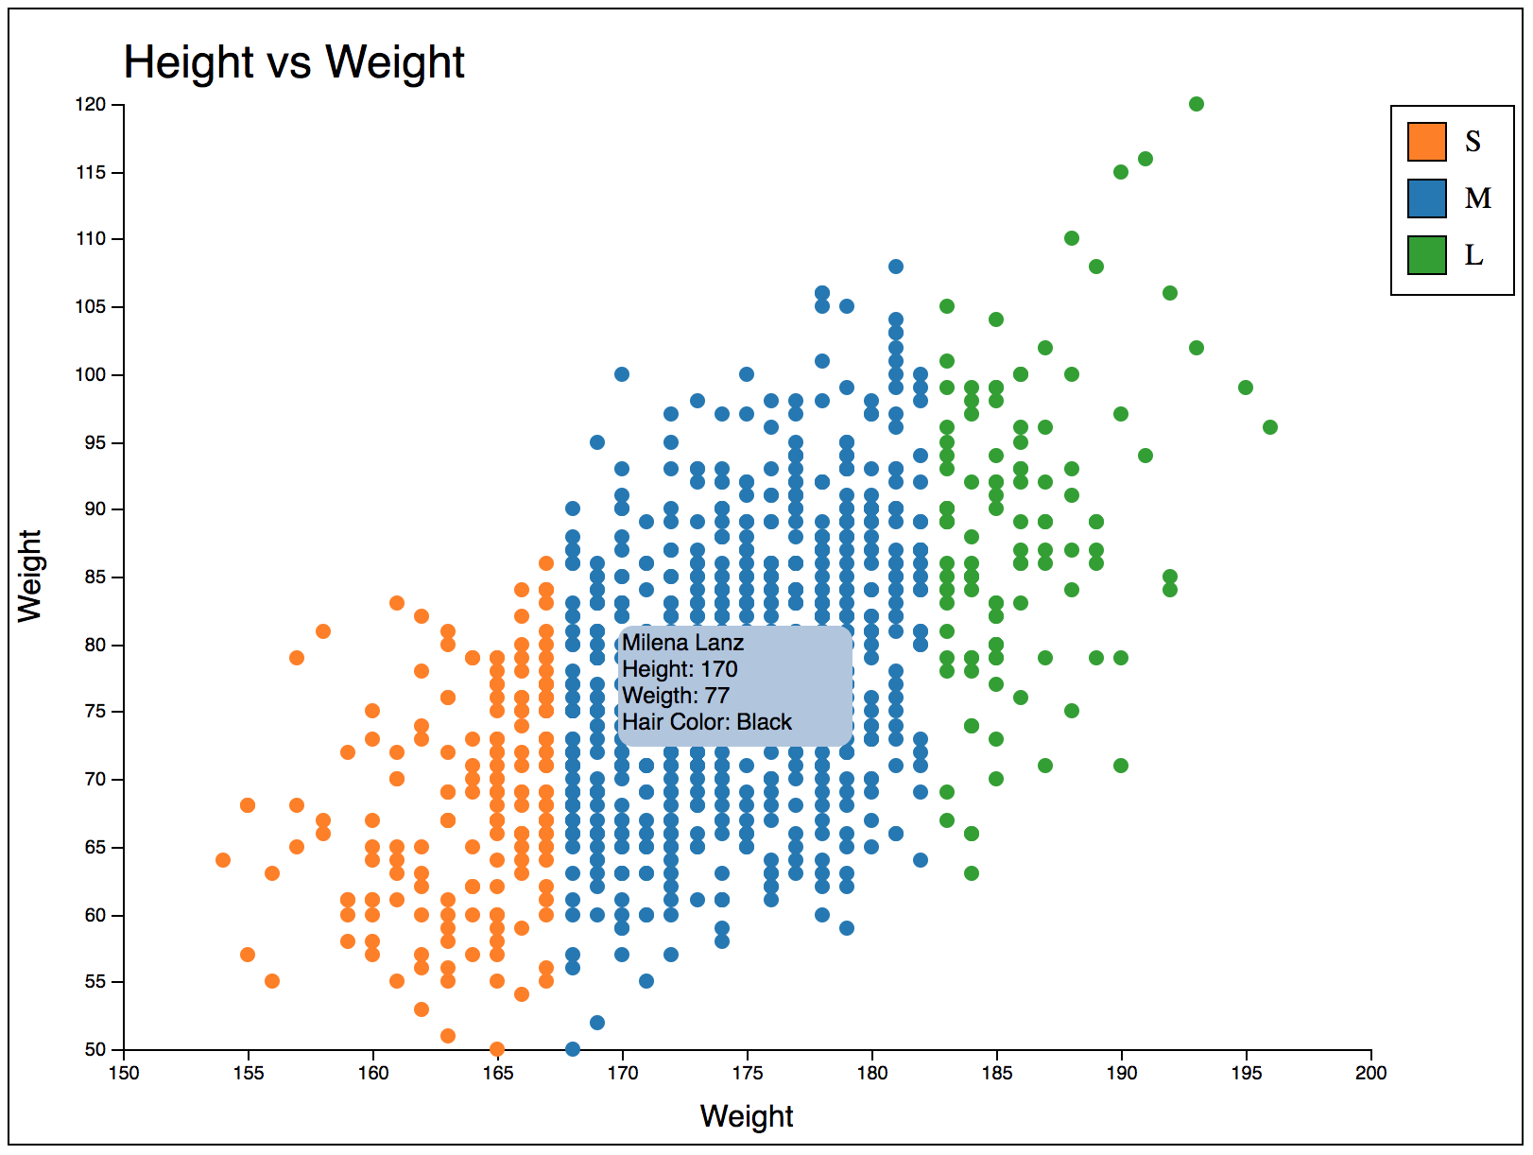
Goal – Interactive Scatterplot

Slide 11
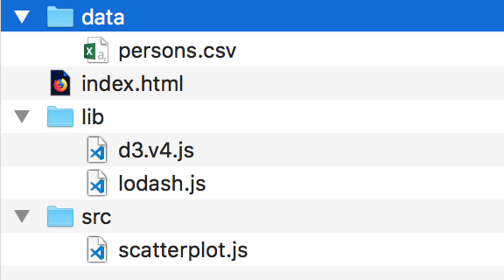
Template Folder

Slide 12
Your turn
Copy template from Active Directory
Startup local web server

Slide 13
D3.js
D3 modules
https://github.com/d3
D3 Gallery
https://github.com/d3/d3/wiki/Gallery
D3 API Reference
https://github.com/d3/d3/blob/master/API.md

Slide 14
HTML Template
<!doctype html>
<html>
<head>
<meta charset="utf-8"/>
</head>
<body>
<!-- put your stuff here -->
<script src='lib/d3/d3.js'></script>
<script src='lib/lodash.js'></script>
<script src='src/scatterplot.js'></script>
</body>
</html>

Slide 15
scatterplot.js – SVG fragment
// create svg canvas
const canvHeight = 600, canvWidth = 800;
const svg = d3.select("body").append("svg")
.attr("width", canvWidth)
.attr("height", canvHeight)
.style("border", "1px solid");
// calc the width and height depending on margins.
const margin = {top: 50, right: 20, bottom: 50, left: 60};
const width = canvWidth - margin.left - margin.right;
const height = canvHeight - margin.top - margin.bottom;
// create parent group and add left and top margin
const g = svg.append("g")
.attr("id", "chart-area")
.attr("transform", "translate(" +margin.left + ","
+ margin.top + ")");

Slide 16
D3 – .select() and .selectAll()
Name | Behaviour | Example
.style() | Update the style (css) | d3.selectAll('circle').style('fill', 'red')
.attr() | Update an attribute (html) | d3.selectAll('rect').attr('width', 10)
.classed() | Add/remove a class attribute | d3.select('.item').classed('selected', true)
.property() | Update an element's property | d3.selectAll('.checkbox').property('checked', false)
.text() | Update the text content | d3.select('div.title').text('My new book')
.html() | Change the html content | d3.select(‘#chart1').html(‘<h1>A new chart</h1>')

Slide 17
D3 – Nested Selections
<table>
<thead>
<tr><td> A</td><td> B</td><td> C</td><td> D</td></tr>
</thead>
<tbody>
<tr><td> 0</td><td> 1</td><td> 2</td><td> 3</td></tr>
<tr><td> 4</td><td> 5</td><td> 6</td><td> 7</td></tr>
<tr><td> 8</td><td> 9</td><td> 10</td><td> 11</td></tr>
<tr><td> 12</td><td> 13</td><td> 14</td><td> 15</td></tr>
</tbody>
</table>
var td = d3.selectAll("tbody td");
var td = d3.select("tbody").selectAll("td");
var td = d3.selectAll("tbody tr").selectAll("td");

Slide 18
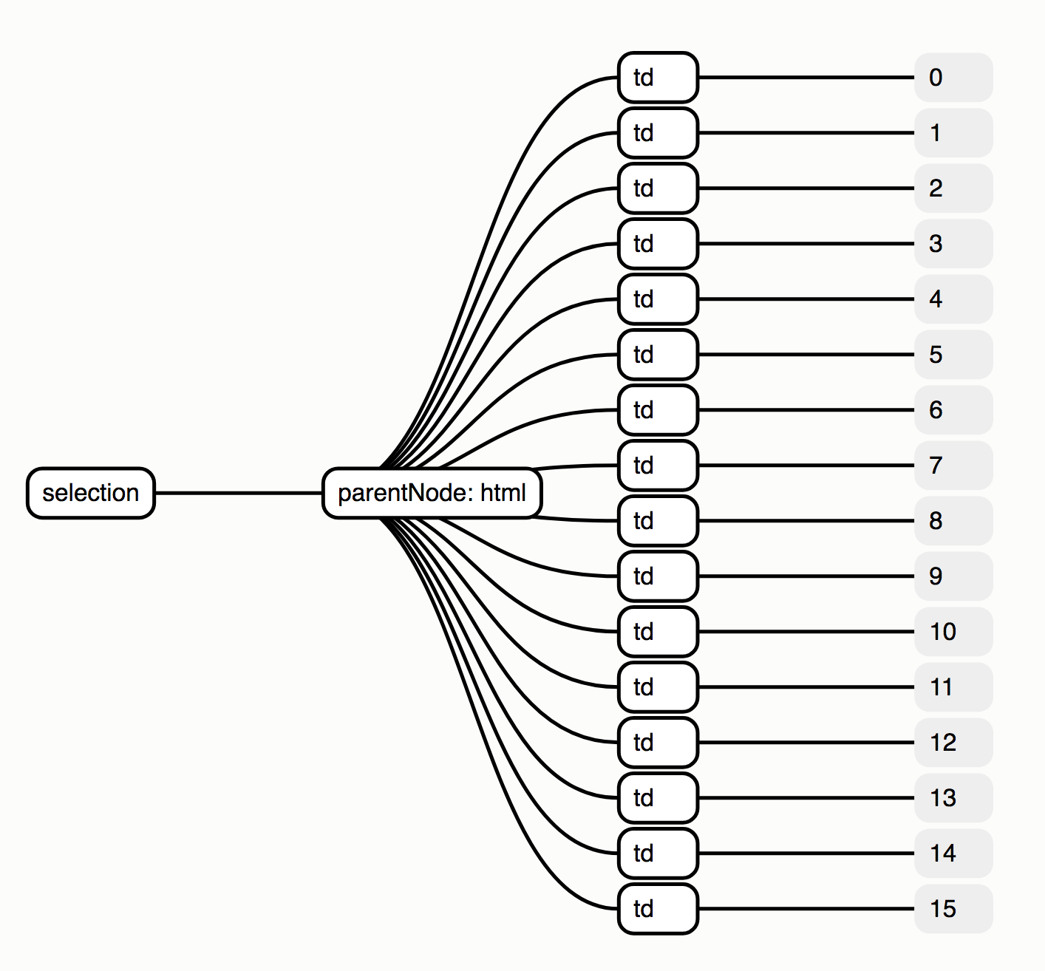
D3 – Nested Selections
var td = d3.selectAll("tbody td");

Slide 19
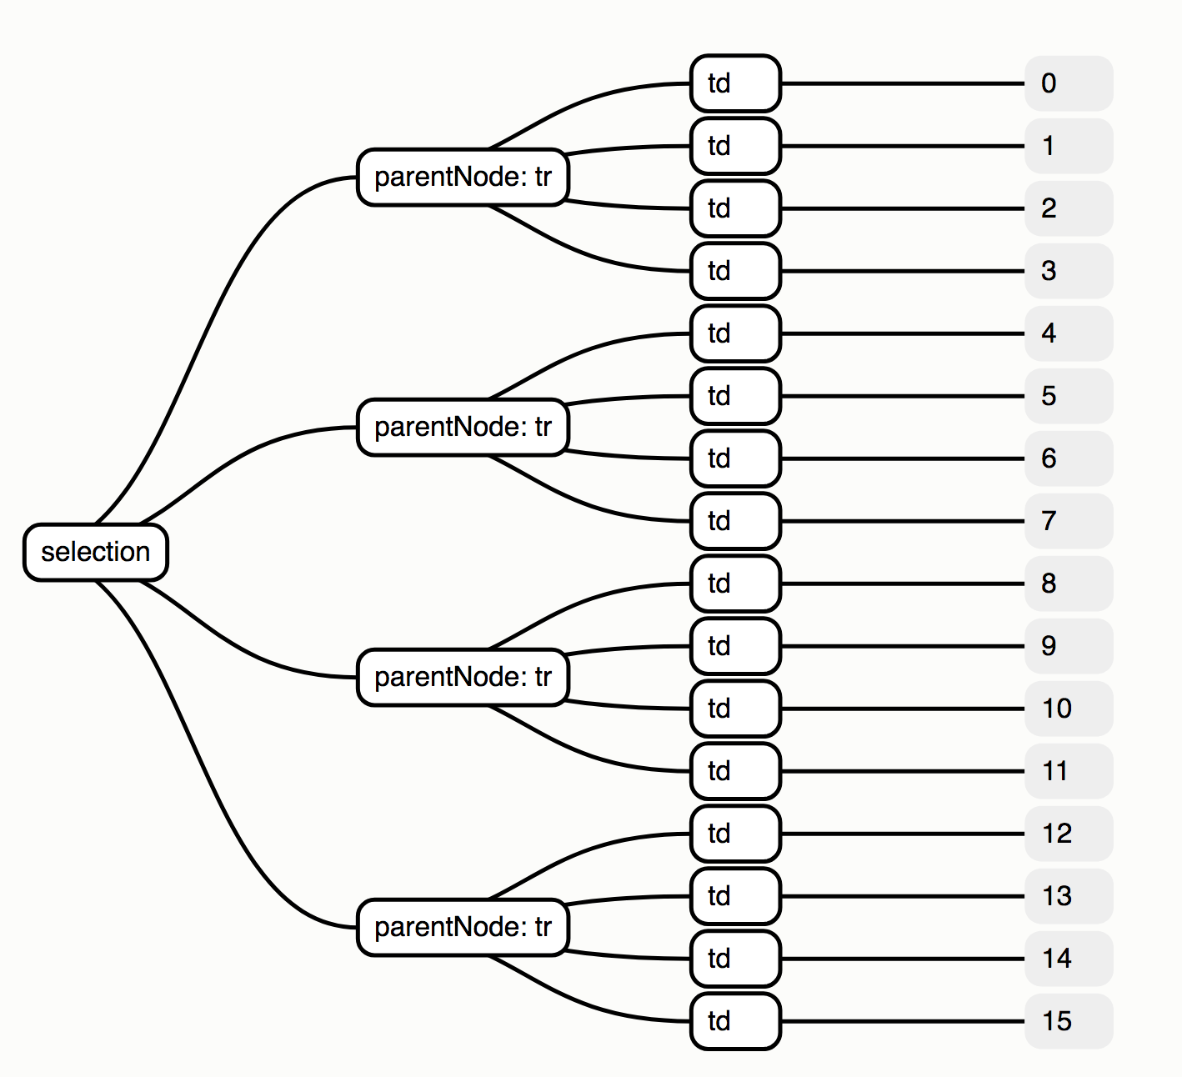
D3 – Nested Selections
var td = d3.selectAll("tbody tr").selectAll("td");
td.style("color", function(d, i) => i % 2 ? null : "red"; }); //col
td.style("color", function(d, i, j) => j % 2 ? null : ”blue"; }); //row

Slide 20
scatterplot.js – Text labels
// chart title
svg.append("text")
.attr("y", 0)
.attr("x", margin.left)
.attr("dy", "1.5em")
.attr("font-family", "sans-serif")
.attr("font-size", "24px")
.style("text-anchor", "left")
.text("Height vs Weight");
as HTML
<text y="0" x="60" dy="1.5em" font-family="sans-serif" font-size="24px">
Height vs Weight
</text>
Notes:
http://www.cheat-sheets.org/own/svg/index.xhtml#Text

Slide 21
scatterplot.js – Fetch Data
v3
d3-request
v4
d3-fetch
Notes:
Text: CSV, TSV, JSON, XML, SVG
Binary: image

Slide 22
scatterplot.js – Fetch Data
// load the data from the cleaned csv file.
// note: the call is done asynchronous.
// That is why you have to load the data inside of a
// callback function.
d3.csv("./data/persons.csv").then(function(data) {
const heightDomain = d3.extent(data, d => Number(d.Height));
const weightDomain = d3.extent(data, d => Number(d.Weight));
...
}
https://github.com/d3/d3-fetch
Notes:
Text: CSV, TSV, JSON, XML, SVG
Binary: image

Slide 23
scatterplot.js – Data Statistics
Methods for computing basic summary statistics.
d3.min - compute the minimum value in an array.
d3.max - compute the maximum value in an array.
d3.extent - compute the minimum and maximum value in an array.
d3.sum - compute the sum of an array of numbers.
d3.mean - compute the arithmetic mean of an array of numbers.
d3.median - compute the median of an array of numbers (the 0.5-quantile).
d3.quantile - compute a quantile for a sorted array of numbers.
d3.variance - compute the variance of an array of numbers.
d3.deviation - compute the standard deviation of an array of numbers.
https://github.com/d3/d3-array

Slide 24
scatterplot.js – Data Conversion
JavaScript data types
string ← String() converts to string
number ← Number() converts to number
boolean ← Boolean () converts to boolean
object
Object
Date
Array
function

Slide 25
scatterplot.js – Scales
// create scales for x and y direction
const xScale = d3.scaleLinear()
.domain(heightDomain)
.rangeRound([0,width])
.nice(5);
const yScale = d3.scaleLinear()
.domain(weightDomain)
.rangeRound([height,0])
.nice(5);
const colorScale = d3.scaleOrdinal(d3.schemeCategory10);

Slide 26
scatterplot.js – Axis
// create xAxis
const xAxis = d3.axisBottom(xScale);
g.append("g") // create a group and add axis
.attr("transform", "translate(0," + height + ")").call(xAxis);
// create yAxis
const yAxis = d3.axisLeft(yScale);
g.append("g") // create a group and add axis
.call(yAxis);
Notes:
Text: CSV, TSV, JSON, XML, SVG
Binary: image

Slide 27
scatterplot.js – Data Points
// add circle
g.selectAll("circle") // this results in an empty selection
.data(data) // which is joined with the data
.enter() // and a selection of new elements is created
.append("circle")
.attr("cx", d => xScale(d.Height))
.attr("cy", d => yScale(d.Weight))
.attr("r", 4)
.style("fill", d => colorScale(d["Shirt Size"]));
Notes:
Text: CSV, TSV, JSON, XML, SVG
Binary: image

Slide 28
Data Joins – .data()
Data
DOM elements
var scores = [
{ "name": "Andy", "score": 25},
{ "name": "Beth", "score": 39},
{ "name": "Craig", "score": 42},
{ "name": "Diane", "score": 35},
{ "name": "Evelyn", "score": 48}
]
<circle r="40" />
<circle r="40" cx="120" />
<circle r="40" cx="240" />
<circle r="40" cx="360" />
<circle r="40" cx="480" />
Join
d3.selectAll('circle’)
.data(scores);
http://d3indepth.com/datajoins/
Notes:
Text: CSV, TSV, JSON, XML, SVG
Binary: image

Slide 29
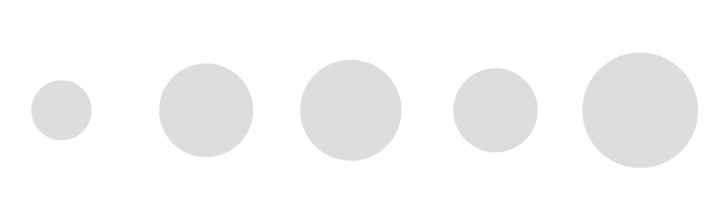
Data Joins – .data()
d3.selectAll('circle’)
.data(scores)
.attr('r', d => d.score);
Notes:
Text: CSV, TSV, JSON, XML, SVG
Binary: image

Slide 30
.enter() and .exit()
If the data array is longer than the DOM selection
there is a shortfall of DOM elements and
we need to add elements
→ .data().enter() is called
If the data array is shorter than the DOM selection
there is a surplus of DOM elements and
we need to remove elements
.data().exit() is called
Notes:
Text: CSV, TSV, JSON, XML, SVG
Binary: image

Slide 31

.enter()
Data
var myData = ['A', 'B', 'C', 'D', 'E'];
DOM
<div id="content">
<div></div>
<div></div>
<div></div>
</div>
Join
d3.select('#content’)
.selectAll('div’)
.data(myData)
.enter()
.append('div’)
.style("background-color", "blue");
https://bl.ocks.org/d3indepth/1450ba61704293ce528646a1cf02fd85
Notes:
Text: CSV, TSV, JSON, XML, SVG
Binary: image

Slide 32
.exit()
Data
var myData = ['A'];
DOM
<div id="content">
<div></div>
<div></div>
<div></div>
</div>
Join
d3.select('#content’)
.selectAll('div’)
.data(myData)
.exit()
.remove();
Notes:
Text: CSV, TSV, JSON, XML, SVG
Binary: image

Slide 33

.merge()
Data
var myData = ['A', 'B', 'C', 'D', 'E'];
DOM
<div id="content">
<div></div>
<div></div>
<div></div>
</div>
var u = d3.select('#content’)
.selectAll('div’)
.data(myData);
u.enter()
.append('div’)
.merge(u)
.style("background-color", "blue");
Join
Notes:
Text: CSV, TSV, JSON, XML, SVG
Binary: image

Slide 34
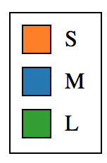
scatterplot.js - Legend
legendDomain = ["S", "M", "L"];
createLegend(legendDomain, colorScale);
function createLegend(legendDomain, colorScale) {
// 1. create a group to hold the legend // 2. create the legend boxes and the text label
// use .data(legendDomain) on an empty DOM selection // 3. create the main border of the legend
}
Notes:
Text: CSV, TSV, JSON, XML, SVG
Binary: image

Slide 35
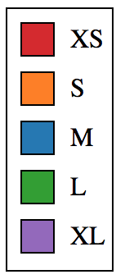
Your turn
Implement createLegend()
Test with
function createLegend(legendDomain, colorScale) {
// 1. create a group to hold the legend // 2. create the legend boxes and the text label
// use .data(legendDomain) on an empty DOM selection // 3. create the main border of the legend
}
legendDomain = ["XS", "S", "M", "L", "XL"];

Slide 36
Events – .on()
d3.selectAll('circle’)
.on('click', function(event, d) {
d3.select('.status’)
.text('You clicked on ‘ + d.Name);
});

Slide 37
Events
Event name | Description
click | Element has been clicked
mouseenter | Mouse pointer has moved onto the element
mouseover | Mouse pointer has moved onto the element or its children
mouseleave | Mouse pointer has moved off the element
mouseout | Mouse pointer has moved off the element or its children
mousemove | Mouse pointer has moved over the element
See https://developer.mozilla.org/en-US/docs/Web/Events#Standard_events for a full list of events

Slide 38
Your turn
Create a Tooltip with contextual information
Create a tooltip div (style it with CSS from next slide)
Add “mouseover” event to every circle
Display tooltip at mouse position (use .style(“left”, x) and .style(“top”, y)
Create tooltip content (use .html())
Add “mouseout” event to every circle
Hide tooltip (use attr(“visibility”, “hidden”))

Slide 39
Your turn
CSS for Tooltip <div class=“tooltip”>
div.tooltip {
position: absolute;
text-align: left;
width: 80px;
height: 60px;
padding: 2px;
font: 12px sans-serif;
background: lightsteelblue;
border: 0px;
border-radius: 8px;
pointer-events: none;
}

Slide 40
Interactive Scatterplot

