Slide 1
Information Visualization 2021 | Computer Science & iCompetence
Marco Soldati
March y2021
D3 Introduction
Animations and
beyond
04

Slide 2
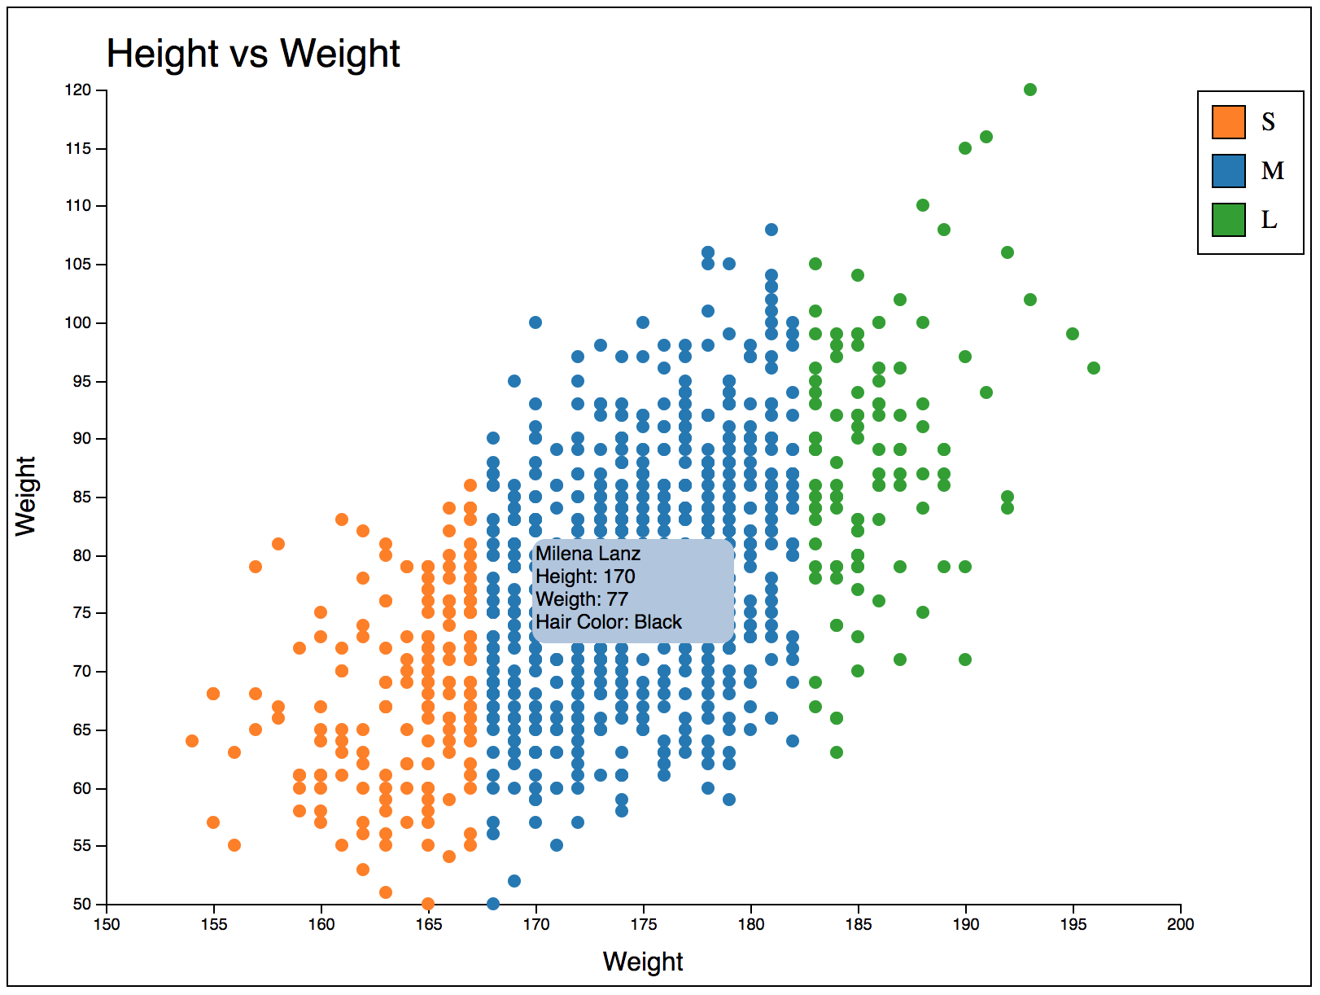
Goal – Animate Scatterplot

Slide 3
Data Joins
Prefer new selection.join() pattern. It combines enter(), exit(), merge().
{
const svg = d3.create("svg")
.attr("width", width)
.attr("height", 33)
.attr("viewBox", `0 -20 ${width} 33`);
svg.selectAll("text")
.data(randomLetters())
.join("text")
.attr("x", (d, i) => i * 16)
.text(d => d);
return svg.node();
}

Slide 4
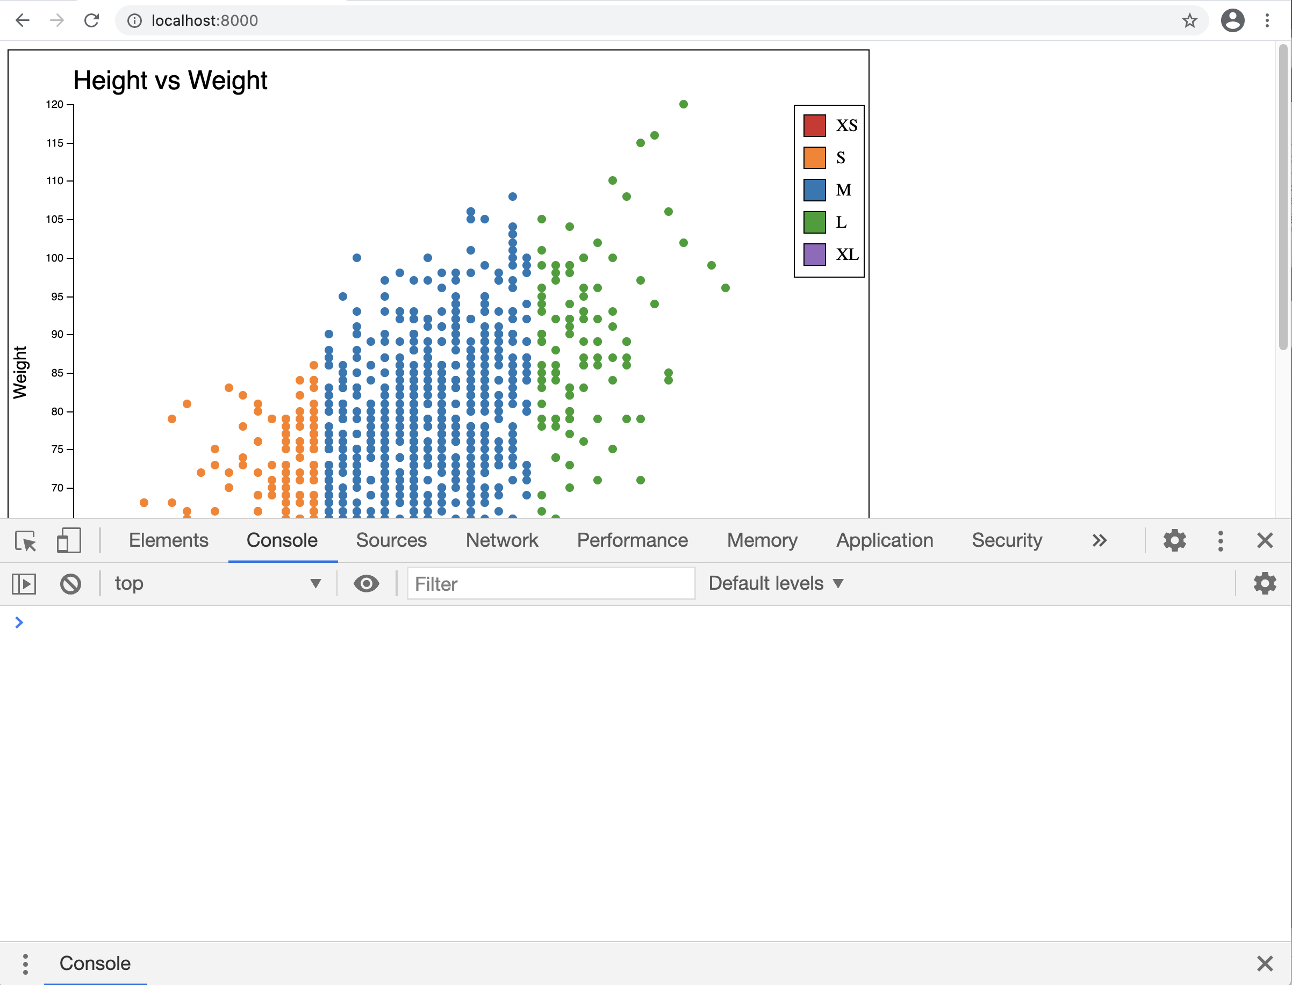
Browser Console
CTRL-F12 CMD-F12

Slide 5
D3 – Animations
Method | Description
selection.transition() | this schedules a transition for the selected elements
transition.duration() | duration specifies the animation duration in milliseconds for each element
transition.ease() | ease specifies the easing function, example: linear, elastic, bounce
transition.delay() | delay specifies the delay in animation in milliseconds for each element
Notes:
Header

Slide 6
D3 – .transition() .duration()
<body>
<div id="container" style="height: 100px; width: 100px;
background-color: black; position:absolute;"></div>
<script>
d3.select("#container")
.transition()
.duration(1000)
.style("background-color", "red");
</script>
</body>
Notes:
Header

Slide 7
D3 – .delay()
<body>
<div id="container" style="height: 100px; width: 100px;
background-color: black; position:absolute;"></div>
<script>
d3.select("#container")
.transition()
.delay(2000)
.duration(1000)
.ease(d3.easeBounce)
.style("background-color", "red")
.transition()
.style("left", "500px");
</script>
</body>
Notes:
Header

Slide 8
D3 – .ease()
<body>
<div id="container" style="height: 100px; width: 100px;
background-color: black; position:absolute;"></div>
<script>
d3.select("#container")
.transition()
.duration(1000)
.ease(d3.easeBounce)
.style("background-color", "red");
</script>
</body>
https://observablehq.com/@d3/easing-animations
Notes:
Header

Slide 9
Your turn
Add initial amination to interactive scatterplot

Slide 10
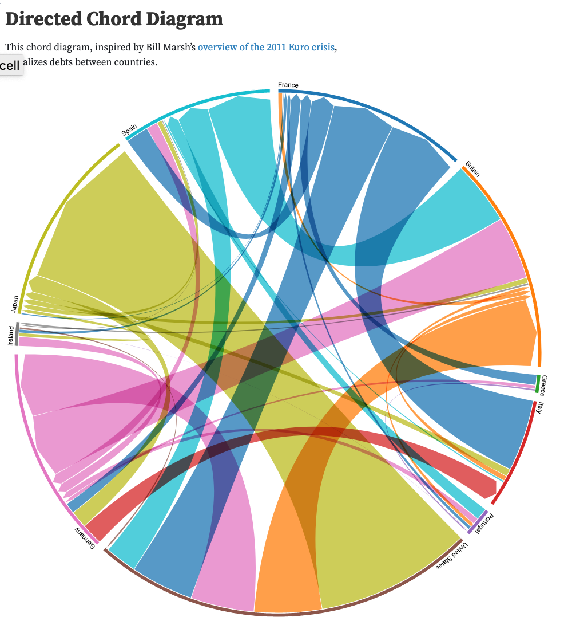
D3 – Chord
https://github.com/d3/d3-chord
Notes:
Header

Slide 11
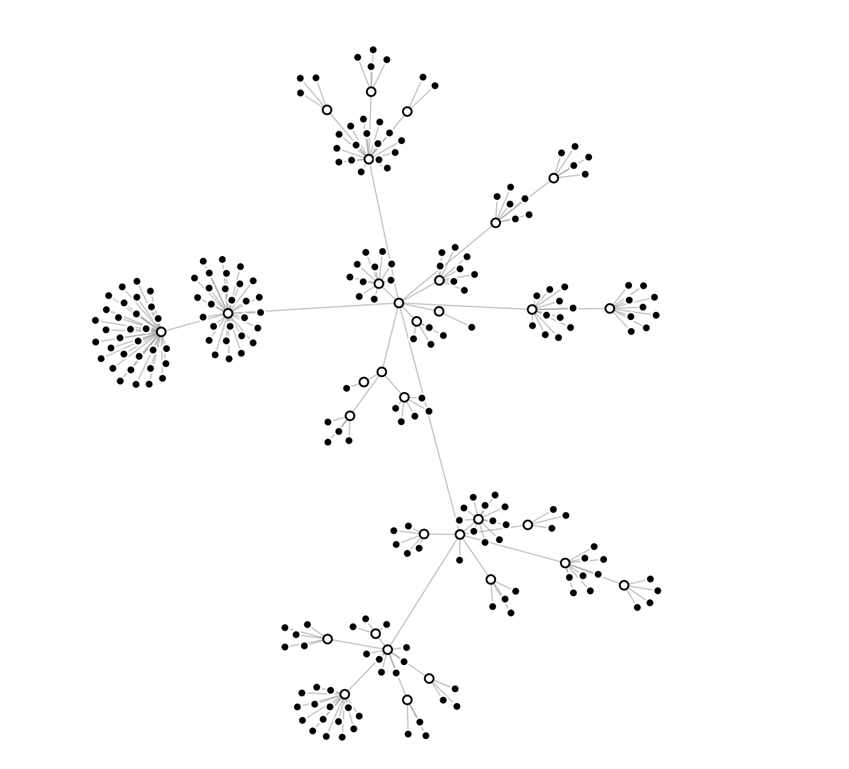
D3 – Force
https://github.com/d3/d3-force
https://observablehq.com/@d3/simulation-tick?collection=@d3/d3-force
Notes:
Header

Slide 12
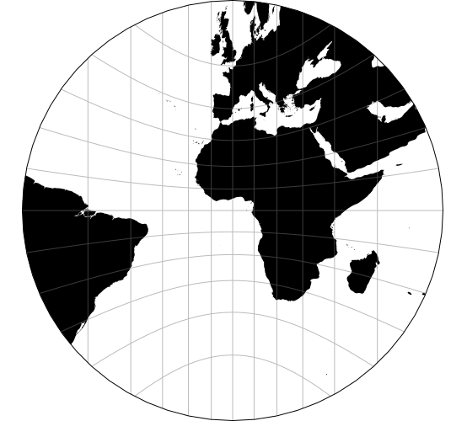
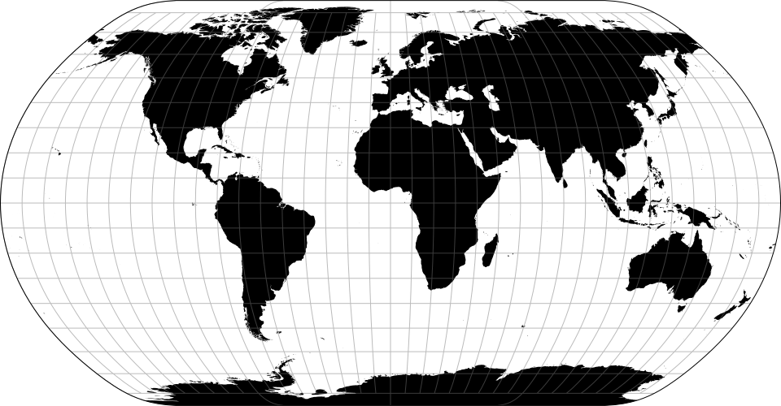
D3 – Geo
https://github.com/d3/d3-geo
https://observablehq.com/collection/@d3/d3-geo
Notes:
Header

Slide 13
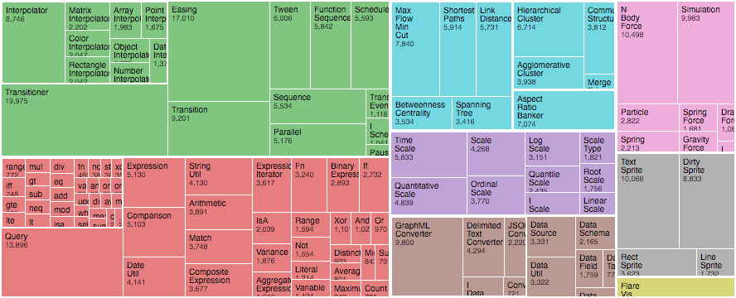
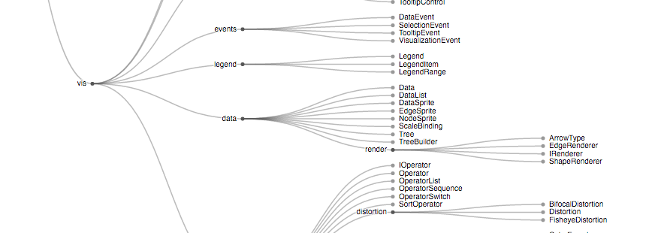
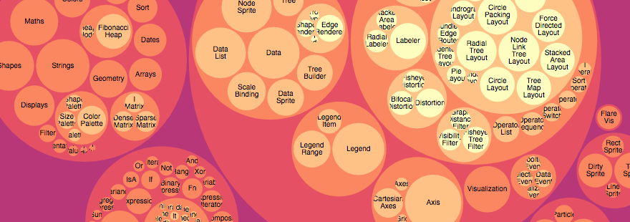
D3 – Hierarchy
https://github.com/d3/d3-hierarchy
Treemap
Tree
Pack
Notes:
Header

Slide 14
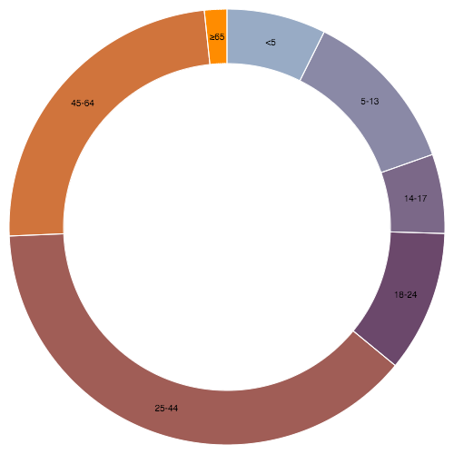
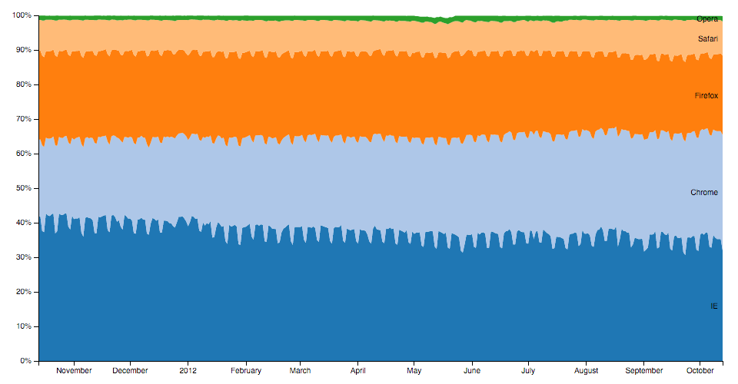

D3 – Shapes
https://github.com/d3/d3-shape
Symbol
Area
Arc
https://observablehq.com/@d3/learn-d3-shapes
Notes:
Header

Slide 15
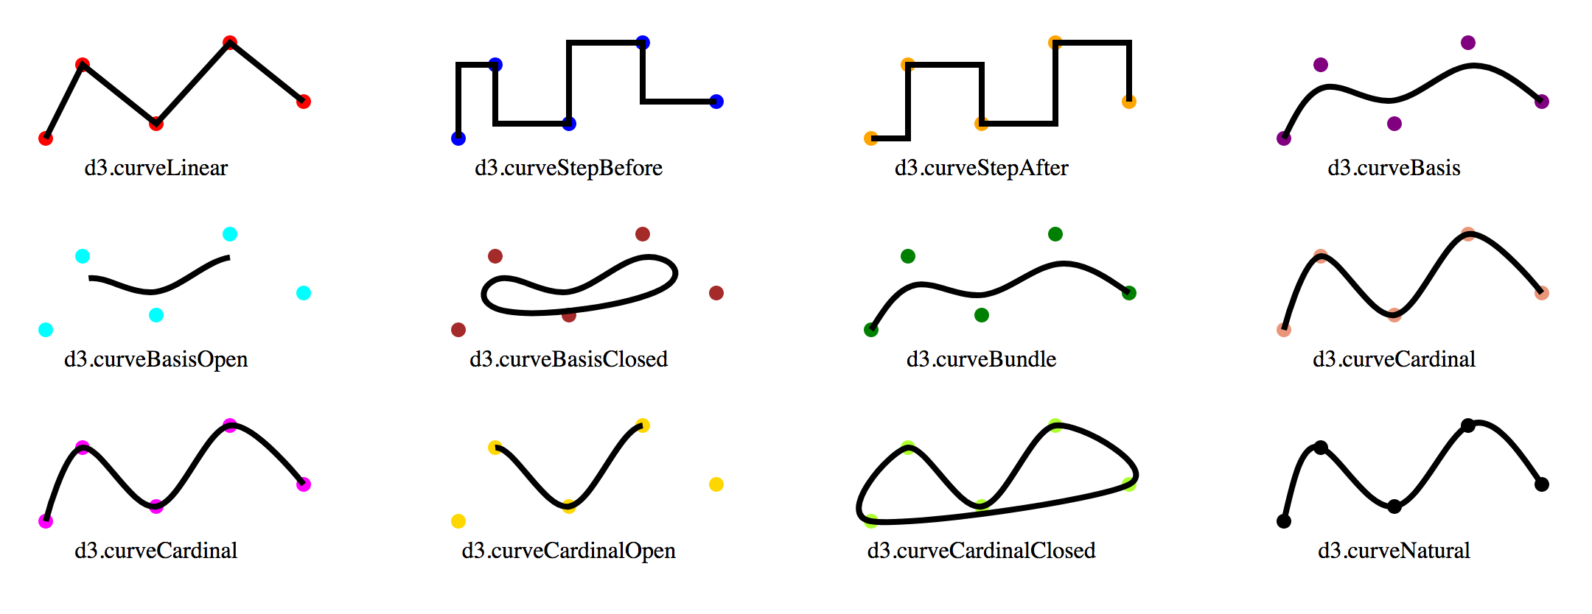
D3 – Shapes (Lines)

