Slide 1
Automatic Speech Recognition with CTC Deep Neural Models
Alessandro Folloni, Gabriele Fossi, Daniele Napolitano and Marco Solime
Project work in Natural Language Processing
Master's Degree in Artificial Intelligence, University of Bologna

Slide 2
Objectives
Studying SoTA literature to identify the best ASR approaches and methodologies
Implementing different models:
DeepSpeech 2
Jasper
Conformer
Wav2Vec2 (pre-trained)
Train and evaluate on a benchmark dataset.

Slide 3
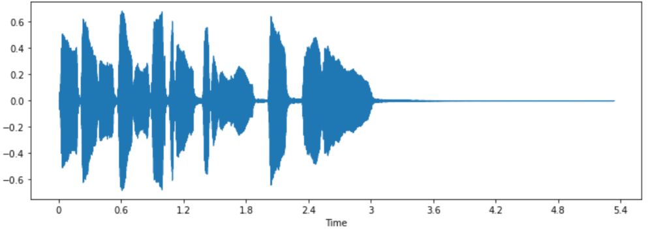
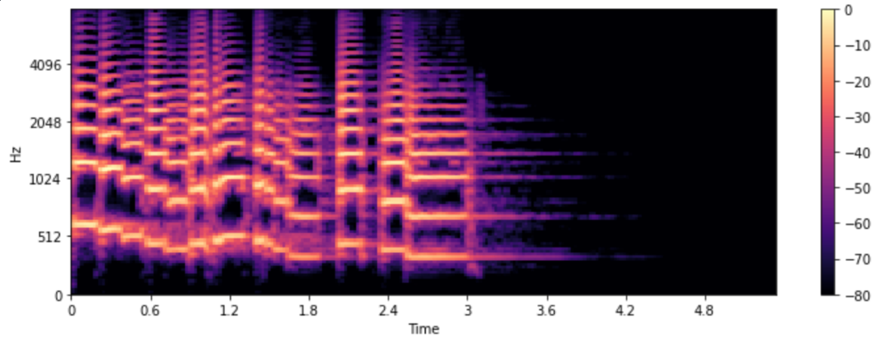
Pictures of Sound
Raw audio signals are converted in MEL spectrograms
Convolutions extract high-level features from 2D representations
MEL Spectrograms
Pictures of sound
a 2D image representation of frequencies (y) over time (x), which emphasizes human-audible frequencies

Slide 4
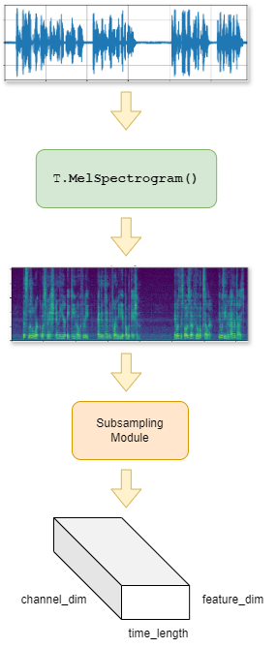
Subsampling Module
Raw audio file
a 1D vector of floats with varying length
MEL Spectrogram
Subsampling Module
takes MEL spectrograms
extract features and shrinks x and y axis
3D Activations
time length subsampled by 2 or 4
Frequency length sub sampled by 2

Slide 5
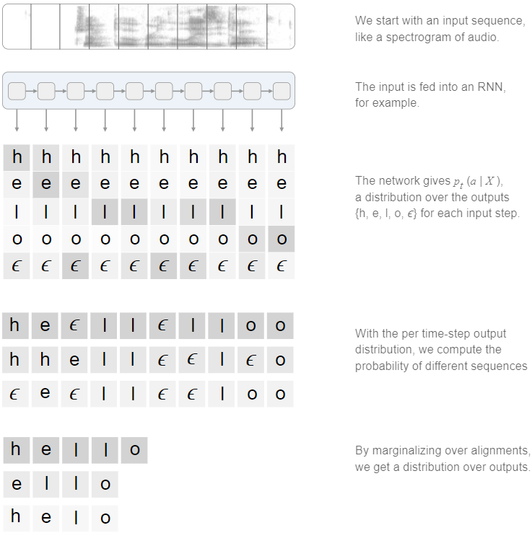
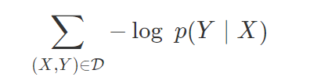
CTC Loss
Connectionist Temporal Classification
Alignment-Free
Sequence prediction with no explicit alignment
Blank Token
Handle varying input lengths
Multiple Paths
Computes probabilities of all possible alignments, summing over them
Output collapsing
Removes repeated characters and blank tokens
Loss: Negative log-likelihood of the correct
transcription Y given the output of the model X

Slide 6

CTC Loss - Continued
Why Multiple Alignments?
Flexibility: variation of length and timing of seq. data.
Robustness: summing to be insensitive to slight variations of input data.
CTC loss sums over the probabilities of all possible alignments of transcription Y.
Feasible alignments of length 8 for Y = “hello”
“h e l _ l o o _”
“h h e l _ l l o”
Time Step Probabilities
Each time step in the input sequence X has a probability distribution over the possible characters (including the blank token)
Compute Probability for Each Alignment
Multiply the probabilities at each time step for a given alignment
Sum Over All Alignments
The final CTC loss considers the sum of probabilities of all feasible alignments.

Slide 7
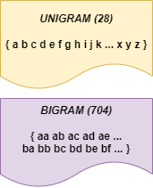
Word Piece Models
Due to CTC Loss, length(X) > length(Y)
X: output sequence of the model
Y: reference transcription
Stride of 2 or 4 on the input audio
Output single or pairs of characters
Unigrams: distribution is over 28 characters
Bigrams: distribution is over 704 pairs
Whole vocabulary of well-formed words would have too many tokens (~10-50K)
Word models, content, and cardinality
Notes:
Potrebbe chiedere la differenza tra unigram e bigram

Slide 8
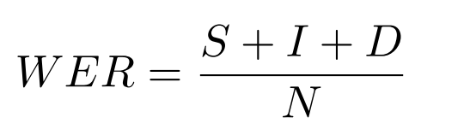
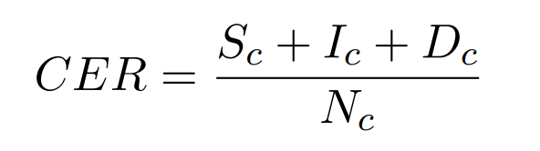
Metrics
Word Error Rate (WER)
De facto standard metric
word level
Character Error Rate (CER)
Character level
More fine-grained measure
S = substitutions
I = insertions
D = deletions
N = # of words (or characters)

Slide 9
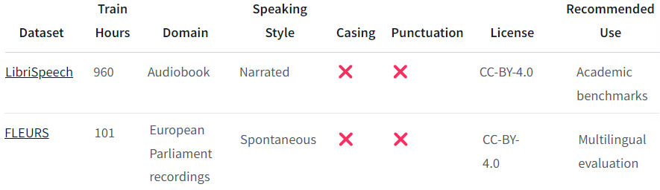
Datasets
Reference table for selecting a dataset. From Hugging Face 🤗

Slide 10
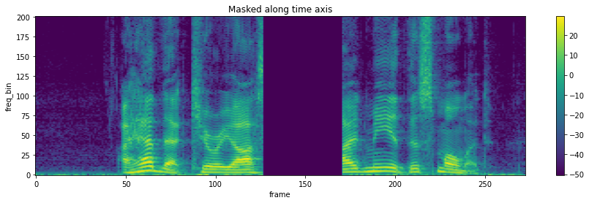
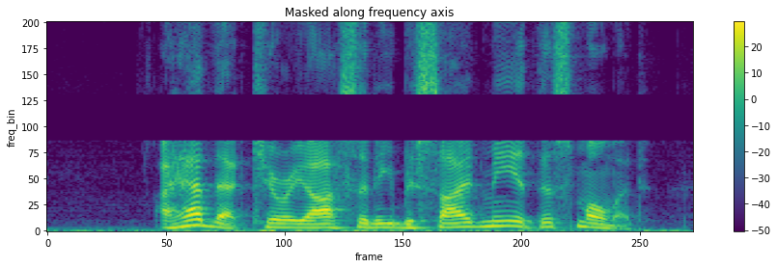
Preprocessing
2 Modalities: Audio and Text
Audio
Raw data to Mel Spectrograms
SpecAugment [1]
Random masking on consecutive timeframes
Text
Convert to lowercase
Get rid of special characters
Tokenize character-level
From PyTorch doc (https://pytorch.org/audio/stable/index.html)

Slide 11
Models
We built and trained from scratch 3 ASR models
Deep Speech 2 [2]
Conformer [4]
Jasper [3]
Additionally, we took a pretrained model from Hugging Face 🤗
Wav2Vec2 [5]
… and fine-tuned it on a small fraction of LibriSpeech [6] clean train set.
The Ultimate Challenge ⚔️🔥
Pretrained models vs Trained-from-scratch Models

Slide 12
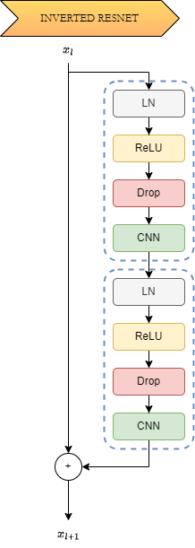
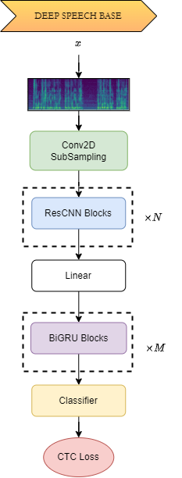
Deep Speech 2
Created in 2015 by Baidu Research [2]
2 Neural Blocks
Convolutional Layers (ResCNN Blocks)
Recurrent Layers (BiGRU Blocks)
Convolutional block learns audio features
ResNet vs ResNetInv🏆 (Pre-Layer Norm)
N=3 in all experiments
Recurrent block extract temporal information
Gated Recurrent Units (BiGRU); M=5
Vanilla Prenorm Encoders (MHSA); M=12
Classifier
2 Linear Layers, Dropout, Softmax

Slide 13
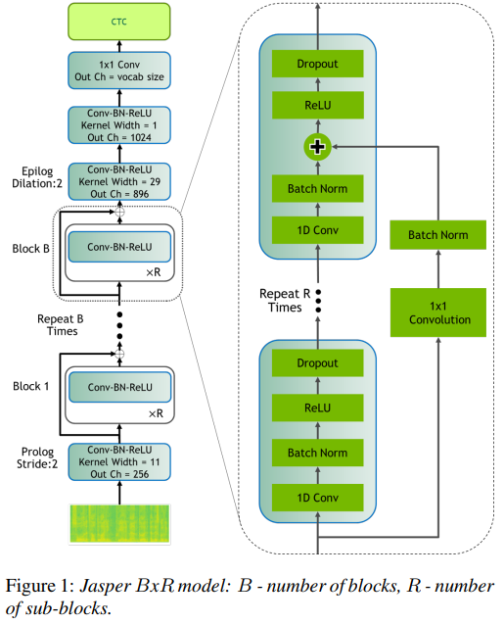
Jasper
Created in 2019 by NVIDIA [3]
Extremely modular architecture
Inner/Outer Blocks repeated many times
Jasper 5x3 model & DR 5x3 model
Leverages the depth of the neural network to learn good audio features
Only 3 ingredients
1D Convolutions
Batch Norms
Skip connections
Hence, recurrent and attention free!

Slide 14
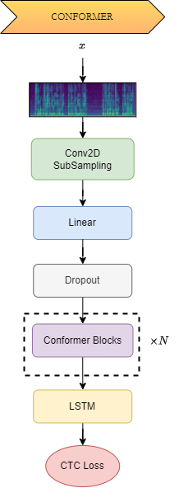
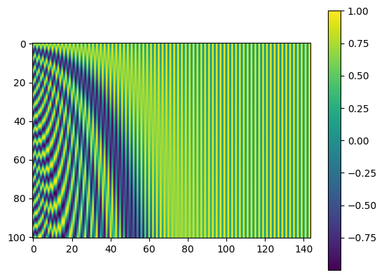
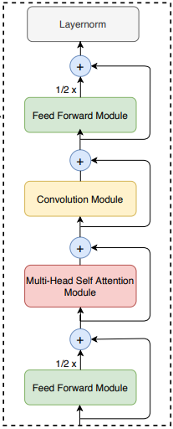
Conformer
Created in 2020 by Google [4]
2 Neural Blocks
Convolution Subsampling block
Stack of Conformer blocks
Conformer blocks
2 Feed Forward modules sandwich a MHSA block + Conv block
Sinusoidal positional embeddings (good for long sequences)
Decoder
LSTM layer with 320 hidden units
linear layer outputs a probability distribution over alphabet for each frame
Sinusoidal Embeddings
Conformer Block

Slide 15
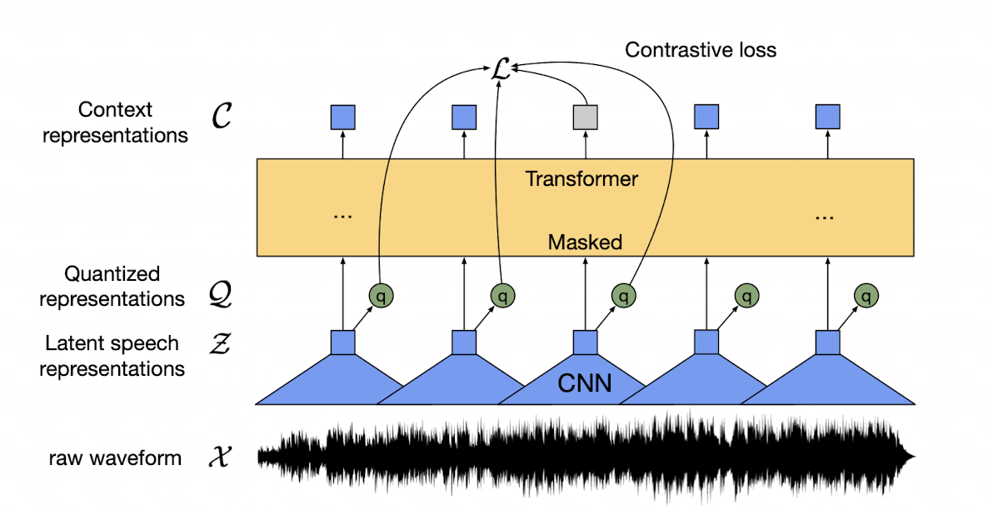
Wav2Vec2
By Facebook AI, 2020 [5]
Trained on unsupervised audio speech data (960 hours)
Model card on 🤗
Uses Masked Language Modeling and Contrastive loss
Fine-tuned on small fractions of Libri Speech clean.
FLEURS [7] audioset was also tried, showing poor results

Slide 16
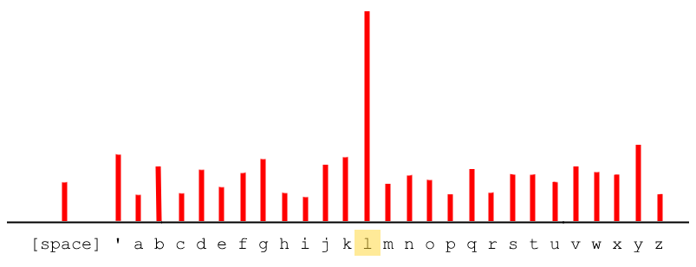
Decoding
Greedy decoding strategy
for each timeframe, pick the most probable character
No Language Model used
hence no semantic of text
grammar mistakes, missing character, joined words
no huge impact on CER (more on WER)
Post-processing
since utterances are pronounced with different speed…
collapse repeated characters
remove [blank] tokens
Original: "he hoped there would be stew for dinner"
Raw: "heee hope ttthere woullld bee stoooo forrr dinnner"
Final: "he hope there would be sto for diner"

Slide 17
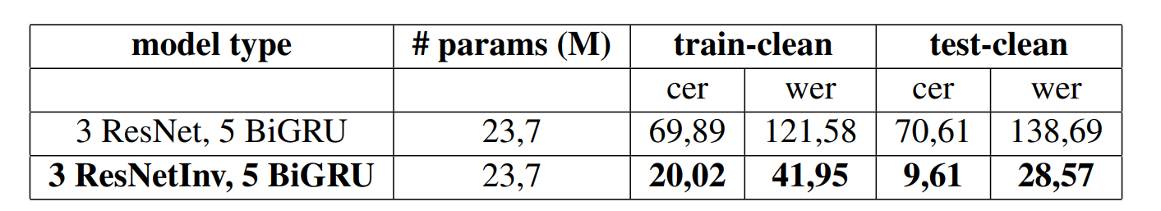
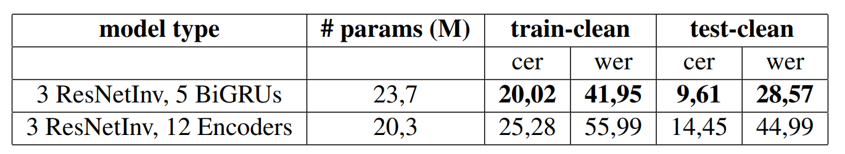
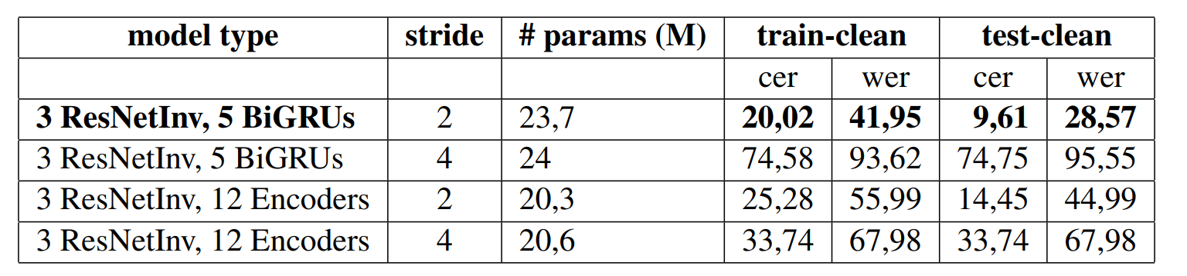
ResNet vs Inverted ResNet
BiGRU vs Prenorm Encoders
Unigrams (stride 2) vs Bigrams (stride 4)
Results: Deep Speech 2

Slide 18
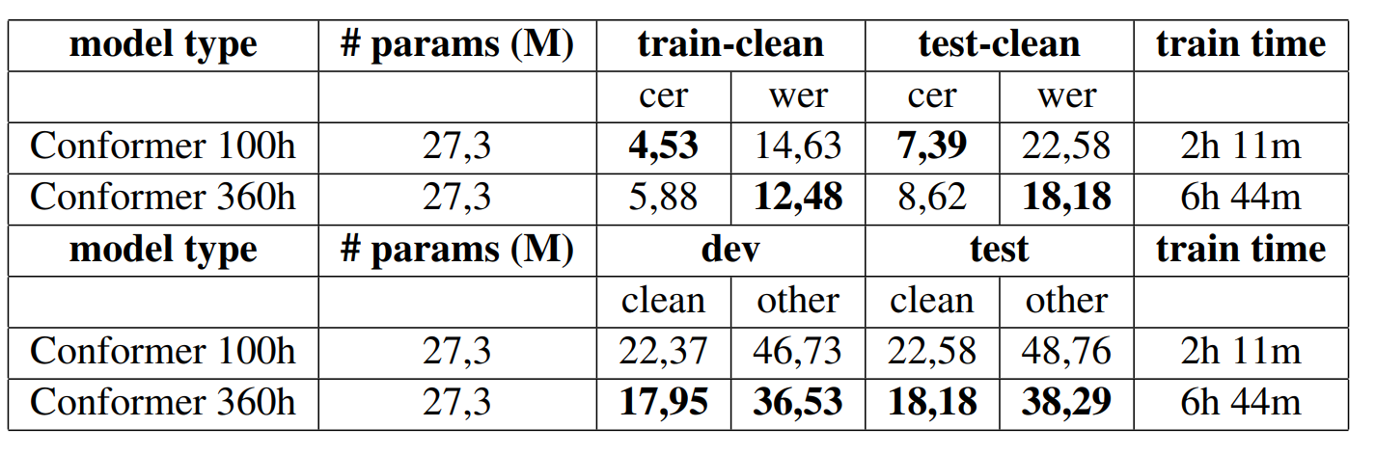
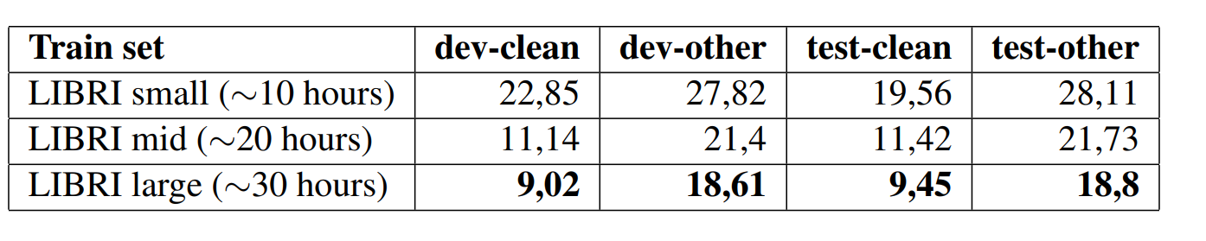
Conformer
Wav 2 Vec 2 (5 epochs)
Results: Conformer and Wav2Vec 2

Slide 19
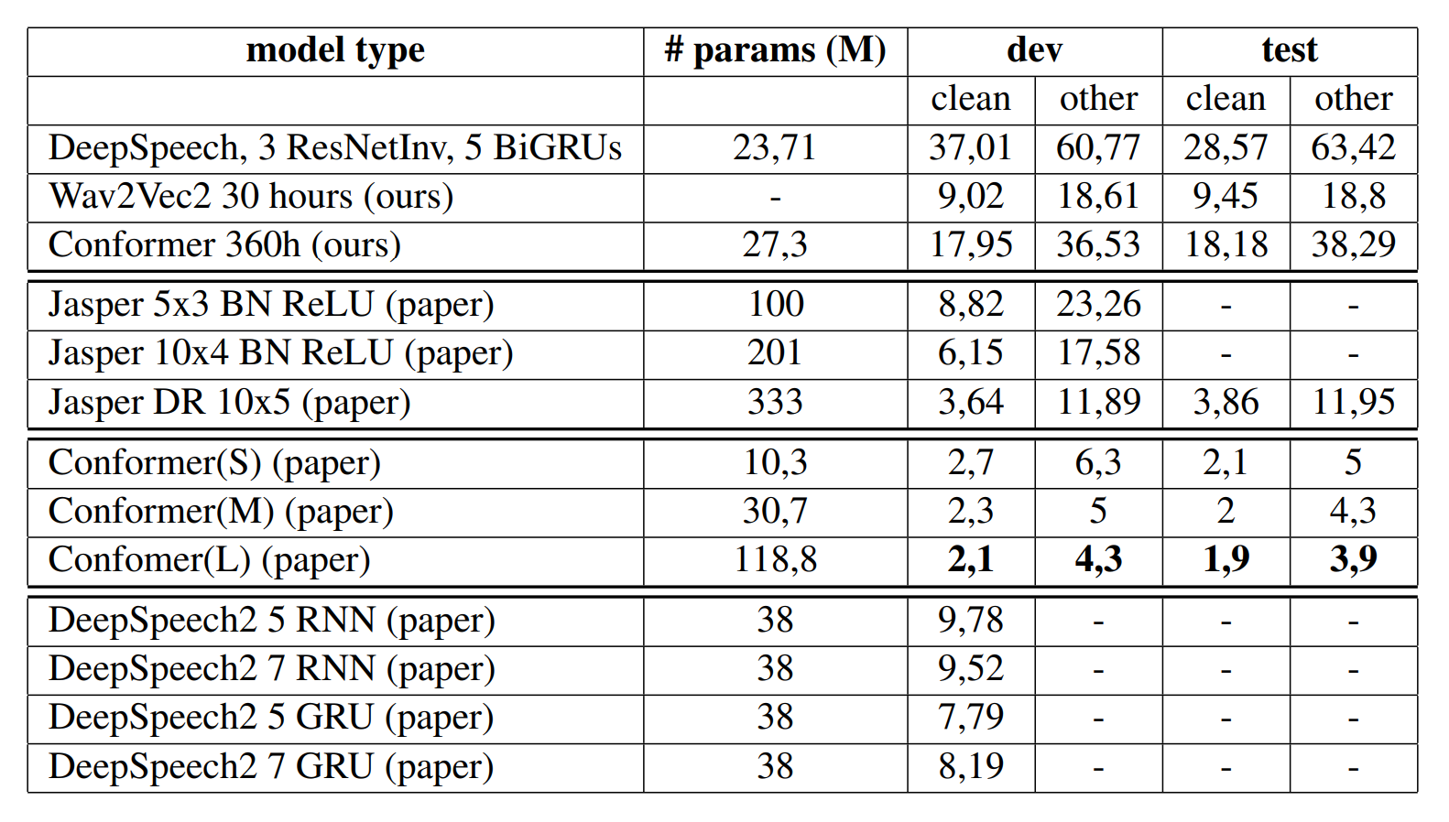
Comparison with baselines

Slide 20

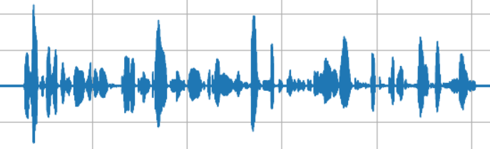
Error Analysis
Deep Speech 3BiGRU (WER=0.28)
he hoped there would be stoo her dinner turnips and carrates and brozed potatos and fhat muten pieces to be latled out in t thick pepered flower fatend sous
Deep Speech 12 Encoders (WER=0.45)
he hoped ther would be stoo her diner turnipsan carit send brosed potae hos and that muttent peces to be latledoutin e tick pepered flowr thatten sos
Original:
he hoped there would be stew for dinner turnips and carrots and bruised potatoes and fat mutton pieces to be ladled out in thick peppered flour fattened sauce
Conformer (WER=0.18)
he hoped there would be stewver dinner turnips and carrots and bruised potatoes and fat mutton pieces to be latled out in thick peppered flouer fat an sauce le
Wav2Vec2 30h (WER=0.25)
he hoped there would be stwe for dinner turnips and carrets and brused potatos and fat muttein pieces to be ladled out in thick peppered flower fateined sauce

Slide 21
Conclusions
Wav2Vec2:
Best performance
Effectiveness of transfer learning
Conformer:
promising results due to its hybrid architecture and ability to handle longer audio sequences.
Jasper:
High complexity and resource demands
requires further optimization and more powerful hardware.
Deep Speech 2:
Valuable insights
Suboptimal results compared to modern architectures.
Future Work:
Optimizing Jasper
integrating a language model to correct spelling inaccuracies in transcriptions.

Slide 22
References
[1] Park et al., SpecAugment, https://arxiv.org/abs/1904.08779
[2] Amodei et al., Deep Speech 2, https://arxiv.org/abs/1512.02595
[3] Li et al., Jasper, https://arxiv.org/abs/1904.03288
[4] Gulati et al., Conformer, https://arxiv.org/abs/2005.08100
[5] Baevski et al., Wav2Vec2, https://arxiv.org/abs/2006.11477
[6] Panayotov, LibriSpeech, https://www.openslr.org/12
[7] Conneau et al., FLEURS, https://arxiv.org/abs/2205.12446

Slide 23
Thank you for your time

