Slide 1
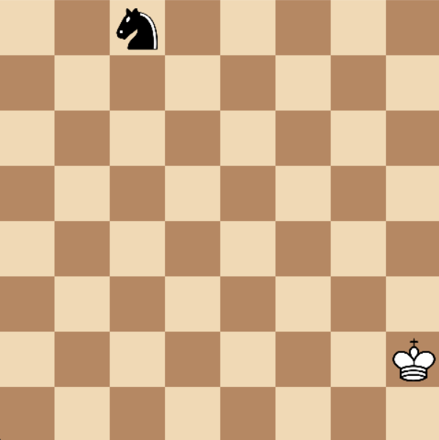
Knight vs King Chess with RL
Marco solime
university of bologna

Slide 2
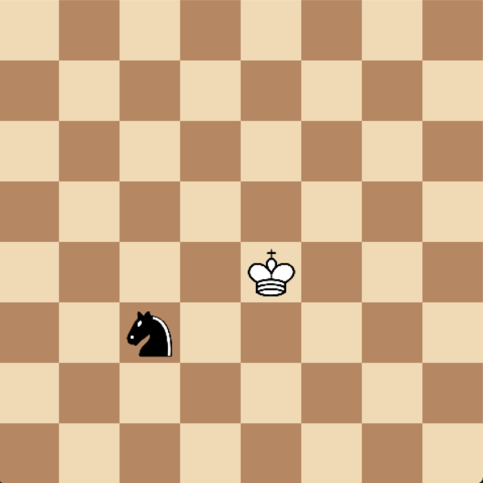
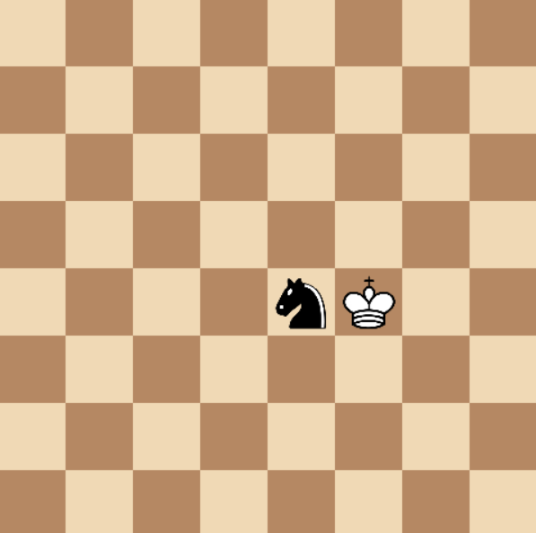
Game Rules ♟️
Played on a standard 8x8 chessboard
Aim of the game: Check the King!
Episodic game with random initial positions
Knight moves, King waits
Reward scheme:
-1: neutral move
-5: out-of-moves (OOM)
-5: out-of-board (OOB)
-10: knight is captured
+10: knight checks
Knight Wins (+10)
Knight Loses (-10)

Slide 3
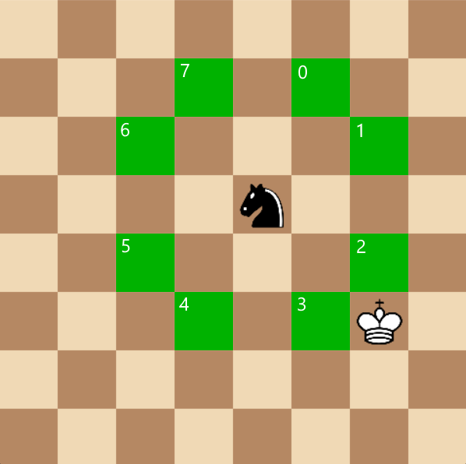
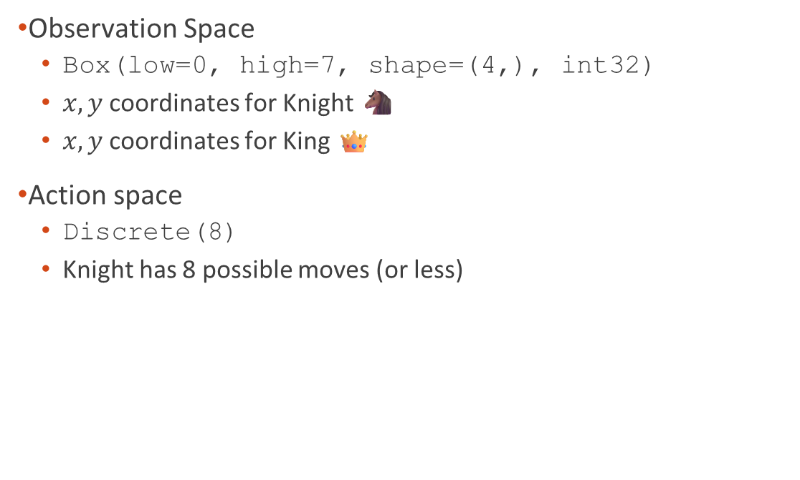
Custom Environment 🎮
Observation Space
Box(low=0, high=7, shape=(4,), int32)
$x,y$coordinates for Knight 🐴
$x,y$coordinates for King 👑
Action space
Discrete(8)
Knight has 8 possible moves (or less)
Checked squared by Knight

Slide 4
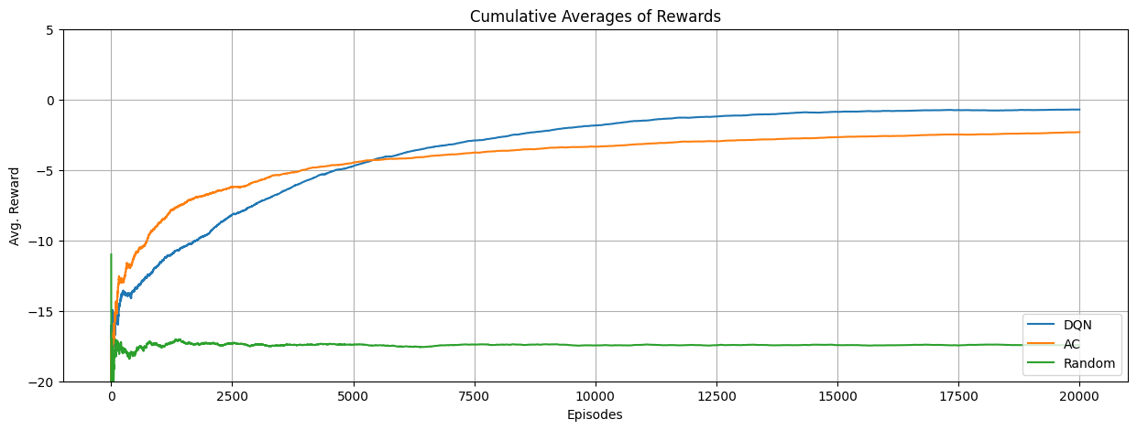
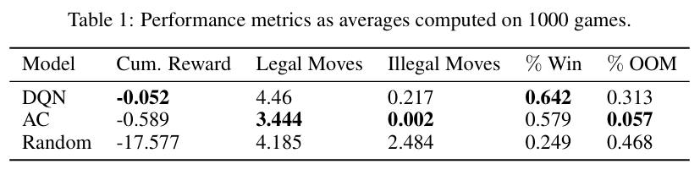
RL Agents 🥷
DQN – Deep Q-Network
Value Approximation Method
Epsilon-greedy policy 🎲
Experience Buffer Replay
A-C: Actor-Critic
Policy Gradient Method
Neural Architecture
Linear Layers with ReLUs
Training Episodes: 20K

Slide 5
Let’s Play 🎮

