Slide 1











EC2 Spot Instance Interruption Notices
AWS Cloud
Propagate and trigger additional logic
Spot Fleet
EC2 instance contents
Amazon CloudWatch
CloudWatch Logs Agent pushes your logs to AWS
2. Save state and terminate
AWS Lambda
watchdog
1. Read the metadata every 5 secs
your app
Instance Metadata:
http://169.254.169.254/latest/meta-data/spot/termination-time
event
rule
Amazon Simple Notification Service
404 | 2015-01-05T18:02:00Z
Amazon Simple Queue Service
two-minute warning before Amazon EC2 must stop or terminate your Spot Instance

Slide 2
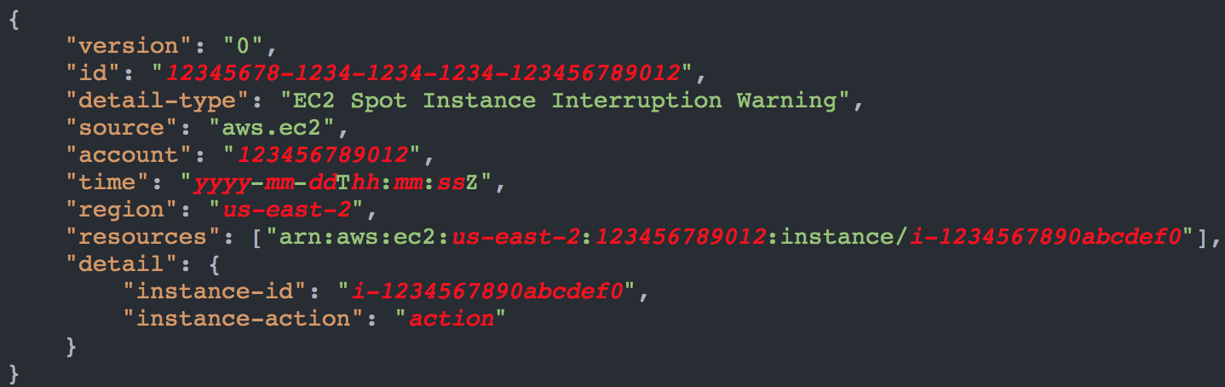
EC2 Spot Instance Interruption Event
hibernate, stop or terminate
https://docs.aws.amazon.com/AWSEC2/latest/UserGuide/spot-interruptions.html

Slide 3
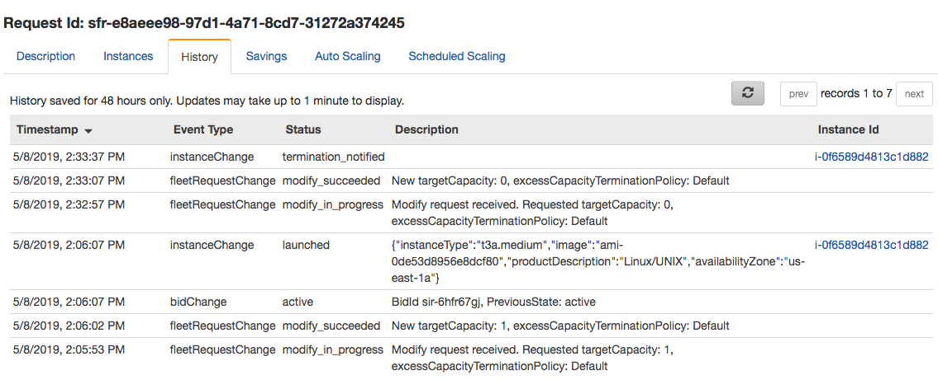
Spot Request History
EC2 instance ids
History tab
Termination notice. Instances will stop at 5/8/2019, 2:35:37 PM (2 minutes later)

Slide 4
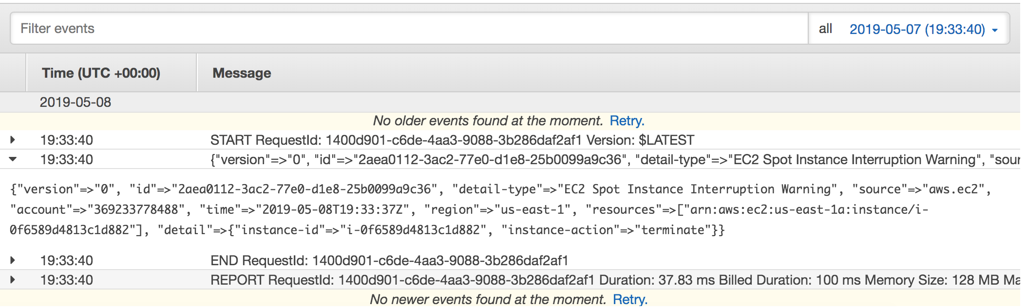
Lambda Logs
Event source
Termination notice. Instances will stop at 2019-05-08T19:35:37Z (2 minutes later)
Instance id
3 seconds after the termination notification, the lambda function is called

Slide 5
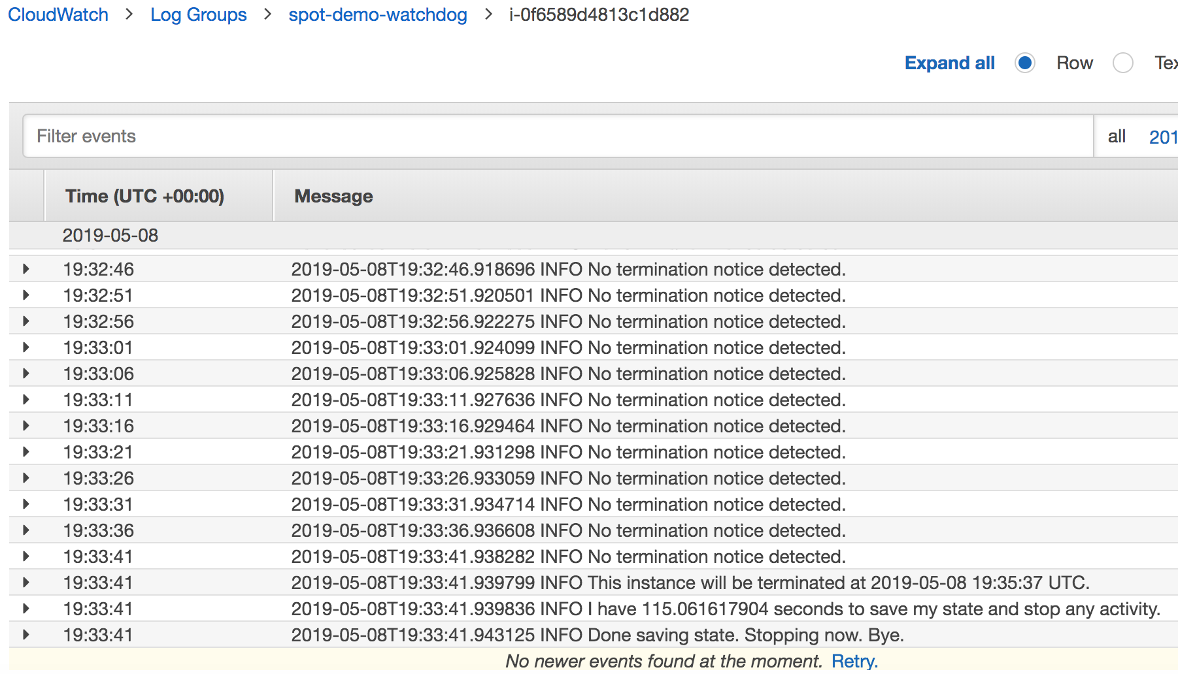
Watchdog CloudWatch Logs
Instance id
Time to save state and stop
Termination time

Slide 6
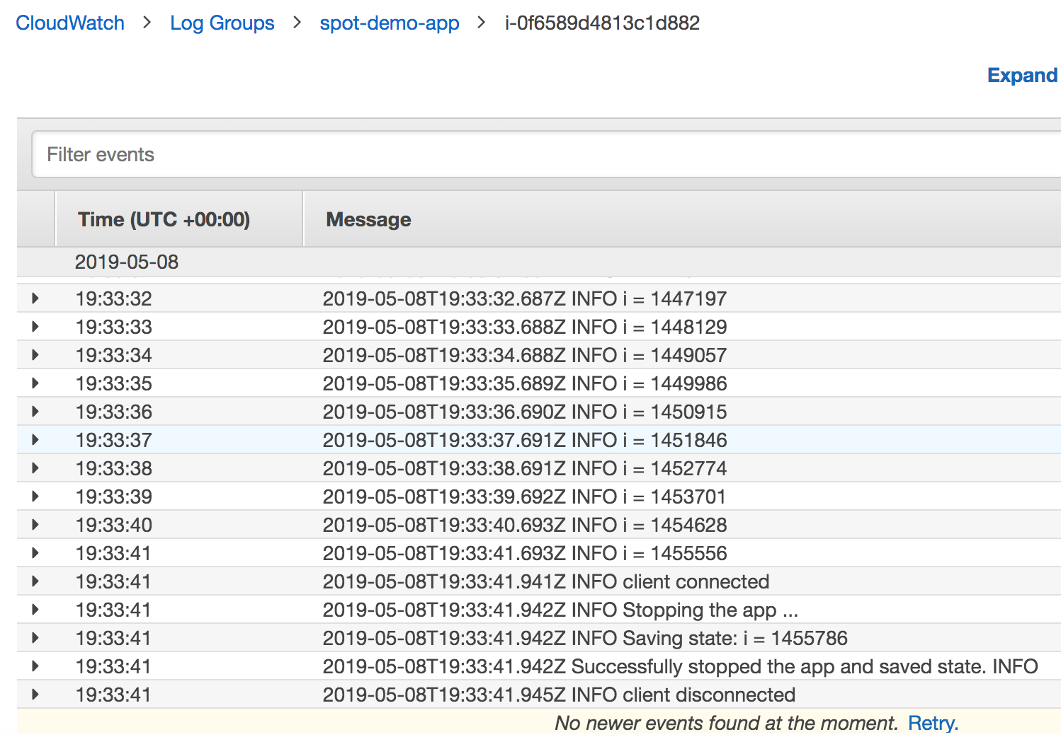
App CloudWatch Logs
Instance id
Watchdog notifies app
App stops and save state

