Slide 1
Analysis of A/B Test Results
Data Scientist: Marcos Roberto Souza
© 2024 Udacity.

Slide 2
Agenda
Findings of A/B test analysis
Experiment Setup
Conversion Rates
Experiment Results

Slide 3
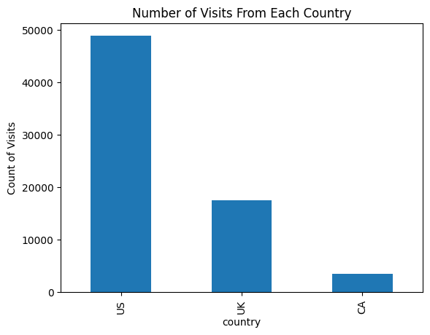
How Was the Experiment Implemented?
Total Variant Visitors: 35211
Total Control Participants: 34678

Slide 4
Conversion Rates
 | U.S. | U.K. | CA
Control | 10.7% | 10.16% | 9.44%
Treatment | 15.8% | 14.87% | 15.40%
Executive Summary: The treatment group consistently outperforms the control across all countries, with ~5 percentage points higher conversion rates. Country of origin has minimal impact on conversion.
Group assignment (treatment vs. control) is a stronger predictor of conversion than country. These results suggest the treatment page leads to meaningfully higher conversion rates.

Slide 5
Experiment Results
Treatment Conversion Rate: 15.53%
Control Conversion Rate:​ 10.53%
Delta in Treatment vs. Control Conversion Rate:​ +5.00 pp
p-value:​ ≈ 0.00
Conclusion:
​The p-value is effectively 0, well below the 0.05 threshold, so we reject H₀. There is statistically significant evidence that the treatment page leads to a higher conversion rate. The takeaway is that the company should consider adopting the treatment page, as it consistently outperforms the control across all countries.

