Slide 1

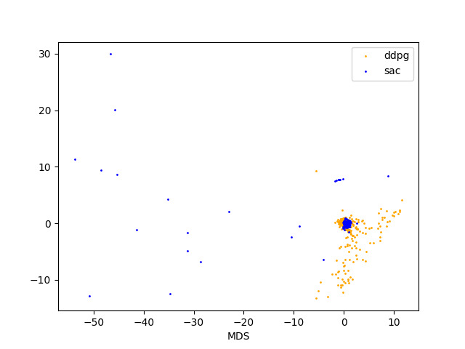
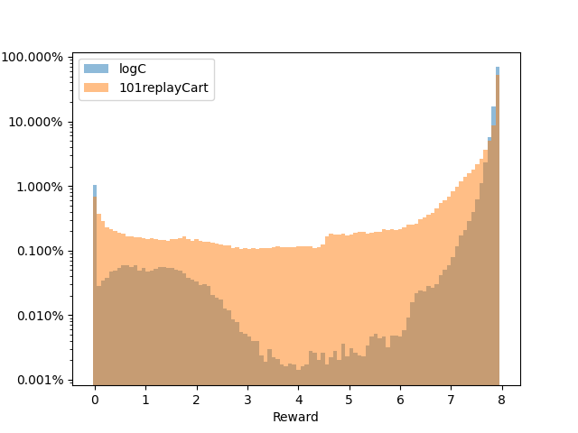
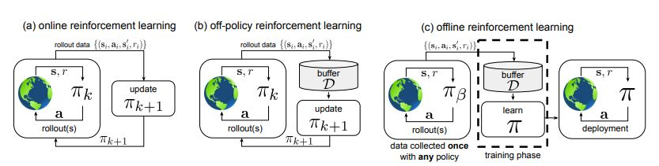

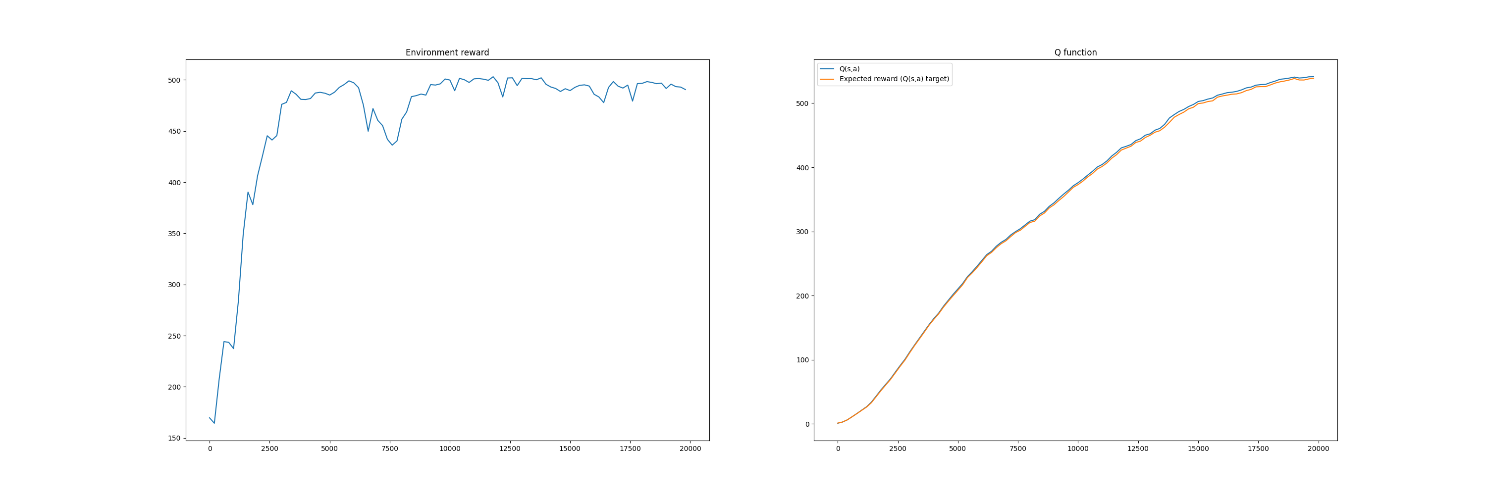
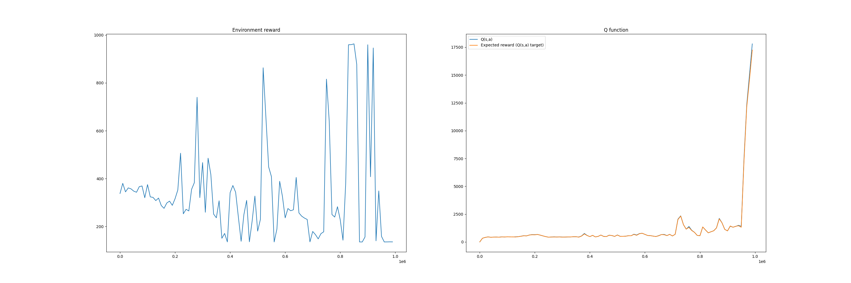
Importance of data in Offline Reinforcement Learning
Marco Enzo Squillacioti (s200142), Shubham Sanjay Ingole(s200092), Steinn Orri Erlendsson(s153716)
Technical University of Denmark
Introduction:
In this presentation we will compare Offline and Online DDPG to solve the cartpole-balance problem from the deep mind-control suite.
Deep Deterministic Policy Gradient (DDPG) is an algorithm which concurrently learns a Q-function and a policy. It uses off-policy data and the Bellman equation to learn the Q-function and uses the Q-function to learn the policy.
However, with our current algorithms makes it difficult to train it offline and getting expected rewards. Thus, we wanted to provide the understanding of theses challenges and the results from it.
Motivation:
We aim to make decisions based on the prediction by the neural network. However, it is difficult to do with normal networks because the decision alters the environment, hence we wanted to implement Offline RL by using the previous experiences and attempts to match the automate complex human decisions or to improve with the help of results. In order to compare them we used the same problem for online RL.
Generating the Data:
Two sets of data have been used: one generated by the Pytorch SAC+AE repository and another one generated by running the same algorithm developed by the group but online instead of offline.
The main reason to generate data from our own algorithm is that the first dataset was skewed, as it didn’t have a good variety of actions.
By generating the data, it will also make it possible to compare apples to apples, as the online algorithm will be the same as the online.
Methodology:
:
Results
Our online algorithm does not exceed an average reward of 500. But when applied to the cartpole-balance task it manages to balance the cartpole quite well.
The offline algorithm is behaving quite randomly. It reaches a reward passed 900 but does not achieve a consistent outcome.
What is missing for the report:
Getting the offline algorithm to match the online one. At this point we do not have a working version to compare different hyperparameters.
Once we get this to work. We can compare them for different parameters and datasets.
References:
[1]. Gulcehre.: 2020,“RL Unplugged: Benchmarks for Offline Reinforcement Learning”, Link: https://arxiv.org/pdf/2006.13888.pdf [2]. Sergey Levine, Aviral Kumar, George Tucker,Justin Fu.: 2020 “Offline Reinforcement Learning: Tutorial, Review, and Perspectives on Open Problems”,link: https://arxiv.org/abs/2005.01643v
[3]. OpenAI.: https://spinningup.openai.com/en/latest/algorithms/ddpg.html
[4]. SpinningUp2018.: Achiam, Joshua: "Spinning up in deep reinforcement learning. Link: https://github.com/openai/spinningup/tree/master/spinup
[5]. Seungeunrho.: https://github.com/seungeunrho/minimalRL
Online Rewards
Offline Rewards
Notes:
1

