Slide 1


Marcos Roque Rosa
October 19, 2026

Slide 2

Outline
Executive Summary
Introduction
Methodology
Results
Conclusion
Appendix

Slide 3
Executive Summary
Methodology
Results
Collected launch data from the SpaceX REST API and Wikipedia (web scraping)
Cleaned the data and built a landing label: Class = 1 if the first stage landed
Explored it with pandas/seaborn charts and SQL (SQLite)
Built an interactive Folium map and a Plotly Dash dashboard
Trained and tuned 4 classifiers (LogReg, SVM, Decision Tree, KNN) with 10-fold grid search
90
Falcon 9 launches
2010 – 2020
66.7%
first stages
landed
83.3%
test accuracy,
all 4 models
Landing success rose from 0% (2010–13) to 84–90% (2019–20)
KSC LC-39A is the strongest site: 77% success, 41.7% of all successful landings
SSO, VLEO and LEO missions land most often; GTO is hardest (52%)
The Decision Tree has the best cross-validation accuracy (87.7%)

Slide 4
Introduction
Background
Questions we answer
SpaceX advertises Falcon 9 launches at about $62 million; other providers charge upward of $165 million.
Most of the saving comes from landing and reusing the first stage.
If we can predict whether the first stage will land, we can estimate the cost of a launch — useful for a new company ("Space Y") bidding against SpaceX.
Which factors — launch site, payload mass, orbit, booster version, experience — drive a successful landing?
How have landing outcomes changed over time?
Where are launch sites located, and why there?
Can a machine-learning model predict the landing outcome, and which model works best?

Slide 5

Section 1

Slide 6
Methodology
Executive Summary
1 Data collection SpaceX REST API (launches, rockets, launchpads, payloads, cores) and web scraping of Wikipedia's Falcon 9 launch list
2 Data wrangling Filtered to Falcon 9, imputed missing payload masses, and turned 8 landing outcomes into a binary Class label
3 EDA Scatter, bar and line charts with seaborn/matplotlib; 10 SQL queries on SQLite
4 Interactive visual analytics Folium map of sites, outcomes and proximities; Plotly Dash dashboard with dropdown and payload slider
5 Predictive analysis Standardised features, 80/20 split, GridSearchCV (cv=10) on LogReg, SVM, Decision Tree and KNN; compared on test accuracy and confusion matrices

Slide 7
Data Collection
Two public sources were combined into launch-level datasets of Falcon 9 flights:
SpaceX REST API
api.spacexdata.com/v4 — launches plus rocket, launchpad, payload and core details
Parse & normalise
json_normalize, BeautifulSoup, helper functions; one row per launch
Falcon 9 dataset
90 launches × 17 features (API)
121 launches × 11 columns (Wikipedia)
→ dataset_part_1.csv
→ spacex_web_scraped.csv
Wikipedia (web scraping)
'List of Falcon 9 and Falcon Heavy launches', revision of 9 June 2021

Slide 8
Data Collection – SpaceX API
GET /v4/launches/past and decode the JSON with json_normalize
Keep single-core, single-payload launches up to 13 Nov 2020
Look up each ID: rockets → booster name; launchpads → site, lat/long; payloads → mass, orbit; cores → outcome, block, reuse, serial
Keep Falcon 9 only (90 launches) and replace the 5 missing payload masses with the mean (6,105 kg)
requests.get launches/past
json_normalize → DataFrame
Filter 1 core, 1 payload, ≤ 2020-11-13
API lookups rockets · launchpads · payloads · cores
Build DataFrame 17 columns
Falcon 9 only 90 rows; impute PayloadMass
GitHub: SpaceX API notebook
Export dataset_part_1.csv
The output matches IBM's reference dataset_part_1.csv exactly.

Slide 9
Data Collection - Scraping
Request the 9 June 2021 revision of the Wikipedia launch list with requests
Parse the HTML with BeautifulSoup and collect every <table>
Read column names from the header cells of the first launch table
Walk the rows of all launch tables and extract flight no., date, time, booster, site, payload, mass, orbit, customer, launch and landing outcomes
requests.get oldid=1027686922
BeautifulSoup html.parser
find_all('table') 29 tables
Header cells extract_column_from_header()
Row loop 9 launch tables → launch_dict
pd.DataFrame 121 × 11
GitHub: Web scraping notebook
Export spacex_web_scraped.csv
Result: 121 launch records, 11 columns.

Slide 10
Data Wrangling
Load
dataset_part_1.csv
90 × 17
Profile
missing values, dtypes
Count
launches per site and orbit
Outcomes
8 landing outcome types
Label
Class = 0 / 1
Export
dataset_part_2.csv
Outcome | Meaning | Count | Class
True ASDS | landed on a drone ship | 41 | 1
True RTLS | landed on a ground pad | 14 | 1
True Ocean | controlled ocean landing | 5 | 1
None None | no landing attempt | 19 | 0
False ASDS | drone-ship landing failed | 6 | 0
False Ocean | ocean landing failed | 2 | 0
None ASDS | drone ship, no attempt | 2 | 0
False RTLS | ground-pad landing failed | 1 | 0
LandingPad is the only column with gaps (28.9%) — a gap means no pad was used.
Every outcome that is a failure or no attempt becomes Class 0; landings become Class 1.
Overall success rate: 66.7% (60 of 90).
GitHub: Data wrangling notebook

Slide 11
EDA with Data Visualization
Chart | Type | Why
Flight number vs. launch site | Scatter (catplot) | Does experience at a site change outcomes?
Payload mass vs. launch site | Scatter | Which sites handle heavy payloads, and how well?
Success rate by orbit | Bar chart | Compare success across orbit types
Flight number vs. orbit | Scatter | Does experience matter differently per orbit?
Payload mass vs. orbit | Scatter | Payload/orbit combinations that succeed or fail
Yearly success rate | Line chart | Trend of landing success over time
Feature engineering: selected 12 features and one-hot encoded Orbit, LaunchSite, LandingPad and Serial with get_dummies, then cast everything to float64 (90 × 80) for the models.
GitHub: EDA with data visualization notebook

Slide 12
EDA with SQL
Loaded Spacex.csv into SQLite (SPACEXTABLE) and ran these queries with %sql:
Unique launch sites (SELECT DISTINCT)
5 records for sites beginning with 'CCA' (LIKE, LIMIT)
Total payload for NASA (CRS) (SUM)
Average payload of booster F9 v1.1 (AVG)
Date of the first ground-pad landing (MIN)
Drone-ship landings with 4,000–6,000 kg payload (AND, ranges)
Successful vs. failed mission outcomes (GROUP BY, COUNT)
Boosters that carried the maximum payload (subquery with MAX)
2015 drone-ship failures by month (substr)
Landing outcomes ranked, 2010-06-04 to 2017-03-20 (BETWEEN, ORDER BY)
GitHub: EDA with SQL notebook

Slide 13
Build an Interactive Map with Folium
Object | What it shows | Why
Circle + text label | Each launch site (orange) | See where sites are relative to coasts and the Equator
MarkerCluster | All 56 launches, grouped per site | Many launches share one coordinate; clusters keep the map readable
Marker (green / red) | One per launch, coloured by outcome | Compare success rates between sites at a glance
MousePosition | Lat/long under the cursor | Read coordinates of nearby coastline, rail, roads, towns
PolyLine + distance label | Site → coastline, railway, highway, city | Measure how close sites are to infrastructure and people
Distances were computed with the Haversine formula (calculate_distance) from coordinates read off the map.
GitHub: Folium map notebook

Slide 14
Build a Dashboard with Plotly Dash
Component | Shows / controls | Why
Dropdown (site-dropdown) | All sites or one of 4 sites | Switch between the overall picture and a single site
Pie chart (success-pie-chart) | All sites: share of successes per site One site: success vs. failure | Find the sites with the most and the highest-rate successes
RangeSlider (payload-slider) | Payload 0 – 10,000 kg, 1,000 kg steps | Isolate payload ranges
Scatter (success-payload-scatter-chart) | Payload vs. outcome, coloured by booster version | See how payload and booster version relate to success
Two callbacks connect the inputs to the charts: the dropdown drives the pie chart, and the dropdown plus the slider drive the scatter plot.
GitHub: Plotly Dash app (spacex_dash_app.py)

Slide 15
Predictive Analysis (Classification)
Prepare
Y = Class
X = 80 features
Standardise
StandardScaler
Split
80/20, random_state=2
72 train / 18 test
Tune
GridSearchCV, cv=10
4 models
Evaluate
test accuracy,
confusion matrix
Select
best test + CV score
Model | Hyper-parameters searched
Logistic Regression | C ∈ {0.01, 0.1, 1}, L2, lbfgs
Support Vector Machine | kernel (linear, rbf, poly, sigmoid), C and gamma ∈ logspace(-3, 3, 5)
Decision Tree | criterion, splitter, max_depth 2–18, max_features, min_samples_leaf/split
K-Nearest Neighbors | n_neighbors 1–10, algorithm, p ∈ {1, 2}
GitHub: Machine learning prediction notebook

Slide 16
Results
Exploratory analysis
Interactive analytics
Predictive analysis
Success climbs with experience: 25% for flights 1–20 vs. 83% for flights 61–90
KSC LC-39A and VAFB SLC-4E reach 77%; CCAFS SLC-40 60%
SSO/VLEO/LEO high, GTO lowest (52%)
All sites sit within ~1–1.5 km of the ocean and ≥ 20 km from towns
KSC LC-39A: most successes (41.7%) and best ratio (76.9%)
2,000–4,000 kg payloads succeed most; FT boosters lead
All 4 tuned models: 83.3% on the test set
Decision Tree best in cross-validation (87.7%)
Errors are failed landings predicted as landed

Slide 17

Section 2

Slide 18
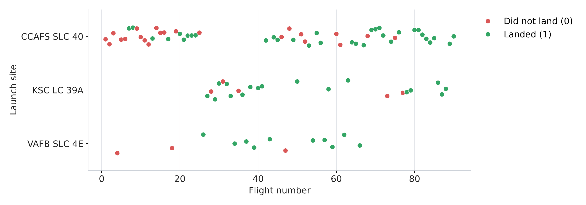
Flight Number vs. Launch Site
CCAFS SLC 40 carries most flights (55 of 90), including nearly all early failures.
Later flights succeed far more often at every site: 25% for flights 1–20 vs. 83% for flights 61–90.
KSC LC 39A is used from flight 27 onward and has the highest success rate (77%).

Slide 19
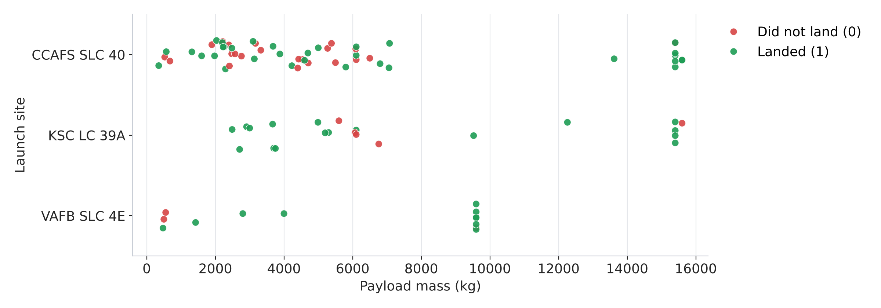
Payload vs. Launch Site
VAFB SLC 4E never flew more than 9,600 kg; payloads above 10,000 kg flew only from the Florida sites.
Heavy payloads landed well: 87% success above 8,000 kg vs. 50–70% for lighter ones.
For light and medium payloads the classes overlap, so payload alone does not decide the outcome.

Slide 20
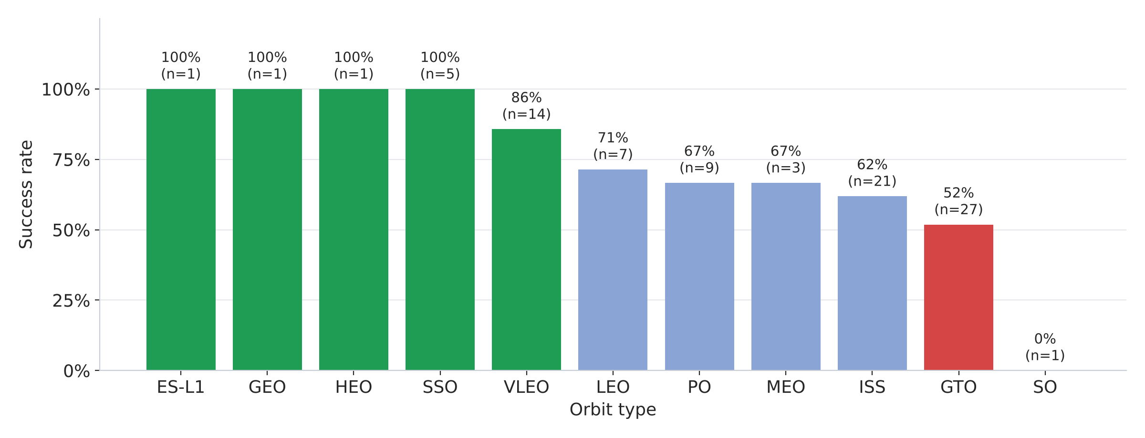
Success Rate vs. Orbit Type
SSO is the most convincing perfect record (5 of 5); ES-L1, GEO and HEO are 100% but only 1 launch each.
VLEO (86%, 14 launches) and LEO (71%) are also strong.
GTO is the hardest common orbit (52% of 27 launches); the single SO launch failed.

Slide 21
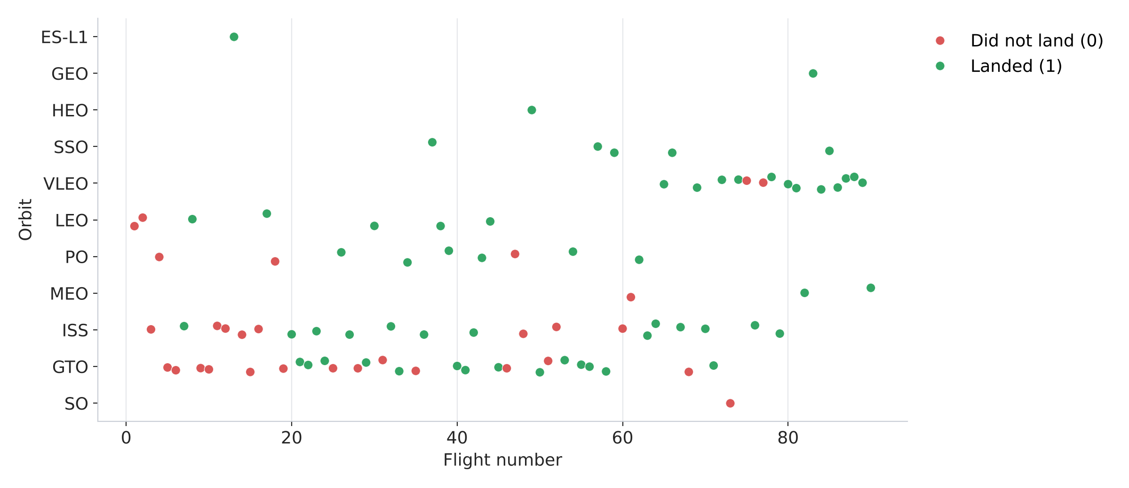
Flight Number vs. Orbit Type
In LEO, success follows the flight number — early LEO flights failed, later ones landed.
VLEO launches only start after flight 65 and almost all landed.
GTO outcomes stay mixed across the whole range of flight numbers.

Slide 22
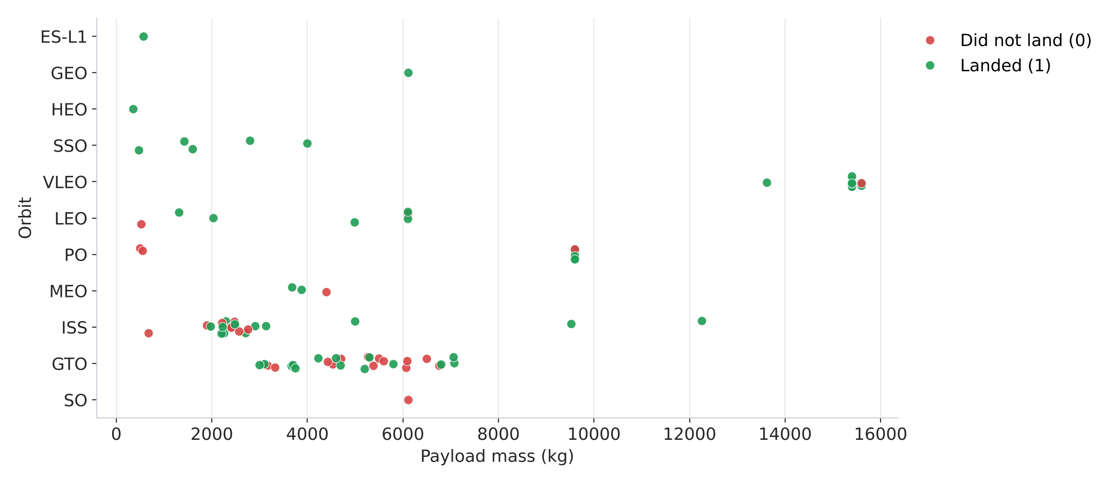
Payload vs. Orbit Type
Heavy payloads to Polar, LEO and ISS orbits land successfully more often.
GTO payloads sit in a narrow 3,000–7,100 kg band where successes and failures overlap.
VLEO missions (Starlink) carry the heaviest payloads (~15,600 kg) and mostly succeed.

Slide 23
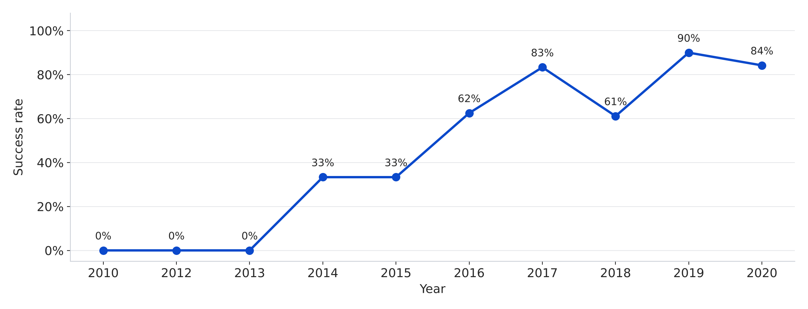
Launch Success Yearly Trend
No landing succeeded before 2014.
The success rate climbs from 33% (2014–15) to 62% (2016) and 83% (2017).
After a dip in 2018 (61%) it reaches 90% in 2019 and 84% in 2020.

Slide 24
All Launch Site Names
%sql SELECT DISTINCT "Launch_Site" FROM SPACEXTABLE;
Launch_Site
CCAFS LC-40
VAFB SLC-4E
KSC LC-39A
CCAFS SLC-40
SpaceX has used four launch sites: three in Florida (Cape Canaveral and Kennedy Space Center) and one in California (Vandenberg).
DISTINCT removes the repeats across 101 launch records.

Slide 25
Launch Site Names Begin with 'CCA'
%sql SELECT * FROM SPACEXTABLE WHERE "Launch_Site" LIKE 'CCA%' LIMIT 5;
Date | Time | Booster | Site | Payload | kg | Orbit | Customer | Mission | Landing
2010-06-04 | 18:45 | F9 v1.0 B0003 | CCAFS LC-40 | Dragon Qualification Unit | 0 | LEO | SpaceX | Success | Failure (parachute)
2010-12-08 | 15:43 | F9 v1.0 B0004 | CCAFS LC-40 | Dragon demo flight C1 | 0 | LEO (ISS) | NASA (COTS) NRO | Success | Failure (parachute)
2012-05-22 | 7:44 | F9 v1.0 B0005 | CCAFS LC-40 | Dragon demo flight C2 | 525 | LEO (ISS) | NASA (COTS) | Success | No attempt
2012-10-08 | 0:35 | F9 v1.0 B0006 | CCAFS LC-40 | SpaceX CRS-1 | 500 | LEO (ISS) | NASA (CRS) | Success | No attempt
2013-03-01 | 15:10 | F9 v1.0 B0007 | CCAFS LC-40 | SpaceX CRS-2 | 677 | LEO (ISS) | NASA (CRS) | Success | No attempt
The first five Cape Canaveral launches were early F9 v1.0 Dragon missions to LEO/ISS: every mission succeeded, but no first stage was recovered (parachute failures or no attempt).

Slide 26
Total Payload Mass
%sql SELECT SUM("PAYLOAD_MASS__KG_") AS "Total_Payload_Mass_kg"
FROM SPACEXTABLE WHERE "Customer" = 'NASA (CRS)';
Total_Payload_Mass_kg
45,596
Boosters flying NASA's Commercial Resupply Services (CRS) missions carried 45,596 kg in total.
Only rows whose customer is exactly 'NASA (CRS)' are counted.

Slide 27
Average Payload Mass by F9 v1.1
%sql SELECT AVG("PAYLOAD_MASS__KG_") AS "Avg_Payload_Mass_kg"
FROM SPACEXTABLE WHERE "Booster_Version" = 'F9 v1.1';
Avg_Payload_Mass_kg
2,928.4
The F9 v1.1 booster carried 2,928.4 kg on average — far less than later Block 5 boosters (up to 15,600 kg).

Slide 28
First Successful Ground Landing Date
%sql SELECT MIN("Date") AS "First_Successful_Ground_Pad_Landing"
FROM SPACEXTABLE WHERE "Landing_Outcome" = 'Success (ground pad)';
First_Successful_Ground_Pad_Landing
2015-12-22
The first successful ground-pad (RTLS) landing happened on 22 December 2015, five and a half years after the first Falcon 9 flight.

Slide 29
Successful Drone Ship Landing with Payload between 4000 and 6000
%%sql
SELECT DISTINCT "Booster_Version" FROM SPACEXTABLE
WHERE "Landing_Outcome" = 'Success (drone ship)'
AND "PAYLOAD_MASS__KG_" > 4000 AND "PAYLOAD_MASS__KG_" < 6000;
Booster_Version
F9 FT B1022
F9 FT B1026
F9 FT B1021.2
F9 FT B1031.2
Four Full Thrust (FT) boosters landed on a drone ship with a 4,000–6,000 kg payload.
Two of them (B1021.2, B1031.2) were already re-flown boosters.

Slide 30
Total Number of Successful and Failure Mission Outcomes
%%sql
SELECT TRIM("Mission_Outcome") AS "Mission_Outcome", COUNT(*) AS "Total"
FROM SPACEXTABLE GROUP BY TRIM("Mission_Outcome");
Mission_Outcome | Total
Failure (in flight) | 1
Success | 99
Success (payload status unclear) | 1
100 of 101 missions succeeded; only one failed in flight.
TRIM merges a 'Success ' value that has a trailing space in the raw data.
Mission success ≠ landing success: the payload reaching orbit says nothing about the first stage.

Slide 31
Boosters Carried Maximum Payload
%%sql
SELECT DISTINCT "Booster_Version" FROM SPACEXTABLE
WHERE "PAYLOAD_MASS__KG_" = (SELECT MAX("PAYLOAD_MASS__KG_") FROM SPACEXTABLE);
Booster_Version | Booster_Version (cont.)
F9 B5 B1048.4 | F9 B5 B1049.5
F9 B5 B1049.4 | F9 B5 B1060.2
F9 B5 B1051.3 | F9 B5 B1058.3
F9 B5 B1056.4 | F9 B5 B1051.6
F9 B5 B1048.5 | F9 B5 B1060.3
F9 B5 B1051.4 | F9 B5 B1049.7
12 Block 5 boosters carried the maximum payload (15,600 kg — Starlink batches).
All are re-flown boosters (suffix .2 to .7), showing how far reuse had come by 2020.

Slide 32
2015 Launch Records
%%sql
SELECT substr("Date", 6, 2) AS "Month", "Landing_Outcome", "Booster_Version", "Launch_Site"
FROM SPACEXTABLE
WHERE substr("Date", 0, 5) = '2015' AND "Landing_Outcome" = 'Failure (drone ship)';
Month | Landing_Outcome | Booster_Version | Launch_Site
01 | Failure (drone ship) | F9 v1.1 B1012 | CCAFS LC-40
04 | Failure (drone ship) | F9 v1.1 B1015 | CCAFS LC-40
Both 2015 drone-ship failures (January and April) were F9 v1.1 boosters launched from CCAFS LC-40 — the first attempts at landing on a ship.

Slide 33
Rank Landing Outcomes Between 2010-06-04 and 2017-03-20
%%sql
SELECT "Landing_Outcome", COUNT(*) AS "Outcome_Count" FROM SPACEXTABLE
WHERE "Date" BETWEEN '2010-06-04' AND '2017-03-20'
GROUP BY "Landing_Outcome" ORDER BY "Outcome_Count" DESC;
Landing_Outcome | Outcome_Count
No attempt | 10
Success (drone ship) | 5
Failure (drone ship) | 5
Success (ground pad) | 3
Controlled (ocean) | 3
Uncontrolled (ocean) | 2
Failure (parachute) | 2
Precluded (drone ship) | 1
In this early period 'No attempt' was most common (10).
Drone-ship landings were a coin flip (5 successes, 5 failures) and there were 3 ground-pad successes — 8 successful landings out of 31 launches.

Slide 34

Section 3

Slide 35
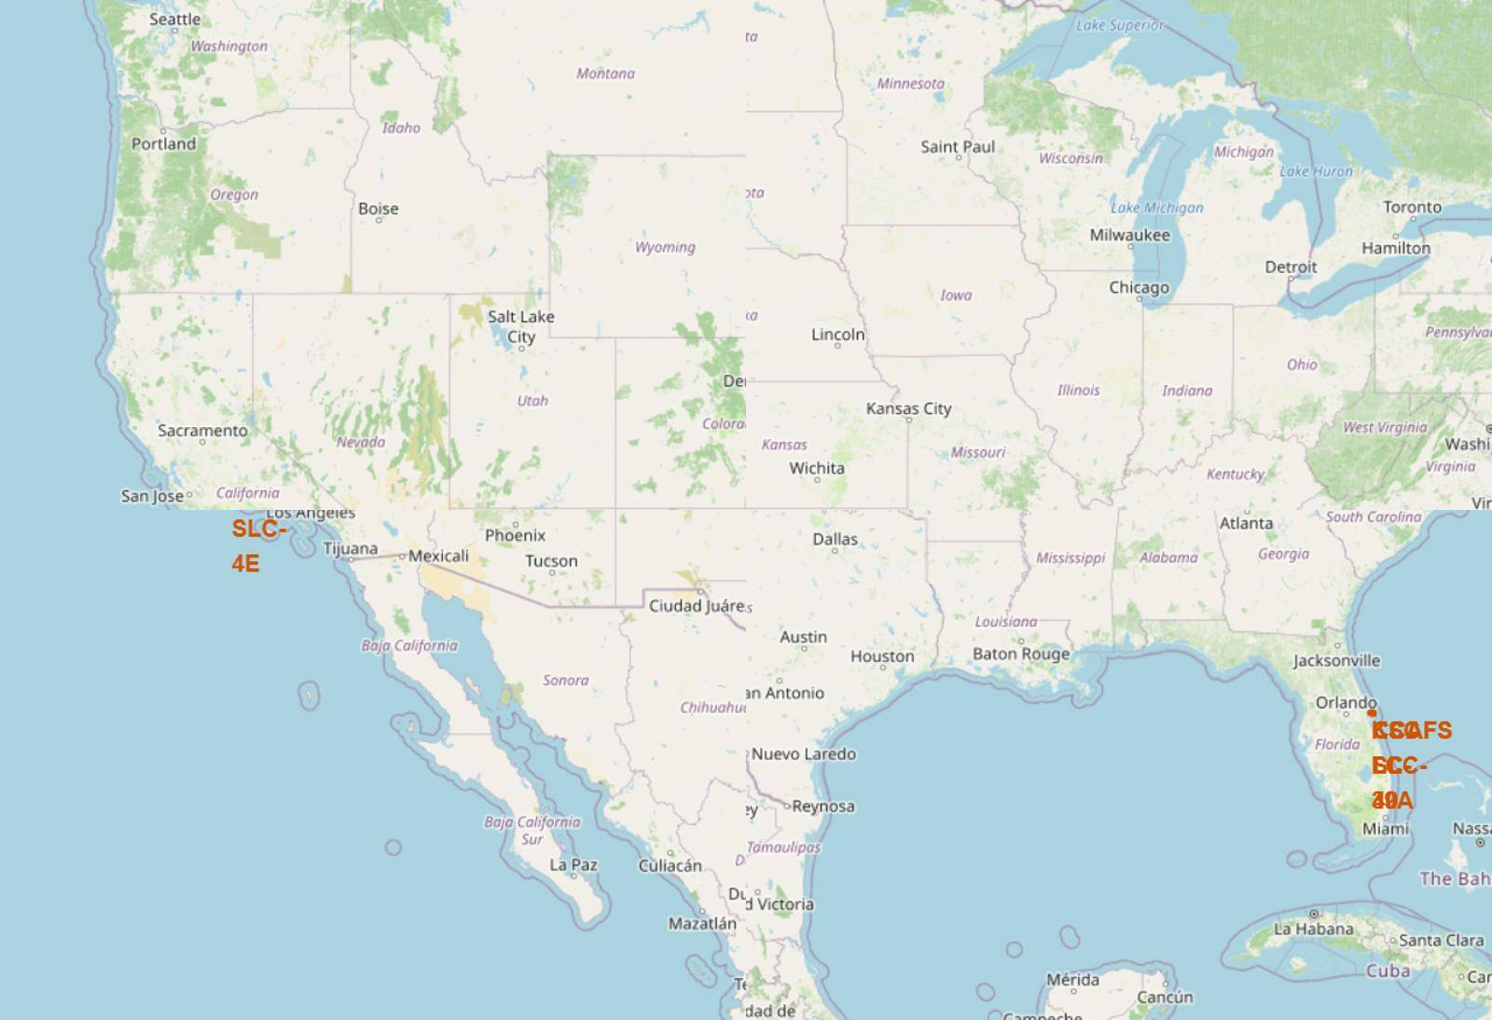
All Launch Sites on a Map
Orange circles mark the four launch sites: VAFB SLC-4E in California and CCAFS LC-40, CCAFS SLC-40 and KSC LC-39A on Florida's Cape Canaveral.
No site is near the Equator, but the Florida sites (~28.5° N) are the most southerly options in the continental US, which helps eastward launches.
Every site sits on the coast, so rockets fly out over the ocean.
Map data © OpenStreetMap contributors

Slide 36
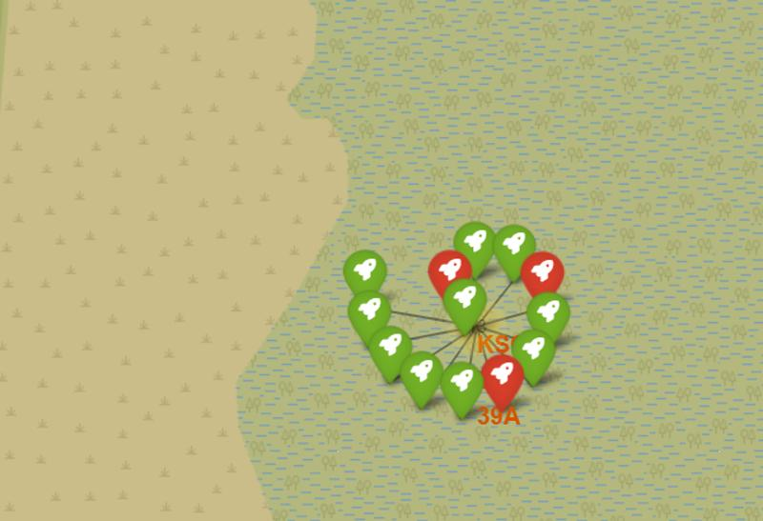
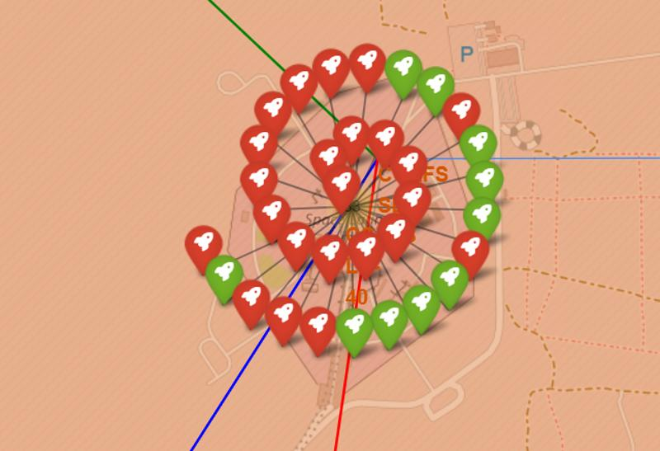
Launch Outcomes by Site
Launches are grouped in clusters per site; expanded, each marker is one launch: green = landed, red = did not land.
Top – KSC LC-39A: 10 of 13 green (77%), the best ratio.
Bottom – CCAFS LC-40 + SLC-40 (shared cluster): 10 of 33 green; the early, mostly failed flights flew from here.
VAFB SLC-4E: 4 of 10 landed (40%).
Map data © OpenStreetMap contributors

Slide 37
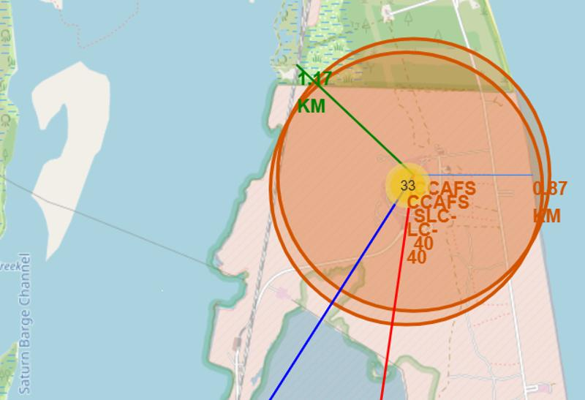
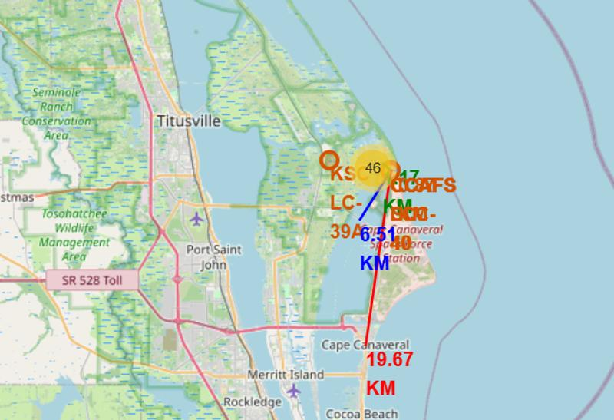
CCAFS SLC-40 and Its Proximities
Coastline 0.87 km – Atlantic beside the pad
Railway 1.17 km – NASA Railroad (plus the pad's own spur)
Highway 6.51 km – NASA Parkway East
City 19.67 km – Cape Canaveral town
Close to the sea and to rail, but kept well away from people.
Left: pad close-up. Right: lines to highway and town. Map data © OpenStreetMap contributors

Slide 38

Section 4

Slide 39
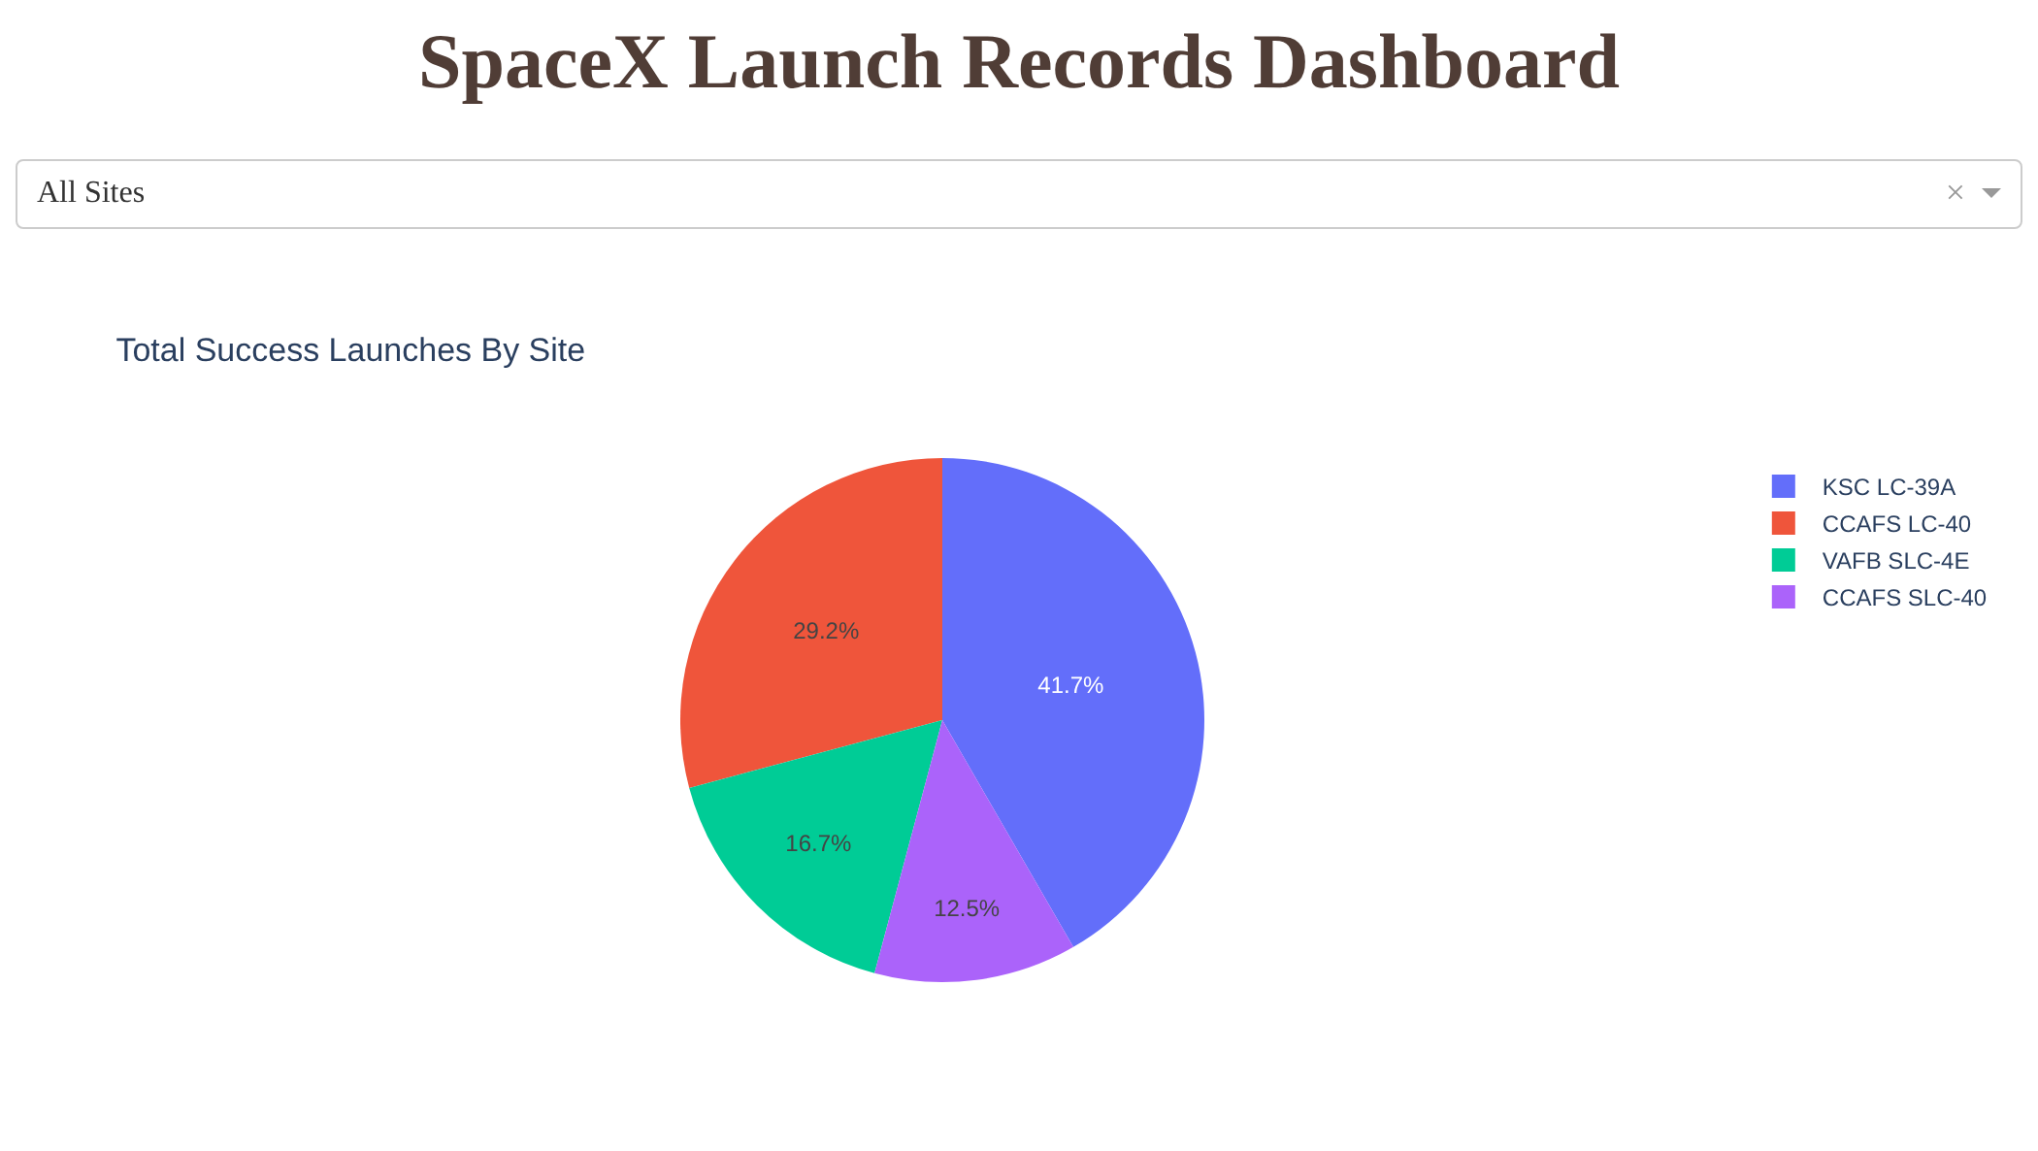
Total Successful Launches by Site
With 'All Sites' selected, the pie shows each site's share of all successful landings.
KSC LC-39A has the most successes (41.7%, 10 landings), followed by CCAFS LC-40 (29.2%), VAFB SLC-4E (16.7%) and CCAFS SLC-40 (12.5%).
24 successful landings in total in the dashboard data (56 launches).

Slide 40
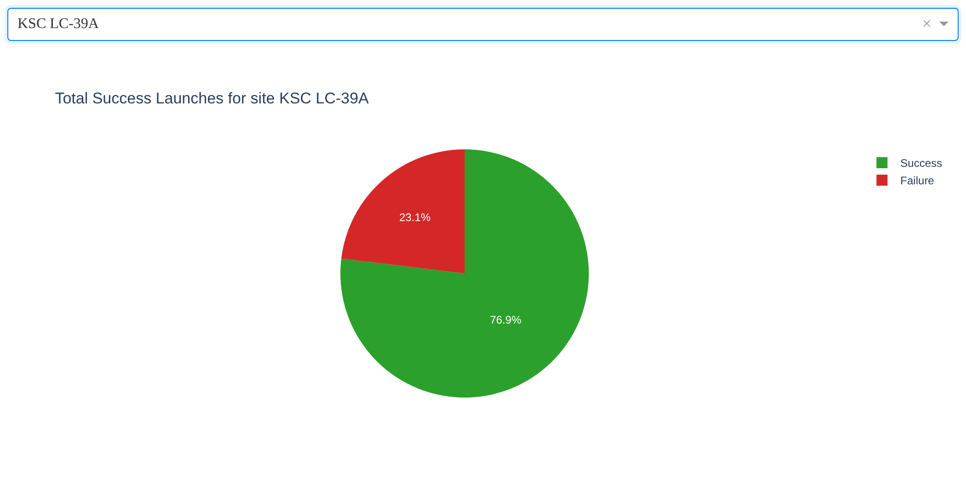
KSC LC-39A: Highest Launch Success Ratio
Selecting KSC LC-39A shows its own success vs. failure split.
76.9% of its launches landed (10 of 13) — the best ratio of any site.
For comparison: CCAFS SLC-40 43%, VAFB SLC-4E 40%, CCAFS LC-40 27%.

Slide 41
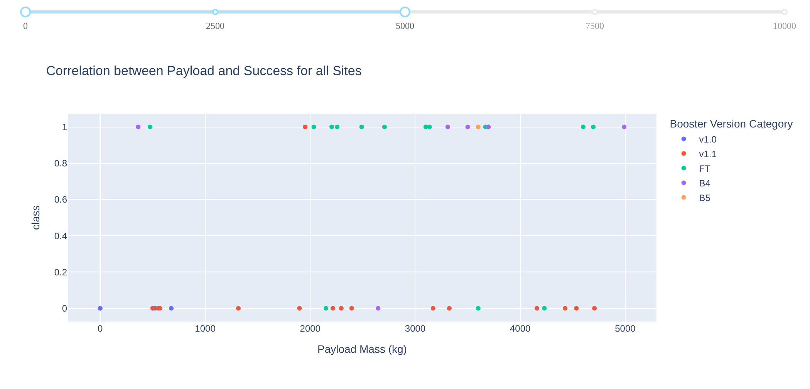
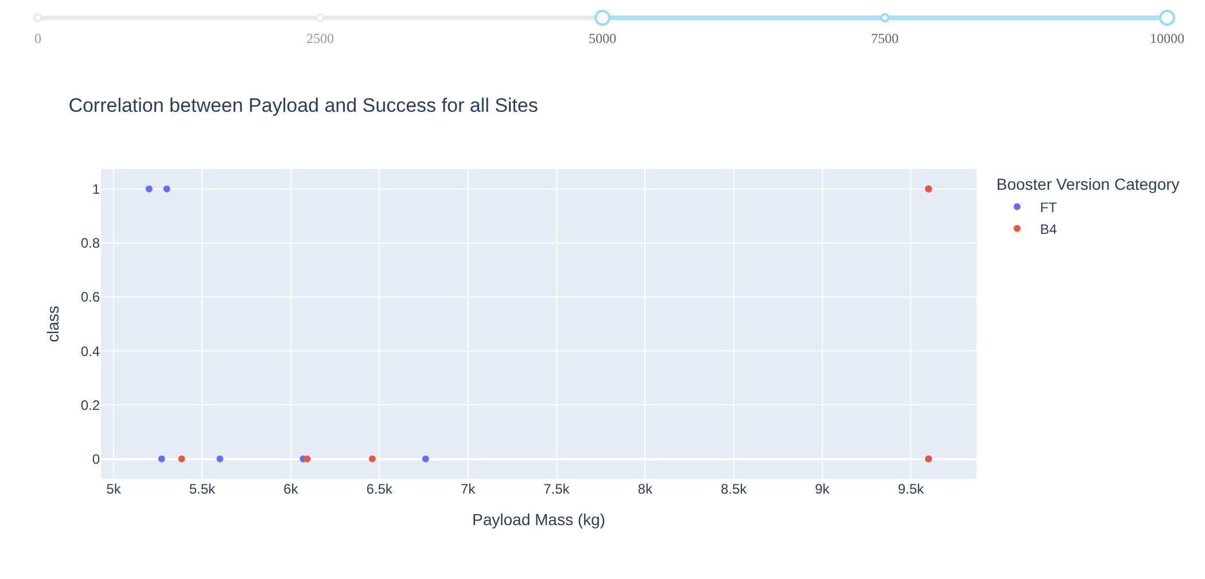
Payload vs. Launch Outcome for All Sites
Slider 0 – 5,000 kg
Slider 5,000 – 10,000 kg
2,000–4,000 kg has the highest success rate (62%); 6,000–8,000 kg the lowest (0 of 4), with 0–2,000 kg also weak (23%).
By booster version, FT is the best version with a real sample (67% of 24); v1.0 (0 of 5) and v1.1 (1 of 15) rarely landed. B5 is 1 of 1.
Light and heavy payloads both fail with old boosters — booster version matters more than payload.

Slide 42

Section 5

Slide 43
Classification Accuracy
All four tuned models reach the same 83.3% accuracy on the 18-launch test set (15 correct).
The tie is broken by cross-validation: the Decision Tree scores 87.7%, ahead of SVM and KNN (84.8%) and Logistic Regression (84.6%).
Best model: Decision Tree
gini, max_depth 8, max_features sqrt, min_samples_leaf 2, min_samples_split 10

Slide 44
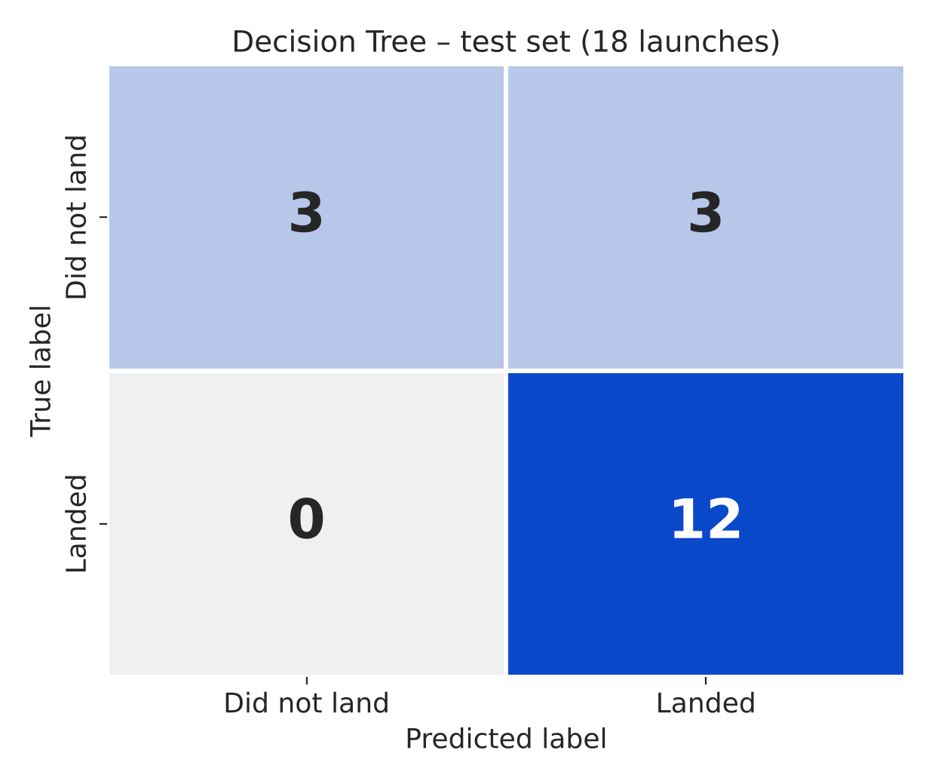
Confusion Matrix
Decision Tree on the 18 test launches:
12 true positives — every landing was predicted correctly.
3 true negatives — failed landings correctly flagged.
3 false positives — failed landings predicted as landed.
0 false negatives.
The model is optimistic: it never misses a landing but over-predicts success for half of the failures. The other three models make exactly the same errors.

Slide 45
Conclusions
Experience pays off Landing success rose from 0% before 2014 to 84–90% in 2019–2020; later flights land far more often.
Site matters KSC LC-39A has the most successful landings and the best ratio (77%).
Orbit and payload matter SSO, VLEO and LEO missions land most often; GTO is the hardest. Heavy payloads to LEO/Polar/ISS land well.
Booster version matters Full Thrust and Block 5 boosters land; v1.0 and v1.1 rarely did.
Location All sites are coastal, close to rail, and ≥ 20 km from towns.
Prediction A tuned Decision Tree predicts landings with 83% test accuracy (88% CV) — good enough to support Space Y's bid pricing, though it over-predicts success.

Slide 46
Appendix
File (GitHub) | Content
jupyter-labs-spacex-data-collection-api-v2.ipynb | Data collection – SpaceX API
jupyter-labs-webscraping.ipynb | Data collection – web scraping
labs-jupyter-spacex-Data wrangling-v2.ipynb | Data wrangling
jupyter-labs-eda-sql-coursera_sqllite.ipynb | EDA with SQL
jupyter-labs-eda-dataviz-v2.ipynb | EDA with visualization
lab-jupyter-launch-site-location-v2.ipynb | Interactive map with Folium
spacex_dash_app.py | Plotly Dash dashboard
SpaceX-Machine-Learning-Prediction-Part-5-v1.ipynb | Machine learning prediction
Execution notes
The public SpaceX API (api.spacexdata.com) was offline (HTTP 522) in October 2026, so the API notebook's per-ID lookups were served from IBM's archived copies of the same API responses; the output reproduces IBM's dataset_part_1.csv exactly.
Scikit-learn 1.3+ removed max_features='auto'; the Decision Tree grid uses 'sqrt' and 'log2' instead.
Repository: https://github.com/marcosroquerosa/ibm-data-science-capstone

Slide 47


