Slide 1




UNIVERSITY OF PADUA
UNIVERSITA’ DEGLI STUDI DI PADOVA
Prediction of Coronary Heart Disease
Francesco Vo, 1234567
Marco Uderzo, 2096998

Slide 2
Context and Motivation
Cardiovascular diseases (CVDs) are the number one cause of death globally, Heart failure is a common event caused by CVDs and this dataset contains 11 features that can be used to predict a possible heart disease.
People with cardiovascular disease or who are at high cardiovascular risk need early detection wherein statistical learning models can be of great help.

Slide 3
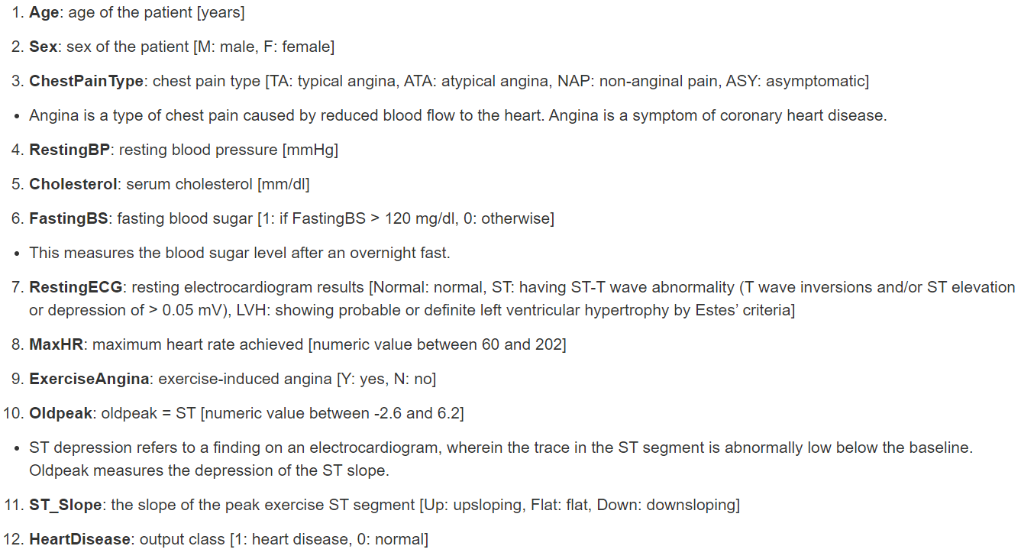
The Dataset

Slide 4
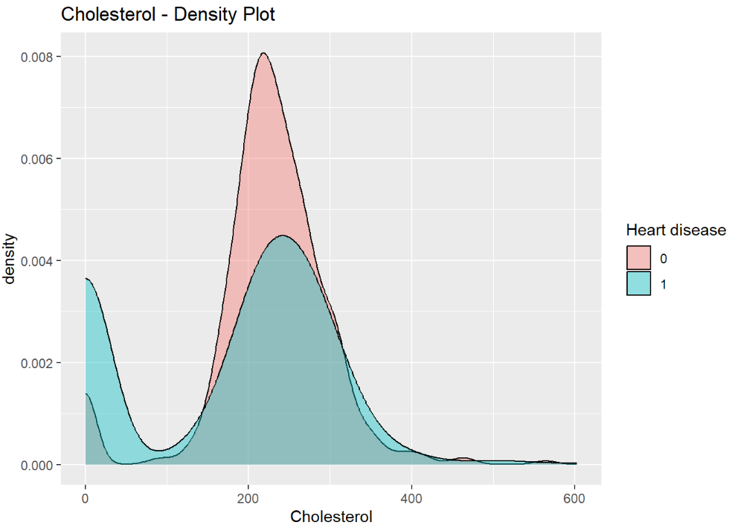
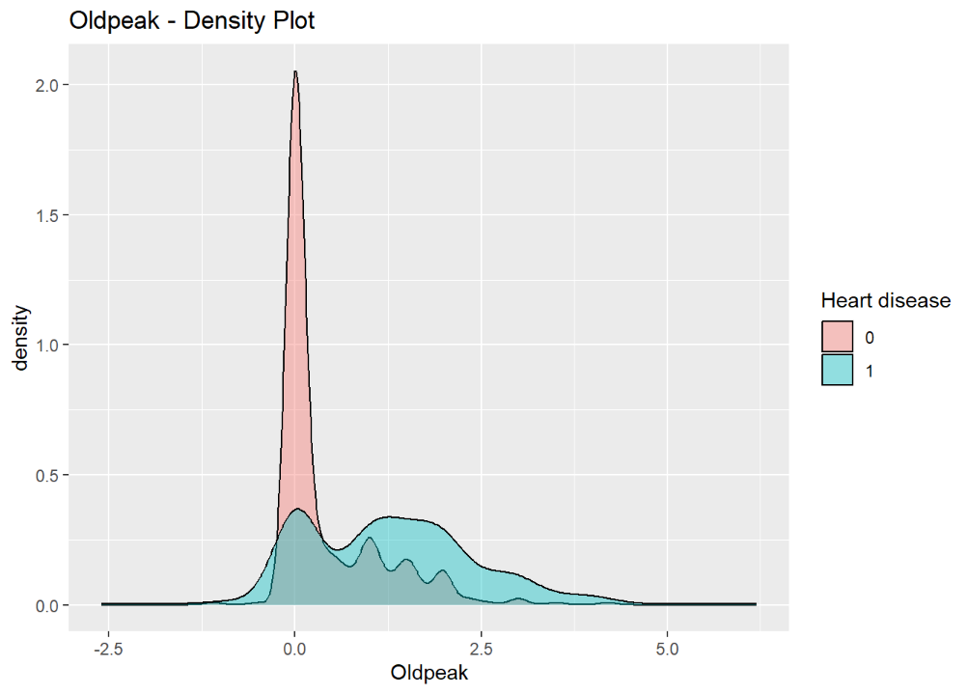
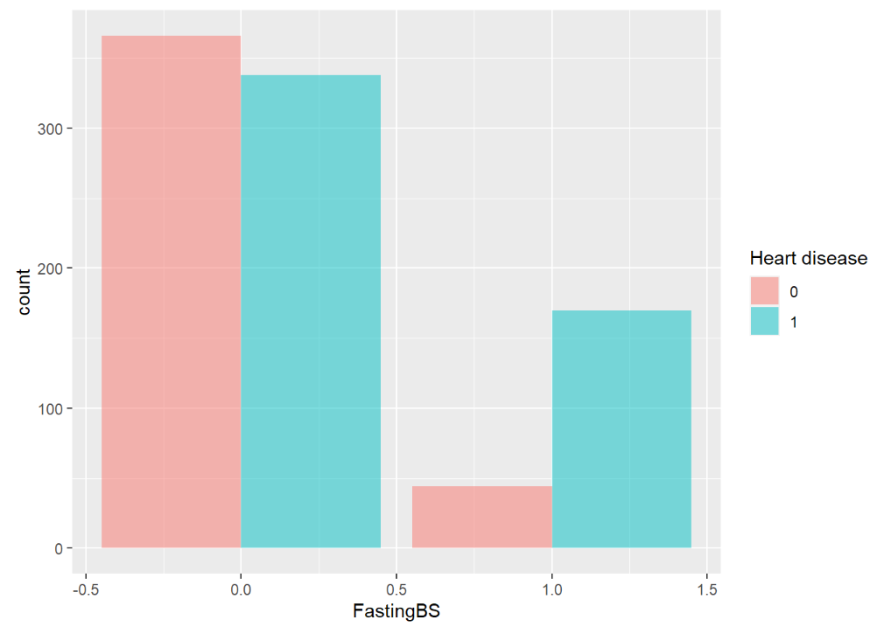
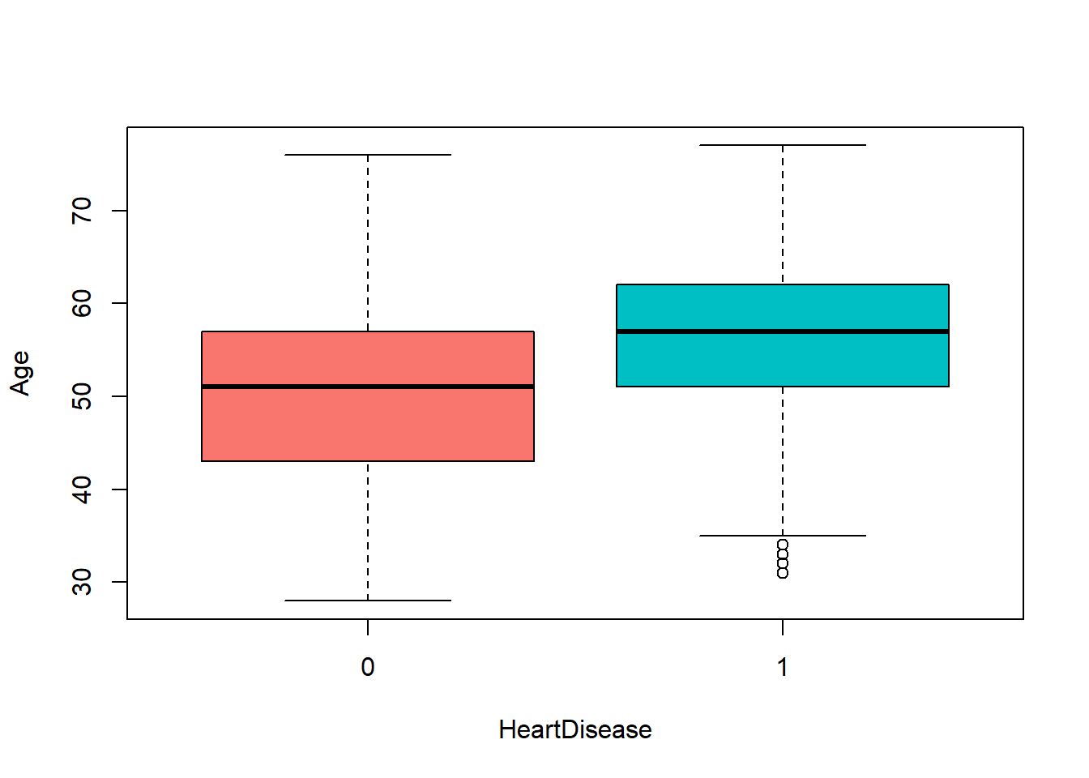
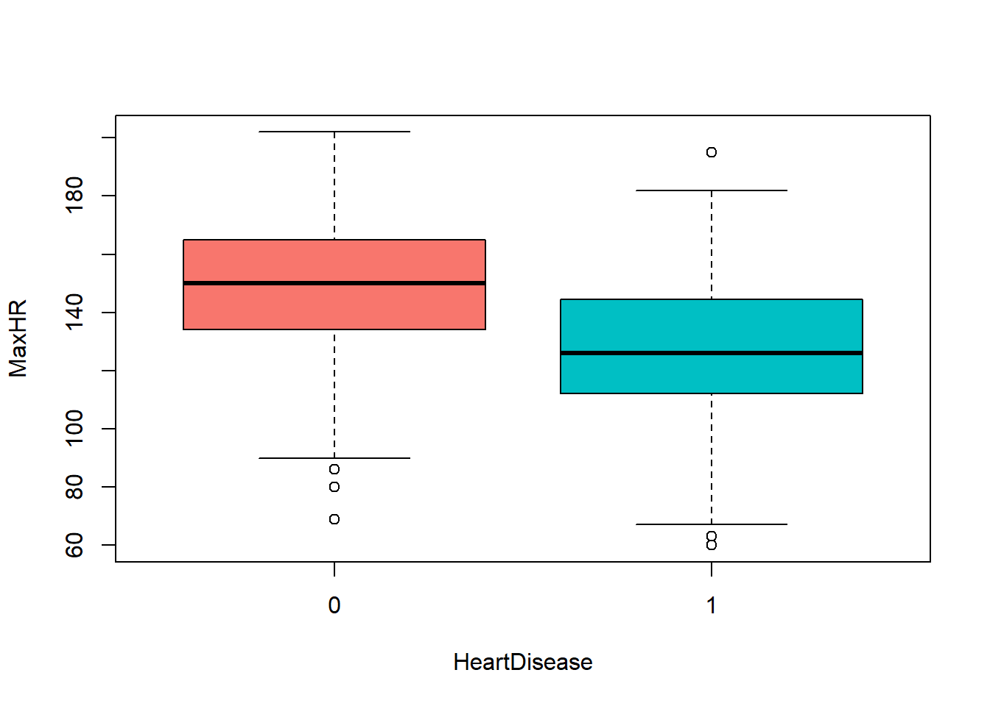
Data Visualization and Cleaning

Slide 5
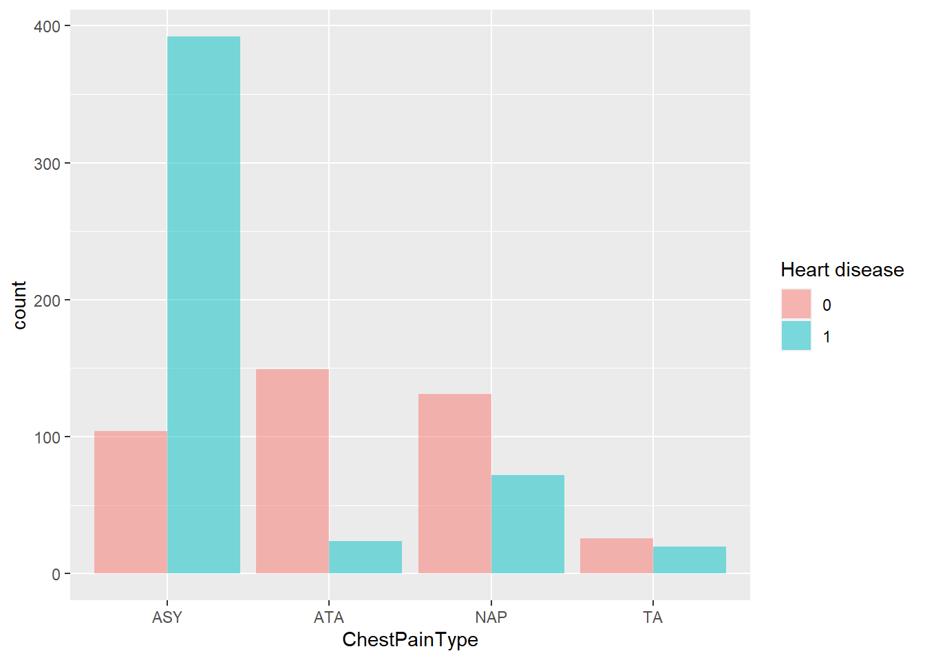
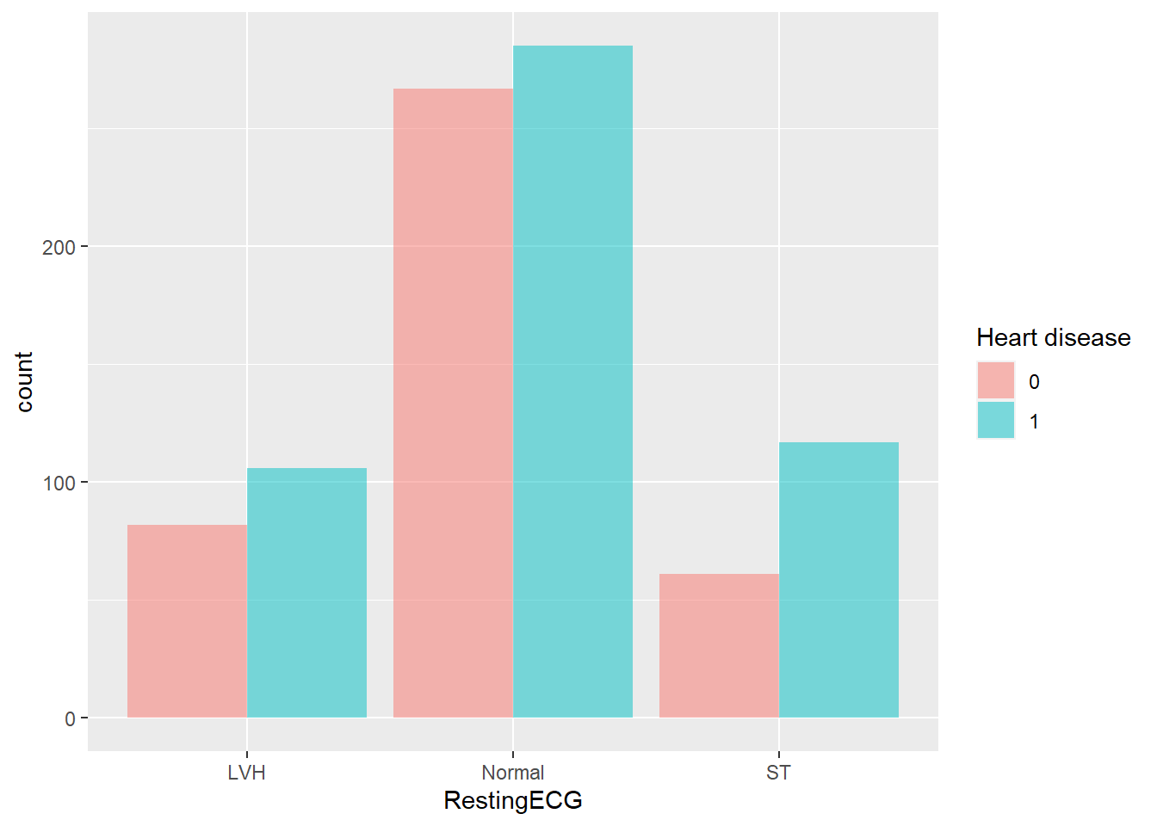
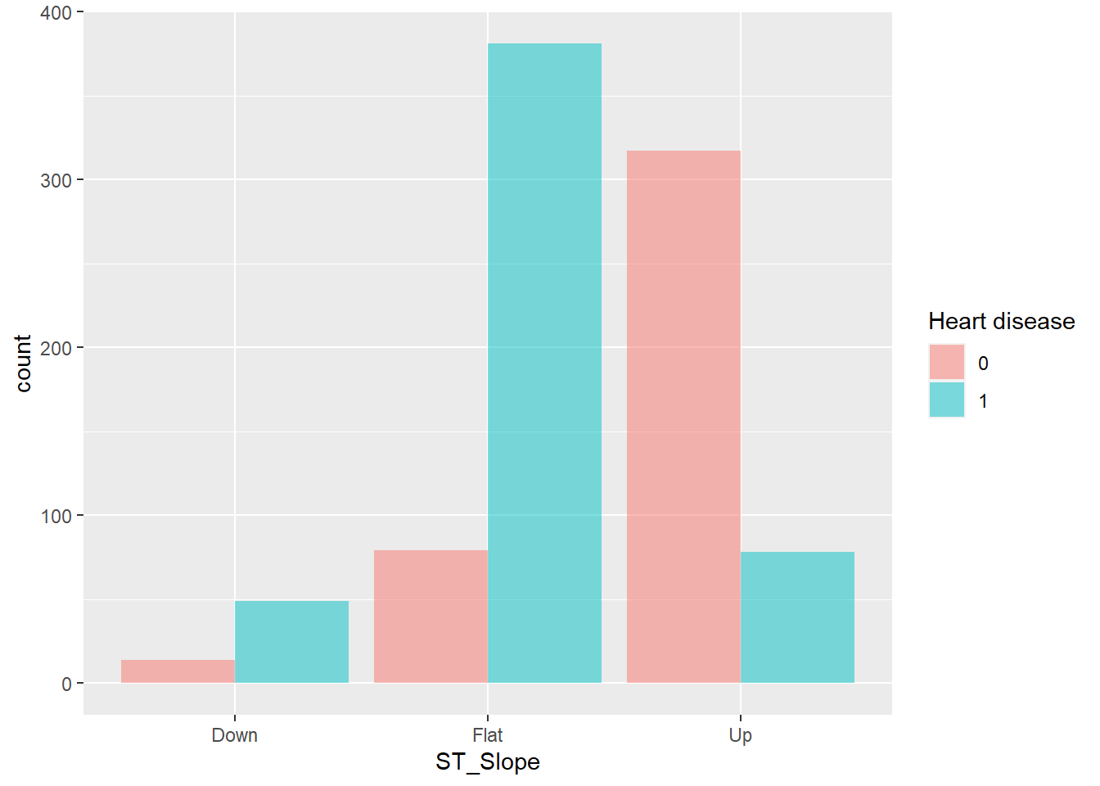
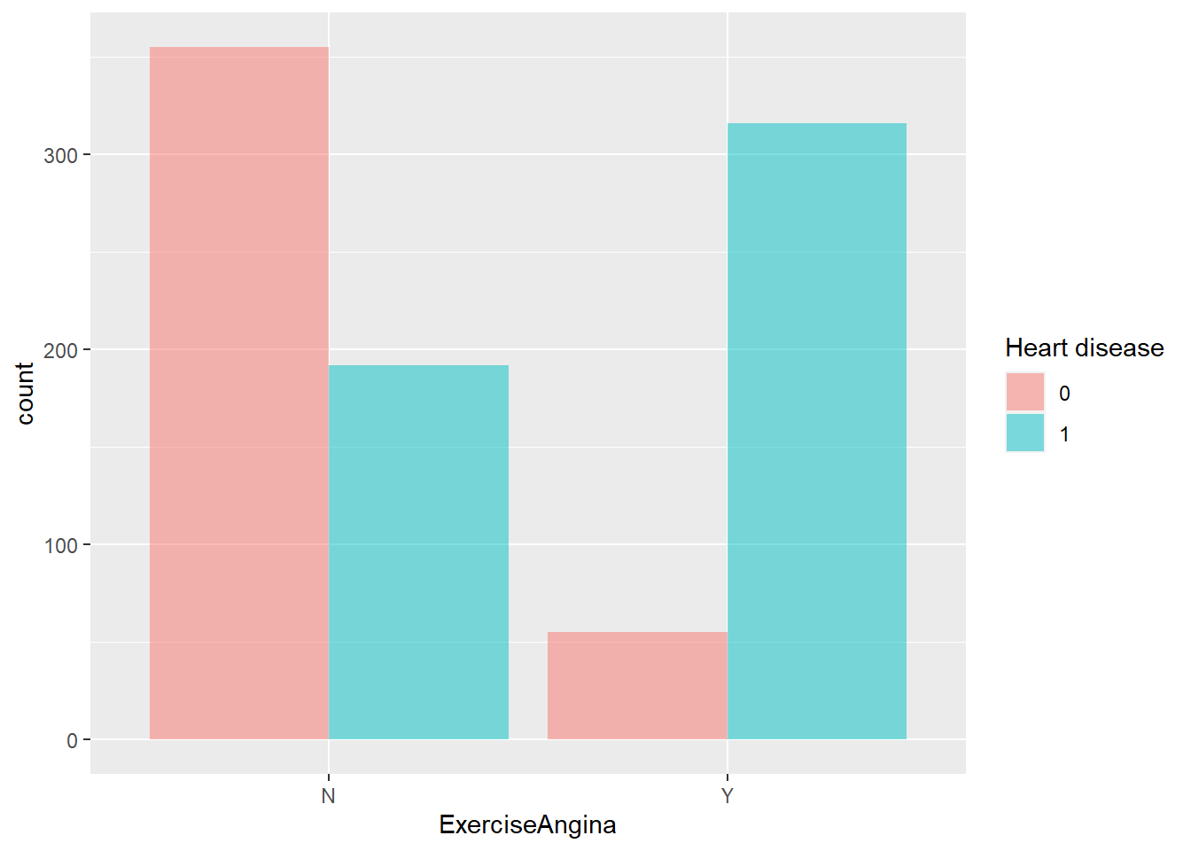
Data Visualization and Cleaning

Slide 6
Considerations
We have seen from the plots that there are 172 variables in Cholesterol that have value equal to 0. Also we have noted that patients that have Cholesterol equal to 0 are very likely to have the heart disease.
Reasons could be:
Cholesterol was incorrectly recorded
Cholesterol did not affect the prediction that much, so we dropped it.

Slide 7
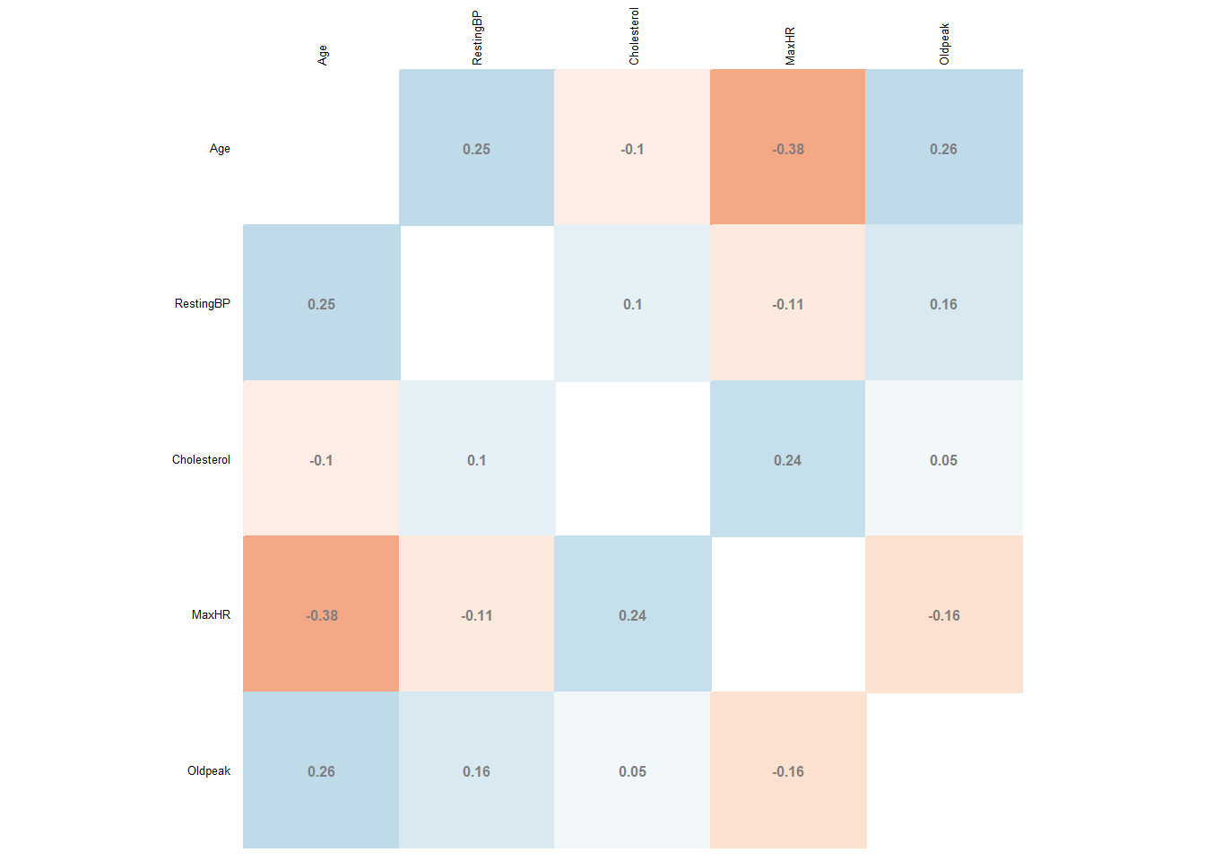
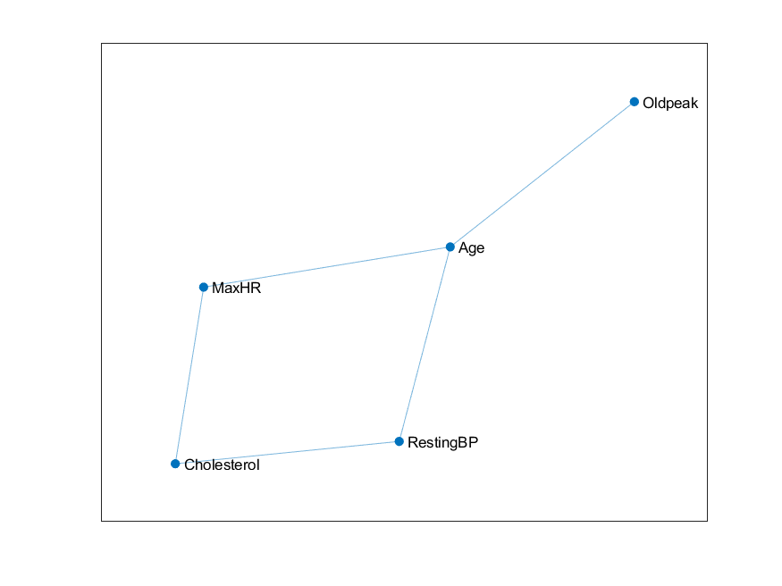
Correlations: Matrix and Graph

Slide 8
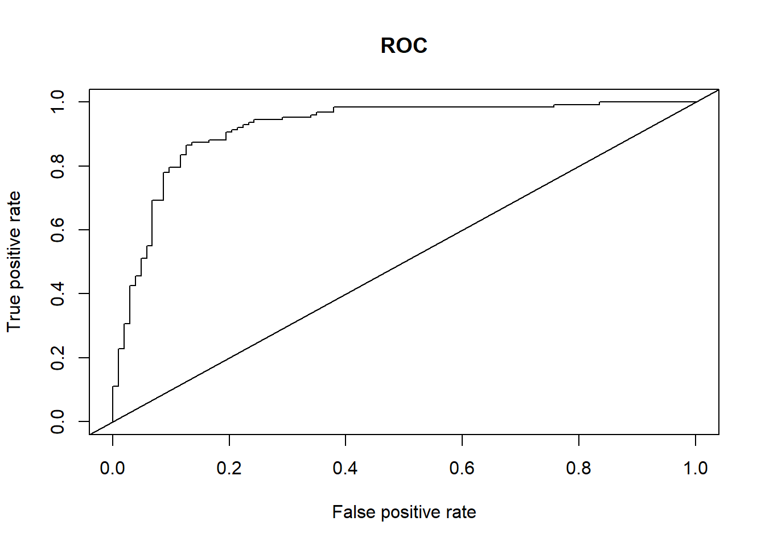
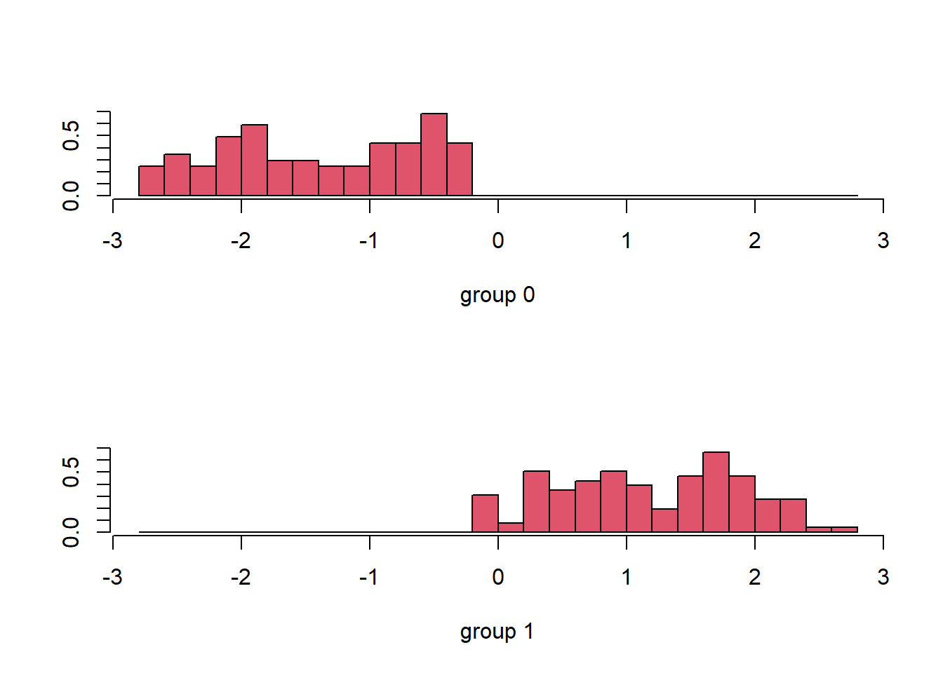
Linear Discriminant Analysis
Linear Discriminant Analysis (LDA) is a classification algorithm, where a discriminant rule tries to divide the data points into K disjoint regions, where K is the number of classes (in this case K = 2).
Accuracy: 0.86
Precision: 0.88
Recall: 0.87
F1-Score: 0.87
AUC: 0.92

Slide 9

Quadratic Discriminant Analysis
Quadratic Discriminant Analysis (QDA) doesn’t assume the equal variance of the classes. For this reason the decision boundary is not linear but quadratic.
Accuracy: 0.86
Precision: 0.87
Recall: 0.87
F1-Score: 0.87
AUC: 0.90

Slide 10

GLM: Generalized Linear Model
Logistic Regression is the easiest and most common model to perform binary classification.
The goal is to predict whether or not a patient has CHD
VIF: We consider the Variance Inflation Factor to assess multicollinearity
All predictors are included
Threshold selection initially not optimized
Accuracy: 0.86
Precision: 0.9
Recall: 0.84
F1-Score: 0.87
AUC: 0.91

Slide 11
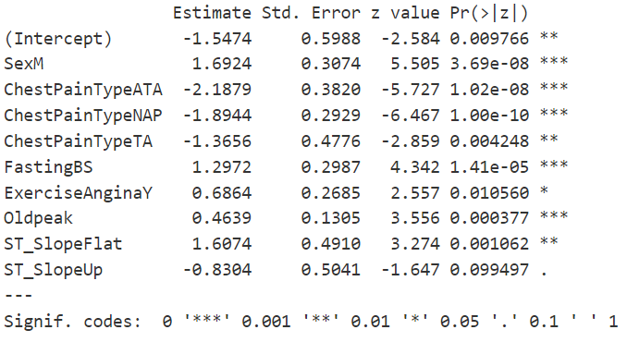
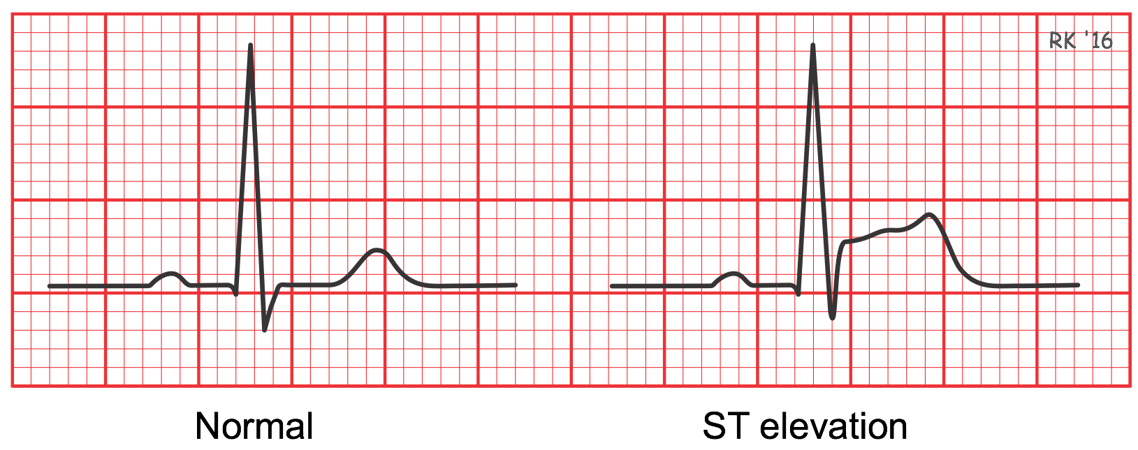
GLM: Backward Selection with p-value
Removed Predictors:
Age, RestingECG, MaxHR, RestingBP
Best Predictors (p <= 0.001):
SexM, ChestPainType[“ATA”, “NAP”], FastingBS, Oldpeak
Considerations:
RestingBP only contains systolic BP, not considering diastolic and pulse pressure
MaxHR could be useful to assess heart functioning at rest
ST_SlopeUp (ST segment elevation) is a good predictor of CHD, so we kept it despite p-value > 0.05

Slide 12
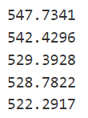

GLM: BIC & Analysis of Deviance
The Bayesian Information Criterion, often abbreviated BIC, is a metric that is used to compare the goodness of fit of different regression models.
BIC consistently dropped after removal of aforementioned predictors
Deviance is a quality-of-fit statistic for a model that is often used for statistical hypothesis testing.
Deviance difference test yields a p-value of 0.2043
Therefore:
Reduced model is not significantly different from full model
Removed predictors are indeed not useful

Slide 13
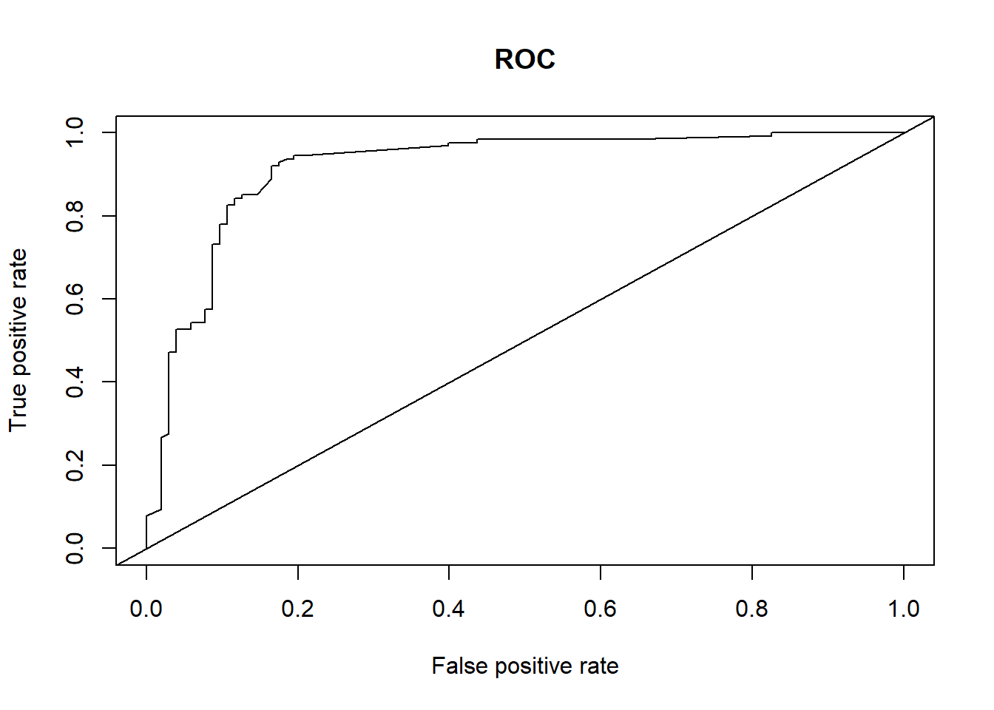
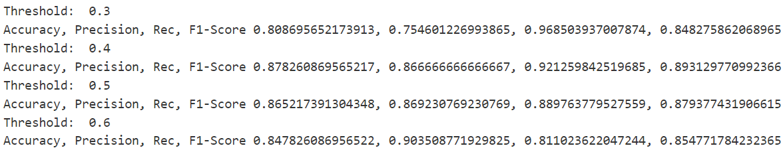
GLM: Threshold Selection
Objective: maximize Recall, in order to minimize wrongly discharged patients with CHD. At the same time, other metrics must be acceptable.
Thresholds: 0.3, 0.4, 0.5, 0.6
0.3 Maximized Recall but Accuracy and Precision would suffer
Best Overall Threshold: 0.4
Accuracy: 0.88
Precision: 0.87
Recall: 0.92
F1-Score: 0.89
AUC: 0.92

Slide 14
Regularized Regression
Generalized models with some penalizations according to λ value
Estimators with very large variants and small bias can lead to multicollinearity and produce poor estimates (overfitting)
Regularized Regression methods use automatic selection of variables through shrinkage on the coefficients of the predictors:
Ridge Regression: coefficients assume values very close to zero
Lasso Regression: coefficients assume values that can even be zero

Slide 15

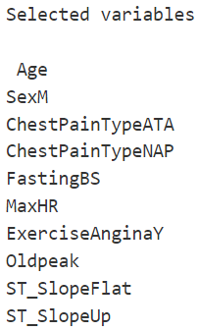
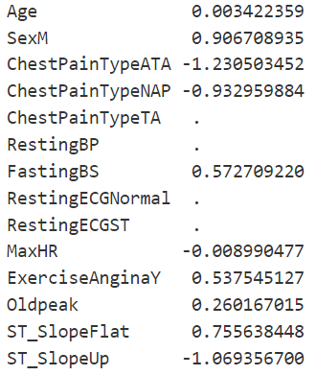
Lasso Regression
Cross-validation performed with glmnet
Best λ: ~ 0.036
Removed Predictors:
RestingECG[“ Normal ”, “ ST ”], RestingBP, ChestPainType[“ TA ”]
Best Predictors (largest absolute magnitude):
SexM, ChestPainType[“ATA, “NAP”], ST_Slope[“Up”, “Flat”]
Accuracy: 0.85,
Precision: 0.83
Recall: 0.89
F1-Score: 0.86
AUC: 0.91

Slide 16

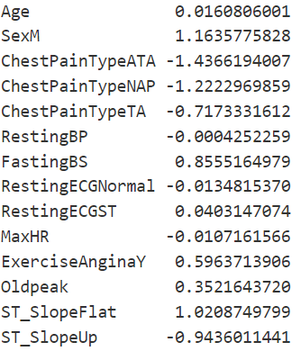
Ridge Regression
Cross-validation performed with glmnet
Best λ: ~ 0.031
Less Important Predictors:
RestingBP, RestingECG[“Normal”, “ST”], MaxHR, Oldpeak
Best Predictors (largest absolute magnitude):
SexM, ChestPainType[“ATA, “NAP”], ST_Slope[“Up”, “Flat”]
Accuracy: 0.87
Precision: 0.85
Recall: 0.91
F1-Score: 0.88
AUC: 0.92

Slide 17

Naive Bayes Classifier
The Naive Bayes Classifier is a classification technique based on Bayes’ Theorem with an independence assumption among predictors.
In simple terms, a Naive Bayes classifier assumes that the presence of a particular feature in a class is unrelated to the presence of any other feature.
Does not perform explicit feature selection
But assigns higher importance to features that have a stronger influence on class probabilities
Best threshold: 0.6
Accuracy: 0.87
Precision: 0.85
Recall: 0.91
F1-Score: 0.88
AUC: 0.92

Slide 18
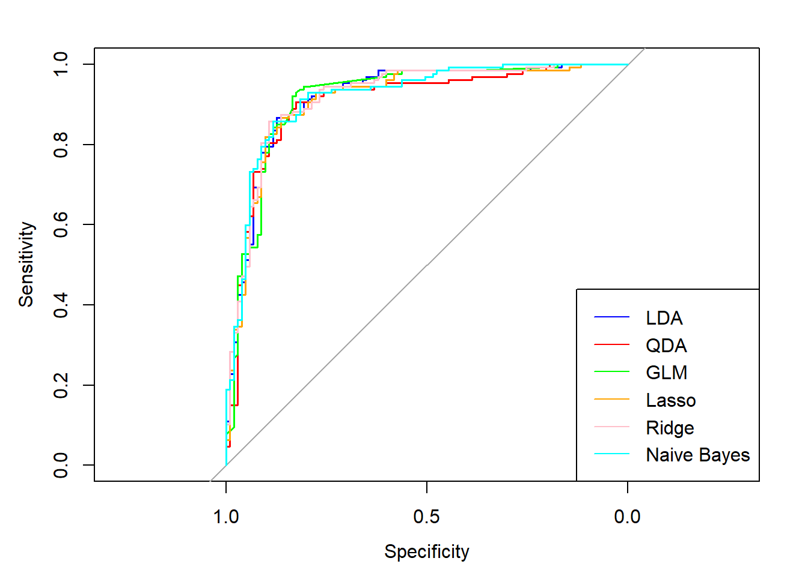
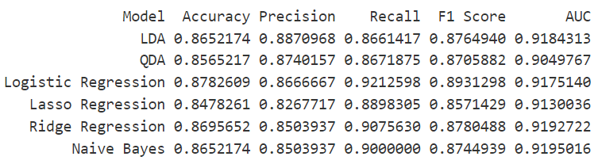
Best Models
All models perform relatively good, with similar ROCs and each with their own strengths and weaknesses in their metrics.
Considering Recall as most important, the best models are:
Logistic Regression (threshold: 0.4)
Ridge Regression
Naive Bayes

Slide 19
Conclusions: Best Predictors
Goal: predicting Coronary Artery Disease (CAD/CHD)
Medical literature was also briefly checked to confirm our findings
Considering all models, the very best predictors are:
SexM: males are more likely to suffer from CAD.
ChestPainType[“ATA, “NAP”]: Atypical Angina is a known symptom preceding Myocardial Infarction. Non-Anginal Pain is non-ischemic related.
ST_Slope[“Up”, “Flat”]: ST Segment Elevation is a known anomaly of the electrophysiology of heart due to coronary blockage and therefore myocardial ischemia.
Oldpeak: ST Segment Depression induced by exercise relative to rest might indicate myocardial ischemia.

