Slide 1


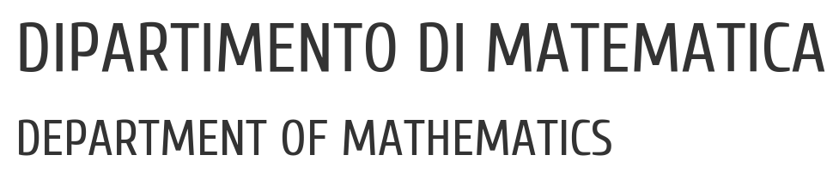

UNIVERSITY OF PADUA
UNIVERSITA’ DEGLI STUDI DI PADOVA
Prediction of Coronary Artery Disease
Statistical Learning 2, A.Y. 2022/23
Marco Uderzo, 2096998
Francesco Vo, 1234567

Slide 2
Context and Motivation
Cardiovascular diseases (CVDs) are the number one cause of death globally.
Coronary Artery Disease (CAD) is a common and very deadly occurrence, and this dataset contains 11 features that can be used to predict it.
People with cardiovascular diseases or who are at high cardiovascular risk need early detection wherein statistical learning models can be of great help.
1/24

Slide 3
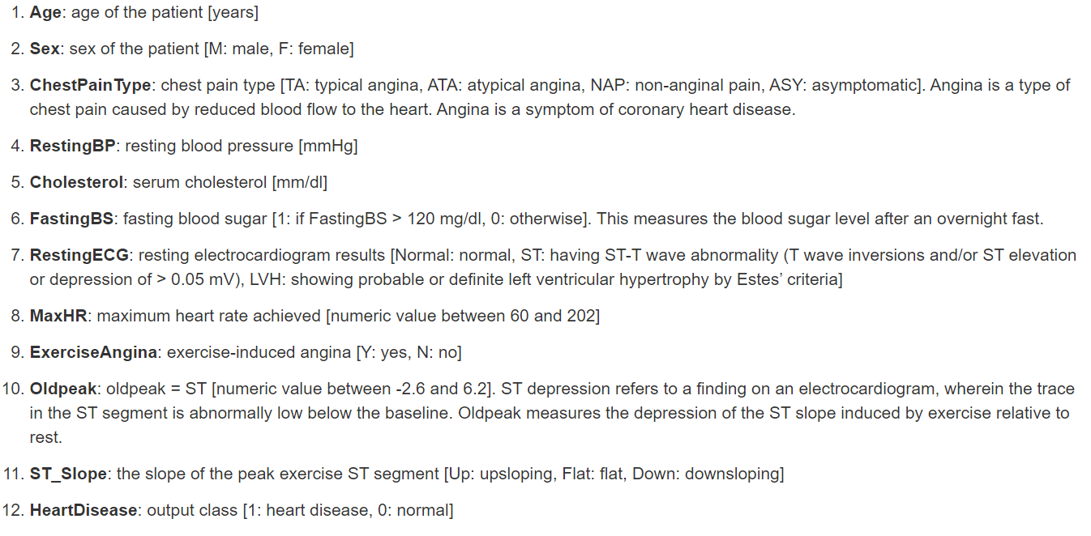
The Dataset
The dataset contains 12 parameters and 918 observations.
2/24

Slide 4
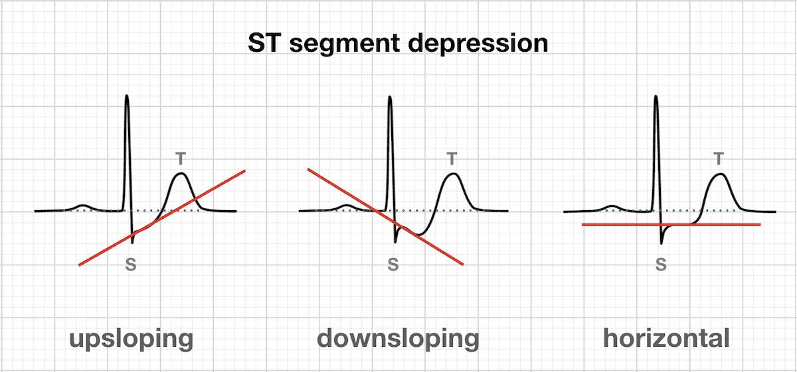
ST Slope
3/24

Slide 5
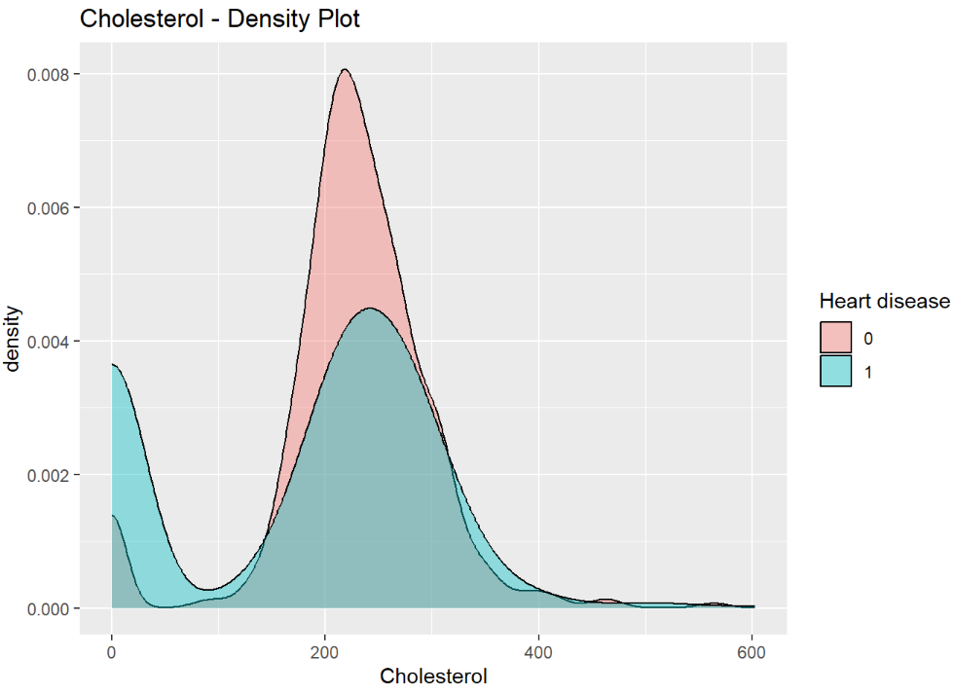
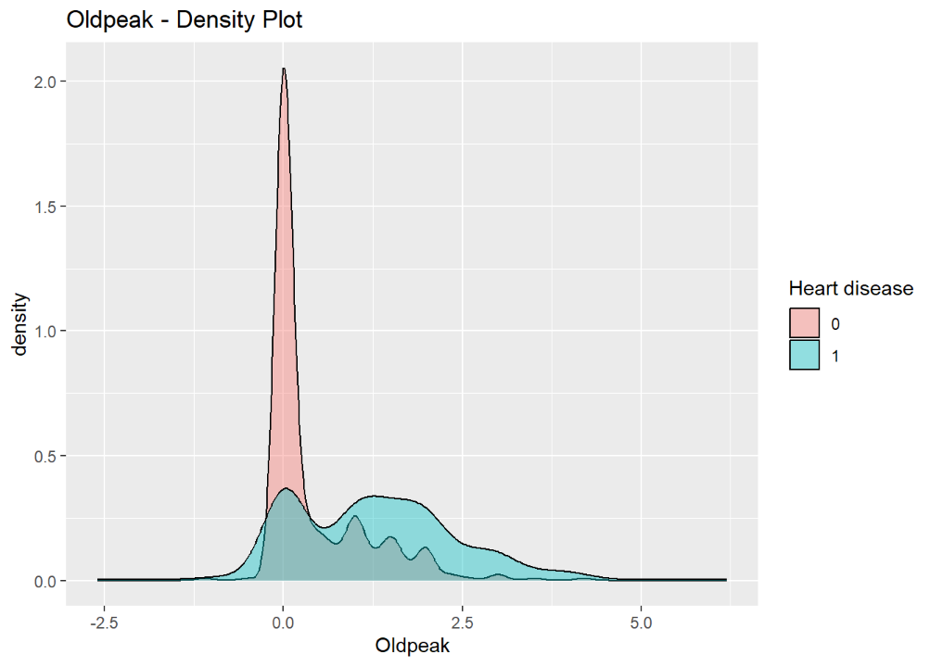
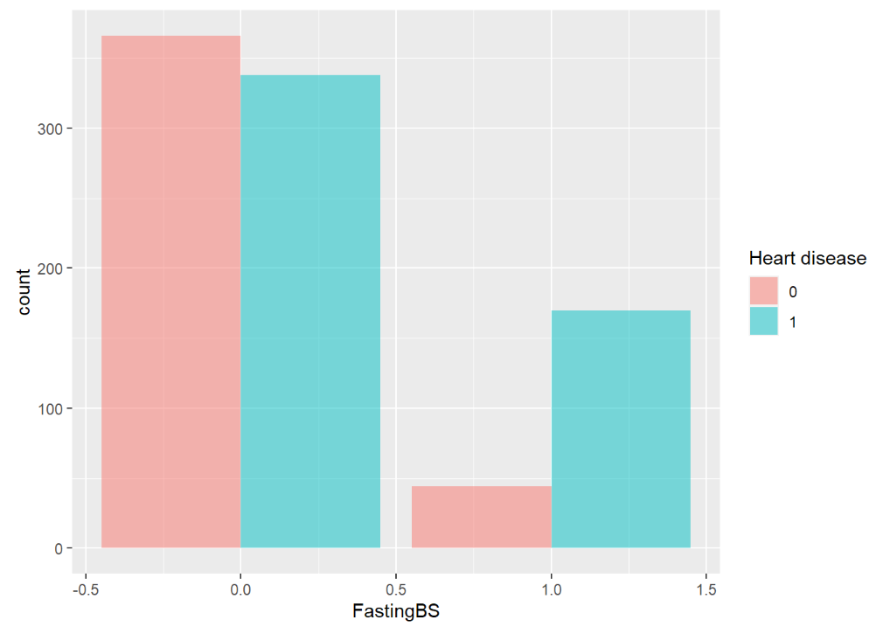
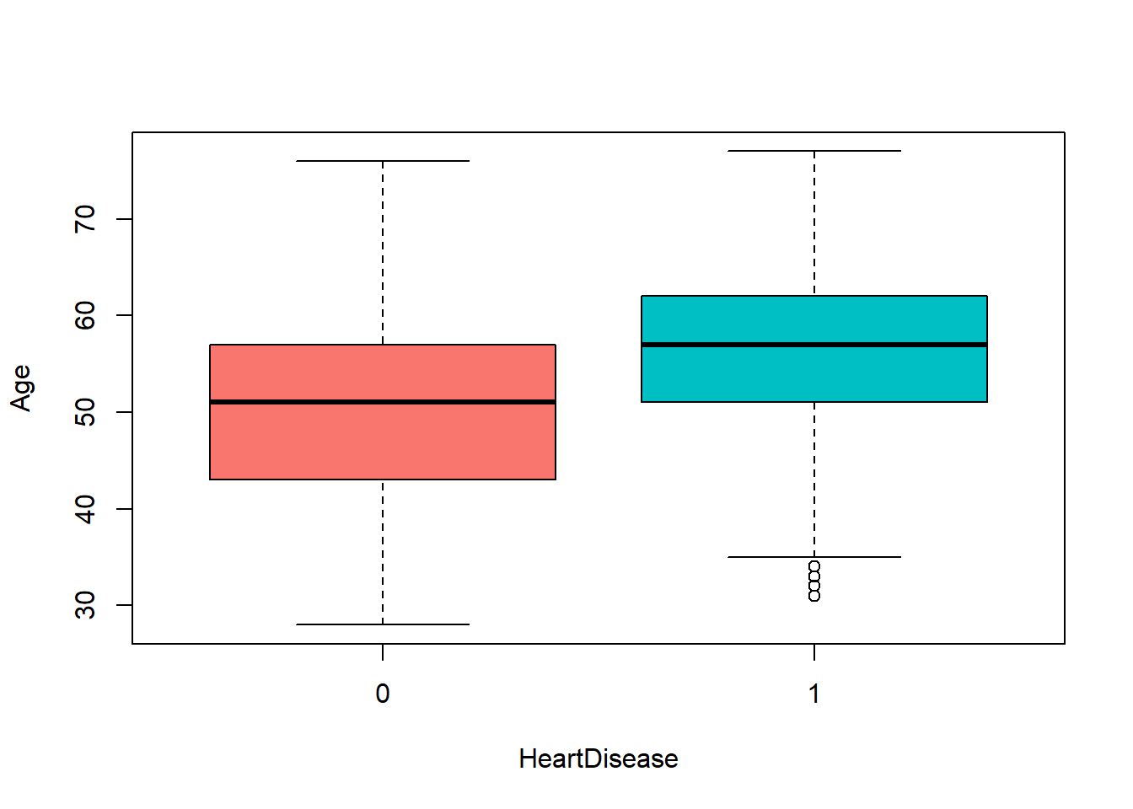
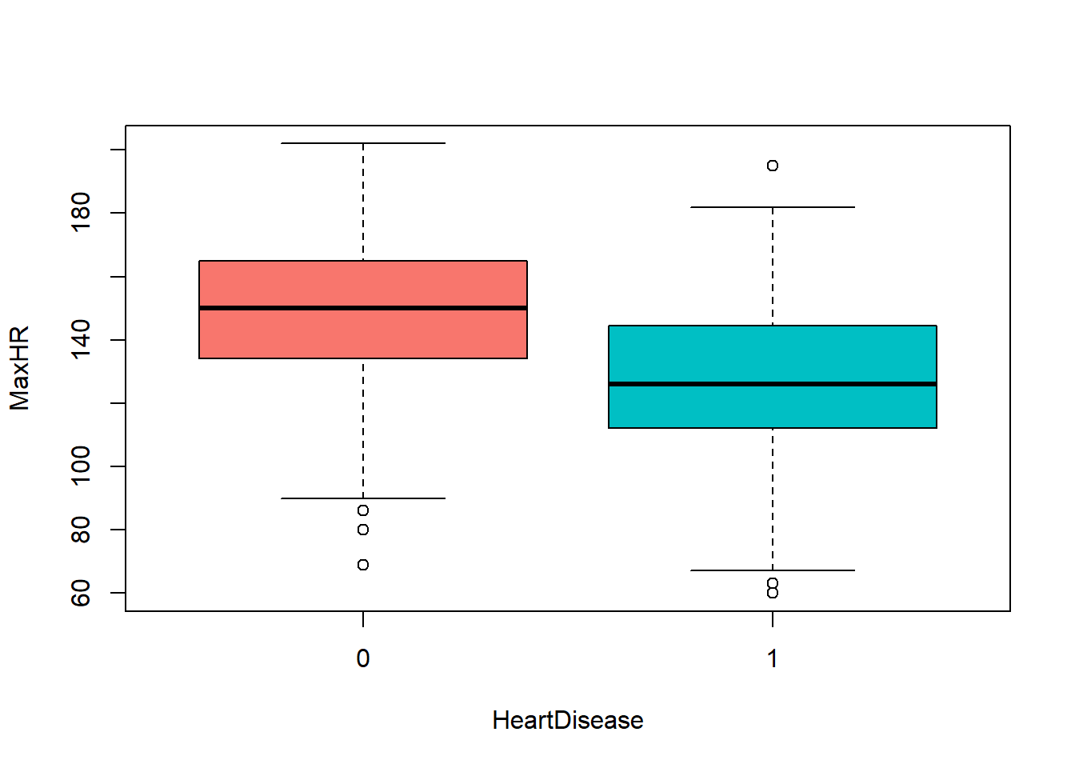
Data Visualization
4/24

Slide 6
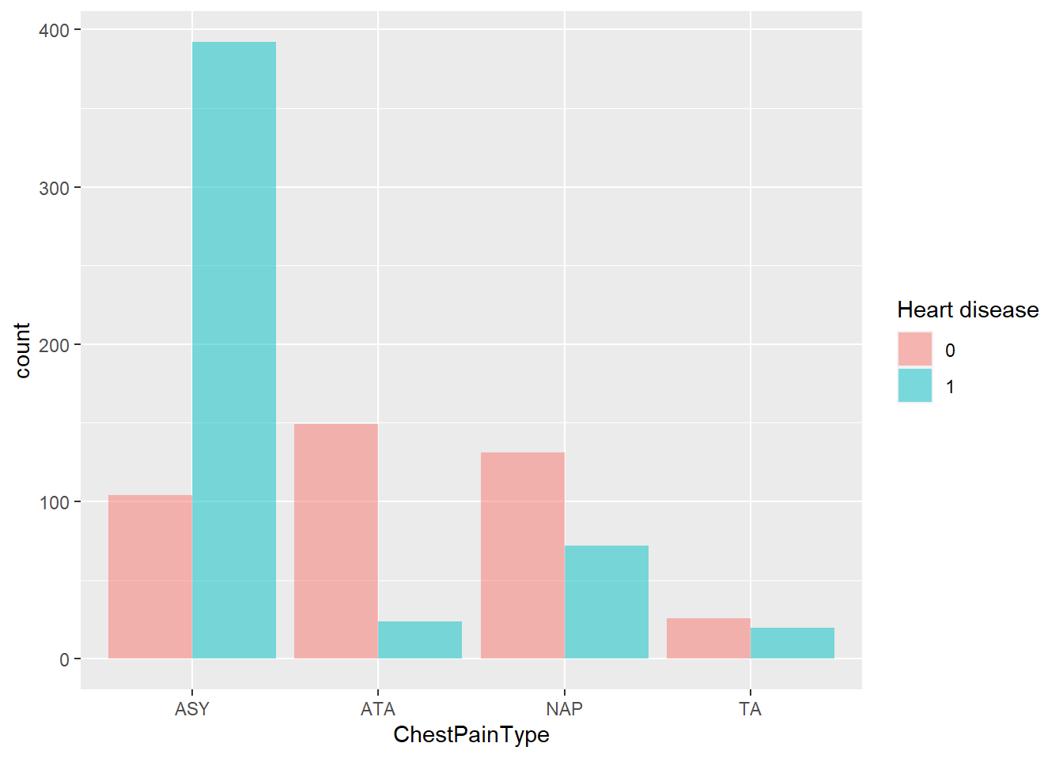
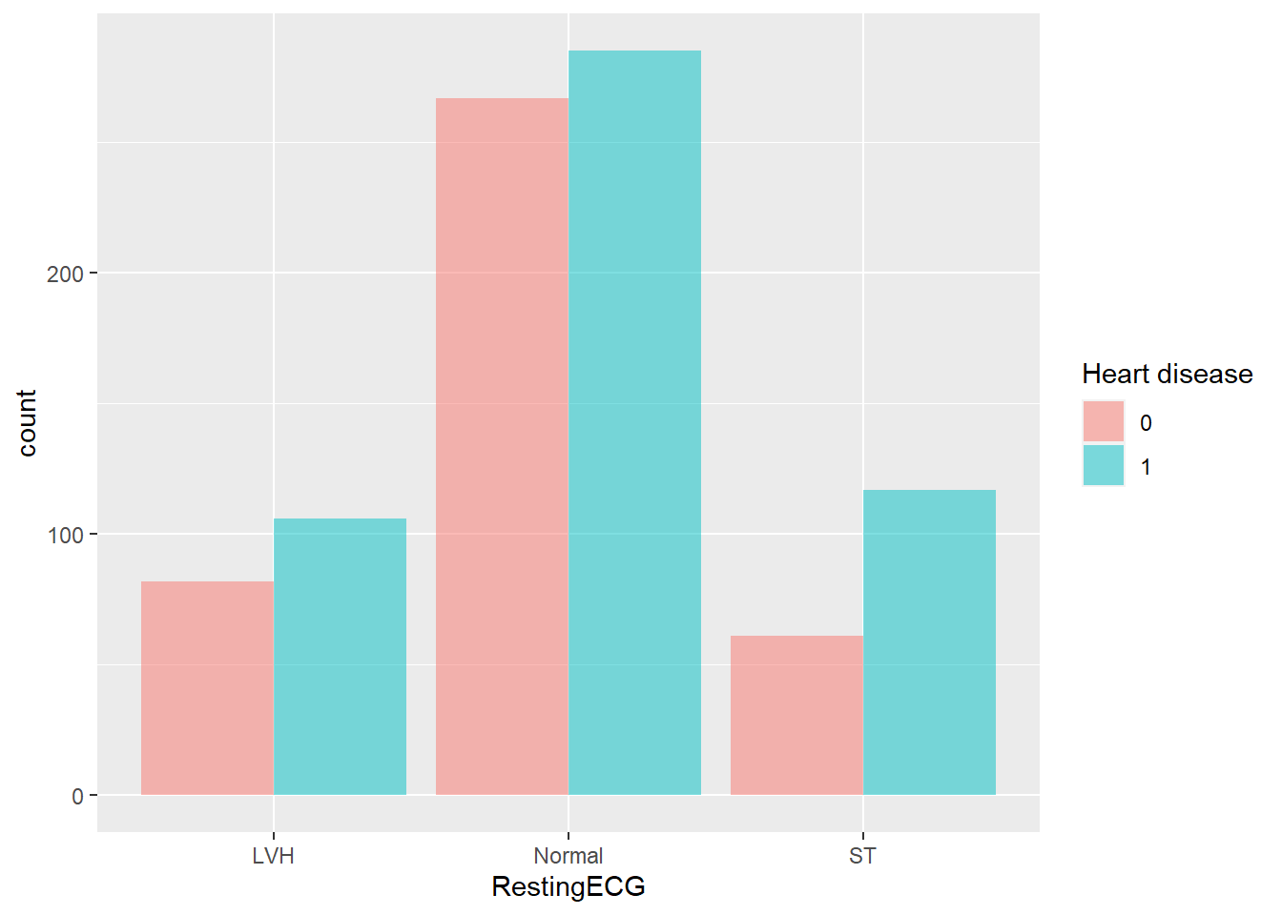
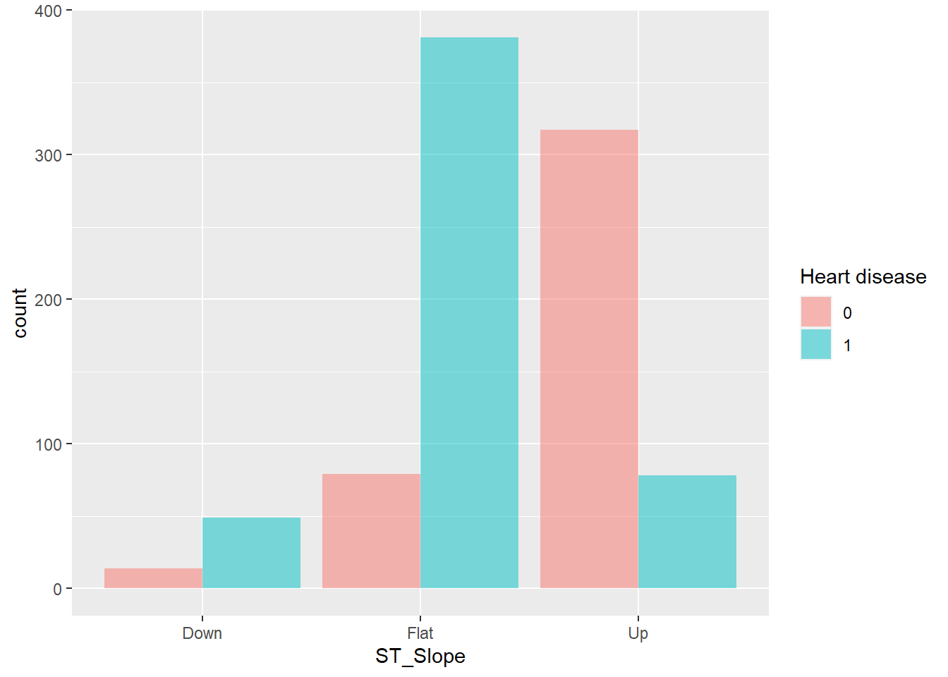
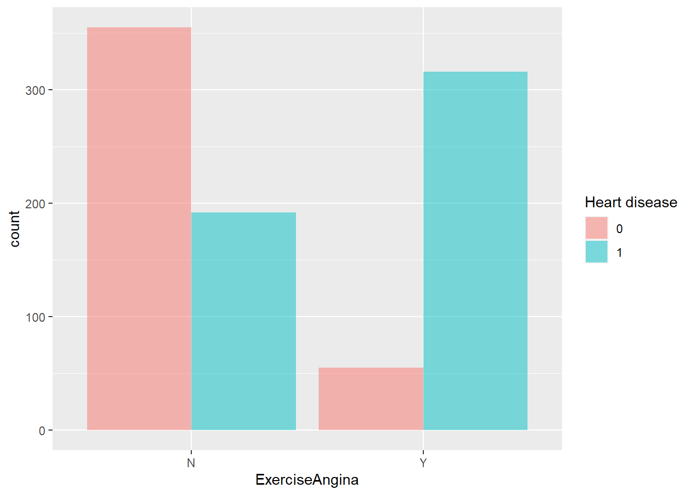
Data Visualization
5/24

Slide 7
Missing Values & Outliers
There are 172 variables in Cholesterol that have value equal to 0. Also we have noted that patients that have Cholesterol equal to 0 are very likely to have the heart disease.
One possibility is that the measurements were taken after the patient was dead, but if we inspect rows with missing data we can safely assume that these patients are alive and the Cholesterol value was incorrectly recorded.
Another guess is that the “serum cholesterol” measured by this variable combines the HDL and LDL values. High HDL and LDL would cancel each other out, making this variable less useful.
We decided not to use this variable in the models and as we are going to see it doesn’t affect much the predictions.
6/24

Slide 8
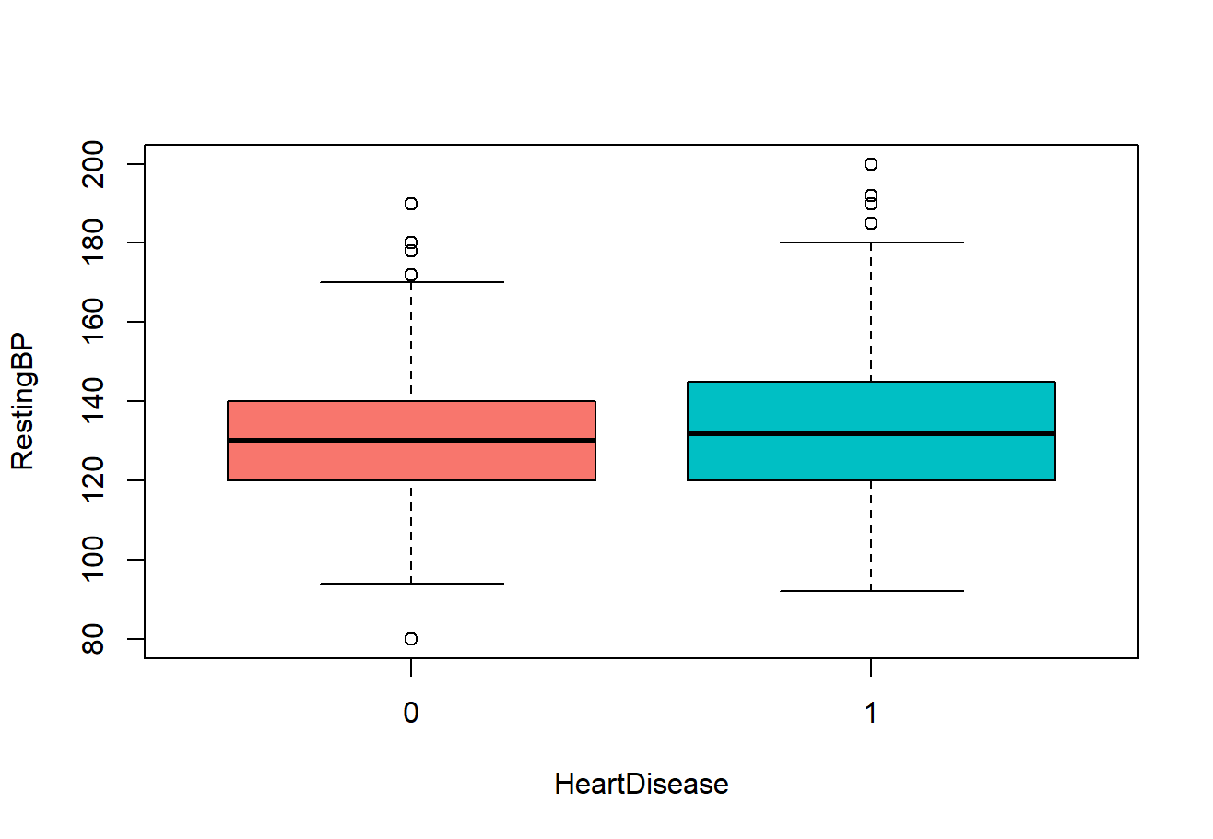
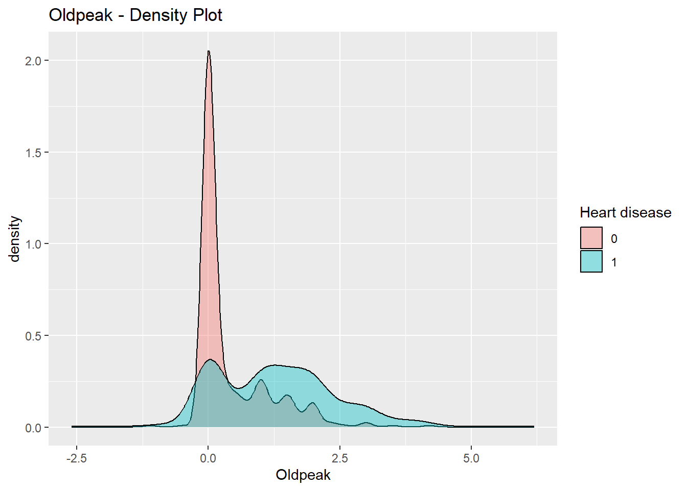
Missing Values & Outliers
Outliers in other continuous variables:
RestingBP: outliers were still plausible values
Oldpeak: the reason why there are many values as 0 is because Oldpeak refers to the difference between the depression of the ST segment in the ECG that has been measured during rest and then during exercise.
Values around 0 are correlated with no CAD.
7/24

Slide 9
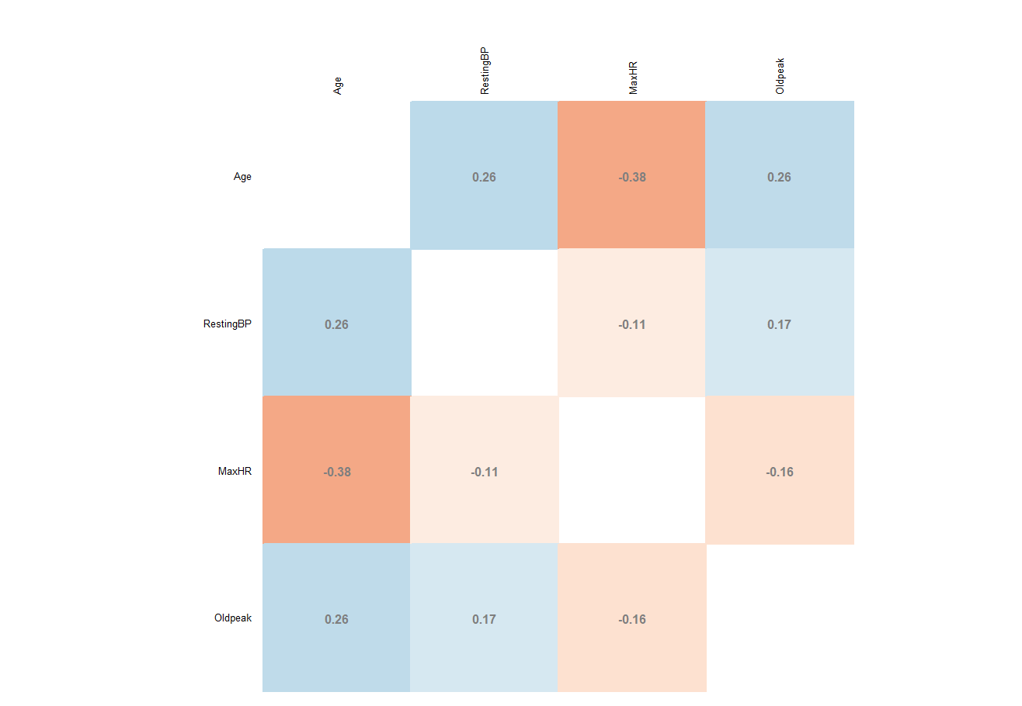
Correlations: matrix
We calculate the correlations for each continuous variable and we plot the correlation matrix.
8/24

Slide 10
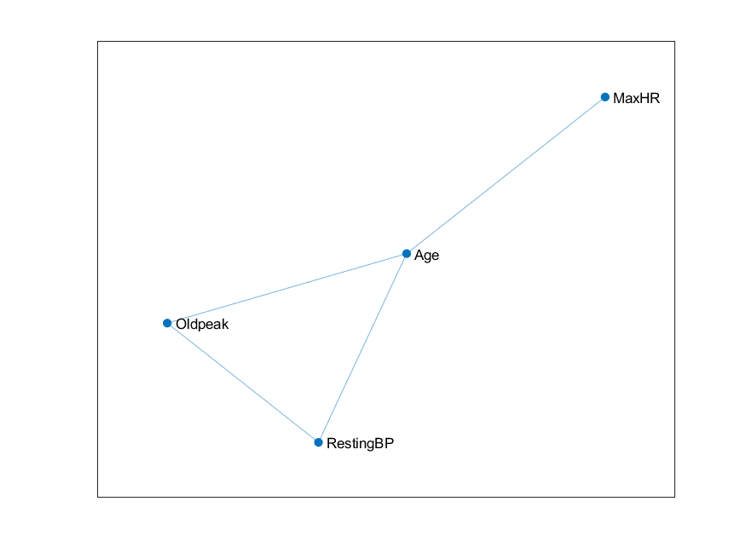
Correlations: graph
Now we want to visualize the correlations through a graph. We see that Age is somewhat “central” with respect to the other variables.
9/24

Slide 11
Data Preparation & General Settings
We see that patients without the condition are 410 (45%) and patient with it are 508 (55%).
We see that our dataset is quite balanced so we don’t need to apply other methods to rescale it.
After this we divide the split the data into training set and test set with a ratio of 75 and 25 with respect to our dataset.
We will train our models on the training set and the evaluate them on our test set.
The metrics we are going to use are Accuracy, Precision, Recall, F1-Score and FN Rate.
10/24

Slide 12
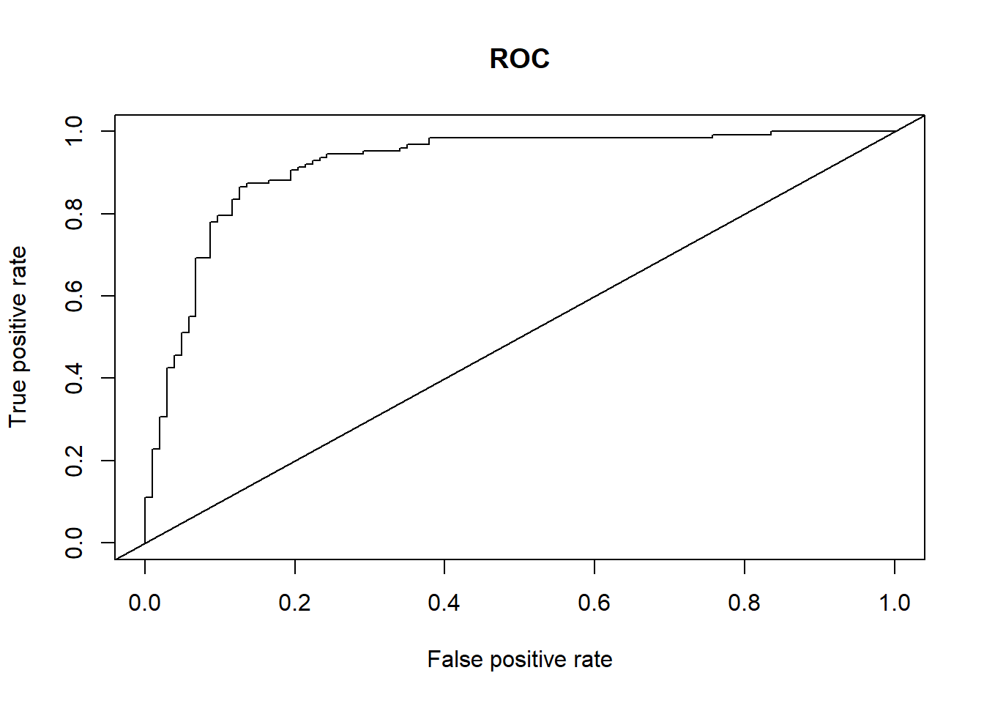
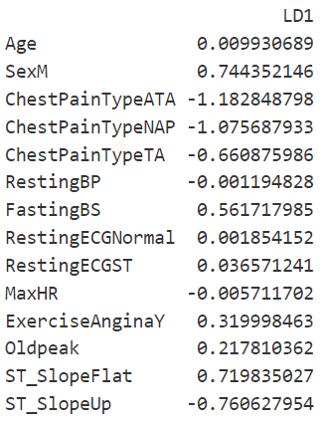
Linear Discriminant Analysis
Linear Discriminant Analysis (LDA) is a classification algorithm, where a discriminant rule tries to divide the data points into K disjoint regions, where K is the number of classes (in this case K = 2).
Accuracy: 0.86
Precision: 0.88
Recall: 0.87
F1-Score: 0.87
AUC: 0.92
FN-Rate: 0.11
11/24

Slide 13
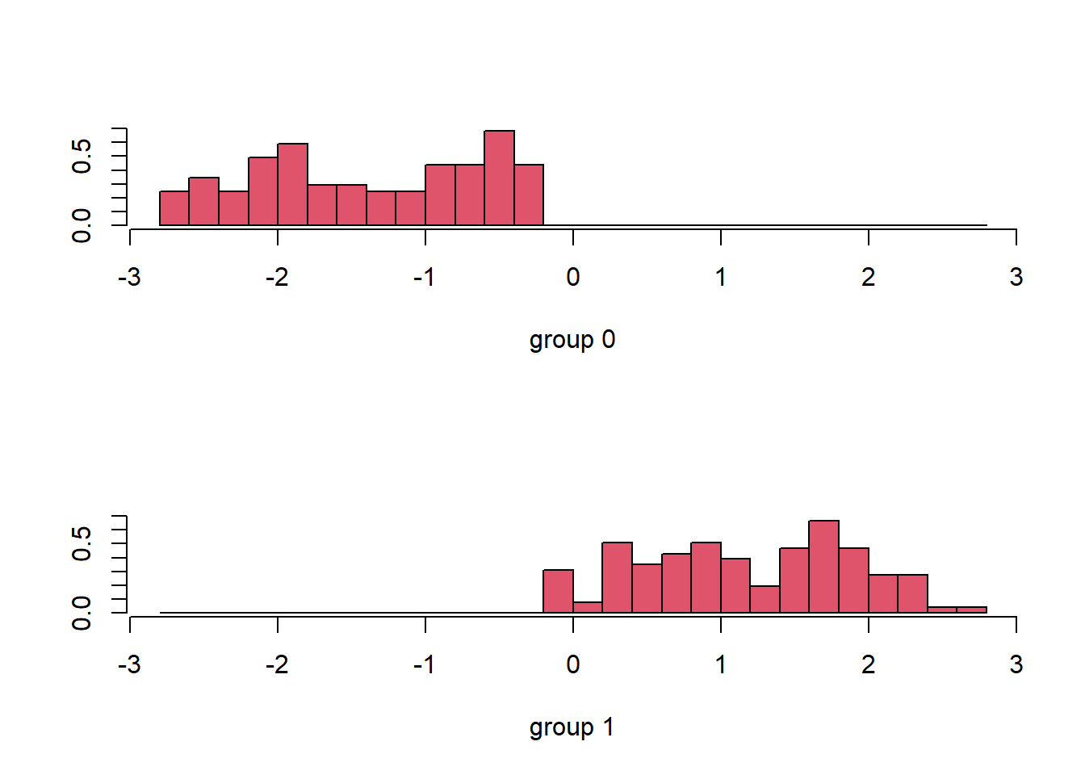
Linear Discriminant Analysis
We see that the models divides the data pretty well.
12/24

Slide 14

Quadratic Discriminant Analysis
Quadratic Discriminant Analysis (QDA) doesn’t assume the equal variance of the classes. For this reason the decision boundary is not linear but quadratic.
Accuracy: 0.86
Precision: 0.87
Recall: 0.87
F1-Score: 0.87
AUC: 0.90
FN-Rate: 0.13
13/24

Slide 15

GLM: Generalized Linear Model
Logistic Regression is the easiest and most common model to perform binary classification. To do so, we use a Generalized Linear Model.
All predictors are initially included
Decision Threshold initially not optimized
Variable Selection:
Iterative Backward Selection, removing weak predictors based on their p-value
Useful Metrics:
Variance Inflation Factor
Bayesian Information Criterion
Misclassification Error
Accuracy: 0.86
Precision: 0.9
Recall: 0.84
F1-Score: 0.87
AUC: 0.91
FN-Rate: 0.09
14/24

Slide 16
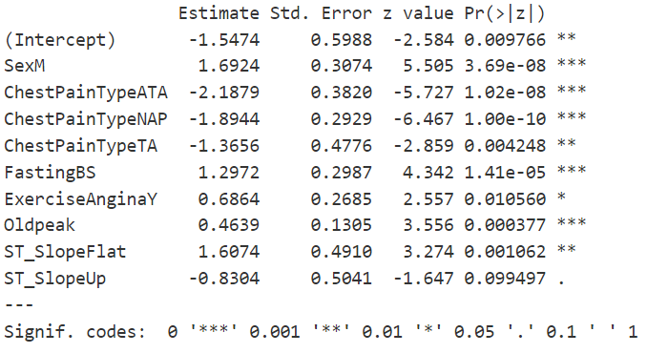
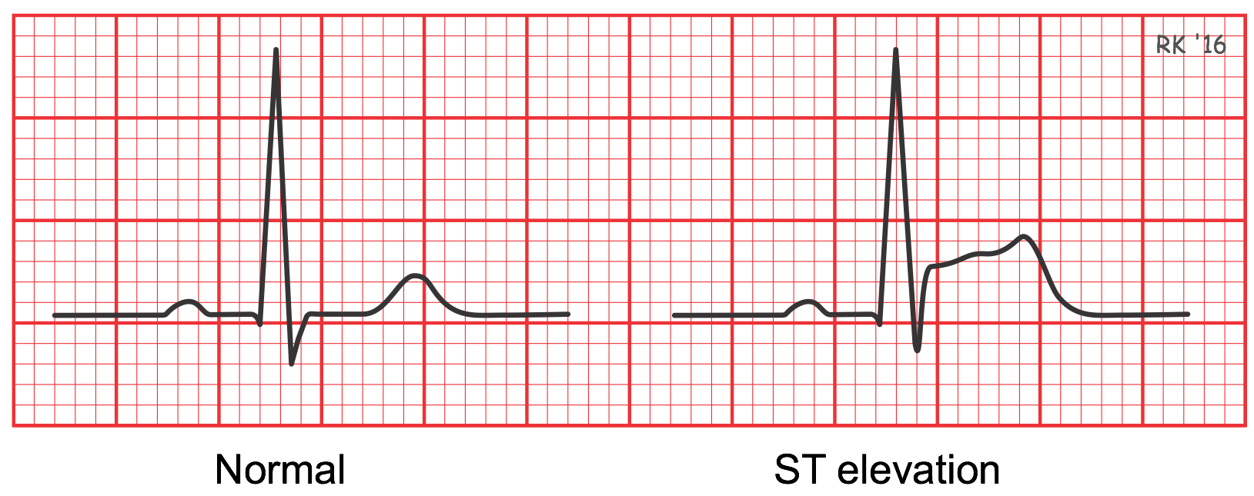
GLM: Backward Selection with p-value
Start with all predictors in the model and remove one at a time (highest p-value)
Removed Predictors:
Age, RestingECG, MaxHR, RestingBP
Best Predictors (p <= 0.001):
Sex[“M”], ChestPainType[“ATA”, “NAP”], FastingBS, Oldpeak
Considerations:
RestingBP only contains systolic BP, not considering diastolic and pulse pressure, so the variable is not very informative
ST_Slope[“Up”] (ST segment elevation) is a good predictor of CAD, so we kept it despite p-value > 0.05
15/24

Slide 17
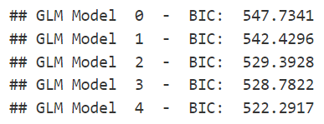
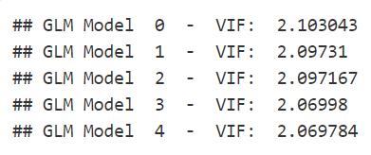


GLM: VIF & BIC
The Variance Inflation Factor measures how much the variance of the estimated regression coefficient for a given independent variable is inflated due to multicollinearity.
The Bayesian Information Criterion is a metric that is used to compare the goodness-of-fit of different regression models.
Both VIF and BIC consistently dropped after removal of predictors with high p-value
VIF indicates some minor correlation between predictors.
Best GLM Model: glm.model.4
16/24

Slide 18
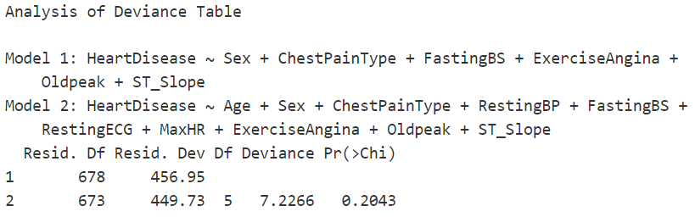

GLM: Analysis of Deviance
Deviance is a quality-of-fit statistic for a model that is often used for statistical hypothesis testing.
Deviance difference test using ANOVA with χ² test yields a p-value of 0.2043
Reduced model is not significantly different from the full model
Removed predictors are indeed not useful
17/24

Slide 19
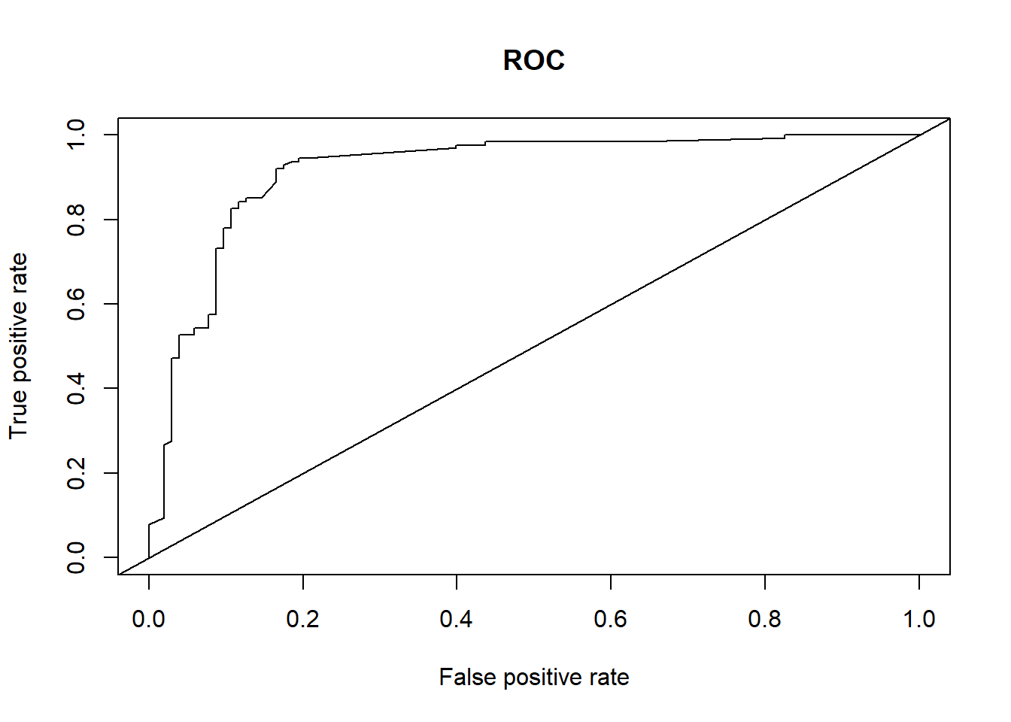
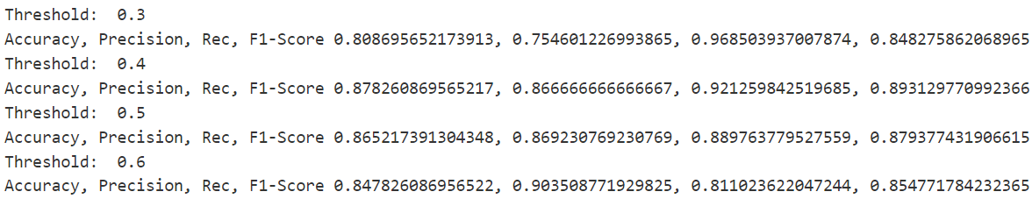
GLM: Threshold Selection
Objective: maximize Recall, in order to minimize wrongly discharged patients with CAD. At the same time, other metrics must be acceptable.
Thresholds: 0.3, 0.4, 0.5, 0.6
0.3 Maximized Recall but Accuracy and Precision would suffer
Best Overall Threshold: 0.4
Accuracy: 0.88
Precision: 0.87
Recall: 0.92
F1-Score: 0.89
AUC: 0.92
FN-Rate: 0.13
18/24

Slide 20
Regularized Regression
Generalized models with some penalizations according to λ value
Estimators with very large variants and small bias can lead to multicollinearity and produce poor estimates (overfitting)
Regularized Regression methods use automatic selection of variables through shrinkage on the coefficients of the predictors:
Ridge Regression: quadratic shrinking, coefficients assume values very close to zero
Lasso Regression: absolute-value shrinking, coefficients assume values that can even be zero
19/24

Slide 21

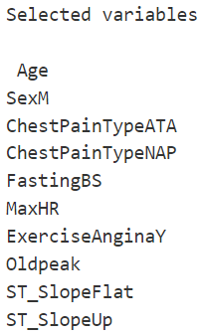
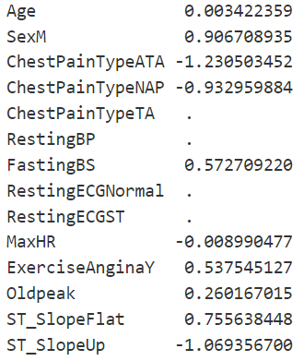
Lasso Regression
Cross-validation performed with glmnet
Best λ: ~ 0.036
Shrunk Predictors:
RestingECG[“Normal”, “ST”], RestingBP, ChestPainType[“TA”]
Best Predictors (largest absolute magnitude):
Sex[“M”], ChestPainType[“ATA, “NAP”], ST_Slope[“Up”, “Flat”]
Accuracy: 0.85,
Precision: 0.83
Recall: 0.89
F1-Score: 0.86
AUC: 0.91
FN-Rate: 0.17
20/24

Slide 22

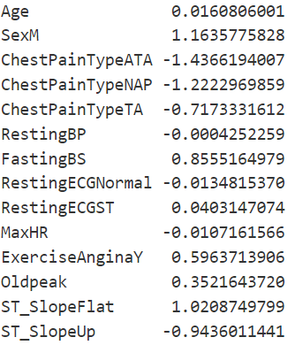
Ridge Regression
Cross-validation performed with glmnet
Best λ: ~ 0.031
Shrunk Predictors:
RestingBP, RestingECG[“Normal”, “ST”], MaxHR, Oldpeak
Best Predictors (largest absolute magnitude):
SexM, ChestPainType[“ATA, “NAP”], ST_Slope[“Up”, “Flat”]
Accuracy: 0.87
Precision: 0.85
Recall: 0.91
F1-Score: 0.88
AUC: 0.92
FN-Rate: 0.15
21/24

Slide 23

Naive Bayes Classifier
The Naive Bayes Classifier is a classification technique based on Bayes’ Theorem with an independence assumption among predictors.
Does not perform explicit feature selection
But assigns higher importance to features that have a stronger influence on class probabilities
Best threshold: 0.6
Accuracy: 0.87
Precision: 0.85
Recall: 0.91
F1-Score: 0.88
AUC: 0.92
FN-Rate: 0.15
22/24

Slide 24
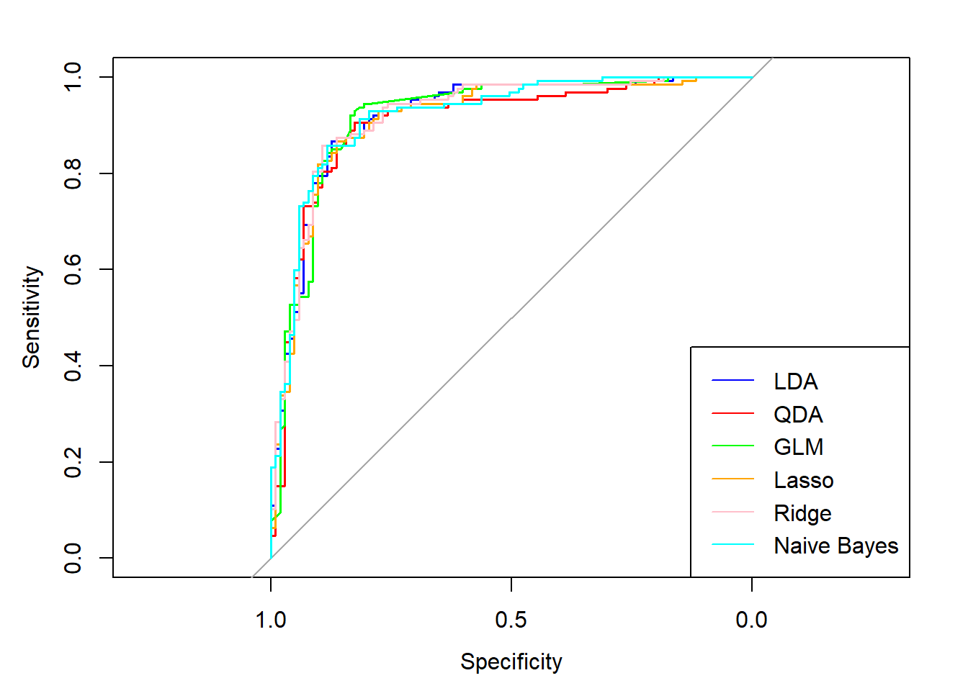
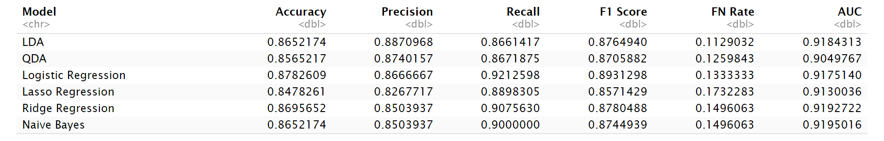
Conclusions: Best Models
All models perform relatively good, with similar ROCs and each with their own strengths and weaknesses in their metrics.
Considering Recall as most important, the best models are:
GLM: Logistic Regression (threshold: 0.4)
LDA
GLM with Ridge
➡ GLM with Logistic Regression can predict CAD with 87% accuracy and 92% recall.
23/24

Slide 25
Conclusions: Best Predictors
Goal: predicting Coronary Artery Disease (CAD/CHD)
Medical literature was also briefly checked to confirm our findings
Considering all models, the very best predictors are:
Sex[“M”]: males are more likely to suffer from CAD.
ChestPainType[“ATA, “NAP”]: Atypical Angina is a known symptom preceding Myocardial Infarction. Non-Anginal Pain is often non-ischemic related.
ST_Slope[“Up”, “Flat”]: ST Segment Elevation is a known anomaly of the electrophysiology of heart due to coronary blockage and therefore myocardial ischemia.
Oldpeak: ST Segment Depression induced by exercise relative to rest might also indicate myocardial ischemia.
24/24

