Slide 1


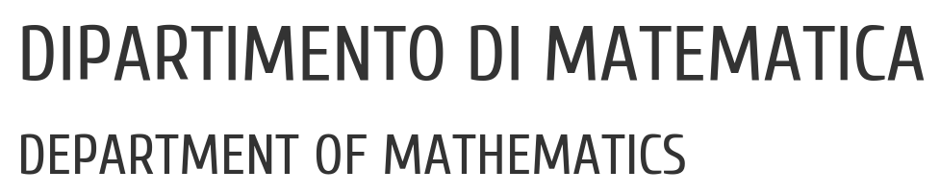

UNIVERSITY OF PADUA
UNIVERSITA’ DEGLI STUDI DI PADOVA
Prediction of Coronary Heart Disease
Francesco Vo, 1234567
Marco Uderzo, 2096998

Slide 2
Context and Motivation
Cardiovascular diseases (CVDs) are the number one cause of death globally, Heart failure is a common event caused by CVDs and this dataset contains 11 features that can be used to predict a possible heart disease.
People with cardiovascular disease or who are at high cardiovascular risk need early detection wherein statistical learning models can be of great help.

Slide 3
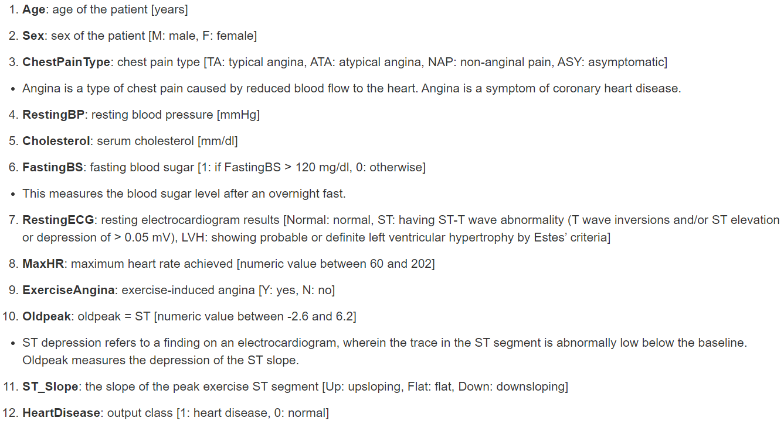
The Dataset

Slide 4
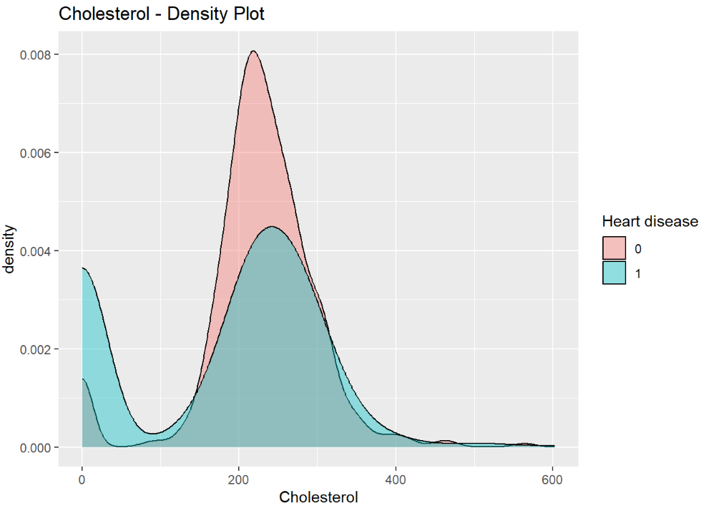
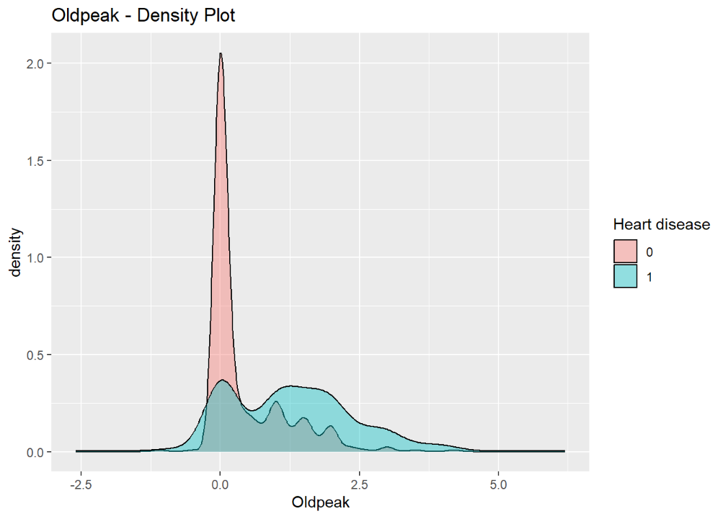
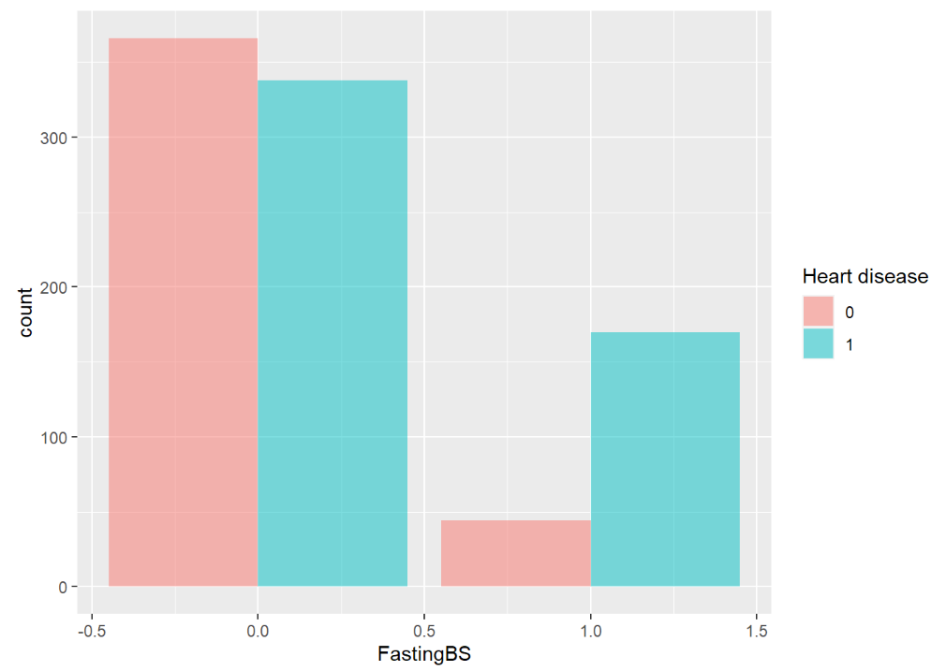
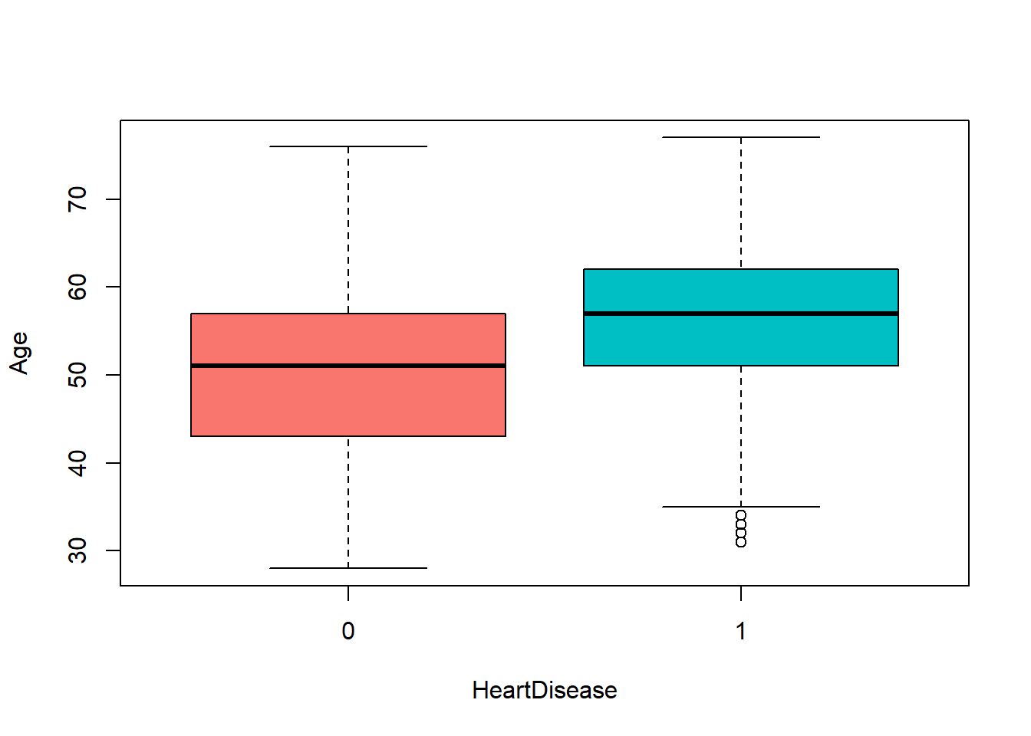
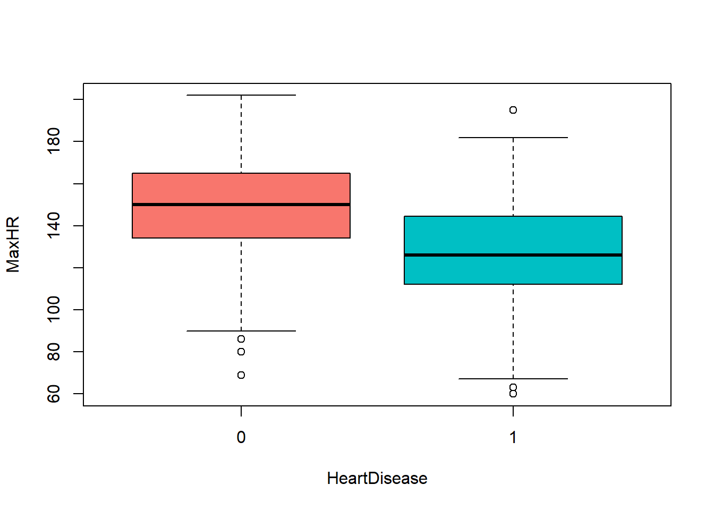
Data Visualization and Cleaning Continuous Variables

Slide 5
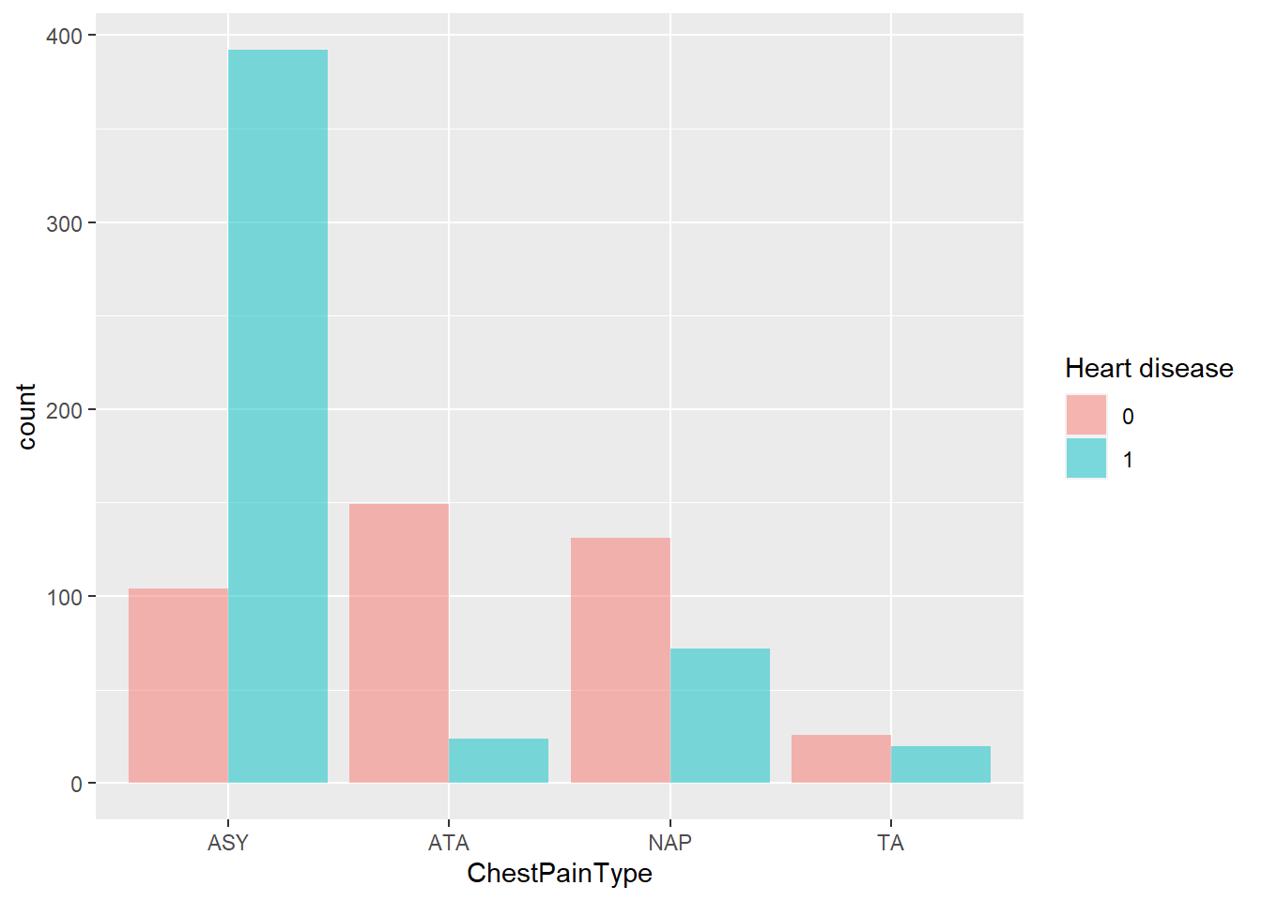
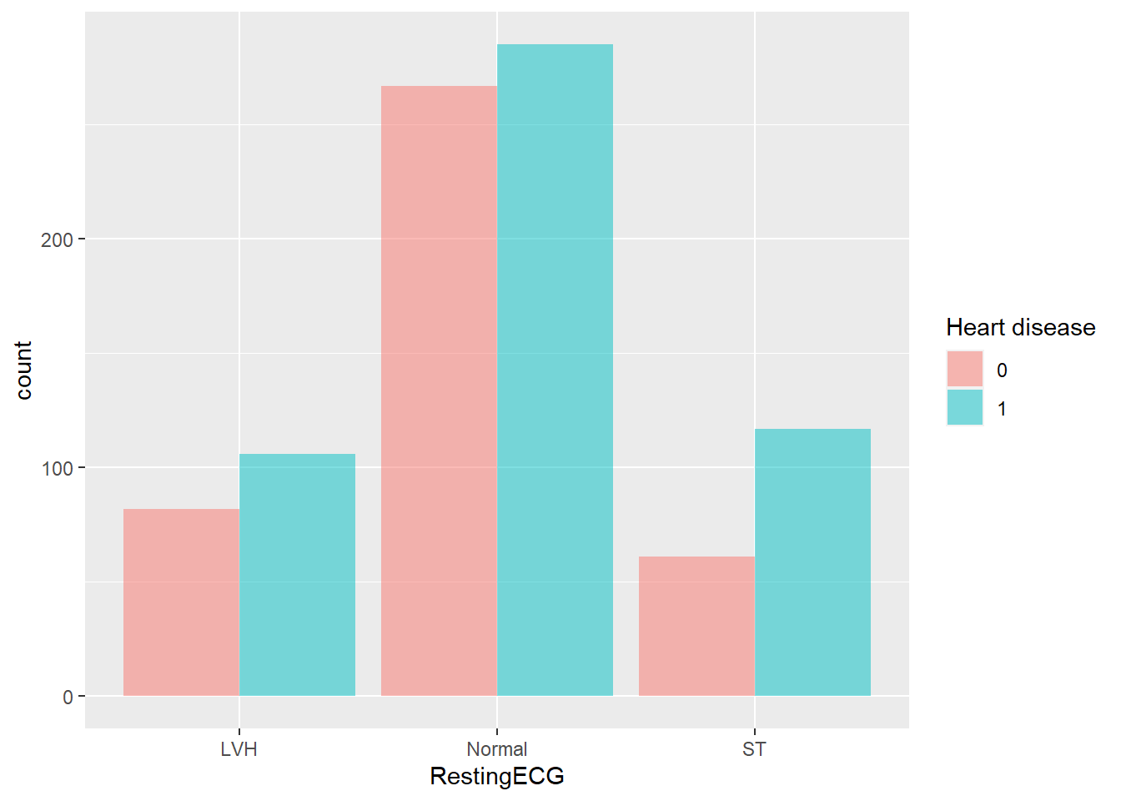
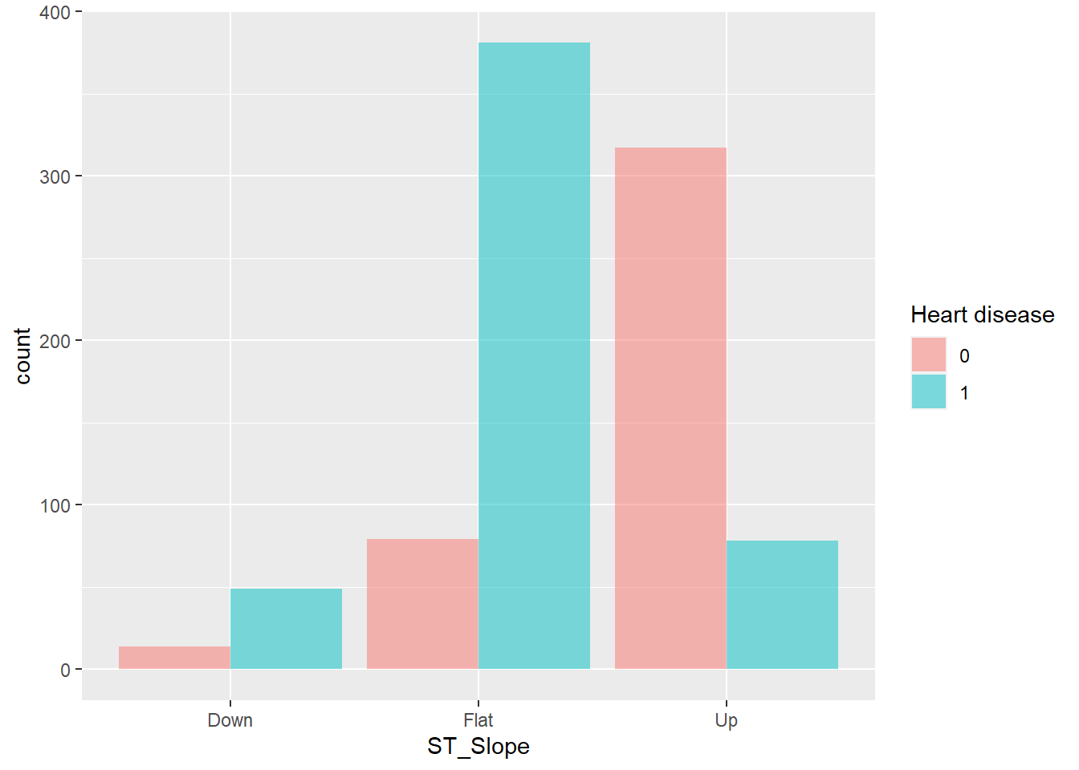
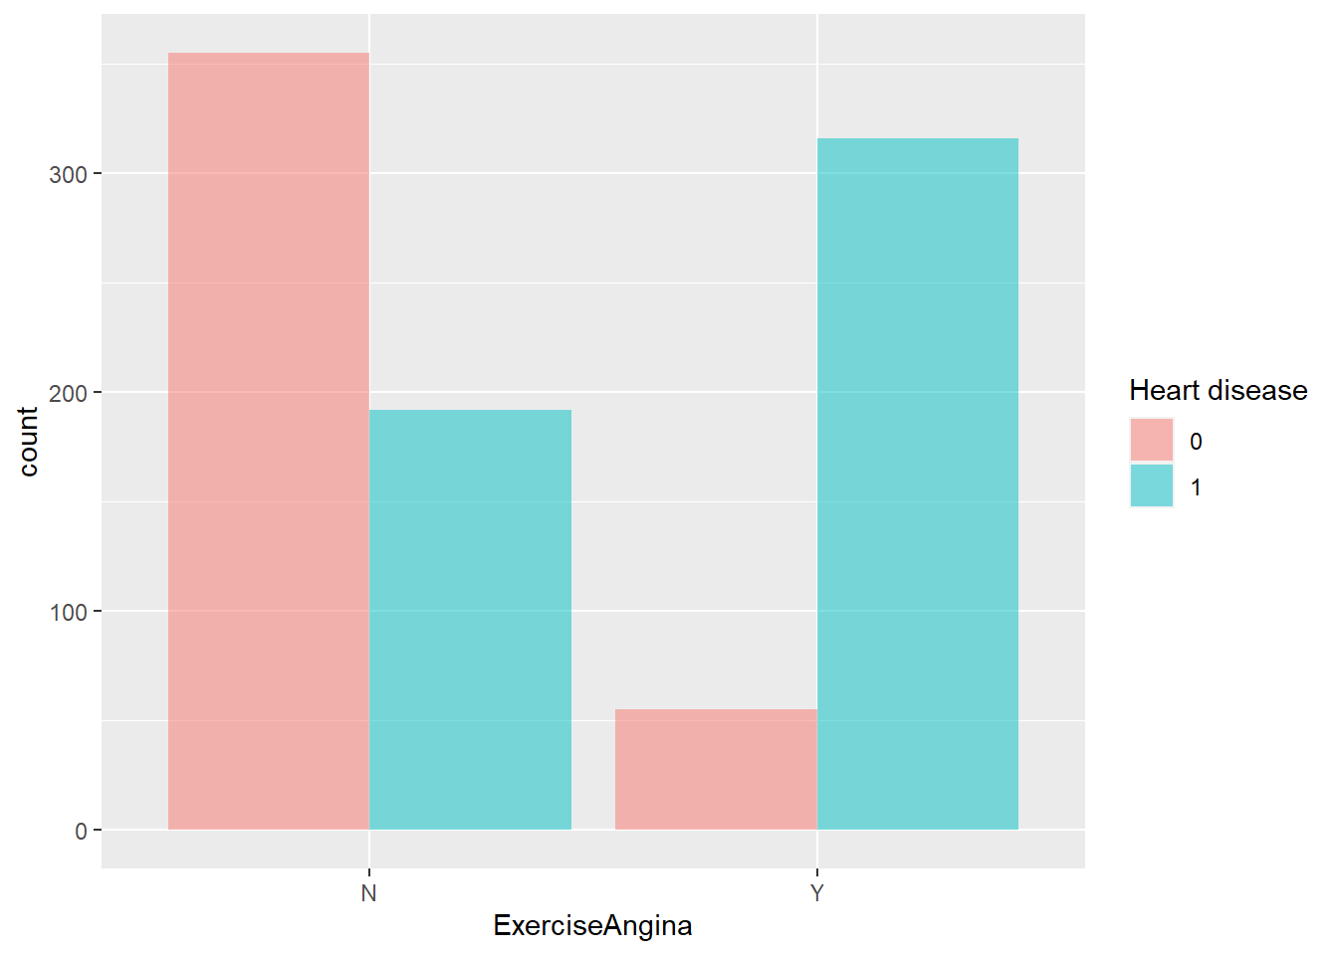
Data Visualization and Cleaning Categorical Variables

Slide 6
Considerations
We have seen from the plots that there are 172 variables in Cholesterol that have value equal to 0. Also we have noted that patients that have Cholesterol equal to 0 are very likely to have the heart disease.
Reasons could be:
Cholesterol was incorrectly recorded
Cholesterol did not affect the prediction that much, so we dropped it.

Slide 7
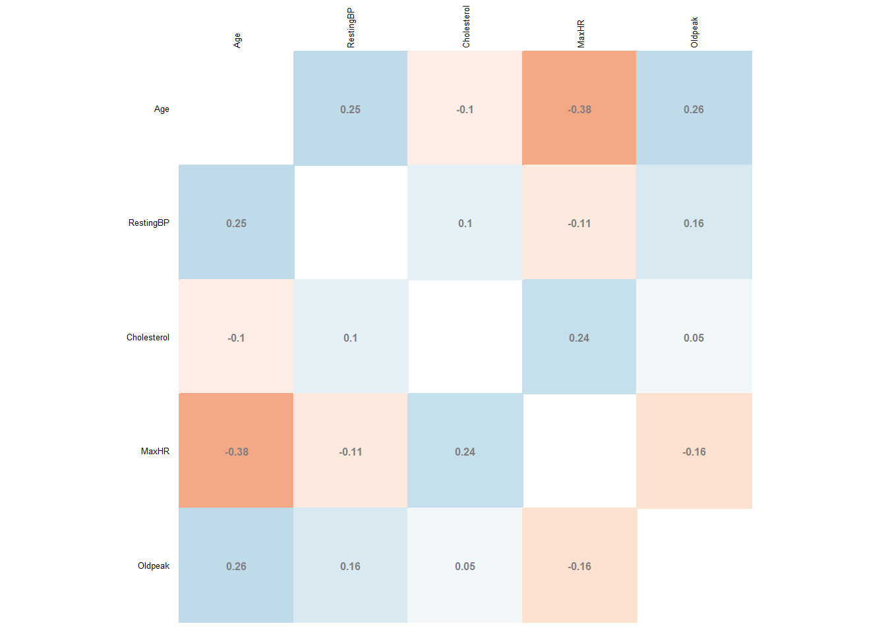
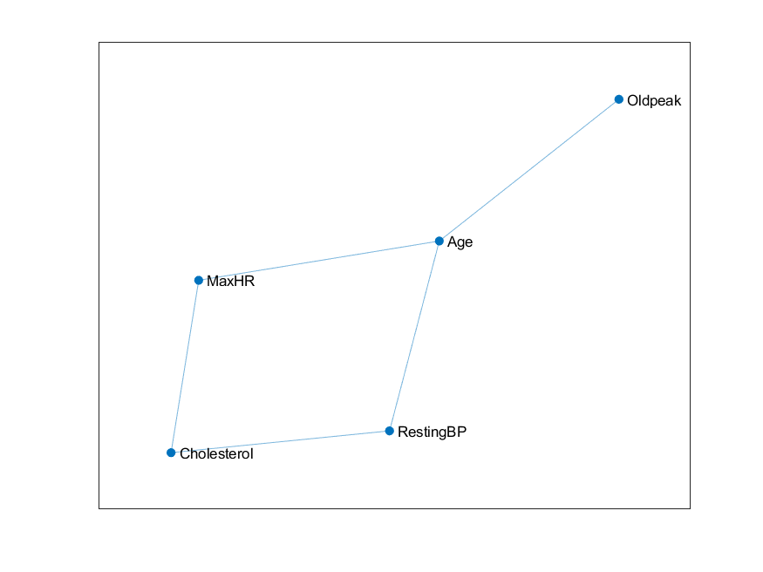
Correlations: Matrix and Graph

Slide 8
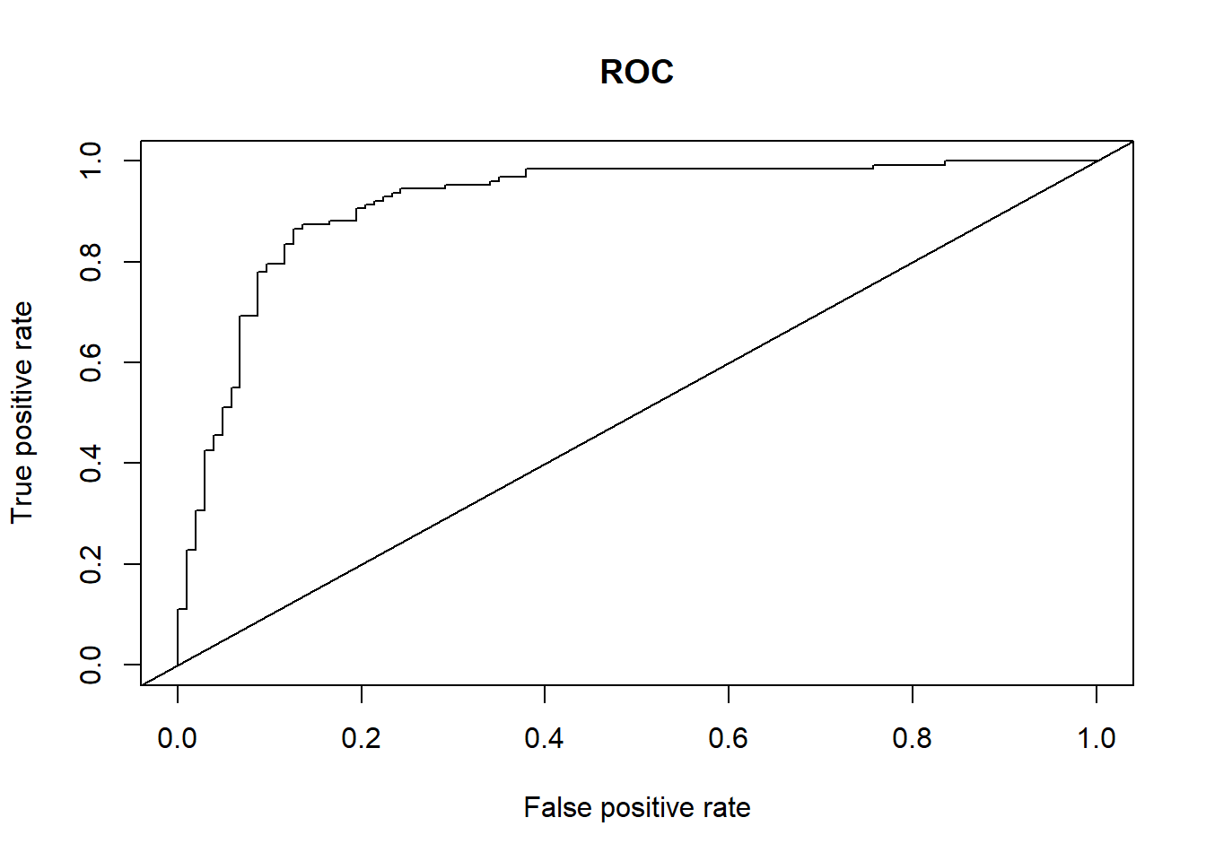
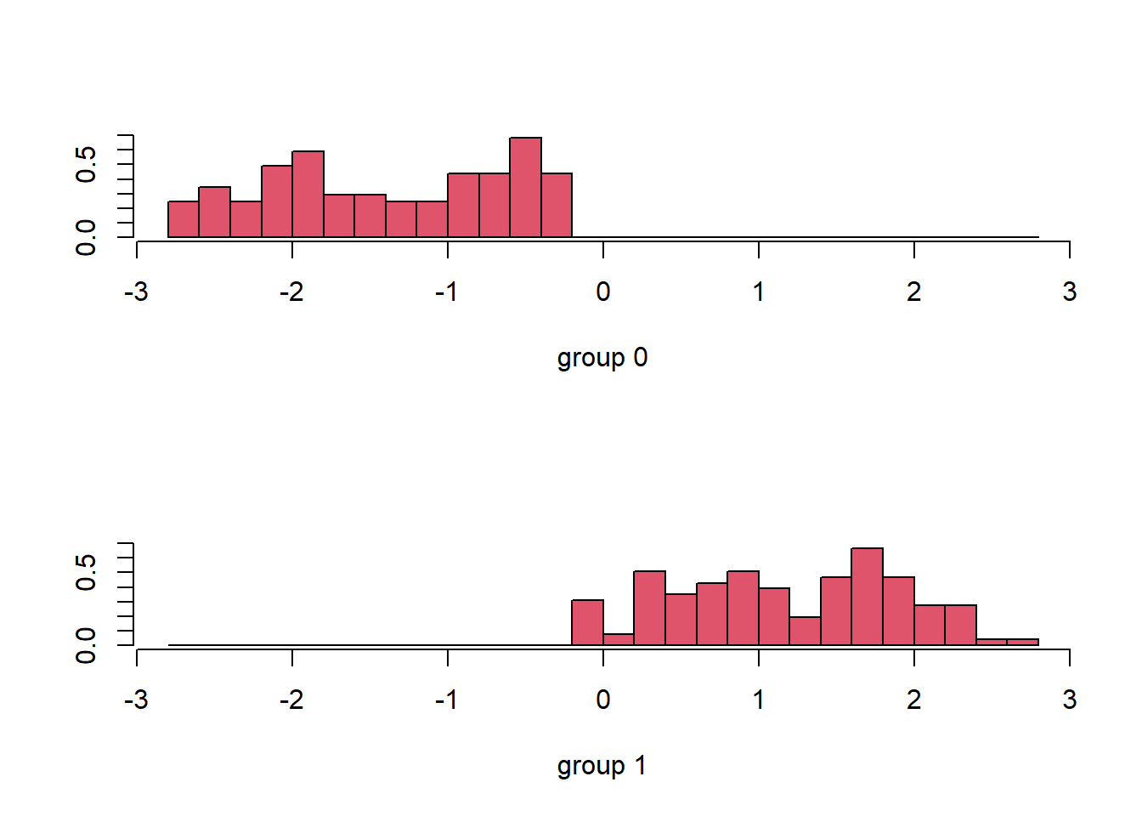
Linear Discriminant Analysis
Linear Discriminant Analysis (LDA) is a classification algorithm, where a discriminant rule tries to divide the data points into K disjoint regions, where K is the number of classes (in this case K = 2).
AUC: 0.9184313

Slide 9

Quadratic Discriminant Analysis
Quadratic Discriminant Analysis (QDA) doesn’t assume the equal variance of the classes. For this reason the decision boundary is not linear but quadratic.
AUC: 0.9049767

Slide 10

GLM: Generalized Linear Model
Logistic Regression is the easiest and most common model to perform binary classification.
The goal is to predict whether or not a patient has CHD
VIF: We consider the Variance Inflation Factor to assess multicollinearity
All predictors are included
Threshold selection not optimized
Accuracy: 0.86
Precision: 0.9
Recall: 0.84
F1-Score: 0.87
AUC: 0.91

Slide 11
GLM: Backward Selection with p-value
Removed Predictors: Age, RestingECG, MaxHR, RestingBP, ST_SlopeUp(?)
Considerations:
RestingBP only contains systolic BP
MaxHR could be useful to assess heart functioning at rest
ST_SlopeUp should be a good predictor of CHD

Slide 12
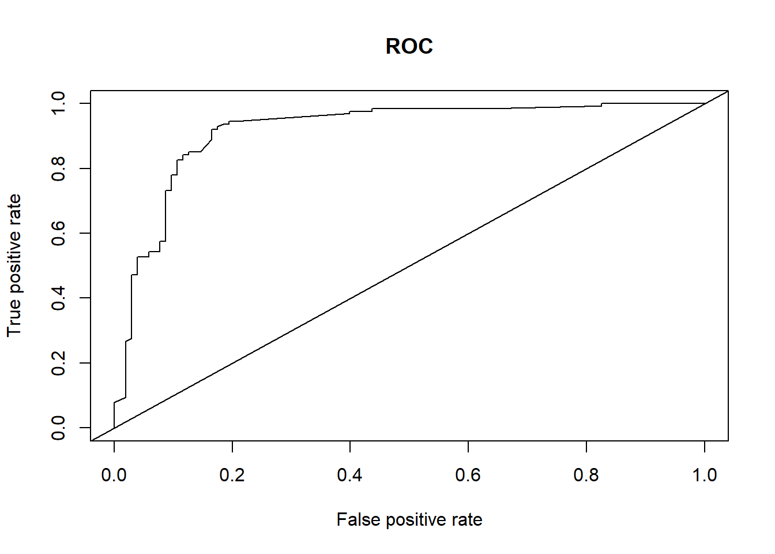
GLM: Threshold Selection
Objective: maximize Recall, in order to minimize wrongly discharged patients with CHD. At the same time, other metrics must be acceptable.
Best Threshold: 0.4
Accuracy: 0.88
Precision: 0.87
Recall: 0.92
F1-Score: 0.89
AUC: 0.92

Slide 13
GLM: Analysis of Deviance
Objective: maximize Recall, in order to minimize wrongly discharged patients with CHD.

Slide 14
Regularized Regression
Generalized models with some penalizations according to lambda
Estimators with very large variants and small bias can lead to multicollinearity and produce poor estimates (overfitting)
Regularized Regression methods use automatic selection of variables through shrinkage on the coefficients of the predictors:
Ridge Regression: coefficients assume values very close to zero
Lasso Regression: coefficients assume values that can even be zero

Slide 15

Lasso Regression
Best λ: ~ 0.036
Cross-validation?
Considerations:
Lasso removed RestingECG and RestingBP, ChestPainTypeTA
Accuracy: 0.85
Precision: 0.83
Recall: 0.89
F1-Score: 0.86
AUC: 0.91

Slide 16

Ridge Regression
Best λ: ~ 0.031
Cross-validated
Accuracy: 0.87
Precision: 0.85
Recall: 0.91
F1-Score: 0.88
AUC: 0.92

Slide 17

Naive Bayes Classifier
The Naive Bayes Classifier is a classification technique based on Bayes’ Theorem with an independence assumption among predictors.
In simple terms, a Naive Bayes classifier assumes that the presence of a particular feature in a class is unrelated to the presence of any other feature.
Accuracy: 0.87
Precision: 0.85
Recall: 0.91
F1-Score: 0.88
AUC: 0.92

