Slide 1
INFN Cloud Spark + Jupyter as a Service
Marco Verlato (INFN Padova)
CCR Tutorial Days
28-29/10/2020

Slide 2
Layout
Spark introduction
overview
glossary
basic abstractions and operations
Spark on Kubernetes
Jupyter notebooks and extensions
INFN Cloud deployment
Live demo
https://spark.apache.org/
https://jupyter.org/index.html

Slide 3
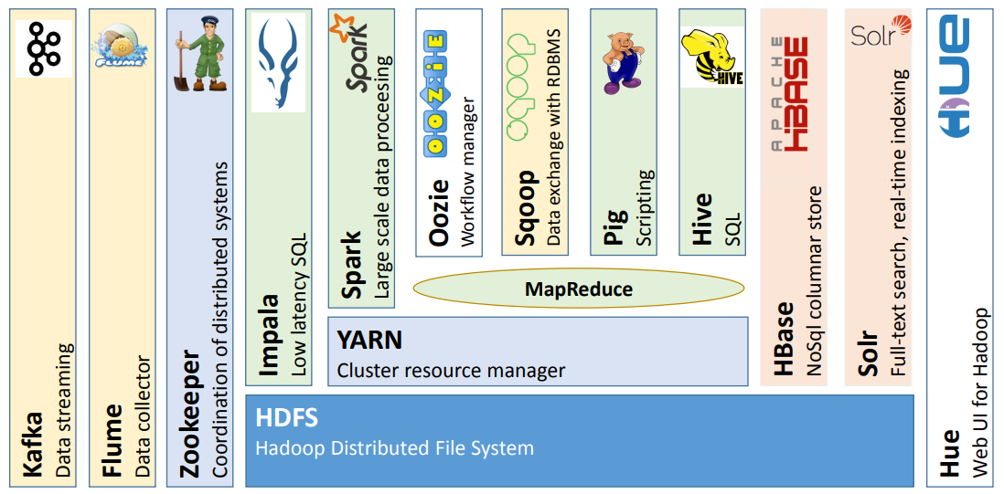
Apache Hadoop ecosystem
Since 2004 MapReduce + HDFS, inspired by Google File System​
Contributions from Yahoo, Facebook, LinkedIn, eBay, IBM​. etc.

Slide 4
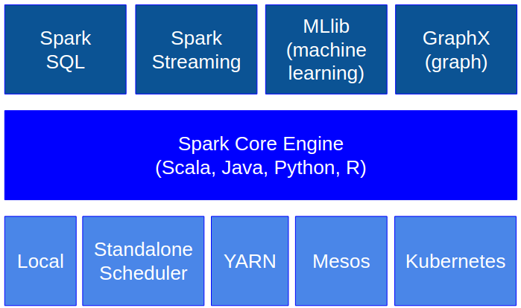
Spark overview
Spark is “a unified analytics engine for large-scale data processing”
Open-source, general-purpose cluster-computing framework up to 100x faster than MapReduce-Hadoop (in-memory computing, lazy evaluation)
Supports SQL, batch, stream, graph processing and ML
Supports various programming languages
Supports various resource managers
Supports HDFS, S3, Swift, GCS, Azure, etc.

Slide 5
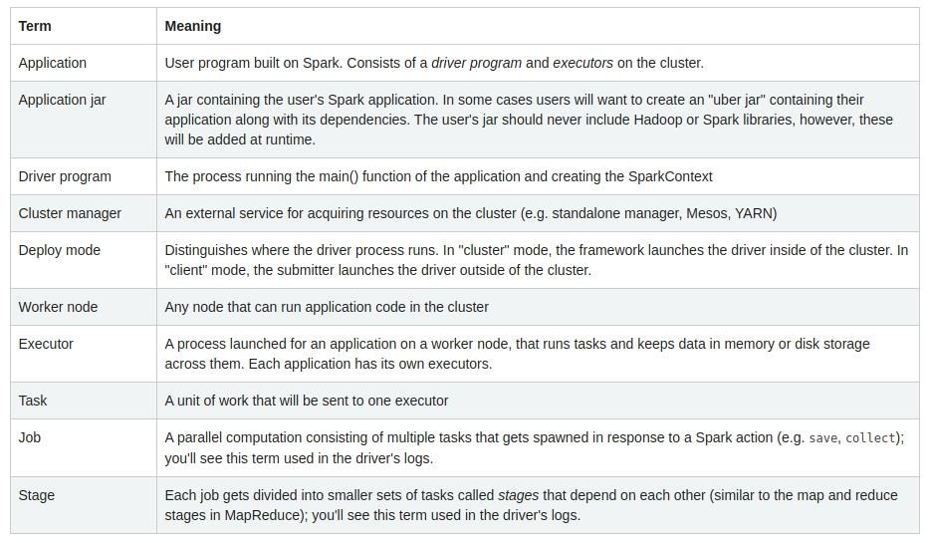

Spark architecture
Master-Slave architecture
SparkContext object is the entry point of the user application:
connects to the cluster
acquire the executors
send the code to the executors
divide the jobs in DAGs of stages
send the tasks to the executors

Slide 6
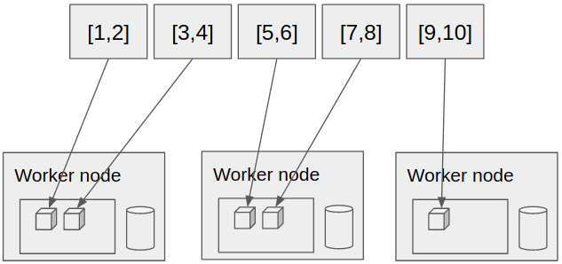
Spark basic abstractions
RDD (Resilient Distributed Dataset): an immutable, partitioned collection of elements distributed across the cluster that can be operated on in parallel
created from the SparkContext object, e.g.:
or from a file:
DataFrame: a distributed collection of data organized into named columns
conceptually equivalent to a table in a relational database, or a DataFrame in R/Python
simpler syntax and much faster with extra optimizations from the Spark SQL engine
created from and existing rdd (rdd.toDF()) or the SparkSession object, e.g.:

Slide 7
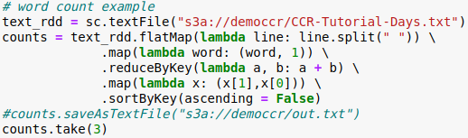
Spark basic operations
Transformations
create a new dataset from an existing one
lazy: are only computed when you run an action
examples: map, filter, flatMap, sortBy, sortByKey, reduceByKey, etc.
Actions
return a value to the driver program (or save it on external storage) after running a computation on the dataset
eager: their result is immediately computed
examples: collect, count, reduce, take, max, saveAsTextFile, etc.

Slide 8
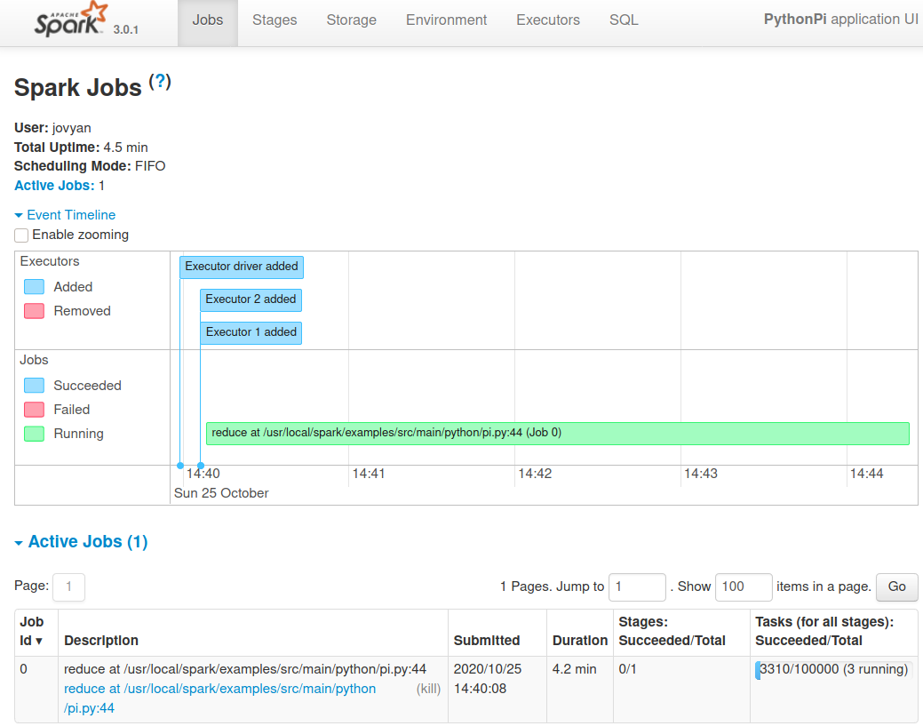
Spark monitoring
Every SparkContext launches a Web UI, by default on port 4040, that displays useful information about the application:
a list of scheduler stages and tasks
a summary of RDD sizes and memory usage
environmental information
information about the running executors
By default is only available for the duration of the application

Slide 9
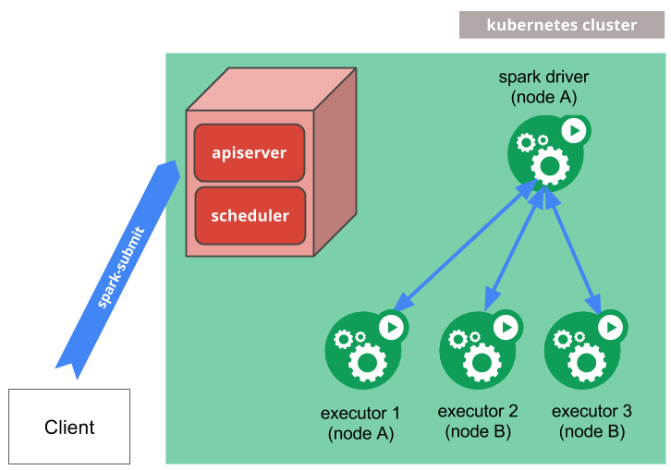

Spark on Kubernetes
Cloud-native support of Kubernetes from Spark v. 2.3 (Feb 2018)
Advantages: fast provisioning, self-healing, elasticity, seamlessly integration with monitoring solutions
Spark ships with Dockerfile and tools to build and push images (possibly customized) that can be deployed into containers within pods
Spark driver and executors run within K8s pods
When the application completes:
executor pods terminate and are cleaned up
driver pod persists logs and remains in “completed” state (not using CPU/RAM resources) until it’s eventually garbage collected or manually cleaned up

Slide 10
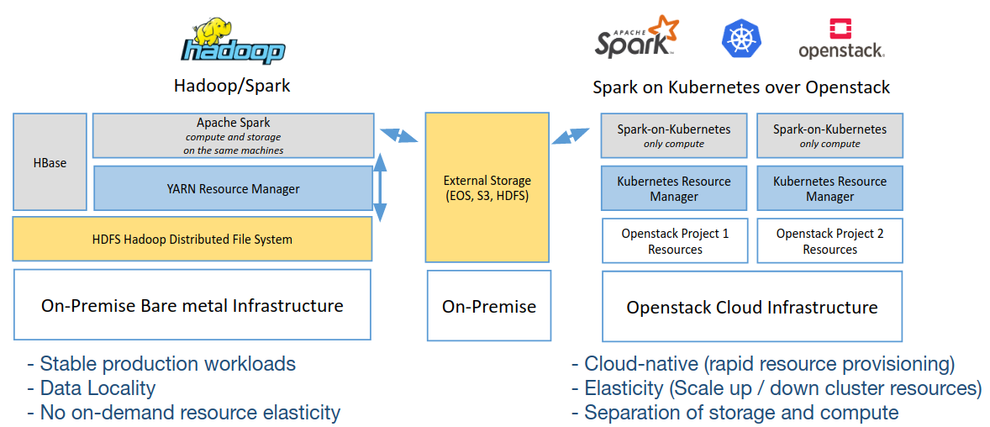
Elastic resource provisioning with Spark on Kubernetes: the CERN experience
From EPJ Web of Conferences 214, 07020 (2019), https://doi.org/10.1051/epjconf/201921407020

Slide 11
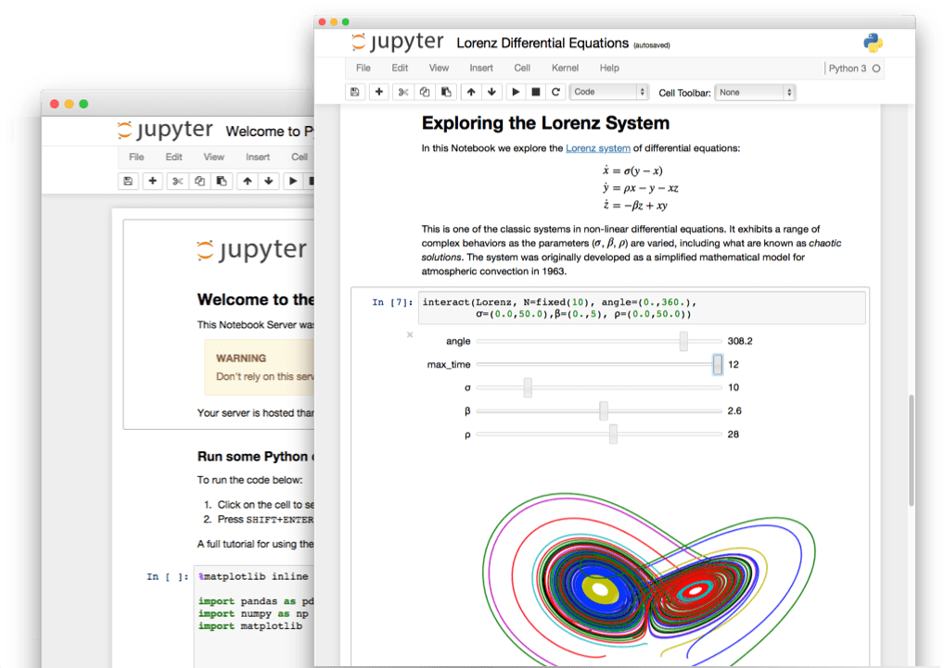
Jupyter notebooks
Popular open-source web application that allows you to create and share documents that contain live code, equations, visualizations and narrative text
Born out of the IPython Project in 2014 as it evolved to support interactive data science and scientific computing across all programming languages
Has a multi-user version: Jupyterhub
centralized deployment
pluggable authentication
container friendly
Has been deployed on Kubernetes and connected to Spark

Slide 12
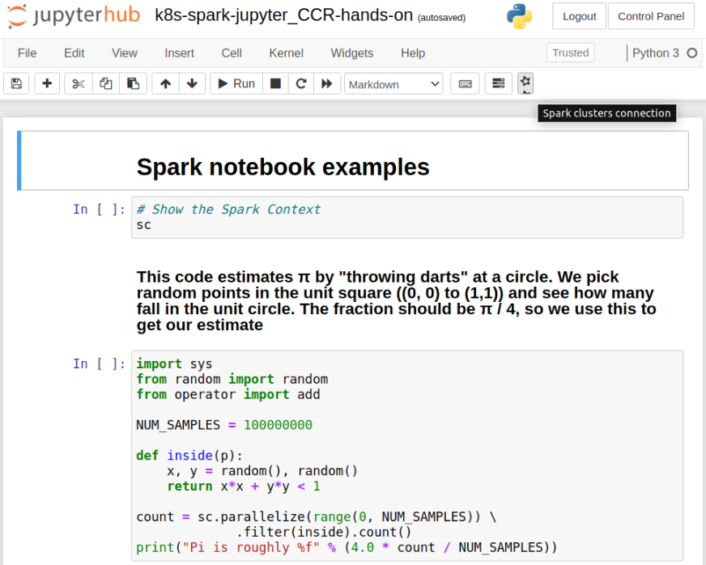
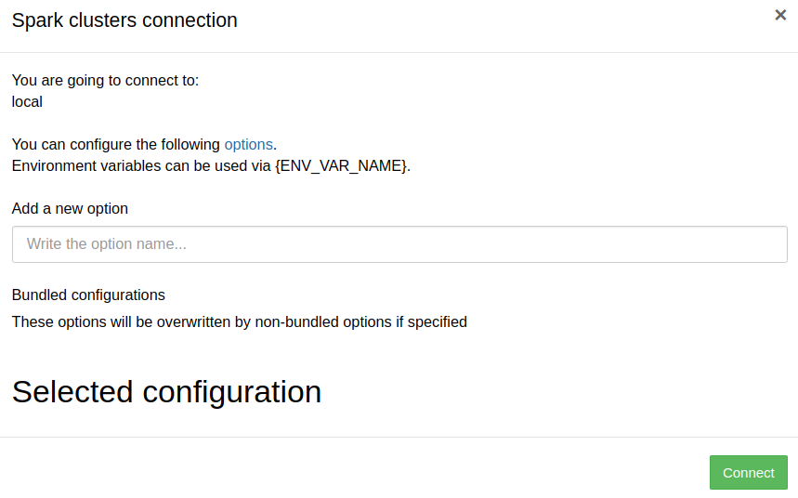
Spark Connector Jupyter extension
Users can specify additional Spark configuration
CERN development adapted to INFN Cloud

Slide 13
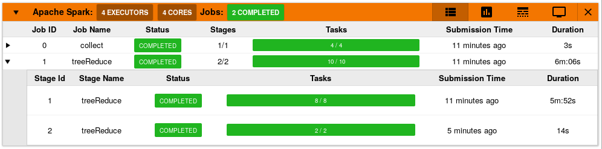
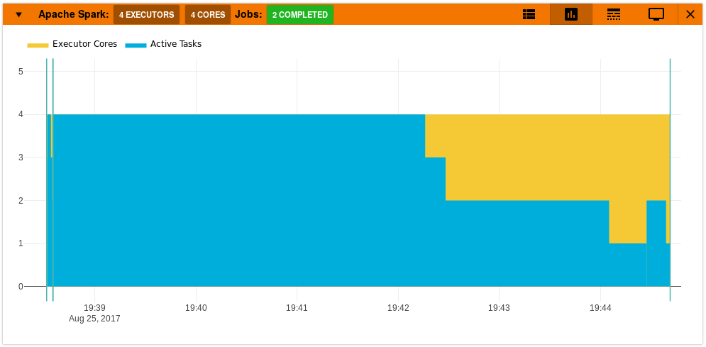
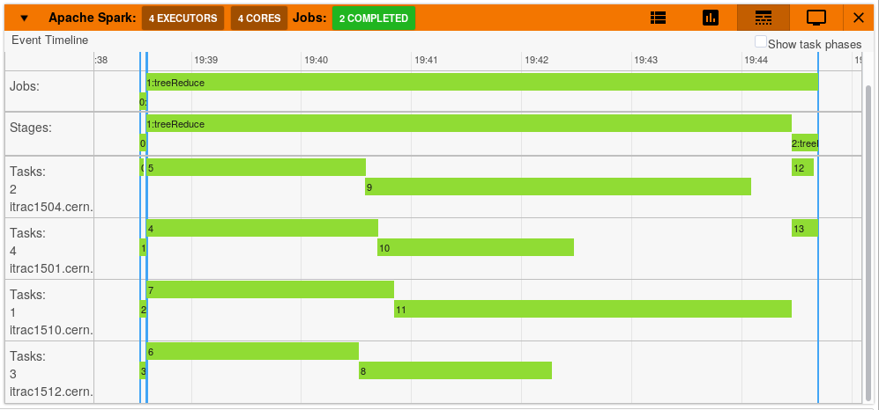
Spark Monitor Jupyter extension
Developed at Google Summer of Code 2017 - HEP Software Foundation (https://krishnan-r.github.io/sparkmonitor/)
..and adapted to INFN Cloud

Slide 14
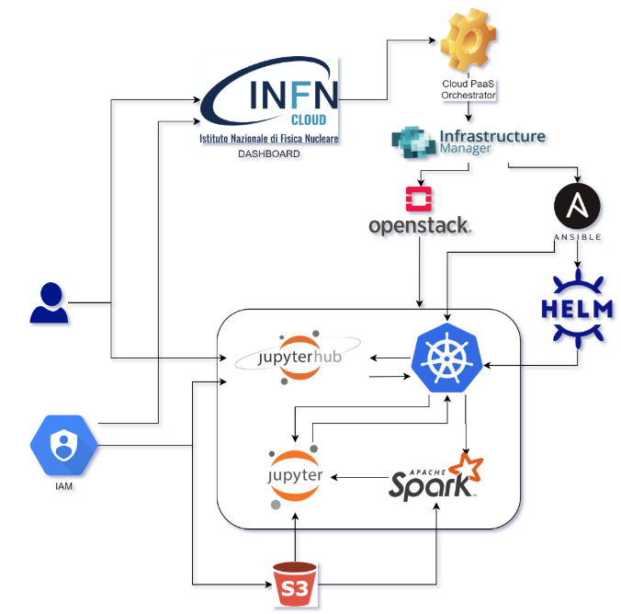
INFN Cloud deployment of the service
The usual PaaS workflow that through a TOSCA template, Ansible roles and Helm charts install and configure Kubernetes, Prometheus & Grafana for monitoring and Jupyterhub
kubespawner software (also known as Jupyterhub Kubernetes Spawner) enables Jupyterhub to spawn single-user notebook servers on a Kubernetes cluster
Users authenticate with INFN Cloud IAM
User notebooks run into Kubernetes pods as container with Spark software installed
In progress:
user notebooks on their own Kubernetes namespace
working area persistency baked up to S3 storage with INFN Cloud IAM authentication

Slide 15

Live Demo

Slide 16
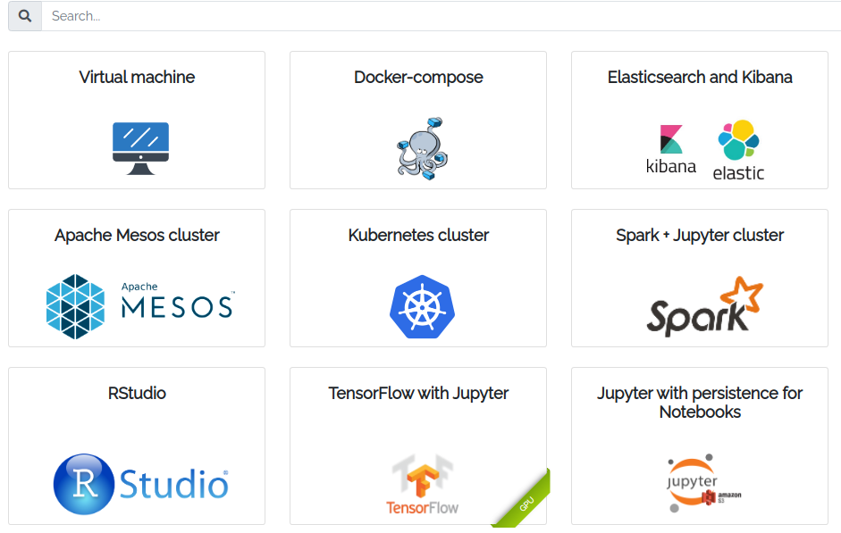
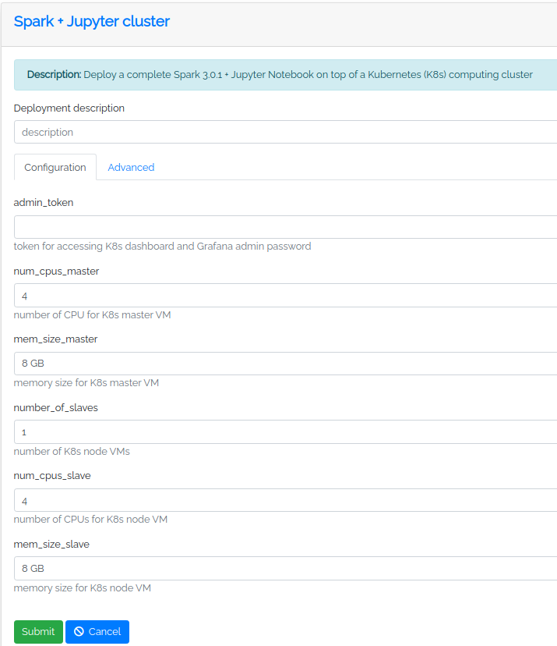
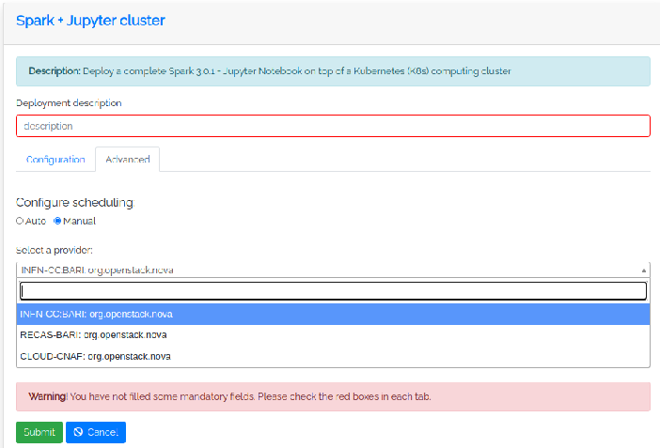
Start the deployment from the Dashboard

Slide 17
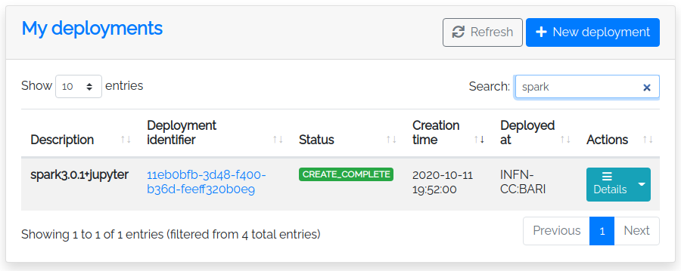
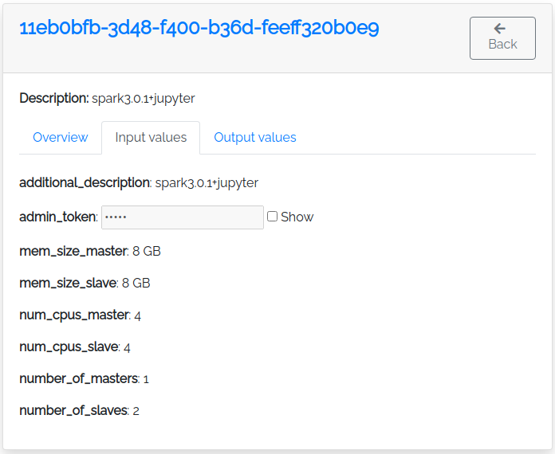
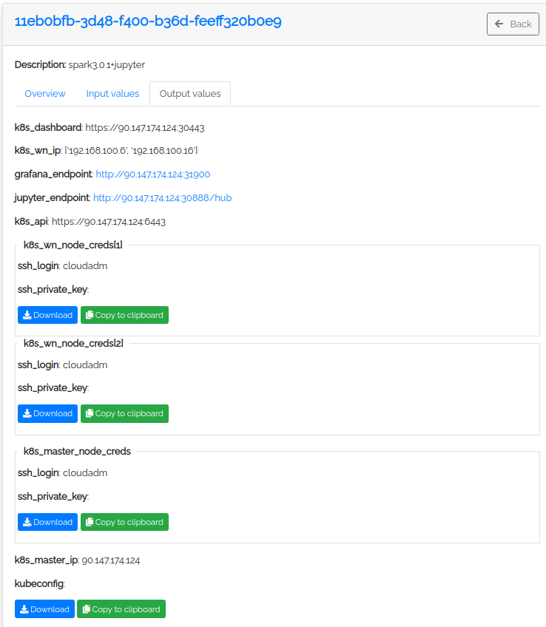
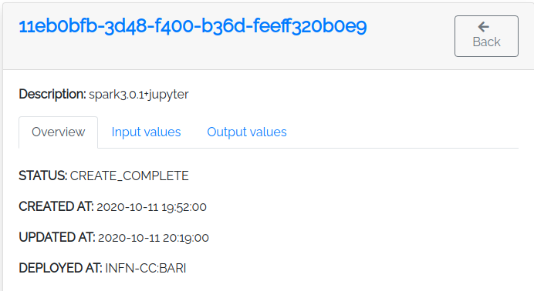
Look at the deployment details

Slide 18
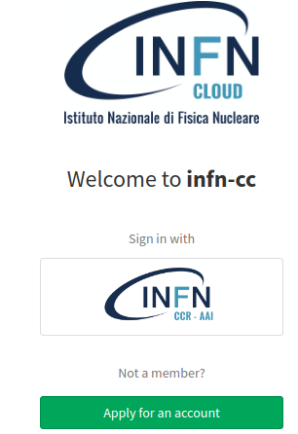
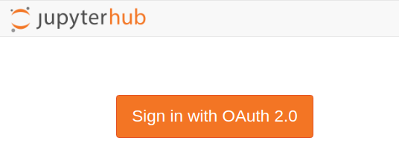
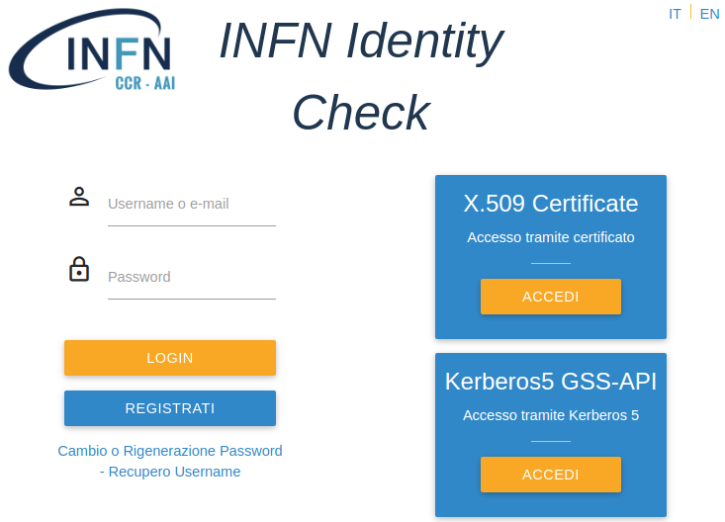
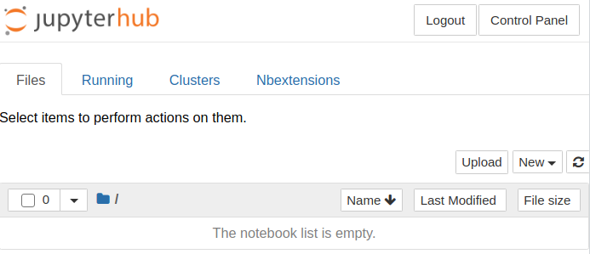
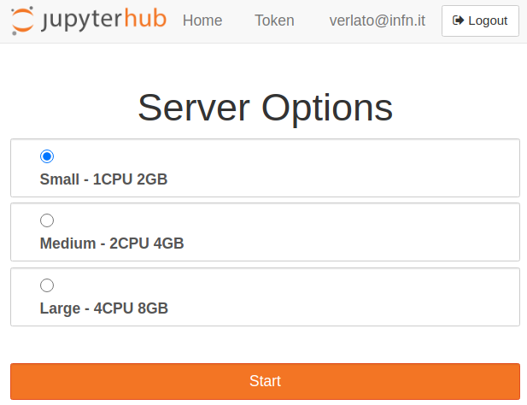
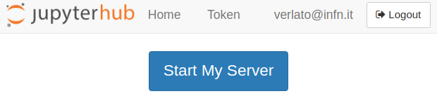
Open your Jupyter notebook

Slide 19
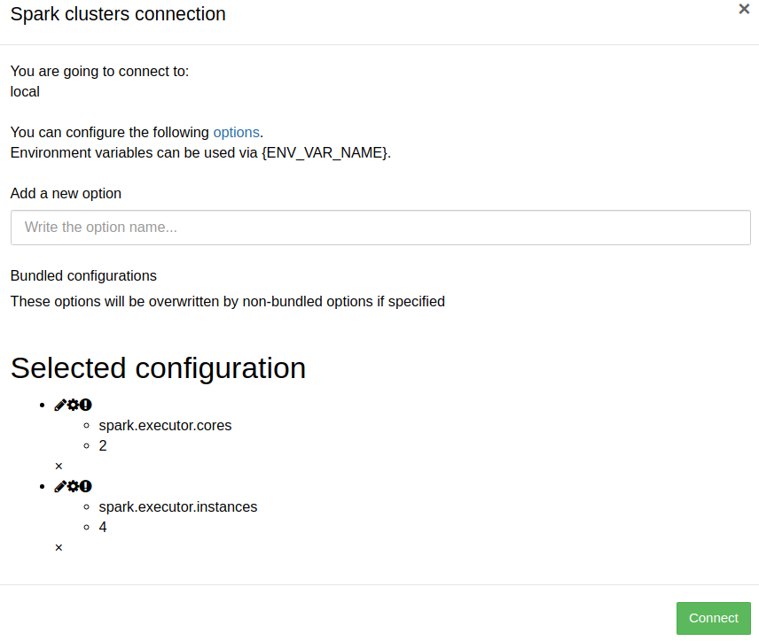
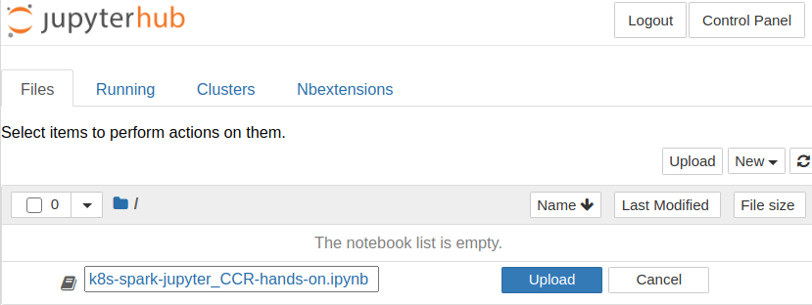
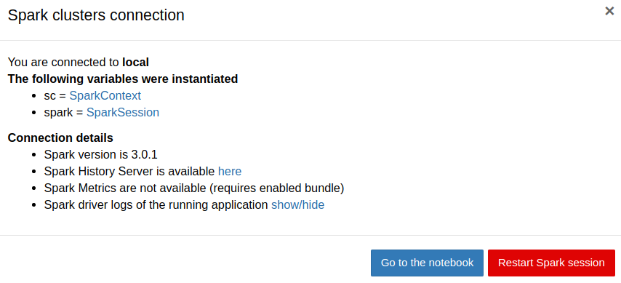
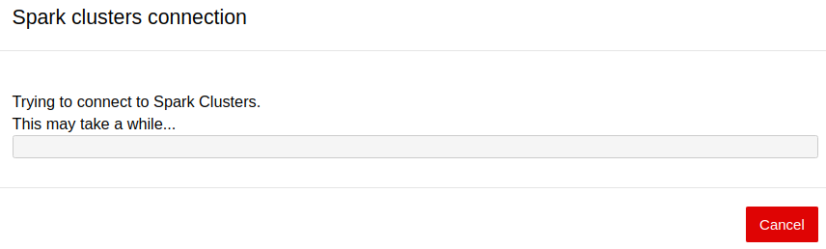
Load your notebook and connect to Spark

Slide 20
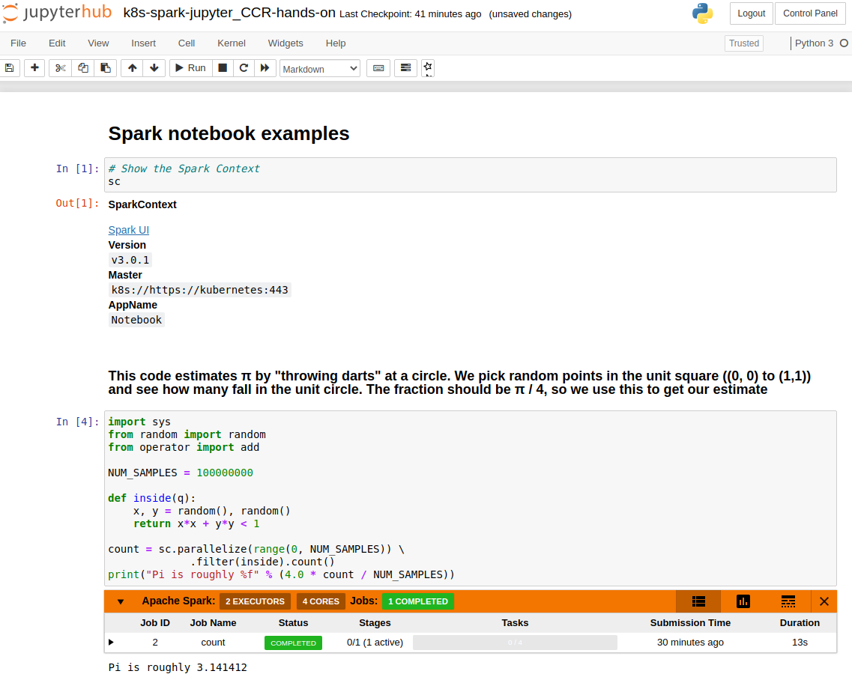
Execute your Spark code interactively
Hands-on notebook at
https://baltig.infn.it/infn-cloud/ccr_utenti_2020/-/tree/master/k8s-spark-jupyter

