Slide 1
fusion-point-cam
Msc. Marco Villegas

Slide 2
Hypothesis
The use of ESP-32-CAM coupled with a temperature sensor allows the experimental determination of melting point of unreported deep eutectic solvents ant it solid-liquid equilibria modelling.

Slide 3
Objetivos
Objetivo general
Estudiar los puntos de fusión de diferentes mezclas eutécticas a temperatura ambiente empleando un dispositivo low cost opensource
Objetivos específicos
Montar un dispositivo low cost que permita determinar los puntos de fusión
Obtener los puntos de fusión a partir del procesamiento de imágenes.
Modelar el comportamiento eutéctico de los DES

Slide 4
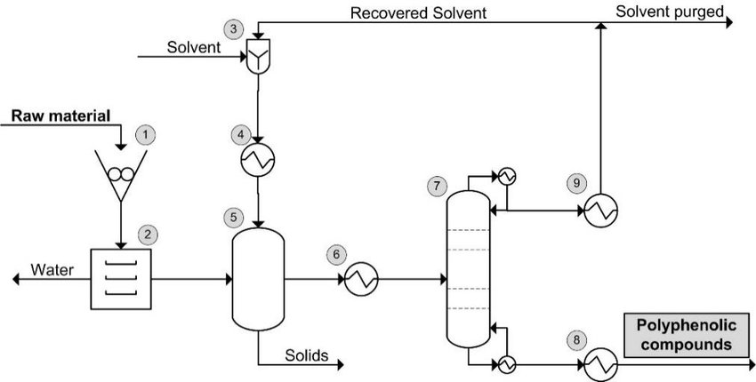
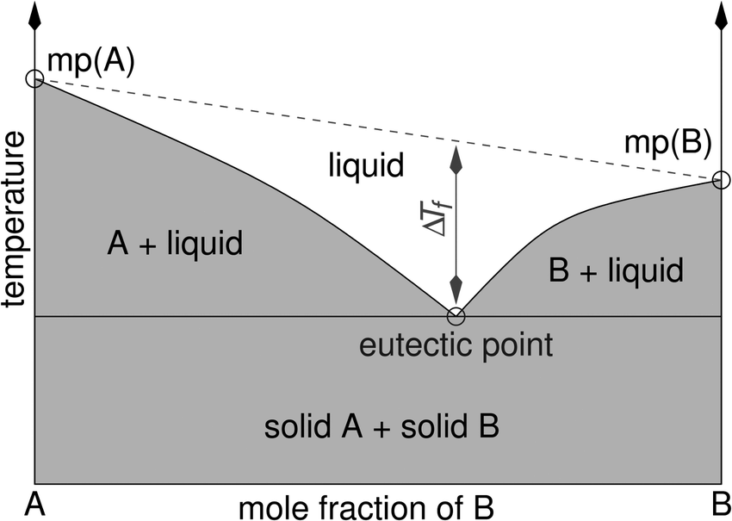
Introduction
Determine the melting point of Deep eutectic solvents at ambient temperature is crucial for designing new and enhanced extraction processes.

Slide 5
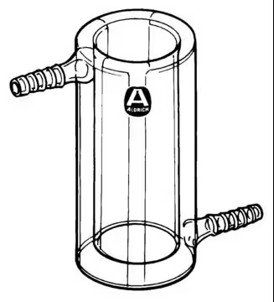
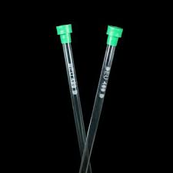
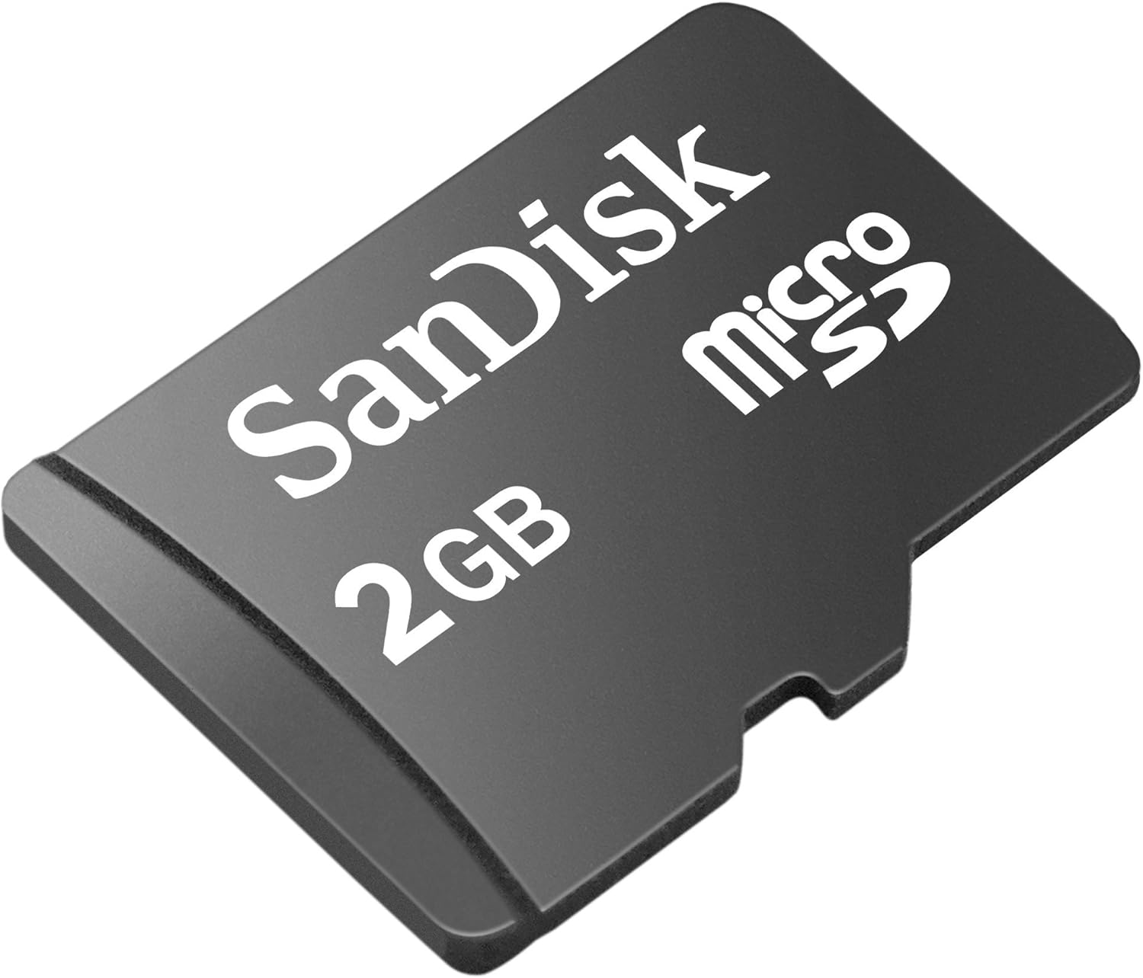
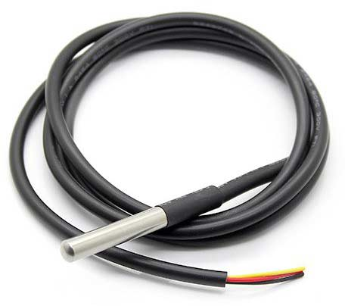
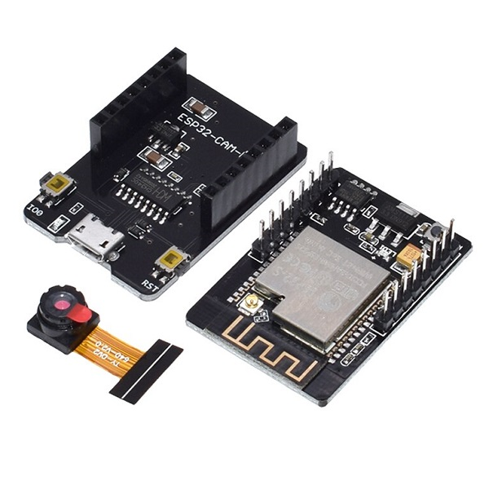
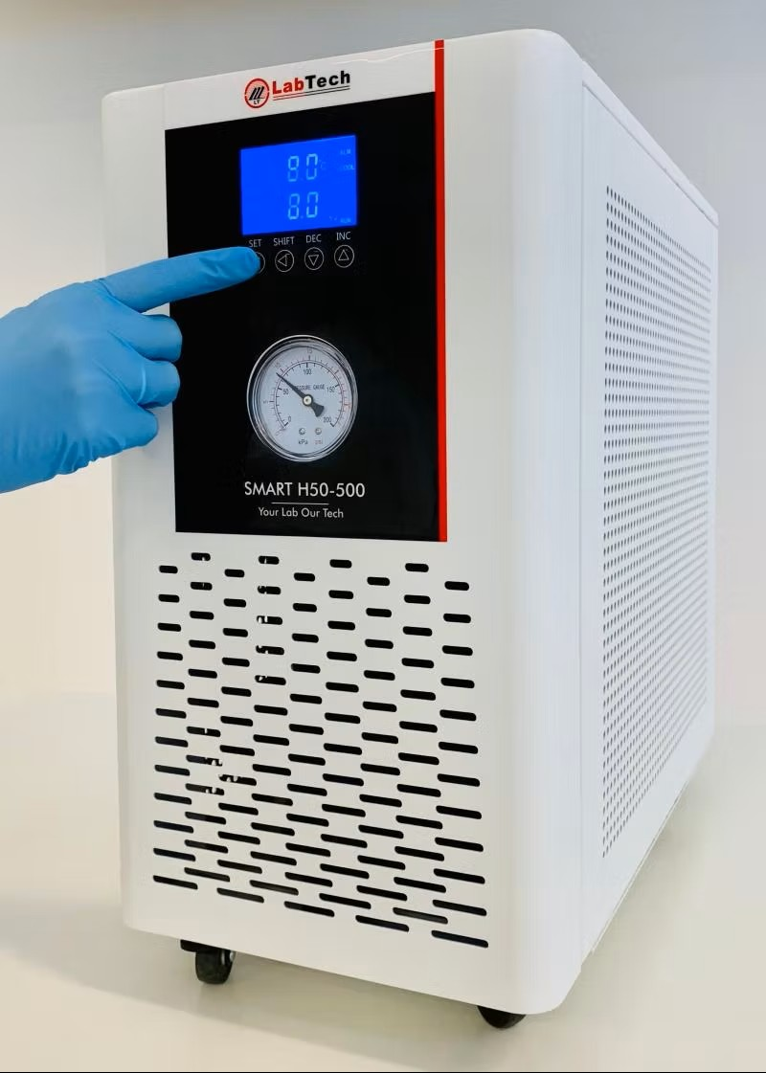
Methodology (hardware)

Slide 6
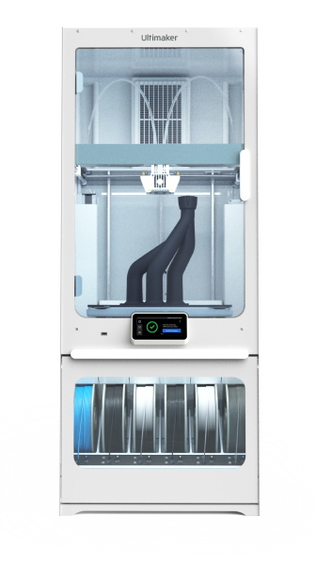


Methodology (hardware)
Add the 3D model from fusión 360

Slide 7
Methodology (firmware)
PlatformIO
GitHub repository
Datails about how the firmware Works based on OOP.

Slide 8









Image processing pipeline
0,653
0,564
0,464
0,345

Slide 9
Results and discussion
Hardware and firmware:
How does it behave?
What is obtained? In what format?
Limitations
Data processing
Result of the pipeline (normalized and filtered images)
Plot of time vs temperatura vs mean brightness
Eutectic modelling.
Use of NRTL model to obtain parameters and eutectic diagrams

Slide 10

HardwareX An open access scientific hardware journal
If this journal is a good fit for your scientific hardware, you can find out more via the Guide for Authors and are invited to submit your manuscript using the HardwareX template.
HardwareX is a multidisciplinary, open access, peer-reviewed journal which publishes articles that describe the design, construction and customization of scientific devices and equipment.
HardwareX promises to make scientific hardware:
Accessible - We will make your hardware article immediately and freely accessible.
Discoverable - We will make your hardware article easy to find and download.
Citable - Receive recognition for the work that you've done to develop scientific hardware with a peer-reviewed article with a distinct DOI. We will help you drive traffic to your hardware article.
Comprehensible - We will help you write a hardware article that is easy to digest and interpret.
Reviewed - Your article will be reviewed by experts in open source hardware.
Reproducible - Reduce duplication of effort with detailed descriptions of your hardware that make it easy for your peers to replicate and reproduce.
HardwareX is open to input from all scientific, technological, and medical disciplines. Scientific infrastructure will be interpreted in the broadest sense. Including hardware modifications to existing infrastructure, sensors and tools that perform measurements and other functions outside of the traditional lab setting (such as wearables, air/water quality sensors, and low cost alternatives to existing tools), and the creation of wholly new tools for either standard or novel laboratory tasks. Authors are encouraged to submit hardware developments that address all aspects of science, not only the final measurement, for example, enhancements in sample preparation and handling, user safety, and quality control. The use of distributed digital manufacturing strategies (e.g. 3-D printing) is encouraged. All designs must be submitted under an open hardware license.

Slide 11
The modelling solid-liquid equilibria of unreported DES correspond to an application of the device, therefore, could be manuscript by its own.

