Slide 1
Camp1_Day1_assign1 Adrian Soh, CCIE #42035 Marco Huang, CCIE #47251
Version 2.0
20th November 2017

Slide 2
User Story
[A. CORE USER]
[B. PRIMARY NEED]
XYZ’s building manager needs to identify unused (available) floor spaces across multiple buildings within the group, because departments are continually demanding for more space due to continual growth (or shrinking). To provision new locations, the additional cost can be prohibitive and it is preferred to maximise existing floor spaces in existing buildings.
Today, XYZ building manager manually visit each building/floor and identify actual vs expected occupancy. Findings are based on human interaction and does not provide real-time view of occupancy throughout the day/evening.
[C. SURPRISING USER-VALIDATED INSIGHT]
[D. HOW current solutions fall short.]
[1. PRIMARY PROBLEM TO SOLVE],
As a result of this, our solution absolutely must: provide an efficient way to identify near real-time occupancy on a floor (and/or room) over period of time,
While being able to present the data on a Dashboard (or email report) so that IT Operations does not need to get involved,
plus, if possible, custom alerts when the occupancy exceeds floor Health & Safety limits.
[2. SECONDARY PROBLEM TO SOLVE],
[3. TERTIARY PROBLEM TO SOLVE].

Slide 3
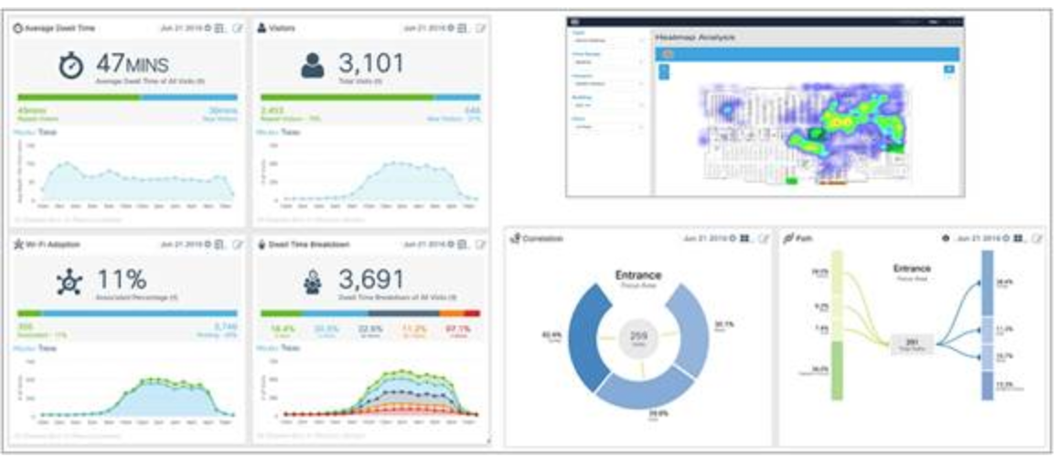

Solution: Let CMX do the walking for you!
Introducing Cisco Connected Mobile Experience (CMX) and making use of the Location and Presence Analytics to determine the presence of people on selected floor at any given time.
Inbuilt Presence metrics such as busiest hour, dwell time, repeat visitor, customised RSSI threshold will assist in capturing workspace utilisation.
Inbuilt Location metrics such as Location-based tag insights, visitor count, dwell time, path analysis, heatmap (device count) will assist in capturing workspace utilisation.
Flexibility and programmability will enable building manager to consume occupancy data in either traditional scheduled reports (PDF, excel, HTML) or notifications.
Introducing Cisco Spark and making the use of providing the report weekly to the company
Discover

Slide 4
Value Proposition Canvas
Custom search per building or tag
Real time view on occupancy
Cisco WIFI infrastructure
Automated reports
Efficient use of space
Identify occupancy and capacity
Connected Mobile Experience (CMX)
Occupancy heatmap
Cost savings
Provide safe environment
REST API / Python
New platform to manage & support
Manual site visit
Manage lease agreement
Spark Room or Email
Require DevOps to optimise reports/queries
Unused available spaces
High cost for building lease
Location Analytics is complex topic
Define
Explore
Notes:
VPC can also be used in this phase to record your discovery
Focus on customer first, put your discovery result in the canvas – what jobs or tasks customer needs to achieve, what are the ideal outcomes - gains, what are the outcomes that will make customer unhappy - pains.
And then you can do brainstorming on your solutions, and how your solutions will map back the customer gains and pains.
Again, it’s always putting customer in the center. Solutions come afterward.

Slide 5
Solution state diagram
CMX API
1
Get Location Data
2
MySQL DB
3
Generate Report
4
Report sent Spark Room

