Slide 1
Computing mu_i in 3MOM
Melissa Cholette, Hugh Morrison & Jason Milbrandt

Slide 2
1D results
3 simulations using 3MOM_noLF_n1:
5.3.15
LT3-v0.3 → as v5.3.15, but solve_mui is moved into a LT(with a change to how the density is computed).
LT3-v1.3 → using a new approach to compute mu_i in LT.

Slide 3
5.3.15 (CONTROL)
In v5.3.15, mu_i is solve iteratively in solve_mui subroutine call solve_mui(mu_i,dum6,dumzz,qitot(i,k,iice),nitot(i,k,iice),zitot(i,k,iice), dum1,dum4,dum5,dum7,dumjj,dumii,dumll,dumi)
outputs
inputs
P3:
mu_old = 0.5 !initial estimate of mu_i
do ind = 1,max_iterations (i.e., 5)
call find_lookupTable_indices_1c(dumzz,dum6,zsize,mu_old)
call access_lookup_table_3mom_LF(dumzz,dumjj,dumii,dumll,dumi,12,dum1,dum4,dum5,dum6,dum7,rhoi)
mom3 = 6./(rhoi*pi)*Qi
mu_i = compute_mu_3moment(Ni,mom3,Zi,mu_i_max)
if (abs(mu_old-mu_i) < tol) exit (tolerance = 0.25)
mu_old = mu_i
enddo
mu_i = min(mu_i,mu_i_max)
Disavantages:
This is expensive if max_iterations is reach.
Depends on the value of rhoi (mean mass-weighted density) from LT1.

Slide 4
5.3.15 – LT3-v0.3
Similar method than solve_mui, but using a LT approach call solve_mui_lt3(mu_i,dum6,dumzz,qitot(i,k,iice),nitot(i,k,iice),zitot(i,k,iice),dum1,dum4,dum5,dum7,dumjj,dumii,dumll,dumi,zsize,zqsize)
outputs
inputs
LT3-v0.3:
New LT3 index
rhom = 200.*pi*sxth ! First estimate
mom3 = q/rhom
dum = mom3/q
mom6 = Z_value/dum
mu_old = 0.5
do i_iter = 1,max_iterations (i.e., 5)
call find_lookupTable_indices_1c(dumzz,dum6,n_mu,mu_old)
call access_lookup_table_3mom_LF(dum6,dumzz,i_rhor,i_Fr,i_Fl,i_Qnorm,1,rhoi)
mom3 = 6./(rhoi*pi)*q
mu_i = compute_mu_3moment(mom3,mom6,mu_i_max)
if (abs(mu_old-mu_i) < tol) exit (tolerance = 0.25)
mu_old = mu_i
enddo
Avantages:
Iterations are done offline.
Disavantages:
Rhoi is not interpolated as a function of prognostic variables since their indices are fixed.
In 5.3.15, it depends on qiliq, qitot, qirim, Birim & Nitot
In 5.3.15-LT3-v0.3, we take i_Fl, i_Fr, i_rhor & i_Qnorm

Slide 5
New LT3-v0.3
LT3 uses the same index as for LT1 except for mu_i (dum6, dumzz), which is changed to Z/Q (dum8, dumzq).
zqsize = 80
LT3-v0.3: Z_value = 2.1**(i_Znorm)*1.e-23 ! range from 2x10^(-23) to 600 using 80 values
New LT3 index

Slide 6
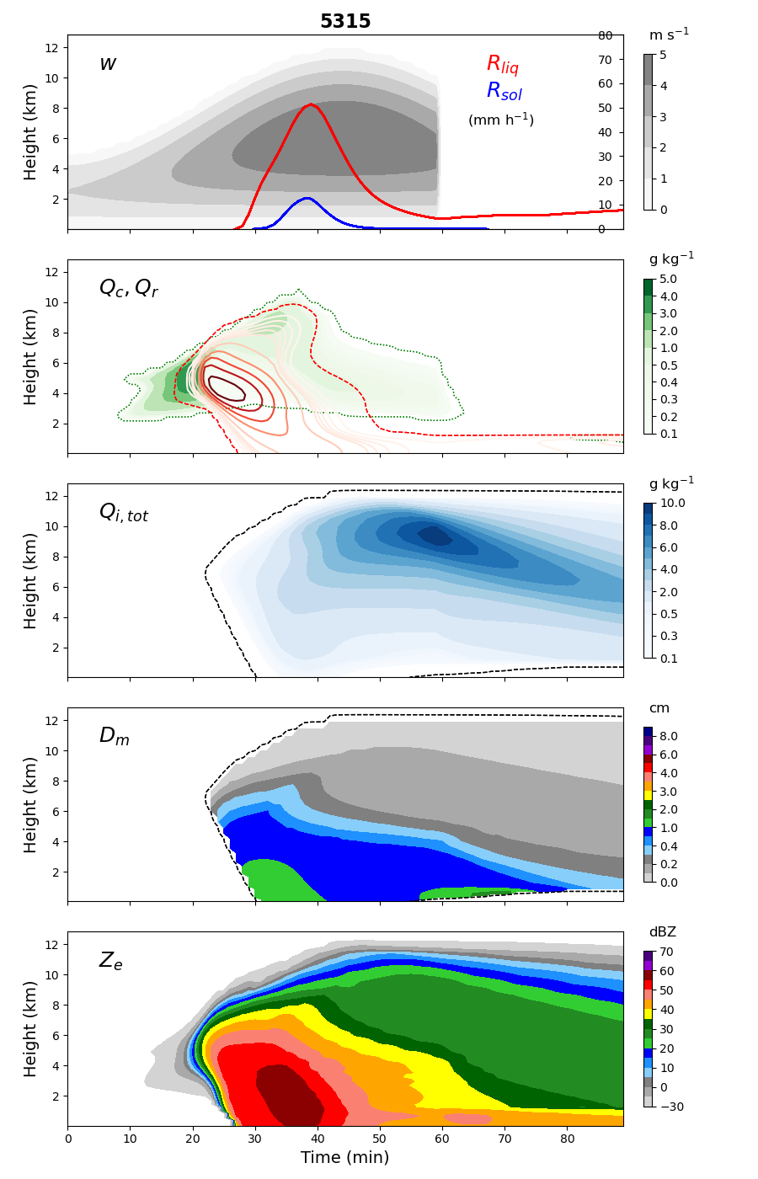
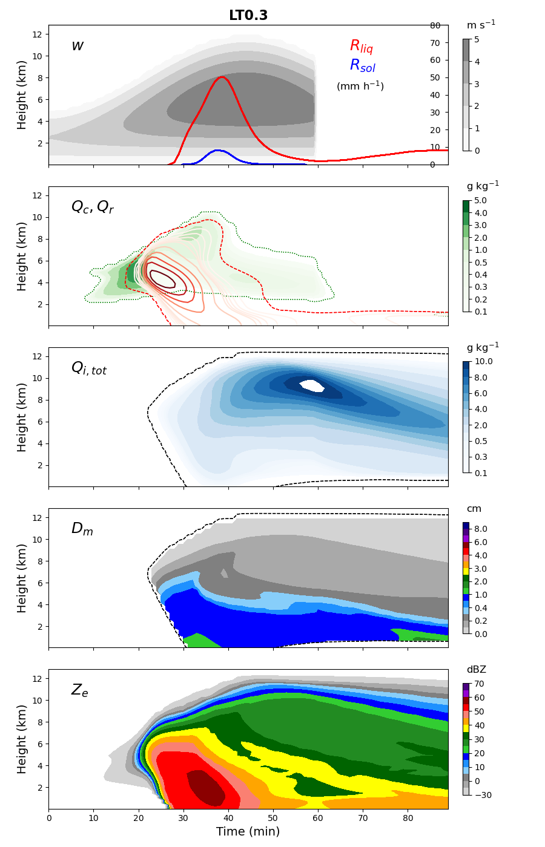
Results
5.3.15
5.3.15 – LT3-v0.3
This approach reduces the total mean time by about 1.5% in 1D with n1 (within the noise).
The bad news is that it is changing the results in 1D:
Because of how density is treated.

Slide 7
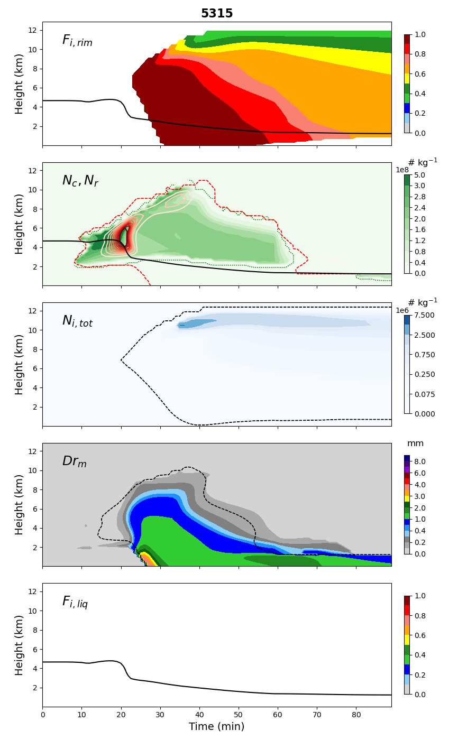
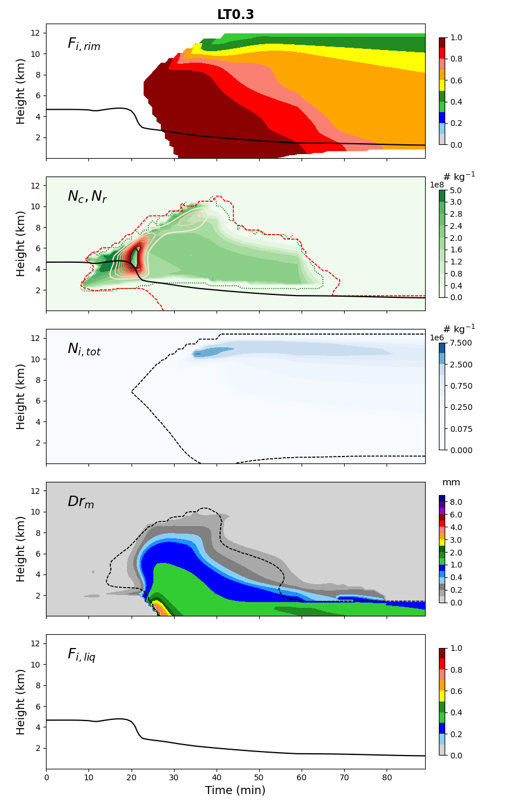
Results
5.3.15
5.3.15 – LT3-v0.3
Results are similar, except for Drm (rain mass-weighted diameter)

Slide 8
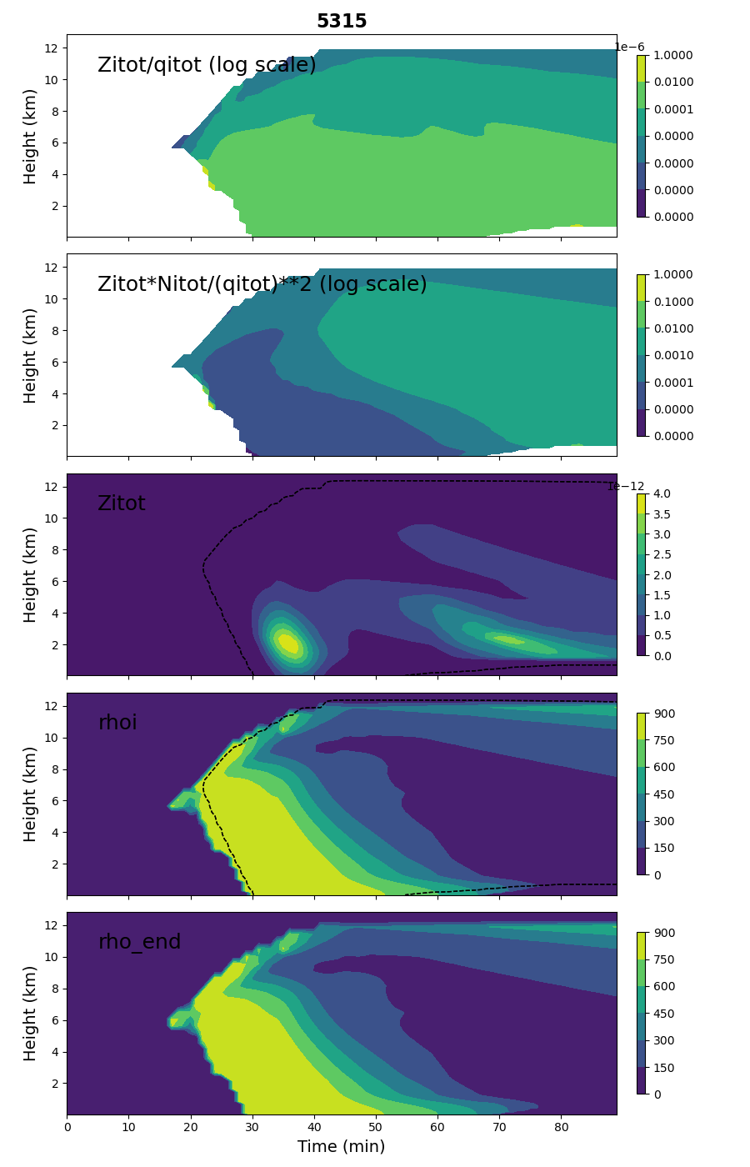
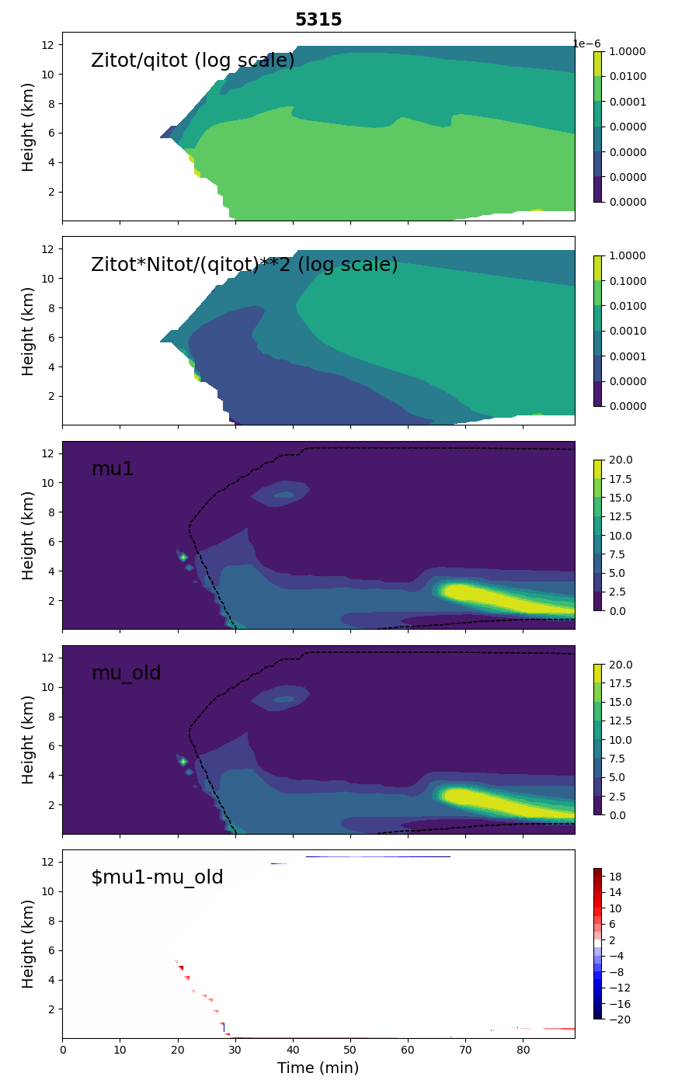
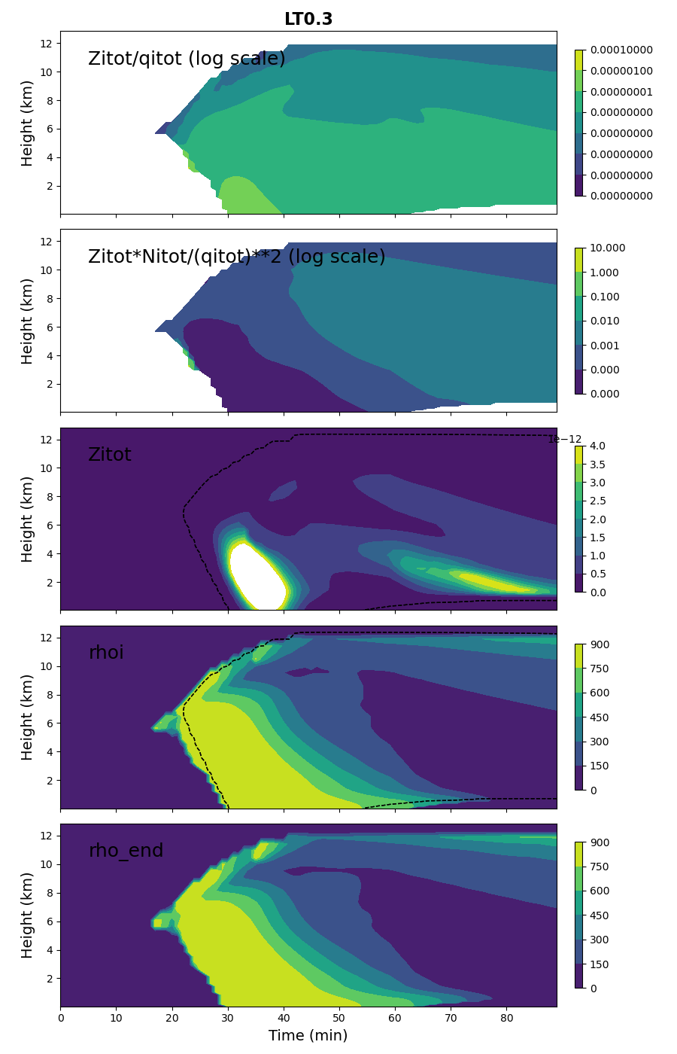
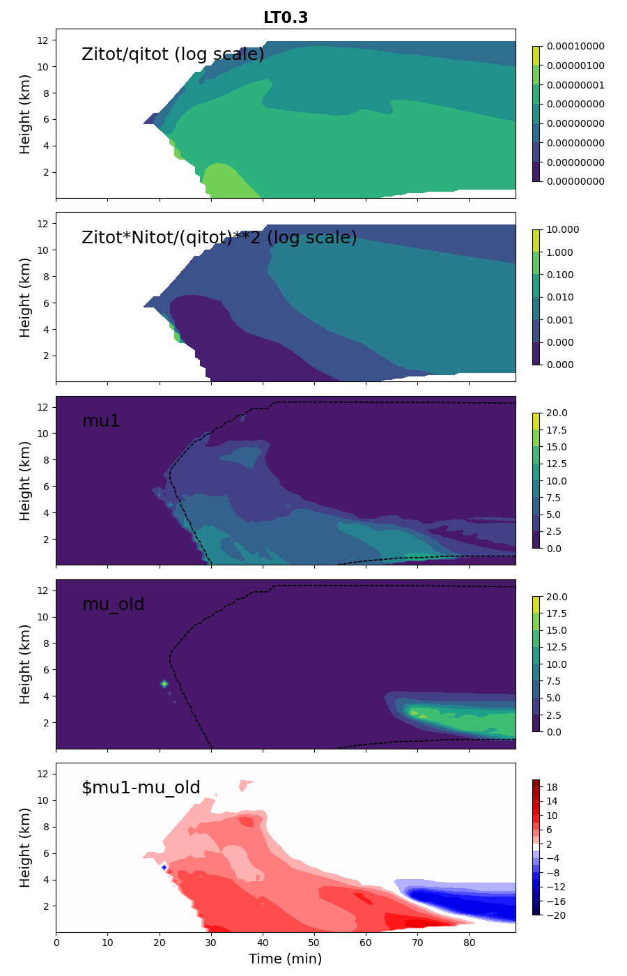
Results
5.3.15
5.3.15 – LT3-v0.3
Higher differences are when Zitot is relatively high, but density is low.

Slide 9
5.3.15 – LT3-v1.3
In v1.3, mu_i is computed using mom3 and the PSD parameters.
call solve_mui_lt3(mu_i,dum6,dumzz,qitot(i,k,iice),nitot(i,k,iice),zitot(i,k,iice),dum1,dum4,dum5,dum7,dumjj,dumii,dumll,dumi,zsize,zqsize)
outputs
inputs
New LT3 index
! first find index for LT3 and interpolates in LT3 to get mu_i
call find_lookupTable_indices_3a(dumzq,dum8,zqsize,Zi,Qi)
call access_lookup_table_3(dumzq,dumjj,dumii,dumll,dumi,1,dum1,dum4,dum5,dum7,dum8,mu_i)
! then find dum6, dumzz from mu_i
call find_lookupTable_indices_1c(dumzz,dum6,zsize,mu_i)
Dumzq is index for Zitot/qitot
What we can control in LT3?
The index dumzq, dum8: (Zi/Qi)
What formula to compute_mui (polynomial approx, numerical or cubib root)
Avantages:
Iterations are done offline.
Calculated directly from M3 (from PSD parameters) and not from an estimated density.

Slide 10
! loop around normalized Q (Qnorm)
i_Qnorm_loop: do i_Qnorm = 1,n_Qnorm
q = 800.**((i_Qnorm+10)*0.1)*1.e-18 ! new lambda limiter
qerror = 1.e+20; zqerror = 1.e+20
rhom = (1.-Fl)*cgp(i_rhor)+Fl*1000.*pi*sxth
! assign provisional values for mom3 (first guess for mom3)
mom3 = q/rhom !note: cgp is pi/6*(mean_density), computed above
! update normalized mom6 based on the updated ratio of normalized mom3 and normalized Q
dum = mom3/q
mom6 = Z_value/dum
iter=0
do
! first estimate of mu_i
mu_i = compute_mu_3moment_1(mom3,mom6,mu_i_max)
mu_i = max(mu_i,mu_i_min) ! make sure mu_i >= 0 (otherwise size dist is infinity at D = 0)
mu_i = min(mu_i,mu_i_max) ! set upper limit
ii_loop_1: do ii = 1,11000 ! this range of ii to calculate lambda chosen by trial and error for the given lambda limiter values
lam = 1.0013**ii*10. ! new lambda_i limiter
dum = Dm_max1+Dm_max2*Fr**2.
lam = max(lam,(mu_i+1.)/dum) ! set min lam corresponding to mean size of x
lam = min(lam,(mu_i+1.)/Dm_min) ! set max lam corresponding to mean size of Dm_min (2 micron)
! normalized n0:
n0 = lam**(mu_i+1.)/(gamma(mu_i+1.))
! calculate integral for each of the 4 parts of the size distribution
! check difference with respect to Qnorm
! set up m-D relationship for solid ice with D < Dcrit:
cs1 = pi*sxth*900.
ds1 = 3.
cs5 = pi*sxth*1000.
call intgrl_section_Fl(lam,mu_i, ds1,ds,dg,dsr, dcrit,dcrits,dcritr,intgrR1,intgrR2,intgrR3,intgrR4,intgrR5)
! sum of the integrals from the 4 regions of the size distribution:
qdum = n0*((1.-Fl)*(cs1*intgrR1 + cs*intgrR2 + cgp(i_rhor)*intgrR3 + csr*intgrR4)+Fl*cs5*intgrR5)
if (ii.eq.1) then
qerror = abs(q-qdum)
lamf = lam
endif
! find lam with smallest difference between Qnorm and estimate of Qnorm, assign to lamf
if (abs(q-qdum).lt.qerror) then
lamf = lam
qerror = abs(q-qdum)
endif
enddo ii_loop_1
lam = lamf
call intgrl_section_Fl(lam,mu_i, ds1,ds,dg,dsr, dcrit,dcrits,dcritr,intgrR1,intgrR2,intgrR3,intgrR4,intgrR5)
n0 = q/((1.-Fl)*(cs1*intgrR1 + cs*intgrR2 + cgp(i_rhor)*intgrR3 + csr*intgrR4)+Fl*cs5*intgrR5)
! calculate normalized mom3 directly from PSD parameters (3-moment-ice only)
mom3 = n0*gamma(4.+mu_i)/lam**(4.+mu_i)
dum = mom3/q
mom6_old = mom6
mom6 = Z_value/dum
zqerror_old = zqerror
zqerror = abs((mom6-mom6_old)/(mom6_old))
if (abs((mom6-mom6_old)/(mom6_old)).lt.1e-16 .or. abs((zqerror-zqerror_old)/zqerror_old).lt.0.01) goto 116
iter=iter+1
if (iter.gt.50) goto 116
enddo
116 continue
mu_i_save(i_Znorm,i_rhor,i_Qnorm,i_Fr,i_Fl) = mu_i
enddo i_Qnorm_loop
LT3-v1.3
First estimate of mom3, mom6
where mom3 = M3/M0 and mom6 = M6/M3
mom6 depends (Z/Q).
Compute_mu_3moment can be
polynomial approx
numerical (_1) → by default
cubib root (_2)
Iterate until errors on mom6 is small
Note: iter = 50 (max) is reached a few times
p3_lookupTable_3.dat-v1.0 has 6 columns (5 for indices, 1 for mu_i)
write(1,'(5i5,1e15.5)') i_Znorm,i_rhor,i_Fr,i_Fl,i_Qnorm, &
mu_i_save(i_Znorm,i_rhor,i_Qnorm,i_Fr,i_Fl)

Slide 11
timing | p3v5314 | P3v5315 (CONTROL) | P3v5315 + solve_mui_lt3-v1.3 Z/Q (80 indices)
2MOM_noLF_n1 | 1 full p3_main 1.425295 100.000000 2 i_loop_main 1.332712 93.504311 3 k_loop_main (proces 0.823946 57.808811 5 update ice reflecti 0.001745 0.122447 6 sedimentation 0.188470 13.223221 8 post i_loop_main 0.051861 3.638602 9 type_diags 0.047288 3.317765 | 1 full p3_main 1.404061 100.000000 2 i_loop_main 1.346879 95.927361 3 k_loop_main (proces 0.838828 59.742981 5 update ice reflecti 0.001726 0.122940 6 sedimentation 0.189710 13.511494 8 post i_loop_main 0.016632 1.184569 9 type_diags 0.012050 0.858201 | 1 full p3_main 1.399231 100.000000 2 i_loop_main 1.341934 95.905128 3 k_loop_main (proces 0.831909 59.454746 5 update ice reflecti 0.001702 0.121660 6 sedimentation 0.189891 13.571088 8 post i_loop_main 0.016661 1.190703 9 type_diags 0.012150 0.868321
2MOM_noLF_n2 | 1 full p3_main 3.622856 100.000000 2 i_loop_main 3.532343 97.501602 3 k_loop_main (proces 2.789240 76.990082 5 update ice reflecti 0.001931 0.053306 6 sedimentation 0.220699 6.091859 8 post i_loop_main 0.044298 1.222742 9 type_diags 0.039182 1.081514 | 1 full p3_main 3.601551 100.000000 2 i_loop_main 3.536673 98.198601 3 k_loop_main (proces 2.789865 77.462860 5 update ice reflecti 0.002031 0.056401 6 sedimentation 0.223331 6.200980 8 post i_loop_main 0.017591 0.488415 9 type_diags 0.012798 0.355356 | 1 full p3_main 3.623204 100.000000 2 i_loop_main 3.559060 98.229630 3 k_loop_main (proces 2.805500 77.431465 5 update ice reflecti 0.001955 0.053959 6 sedimentation 0.224843 6.205640 8 post i_loop_main 0.017519 0.483522 9 type_diags 0.012527 0.345730
3MOM_noLF_n1 | 1 full p3_main 4.607010 100.000000 2 i_loop_main 4.504991 97.785561 3 k_loop_main (proces 1.928024 41.849796 5 update ice reflecti 0.003061 0.066449 6 sedimentation 1.200509 26.058313 8 post i_loop_main 0.055342 1.201250 9 type_diags 0.048862 1.060590 10 post solve_mui 1 0.015049 0.326654 | 1 full p3_main 3.133454 100.000000 2 i_loop_main 3.068457 97.925690 3 k_loop_main (proces 1.409240 44.973999 5 update ice reflecti 0.002899 0.092523 6 sedimentation 0.731473 23.343981 8 post i_loop_main 0.018854 0.601705 9 type_diags 0.012517 0.399463 10 post solve_mui 1 0.003901 0.124480 11 post solve_mui 2 0.004568 0.145785 13 post solve_mui 4 0.003181 0.101502 16 post solve_mui 6 0.003638 0.116110 | 1 full p3_main 3.043156 100.000000 2 i_loop_main 2.977824 97.853165 3 k_loop_main (proces 1.427016 46.892647 5 update ice reflecti 0.003061 0.100596 6 sedimentation 0.671158 22.054667 8 post i_loop_main 0.018897 0.620969 9 type_diags 0.012355 0.405988 10 post solve_mui 1 0.003819 0.125510 11 post solve_mui 2 0.007696 0.252900 13 post solve_mui 4 0.003119 0.102476 16 post solve_mui 6 0.003090 0.101536
3MOM_LF_n1 | 1 full p3_main 5.374827 100.000000 2 i_loop_main 5.300131 98.610252 3 k_loop_main (proces 2.708664 50.395363 5 update ice reflecti 0.003176 0.059085 6 sedimentation 1.005578 18.709030 8 post i_loop_main 0.028725 0.534430 9 type_diags 0.021958 0.408541 10 post solve_mui 1 0.015168 0.282208 | 1 full p3_main 3.694992 100.000000 2 i_loop_main 3.630099 98.243767 3 k_loop_main (proces 2.016253 54.567192 5 update ice reflecti 0.003071 0.083108 6 sedimentation 0.615010 16.644426 8 post i_loop_main 0.018492 0.500454 9 type_diags 0.012145 0.328689 10 post solve_mui 1 0.004344 0.117564 12 post solve_mui 3 0.017653 0.477742 13 post solve_mui 4 0.003295 0.089173 16 post solve_mui 6 0.003610 0.097691 | 1 full p3_main 3.738775 100.000000 2 i_loop_main 3.673573 98.256042 3 k_loop_main (proces 2.131290 57.005043 5 update ice reflecti 0.003047 0.081497 6 sedimentation 0.592012 15.834394 8 post i_loop_main 0.019045 0.509388 9 type_diags 0.012102 0.323692 10 post solve_mui 1 0.003929 0.105092 12 post solve_mui 3 0.006294 0.168351 13 post solve_mui 4 0.002823 0.075503 16 post solve_mui 6 0.003304 0.088384
3MOM_noLF_n2 | 1 full p3_main 7.848687 100.000000 2 i_loop_main 7.758198 98.847076 3 k_loop_main (proces 3.972979 50.619656 5 update ice reflecti 0.003839 0.048907 6 sedimentation 1.035004 13.186966 8 post i_loop_main 0.034947 0.445264 9 type_diags 0.027456 0.349820 10 post solve_mui 1 0.015979 0.203586 | 1 full p3_main 5.960965 100.000000 2 i_loop_main 5.885878 98.740349 3 k_loop_main (proces 3.349500 56.190563 5 update ice reflecti 0.003791 0.063595 6 sedimentation 0.681758 11.437039 8 post i_loop_main 0.020027 0.335972 9 type_diags 0.012994 0.217982 10 post solve_mui 1 0.004206 0.070554 11 post solve_mui 2 0.009303 0.156067 13 post solve_mui 4 0.003009 0.050476 15 post solve_mui 5 0.003266 0.054795 16 post solve_mui 6 0.003567 0.059835 | 1 full p3_main 5.487385 100.000000 2 i_loop_main 5.413799 98.659012 3 k_loop_main (proces 3.164864 57.675259 5 update ice reflecti 0.003777 0.068822 6 sedimentation 0.612392 11.160005 8 post i_loop_main 0.019598 0.357147 9 type_diags 0.012426 0.226454 10 post solve_mui 1 0.004025 0.073341 11 post solve_mui 2 0.003490 0.063609 13 post solve_mui 4 0.003080 0.056135 15 post solve_mui 5 0.003147 0.057352 16 post solve_mui 6 0.003233 0.058916
3MOM_LF_n2 | 1 full p3_main 14.690399 100.000000 2 i_loop_main 14.607220 99.433784 3 k_loop_main (proces 10.339546 70.383018 5 update ice reflecti 0.004129 0.028110 6 sedimentation 1.167345 7.946312 8 post i_loop_main 0.027914 0.190016 9 type_diags 0.019741 0.134381 10 post solve_mui 1 0.016108 0.109647 | 1 full p3_main 13.646402 100.000000 2 i_loop_main 13.570662 99.444977 3 k_loop_main (proces 10.800009 79.141800 5 update ice reflecti 0.004101 0.030050 6 sedimentation 0.724382 5.308230 8 post i_loop_main 0.021105 0.154655 9 type_diags 0.013227 0.096930 10 post solve_mui 1 0.004358 0.031937 12 post solve_mui 3 0.015144 0.110977 13 post solve_mui 4 0.002966 0.021734 15 post solve_mui 5 0.003357 0.024599 16 post solve_mui 6 0.003738 0.027395 | 1 full p3_main 11.267872 100.000000 2 i_loop_main 11.191216 99.319687 3 k_loop_main (proces 8.868504 78.706108 5 update ice reflecti 0.004015 0.035632 6 sedimentation 0.632973 5.617500 8 post i_loop_main 0.021849 0.193902 9 type_diags 0.013266 0.117729 10 post solve_mui 1 0.004263 0.037833 12 post solve_mui 3 0.004005 0.035547 13 post solve_mui 4 0.002918 0.025899 15 post solve_mui 5 0.003042 0.026999 16 post solve_mui 6 0.003128 0.027761
+0.36%
+0.55%
-3%
+1.2%
-8%
-17%

Slide 12
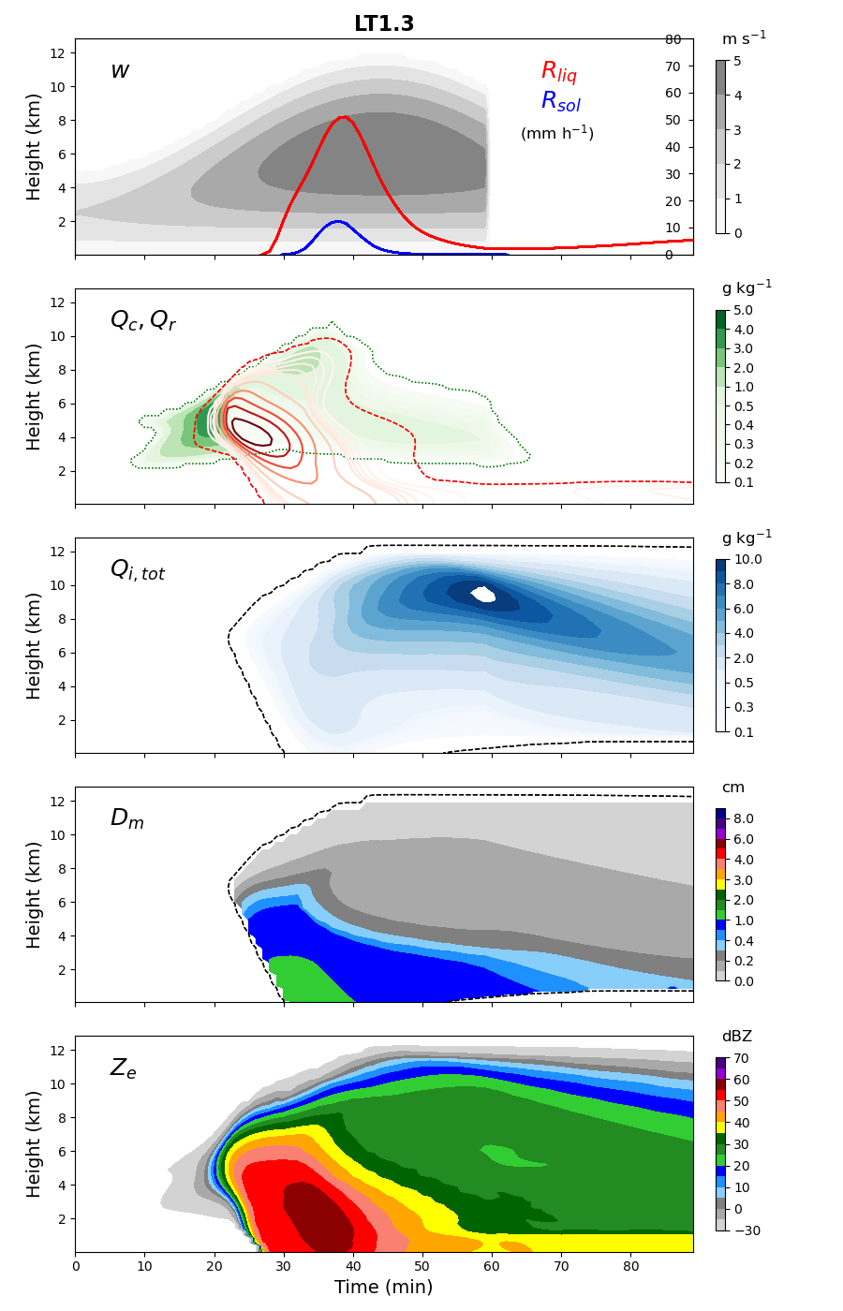

Results
5.3.15
5.3.15 – LT3-v1.3
5.3.15
5.3.15 – LT3-v1.3

Slide 13

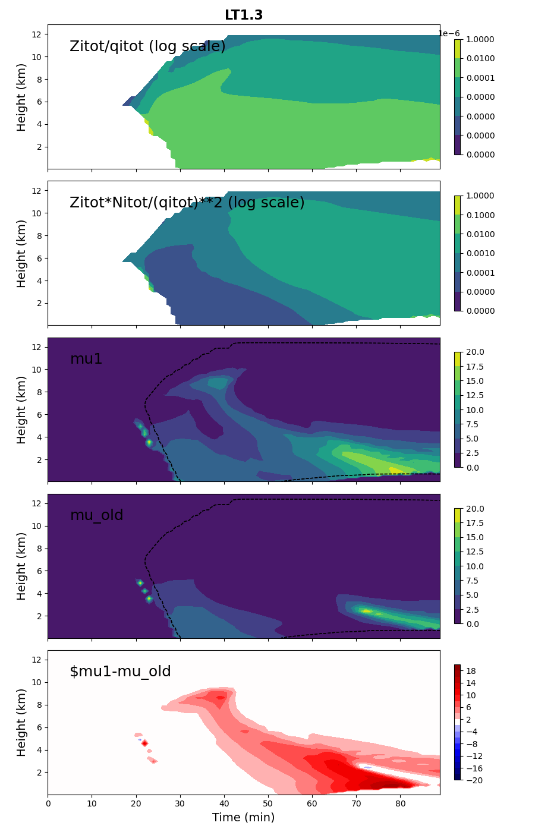
Results
5.3.15
5.3.15 – LT3-v1.3
5.3.15
5.3.15 – LT3-v1.3

Slide 14
Conclusions 1D
Whatever tests I did with using a LT3 approach instead of the CONTROL method to solve for mu_i did not reproduce the 1D CONTROL solution.
It saves a bit of time in 1D, but more for n2 (up to 17% with LF).
The density plays a big role in how mu_i is computed with solve_mui, so I think we should abandon this approach and use LT3-v1.3 instead (which uses error on mom3 from PSD parameters calculated directly).
This LT3-v1.3 approach seems to reduces precipitation.

Slide 15
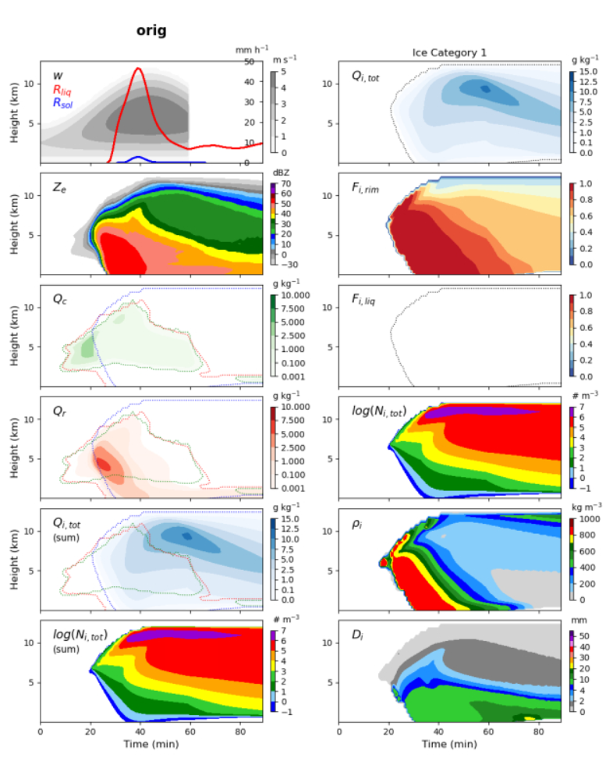
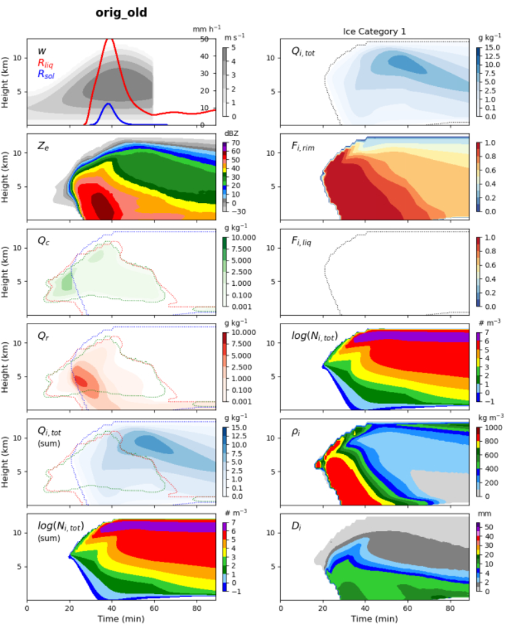
1D v5.4.3+dev-opt
3MOMold_noLF_n1 (2.58)
3MOMnew_noLF_n1 (3.58)

Slide 16
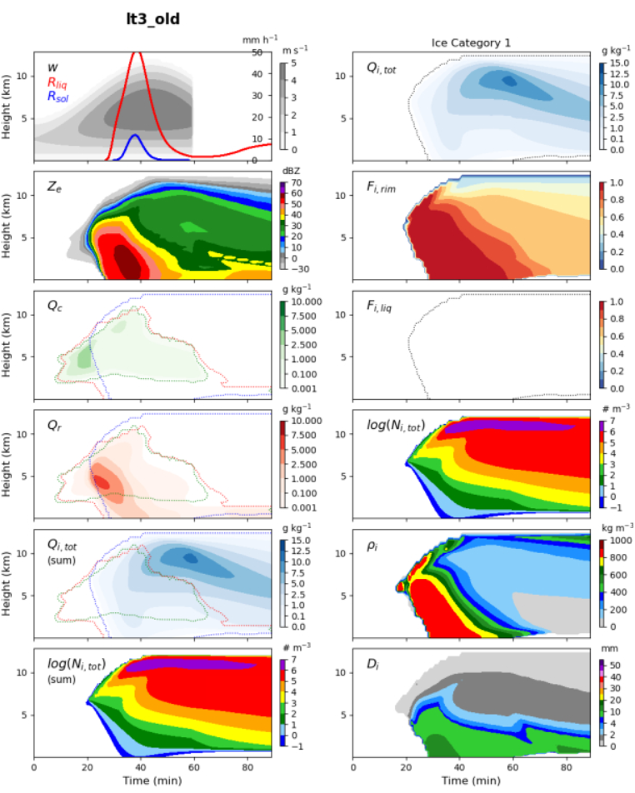
1D v5.4.3+dev-opt vs. v5.4.3+dev-optLT3
3MOMold_noLF_n1 (2.58)
3MOMold_noLF_n1 (2.53)

Slide 17
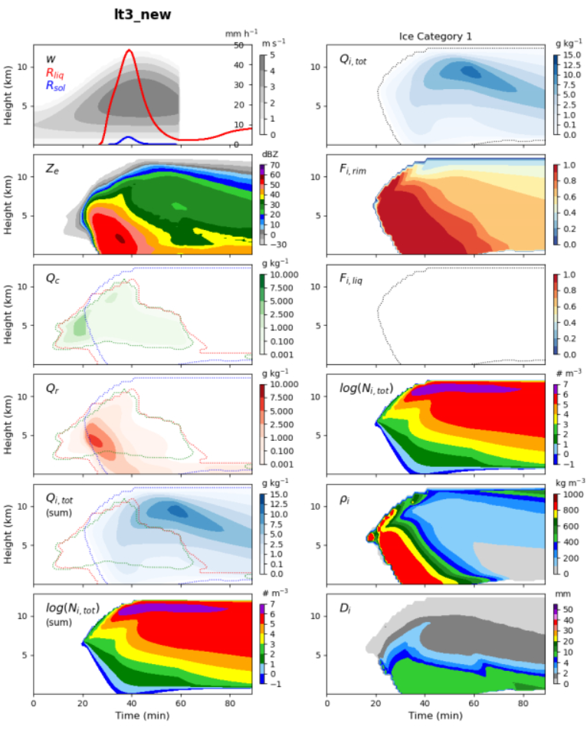
1D v5.4.3+dev-opt vs. v5.4.3+dev-optLT3
3MOMnew_noLF_n1 (3.58)
3MOMnew_noLF_n1 (3.54)

Slide 18
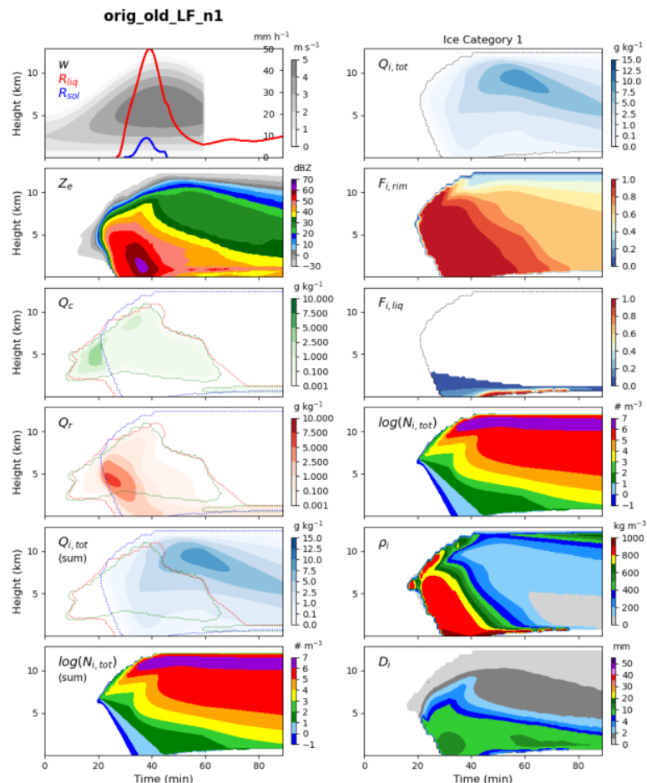
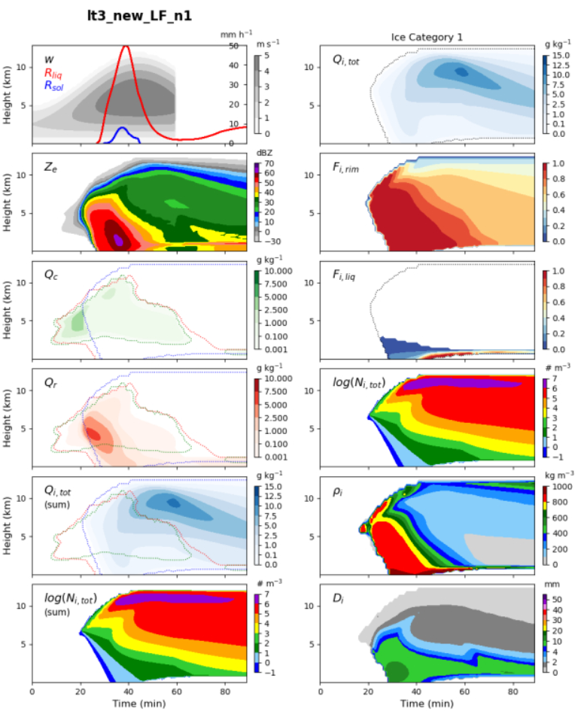
1D v5.4.3+dev-opt vs. v5.4.3+dev-optLT3
3MOMold_LF_n1 (2.98)
3MOMold_LF_n1 (3.01)

Slide 19
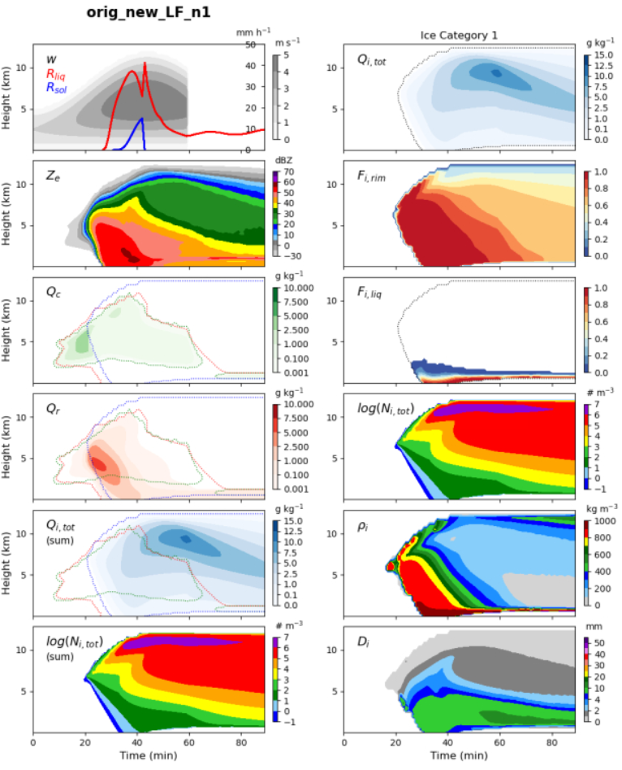
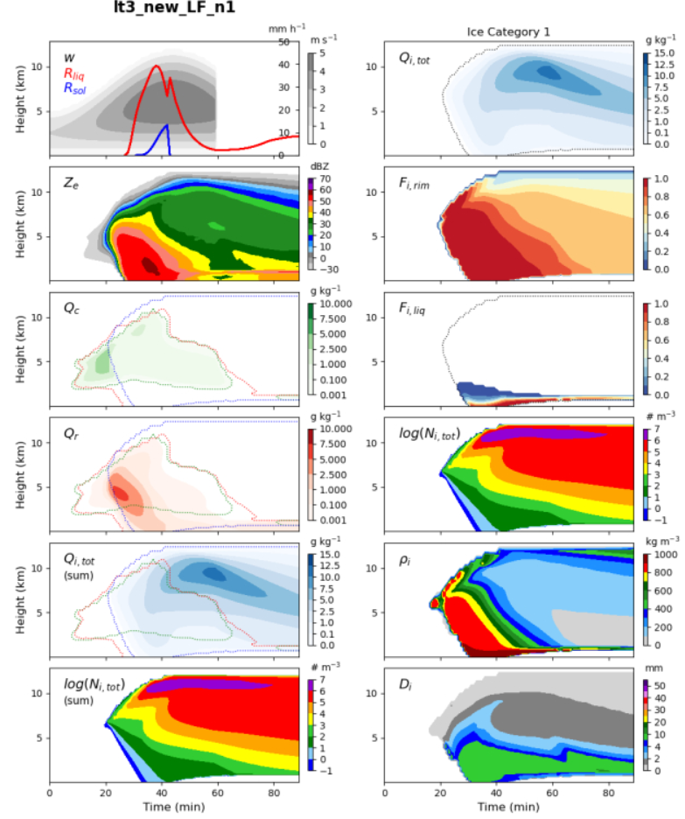
1D v5.4.3+dev-opt vs. v5.4.3+dev-optLT3
3MOMnew_LF_n1 (4.13)
3MOMnew_LF_n1 (4.1)

Slide 20
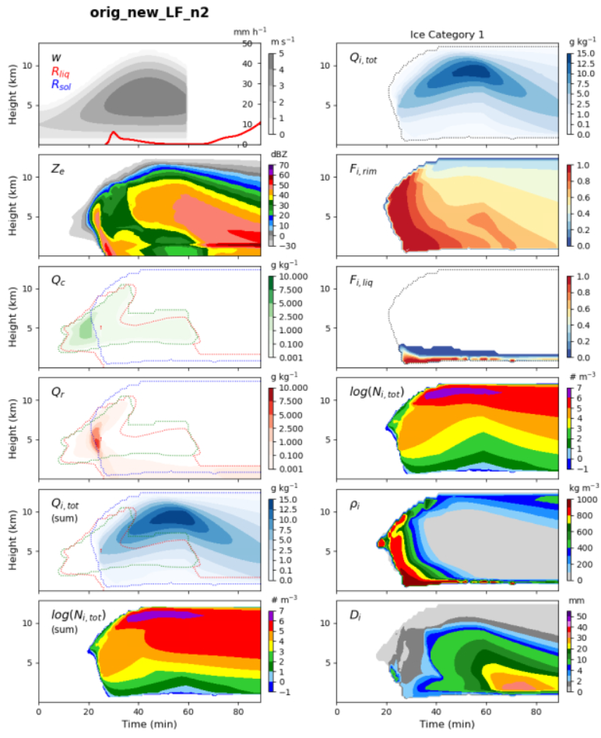
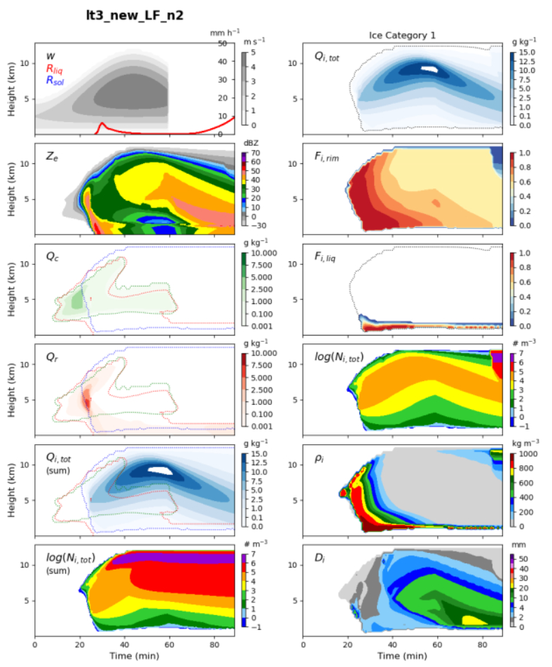
1D v5.4.3+dev-opt vs. v5.4.3+dev-optLT3
3MOMnew_LF_n2 (12.7)
3MOMnew_LF_n2 (13.2)

Slide 21
GEM preliminary results for winter series
2 simulations using 3MOM_LF_n1
5.3.15
5.3.15+LT3-v1.3

Slide 22
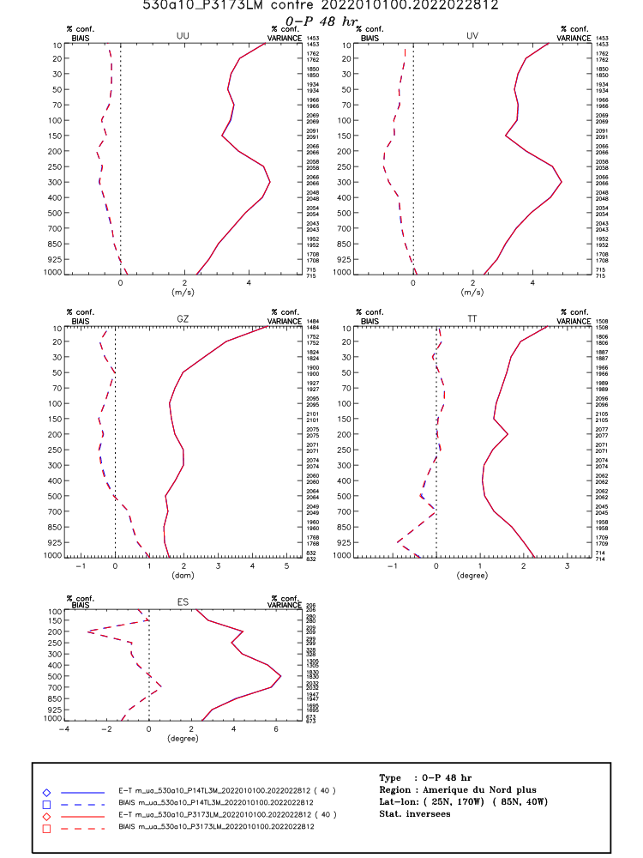
Conclusions
In GEM for winter series the total timing is 6498 for 5.3.14 (prior optimisation), 6277 with 5.3.15 (first round of OPT) and 6144 with the use of LT3 instead of solve_mui. A gain of 2%.
But it is increasing the cold FBI (see next slide).
5.3.15 vs. 5.3.15+LT3-v1.3

Slide 23
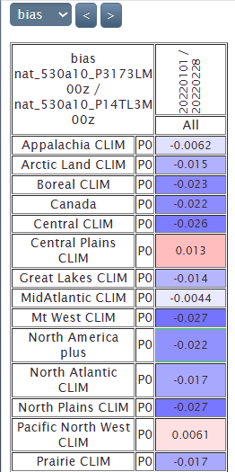
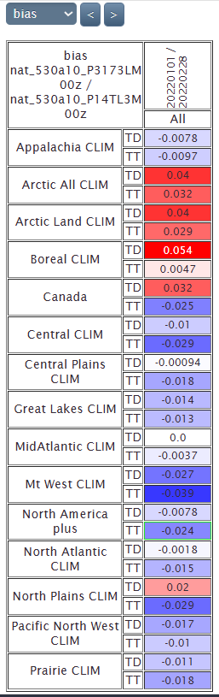
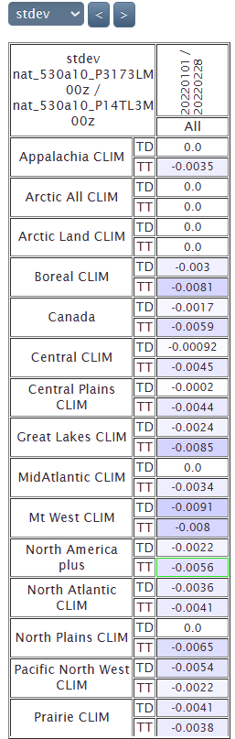
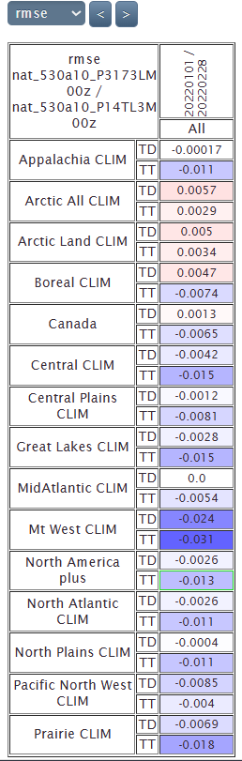
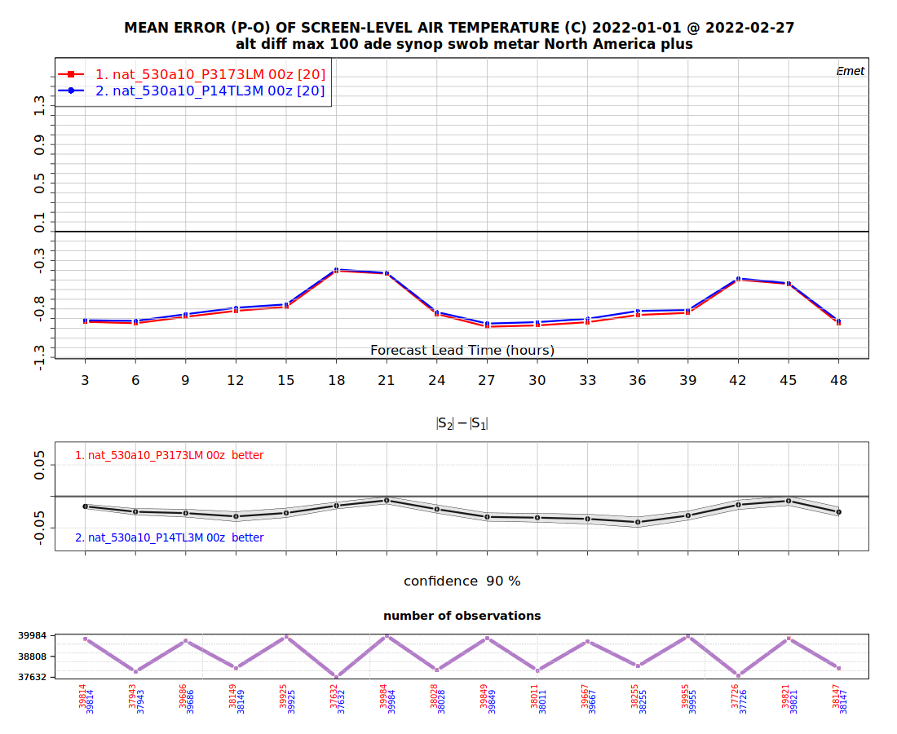
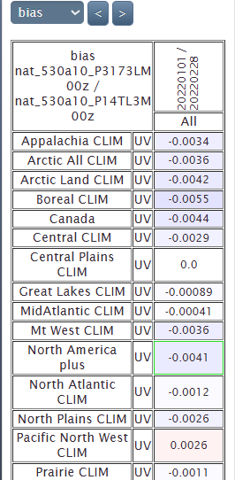
Winter scores v5.3.15 vs. 5.3.15-LT1.3
3MOM-LF
Emet TT, TD, UV, P0
5.3.15 vs. 5.3.15+LT3-v1.3

Slide 24
Winter precipitation scores
To be added

Slide 25
Timing v5.3.15: 3M-LF+dev-optimize (Jason)
HRnat_530a10_P14o23L_2022010100_M_5329719.sc6pbs-001-ib.out.000:oe-00000-00000: Execution time : 6253.9305 seconds (14.10 ms logging)
HRnat_530a10_P14o23L_2022010212_M_5329712.sc6pbs-001-ib.out.000:oe-00000-00000: Execution time : 6589.3261 seconds (14.23 ms logging)
HRnat_530a10_P14o23L_2022010400_M_5329713.sc6pbs-001-ib.out.000:oe-00000-00000: Execution time : 6442.1462 seconds (14.24 ms logging)
HRnat_530a10_P14o23L_2022010512_M_5329716.sc6pbs-001-ib.out.000:oe-00000-00000: Execution time : 6309.4471 seconds (14.32 ms logging)
HRnat_530a10_P14o23L_2022010700_M_5329722.sc6pbs-001-ib.out.000:oe-00000-00000: Execution time : 6483.5052 seconds (14.22 ms logging)
HRnat_530a10_P14o23L_2022010812_M_5329717.sc6pbs-001-ib.out.000:oe-00000-00000: Execution time : 6328.3824 seconds (14.19 ms logging)
HRnat_530a10_P14o23L_2022011000_M_5329724.sc6pbs-001-ib.out.000:oe-00000-00000: Execution time : 6223.7120 seconds (14.76 ms logging)
HRnat_530a10_P14o23L_2022011112_M_5329725.sc6pbs-001-ib.out.000:oe-00000-00000: Execution time : 6254.7443 seconds (13.81 ms logging)
HRnat_530a10_P14o23L_2022011300_M_5329720.sc6pbs-001-ib.out.000:oe-00000-00000: Execution time : 6247.6781 seconds (14.24 ms logging)
HRnat_530a10_P14o23L_2022011412_M_5329715.sc6pbs-001-ib.out.000:oe-00000-00000: Execution time : 6338.6960 seconds (14.25 ms logging)
HRnat_530a10_P14o23L_2022011600_M_5329727.sc6pbs-001-ib.out.000:oe-00000-00000: Execution time : 6272.7617 seconds (14.42 ms logging)
HRnat_530a10_P14o23L_2022011712_M_5329718.sc6pbs-001-ib.out.000:oe-00000-00000: Execution time : 6594.3740 seconds (14.38 ms logging)
HRnat_530a10_P14o23L_2022011900_M_5329714.sc6pbs-001-ib.out.000:oe-00000-00000: Execution time : 6416.1989 seconds (14.38 ms logging)
HRnat_530a10_P14o23L_2022012012_M_5329731.sc6pbs-001-ib.out.000:oe-00000-00000: Execution time : 6355.2092 seconds (14.20 ms logging)
HRnat_530a10_P14o23L_2022012200_M_5329732.sc6pbs-001-ib.out.000:oe-00000-00000: Execution time : 6382.0741 seconds (13.86 ms logging)
HRnat_530a10_P14o23L_2022012312_M_5329735.sc6pbs-001-ib.out.000:oe-00000-00000: Execution time : 6171.8149 seconds (14.09 ms logging)
HRnat_530a10_P14o23L_2022012500_M_5329723.sc6pbs-001-ib.out.000:oe-00000-00000: Execution time : 6147.0140 seconds (14.54 ms logging)
HRnat_530a10_P14o23L_2022012612_M_5329733.sc6pbs-001-ib.out.000:oe-00000-00000: Execution time : 6183.3527 seconds (14.32 ms logging)
HRnat_530a10_P14o23L_2022012800_M_5329737.sc6pbs-001-ib.out.000:oe-00000-00000: Execution time : 6280.9336 seconds (13.98 ms logging)
HRnat_530a10_P14o23L_2022012912_M_5329738.sc6pbs-001-ib.out.000:oe-00000-00000: Execution time : 6637.9957 seconds (14.07 ms logging)
HRnat_530a10_P14o23L_2022013100_M_5330862.sc6pbs-001-ib.out.000:oe-00000-00000: Execution time : 5936.5492 seconds (14.11 ms logging)
HRnat_530a10_P14o23L_2022020112_M_5330865.sc6pbs-001-ib.out.000:oe-00000-00000: Execution time : 6156.1220 seconds (14.20 ms logging)
HRnat_530a10_P14o23L_2022020300_M_5330860.sc6pbs-001-ib.out.000:oe-00000-00000: Execution time : 6363.4273 seconds (14.26 ms logging)
HRnat_530a10_P14o23L_2022020412_M_5330868.sc6pbs-001-ib.out.000:oe-00000-00000: Execution time : 6362.5298 seconds (14.28 ms logging)
HRnat_530a10_P14o23L_2022020600_M_5330938.sc6pbs-001-ib.out.000:oe-00000-00000: Execution time : 6165.0085 seconds (13.95 ms logging)
HRnat_530a10_P14o23L_2022020712_M_5330956.sc6pbs-001-ib.out.000:oe-00000-00000: Execution time : 6257.7985 seconds (14.23 ms logging)
HRnat_530a10_P14o23L_2022020900_M_5330974.sc6pbs-001-ib.out.000:oe-00000-00000: Execution time : 6304.8694 seconds (14.13 ms logging)
HRnat_530a10_P14o23L_2022021012_M_5330962.sc6pbs-001-ib.out.000:oe-00000-00000: Execution time : 6097.0457 seconds (14.28 ms logging)
HRnat_530a10_P14o23L_2022021200_M_5330958.sc6pbs-001-ib.out.000:oe-00000-00000: Execution time : 6095.6607 seconds (14.12 ms logging)
HRnat_530a10_P14o23L_2022021312_M_5330993.sc6pbs-001-ib.out.000:oe-00000-00000: Execution time : 6322.8452 seconds (14.10 ms logging)
HRnat_530a10_P14o23L_2022021500_M_5330985.sc6pbs-001-ib.out.000:oe-00000-00000: Execution time : 6177.0491 seconds (14.50 ms logging)
HRnat_530a10_P14o23L_2022021612_M_5331006.sc6pbs-001-ib.out.000:oe-00000-00000: Execution time : 6344.0081 seconds (14.13 ms logging)
HRnat_530a10_P14o23L_2022021800_M_5331017.sc6pbs-001-ib.out.000:oe-00000-00000: Execution time : 6321.5782 seconds (14.48 ms logging)
HRnat_530a10_P14o23L_2022021912_M_5331030.sc6pbs-001-ib.out.000:oe-00000-00000: Execution time : 6155.8375 seconds (14.20 ms logging)
HRnat_530a10_P14o23L_2022022100_M_5331032.sc6pbs-001-ib.out.000:oe-00000-00000: Execution time : 6112.0270 seconds (14.31 ms logging)
HRnat_530a10_P14o23L_2022022212_M_5331041.sc6pbs-001-ib.out.000:oe-00000-00000: Execution time : 6336.8943 seconds (13.87 ms logging)
HRnat_530a10_P14o23L_2022022400_M_5331048.sc6pbs-001-ib.out.000:oe-00000-00000: Execution time : 6327.3006 seconds (14.31 ms logging)
HRnat_530a10_P14o23L_2022022512_M_5331045.sc6pbs-001-ib.out.000:oe-00000-00000: Execution time : 6182.0517 seconds (13.98 ms logging)
HRnat_530a10_P14o23L_2022022700_M_5331076.sc6pbs-001-ib.out.000:oe-00000-00000: Execution time : 6044.1335 seconds (14.44 ms logging)
HRnat_530a10_P14o23L_2022022812_M_5331094.sc6pbs-001-ib.out.000:oe-00000-00000: Execution time : 6130.4000 seconds (14.40 ms logging)
Mean (3MOM_LF_n1):
251088/40 = seconds (6277)
-3.4% compared to 5.3.14

Slide 26
Timing v5.3.15+3M-LF+LT3 1.3+LF thres
HRnat_530a10_P3173LM_2022010100_M_5563251.sc6pbs-001-ib.out.000:oe-00000-00000: Execution time : 6154.3708 seconds (13.82 ms logging)
HRnat_530a10_P3173LM_2022010212_M_5563260.sc6pbs-001-ib.out.000:oe-00000-00000: Execution time : 6456.3903 seconds (14.09 ms logging)
HRnat_530a10_P3173LM_2022010400_M_5563252.sc6pbs-001-ib.out.000:oe-00000-00000: Execution time : 6292.1047 seconds (13.92 ms logging)
HRnat_530a10_P3173LM_2022010512_M_5563259.sc6pbs-001-ib.out.000:oe-00000-00000: Execution time : 6192.1009 seconds (14.04 ms logging)
HRnat_530a10_P3173LM_2022010700_M_5563261.sc6pbs-001-ib.out.000:oe-00000-00000: Execution time : 6400.0747 seconds (14.12 ms logging)
HRnat_530a10_P3173LM_2022010812_M_5563266.sc6pbs-001-ib.out.000:oe-00000-00000: Execution time : 6180.3245 seconds (14.11 ms logging)
HRnat_530a10_P3173LM_2022011000_M_5563268.sc6pbs-001-ib.out.000:oe-00000-00000: Execution time : 6092.6184 seconds (14.18 ms logging)
HRnat_530a10_P3173LM_2022011112_M_5563267.sc6pbs-001-ib.out.000:oe-00000-00000: Execution time : 6122.5845 seconds (14.26 ms logging)
HRnat_530a10_P3173LM_2022011300_M_5563262.sc6pbs-001-ib.out.000:oe-00000-00000: Execution time : 6129.4528 seconds (14.45 ms logging)
HRnat_530a10_P3173LM_2022011412_M_5563269.sc6pbs-001-ib.out.000:oe-00000-00000: Execution time : 6256.4273 seconds (14.30 ms logging)
HRnat_530a10_P3173LM_2022011600_M_5563270.sc6pbs-001-ib.out.000:oe-00000-00000: Execution time : 6194.2966 seconds (14.11 ms logging)
HRnat_530a10_P3173LM_2022011712_M_5563255.sc6pbs-001-ib.out.000:oe-00000-00000: Execution time : 6365.5064 seconds (14.33 ms logging)
HRnat_530a10_P3173LM_2022011900_M_5563253.sc6pbs-001-ib.out.000:oe-00000-00000: Execution time : 6198.7022 seconds (14.11 ms logging)
HRnat_530a10_P3173LM_2022012012_M_5563254.sc6pbs-001-ib.out.000:oe-00000-00000: Execution time : 6185.8009 seconds (14.55 ms logging)
HRnat_530a10_P3173LM_2022012200_M_5563256.sc6pbs-001-ib.out.000:oe-00000-00000: Execution time : 6223.6950 seconds (13.92 ms logging)
HRnat_530a10_P3173LM_2022012312_M_5563257.sc6pbs-001-ib.out.000:oe-00000-00000: Execution time : 6016.7671 seconds (14.23 ms logging)
HRnat_530a10_P3173LM_2022012500_M_5563265.sc6pbs-001-ib.out.000:oe-00000-00000: Execution time : 5992.2112 seconds (13.96 ms logging)
HRnat_530a10_P3173LM_2022012612_M_5563271.sc6pbs-001-ib.out.000:oe-00000-00000: Execution time : 6058.1623 seconds (13.99 ms logging)
HRnat_530a10_P3173LM_2022012800_M_5563273.sc6pbs-001-ib.out.000:oe-00000-00000: Execution time : 6170.5694 seconds (14.28 ms logging)
HRnat_530a10_P3173LM_2022012912_M_5563272.sc6pbs-001-ib.out.000:oe-00000-00000: Execution time : 6472.8448 seconds (13.83 ms logging)
HRnat_530a10_P3173LM_2022013100_M_5566774.sc6pbs-001-ib.out.000:oe-00000-00000: Execution time : 5846.9303 seconds (14.34 ms logging)
HRnat_530a10_P3173LM_2022020112_M_5566791.sc6pbs-001-ib.out.000:oe-00000-00000: Execution time : 6057.8805 seconds (14.47 ms logging)
HRnat_530a10_P3173LM_2022020300_M_5566818.sc6pbs-001-ib.out.000:oe-00000-00000: Execution time : 6205.7675 seconds (14.15 ms logging)
HRnat_530a10_P3173LM_2022020412_M_5566817.sc6pbs-001-ib.out.000:oe-00000-00000: Execution time : 6207.5682 seconds (14.44 ms logging)
HRnat_530a10_P3173LM_2022020600_M_5566820.sc6pbs-001-ib.out.000:oe-00000-00000: Execution time : 6059.6377 seconds (14.12 ms logging)
HRnat_530a10_P3173LM_2022020712_M_5566826.sc6pbs-001-ib.out.000:oe-00000-00000: Execution time : 6136.9777 seconds (14.21 ms logging)
HRnat_530a10_P3173LM_2022020900_M_5566828.sc6pbs-001-ib.out.000:oe-00000-00000: Execution time : 6195.0999 seconds (14.00 ms logging)
HRnat_530a10_P3173LM_2022021012_M_5566832.sc6pbs-001-ib.out.000:oe-00000-00000: Execution time : 5939.1378 seconds (13.72 ms logging)
HRnat_530a10_P3173LM_2022021200_M_5567074.sc6pbs-001-ib.out.000:oe-00000-00000: Execution time : 5946.0589 seconds (13.91 ms logging)
HRnat_530a10_P3173LM_2022021312_M_5567076.sc6pbs-001-ib.out.000:oe-00000-00000: Execution time : 6158.3531 seconds (14.00 ms logging)
HRnat_530a10_P3173LM_2022021500_M_5567075.sc6pbs-001-ib.out.000:oe-00000-00000: Execution time : 5967.5896 seconds (14.18 ms logging)
HRnat_530a10_P3173LM_2022021612_M_5567077.sc6pbs-001-ib.out.000:oe-00000-00000: Execution time : 6155.7673 seconds (14.19 ms logging)
HRnat_530a10_P3173LM_2022021800_M_5567102.sc6pbs-001-ib.out.000:oe-00000-00000: Execution time : 6186.2816 seconds (14.05 ms logging)
HRnat_530a10_P3173LM_2022021912_M_5567078.sc6pbs-001-ib.out.000:oe-00000-00000: Execution time : 6061.7717 seconds (14.23 ms logging)
HRnat_530a10_P3173LM_2022022100_M_5567107.sc6pbs-001-ib.out.000:oe-00000-00000: Execution time : 5958.5256 seconds (14.02 ms logging)
HRnat_530a10_P3173LM_2022022212_M_5567108.sc6pbs-001-ib.out.000:oe-00000-00000: Execution time : 6168.6899 seconds (14.34 ms logging)
HRnat_530a10_P3173LM_2022022400_M_5567111.sc6pbs-001-ib.out.000:oe-00000-00000: Execution time : 6213.5317 seconds (14.32 ms logging)
HRnat_530a10_P3173LM_2022022512_M_5567109.sc6pbs-001-ib.out.000:oe-00000-00000: Execution time : 6115.8415 seconds (14.15 ms logging)
HRnat_530a10_P3173LM_2022022700_M_5567110.sc6pbs-001-ib.out.000:oe-00000-00000: Execution time : 6020.5913 seconds (14.06 ms logging)
HRnat_530a10_P3173LM_2022022812_M_5567124.sc6pbs-001-ib.out.000:oe-00000-00000: Execution time : 6051.5388 seconds (14.31 ms logging)
Mean (3MOM_LF_n1):
245788/40 = seconds (6144)
-5.4% compared to 5.3.14
-2.1% compared to 5.3.15

Slide 27
Timing v5.3.14FL3M winter
HRnat_530a10_P14TL3M_2022010100_M_4573033.sc6pbs-001-ib.out.000:oe-00000-00000: Execution time : 6602.8478 seconds (14.09 ms logging)
HRnat_530a10_P14TL3M_2022010212_M_4573059.sc6pbs-001-ib.out.000:oe-00000-00000: Execution time : 7076.1070 seconds (14.16 ms logging)
HRnat_530a10_P14TL3M_2022010400_M_4573036.sc6pbs-001-ib.out.000:oe-00000-00000: Execution time : 6830.1561 seconds (14.30 ms logging)
HRnat_530a10_P14TL3M_2022010512_M_4573058.sc6pbs-001-ib.out.000:oe-00000-00000: Execution time : 6670.1400 seconds (14.21 ms logging)
HRnat_530a10_P14TL3M_2022010700_M_4573057.sc6pbs-001-ib.out.000:oe-00000-00000: Execution time : 6909.7215 seconds (13.92 ms logging)
HRnat_530a10_P14TL3M_2022010812_M_4573054.sc6pbs-001-ib.out.000:oe-00000-00000: Execution time : 6700.1883 seconds (14.07 ms logging)
HRnat_530a10_P14TL3M_2022011000_M_4573056.sc6pbs-001-ib.out.000:oe-00000-00000: Execution time : 6570.0106 seconds (14.01 ms logging)
HRnat_530a10_P14TL3M_2022011112_M_4573061.sc6pbs-001-ib.out.000:oe-00000-00000: Execution time : 6676.4408 seconds (14.08 ms logging)
HRnat_530a10_P14TL3M_2022011300_M_4573065.sc6pbs-001-ib.out.000:oe-00000-00000: Execution time : 6609.2287 seconds (14.58 ms logging)
HRnat_530a10_P14TL3M_2022011412_M_4573069.sc6pbs-001-ib.out.000:oe-00000-00000: Execution time : 6758.3806 seconds (13.86 ms logging)
HRnat_530a10_P14TL3M_2022011600_M_4573067.sc6pbs-001-ib.out.000:oe-00000-00000: Execution time : 6671.1626 seconds (13.80 ms logging)
HRnat_530a10_P14TL3M_2022011712_M_4573072.sc6pbs-001-ib.out.000:oe-00000-00000: Execution time : 7122.0449 seconds (14.16 ms logging)
HRnat_530a10_P14TL3M_2022011900_M_4573068.sc6pbs-001-ib.out.000:oe-00000-00000: Execution time : 6799.9311 seconds (14.24 ms logging)
HRnat_530a10_P14TL3M_2022012012_M_4573071.sc6pbs-001-ib.out.000:oe-00000-00000: Execution time : 6796.2416 seconds (13.88 ms logging)
HRnat_530a10_P14TL3M_2022012200_M_4573073.sc6pbs-001-ib.out.000:oe-00000-00000: Execution time : 6827.7273 seconds (14.28 ms logging)
HRnat_530a10_P14TL3M_2022012312_M_4573035.sc6pbs-001-ib.out.000:oe-00000-00000: Execution time : 6560.3851 seconds (14.05 ms logging)
HRnat_530a10_P14TL3M_2022012500_M_4573062.sc6pbs-001-ib.out.000:oe-00000-00000: Execution time : 6483.3155 seconds (14.22 ms logging)
HRnat_530a10_P14TL3M_2022012612_M_4573060.sc6pbs-001-ib.out.000:oe-00000-00000: Execution time : 6551.4251 seconds (14.70 ms logging)
HRnat_530a10_P14TL3M_2022012800_M_4573066.sc6pbs-001-ib.out.000:oe-00000-00000: Execution time : 6608.6021 seconds (14.31 ms logging)
HRnat_530a10_P14TL3M_2022012912_M_4573063.sc6pbs-001-ib.out.000:oe-00000-00000: Execution time : 7121.2519 seconds (13.89 ms logging)
HRnat_530a10_P14TL3M_2022013100_M_4573920.sc6pbs-001-ib.out.000:oe-00000-00000: Execution time : 6217.8572 seconds (14.07 ms logging)
HRnat_530a10_P14TL3M_2022020112_M_4573921.sc6pbs-001-ib.out.000:oe-00000-00000: Execution time : 6565.1633 seconds (14.12 ms logging)
HRnat_530a10_P14TL3M_2022020300_M_4573925.sc6pbs-001-ib.out.000:oe-00000-00000: Execution time : 6809.6734 seconds (14.05 ms logging)
HRnat_530a10_P14TL3M_2022020412_M_4574066.sc6pbs-001-ib.out.000:oe-00000-00000: Execution time : 6760.8974 seconds (14.07 ms logging)
HRnat_530a10_P14TL3M_2022020600_M_4574067.sc6pbs-001-ib.out.000:oe-00000-00000: Execution time : 6483.3920 seconds (13.95 ms logging)
HRnat_530a10_P14TL3M_2022020712_M_4574124.sc6pbs-001-ib.out.000:oe-00000-00000: Execution time : 6589.7529 seconds (14.17 ms logging)
HRnat_530a10_P14TL3M_2022020900_M_4574128.sc6pbs-001-ib.out.000:oe-00000-00000: Execution time : 6685.1644 seconds (14.19 ms logging)
HRnat_530a10_P14TL3M_2022021012_M_4574159.sc6pbs-001-ib.out.000:oe-00000-00000: Execution time : 6398.4372 seconds (13.91 ms logging)
HRnat_530a10_P14TL3M_2022021200_M_4574140.sc6pbs-001-ib.out.000:oe-00000-00000: Execution time : 6347.3886 seconds (14.29 ms logging)
HRnat_530a10_P14TL3M_2022021312_M_4574152.sc6pbs-001-ib.out.000:oe-00000-00000: Execution time : 6702.8717 seconds (14.07 ms logging)
HRnat_530a10_P14TL3M_2022021500_M_4574166.sc6pbs-001-ib.out.000:oe-00000-00000: Execution time : 6482.4028 seconds (14.27 ms logging)
HRnat_530a10_P14TL3M_2022021612_M_4574190.sc6pbs-001-ib.out.000:oe-00000-00000: Execution time : 6732.6073 seconds (14.54 ms logging)
HRnat_530a10_P14TL3M_2022021800_M_4574193.sc6pbs-001-ib.out.000:oe-00000-00000: Execution time : 6636.8613 seconds (13.84 ms logging)
HRnat_530a10_P14TL3M_2022021912_M_4574207.sc6pbs-001-ib.out.000:oe-00000-00000: Execution time : 6496.5478 seconds (14.01 ms logging)
HRnat_530a10_P14TL3M_2022022100_M_4574205.sc6pbs-001-ib.out.000:oe-00000-00000: Execution time : 6493.8271 seconds (14.00 ms logging)
HRnat_530a10_P14TL3M_2022022212_M_4574216.sc6pbs-001-ib.out.000:oe-00000-00000: Execution time : 6819.2784 seconds (14.23 ms logging)
HRnat_530a10_P14TL3M_2022022400_M_4574241.sc6pbs-001-ib.out.000:oe-00000-00000: Execution time : 6810.6079 seconds (13.93 ms logging)
HRnat_530a10_P14TL3M_2022022512_M_4574272.sc6pbs-001-ib.out.000:oe-00000-00000: Execution time : 6536.6468 seconds (14.25 ms logging)
HRnat_530a10_P14TL3M_2022022700_M_4574278.sc6pbs-001-ib.out.000:oe-00000-00000: Execution time : 6362.7212 seconds (13.99 ms logging)
HRnat_530a10_P14TL3M_2022022812_M_4574295.sc6pbs-001-ib.out.000:oe-00000-00000: Execution time : 6454.1240 seconds (13.99 ms logging)
Mean (3MOM_LF_n1):
259951/40 = 6498 seconds

Slide 28
Appendix: Other results

Slide 29
New LT3-v1.3
It uses same indices as for LT1 except the one for mu_i, which is changed to either Z/Q or Z*N/Q^2
zqsize = 80, 100 or 200 (this does not have impact in 1D, therefore zqsize of 80 is choose).
LT3-v1.0: Z_value = 2.1**(i_Znorm)*1.e-23 ! range from 2x10^(-23) to 600 using 80 values (when Z/Q)
LT3-v2.0: Z_value = 10.**(10./99.*i_Znorm-6.1010) ! range from 0.000001 to 10000 using 100 values (when Z*N/Q^2)
New LT3 index

Slide 30


Indices 100 vs. 200

Slide 31



Impacts of using Z/Q vs. Z*N/Q^2
3MOM-noLF-n1
It gives very similar results.
So we’ll continue with Z/Q (80 indices)

Slide 32
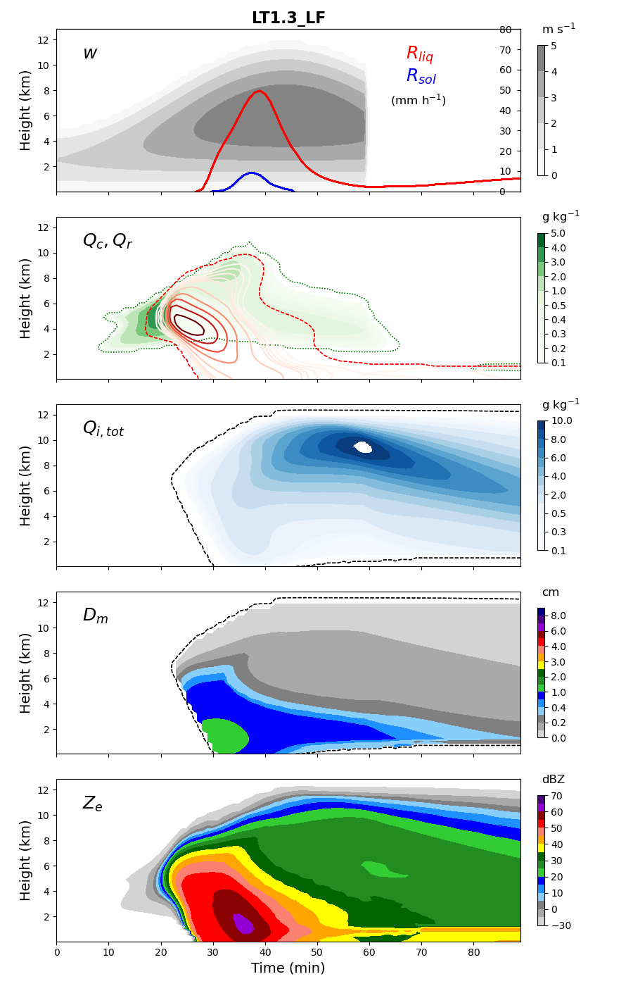
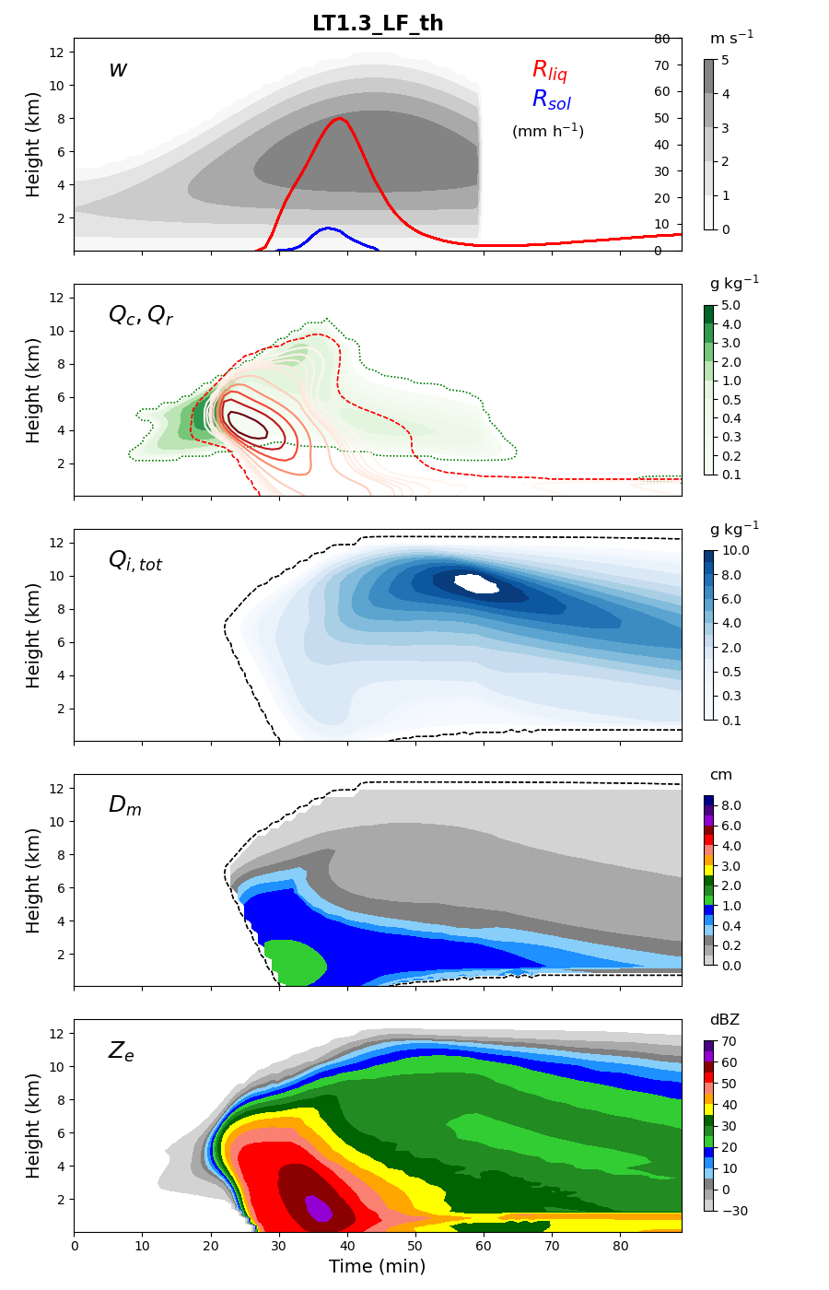
Note
The version using LT3-v1.3 also includes threshold for when Filiq<0.01. This did not changed anything in both 1D and LF for timing, but it changes the solution a bit in 1D.

Slide 33
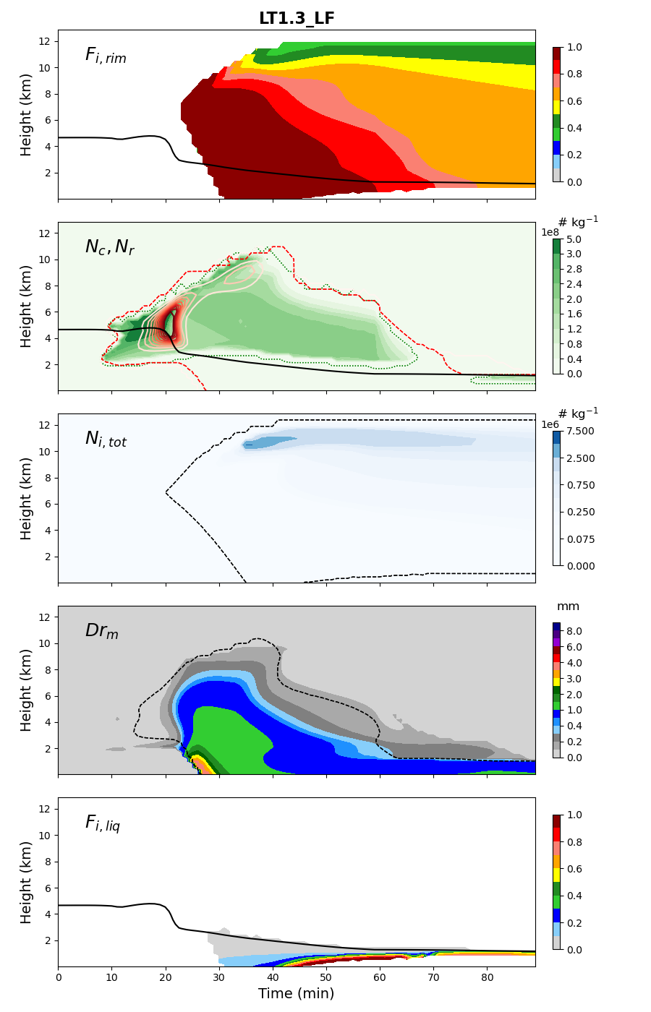

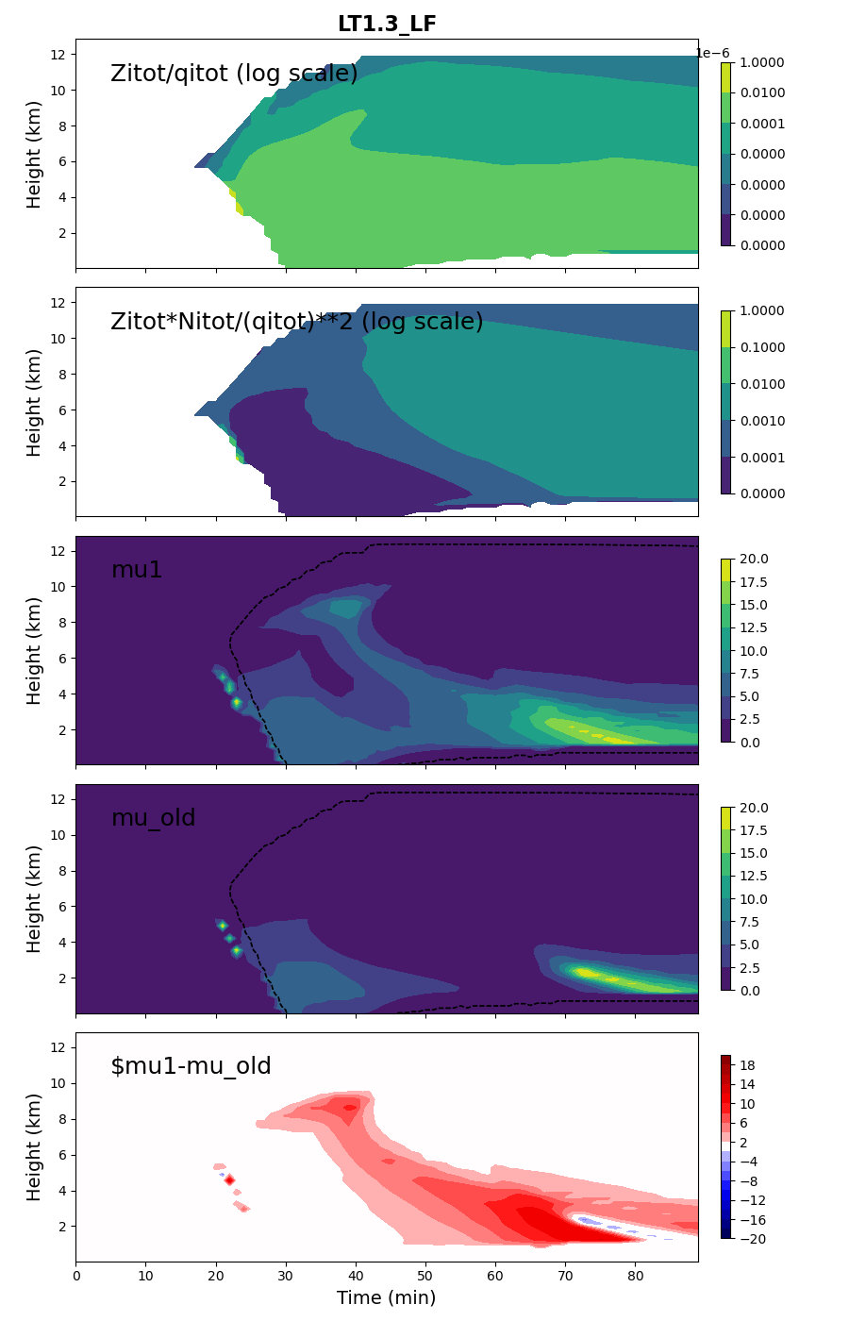


Slide 34
