Slide 1
Compte_mui v5.4.3
Melissa Cholette
May 2025

Slide 2
1D configurations
3 simulations
V5.4.3+dev-opt: CONTROL
V5.4.3+dev-opt+LT3-v1.3: replace mu_i approach with LT3-v1.3
V5.4.3+dev-opt+LT3-v1.4: for full3mom

Slide 3
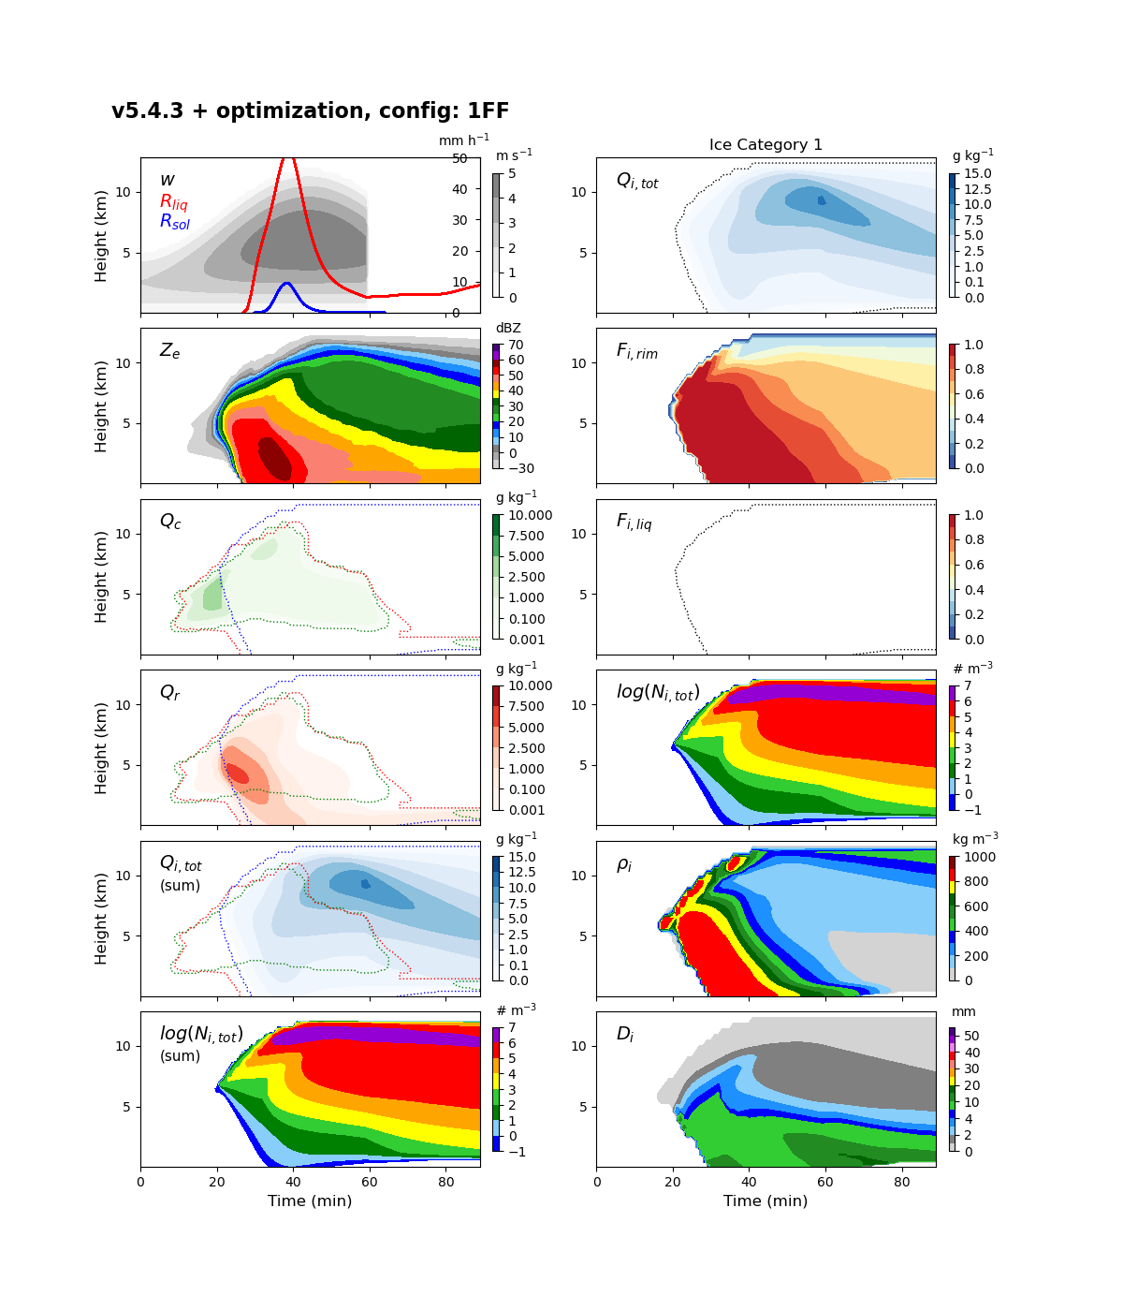
CTL: Old vs. new (3-moment)
1.24
1.26

Slide 4
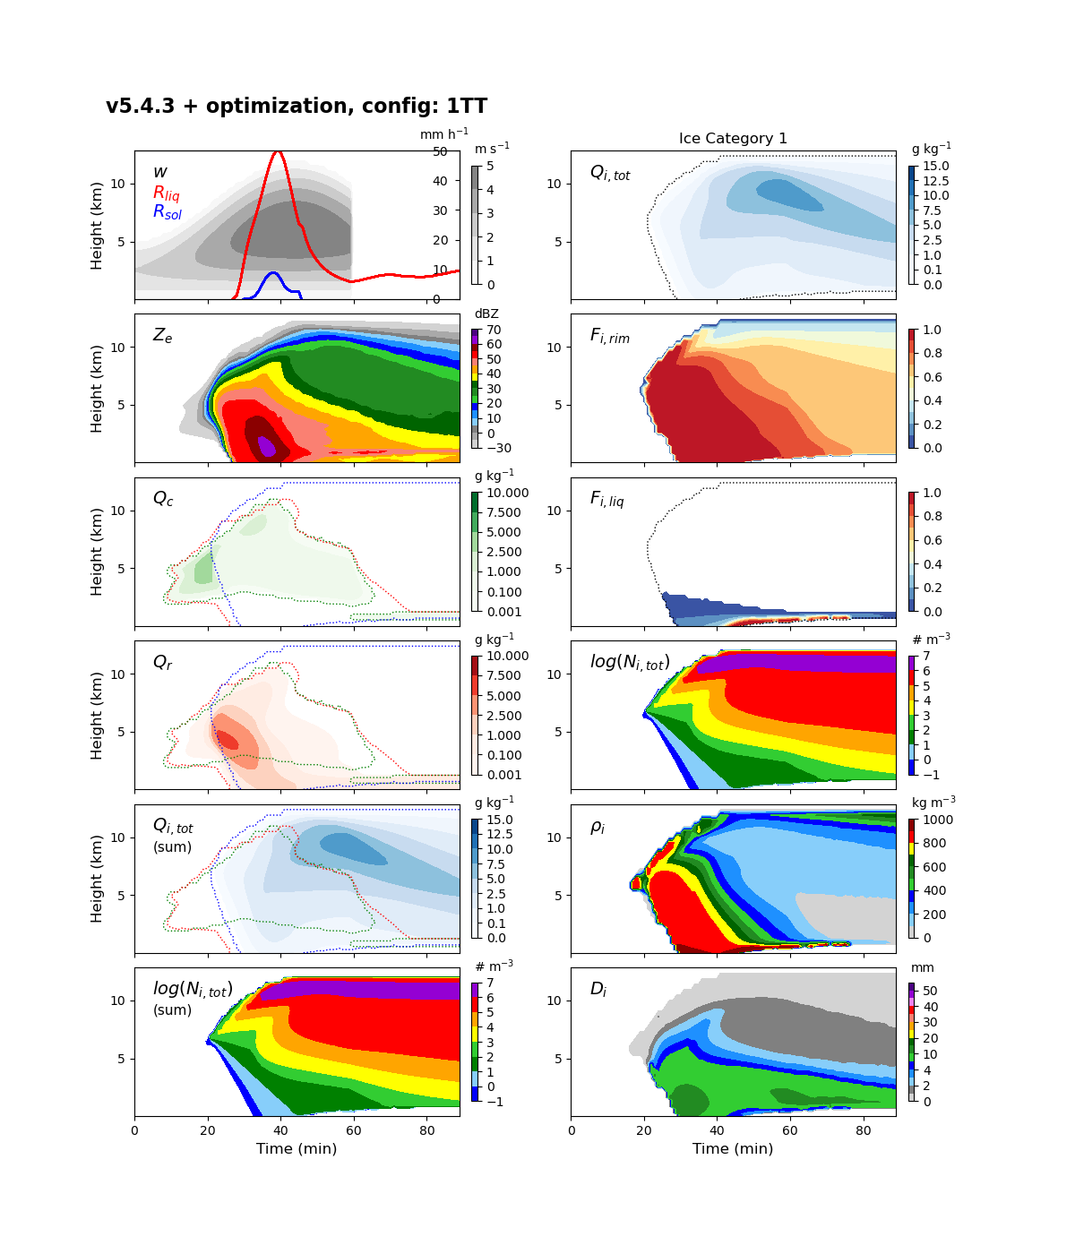
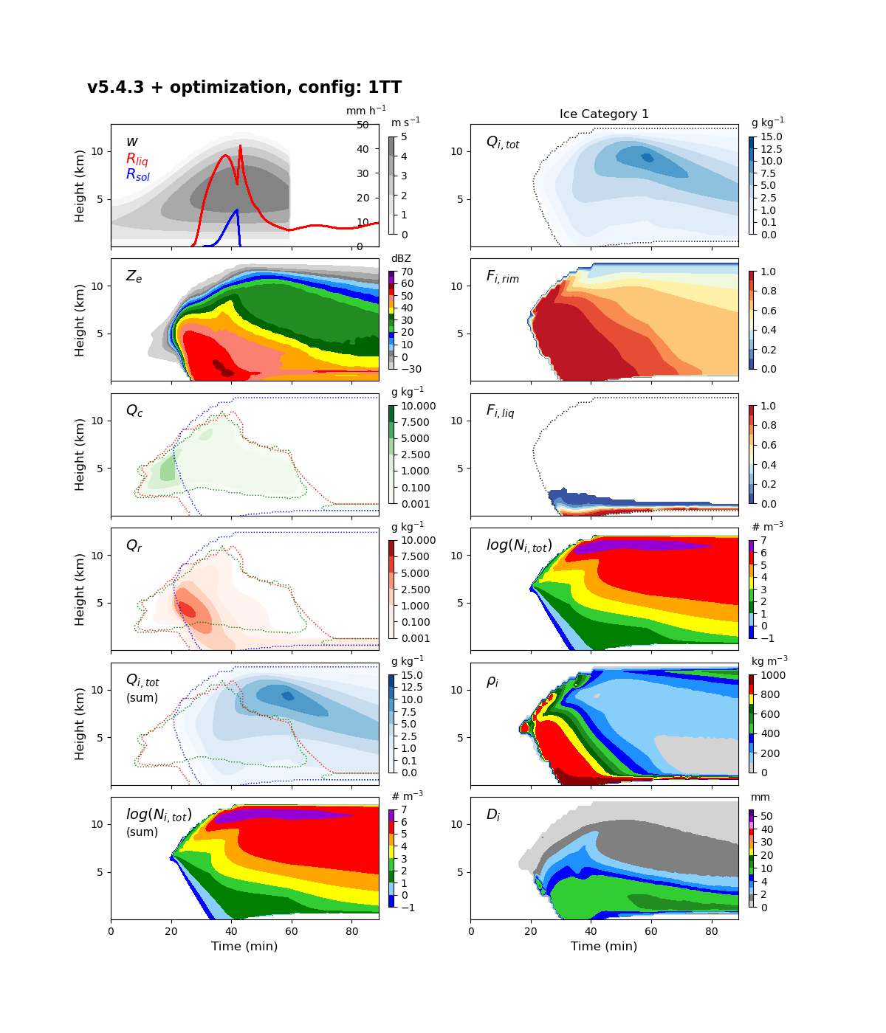
CTL: Old vs. new (3-moment)
3.01
4.12

Slide 5
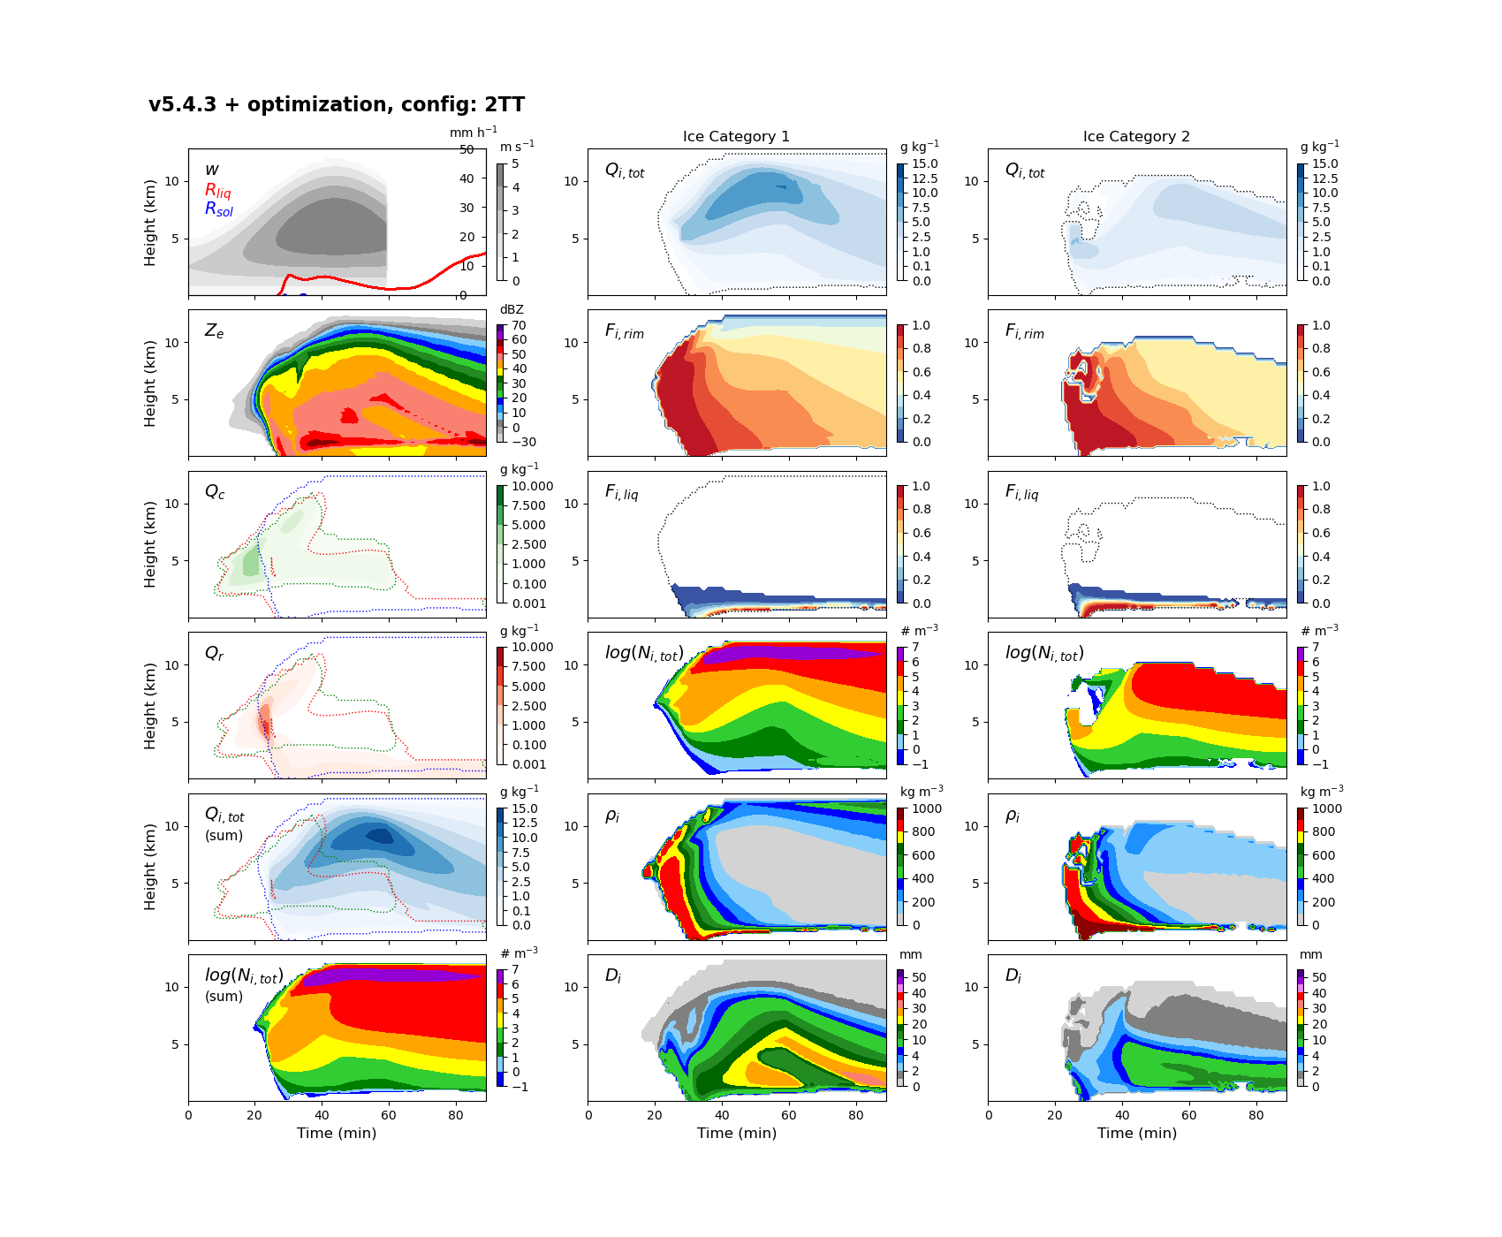
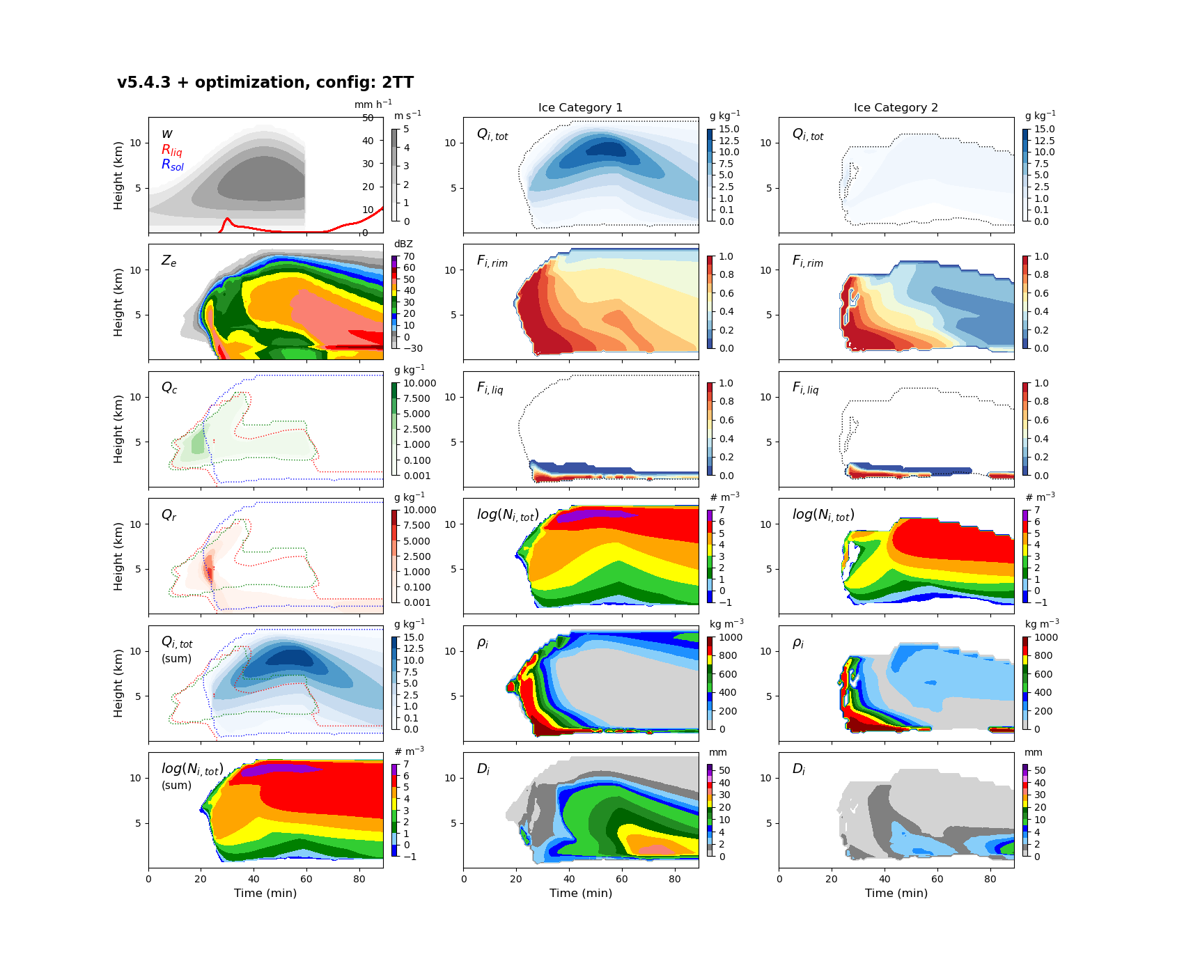
CTL: Old vs. new (3-moment)
11.43
12.7

Slide 6
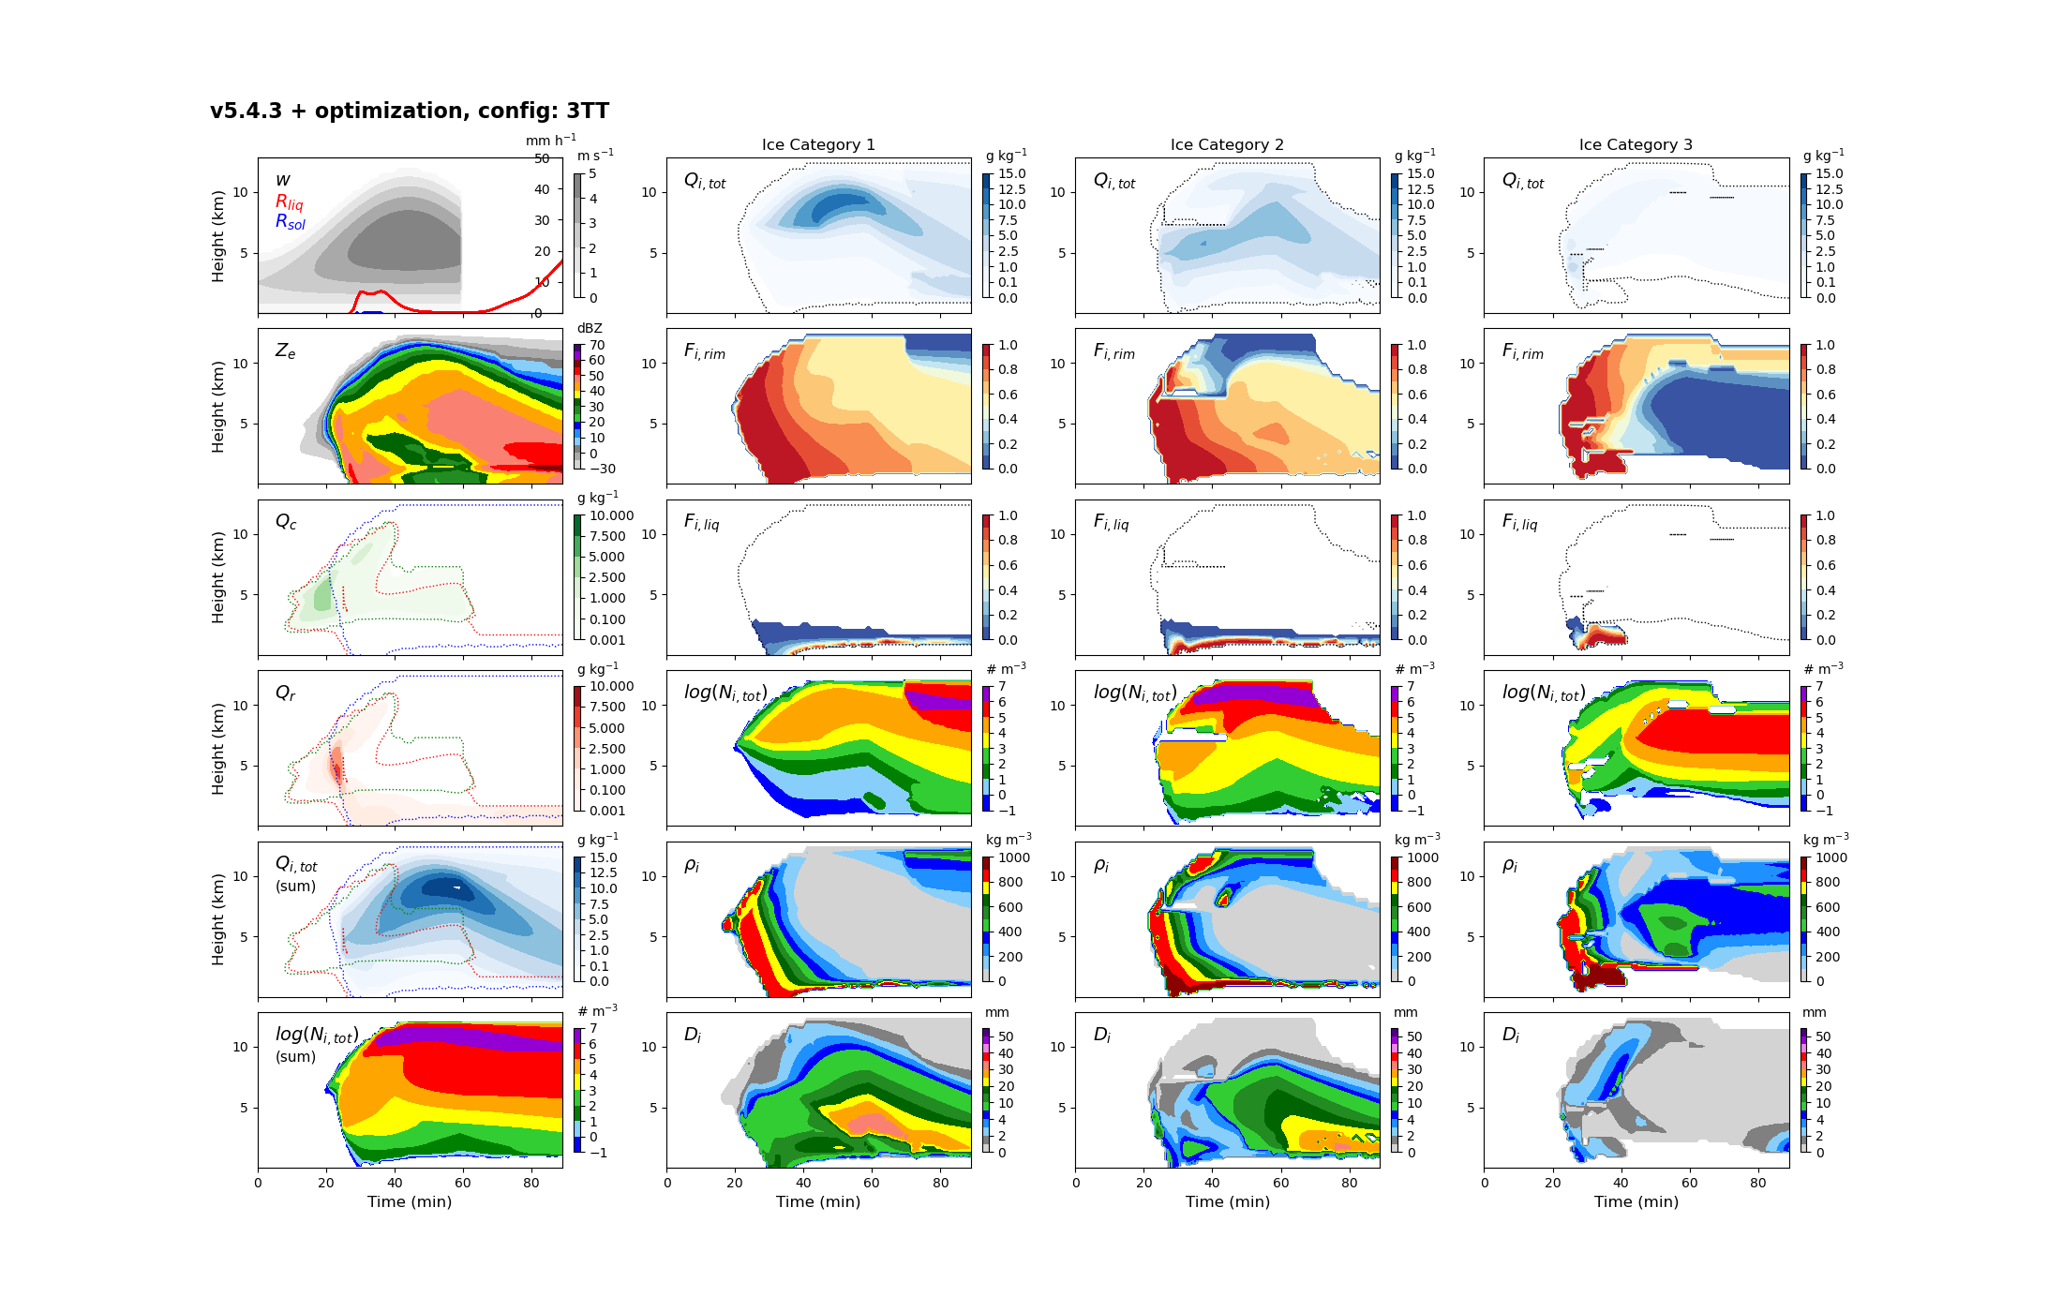
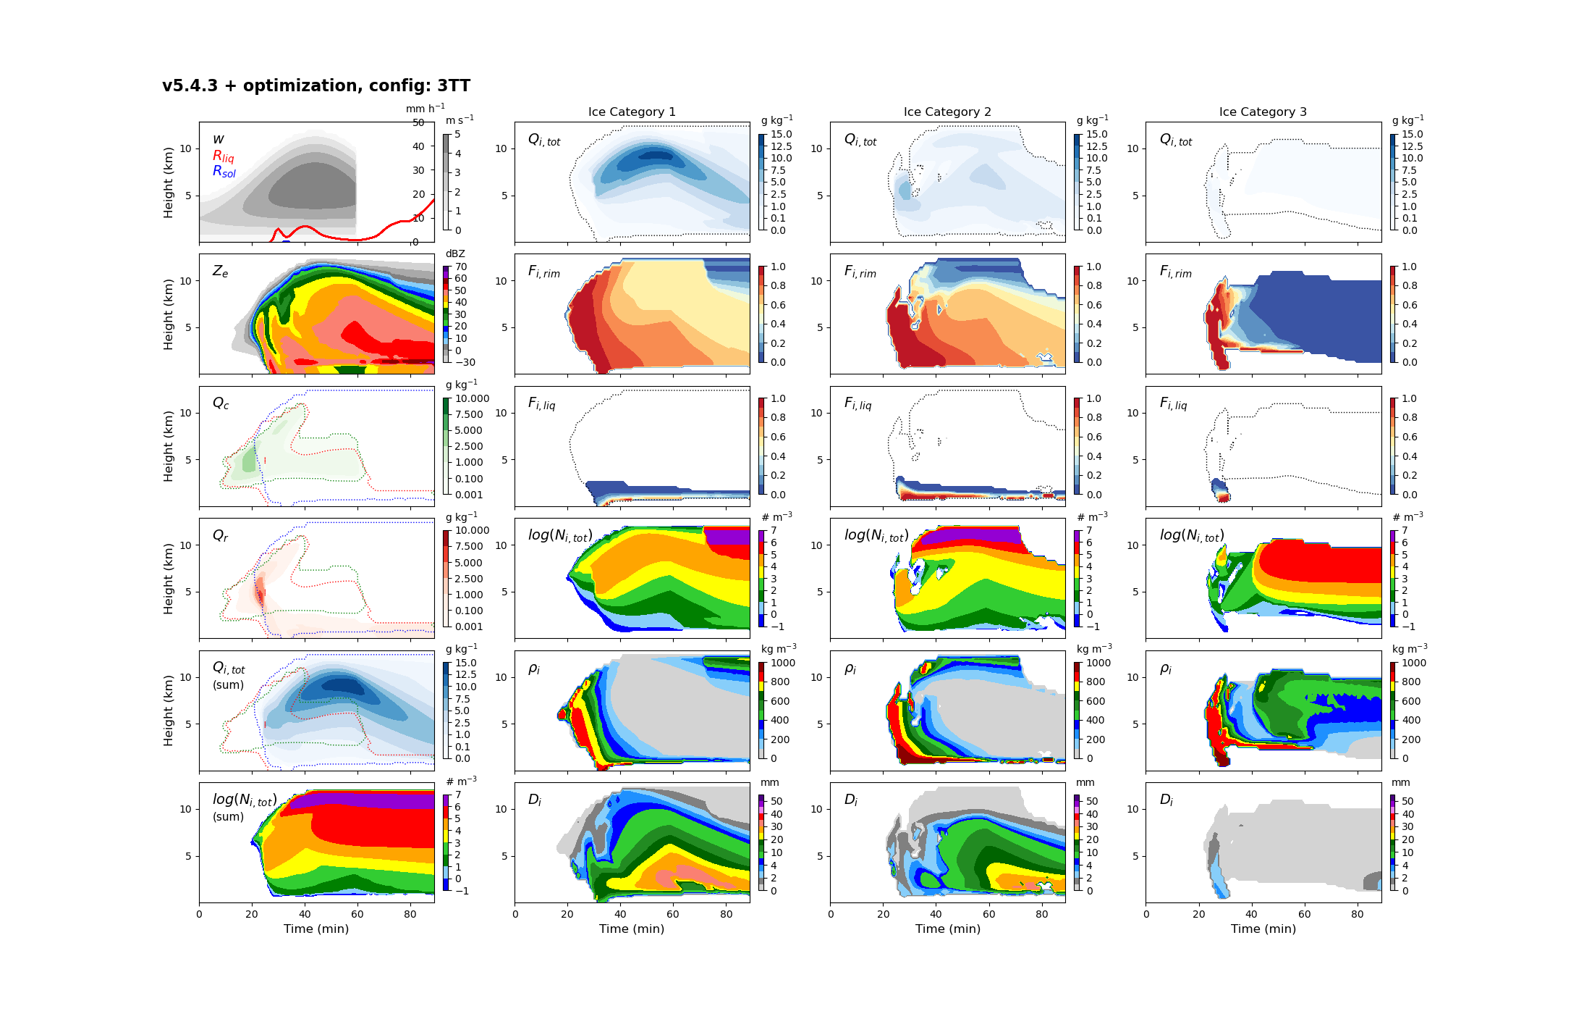
CTL: Old vs. new (3-moment)
22.97
23.84

Slide 8
CTL vs. LT3-v1.3 (OLD_3MOM)
1.24
1.26

Slide 9
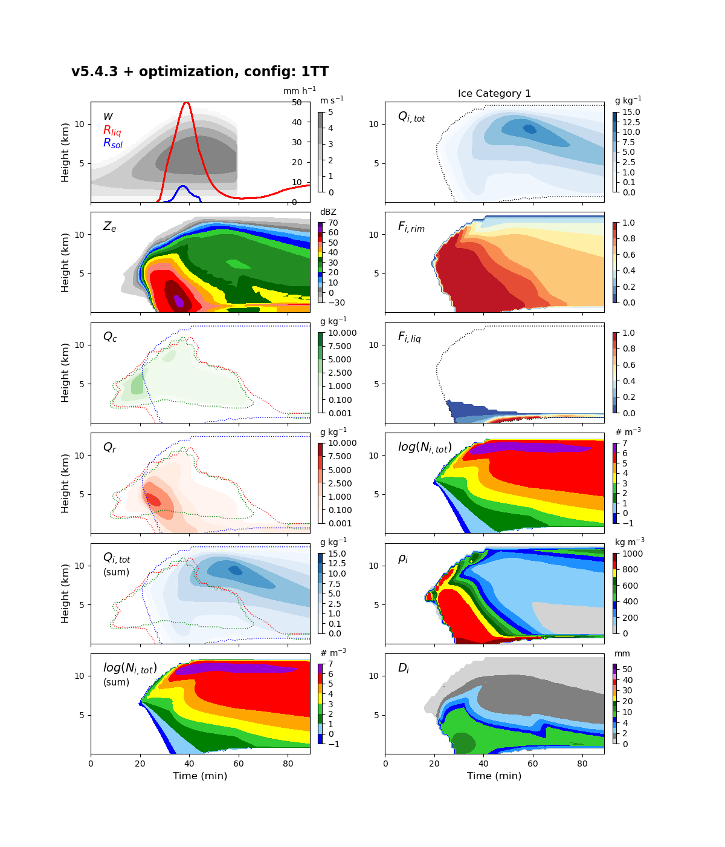
CTL vs. LT3-v1.3 (OLD_3MOM)
3.01
3.01

Slide 10
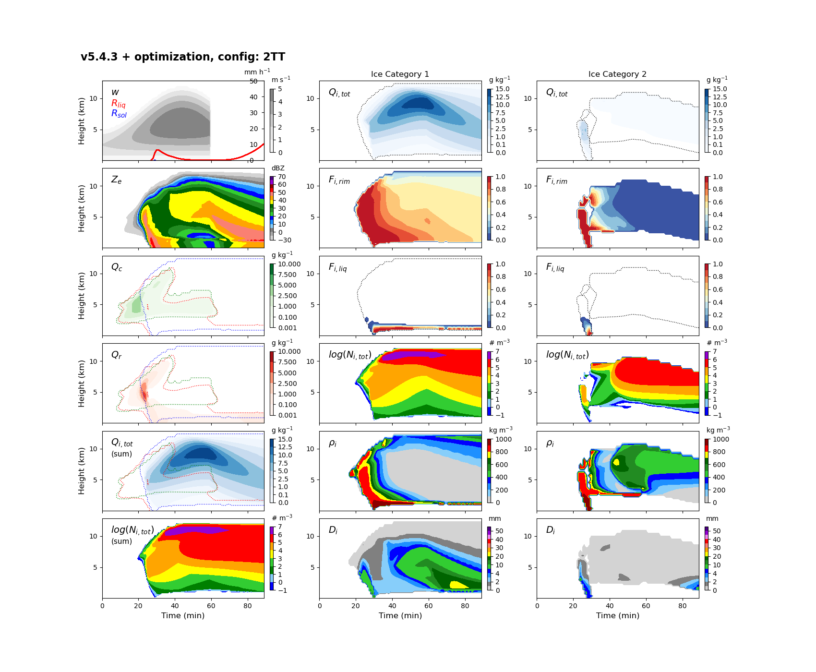
CTL vs. LT3-v1.3 (OLD_3MOM)
11.43
9.03

Slide 11
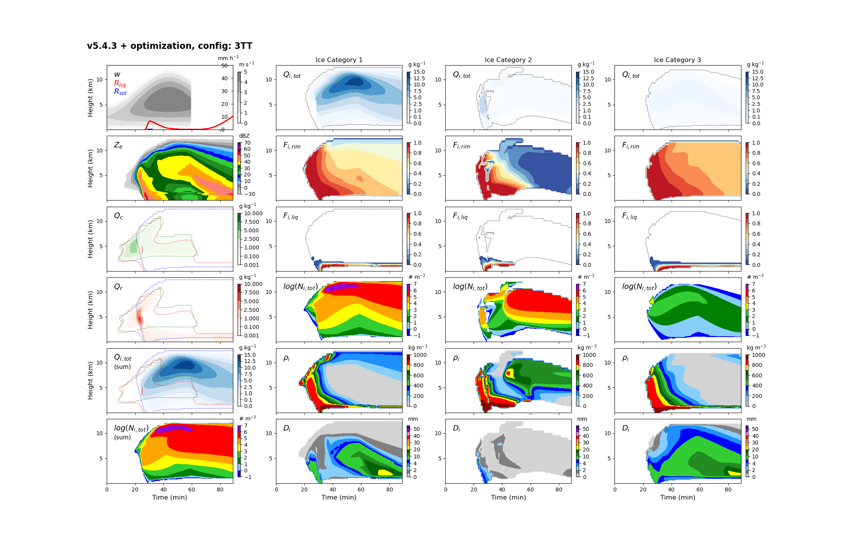
CTL vs. LT3-v1.3 (OLD_3MOM)
22.97
22.96

Slide 13
CTL vs. LT3-v1.3 (NEW_3MOM)
1.26
1.26

Slide 14
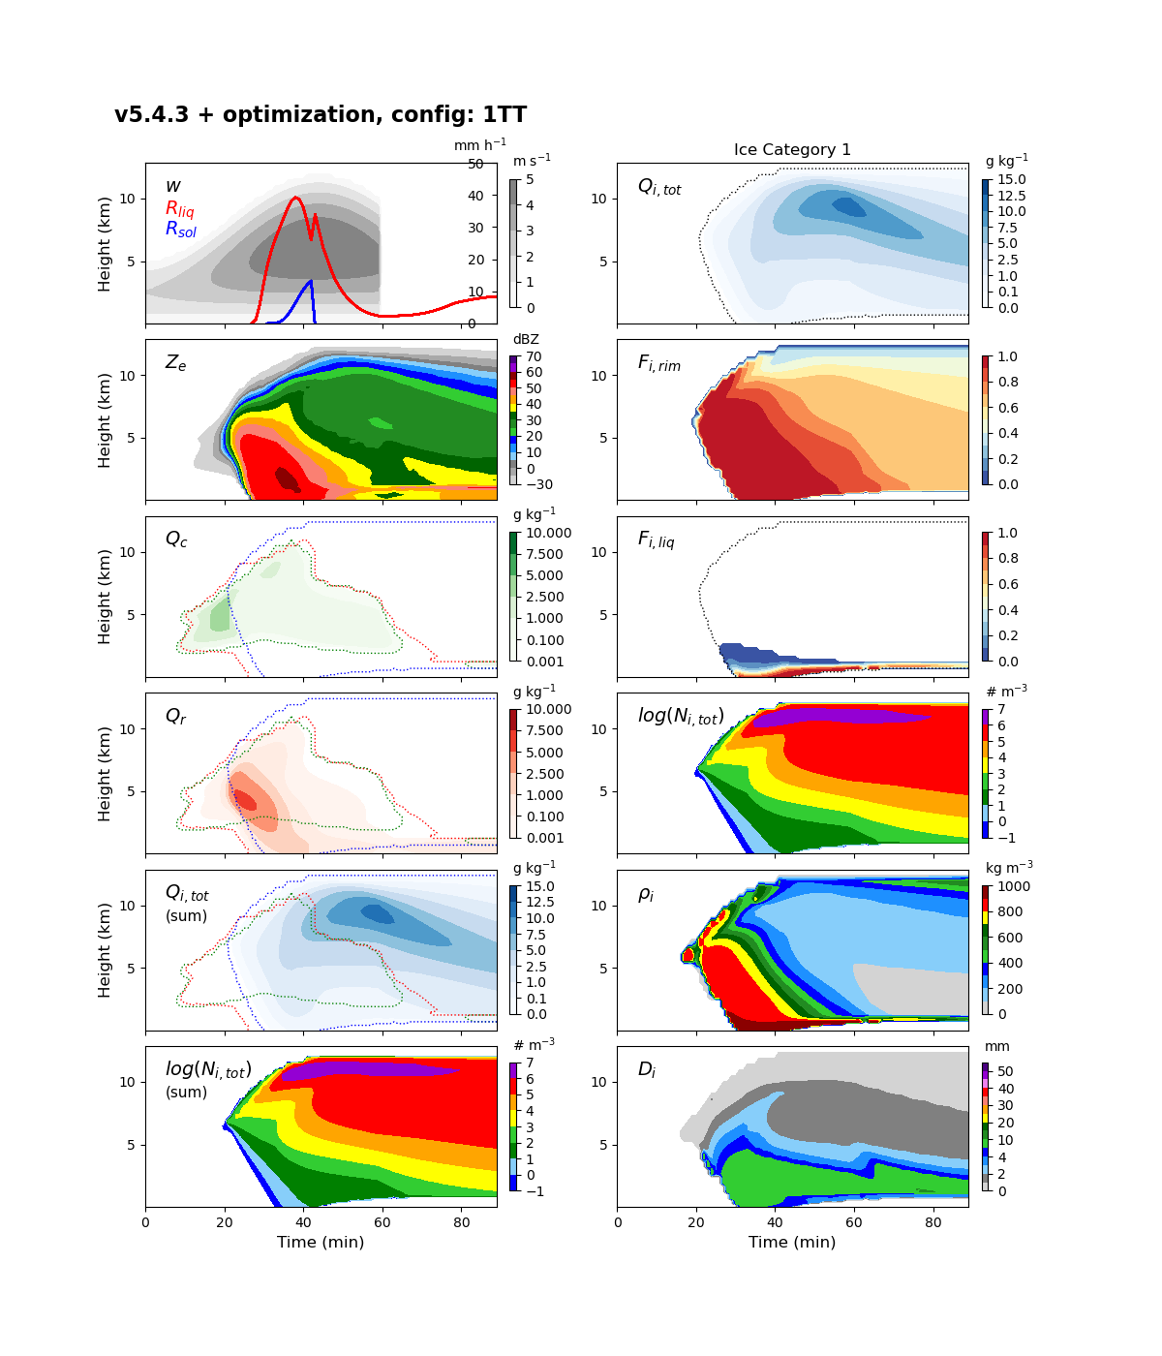
CTL vs. LT3-v1.3 (NEW_3MOM)
4.12
4.09

Slide 15
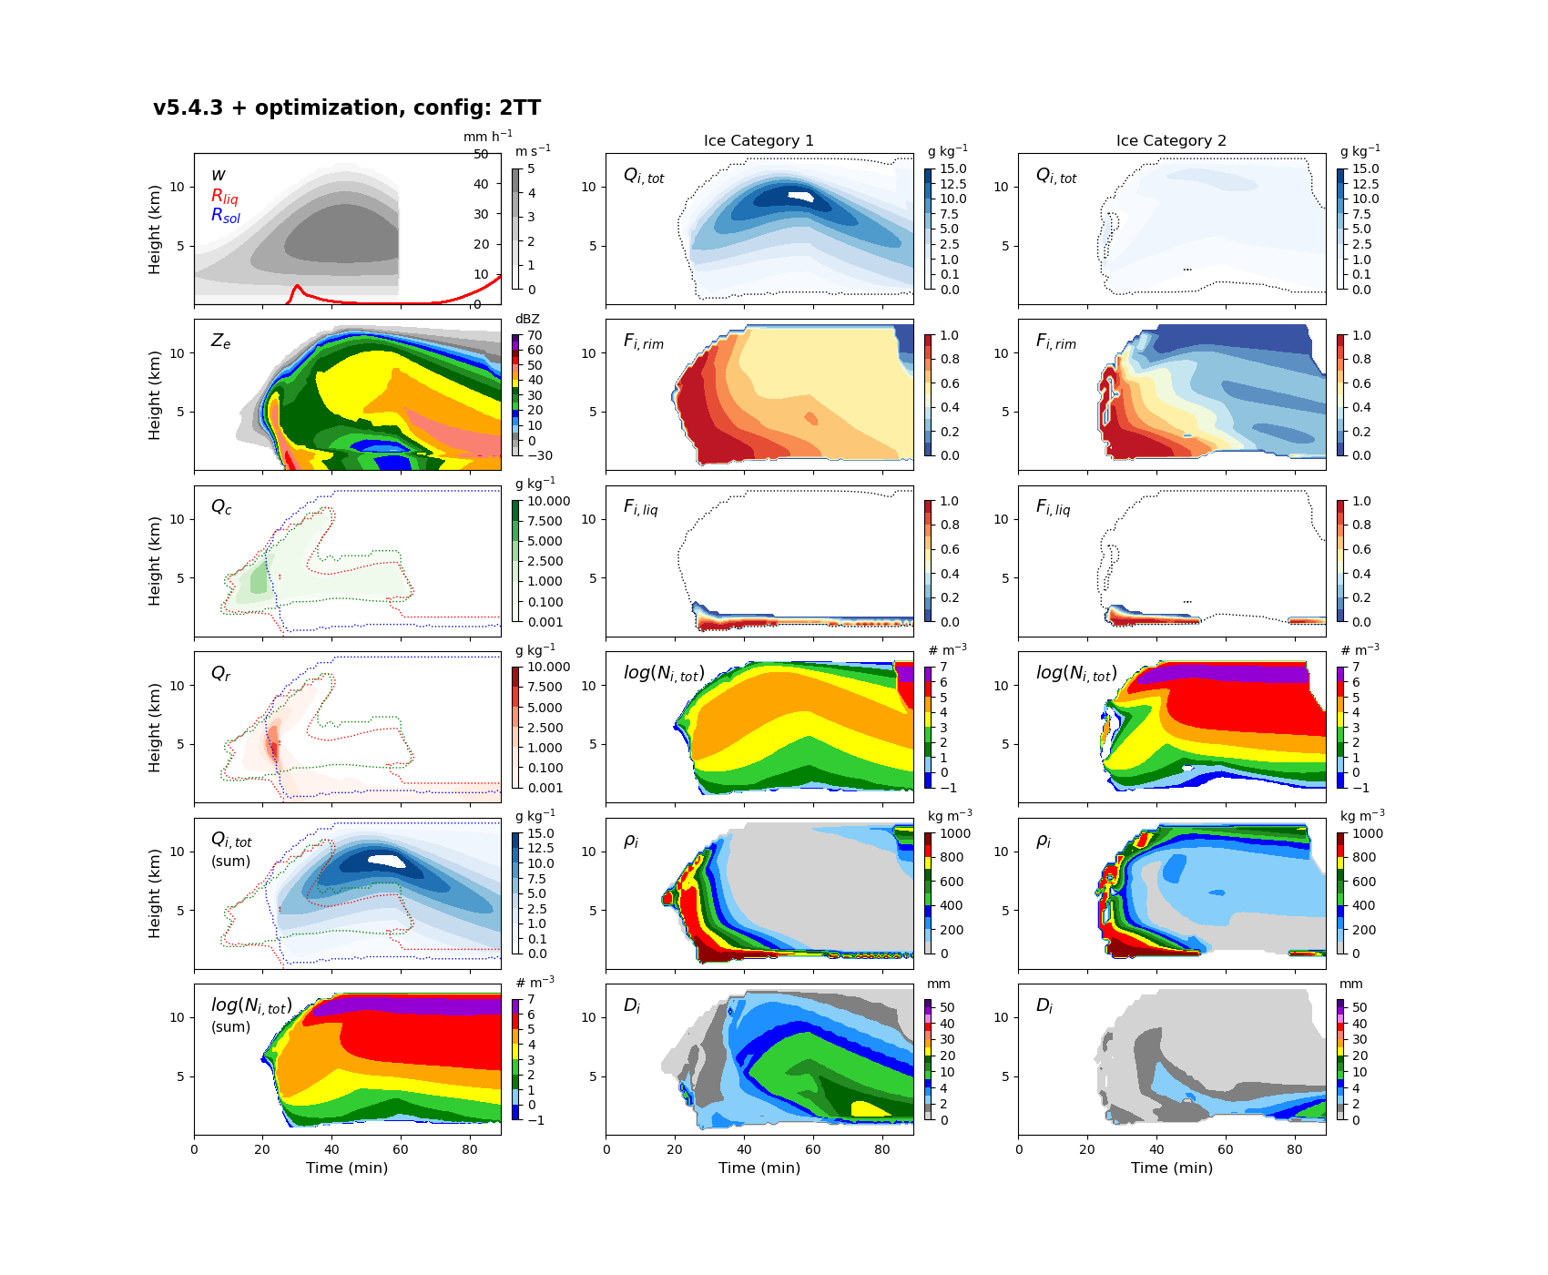
CTL vs. LT3-v1.3 (NEW_3MOM)
12.7
13.22

Slide 16
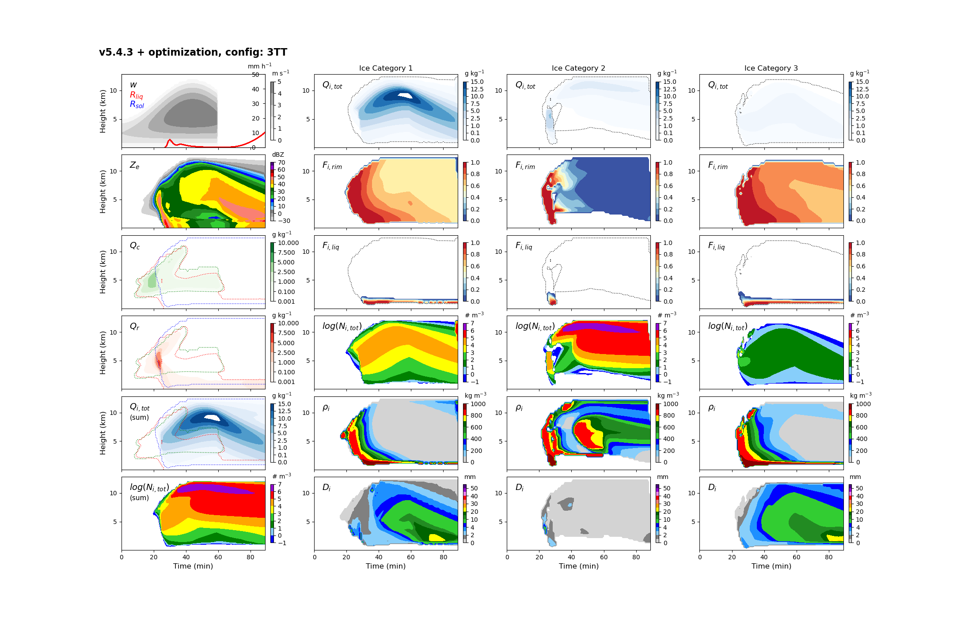
CTL vs. LT3-v1.3 (NEW_3MOM)
23.84
25.14

Slide 18
CTL vs. LT3-v1.4 (OLD_3MOM)
1.24
1.26

Slide 19

CTL vs. LT3-v1.4 (OLD_3MOM)
3.01
3.05

Slide 20

CTL vs. LT3-v1.4 (OLD_3MOM)
11.43
9.05

Slide 21

CTL vs. LT3-v1.4 (OLD_3MOM)
22.97
22.78

Slide 23
CTL vs. LT3-v1.4 (NEW_3MOM)
1.26
1.25

Slide 24

CTL vs. LT3-v1.4 (NEW_3MOM)
4.12
3.32

Slide 25

CTL vs. LT3-v1.4 (NEW_3MOM)
12.7
12.11

Slide 26

CTL vs. LT3-v1.4 (NEW_3MOM)
23.84
23.25

Slide 28
LT3-v1.3 vs. LT3-v1.4 (NEW_3MOM)
1.26
1.25

Slide 29
LT3-v1.3 vs. LT3-v1.4 (NEW_3MOM)
4.09
3.32

Slide 30
LT3-v1.3 vs. LT3-v1.4 (NEW_3MOM)
12.11
13.22

Slide 31
LT3-v1.3 vs. LT3-v1.4 (NEW_3MOM)
25.14
23.25

