Slide 1
Difference in 1D with nCat=2
Only 3MOM_LF_n2 is shown

Slide 2
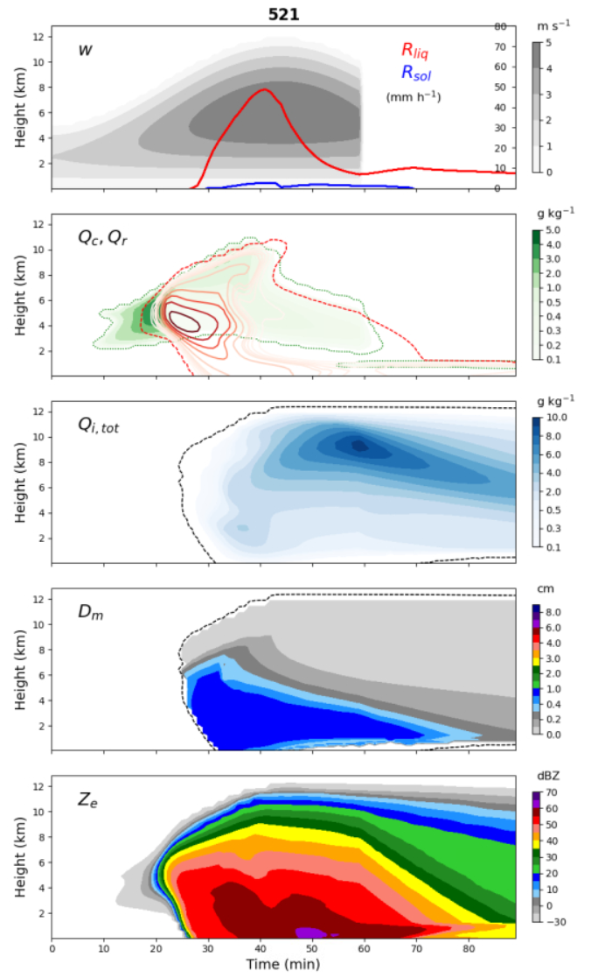
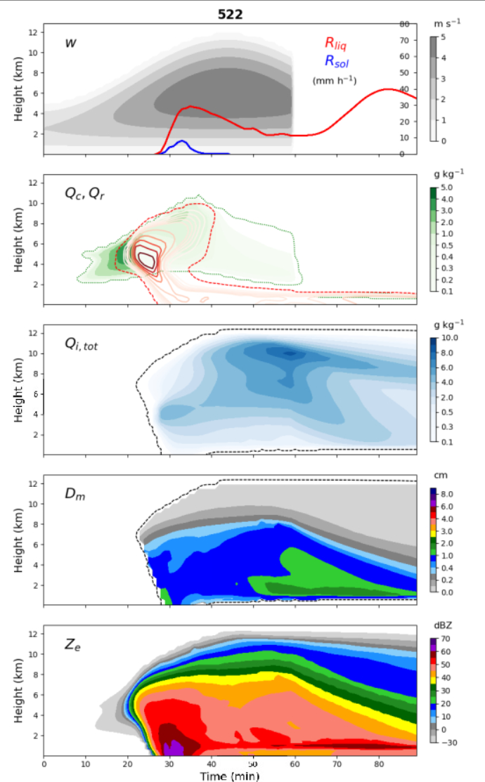
V5.2.1 vs. v5.2.2

Slide 3
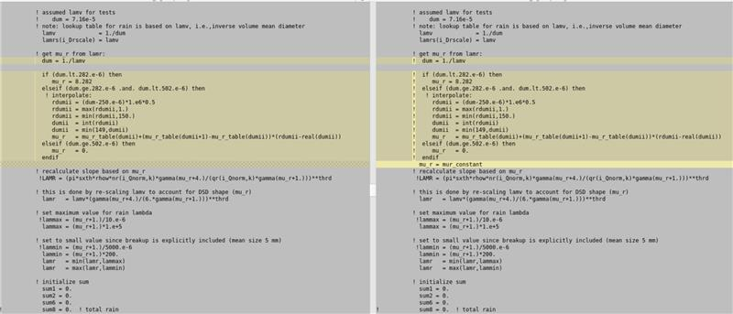
From bugfix in LTs ice-rain collection
LT1:
from 6.3 to 6.4 for both 2mom and 3mom
And LT2 unchanged

Slide 4
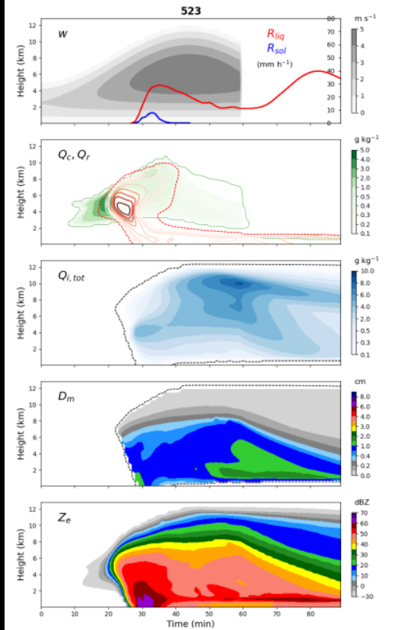
V5.2.2 vs. v5.2.3 → similar

Slide 5
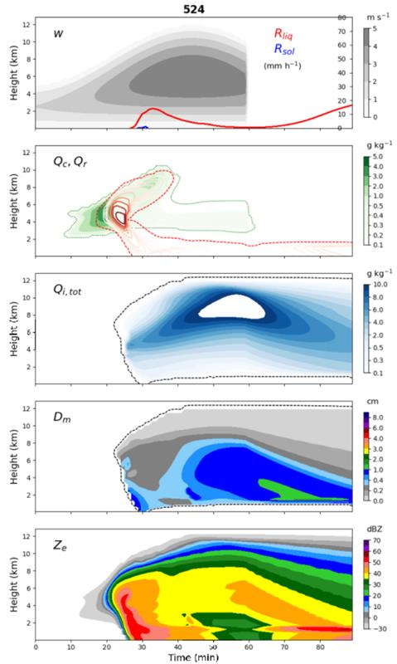
V5.2.3 vs. v5.2.4
Using f1pr15 from LT1
for diag_Di instead of (6*qitot/(nitot*500.*pi))**0.333

Slide 6
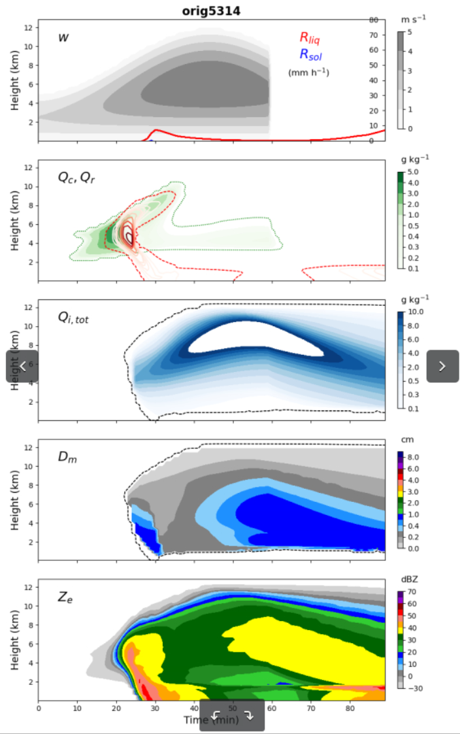
V5.2.4 vs. v5.3.14 → similar
Using f1pr15 from LT1
for diag_Di instead of (6*qitot/(nitot*500.*pi))**0.333

