Slide 1
Data bases 2
Template of the project documentation

Slide 2
Index
Specification
Revision of the specifications
Conceptual (ER) and logical data models
Explanation of the ER diagram
Explanation of the logical model
Trigger design and code
ORM relationship design with explanations
Entities code
Interface diagrams or functional analysis of the specifications
List of components
Motivations of the components design
UML sequence diagrams (optional)

Slide 3
Specifications
Gallia est omnis divisa in partes tres, quarum unam incolunt Belgae, aliam Aquitani, tertiam qui ipsorum lingua Celtae, nostra Galli appellantur. Hi omnes lingua, institutis, legibus inter se differunt. Gallos ab Aquitanis Garumna flumen, a Belgis Matrona et Sequana dividit. Horum omnium fortissimi sunt Belgae, propterea quod a cultu atque humanitate provinciae longissime, minimeque ad eos mercatores saepe commeant atque ea quae ad effeminandos animos pertinent important, proximique sunt Germanis, qui trans Rhenum incolunt, quibuscum continenter bellum gerunt. Qua de causa Helvetii quoque reliquos Gallos virtute praecedunt, quod fere cotidianis proeliis cum Germanis contendunt, cum aut suis finibus eos prohibent aut ipsi in eorum finibus bellum gerunt. Eorum una pars, quam Gallos obtinere dictum est, initium capit a flumine Rhodano, continetur Garumna flumine, Oceano, finibus Belgarum, attingit etiam ab Sequanis et Helvetiis flumen Rhenum, vergit ad septentriones.

Slide 4
Specification interpretation
If there are aspects that you had to interpret or clarify about the specifications that affect the application design and development you can list them here

Slide 5
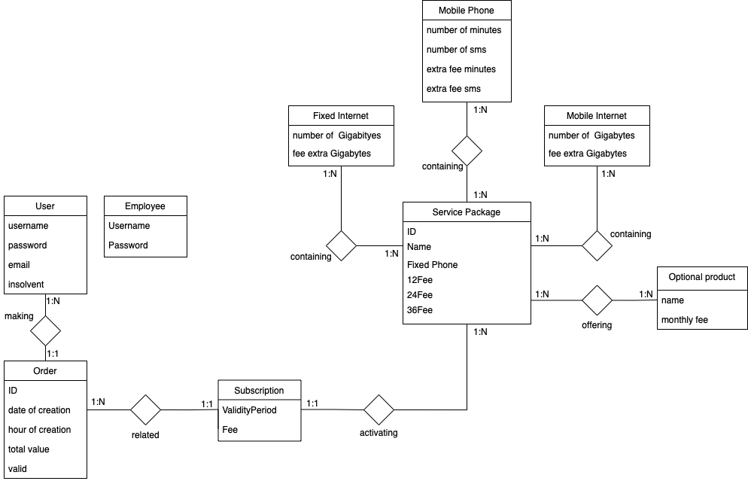
Entity Relationship

Slide 6
Motivations of the ER design
If there are assumptions that you have made that justify the ER diagram you can list them here

Slide 7
Relational model
User (username, Password, Email, Insolvent)
Order (ID, UserID, DateCreated, HourCreated, TotalValue, Valid)
Subscription (ID, ValidityPeriod, Fee, IDOrder, IDPackage)
ServicePackage (ID, Name, FixedPhone, 12Fee, 24Fee, 36Fee)
OptionalProduct (Name, MonthlyFee)
FixedInternet(ID, NoOfGigabytes, ExtraFee)
MobileInternet (ID, NoOfGigabytes, ExtraFee)
MobilePhone (ID, NoOfMinutes, NoOfSms, ExtraFeeMin, ExtraFeeSms)

Slide 8
Motivations of the logical design
If there are considerations about the logical model write them here

Slide 9
Trigger design & code
For all triggers specify at high level
Event
Condition
Action
SQL code of the trigger
Trigger design motivation (if needed)
E.g., ROW vs STATEMENT
BEFORE vs AFTER
Termination and triggering cycle

Slide 10
ORM design

Slide 11
Relationship “making”
making
User → Order @OneToMany
One user can make several subscription
TBD
Order → User @ManyToOne
Multiple orders can be done by a user
Owner of the relationship
Unidirectional 1:N
User
Order
1:N
1:1
User
*
Order
1
User
Order

Slide 12
Relationship “related”
related
Order → Subscription @OneToOne
An order refers to one subscription (if the order is valid)
Subscription → Order @OneToOne
A subscription is related to a (valid) order
Owner of the relationship
Bidirectional
Order
Subscription
0:1
1:1
Order
1
Subscription
1
Order
Subscription

Slide 13
Relationship “activating”
activating
Subscription → ServicePackage @ManyToOne
A subscription refers to the activation of one service package
Owner of the relationship
ServicePackage → Subscription @OneToMany
A service package can have multiple subscribers
TBD
Unidirectional 1:N
Subscription
ServicePackage
1:1
1:N
Subscription
1
ServicePackage
Subscription
*
ServicePackage

Slide 14
Relationship “containing”
containing
Service Package → Service @ManyToOne is necessary to show the service contained inside of the service package
Owner of the relationship
FetchType = FetchType.EAGER to let the costumer get the service details associated with a service package via relationship navigation
Service → Service Package @OneToMany is no requested, but mapped for simplicity
Service Package
Service
1:1
1:N
Service
Package
*
Service
Service Package
1
Service

Slide 15
Relationship “containing”
containing
Service Package → Optional @ManyToMany is necessary to show the optional products contained inside of the service package
Owner = either Service Package or Optional Product
FetchType = FetchType.EAGER to let the costumer get the optional products associated with a service package via relationship navigation
Service → Optional @ManyToMany is no requested, but mapped for simplicity
Service Package
Optional
1:N
1:N
Service
Package
*
Optional
Service Package
*
Optional

Slide 16
SQL DDL
CREATE TABLE `user` (
`id` int(6) NOT NULL AUTO_INCREMENT,
`username` varchar(45) NOT NULL,
`password` varchar(45) NOT NULL,
`name` varchar(45) NOT NULL,
`surname` varchar(45) NOT NULL, PRIMARY KEY (`id`)
)
CREATE TABLE `order` (
`id` int(6) NOT NULL AUTO_INCREMENT,
`costumer` int(6) NOT NULL DEFAULT=`999999`,
`subscription` varchar(45) NOT NULL,
`date_of_creation` date NOT NULL,
`hour_of_creation` time NOT NULL,
`total value` decimal NOT NULL,
`valid` number(1) NOT NULL,
PRIMARY KEY `id`
COSTRAINT `id_costumer` FOREIGN KEY (`costumer`)
REFERENCES `user` (`id`) ON DELETE SET DEFAULT
ON UPDATE CASCADE,
COSTRAINT `id_subscription` FOREIGN KEY (`subscription`)
REFERENCES `subscription` (`id`)
)

Slide 17
SQL DDL
CREATE TABLE `subscription` (
`id` int(6) NOT NULL AUTO_INCREMENT,
`id_order` int(6) NOT NULL,
`id_package` int(6) NOT NULL,
`validity_period` decimal NOT NULL,
`fee` decimal NOT NULL
PRIMARY KEY `id`
COSTRAINT `id_order` FOREIGN KEY (`order`) REFERENCES `order` (`id`)
COSTRAINT `id_package` FOREIGN KEY (`package`) REFERENCES `package`
(`id`) ON DELETE CASCADE, ON DELETE CASCADE
)
CREATE TABLE `package` (
`id` int(6) NOT NULL AUTO_INCREMENT,
`name` varchar(45) NOT NULL DEFAULT=`999999`,
`fixed_phone` number(1) NOT NULL,
`12Fee` decimal NOT NULL,
`24Fee` decimal NOT NULL,
`36Fee` decimal NOT NULL,
PRIMARY KEY `id`
)
CREATE TABLE `product` (
`name` varchar(45) NOT NULL,
`monthly_fee` decimal NOT NULL,
PRIMARY KEY `name`
)

Slide 18
SQL DDL
CREATE TABLE `fixed_internet` (
`id` int(6) NOT NULL AUTO_INCREMENT,
`num_gb` decimal NOT NULL,
`fee_extra_gb` decimal NOT NULL
PRIMARY KEY `id`
)
CREATE TABLE `mobile_phone` (
`id` int(6) NOT NULL AUTO_INCREMENT,
`num_minutes` decimal NOT NULL,
`num_sms` decimal NOT NULL,
`fee_extra_minutes` decimal NOT NULL
`fee_extra_sms` decimal NOT NULL
PRIMARY KEY `id`
)
CREATE TABLE `mobile_internet` (
`id` int(6) NOT NULL AUTO_INCREMENT,
`num_gb` decimal NOT NULL,
`fee_extra_gb` decimal NOT NULL
PRIMARY KEY `id`
)

Slide 19
ORM design motivations
To avoid redundancy, in ”containing” relationship the entity ”Service” refers to the three offers that can be associated to a package. The offers are:
Fixed Internet
Mobile phone
Mobile internet
The “offering“ relationship between ServicePackage and OptionalProduct is also omitted since it is equal to the “containing“ relationship

Slide 20
Entity Employee
@Entity
@NamedQueries({ @NamedQuery(name = “A.query", query = “ . . . "),
. . .})
public class A implements Serializable {
..
// attributes & their annotations
// relationships & their annotations
/*
clone this slide as may times as there are entities
*/
Clone this slide for each entity

Slide 21
Functional analysis of the interaction
Describe the interaction diagrams of the application using any graphical notation (e.g., IFML or similar --- www.ifmledit.org) or a textual notation (see next slides)

Slide 22
Example of diagram
PAGE
PAGE COMPONENT
NAVIGATION
EVENT
ACTION
LOGIN PAGE
username, password
Login form [field: username
field: password]
Check Login
GoToHome
submit
user -> session
missions
wrong user + pswd
HOME

Slide 23
Example of textual notation
A Web application allows the management of travel expenses. After logging in, the user accesses a HOME page where there is a list of travel missions; a mission belongs to a user and has a date, a place, a description, a number of days of duration, and a status ("open", "finalized", "closed"). The list shows the date and place of the missions, which are sorted by date in descending order. On the HOME page there is a form, with which the user can create a new mission, by entering all the data, which are mandatory. A new mission is always in the "open" state. After creating a mission, one is returned to the HOME page. When the user selects a mission in the list, a DETAIL_MISSION page appears, showing all the mission data. If the mission is in the "open" state, a form appears for entering the expenses incurred during the mission; the form contains three fields: food costs, accommodation costs, transport costs. Sending the form data causes the mission status to change from "open " to “finalized ", and the return to the DETAIL_MISSION page. If the mission is in the "finalized“ status, a "close“ button appears which the user can click to report that he has received the reimbursement of expenses; this causes the mission status to change from "finalized" to "closed" and the return to the DETAIL_MISSION page. If the mission is in the "closed" status, the DETAIL_MISSION page shows mission data also the value of the three types of expenditure.
Pages (views), view components, events, actions

Slide 24
Components
Client components
Servlets
Views
Java Beans
Back end components
Entities
Entity1
Entity2
Business Components (EJBs)
BC1
(stateless or stateful)
Method BC11( params)
Method BC11( params)
BC2
(stateless or stateful)
Method BC21( params)
Method BC22( params)

Slide 25
Motivations of the components design
If there are aspects of the components design that you want to illustrate or motivate, write here your explanations

Slide 26
UML sequence diagrams
Only if needed to illustrate some relevant component interaction
CheckLogin
UserDAO
index.html
Session
GoToHome
new UserDAO (user, pass)
doPOST
checkCredentials()
user || null
POST
/CheckLogin
username
password
From: index.html
[user == null ] redirect
[user != null ] setAttribute ("user", user)
[user != null ] redirect
See slide “go to home”

