Slide 1
Robust Journey Planner
Problem statement
We used the delay distributions computed on the dataset of the Zurich transports to implement a robust route planner.
Query example:
I want to leave from A (resp. arrive at B) at instant T, what
route from A to B is the fastest with at least probability Q?

Slide 2
Ecosystem
Nodes: train/bus/metro stations. Identified by the name.
Edges: connections between two nodes. Each edge is associated with:
scheduled departure and arrival times.
a continuous distribution representing the arrival delay.
a trip id, identifying the trip done at a specific time of the day.
a path id, identifying the path done by the transport independently from the time of the day.
a probability, indicating the probability of taking the whole path up to this edge.
Notes:
Note that two edges may have same path id (if they corresponds to two transports which do the same path) but different trip id (if the transports travel at different times of the day), but not the opposite (same trip id implies same path id).

Slide 3
Assumptions
There is no real-time information.
If two edges depart from A and share the same path id then the best edge is the one that departs the soonest. In other words, between two means of transport that do the same path, the one that arrives first is the one that departs first.

Slide 4
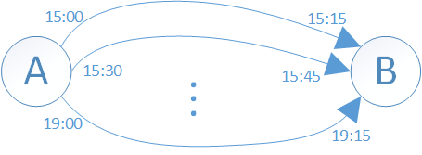
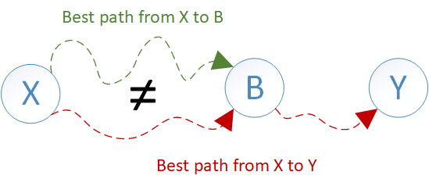
Differences wrt Dijkstra
Many edges between two nodes. the set of available edges depend on the time we can/want to depart from node A.
Delay distributions and threshold. In Dijkstra, if node A is on the shortest path between X and Y then that path must contain the shortest path to A. However, this does not hold anymore.
Notes:
If this was the only difference, i.e. we did not consider any delay distribution, then we could just implement the Dijkstra algorithm with the small variation of always picking the edge between A and B that depart the first given our arrival time at A.
You may find the best path to A but it may happen that, for example, at A you have to change mean of transport and you may also have a high probability of missing the first connection and, therefore, have to wait for the next connection. In other words, sometimes is better to arrive a bit later but with the correct transport.

Slide 5
Our approach
For each reached node, we would need to store all the incoming edges that we took to reach the node. Each edge may have a different set of available outgoing edges from the node. This is quite cumbersome and messy....
We decide to visit and label the edges instead of the nodes. Similarly as Dijkstra we keep a list of visited edges and iteratively expand the edge with the lowest arrival time. When visiting an edge, we compute the probability of taking it and prune if the overall probability falls below the given threshold.

Slide 6
Our approach
The algorithm is similar to Dijkstra but:
When expanding the current best edge we (1) visit each unvisited edge, and (2) we try to improve the probability of the already visited edges.
We prune the set of possible next edges by using the path id: we group all the edges between A and B by their path id and for each group we visit the edges in ascending order of departure time until the first edge with a high connection probability.
Walk edges have no starting or arrival time nor a delay distribution but only a fixed walking time. They propagate the delay distribution of the previous edge.
Notes:
You cannot improve the probability of taking the last connection since the second time you must arrive a bit later (you expand the best edge first...), however the second overall path may have an higher probability. This could enable the possibility of proceeding on a path whose probability would otherwise fall below the threshold.
In this way, we are sure to take at least a transport that does a specific path, and there is obviously no need in trying to take another transport that does the same path. In this step, we are applying our second assumption
In fact, the delay distribution of the previous edge clearly affects the time at which we start walking and, therefore, the time at which we will arrive by foot at our destination.

Slide 7
Our approach
What if the arrival time is given instead? We just reverse all the edges and change the metric for picking the best edge, i.e. the best edge is the one with the highest departure time.
A variant has been trivially implemented to manage queries in which we are only given the departure node and time to fetch the set of all the reachable nodes.

