Slide 1
EAI.Azure.2023
Notes:
Divider, option two

Slide 2
Http - Overview
ExtendableHttp EAI.General. ExtendableHttp, EAI.General
OAuth EAI.OAuth
Rest EAI.Rest
Odata EAI.OData
Dataverse + ModelGenerator EAI.Dataverse +

Slide 3
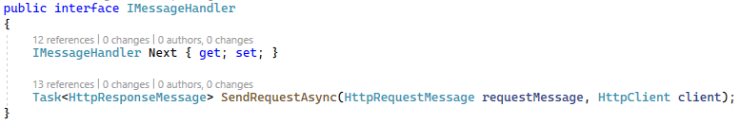
ExtendableHttp
Project EAI.General
Simple ExtendableHttpClient (MessageHandler, BaseUri, Timeout)
Chains additional functionality via own IMessageHandler Interface
Implementations
RetryPolicyHandler
ThrottleHandler
LogHandler
SendMessageHandler

Slide 4
Implementations
RetryPolicyHandler
Retries http message send for specified HttpStatusCodes
RetryStatusCodes (default: InternalServerError, ServiceUnavailable, RequestTimeout, GatewayTimeout)
RetryCount (default: 3)
WaitSeconds (default: 3)
ThrottleHandler
Throttles http messages based on http status code 429 automatically. No additional configuration is required
LogHandler
Logs request and response message information based on property settings
LogRequestUri
LogRequestContent
LogResponse
LogResponseContent
SendMessageHandler
Finaly sends the message to the server

Slide 5
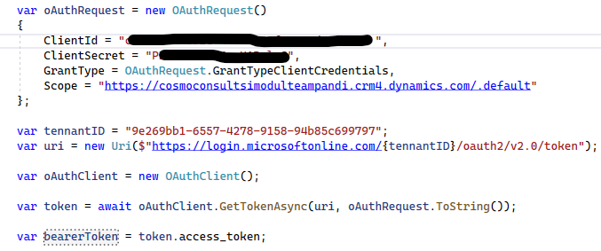
OAuth
Project EAI.OAuth
Based on ExtendableHttpClient
Lightweight oauth client
Support for oauth request building
OAuthMessageHandler
Designed for ExtendableHttpClient, Transparent authentication through IMessageHandler chain
Caches oauth token and automatic per request refresh

Slide 6
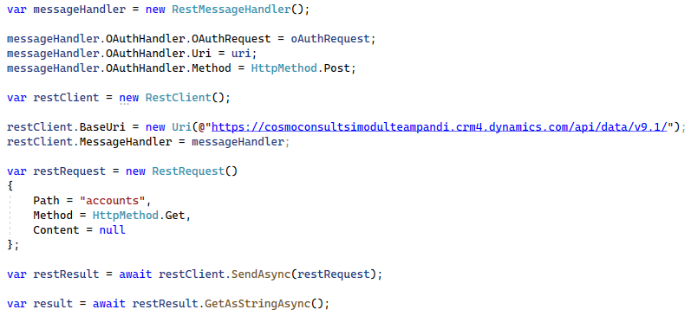
Rest
Project EAI.Rest
Based on ExtendableHttpClient
Simple Rest client with serialization / deserialization through Newtonsoft.Json
RestMessageHandler: Combines RetryPolicyHandler, ThrottleHandler and OAuthMessageHandler

Slide 7
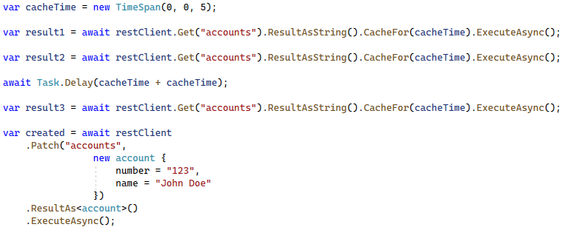
Rest - Fluent
Basic Fluent Api
Create Simple REST Request avoiding await chains
Implements response caching with timeout based on request URL
REST Actions are implemented as extension methods

Slide 8
OData
Project EAI.Rest
Based on RestClient with specialized JsonSerializerSettings
Special types for ODataBind and ODataType, can also be used in anonymous types
ODataQuery to support building OData queries
OData Actions are implemented as extension methods

Slide 9

Dataverse
Project EAI.Dataverse
Base classes for model generation
DataverseAction
DataverseEntity
C# Class model for actions and entities
Model generation via unit test
Inherit partial class from DataverseAction or DataverseEntity

Slide 10
Dataverse - ModelGenerator
public class ModelGeneratorTests
{
[Fact()]
public async Task GenerateCodeTest()
{
var setting = new JsonSerializerSettings()
{
TypeNameHandling = TypeNameHandling.Auto
};
var configJson = GetConfigResource();
var odataClient = JsonConvert.DeserializeObject<ODataClient>(configJson, setting);
var modelGenerator = new ModelGenerator()
{
GenerateDynamicNavigationProperties = true,
GenerateLookups = true,
GenerateNavigationProperties = true,
UseEnumTypeForPicklistProperties = true
};
var code = await modelGenerator.GenerateCodeAsync(odataClient, typeof(account).Assembly);
ModelWriter.Write(typeof(account).Assembly, code);
}
private static string GetConfigResource()
{
using (var stream = typeof(ModelGeneratorTests).Assembly.GetManifestResourceStream("EAI.Dataverse.ModelGeneratorTests.config.json"))
using (var reader = new StreamReader(stream, Encoding.UTF8))
return reader.ReadToEnd();
}
}

