Slide 3
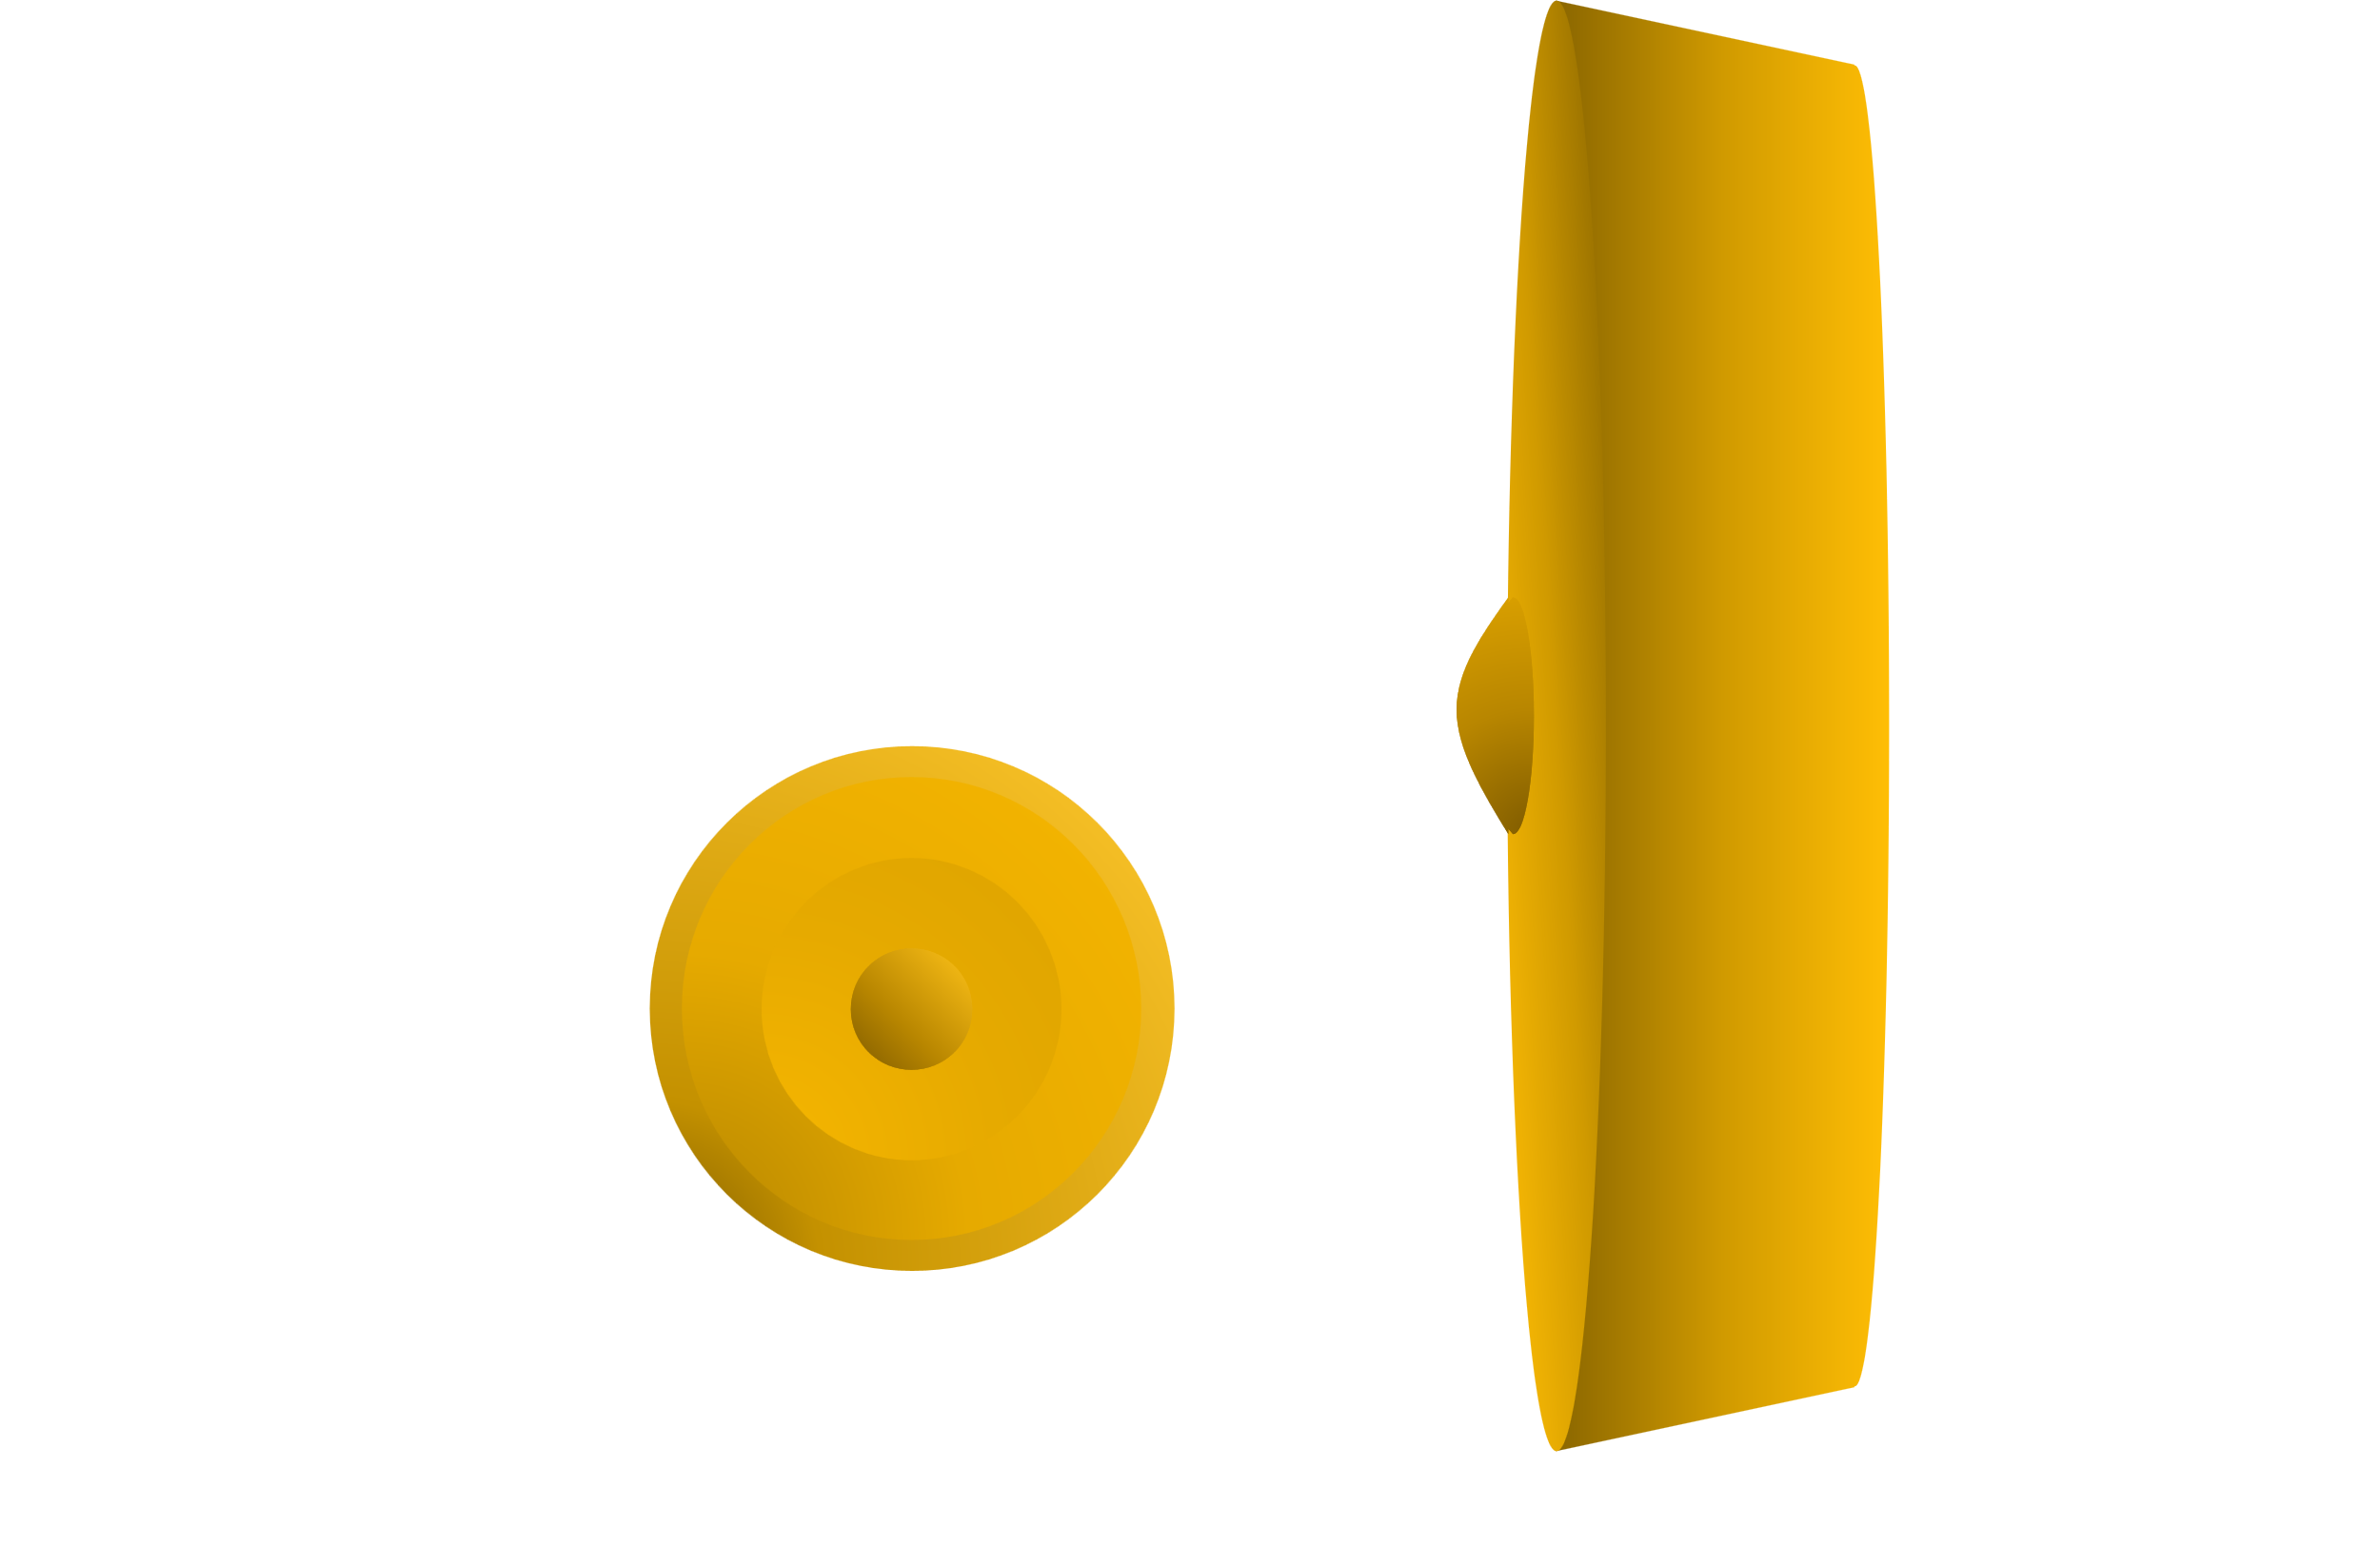

Slide 4
)
0
*
8
9
(

Slide 6


