Slide 1
MUHC ML Algorithm
By: Marc Palaci
Date: August 23, 2016
For any additional help or inquires do not hesitate to contact me:
marcpalaci689@gmail.com

Slide 2
Basic Overview of how to run the program

Slide 3
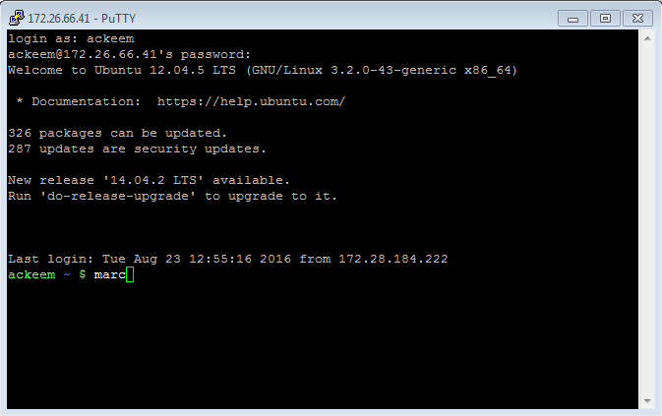
Where to find the files and how to run
First log on to the server using PuTTY
The ML Algorithm can be found on the server using the directory /var/www/devDocuments/marc/ML_Algorithm_MUHC
I set up an alias on the .bashrc so instead of having to type that whole directory in the command line, you can just type the command “marc”

Slide 4
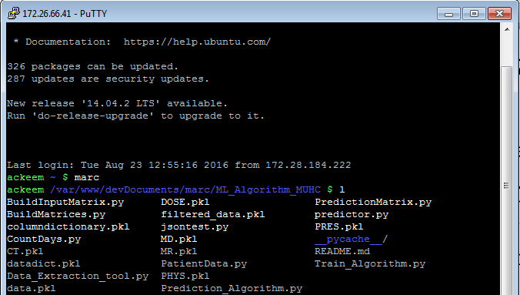
Executable files
Now you should be in the directory that contains all the scripts used for the algorithm.
Do not be overwhelmed… most of the scripts are modules. There are only 2 executable scripts: Train_Algorithm.py and predictor.py
The Train_Algorithm.py script is responsible for training the algorithm and creating the models using a Gradient Boosting Regressor algorithm.
The predictor.py is the script called by the OPAL app that is called to return a patients most recent treatment planning history and a prediction for when his planning will be Ready For Treatment.

Slide 5
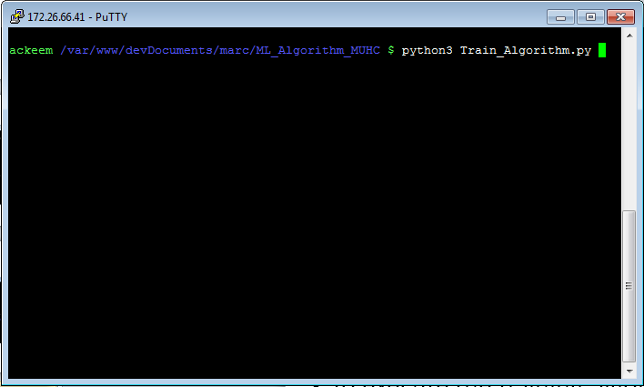
How to train the algorithm
Training is quite simple. All that has to be done is the Train_Algorithm.py has to be executed by the python interpreter.
My algorithm was built using the newest version of Python (3.4 at the time), however the server originally only had Python 2.
To execute the training algorithm you must use the python3 command to specify the right version of python.
Once in my repository you simply input: “python3 Train_Algorithm.py”
Upon entering the command, you should see the algorithm running.

Slide 6
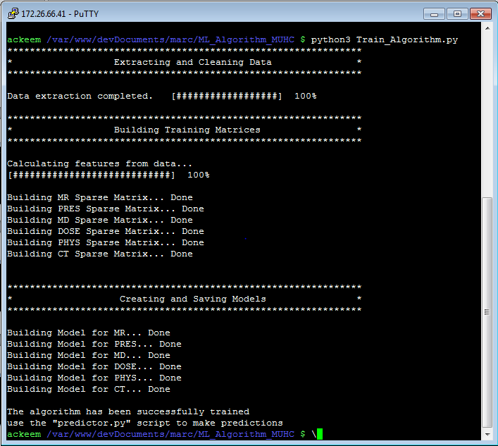
Basic overview of the training algorithm
The training algorithm consists of 4 main steps.
Firstly, data is extracted from the devAEHRA database
Secondly, this data is cleaned as best as possible to ensure that no misleading data is used
Thirdly, the Feature and Target matrices (coined as X and y matrices in most machine learning environments) are built.
Finally, the models are built and saved as encrypted pickled files.

Slide 7
Predicting Algorithm
Once trained, all the models are saved and you may call the predictor.py script. This script accepts a patient number as an argument.
The output will be a JSON object that includes:
A response attribute that returns either ‘success’ or ‘failed’ if the prediction algorithm worked successfully or not.
If the algorithm failed it will include a reason attribute which explains why the algorithm did not work.
If the algorithm was successful it will include a steps attribute which returns an array of all the most recent planning history data. Also it will include a prediction attribute which just returns the prediction.

Slide 8
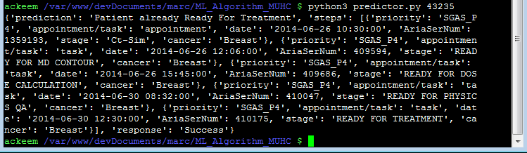
Running the predictor
To run the predictor, type the command: “python3 predictor.py #####” where ##### is the Patient Aria Ser.

Slide 9
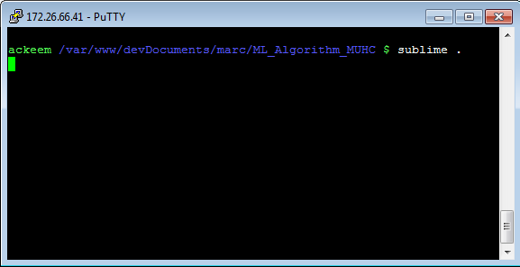
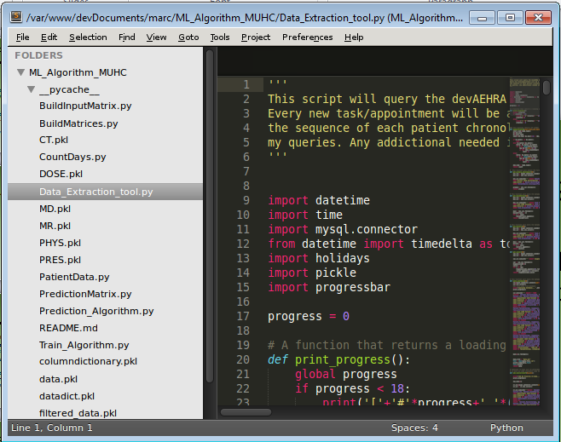
Opening all the scripts
To open all the scripts in Sublime… you can simply type “sublime .”

Slide 10
Algorithm Flowcharts

Slide 11
Overview flowchart
Training Algorithm
DATA
models
DATA
Server
models
Patient Recent
Data
Predictor
Prediction to front-end

Slide 12
Training Algorithm
Training_Algorithm.py
Call
BuildMatrices.py
Call
Data_Extraction_tool.py
1
2
5
4
3
Returns X and y matrices for building models
Returns a dictionary of cleaned data
Get data from devAEHRA database
Creates models for each stage and then saves those models in independent files on the server.
Server

Slide 13
Prediction Algorithm
Call
PatientData.py
Prediction_Algorithm.py
1
Get data from devAEHRA database
Return array of the patients most recent treatment planning history
2
Call
PredictionMatrix.py
Call
BuildInputMatrix.py
3
6
Return prediction and patient’s most recent history
Return X matrix for last known step
8
7
9
4
Output results as JSON object to front-end
Request
for desired model
Return model
5
Server

Slide 14
For Future Work…
These are just mere suggestions
The prediction algorithm takes most of its time extracting the patients most latest treatment planning history… It would be better to have this running in the backend and saving it into a database so that rather than the algorithm having to extract it, it will simply have to be queried from the database
Someone will have to record the predictions in a database in order to monitor how the predictions are performing.

