Slide 1
Introduction to (Y3 cluster use of) CosmoSIS
Marc Paterno
DES Collaboration Meeting
15 May 2018

Slide 2
MCMC is numerical integration
The MCMC technique (as in CosmoSIS) generates samples in an n-dimensional space of interest.
this includes both (cosmological) parameters of interest, and nuisance parameters
When the sample generation reaches stability, it is producing samples according according to the distribution that is defined by the integral:
the probability of a sample landing in a given volume is proportional to the value of the integral over that volume.
Expectation values of functions can be calculated by averaging over the samples.

Slide 3
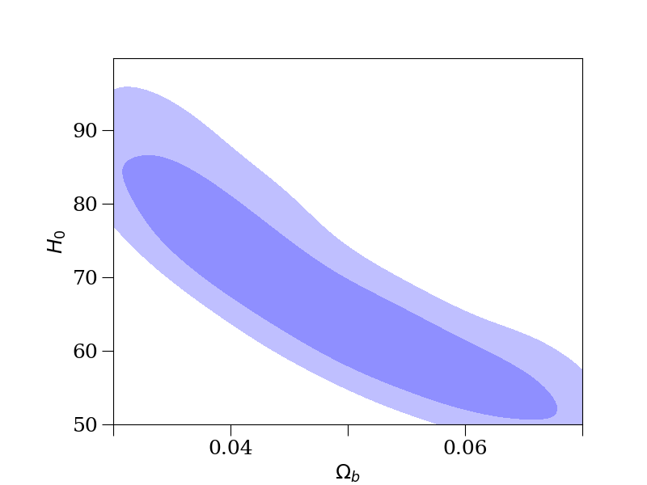
What is CosmoSIS?
CosmoSIS is framework for Markov Chain Monte Carlo parameter estimation.
Framework: this means CosmoSIS provides the main program that calls your code.
You provide your code as a “module”.
It is a framework for structuring cosmological parameter estimation in a way that eases re-usability, debugging, verifiability, and code sharing in the form of calculation modules.
It consolidates and connects together existing code for predicting cosmic observables, and makes mapping out experimental likelihoods with a range of different techniques much more accessible.
See https://bitbucket.org/joezuntz/cosmosis

Slide 4
A high-level view of CosmoSIS
(Log) Likelihoods are calculated by modules
A pipeline consists of a sequence of modules
modules = consistency bbn_consistency camb fgas
Each module does one or both of:
calculate physical quantities of interest to other modules in the pipeline, e.g. matter power spectrum
calculate a contribution to the (log) likelihood (there can be more than one contribution) for some data
A program is configured by writing an “ini” file that specifies:
what sampler is to be used (CosmoSIS provides several)
what modules are to be loaded, and made part of the pipeline
how those modules should be configured

Slide 5
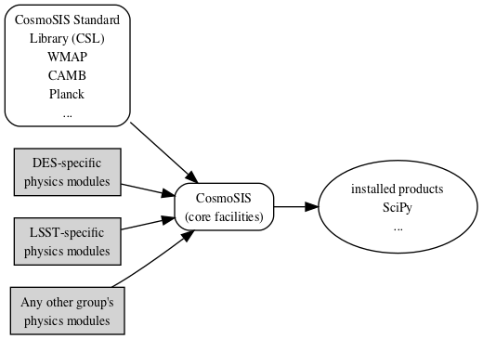
Where does code live?
CosmoSIS relies on some 3rd-party products, delivered by a bootstrap script or Docker container.
CosmoSIS code comes from multiple repositories.
One of these is our y3_cluster_cpp repository
https://bitbucket.org/mpaterno/y3_cluster_cpp

Slide 6
How does y3_cluster_cpp reflect what you just heard about?
For computational speed, the likelihood function Spencer spoke about is being implemented in C++.
The integrand has many terms that can be implemented (specialized) in different ways.
To allow this flexibility while maintaining efficiency, we are implementing the integrand as a class template.
The current implementation is called trivial_gamma_t. We should change the name when it is no longer trivial!

Slide 7
The (current plan for) a CosmoSIS module class template
The integrand is not itself a CosmoSIS module.
Some “plumbing” needs to be provided to make a C++ module for calling the integrand.
obtain inputs (cosmological parameters, other calculations) from the CosmoSIS pipeline
calculate the likelihood for the current sample
put the likelihood back into the pipeline
The detailed design of the module class template will depend on the final design for the integrand
I am hoping we can determine everything necessary for finalizing the design this week.
Users of this module will be able to tailor it by
specifying the implementations of the various terms in the integrand, and
compiling the result into a (C++-base) CosmoSIS module.

Slide 8
Some of the tools we are using
Integration is done by algorithms in the CUBA library (http://www.feynarts.de/cuba)
CUBA is wrapped for use in C++: https://bitbucket.org/mpaterno/cubacpp
y3_cluster_cpp also contains a few other utilities:
integration_range, for setting ranges of integration (CUBA integrates of the unit hypercube in n-dimensions)
interp_1D and interp_2D, for linear and bilinear interpolation (wrapping up GSL integration routines for easier use).
We are using a (slightly customized) version of the Docker delivery of CosmoSIS, so that
we can use a new enough C++ compiler to support our code
we can take advantage of Shifter at NERSC for running large jobs.

