Slide 1
Mitigating Tony Hoare's CAD$2.16 billion dollar mistake
C++ Ottawa
27 March 2025
Marc Pawlowsky

Slide 2

2009
Tony Hoare introduced Null references in ALGOL W back in 1965 "simply because it was so easy to implement"
https://www.infoq.com/presentations/Null-References-The-Billion-Dollar-Mistake-Tony-Hoare/

Slide 3
What is int* p?
Pointer to a piece of data
Pointer to a collection of data, *(p+4)
No data is available,
int *p = 0; p == nullptr;
Pointer to a resource that must be released
Pointer to a resource that must not be released

Slide 4
void
do_not_delete(int const * const p)
{
delete p;
}
https://godbolt.org/z/zMd6YsqMr

Slide 5
Today’s goals
Reduce the chance of following a null-pointer
Reduce your cognitive load
  Make the implicit explicit

Slide 6
Backlog
Pointer to a piece of data
Pointer to a collection of data, *(p+4)
0 as nullptr
No data is available
Pointer to a resource that must be released
Pointer to a resource that must not be released

Slide 7
Backlog
Pointer to a piece of data
Pointer to a collection of data, *(p+4)
0 as nullptr
No data is available
Pointer to a resource that must be released
Pointer to a resource that must not be released
What is the binary representation of 0

Slide 8
Inspiration
Java Programmers FAQ post by Marc Pawlowsky (~1996)
Does Java have the equivalent of "const" arguments in C and C++?
Correct by Construction: APIs That Are Easy to Use and Hard to Misuse : C++ On Sea,Matt Godbolt, 2020
gsl::not_null, and gsl::owner
Guidelines support library

Slide 9
Technique
Step by step refactoring of legacy code to catch the possible misuse pointers
  Real world:
    C++98 using Boost
    New code in C++17
Introduce a compiler failure in an API and fixit.

Slide 10
Tools?
GSL : Guidelines Support Library
clang-tidy
  static analyzers

Slide 11
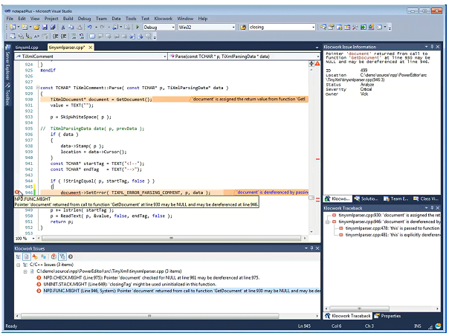

Slide 12
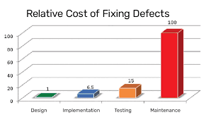
Static Analysis

Slide 13

mp
namespace mp = marcpawl::pointers
https://github.com/marcpawl/nullptr/tree/20250327

Slide 14
Wrapping gotchas
operator bool()

Slide 15
Take a look at:
    2020 LLVM Developers’ Meeting
    Using Clang-tidy for Customized Checkers and Large Scale Source Tree Refactoring - Vince Bridgers
    How to write your own rules
    Fix one clang-tidy rule at a time across a whole project

Slide 16
Step 1: nullptr
Replace 0 with nullptr
  clang-tidy - modernize-use-nullptr
int* p = 0;
=====>
int* p = nullptr;

Slide 17
Step 1: nullptr
Replace implicit use in conditional
  clang-tidy - readability-implicit-bool-conversion
int* p;
If (p) {}
=====>
if (p == nullptr) {}

Slide 18
Backlog
Pointer to a piece of data
Pointer to a collection of data, *(p+4)
0 as nullptr
No data is available
Pointer to a resource that must be released
Pointer to a resource that must not be released
What is the binary representation of 0

Slide 19
Step 2 : Describe data availability

Slide 20
Data may not available
Comments as a type
// a flag for saying go fetch the data
void foo(int* ptr) {
if (nullptr == ptr) {
ptr = new int(4);
}
}
// a flag for no-op
void fee(int* ptr) {
if (nullptr == ptr) {
return;
}
}

Slide 21
Data must be available
Comment as type
// @param p may not be null
int square(int* p) {
return (*p) * (*p);
}

Slide 22
Data must be available
Soft failure
// @param p must not be null, ...
// @return -1 if p is nullptr, else ...
int square(int* p) {
if (nullptr != p) {
// Fix for BUG12345
return -1; // in-band encoding
}
return (*p) * (*p);
}

Slide 23
Data must be available
Hard failure
// @param p must not be null
int square(int* p) {
assert(nullptr != p);
return (*p) * (*p);
}

Slide 24
Backlog
Pointer to a piece of data
Runtime type description of data must be available
Pointer to a collection of data, *(p+4)
No data is available
Pointer to a resource that must be released
Pointer to a resource that must not be released
What is the binary representation of 0

Slide 25
Step 3: Use a type
Have the compiler tell you when data must be available with run time checks.

Slide 26
Step 3.1 : gsl::not_null
Use gsl::not_null to indicate data MUST be available
void hum(gsl::not_null<int*> p)
  Opinionated: prevents pointer arithmetic
clang-tidy - cppcoreguidelines-owning-memory
https://github.com/microsoft/GSL/blob/3.0.1/include/gsl/pointers#L69

Slide 27
Step 3.2 : gsl::strict_not_null
Use gsl::strict_not_null
Removes explicit constructor and automatic conversion.
void hum(gsl::strict_not_null<int*> p)

Slide 28
Cost gsl::not_null
No extra space
void foo(int *p) { auto np = gsl::strict_not_null<int*>(p);}
we have a conditional, equivalent to the assert.
void bar(gsl::strict_not_null<int*> q);
void foo(gsl::strict_not_null<int*> p) { bar(p);}
No conditional, no need for asserts.
Compiler optimizes out extra check.

Slide 29
Step 3.3 : mp::nullable
Type as a comment.
template<
class T,
std::enable_if_t<std::is_pointer<T>::value, bool> = true>
using nullable = T;
void foo(nullable<int*> ptr);

Slide 30
Where are we
gsl::strict_not_null<int*>
mp::nullable<int*>
  it is intentional that null is a valid value
int*
  To be determined

Slide 31
Backlog
Compile time description of data must be available
Force nullable to be checked before use.
Pointer to a collection of data, *(p+4)
Pointer to a resource that must be released
Pointer to a resource that must not be released
What is the binary representation of 0

Slide 32
Step 4 : std::span or gsl::span
clang-tidy - cppcoreguidelines-pro-bounds-pointer-arithmetic
Switch from legacy:
void print(Node const* nodes, size_t count)
To bounds check:
void print(std::span<Node const>& nodes)
https://godbolt.org/z/71Tn5s3KE

Slide 33
std::span<T>::operator[](size_t)
Bounds checking
Coming in C++26

Slide 34
std::span cost
Space is larger?
  Pointer
  Size
    Maybe you only need a UINT8

Slide 35
Backlog
Force nullable to be checked before use.
Pointer to a collection of data, *(p+4)
Pointer to a resource that must be released
Pointer to a resource that must not be released
What is the binary representation of 0

Slide 36
Delete or not to delete?
struct Node {
Node* next;
Node(Node* next_):
next(next_)
{}
~Node() {
delete next; // ?
}
}

Slide 37
Step 5 : Comments as a type
struct Node {
// next’s lifespan is distinct from this node.
// should not be deleted.
Node* next;
Node(Node* next_):
next(next_)
{}
~Node() {
}
}

Slide 38
Backlog
Force nullable to be checked before use.
Pointer to a resource that must be released
Pointer to a resource that must not be released
Type for Pointer to a resource that must be released
Type for Pointer to a resource that must not be released
What is the binary representation of 0

Slide 39
Step 6 : types for ownership

Slide 40
Types as comments
gsl::owner
template <class T, std::enable_if_t<std::is_pointer<T>::value, bool> = true>
using owner = T;
https://godbolt.org/z/ax45bfYxz
gsl/pointers#L78

Slide 41
Types as comments
mp::nonowner
https://godbolt.org/z/raeTMcWvj
template <
class T,
std::enable_if_t<std::is_pointer<T>::value, bool> = true>
using nonowner = T;
void bar(nonowner<Node*> t) { ...}

Slide 42
Owner guidelines
Do not use gsl::owner<T*> const&, use mp::nonowner<T*> const& instead.
If you are not manipulating the pointer why are you identifying it as an owner.

Slide 43
Where are we
gsl::owner< gsl::strict_not_null<int*>> | gsl::owner< mp::nullable<int*>> | gsl::owner< std::span<int>>
mp::borrower< gsl::strict_not_null<int*>> | mp::borrower< mp::nullable<int*>> | mp::borrower< std::span<int>>
gsl::strict_not_null<int*> | mp::nullable<int*> | std::span<int>
gsl::owner<int*> | mp::borrower<int*> | int*

Slide 44
Backlog
Force nullable to be checked before use.
Type for Pointer to a resource that must be released
Type for Pointer to a resource that must not be released
Managed resources
What is the binary representation of 0

Slide 45
Step 7 : Managed resources
std::unique_ptr
std::shared_ptr
std::weak_ptr

Slide 46
std::shared_ptr
https://godbolt.org/z/vb7P3YrfW

Slide 47
std::weak_ptr
https://godbolt.org/z/M1rczeMjd
Use lock() to get a shared_ptr
Check to see if not null_ptr

Slide 48
std::shared_ptr
Reference counted
  Not garbage collected
Thread safe initialization
  Slow to construct
Indicates shared ownership

Slide 49
std::unique_ptr
Used to indicate ownership
https://godbolt.org/z/Ecd1sx41P

Slide 50
Non-null managed pointers
gsl::strict_not_null<std::unique_ptr<int>&> &
gsl::strict_not_null<std::shared_ptr<int>> &
https://godbolt.org/z/Gs59Pzran

Slide 51
nullable pointers
std::optional<gsl::strict_not_null<int*>> &
https://godbolt.org/z/1Y7roG44d

Slide 52
nullable managed pointers
std::unique_ptr<int>
std::shared_ptr<int>
Used as return type from factories
https://godbolt.org/z/1TPTsPeM6

Slide 53
nullable managed pointers
std::optional<
gsl::strict_not_null<
std::unique_ptr<int>&>> &
std::optional<
gsl::strict_not_null<
std::shared_ptr<int>>> &
Used as return type from factories
forces client to check if value is present.
https://godbolt.org/z/1Y7roG44d

Slide 54
Backlog
Force nullable to be checked before use.
Managed resources
Cheaper checks on nullable
Enforce safety owner = borrower
What is the binary representation of 0

Slide 55
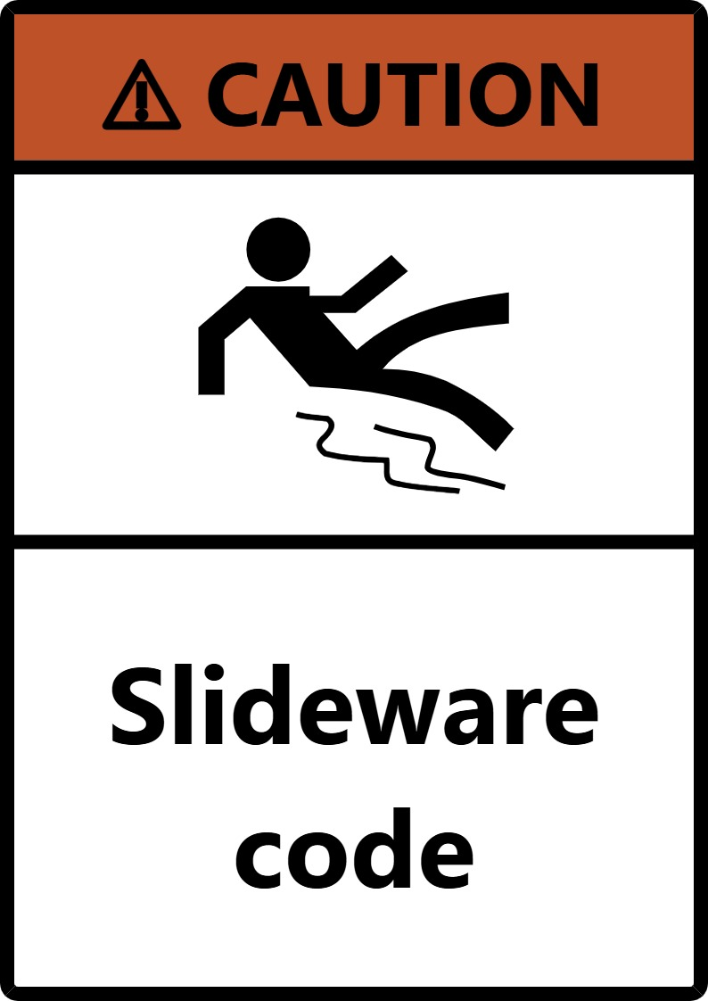
One step beyond
Madness

Slide 56
Step 8: Compile time checking

Slide 57
Haskell
data OptionalInt = Some Int | None
deriving (Show)
addOne :: OptionalInt -> OptionalInt
addOne None = None
addOne (Some x) = Some (x + 1)
main :: IO ()
main = do
let value1 = Some 5 :: OptionalInt
let value2 = None :: OptionalInt
print $ addOne value1 -- Output: Some 6
print $ addOne value2 -- Output: None

Slide 58
mp::strict_not_null
copy gsl::strict_not_null
Extra overloads to handle std::optional<strict_not_null<std::unique_ptr>>

Slide 59
mp::maybe_null
Deprecates *, ->
as_optional_not_null
as_variant_not_null
visit
ptr.hpp#L488
maybe_null_tests.cpp#L358

Slide 60
mp::borrower and mp::owner
Owner cannot share ownership
Owner can share usage with borrower
Borrower can share usage with another borrower
Borrower cannot give away ownership

Slide 61
mp::owner
Cannot be assigned to another owner
auto fail()
{
int p;
mp::borrower<int*> ptr{&p};
// ERROR: cannot create an owner from a borrower.
mp::owner<int*> owner{ptr};
return owner;
}

Slide 62
mp::owner
as_borrower
borrower<T>
as_borrower() const {
return borrower<T>(this->get());
}
Borrower explicit constructor
template<Pointer U>
explicit borrower(owner<U> const &other)

Slide 63
mp::borrower
Compile time failure for delete
  Can delete a pointer to a borrower
  Can delete the pointer the borrower contains (BAD)
  Cannot delete an object.
  mp::borrower<int*> p;
  delete p;

Slide 64
Backlog
Force check of maybe null
What is the binary representation of 0

Slide 65
Nullptr binary representation
conv.ptr
basic.compound
On most platforms, a null pointer is represented by a binary value of all zeros (e.g., 0x00000000 on a 32-bit system). However, this is not guaranteed by the standard. Some platforms might use a different representation for null pointers.

Slide 66
Backlog
What is the binary representation of 0

Slide 67
Summary
Three dimensions:
Can be null?
Collection?
Ownership?
Strict typing
provides compile
time checks

Slide 68
Thank you
marcpawl@gmail.com

