Slide 1
HERMES : Requirements Management System

Slide 2
HERMES : Requirements Management System
Manage a product’s specification.
  A set of requirements (id, text, category)
Developed as a playground
  For teaching software architecture
Available on Github
  https://github.com/marcpetit/hermes

Slide 3
Requirements
Create a product.
Create a product version.
Create a requirements category.
Create a product requirement, linked to a product version and attached to a category.
Delete previous elements.
Modify previous elements.
Save and load a product specification.

Slide 4
Model
Product
name (String) reference (String)
*
*
*
Milestone
id (String)
Requirement
id (String) text (String)
Category
name (String) uri (String) description (String)

Slide 5
Architecture
Views
Controllers
Model

Slide 6





Technologies
JAXB

Slide 7
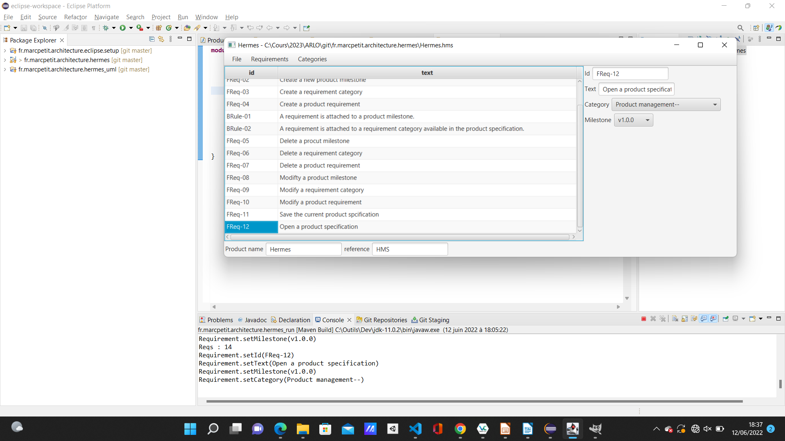
Demo

Slide 8
Thank you for your attention

