Slide 1

Anomalies in Multivariate Time Series Anomaly Detection Benchmarks Are Mostly Univariate
Marc PINET ¹,²
Julien CUMIN ¹
Samuel BERLEMONT ¹
Dominique VAUFREYDAZ ²
¹ Orange Research
² Univ. Grenoble Alpes, CNRS, Grenoble INP, LIG

Slide 2
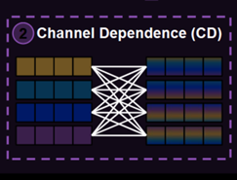
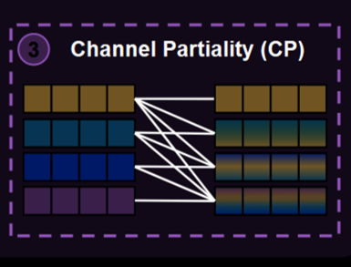
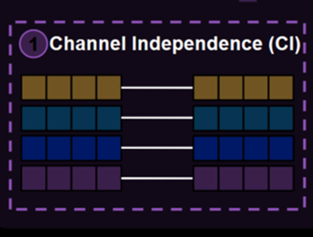
State-of-the-art of Multivariate Anomaly Detection: CI vs CD vs CP
Channel-dependent (CD)
OmniAnomaly (Su et al. 2019)
MSCRED (Zhang et al. 2019)
USAD (Audibert et al. 2020)
TranAD (Tuli et al. 2022)
… and more
Channel-partiality (CP)
Graph-based: GDN (Deng & Hooi 2021), MTAD-GAT (Zhao et al. 2020), …
MLP-mixers: PatchAD (Zhong et al. 2025), CCM-TAD (Murad & Yilmaz 2025), …
Cross-channel Attention: CATCH (Wu et al. 2025), XCTFormer (Zexer & Azencot 2026), …
Hybrid CI/CD: DBAD (Sun et al. 2025)
… and more
Channel-independent (CI)
CrossAD (Li et al. 2025)
DADA (Shentu et al. 2025)
DCdetector (Yang et al. 2023)
KAN-AD (Zhou et al. 2025)
CiTranGAN (Chen et al. 2025)
… and more
Original way of training TS models (before CI and CP)
Emerging trend since PatchTST (Nie et al. 2023) in forecasting
Source: A Comprehensive Survey of Deep Learning for MTS Forecasting: A Channel Strategy Perspective, Qiu et al. (2025)

Slide 3
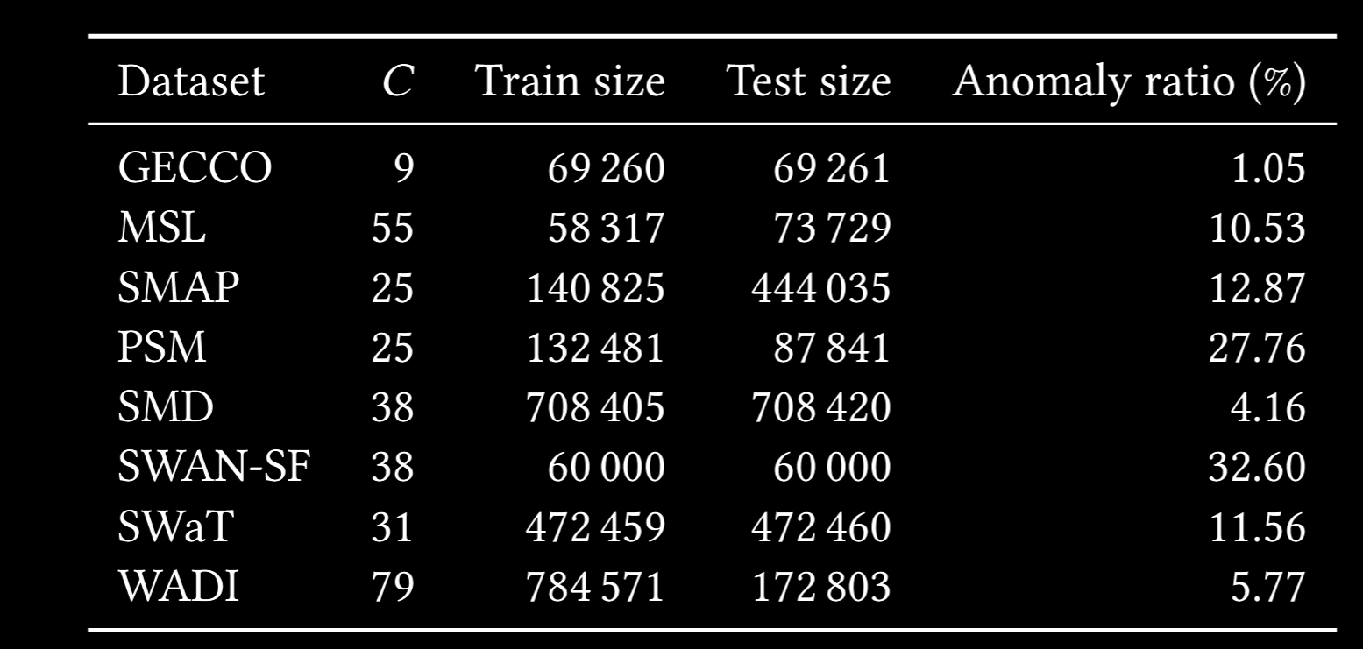
Evaluation using the same public benchmarks
GECCO (Water Quality Dataset) - Moritz et al. 2018
MSL (Mars Science Laboratory) - Hundman et al. 2018
SMAP (Soil Moisture Active Passive) - Hundman et al. 2018
PSM (Pooled Server Metrics) - Abdulaal et al. 2021
SMD (Server Machine Dataset) - Su et al. 2019
SWAN-SF (Space Weather ANalytics for Solar Flares) - Angryk et al. 2020
SWaT (Secure Water Treatment) - Goh et al. 2017
WADI (WAter DIstribution) - Ahmed et al. 2017

Slide 4
The problem On these benchmarks, CI beats CD and CP, why?
Known suspicions were never quantified
Wu & Keogh 2021 (Univariate scope only) Benchmarks are flawed
Garg et al. 2022 A univariate AE beats SOTA models
Wenig et al. 2024 Univariate detectors beat multivariate ones on real benchmarks
Explanatory hypothesis
- Garg 2022, Wenig 2024 If univariate (CI) models already perform well on these benchmarks…
… do these benchmarks require cross-channel modeling at all?
Let’s infer directly on the data rather than on detector performances…

Slide 5
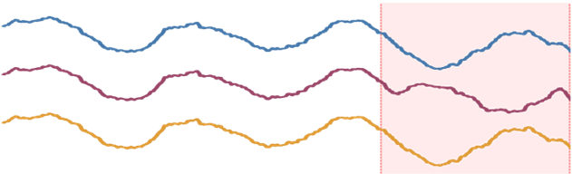
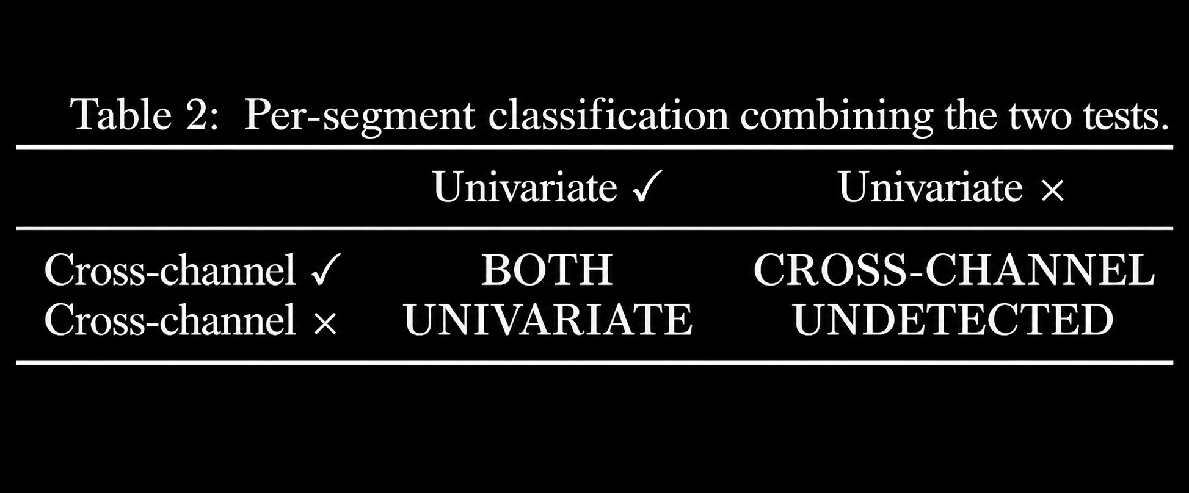
Methodology Characterize the dataset, not the detector!
For each labeled anomalous segment:
Define normal history
Use history to characterize
Classify into 4 categories
Characterizations
univariate Univariate Test density of univariate timesteps Univariate Ratio
cross-channel structure Correlation Test
Classification
ch0
ch1
ch2
Normal history
Anomaly
with lag support

Slide 6
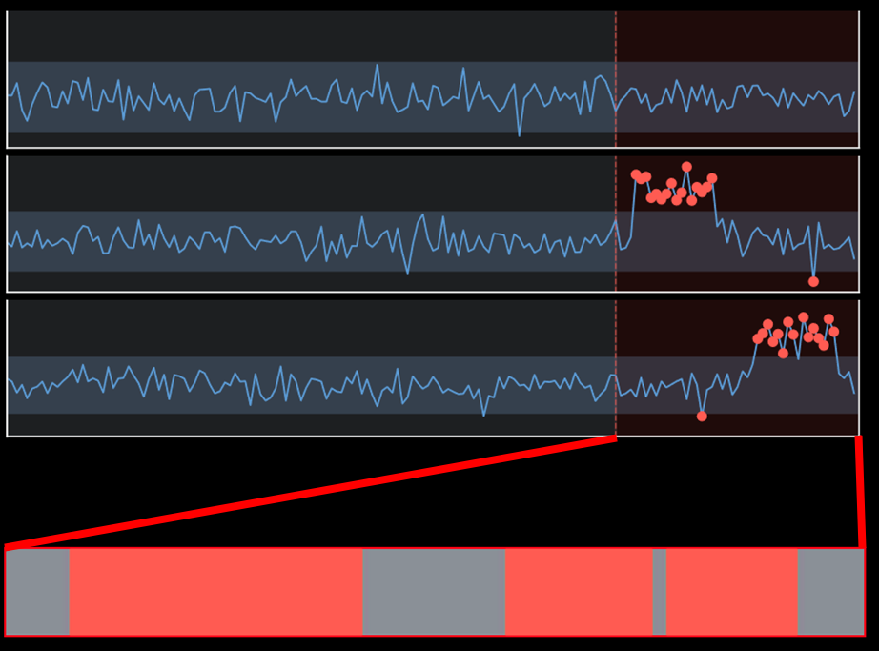

Univariate Test & Univariate Ratio
Univariate Test
One channel carries the contextual anomaly
Univariate Ratio
Ratio of timesteps that trigger the univariate test in a contextual anomaly
31/48 anomalous timesteps = 0.65

Slide 7
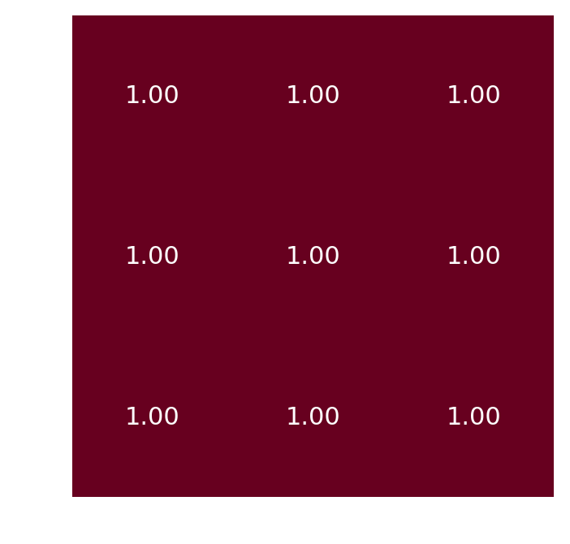
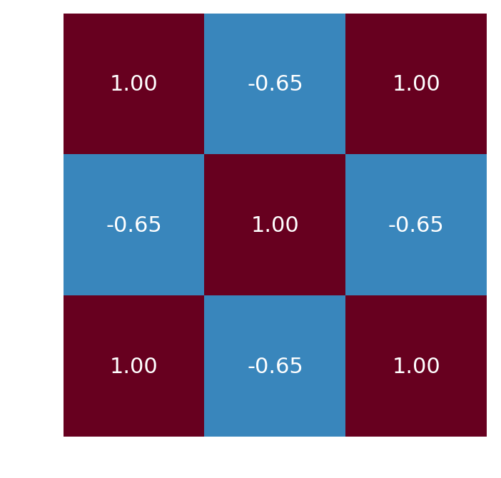
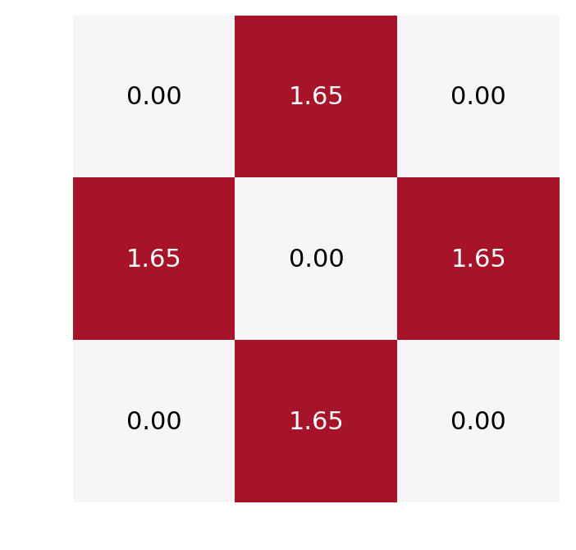


Change in cross-channel structure
ch0
ch1
ch2
Normal history
Anomaly
Correlations in normal history
Correlations in anomaly
Correlation change
$$−$$
$$=$$

Slide 8
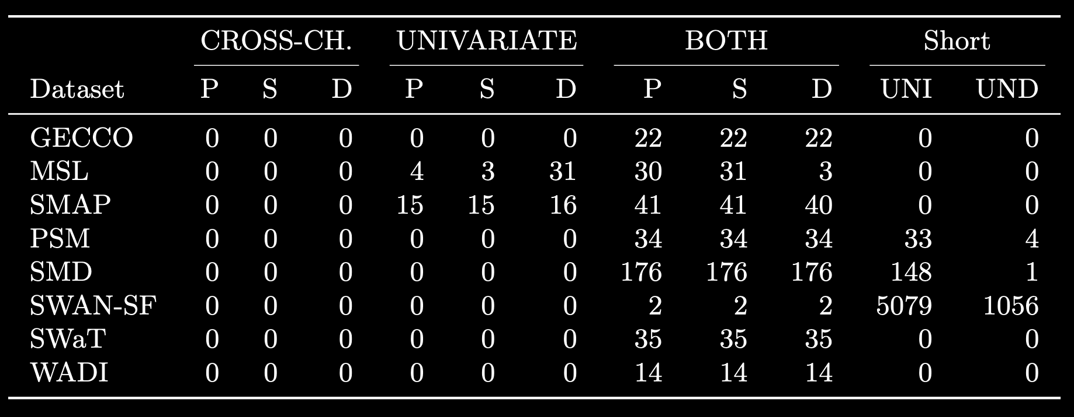

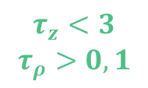
Classification results on these benchmarks
$$τ_{z}<3$$
$$τ_{ρ}>0,1$$
At reasonable thresholds, no pure cross-channel anomalies
Even at the most permissive thresholds,
only 9% of all segments across all benchmarks are purely cross-channel.

Slide 9
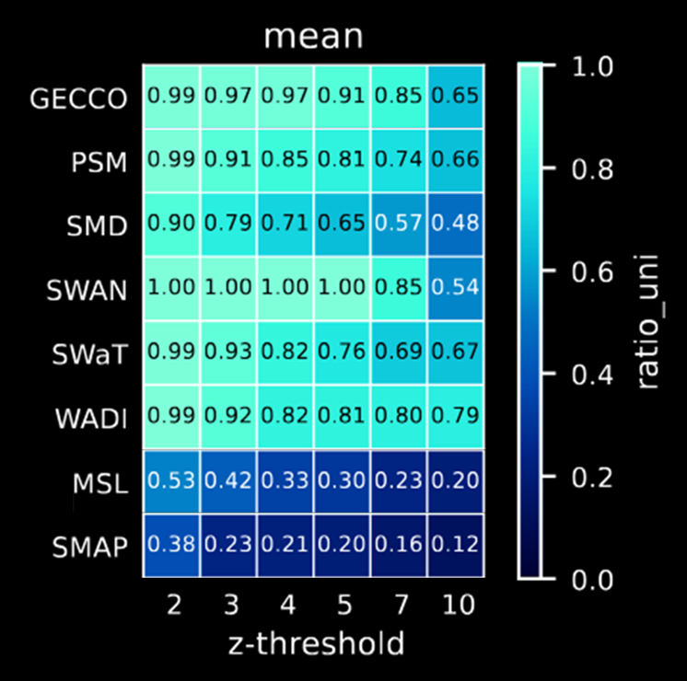
Univariate ratio: not a lone spike, univariate (almost) everywhere!
We evaluate how univariate the anomalies are
Even with absurd thresholds, most of them are still very univariate
Avg. anomaly: ~80-100% univariate timesteps!
Binary channels ➜ fallback to Univariate Matrix Profile
27/31 and 37/43 segments recovered (~87%)

Slide 10
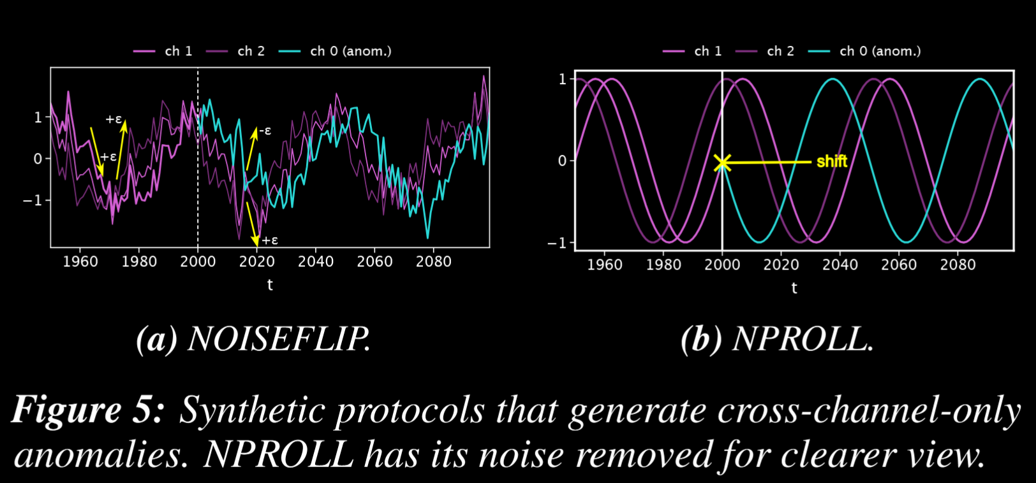
But can our framework detect cross-channel anomalies when present?
Synthetic datasets with CROSS-CHANNEL-only anomalies
*noise removed for clearer view

Slide 11
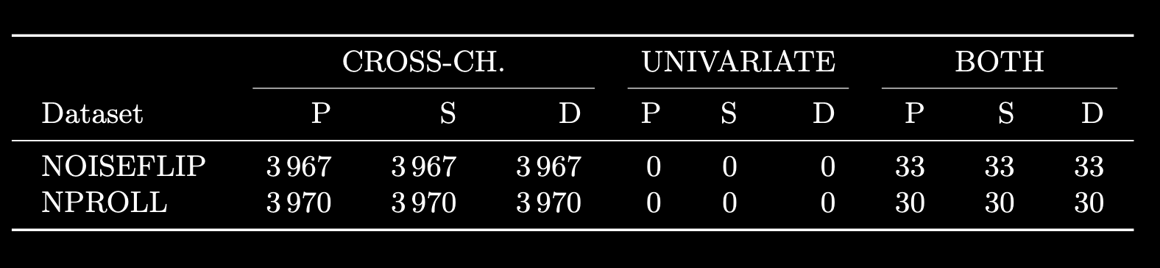
Our framework correctly characterizes the synthetic anomalies!
Classification results out of 4000 segments
99.2% success rate
Outliers due to Gaussian noise
No segment misclassified as UNIVARIATE

Slide 12
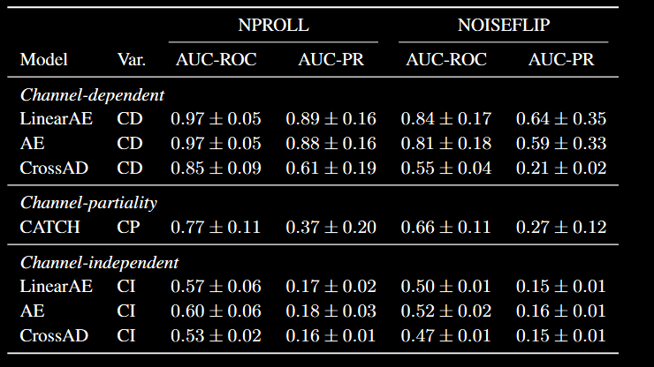
How does CD perform compared to CI on these synthetic data?
✅
〰️
❌
Source: CrossAD: Time Series Anomaly Detection with Cross-scale Associations and Cross-window Modeling, Li et al. (NeurIPS 2025)
Source: CATCH: Channel-Aware Multivariate Time Series Anomaly Detection via Frequency Patching, Wu et al. (ICLR 2025)

Slide 13
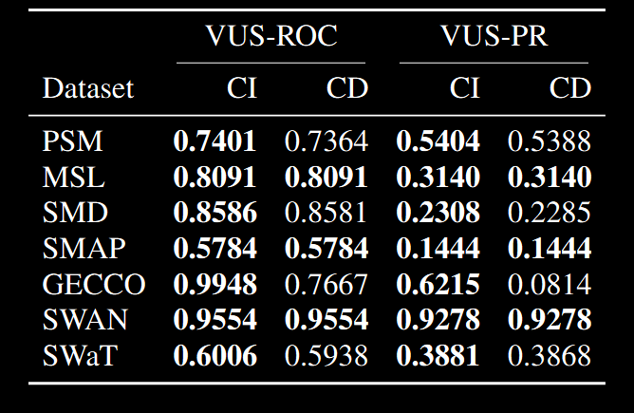
How does CrossAD (CD) perform against (CI) on real benchmarks?
CrossAD (CD) detects cross-channel ruptures yet brings no gain over CrossAD (CI) on real benchmarks.

Slide 14
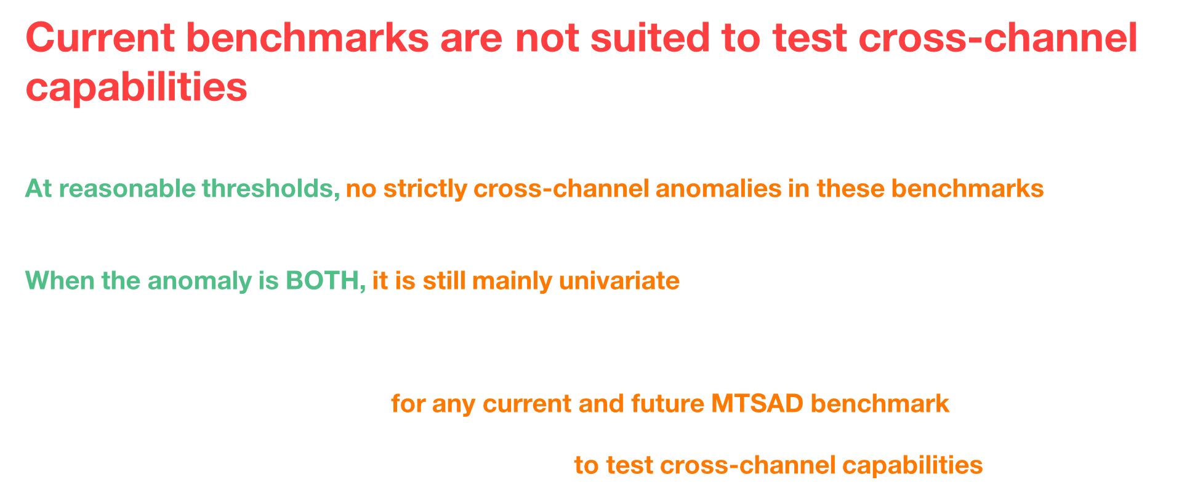
Conclusion
Current benchmarks are not suited to test cross-channel capabilities
At reasonable thresholds, no strictly cross-channel anomalies in these benchmarks
They do appear at extreme ones but remain scarce ($<9\%$ of the segments in all benchmarks)
When the anomaly is BOTH, it is still mainly univariate
The average anomaly deviates univariately on ~80-100% of its timesteps
Our framework is reusable for any current and future MTSAD benchmark
Our NPROLL and NOISEFLIP can be used to test cross-channel capabilities

Slide 15
Future Work
What to do next?
Development of more suited benchmarks to evaluate cross-channel modeling capabilities
Evaluate more datasets and focus on finding real cross-channel anomalies.
Advice for future benchmarks
No more channel anonymization!
If applicable, label per channel, not just per timestep
This could also pave the way for anomaly explanation…

Slide 16

Thank you!
Paper
Code

Slide 17
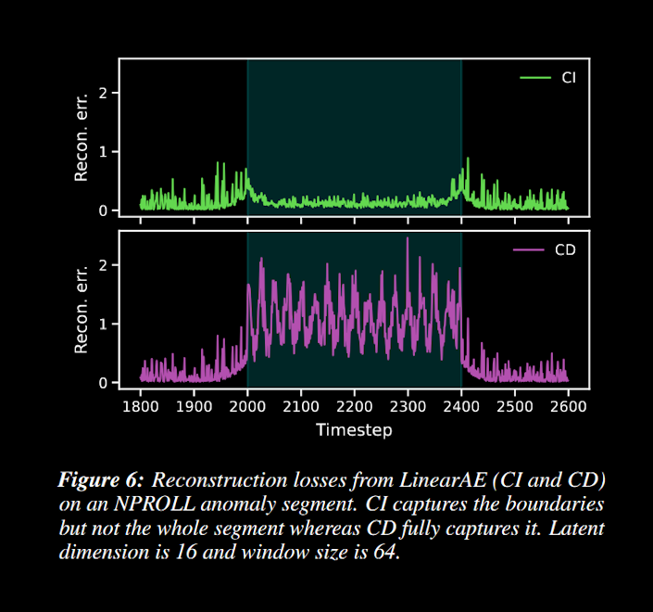
NPROLL Reconstruction Error

Slide 18
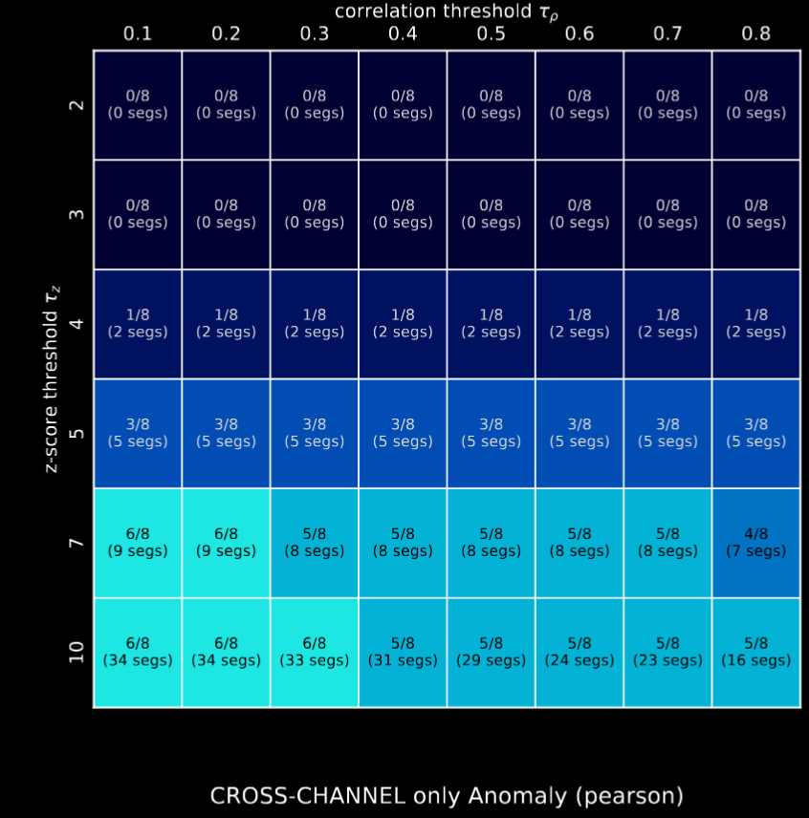
Anomaly characterization along two axes: threshold sensitivity
N/8 = how many benchmarks have a CROSS-CHANNEL anomaly
( … segs) = how many segments are CROSS-CHANNEL (sum on all benchmarks)
No CROSS-CHANNEL anomaly at reasonable thresholds
Even at the most permissive thresholds, only 9% of the segments for all benchmarks are CROSS-CHANNEL!

Slide 19
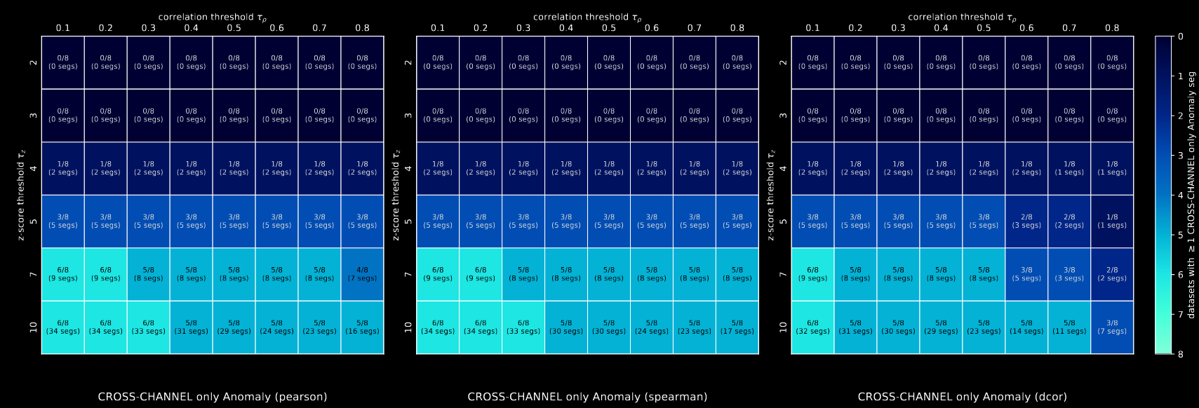
All correlation metrics
Number of CROSS-CHANNEL segments at different thresholds $τ_{z}$

Slide 20
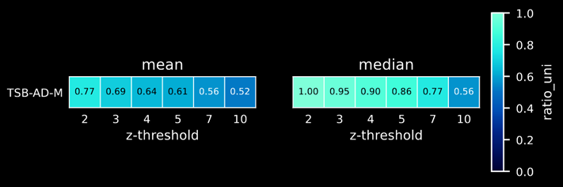
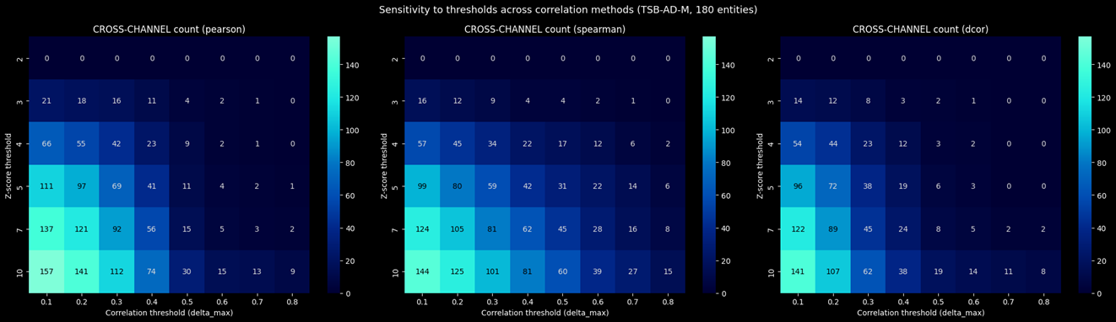
Run on TSB-AD-M
~9000 segments of length < 10 (excluded)
~3000 segments of length > 10:
• ~2500 univariate
• ~500 both
Only some CROSS-CHANNEL-only where $τ_{z}=3$
Number of CROSS-CHANNEL segments at different thresholds $τ_{z}$

Slide 21
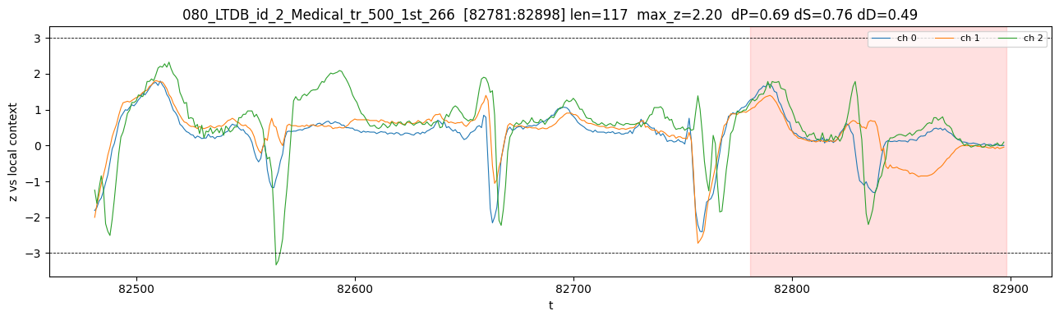
Run on TSB-AD-M: the only dataset that has cross-channel-only anomalies
Source: PhysioBank, PhysioToolkit, and PhysioNet: Components of a New Research Resource for Complex Physiologic Signals, Goldberger et al. (2000)
VUS-PR (mean over all entities of LTDB)
LinearAE-CD : 0.3614
LinearAE-CI : 0.2093
Example

Slide 22
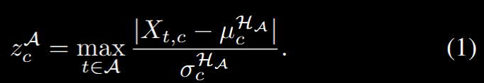
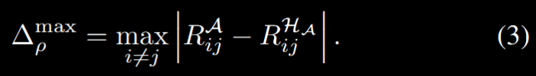
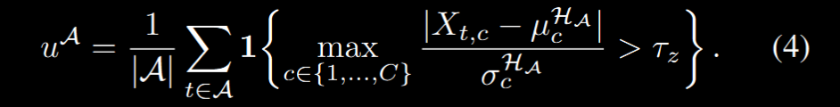
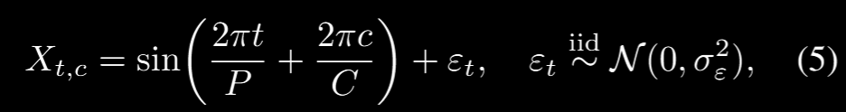
Formulas

Slide 23
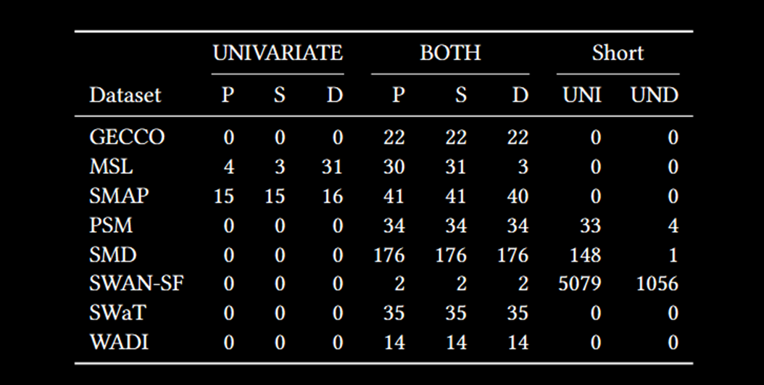
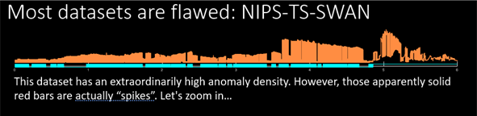

Default thresholds and Matrix Profile on MSL and SMAP
• $τ_{z}=3$
• ${ τ}_{ρ}=0.1$
• $\left|\text{𝒜}\right|≥10$
MSL & SMAP: A Univariate Matrix Profile detected 64/74 segments (after visual inspection, the remaining 10 were known labeling errors)
Source: Current Time Series Anomaly Detection Benchmarks Are Flawed and Are Creating the Illusion of Progress, Wu & Keogh (TKDE 2021)
Source: Irrational Exuberance: Why we should not believe 95% of papers on Time Series Anomaly Detection, Eamonn Keogh (MILETS 2021)

Slide 24
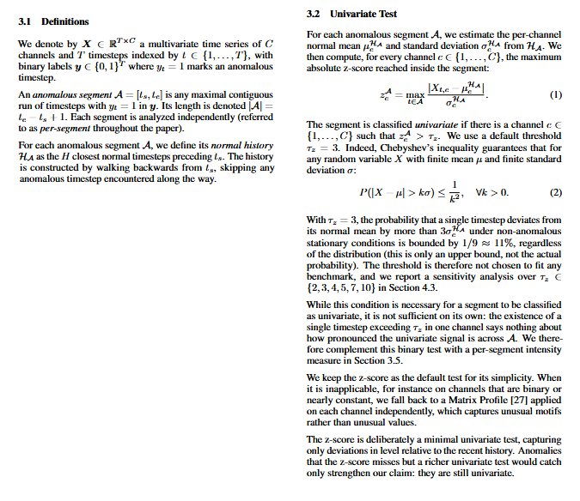
Excerpts from the paper

Slide 25
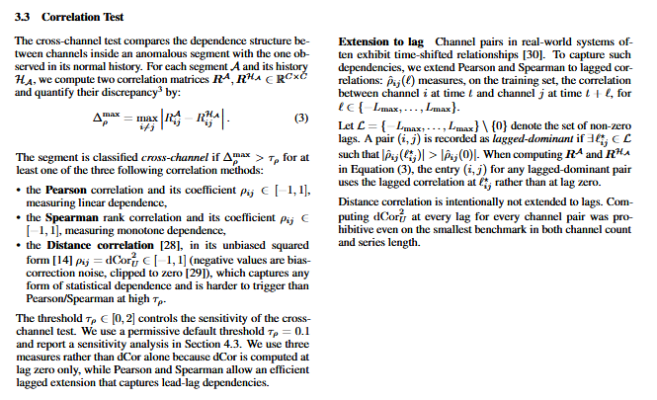
Excerpts from the paper

Slide 26
Excerpts from the paper

Slide 27
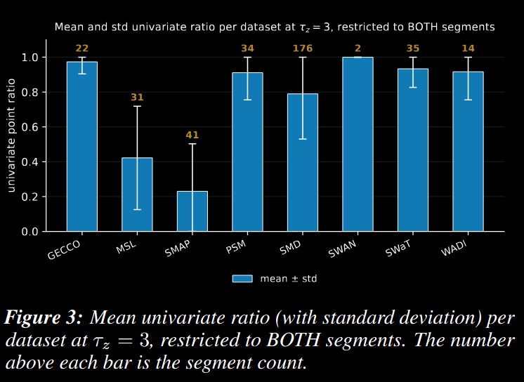
Univariate ratio at tau_z = 3

Slide 28
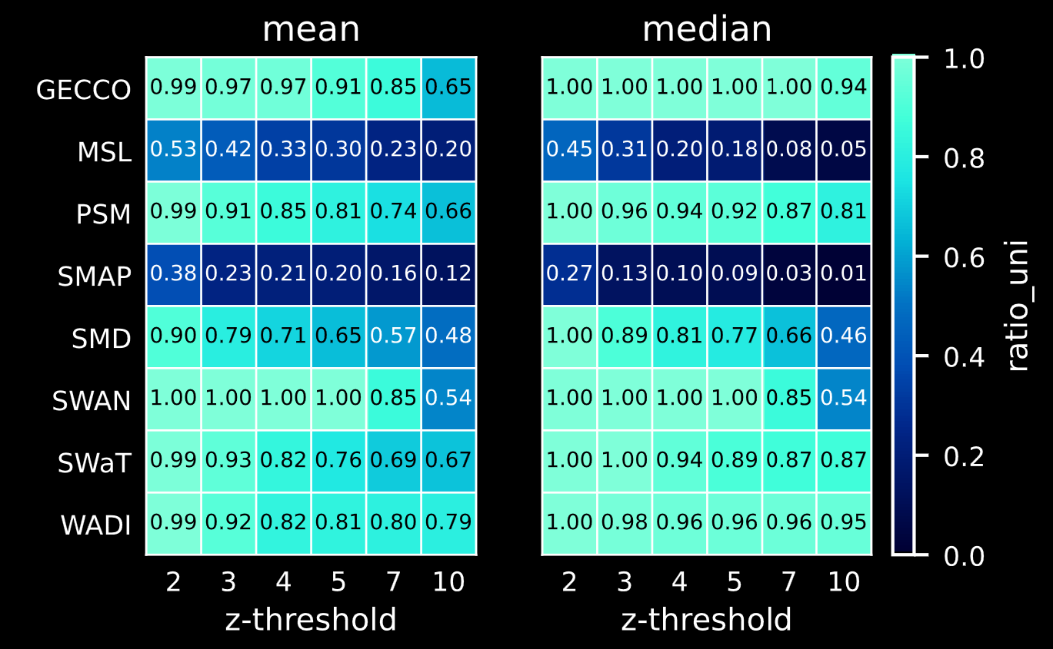
Univariate ratio (mean and median)

