Slide 1
CNN for Alzheimer Disease and Mild Cognitive Impairment discrimination
Marc Rodríguez Salazar

Slide 2

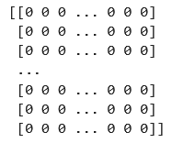
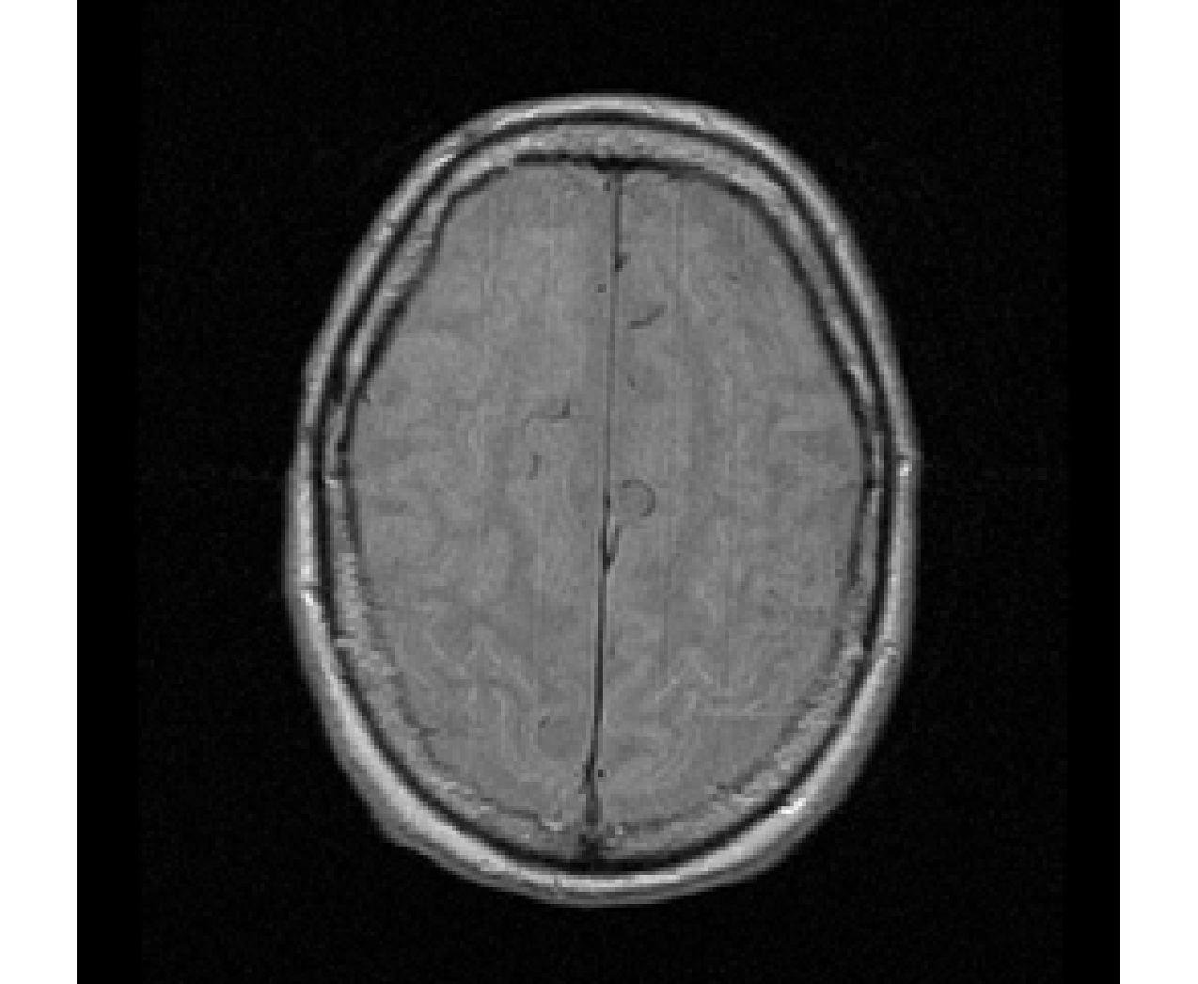
Image treatment
Data from ADNI in Image Data Archive
Pydicom library in Python
.dcm
(DICOM file)
.npy
(numpy matrix)
.png
(Image)

Slide 3
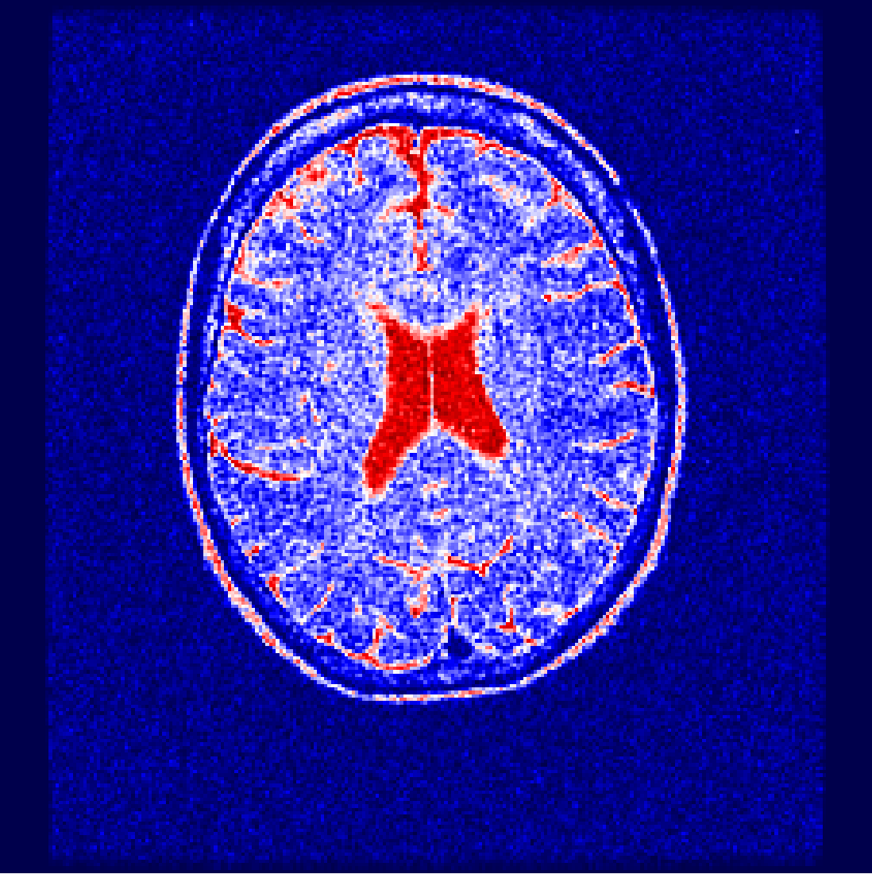
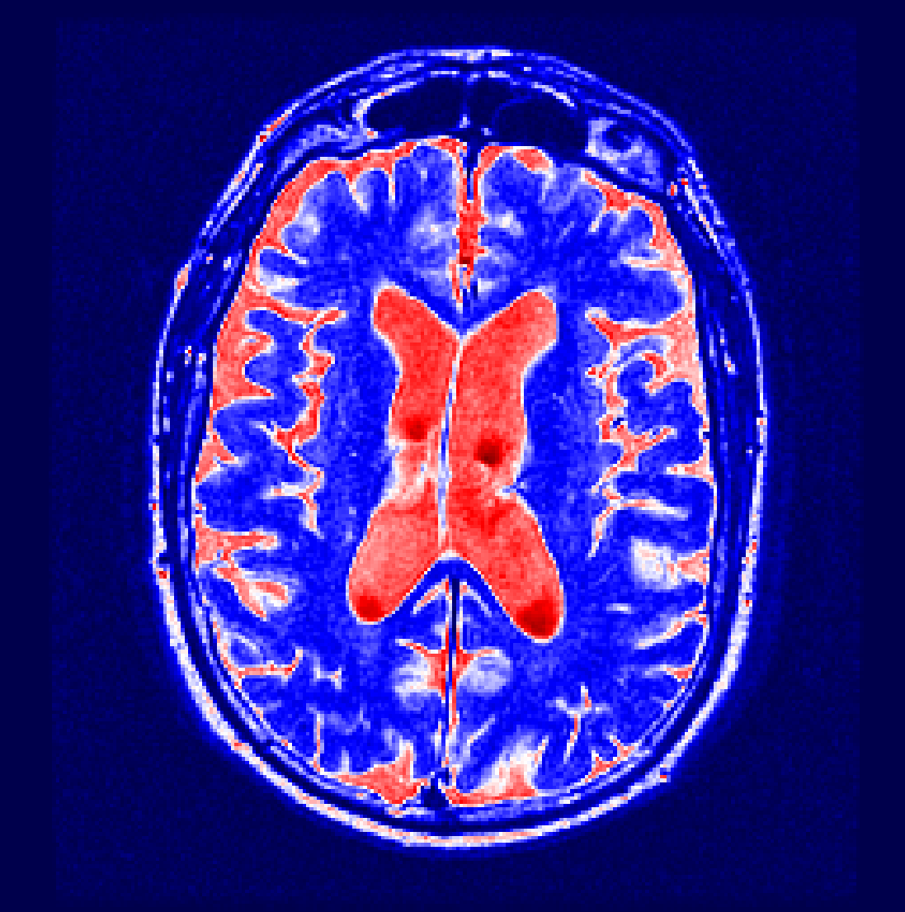
CNN to discriminate AD and MCI
We built a Convolutional Neural Network (CNN) binary classifier to discriminate AD and MCI. These are the types of images we want to differentiate:
Mild Cognitive Impairment (MCI)
Alzheimer Disease (AD)
MCI is the transitional stage between age-related memory decline and the more severe dementia. Is important to differentiate between MCI and AD because the treatment is different.

Slide 4
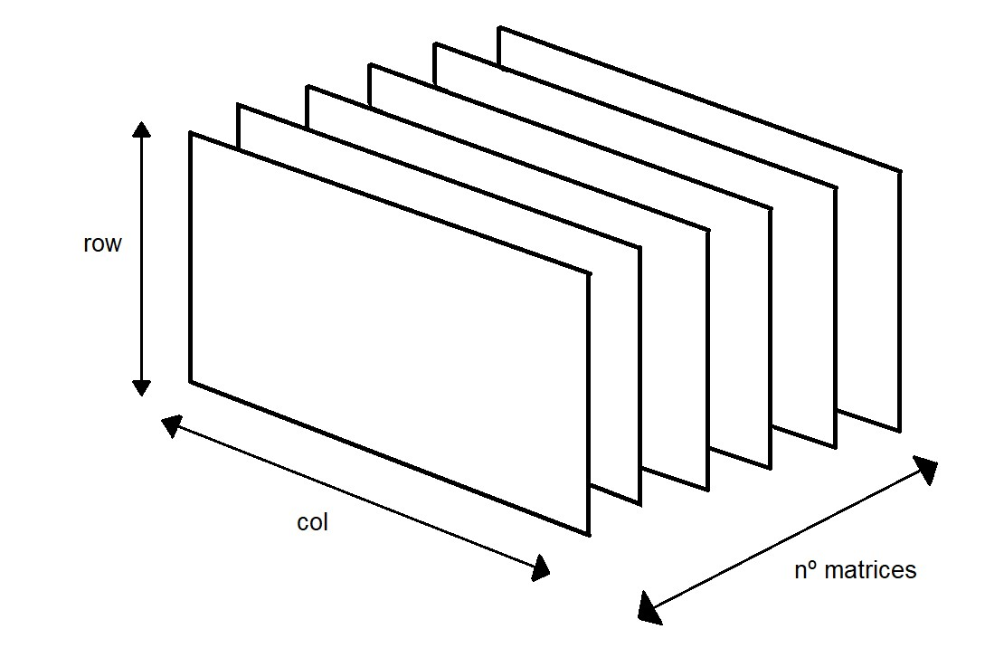
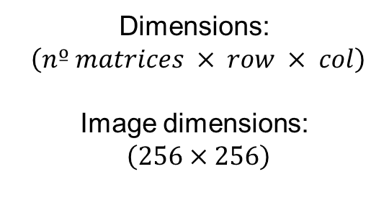
CNN to discriminate AD and MCI
Input (X): a tensor is built with the numpy matrices:
Dimensions:
$\left(nº matrices × row × col\right)$
Image dimensions:
$\left(256×256\right)$
Output (Y): 0 for AD, 1 for MCI
Randomize X and Y and split it into training and test (80% training, 20% test)

Slide 5
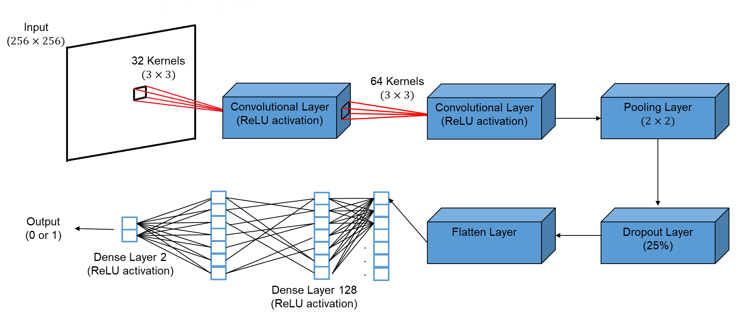
CNN to discriminate AD and MCI
CNN structure

Slide 6
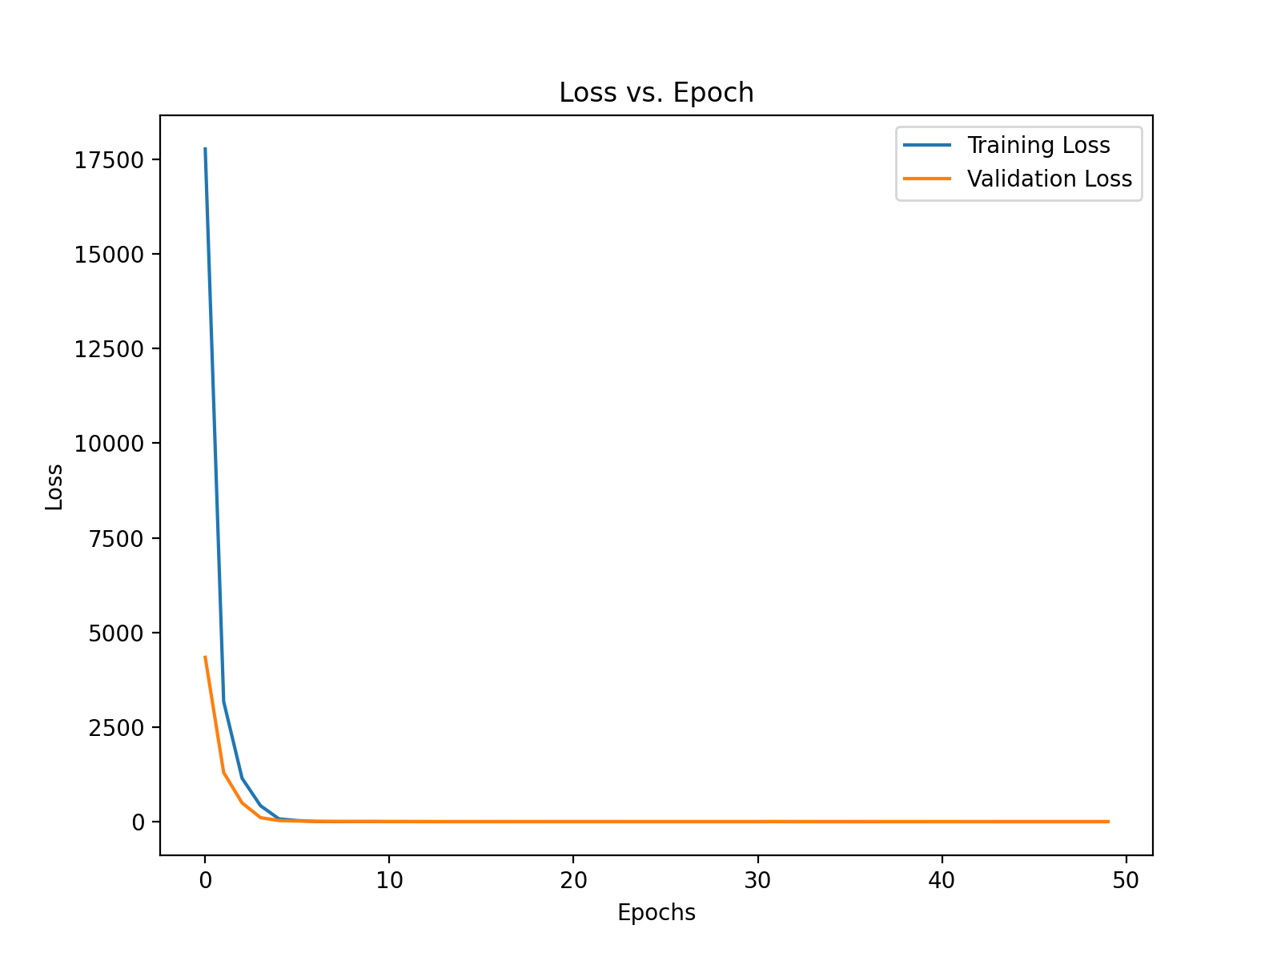
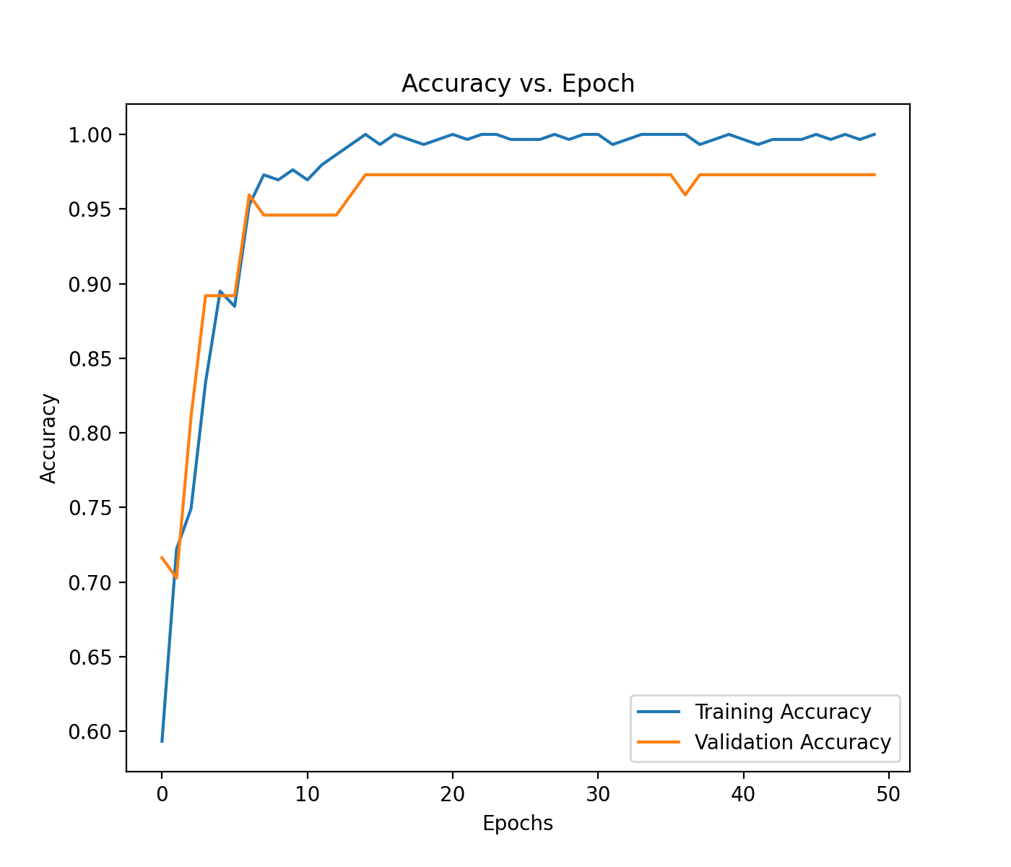
CNN Results
50 epochs of training
Loss and Accuracy graphs:

Slide 7
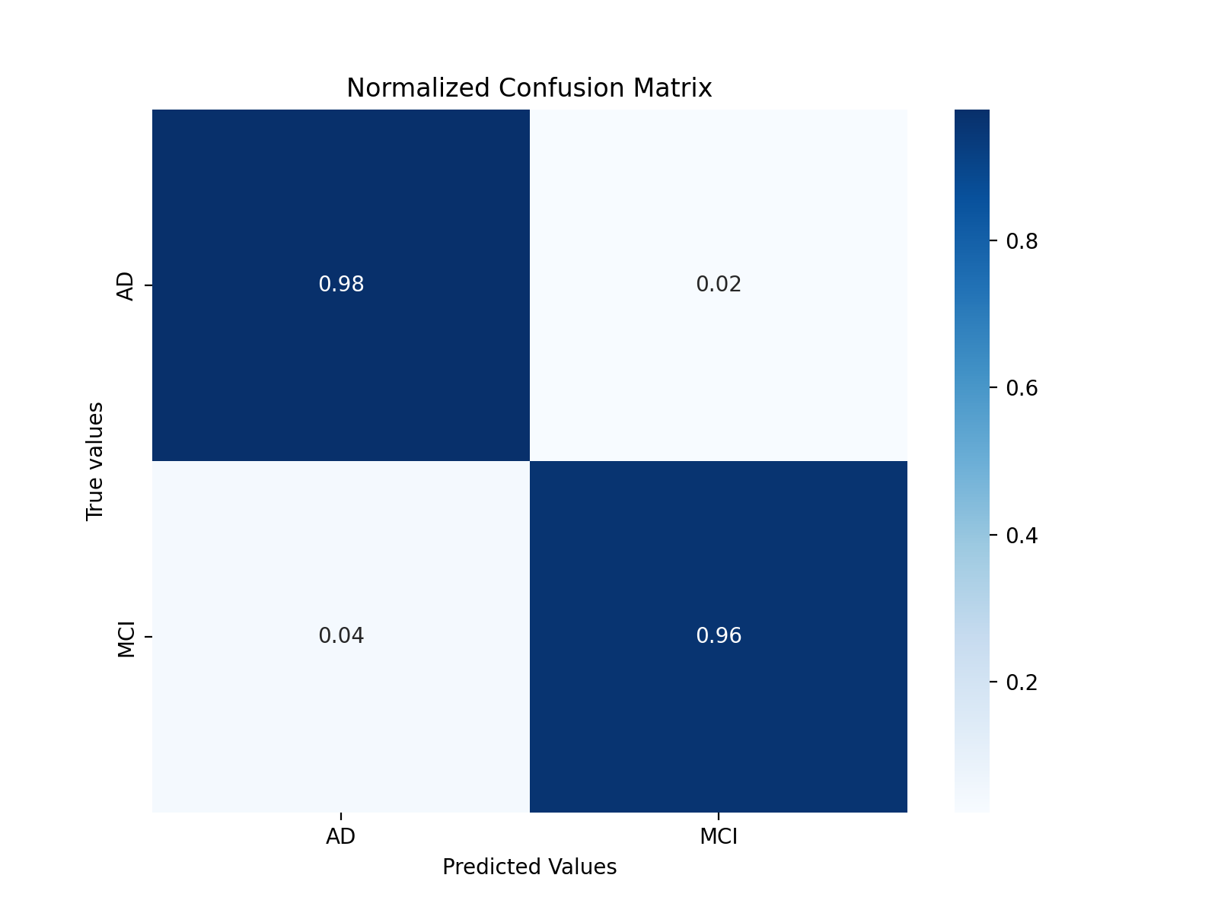
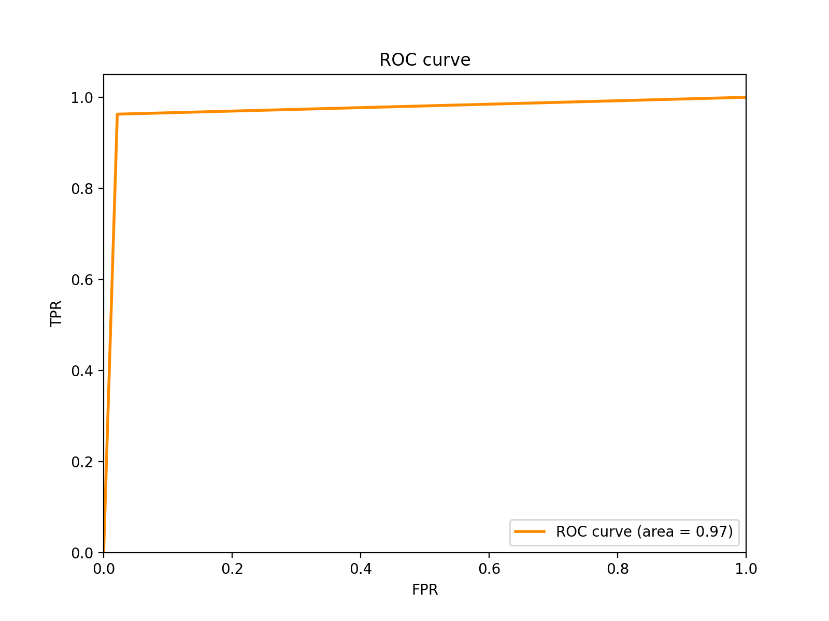
CNN Results
Good discrimination between AD and MCI (98% and 96% respectively)

