Slide 1

Notes:
Speaker notes: Welcome. This deck introduces three complementary, additive drafts: a canonical Avro binary encoding for OPC UA, a domain-neutral registry base (xRegistry), and an in-server Schema Registry built on it. Everything shown is a working draft with a reference C# implementation and an executable reversibility corpus — the goal today is to motivate the design and gather reviewer feedback, not to ratify text.

Slide 2
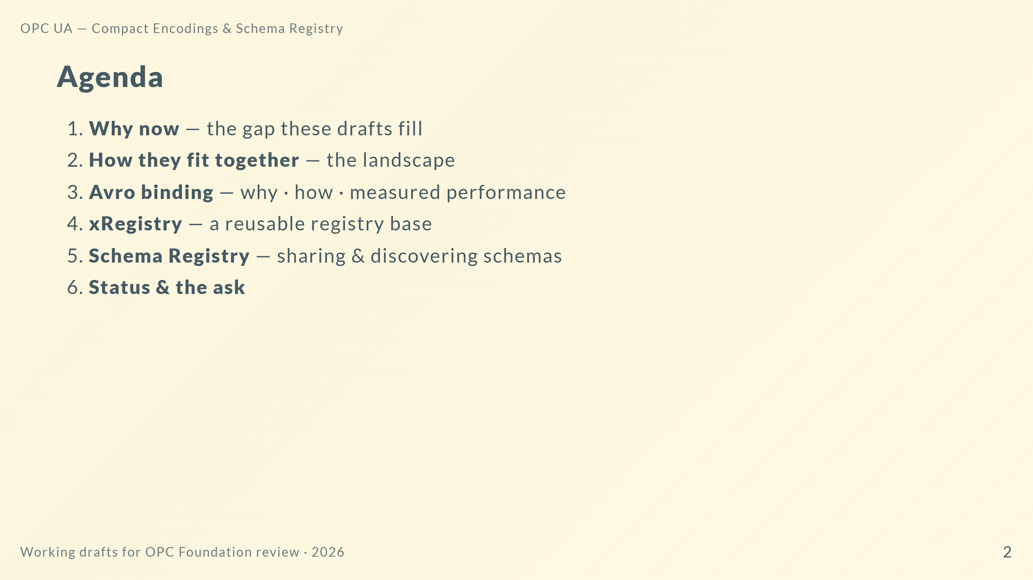
Notes:
Speaker notes: Four content blocks. The bulk of the technical detail is Avro, because it is the piece with hard performance numbers. xRegistry and Schema Registry are about interoperable schema sharing. We close with where the drafts stand and what we need from reviewers.

Slide 3
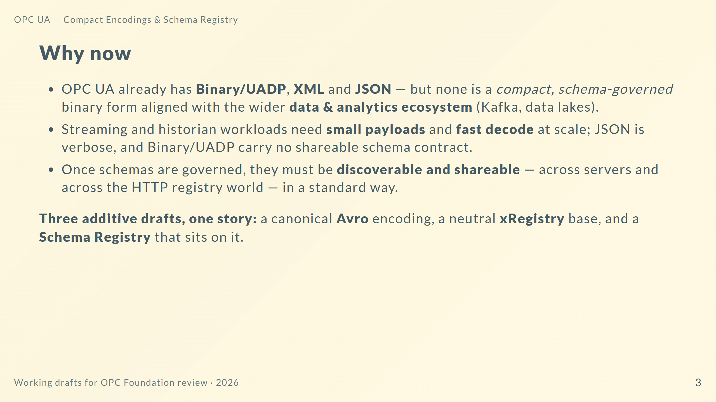
Notes:
Speaker notes: The framing is "additive, not replacement." We are not deprecating any existing encoding. Avro fills the compact-schema-governed niche and bridges to the analytics ecosystem. The registries make the schemas first-class, discoverable objects — the same way an HTTP xRegistry would, so OPC UA and non-OPC-UA consumers share one model.

Slide 4
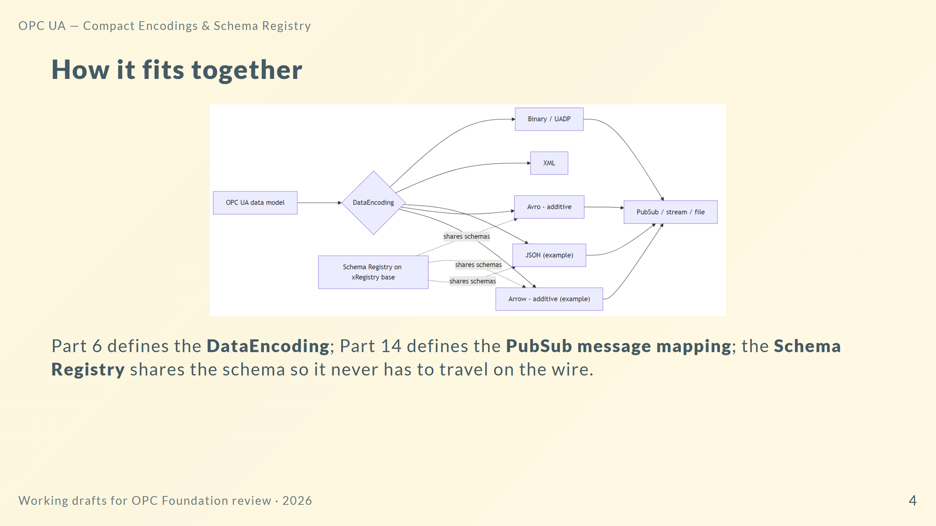
Notes:
Speaker notes: Left to right, the same OPC UA value can be rendered by any encoding. Avro and Arrow are the new additive ones. The registry is orthogonal — it governs and shares the schema so schema-governed encodings can keep the schema off the wire. Arrow is shown for context; today's ask is Avro plus the registries.

Slide 5
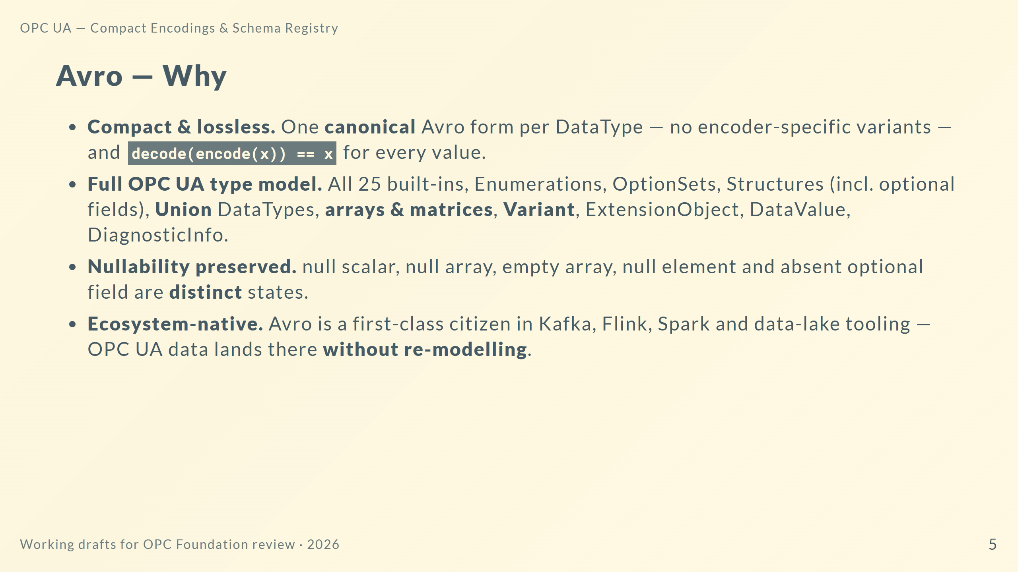
Notes:
Speaker notes: The two headline properties are "one canonical form" and "provably reversible." Reviewers often ask about matrices and about null-versus-empty — both are explicitly preserved, and there is a 107-case corpus that proves it. The strategic point is ecosystem fit: emitting Avro means OPC UA telemetry is directly consumable by the mainstream streaming and analytics stack.

Slide 6
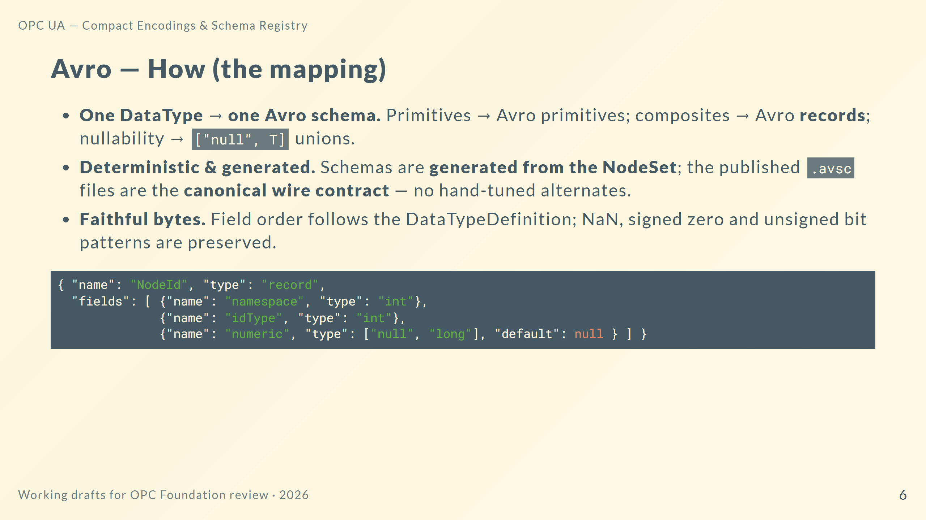
Notes:
Speaker notes: The mapping is mechanical and generator-driven, which is what makes it auditable and drift-free. The .avsc files are normative — implementers consume them directly. The NodeId snippet shows the union-for-nullability pattern and the record shape; the full per-type reference (schema, example, annotated bytes) is generated in the Part 6 annex.

Slide 7
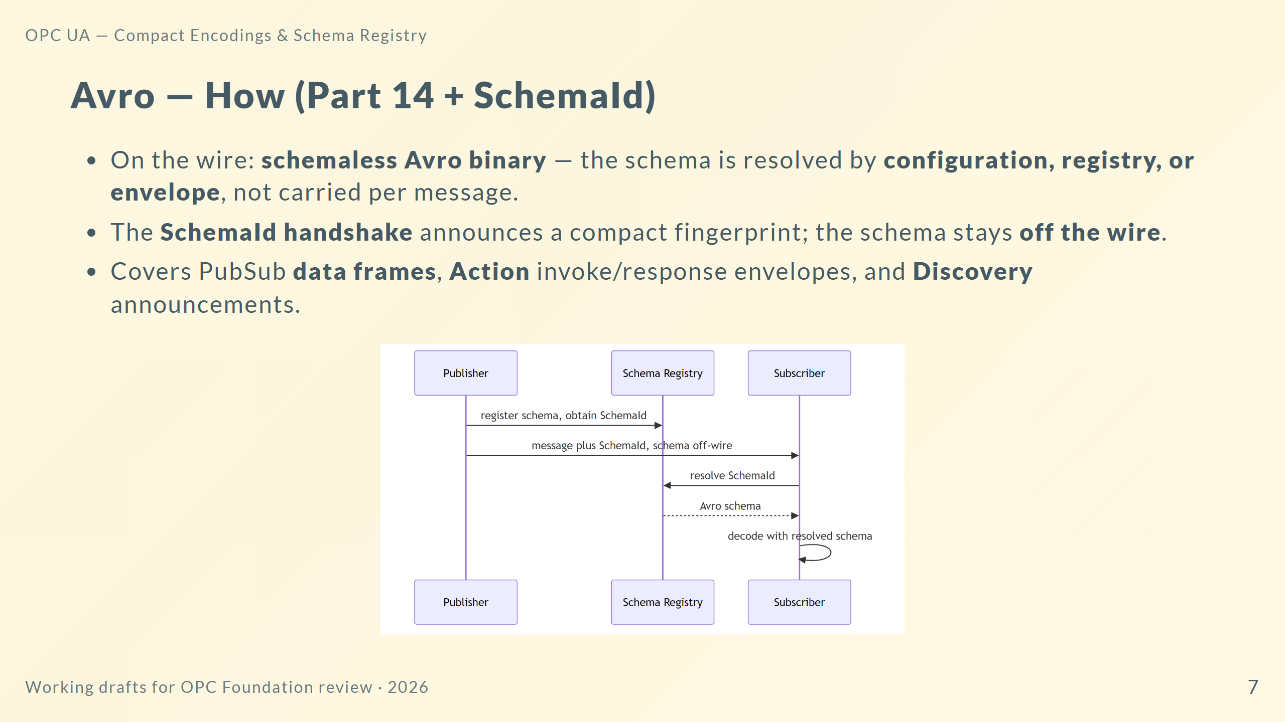
Notes:
Speaker notes: This is where the registry earns its keep. Publishers reference a SchemaId; subscribers resolve it once and cache it. The schema never rides in every message, which is the difference between JSON-style self-description and a schema-governed channel. The same handshake model is reused by the Arrow batch framing.

Slide 8
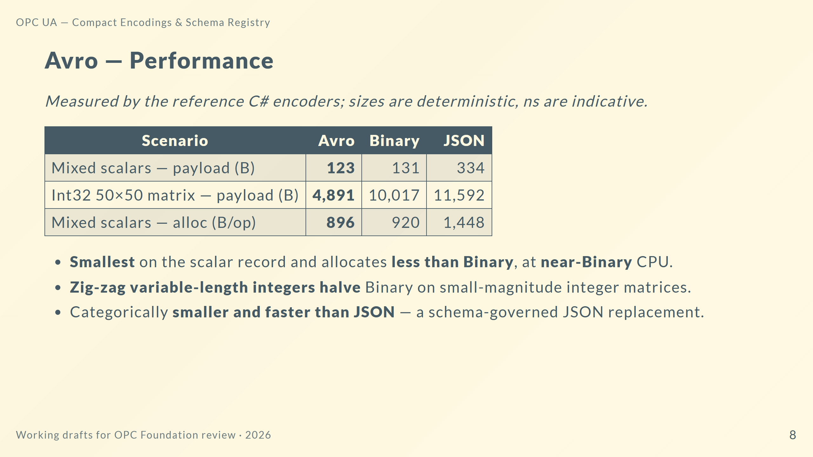
Notes:
Speaker notes: These are from the informative performance report in the repo. Two deterministic wins: Avro is the smallest scalar payload and allocates below Binary, and variable-length integers halve Binary on integer-heavy matrices — 4.9 KB versus 10 KB. Framing on timings: treat them as orders of magnitude. Bottom line: Avro is the solid all-rounder and the right replacement wherever JSON is used today.

Slide 9
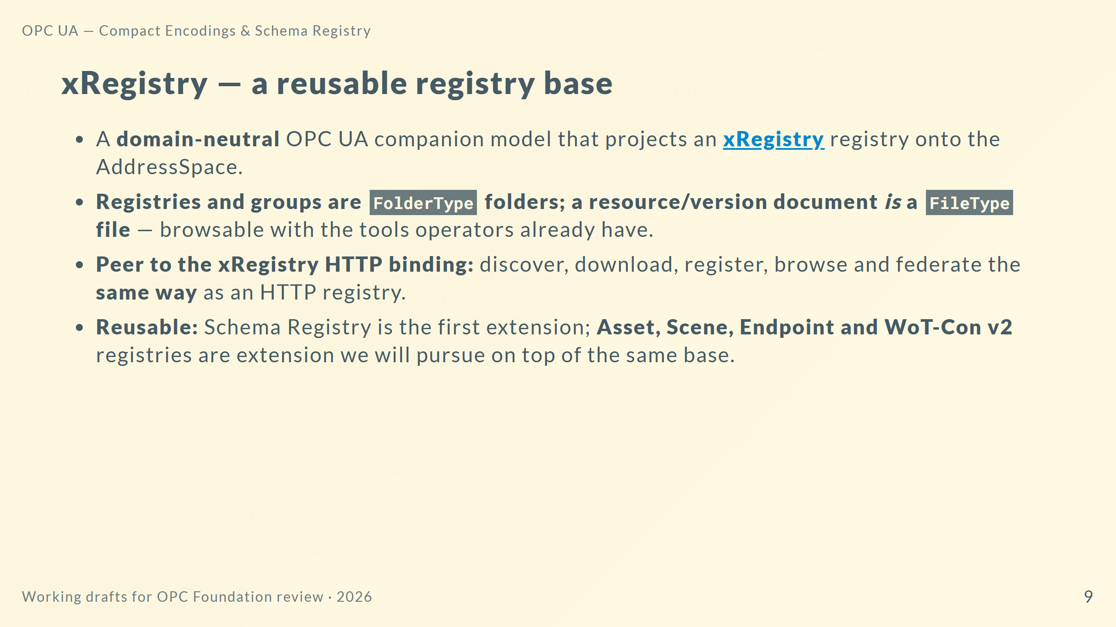
Notes:
Speaker notes: xRegistry is deliberately not about schemas. It is a generic registry projection — folders and files — so any registry domain can reuse it. The key interoperability claim is peer bindings: an OPC UA xRegistry and an HTTP xRegistry are two faces of one model, so tooling and federation carry across. That is what makes the Schema Registry more than an OPC-UA-only feature.

Slide 10
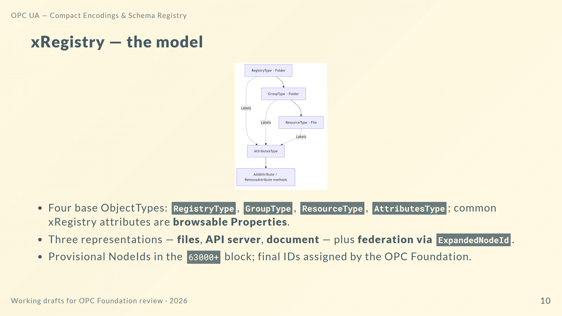
Notes:
Speaker notes: The model is minimal-first: three container types plus an attributes container. Labels and arbitrary attributes materialise as real, browsable Property variables added and removed by methods, so a generic OPC UA client sees them without special knowledge. Federation via ExpandedNodeId is how registries reference resources in other registries or servers.

Slide 11
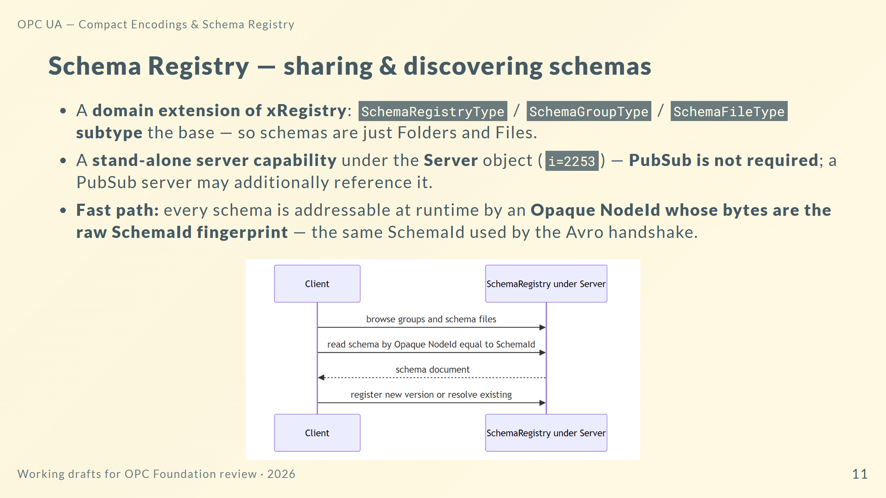
Notes:
Speaker notes: This closes the loop with the Avro handshake: the SchemaId a publisher announces is literally the NodeId you read to fetch the schema — no lookup table. It is a stand-alone capability, so any server can be a schema registry without PubSub. Versioning, evolution and federation follow the xRegistry model; the PubSub DataSet-schema behaviour is isolated in an optional Annex profile so it does not burden non-PubSub servers.

Slide 12
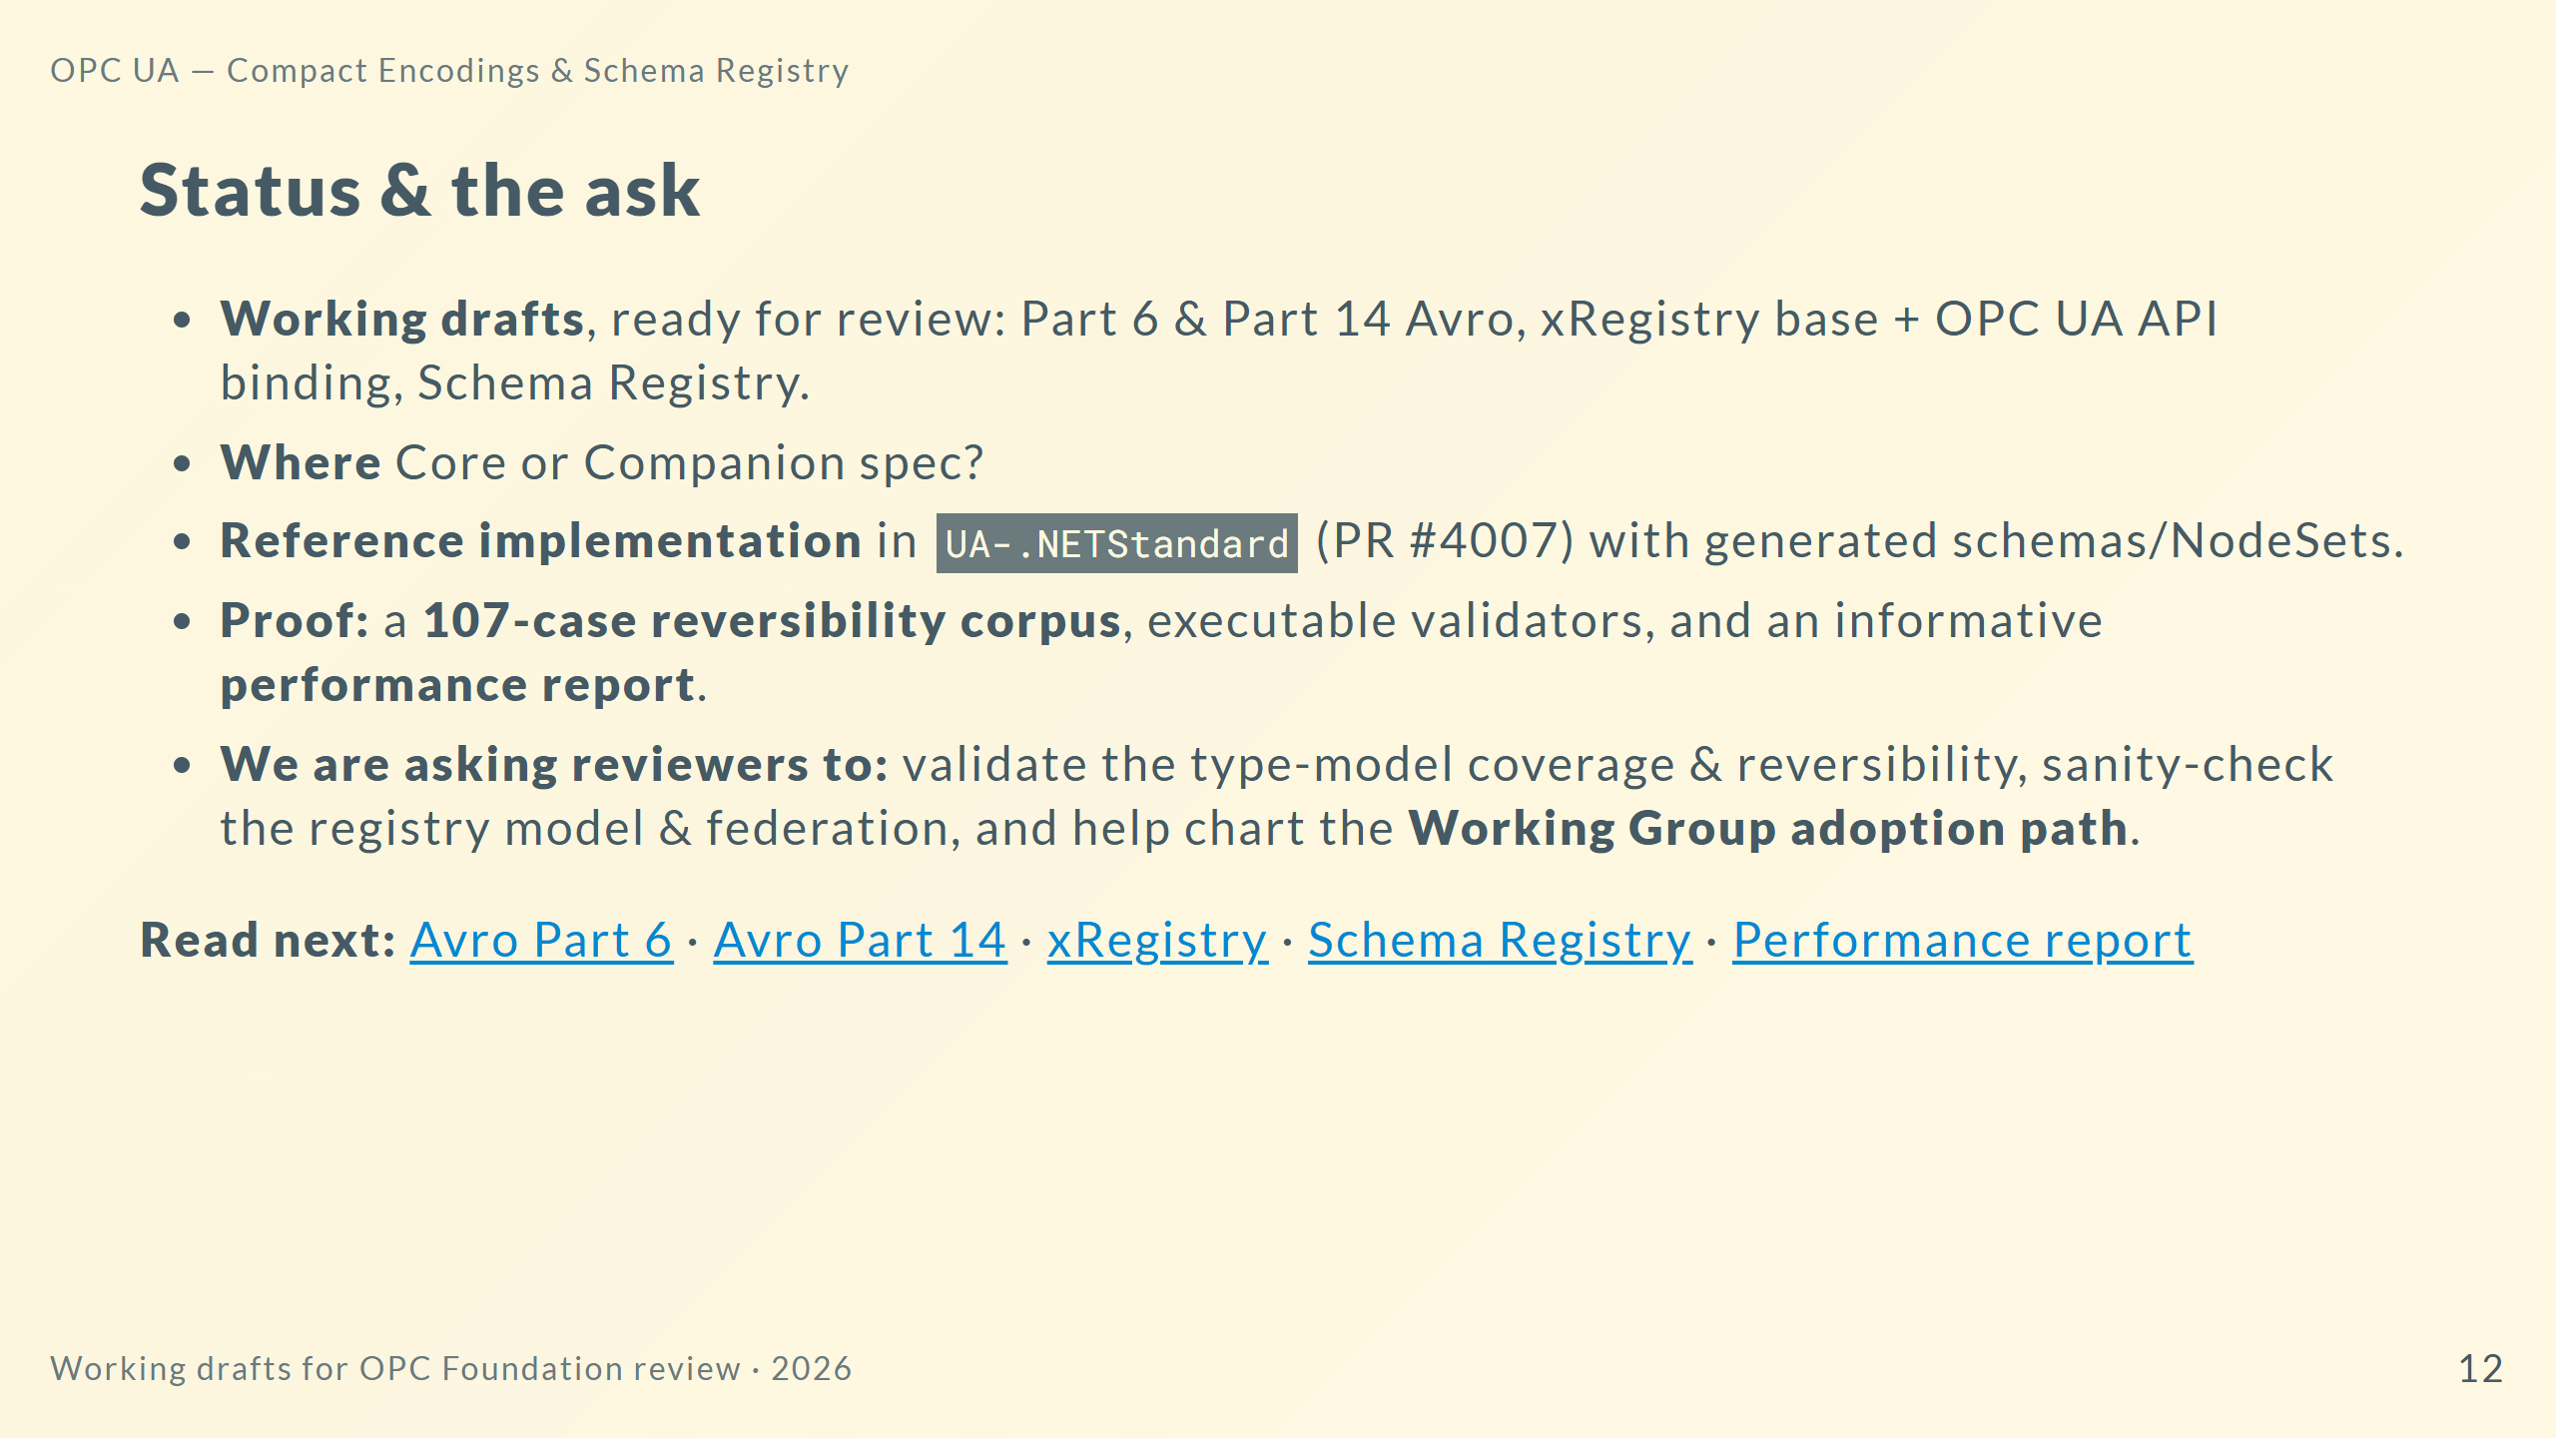
Notes:
Speaker notes: Everything is a working draft with running code and reproducible evidence, not a paper proposal. The three concrete asks: confirm we have the type model and reversibility right, pressure-test the registry and federation design, and agree how this enters the formal Working Group process. The footer links are the entry points into the normative drafts and the measurements.

