Slide 1
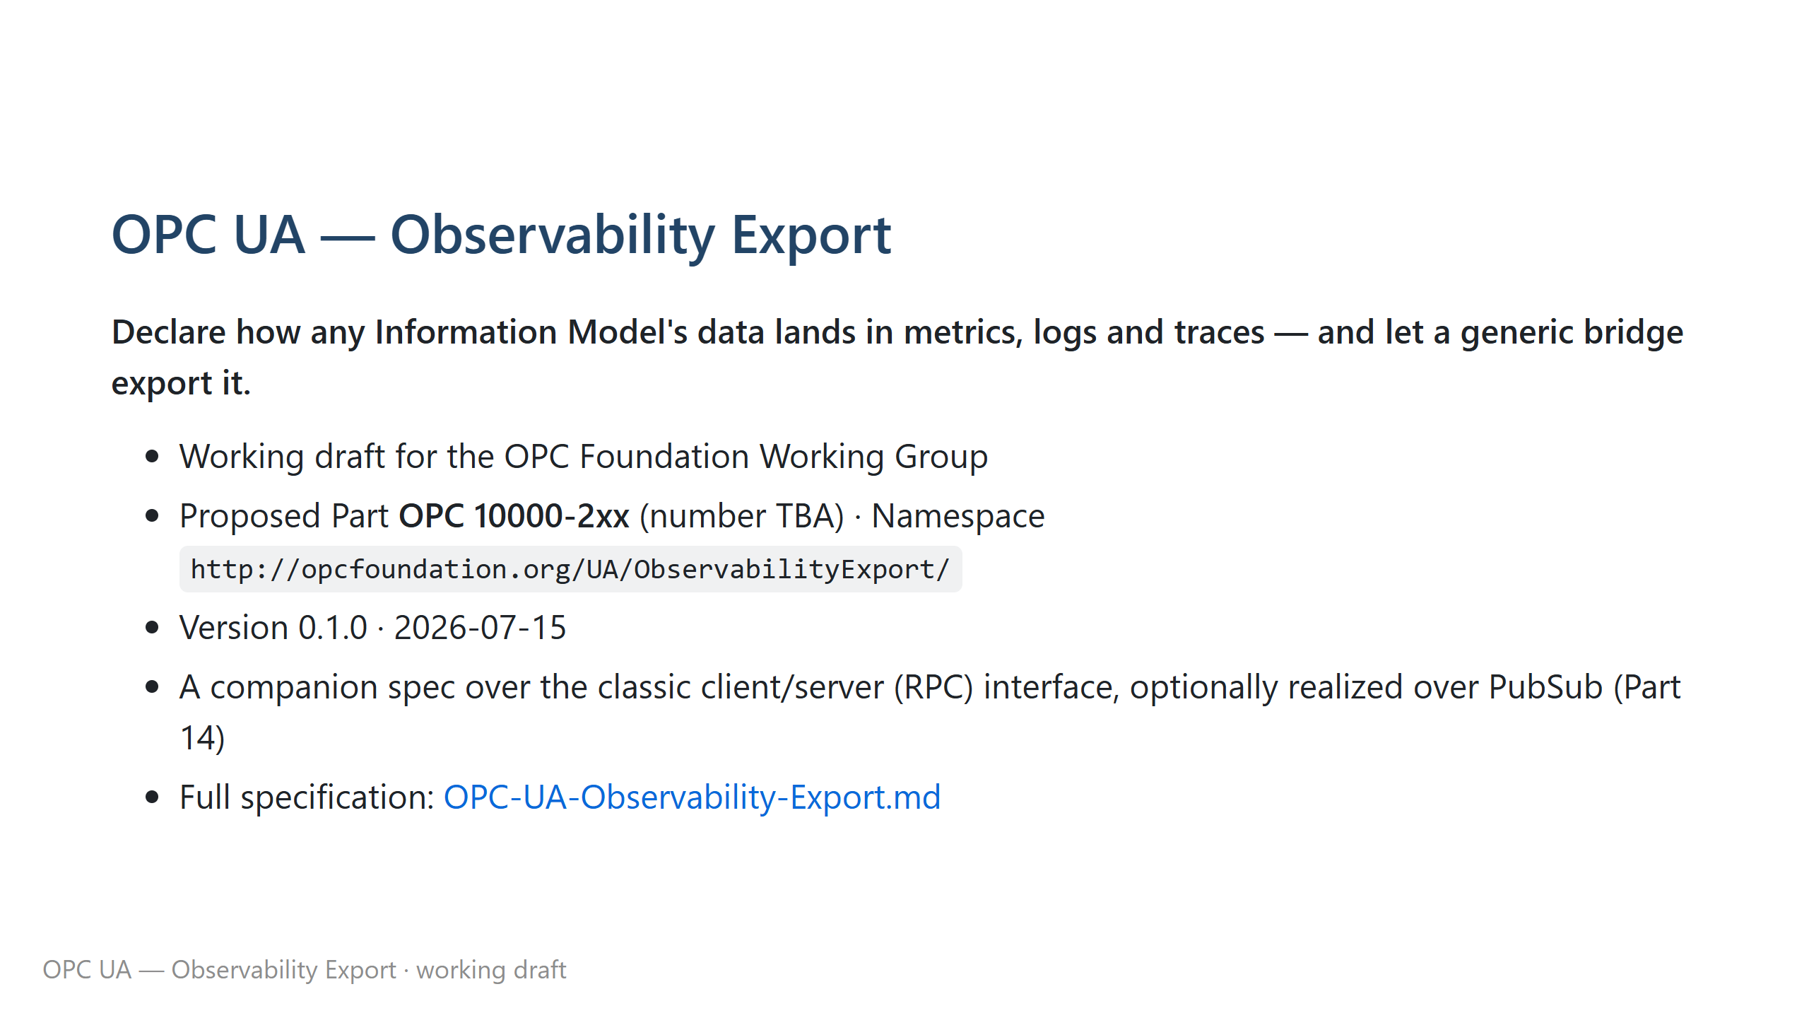
Notes:
Non-normative overview deck for the Observability Export companion specification. Rendered on GitHub (the mermaid diagrams render inline). To export slides: `npx --yes @marp-team/marp-cli README.md -o deck.html` (mermaid needs a Marp mermaid plugin, or just present the GitHub-rendered file).

Slide 2
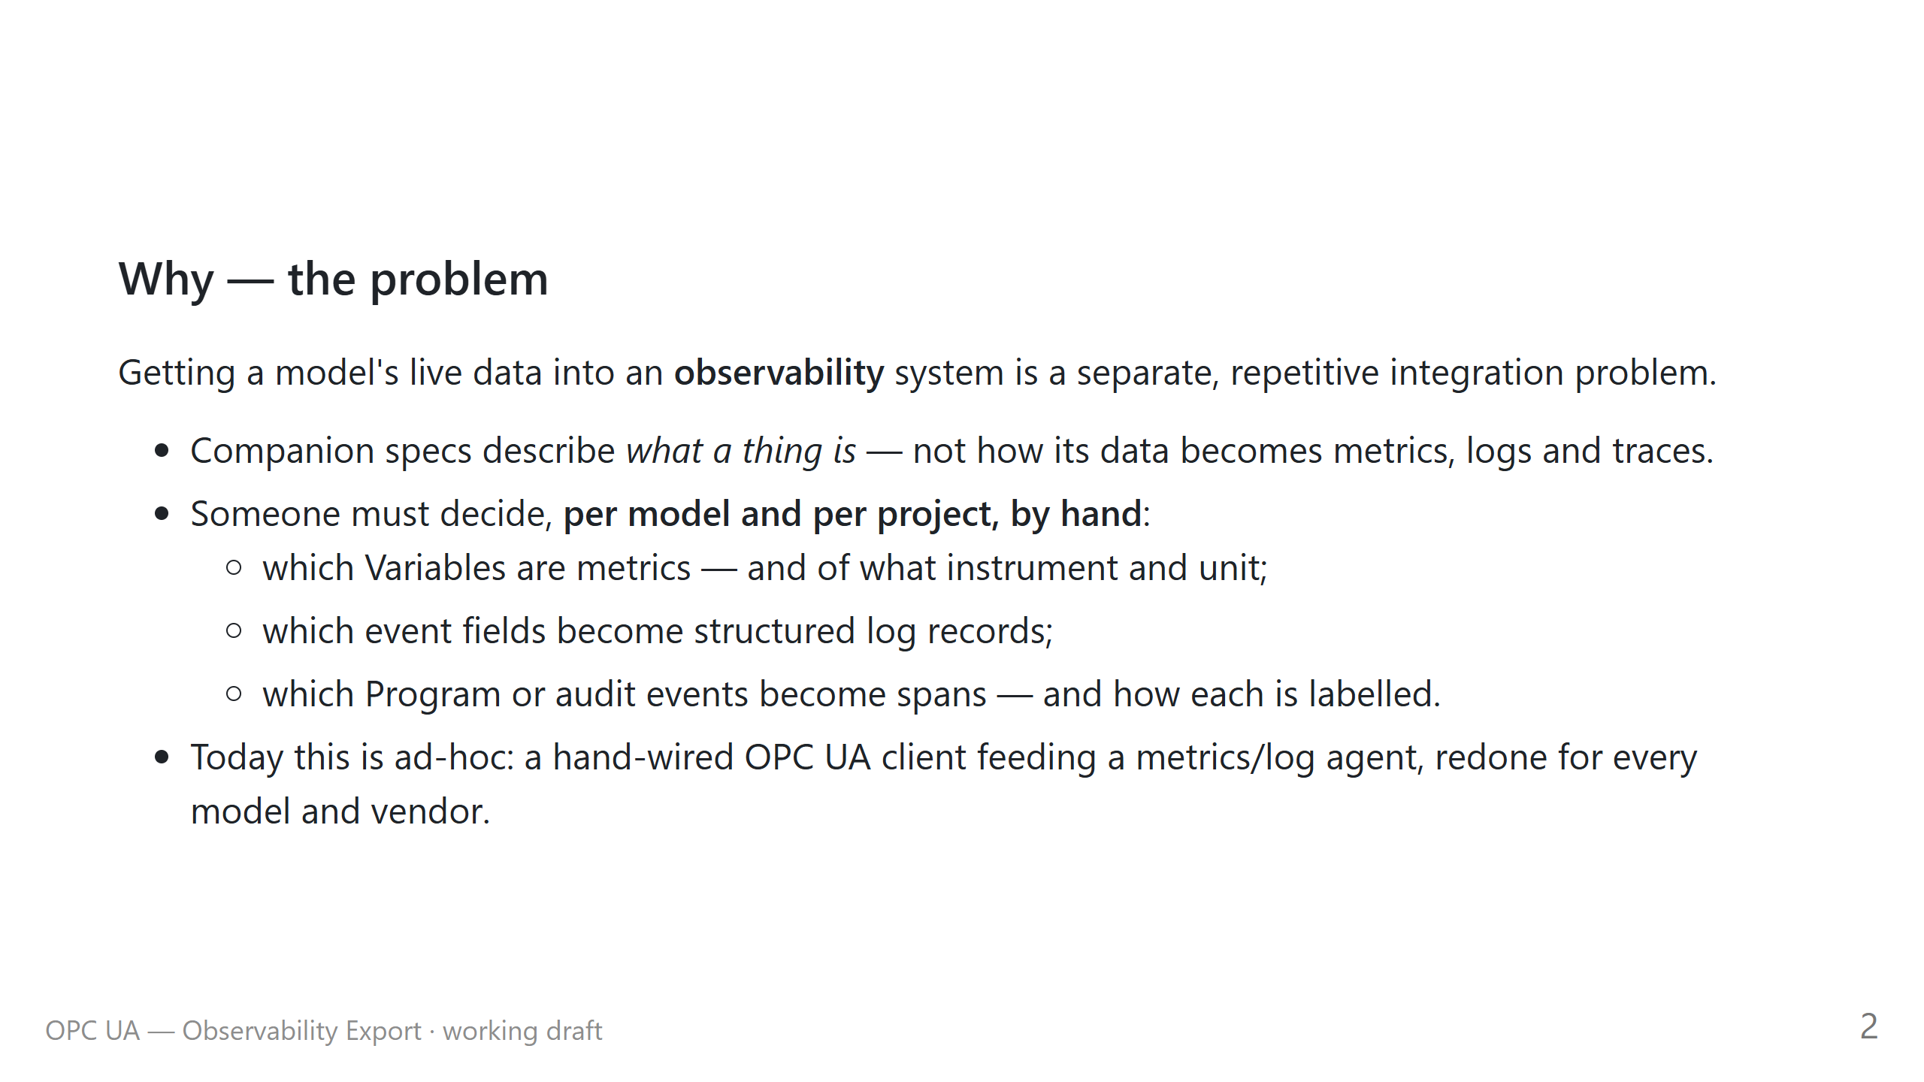

Slide 3
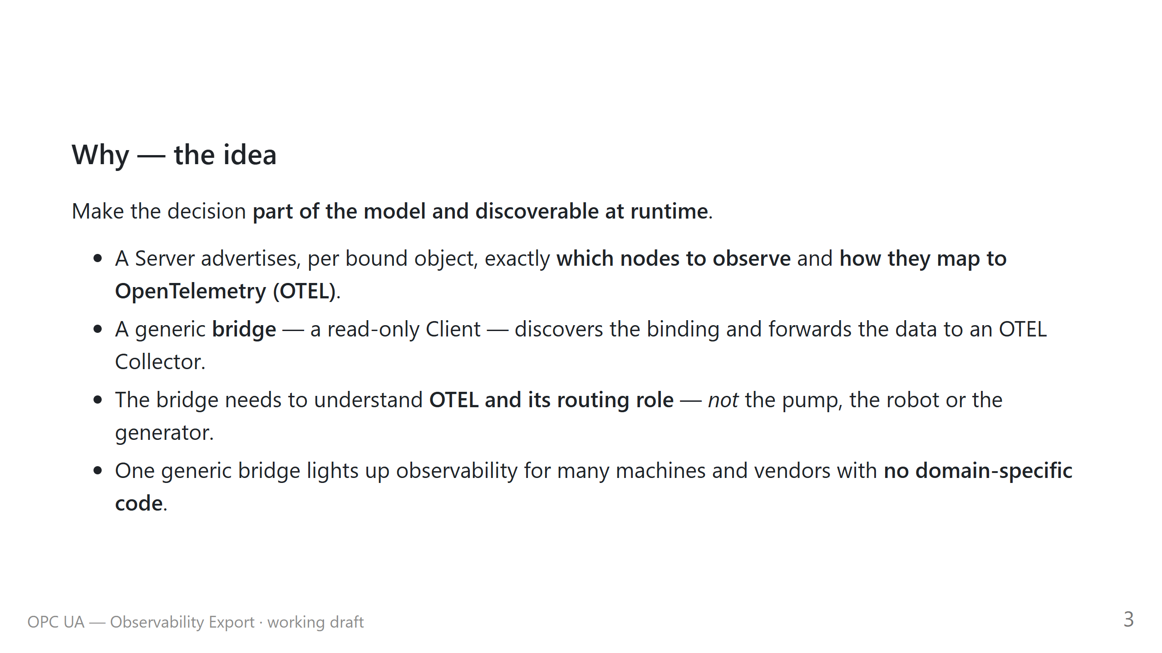

Slide 4
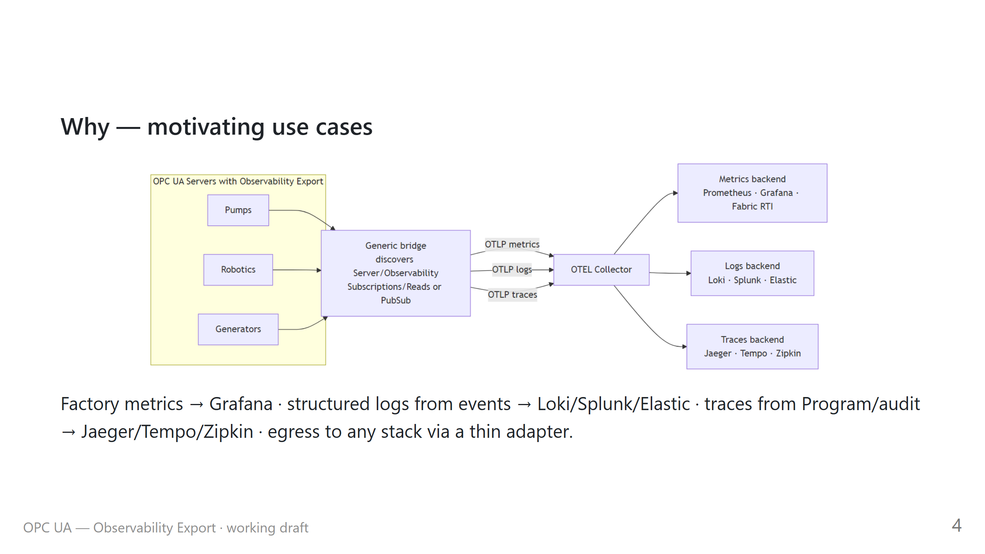

Slide 5
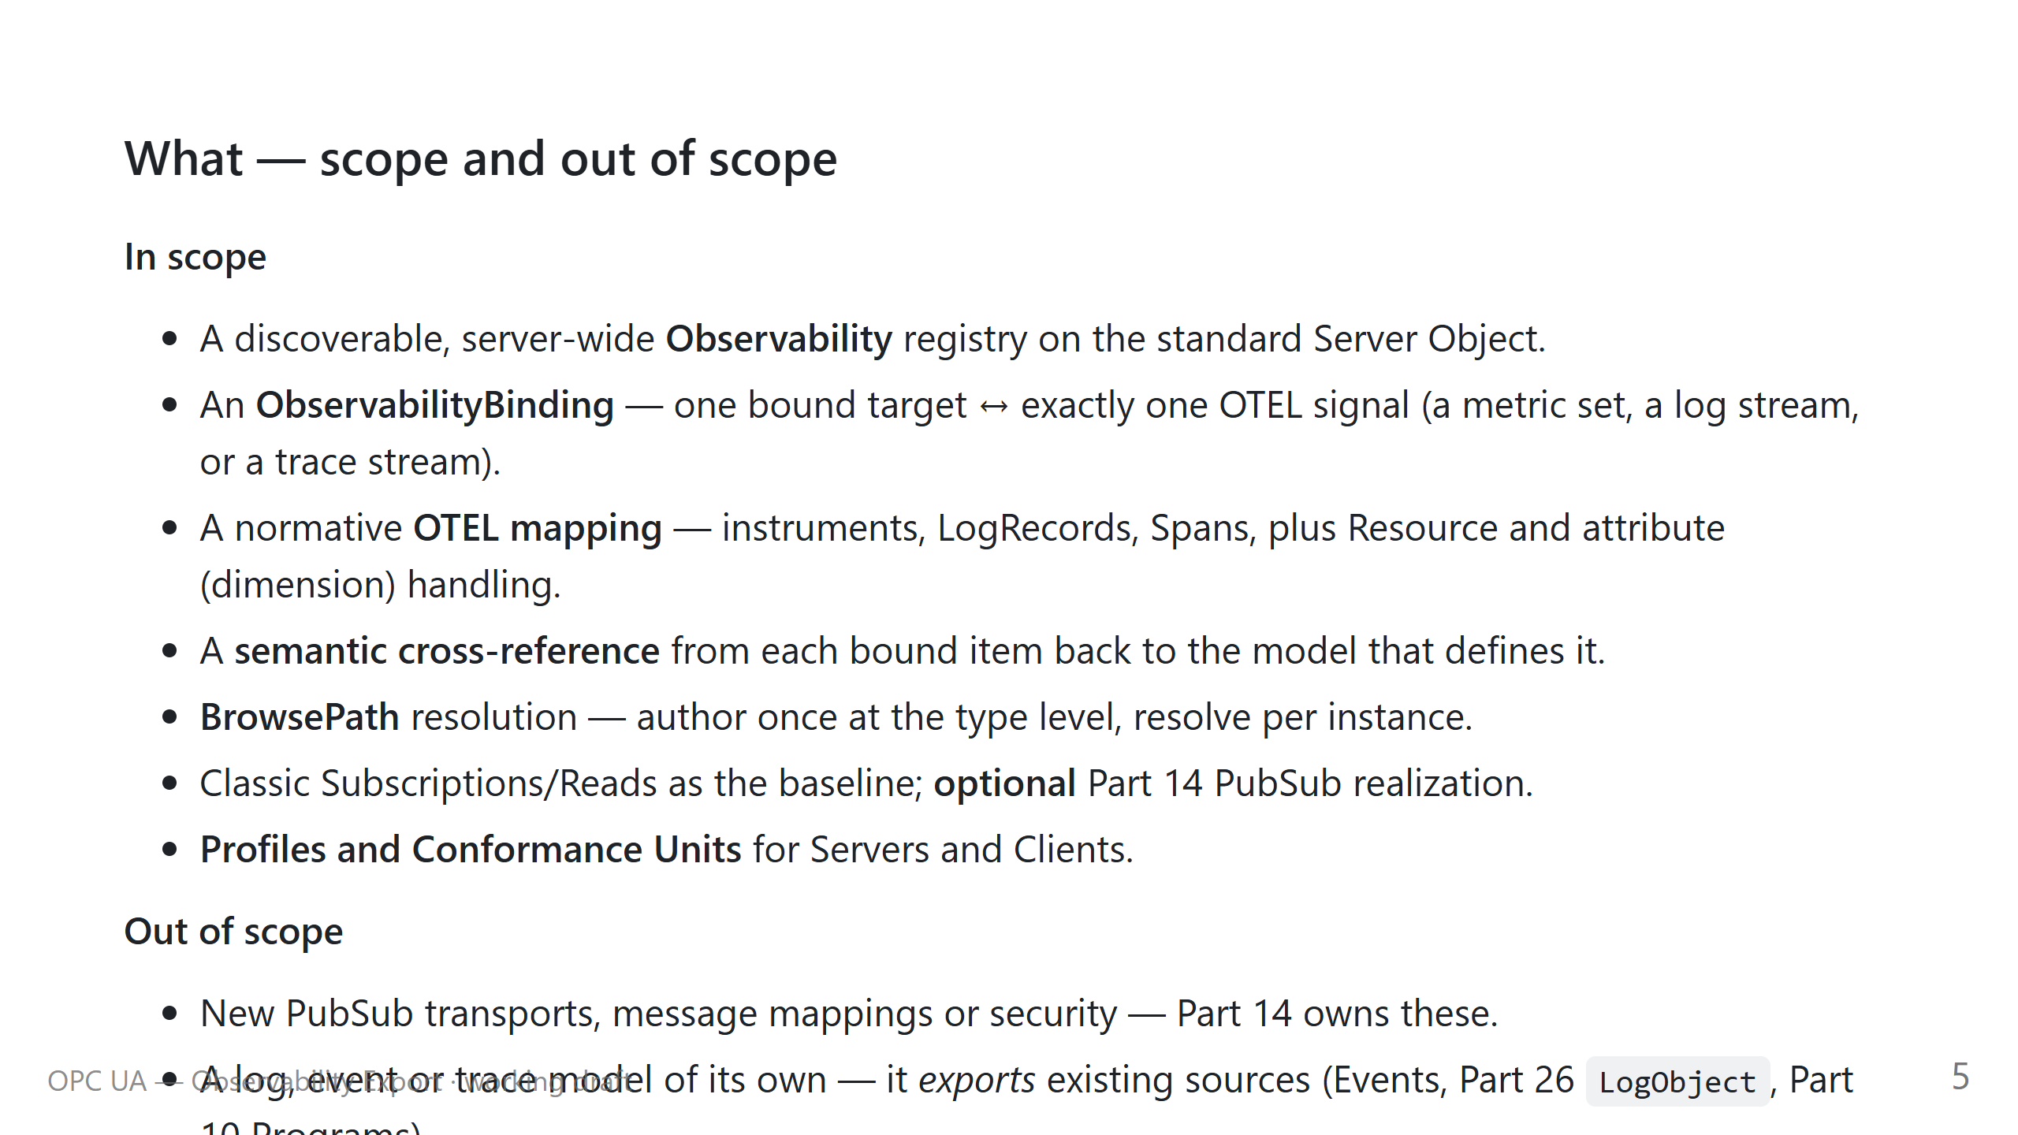

Slide 6
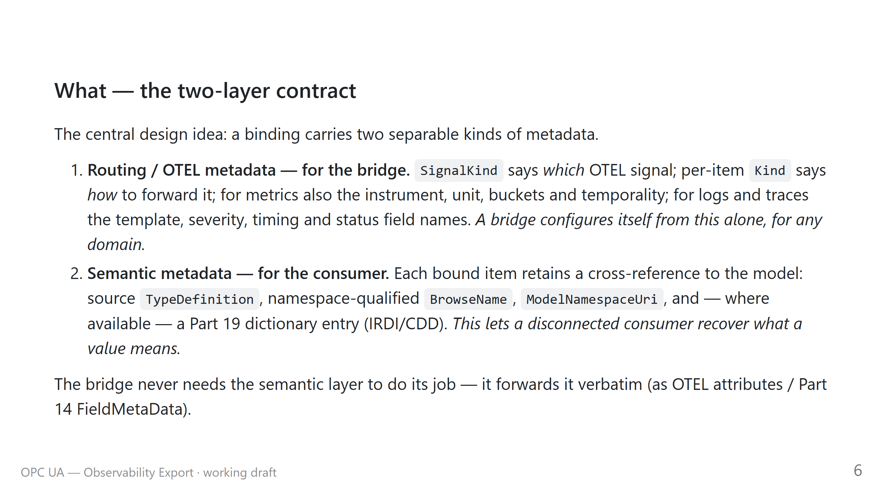

Slide 7
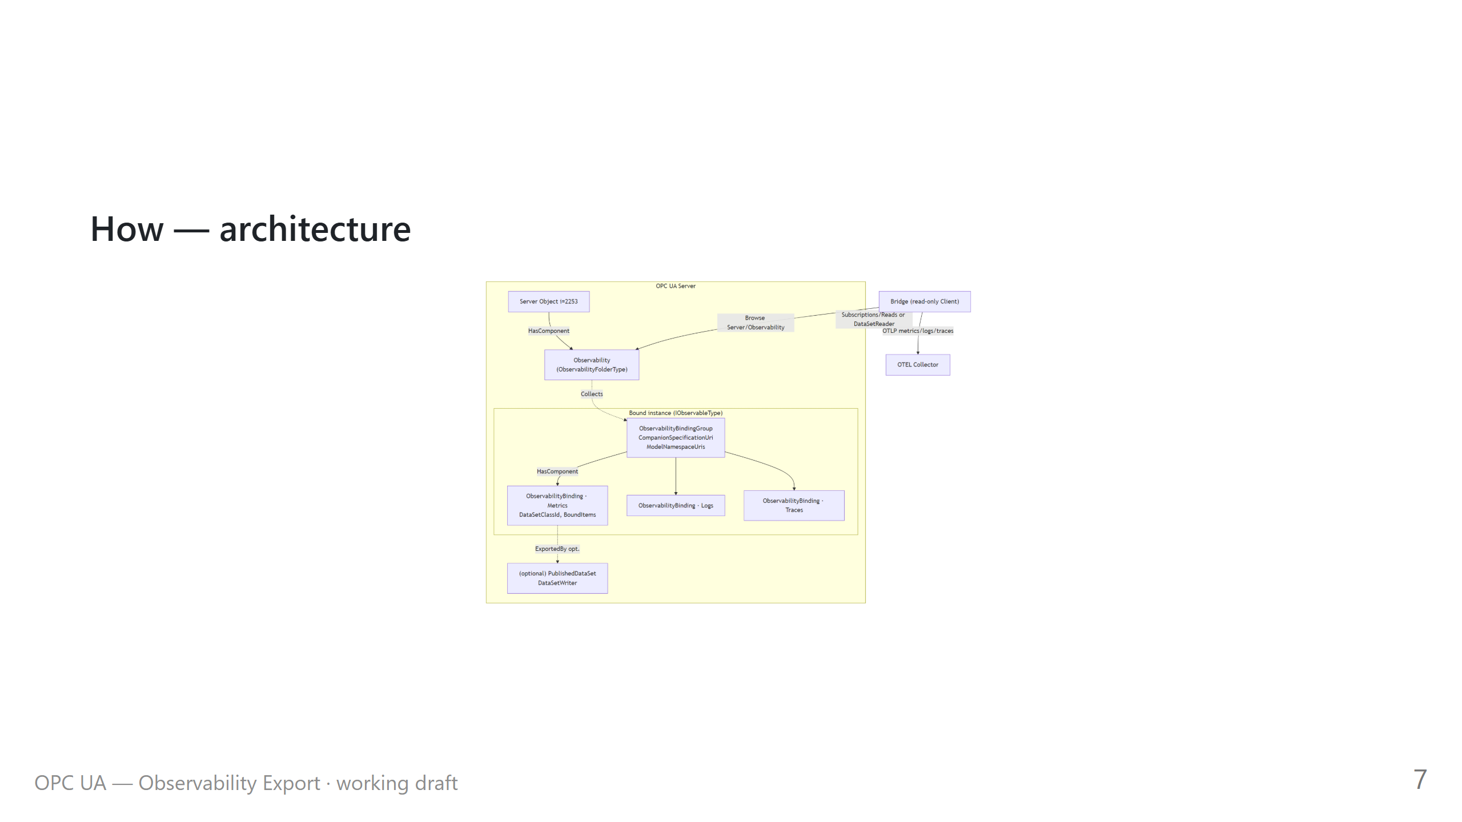

Slide 8
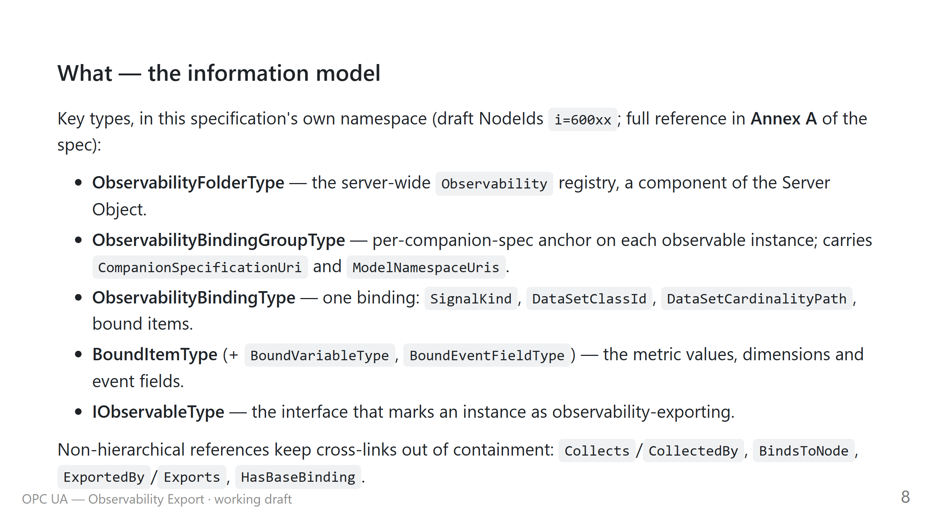

Slide 9
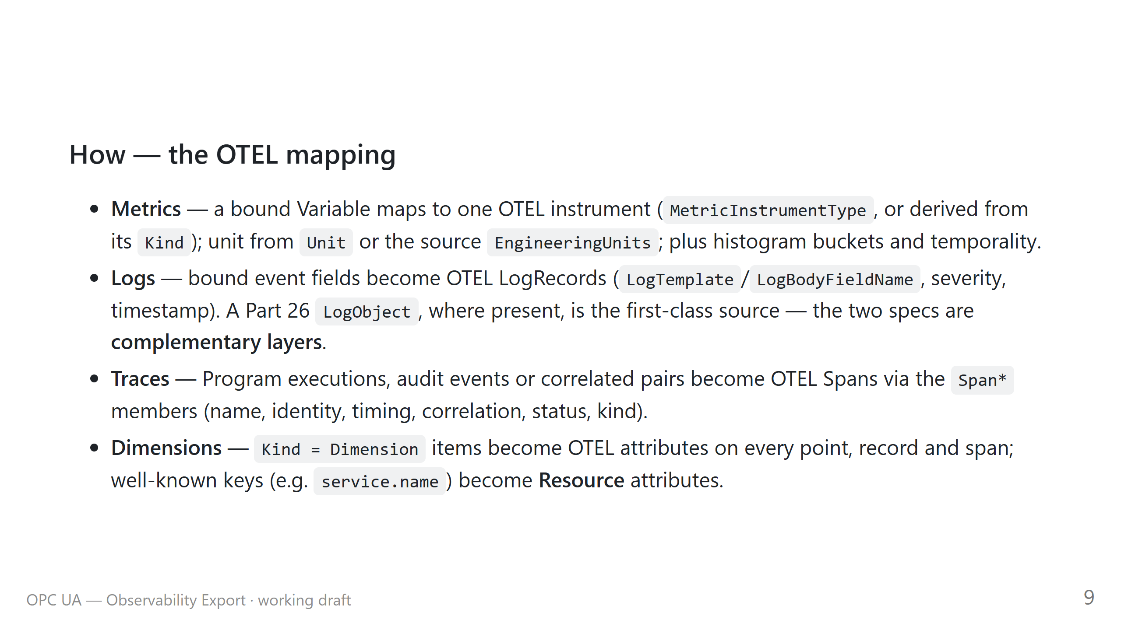

Slide 10
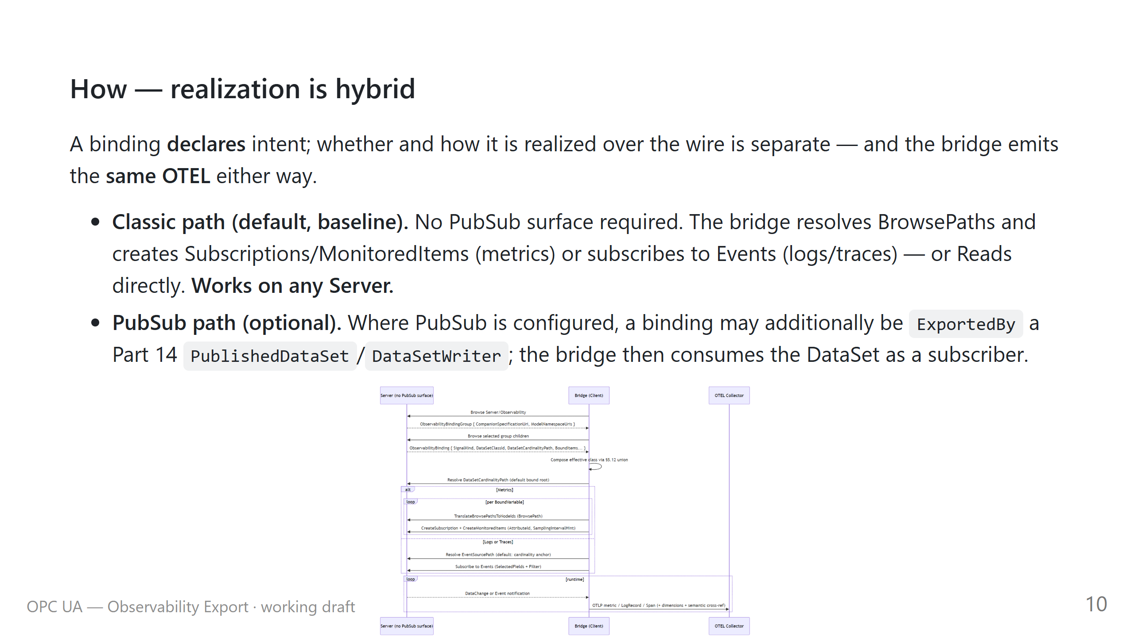

Slide 11
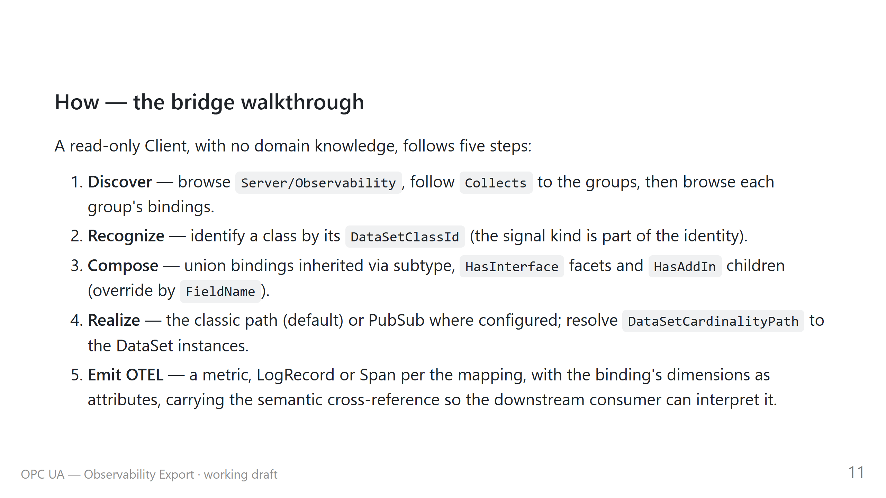

Slide 12
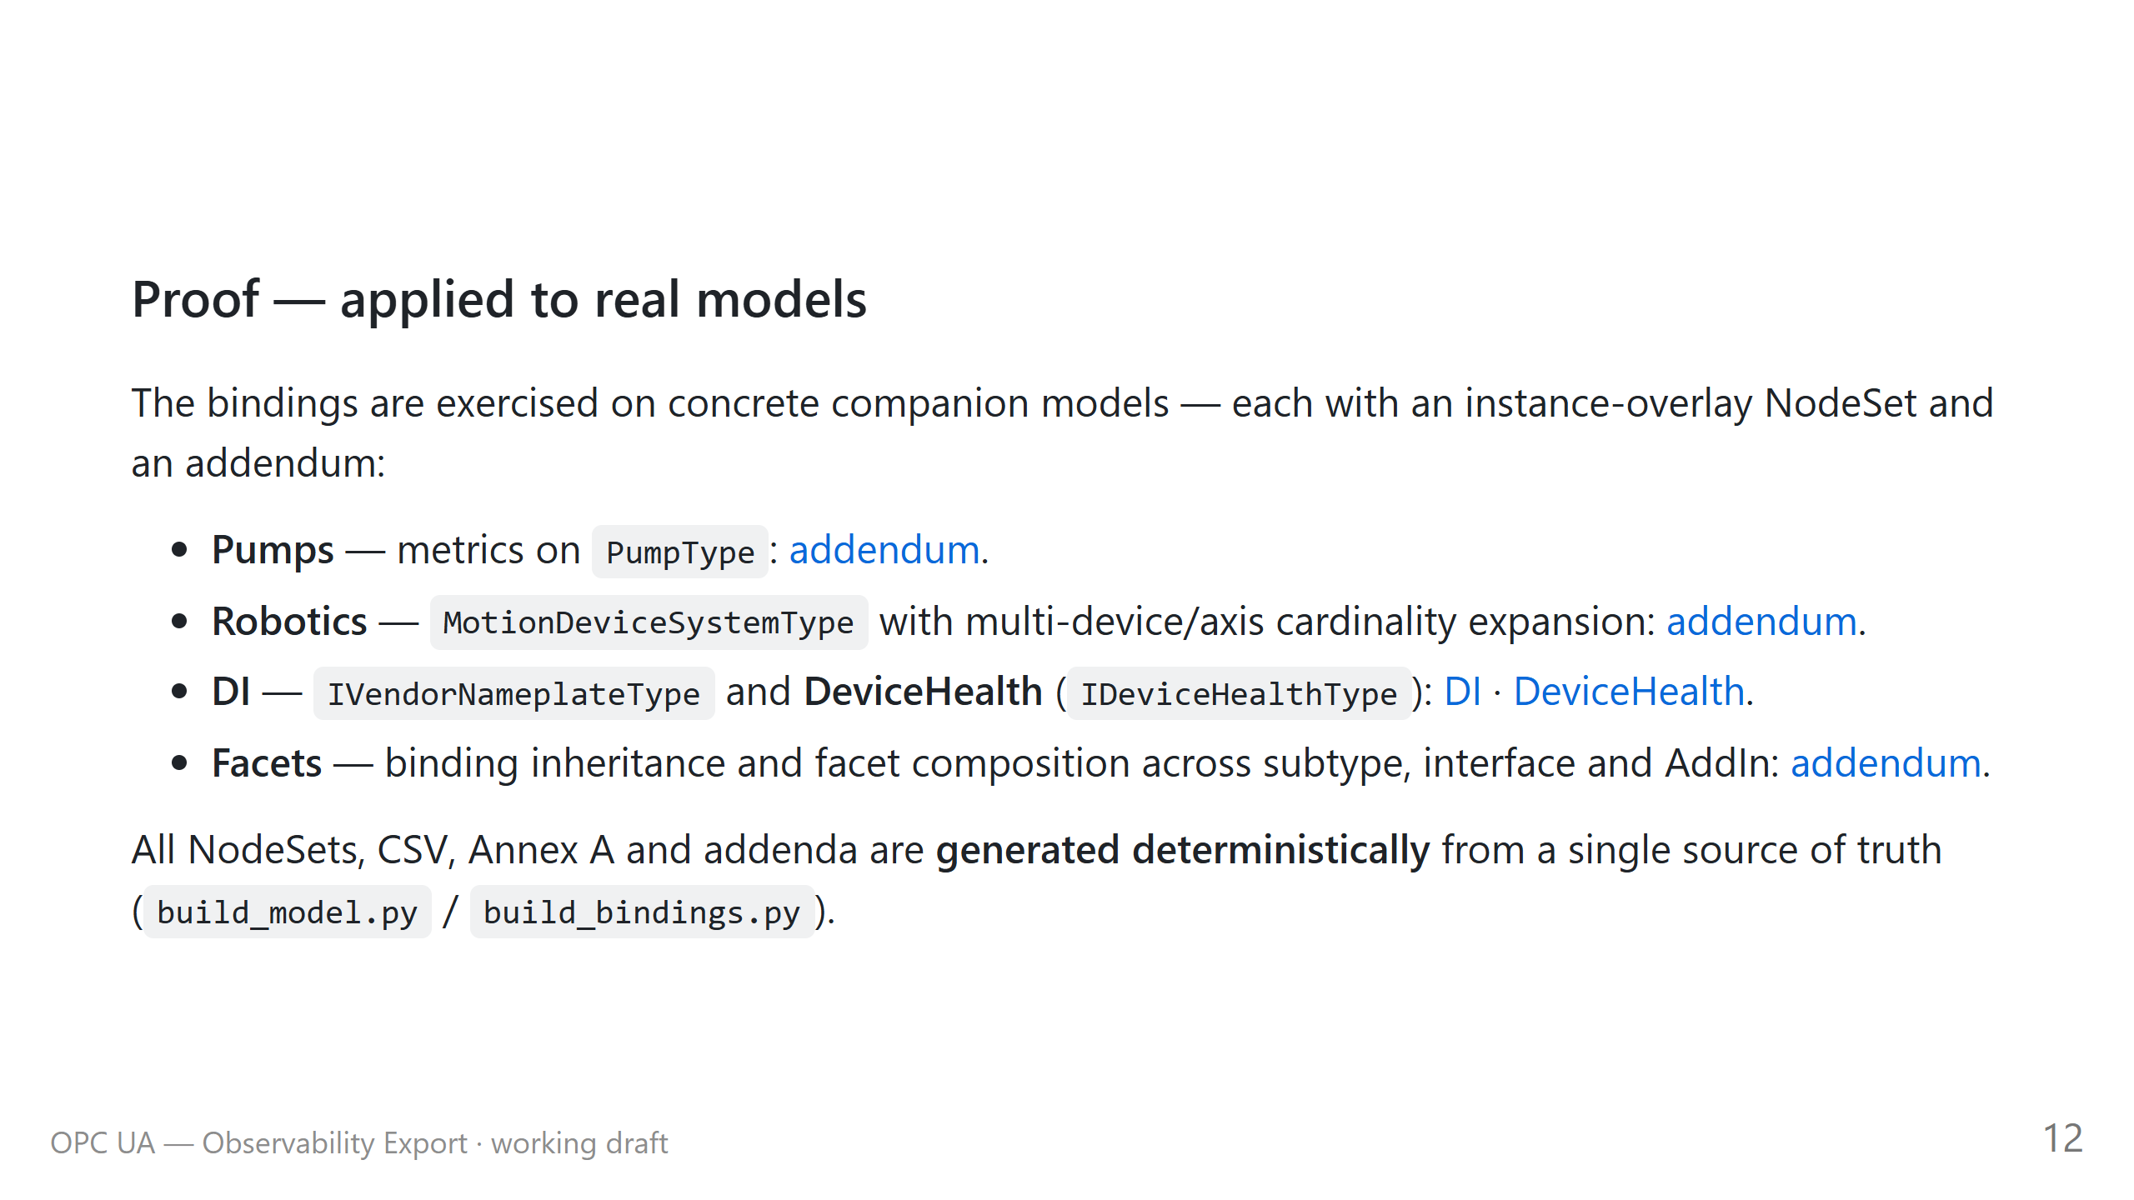

Slide 13
