Slide 1
The Family Microbiome and Familial Adenomatous Polyposis
Research Talk
Marc Sze
July 21st, 2016
Notes:
Talk about how we want to be able to combine both heritability and family into a microbiome study that investigates both normal and CRC.

Slide 2
Introduction: Previous Studies
Family Centered Studies | Heritability Centered Studies
Schloss, 2014 (PMID 25061514) | Goodrich, 2014 (PMID 25417156)
Lax, 2014 (PMID 25170151) | Hua, 2015 (bioRxiv)
http://americangut.org/intra-family-microbial-dynamics/ Posted on April 2016 | Davenport, 2015 (PMID 26528553)
http://www.ubiomeblog.com/the-microbiome-family/ Posted on July 2016 | Lim, 2016 (PMID 27053630)
 | Goodrich, 2016 (PMID 27173935)
Notes:
Heritability Centered Studies - Mention how these are studies specifically looking at heritability and measures for such things and that there are many more that utilize twins to test hypothesis on how heritable the microbiome is for a specific disease not using heritability measures directly (e.g. Turnbaugh, et al. 2009)

Slide 3
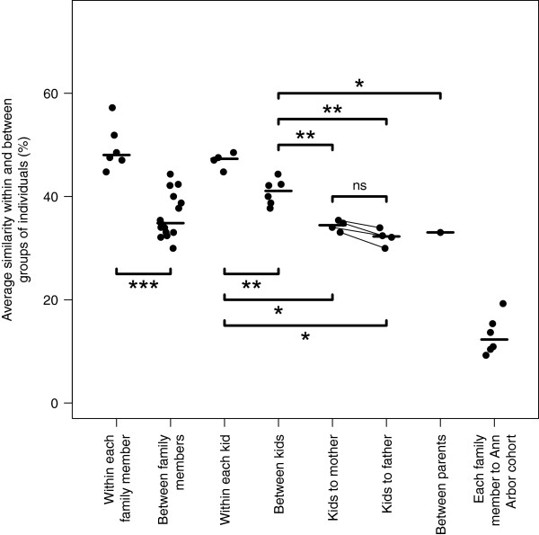
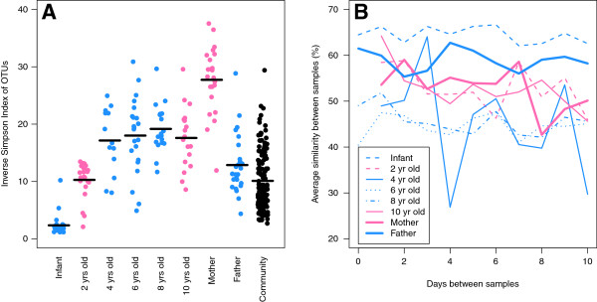
Introduction: Previous Gut Family Study
Schloss PD, et al. The dynamics of a family’s gut microbiota reveal variations on a theme

Slide 4
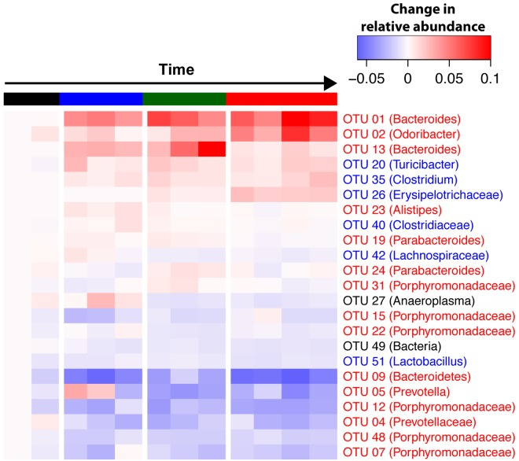
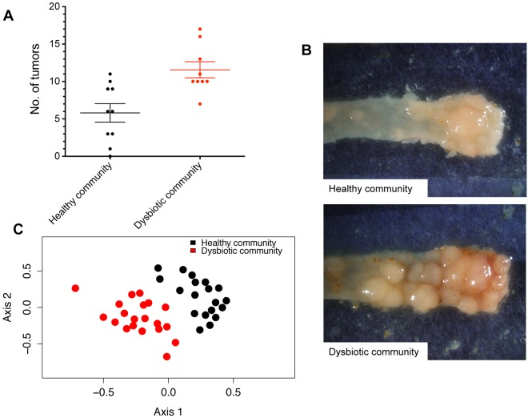
Introduction: Colorectal Cancer and the Microbiome
Zackular JP, et al. The gut microbiome modulates colon tumorgenesis

Slide 5
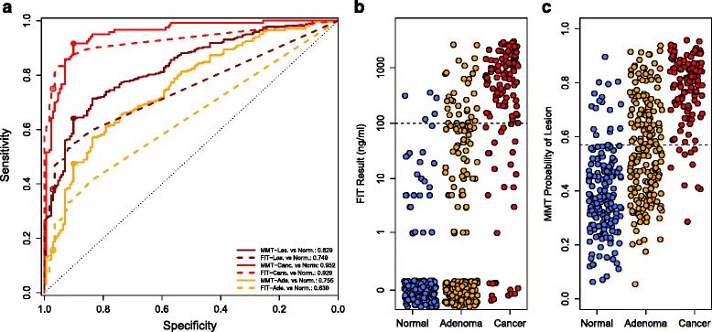
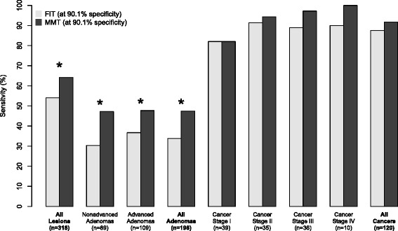
Introduction: Colorectal Cancer and the Microbiome
Baxter NT, et al. Microbiota-based model improves the sensitivity of fecal immunochemical test for detecting colonic lesions

Slide 6
Overarching Hypothesis and Specific Aims
Whether the bacterial community between normal and FAP families is different and whether specific members’ heritability is strongly influenced by the autosomal dominant APC gene defect.
Aim 1: Is there a detectable difference in stool in those with and without FAP?
Aim2: Within the same family and across families is there a consistent microbiome signature difference between those with FAP and those without disease?
Aim3: Is there a detectable difference between the bacterial microbiome of benign and polyp tissue in those with FAP?

Slide 7
Sampling Overview
Repeated every year
Whole family sampled
Assumed average n/family = 4
Samples kits mailed to families
Go for 10 years concurrently
Stool
Stool
Stool
1st Sampling
2nd Sampling
3rd Sampling
Demographics
Food Frequency Questionnaire
Medical History
Repeated each routine colonoscopy
Only those needing endoscopy
Plan on children being included
Go for 10 years concurrently
5/6 matched polyp and benign
tissue samples
Stool
Stool
Before Colonoscopy
Colonoscopy
After Colonoscopy
Demographics
Food Frequency Questionnaire
Medical History
Number of polyps
Size of polyps
Evasiveness of polyps

Slide 8
Aim 1
Is there a detectable difference in stool in those with and without FAP?
“Normal”
FAP
“Normal”
“Normal”
FAP
FAP
VS
VS
Notes:
Aim 1: We will be collecting stool samples from family units. The 16S rRNA -encoding gene sequence analysis and corresponding metagenome analysis will help us compare how the bacterial community of those with FAP could be different from those without the disease. This analysis will be completed on the baseline samples for all participants and samples will not be grouped by family.

Slide 9


Aim 2
Within the same family and across families is there a consistent microbiome signature difference between those with
FAP and those without disease?
“Normal”
“Normal”
FAP
AND
VS
FAP
Notes:
Aim 2: Although there may be differences between FAP and those without the disease this aim will investigate whether or not within a family unit those with FAP have a detectable signature difference versus those in families that do not have the disease. Additionally, it will also investigate if the ‘core’ microbiome of FAP families is different than the ‘core’ microbiome of those without the disease. The analysis will be completed on both 16S and metagenome sequencing. This aim will utilize both cross-sectional data as well as longitudinal data.

Slide 10
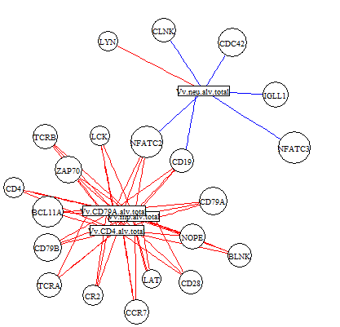
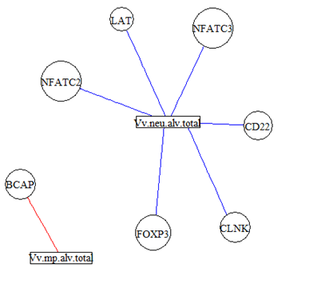
Aim 3
Is there a detectable difference between the bacterial microbiome of benign and polyp tissue in those with FAP?
“Normal”
FAP
Taxa 1 on normal tissue
Taxa 1 on polyp tissue
VS
AND
“Normal”
FAP
VS
FAP
“Normal”
Notes:
Aim 3: Even though there may be differences between those with and without FAP as well as distinct differences between affected and unaffected families, these aims do not address potential pathogenic mechanisms by which disease may occur. Here we will investigate whether the microbiome is different between polyp and benign tissue. Additionally, we will investigate how these communities interact with both the benign and polyp host tissue. Specifically, this aim will help to elucidate how the microbiome and host together might initiate the changes and differences observed in both aim 1 and 2.

Slide 11
Study Progress
Overall Study Milestones
IRB - Submitted
Clinical Section Milestones
Procedures and cohort identified – Completed
Find half time study coordinator – Underway
REDCap Registry Launch – Final Approvals and User testing
Wet Lab Section Milestones
Fecal Collection Tubes – Currently testing Zymo versus OmniGeneGut
DNA/RNA joint extraction (Tissue) – Identified a working method, need to confirm and try with electronic pipette
- https://github.com/marcsze/WetLabStuff/tree/master/LabReports
Dry Lab Section Milestones
None currently underway

Slide 12

One Final Thought on Analysis
Used ACE model
A (additive genetics)
A = 2 * (r_{mz} – r_{dz})
r_{mz} = correlation of trait in identical twins
r_{dz} = correlation of trait in fraternal twins
C (common environment)
C = r_{mz} - A
E (unique environment)
E = 1 – r_{mz}
Falconer’s formula to calculate Heritability
H2 = A = 2 * (r_{mz} – r_{dz})

Slide 13
One Final Thought on Analysis
All previous Genotype microbiome studies (e.g. Goodrich, et al. 2016):
Environment
Genotype
Microbiome
Phenotype
An alternative hypothesis
Environment
Genotype
Phenotype
Microbiome

Slide 14
Thanks for your time and attention.

Slide 15
One Final Thought on Analysis
Wet Lab Overview:
Goals:
Test which collection kit is better at preventing growth
Split
Equally
Needed Disposables:
16 Zymo Fecal Collection Kits
16 OmniGene Gut Collection Kits
1 MO BIO Powersoil DNA extraction Kit
BR DNA Qubit
70 rxns 16S V4 PCR
1 MiSeq Run (or part of one)
Bead beating with
Omni or Zymo storage
Assess optimum
extraction conditions
MO BIO
Time Course:
Omni 4 samples
(3 replicates each)
Zymo 4 samples
(3 replicates each)
RT 4 samples
Extraction
Protocol
4 samples
(3 replicates each)
Omni 4 samples
Zymo 4 samples
RT 4 samples
Omni 4 samples
Zymo 4 samples
RT 4 samples
0
3 day
1 week
2 week
Qubit BR DNA
Number of Samples Needed:
16S V4 30 cycle PCR
*Need 4 control stool samples (20 samplings for each)
- Added 2 extra (1 Omni and 1 Zymo)
- Test DNA extraction with collection kit ahead of time
- Take an aliquot, solid chunks, etc.
MiSeq Sequencing

