Slide 1
Schloss Journal Club
Genetic Determinant of the Gut Microbiome in UK Twins
Marc Sze
July 14th, 2016
Notes:
Disclaimer: Note that I thought they did a good job of trying to tie in a very large multifactorial data set. A lot of work to actually accumulate this information.

Slide 2
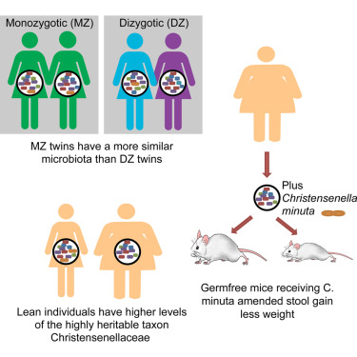
Introduction
 |  | P-value MZ more similar than DZ
Weighted UniFrac | All Bacteria | 0.094
 | Ruminococcaceae | 0.07
 | Lachnospiraceae | 0.016
 | Bacteroidaceae | 0.806
Unweighted UniFrac | All Bacteria | 0.032
 | Ruminococcaceae | 0.024
 | Lachnospiraceae | 0.39
 | Bacteroidaceae | 0.196
Bray Curtis | All Bacteria | 0.11
 | Ruminococcaceae | 0.097
 | Lachnospiraceae | 0.036
 | Bacteroidaceae | 0.448
*No mention of multiple
comparison correction

Slide 3
Introduction

Slide 4




Introduction
Replicate previous findings using larger n
Identify additional heritable taxa
Identify gene-microbiome interactions (co-evolution)

Slide 5

Heritability Calculations
Used ACE model
A (additive genetics)
A = 2 * (r_{mz} – r_{dz})
r_{mz} = correlation of trait in identical twins
r_{dz} = correlation of trait in fraternal twins
C (common environment)
C = r_{mz} - A
E (unique environment)
E = 1 – r_{mz}
Falconer’s formula to calculate Heritability
H2 = A = 2 * (r_{mz} – r_{dz})
Notes:
A few classic problems arise from this formula and estimation of heritability.
A can go above 1 and below 0
Overestimates relatedness

Slide 6
OTU Heritability and Replication
A few discrepancies:
Performed two FDR tests one with all data and one with no OTUs.
Original P-values distribution is not one that is amenable to FDR correction (more on this on the next two slide)
Multiple significant findings from the same value used (non-independence of samples -> more on the next two slide)

Slide 7
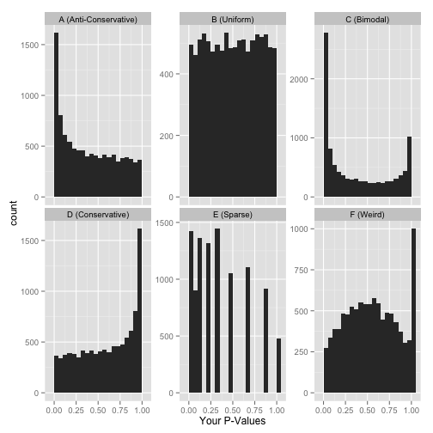
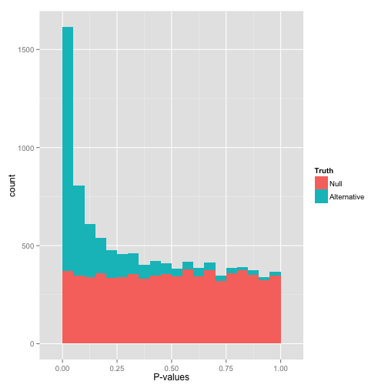
OTU Heritability and Replication
Images from David Robinson: http://varianceexplained.org/statistics/interpreting-pvalue-histogram/
Notes:
You have (on the surface) a set of well-behaved p-values.
That flat distribution along the bottom is all your null p-values, which are uniformly distributed between 0 and 1. Why are null p-values uniformly distributed? Because that’s part of a definition of a p-value: under the null, it has a 5% chance of being less than .05, a 10% chance of being less than .1, etc. This describes a uniform distribution.
That peak close to 0 is where your alternative hypotheses live- along with some potential false positives. If we split this up into nulls and alternatives, it might look like this
This is what your p-values would look like if all your hypotheses were null. Now, seeing this does not mean they actually are all null! It does mean that
At most a small percentage of hypotheses are non-null. An FDR correction method such as Benjamini-Hochberg will let you identify those.
Applying an uncorrected rule like “Accept everything with p-value less than .05” is certain to give you many false discoveries. Don’t do it!

Slide 8
OTU Heritability and Replication
1st FDR with all 945 tests
2nd FDR with 163 tests
After removal of duplicates from 2nd test P-values < 0.05 went from 58 to 40
Notes:
Do not look at this distribution and say, “Oh, I guess I don’t have any significant hypotheses.” If you had no significant hypotheses, your p-values would look something like (B) above. P-values are specifically designed so that they are uniform under the null hypothesis.
A graph like this indicates something is wrong with your test. Perhaps your test assumes that the data fits some distribution that it doesn’t fit. Perhaps it’s designed for continuous data while your data is discrete, or perhaps it is designed for normally-distributed data and your data is severely non-normal. In any case, this is a great time to find a friendly statistician to help you.
(Update 12/17/14: Rogier in the comments helpfully notes another possible explanation: your p-values may have already been corrected for multiple testing, for example using the Bonferroni correction. If so, you might want to get your hands on the original, uncorrected p-values so you can view the histogram yourself and confirm it’s well behaved!)
People sometimes run into the case where there's actually a depletion of p-values in the 0-0.05 range or a significant slant from lower left or to upper right in the p-value histogram and wonder what that's about. The common cause of this is a batch effect or some other variable that's not being properly controlled.

Slide 9
Correlation between Heritable bacteria and Alpha and Beta Diversity

Slide 10
Heritability: Stability and Diversity
Falconer’s formula to calculate Heritability
H2 = A = 2 * (r_{mz} – r_{dz})

Slide 11
Gene, SNPs, and Heritable Taxa
Choose 20 taxa with heritability > 0.20 (all from figure 1)
Significance for trait determined by taking lowest p-value and comparing it to 1000 iterations of p-values of the taxa residuals
If there were 3 tests done for a group (p-values = 0.05, 0.000001, and 0.4) the lowest of the three would then be compared to the distribution of the 1000 p-values of the taxa residuals. This would determine if the trait was significant or not.
Notes:
668 total genes, 32378 total SNPs

Slide 12
GWAS and Microbiome Part 1
Tested all SNPs (1,300,091) against the 20 heritable taxa identified
Found no associations that achieved study wide significance (FDR < 0.2)
Potential correlation between Bifidobacterium and SNPs in genes involved with lactase persistence
Used Hutterite data set to try and validate this finding (Davenport, 2015)
Used custom algorithm to impute genotypes 98 individuals to 1,317 (>99% accurate in test cases)
Notes:
Mention that they are probably not sufficiently powered to adequately test this
Mention that FDR < 0.2 is really aggressive (open to lots of false positives)

Slide 13
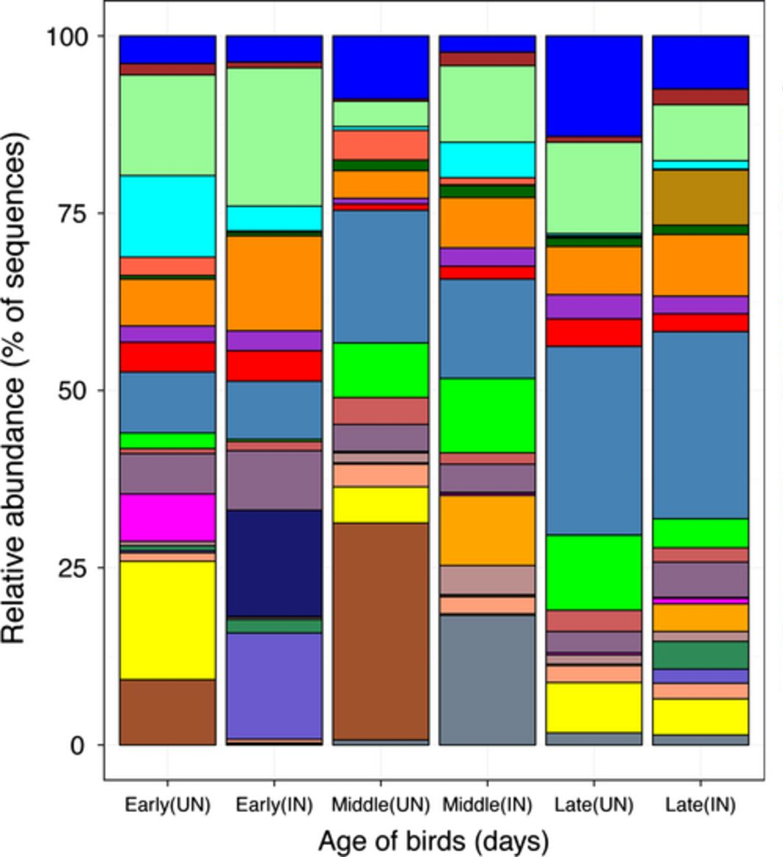

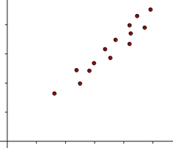
GWAS and Microbiome Part 2
Used program called microbiomeGWAS (Hua et al., 2015)
Two problems with initial manuscript (still in biorxiv)
No benchmarking against traditional methods
Correction removed the signal
Trying to correct the large skewness and positive kurtosis that arises from these types of comparisons (i.e. make normally distributed)
Typically use permutations or bootstrap
Notes:
Kurtosis = sharper peak
Positive kurtosis = heavier tails and sharper peak

Slide 14
GWAS and Microbiome Part 2
SNP (rs563779) within UHRF2 was associated with weighted UniFrac
P-value = 9.77x10⁻⁹
Two SNPs associated with Bray Curtis dissimilarity

Slide 15
Imputed Gene Expression and Microbiome
Used PrediXcan
Imputes expression in 40 different tissues based on SNPs and Genotype
Compared full 945 taxa set
Had two separate significance cutoffs
Study-wide
0.05/(40x945x338372) = 3.91x10⁻¹²
Tissue-wide
0.05/(945 x # genes imputed in that tissue) or 5x10⁻⁸

Slide 16
Imputed Gene Expression and Microbiome
Transverse colon SIGLEC15 expression associated with Akkermansia (p = 6.21 x 10⁻⁹)
Number of other gene-microbiome under cut-off of 5x10⁻⁸
ZDHHC11B in Brain (cerebellum and Hypothalamus) – ML615J.28
RAB4B in Artery (Tibial) – Lachnospiraceae (4331360)
RPS27L Colon (Transverse) – Ruminococcaceae (352347)
HSF2 Heart (Left-Ventricle) – Bacteroides
RPS-468k18.5 Nerve (Tibial) – Ruminococcaceae (44151)
INSL3 Skin (Sun exposed lower leg) – Lachnospiraceae (179384)
JPH4 Spleen – Clostridiales (193075)
PPP1R3E Cells (Transformed Fibroblasts) – Clostridiales (193075)

Slide 17
Heritability across Studies
Want to show that there is consistency between studies in both mouse and humans with respect to heritable taxa within the microbiome.
Notes:
The color gradient over the heritability estimates ranges from the lowest heritability estimate (white) to the highest heritability estimate (red) in the given study. For the TwinsUK heritability estimates, the bold values indicate heritability estimates with a 95% confidence interval not overlapping 0. The estimates for Davenport, et al. are the proportion of variance explained (PVE) estimates (“chip heritability”). We report the winter (W), summer (S), and seasons combined © datasets. For the Davenport study, bold values indicate heritability estimates with a standard error not overlapping 0. For Org et al, we report results using all mice(All), just males (M), just females (F), and average per strain (Avg), and a single mouse per strain (One). No significance value was reported for the Org et al and O’Conner et al heritability estimates. The coloring over the QTL/GWAS studies indicates if each taxon had a significant association (blue) or not (dark gray) in the given study. Light gray indicates that the taxon was not observed in the given study or was excluded from the study analysis for other reasons.

Slide 18
Summary
The cartoon is supposed to emphasize that Bifdobacterium is a heritable taxa and that it is linked to polymorphisms in the LCT gene. So those with a specific SNP in the LCT gene will have more Bifdobacterium then those that do not.
What do you think?

