Slide 1
Journal Club
The Effect of Host Genetics on the Gut Microbiome
October 20th, 2016
Marc Sze

Slide 2
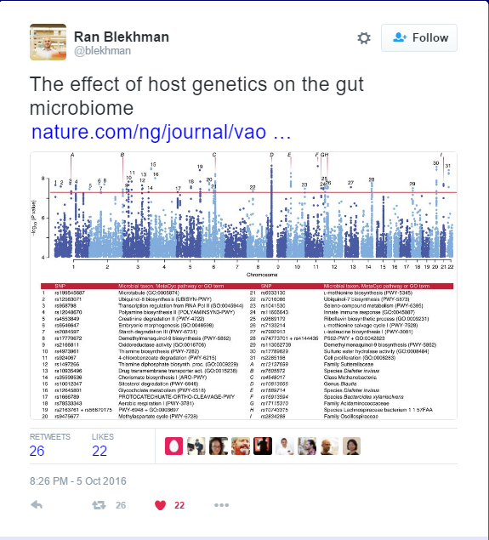
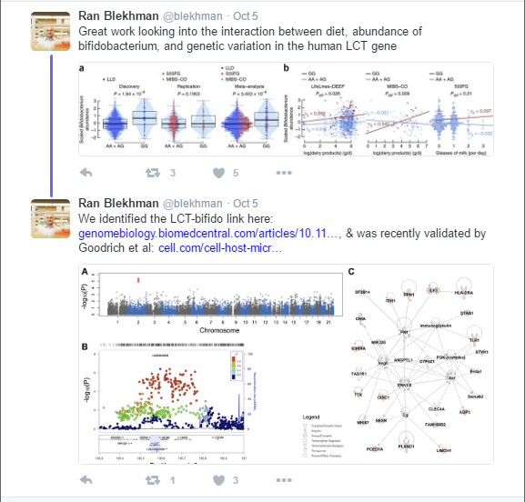

Introduction

Slide 3
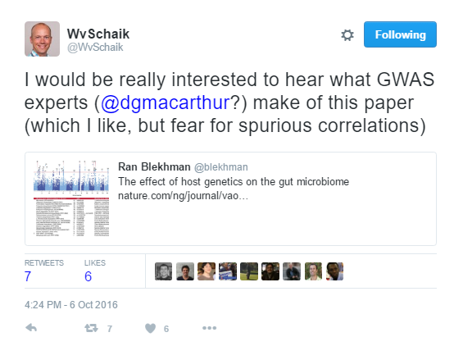


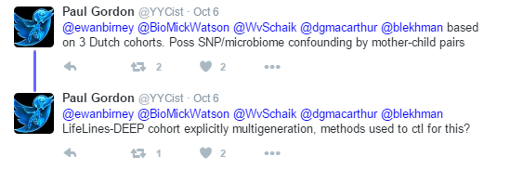

Introduction

Slide 4
Overview
MetaPhlan2.2 to generate abundance data
HUManN2 to generate 636 metabolic pathway counts
HUManN2 to generate 661 non-redundant GO
terms for analysis
General Analysis Pipeline:
Use Linear Model
Correct for age, sex,
sequence depth
Quantile
Normalized
Data
Remove
Non-Zero
Counts
Compare to
Host Genes
Notes:
HUMAnN2 maps reads to a customized database of functionally annotated pan-genomes.

Slide 5
Quantile Normalization
Gene | S1 | S2 | S3
A | 5 | 4 | 3
B | 2 | 1 | 4
C | 3 | 4 | 6
D | 4 | 2 | 8
Gene | S1 | S2 | S3
A | 2 | 1 | 3
B | 3 | 2 | 4
C | 4 | 4 | 6
D | 5 | 4 | 8
Rank | Mean
I | 2
II | 3
III | 4.67
IV | 5.67
2
3
Rearrange
values from
lowest to highest
Find mean
of each
row
Rank
lowest to
highest
1
Gene | S1 | S2 | S3
A | 5.67 | 4.67 | 2
B | 2 | 2 | 3
C | 3 | 4.67 | 4.67
D | 4.67 | 3 | 5.67
4
Gene | S1 | S2 | S3
A | IV | III | I
B | I | I | II
C | II | III | III
D | III | II | IV
Use rankings to assign
mean values to gene and sample.
Example from: https://en.wikipedia.org/wiki/Quantile_normalization

Slide 6
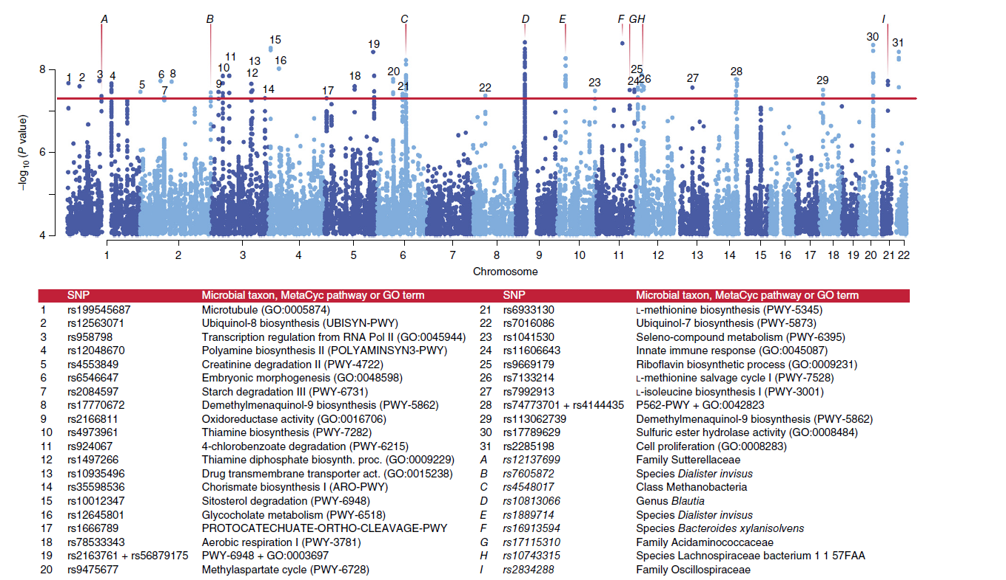
Results: GWAS and Microbiome
Notes:
Manhattan plot of genome-wide associations with microbes and functional units (MetaCyc pathways and GO2000 terms). The manhattan plot shows QTLs for microbial abundance, labeled with letters, and QTLs for microbial function, labeled with numbers. Details for the associations are given in the table below; QTLs for microbial abundance are italicized. The red line corresponds to a significance threshold of 5 x 10 -8.
QTLs – Quantitative Trait Locus, section of DNA that correlates with variation in a phenotype (the quantitative trait). The QTL typically is linked to, or contains, the genes that control that phenotype.

Slide 7
Results: GWAS and Microbiome - Taxonomy
1
Blautia
IBD
Intergenic region
upstream of LINGO2
Obesity
Lipid Levels
Methanobacteriaceae
Motion Sickness
3
BMI
High expression in gut tissue
Sutterellacea
Pouch Health
SNP in VANGL1 gene
2
Wound Healing
Invasiveness and progression of colon cancer cells
SNPs in 2q37.3 and 10p12.1
Dialister invisus
Diet-dependent inflammation and cytokine

Slide 8
Results: GWAS and Microbiome - Pathways
1
Obesity
SNPs in SORCS2 gene and
in SLIT3 gene
3
Plant-derived steroid degradation (PWY-6948)
Insulin-like growth factors
Cell adhesion
SNPs in C-type lectin
domain family 4
Cell Signaling
Inflammation
Riboflavin biosynthetic process
Immune Response
2
Focal Adhesion
Faecalibacterium prauznitsii
SNPs in ARAP1 gene
Ileal Crohn’s Disease
Bile acid metabolism (PWY-6518)
Type 2 Diabetes

Slide 9
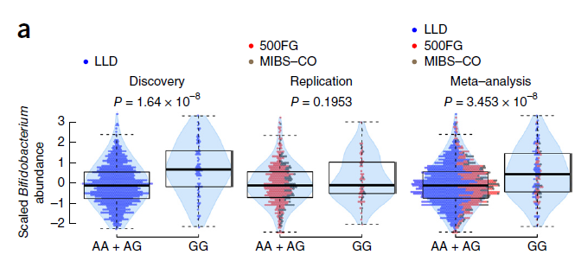
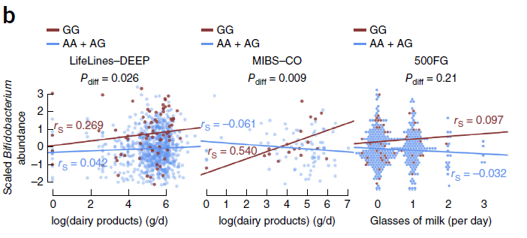
Results: Targeted Approach and Microbiome
Notes:
Going to stick specifically to the Bifidobacterium, gene, and diary story since the others aren’t super exciting
(e.g. we limited to innate immune genes and found correlations to innate immune genes).
Legend: Complex interaction between a functional LCT variant, dairy intake and Bifidobacterium abundance.
Microbial QTL plots showing association of a functional LCT SNP (rs4988235) with the abundance of Bifidobacterium. The three plots show the effect of genotype at the functional SNP on Bifidobacterium abundance. The plots are a combination of violin plots and box plots; box plots show the median and the 25% and 75% quantiles (LLD: LifeLines-DEEP)
Interaction of LCT genotype, intake of dairy products and Bifidobacterium abundance in the three cohorts. Data on total dairy consumption were unavailable for the 500FG cohort, but the same trend was observed with respect to data on the number of glasses of milk drunk per day in this cohort. Pdiff shows the significance of the difference in the correlation of diary product consumption and Bifidobacterium abundance between the two genotype groups (GG versus AA and AG)

Slide 10
Some Important Caveats
Some “Tricksy” Math
Based on authors chosen P-value the expectation is for 50,000 False Positives in first stage
No report of total comparisons under P-value to judge how many in first stage could be expected to be not false positives (e.g. 50,004 -50,000)
Judge their False Discovery Rate for second stage (validation) based on the 50,000 from the first stage.
FDR = 50,000 x 0.01 = 500
My thoughts are validation FDR should be independent not dependent on first set for true validation.
Have a higher trust in combined data
Cutoff p-value = 5x10-8
FDR ranges from 1.5 – 5 (so 2%-12%)
Accepted loose FDR now accepted as 5%
Notes:
The distribution of P-values from the figure is something one would expect if the null hypothesis is true (overall no effect between gene and microbiome (specifically Taxonomy))

Slide 11
Some Important Caveats
Could be comparing
Extended families with
shared environments.
Confounds the results.

Slide 12
Some Important Caveats
Three types of patterns emerge from significant data
Two out of three are easily biologically interpretable
These are easily interpretable based on biology

Slide 13
And Now the LCT Story
Ideally qPCR for Bifidobacterium would have been good to complement the inferred abundances
Would categorize the evidence as still up for debate.
Notes:
Haven’t read the Blekhman paper on this yet but the Goodrich link was reviewed previously in Journal club and the link to LCT is somewhat tenuous
In this manuscript although the correlation is significant the correlation is weak. The two replication data sets are hampered by relatively low n (although one has a relatively strong correlation)

Slide 14
Thank you for your time and attention!!

