Slide 1
Schloss Journal Club
Genetic Determinant of the Gut Microbiome in UK Twins
Marc Sze
July 14th, 2016
Notes:
Disclaimer: Note that I thought they did a good job of trying to tie in a very large multifactorial data set. A lot of work to actually accumulate this information.

Slide 2
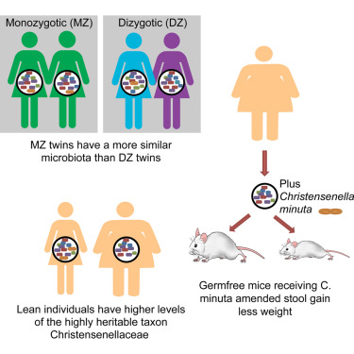
Introduction
 |  | P-value MZ more similar than DZ
Weighted UniFrac | All Bacteria | 0.094
 | Ruminococcaceae | 0.07
 | Lachnospiraceae | 0.016
 | Bacteroidaceae | 0.806
Unweighted UniFrac | All Bacteria | 0.032
 | Ruminococcaceae | 0.024
 | Lachnospiraceae | 0.39
 | Bacteroidaceae | 0.196
Bray Curtis | All Bacteria | 0.11
 | Ruminococcaceae | 0.097
 | Lachnospiraceae | 0.036
 | Bacteroidaceae | 0.448
*No mention of multiple
comparison correction

Slide 3
Introduction

Slide 4

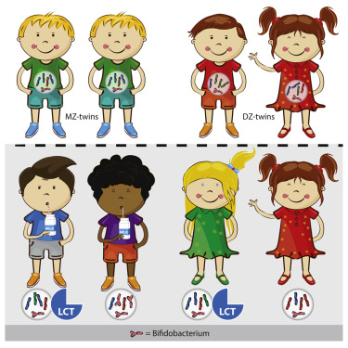


Introduction
Replicate previous findings using larger n
Identify additional heritable taxa
Identify gene-microbiome interactions (co-evolution)

Slide 5

Heritability Calculations
Used ACE model
A (additive genetics)
A = 2 * (r_{mz} – r_{dz})
r_{mz} = correlation of trait in identical twins
r_{dz} = correlation of trait in fraternal twins
C (common environment)
C = r_{mz} - A
E (unique environment)
E = 1 – r_{mz}
Falconer’s formula to calculate Heritability
H2 = A = 2 * (r_{mz} – r_{dz})
Notes:
A few classic problems arise from this formula and estimation of heritability.
A can go above 1 and below 0
Overestimates relatedness

Slide 6
OTU Heritability and Replication
A few discrepancies:
Performed two FDR tests one with all data and one with no OTUs.
Original P-values distribution is not one that is amenable to FDR correction (more on this on the next two slide)
Multiple significant findings from the same value used (non-independence of samples -> more on the next two slide)

Slide 7
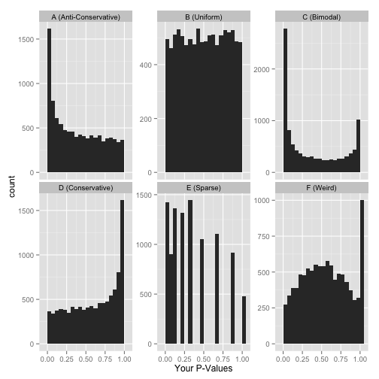
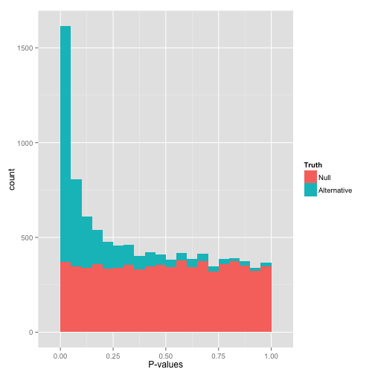
OTU Heritability and Replication
Images from David Robinson: http://varianceexplained.org/statistics/interpreting-pvalue-histogram/

Slide 8
OTU Heritability and Replication
1st FDR with all 945 tests
2nd FDR with 163 tests
After removal of duplicates from 2nd test P-values < 0.05 went from 58 to 40
Notes:
Do not look at this distribution and say, “Oh, I guess I don’t have any significant hypotheses.” If you had no significant hypotheses, your p-values would look something like (B) above. P-values are specifically designed so that they are uniform under the null hypothesis.
A graph like this indicates something is wrong with your test. Perhaps your test assumes that the data fits some distribution that it doesn’t fit. Perhaps it’s designed for continuous data while your data is discrete, or perhaps it is designed for normally-distributed data and your data is severely non-normal. In any case, this is a great time to find a friendly statistician to help you.
(Update 12/17/14: Rogier in the comments helpfully notes another possible explanation: your p-values may have already been corrected for multiple testing, for example using the Bonferroni correction. If so, you might want to get your hands on the original, uncorrected p-values so you can view the histogram yourself and confirm it’s well behaved!)

Slide 9
Correlation between Heritable bacteria and Alpha and Beta Diversity

Slide 10
Heritability: Stability and Diversity

Slide 11
Gene, SNPs, and Heritable Taxa
Choose 20 taxa with heritability > 0.20 (all from figure 1)
Significance for trait determined by taking lowest p-value and comparing it to 1000 p-values of the taxa residuals
If there were 3 tests done for a group (p-values = 0.05, 0.000001, and 0.4) the lowest of the three would then be compared to the distribution of the 1000 p-values of the taxa residuals. This would determine if the trait was significant or not.
Notes:
668 total genes, 32378 total SNPs

Slide 12
GWAS and Microbiome Part 1
Tested all SNPs (1,300,091) against the 20 heritable taxa identified
Found no associations that that achieved study wide significance (FDR < 0.2)
Potential correlation between Bifidobacterium and SNPs in genes involved with lactase persistence
Used Hutterite data set to try and validate this finding (Davenport, 2015)
Used custom algorithm to impute genotypes 98 individuals to 1,317 (>99% accurate in test cases)
Notes:
Mention that they are probably not sufficiently powered to adequately test this

