Slide 1
Correcting for Microbial Blooms in Fecal Samples during Room-Temperature Shipping
Journal Club
Marc Sze
May 4th, 2017

Slide 2
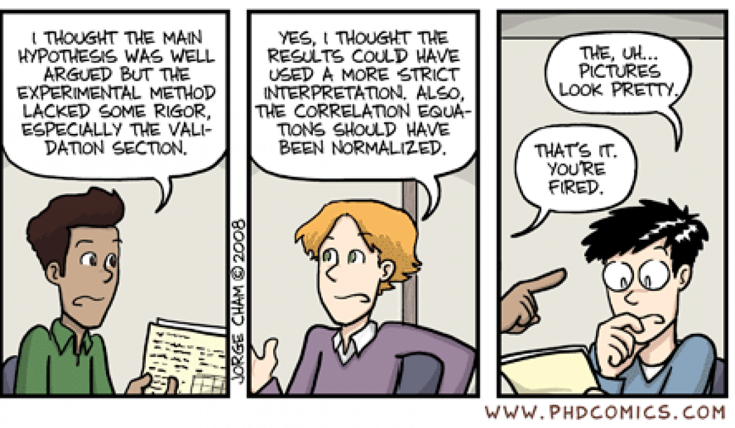
Outline
Go through the Abstract
Assess
Statement of Research Question
Approach
Results
Answer
Modify to improve
Discuss changes
Work through the paper

Slide 3
The Main Contention
Can correct out microbial blooms by removing the problematic reads
Makes a few Assumptions:
__________________!!!!!!
___________________
___________________
Notes:
- Major one is that blooms happen without any underlying impact on the microbial community being examined
Can identify exactly which sequences/species are blooming with 150 bp
Class level is a good enough indicator of community similarity.
Pro: Everything is up on GitHub for you to look at

Slide 4
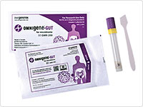

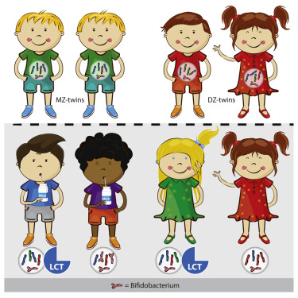


Methods
Preservation
Room Temperature Storage
Storage Study
PGP
UK Twins
No Preservation
Room Temperature Shipping
Fresh Frozen
Unplublished Qiita 1189
EWF
AGP
Notes:
Main idea is to use 4 very different data sets to find what should be removed

Slide 5
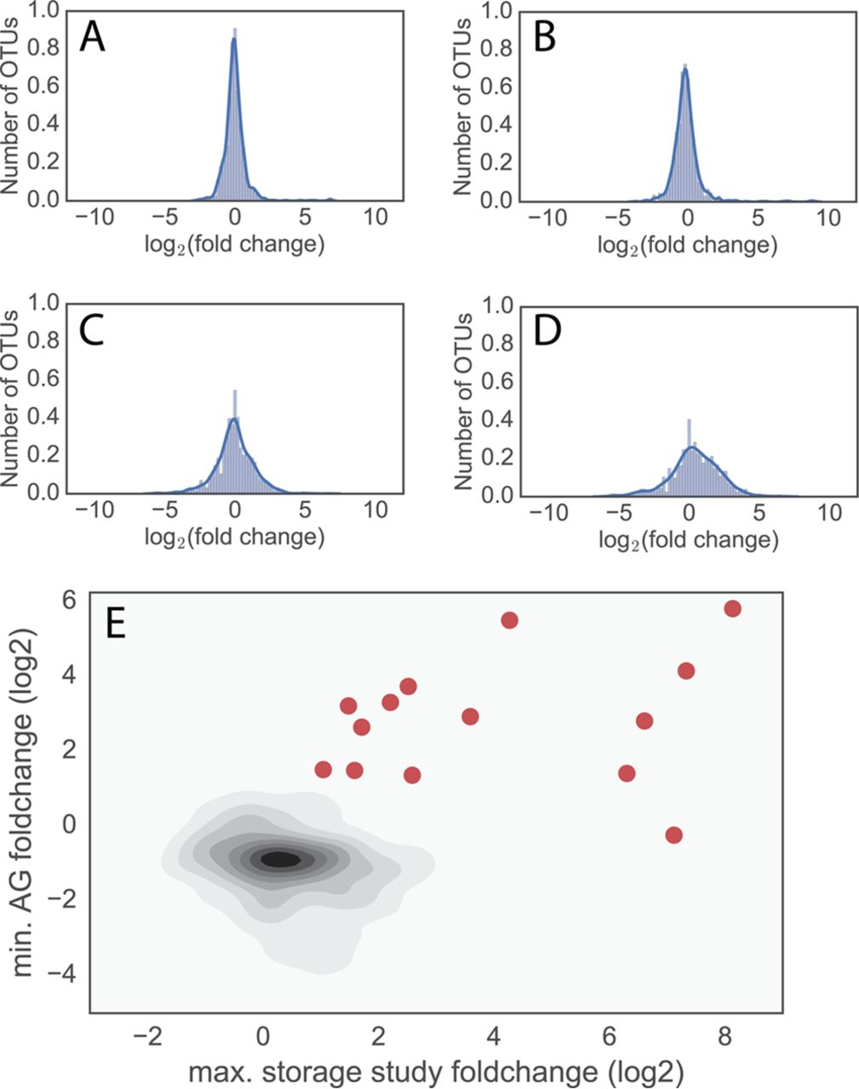
More OTUs at Tails for Longer Room Temp Storage
Storage Study
Song, et al.
Day 1 and Day 2
Storage Study
Mayo Clinic
Day 7 and Day 14
Notes:
- Combination of two different studies
- Main point here is that even with stabilization more outliers appear.
- So by looking at outliers to remove you can ID what needs to be removed

Slide 6
One of the criteria markers for blooming
Notes:
Statement that using min AG foldchange (log2) minimal ratio over the three studies was used to mitigate per study differences.
I’m personally not sure if this is the case.

Slide 7
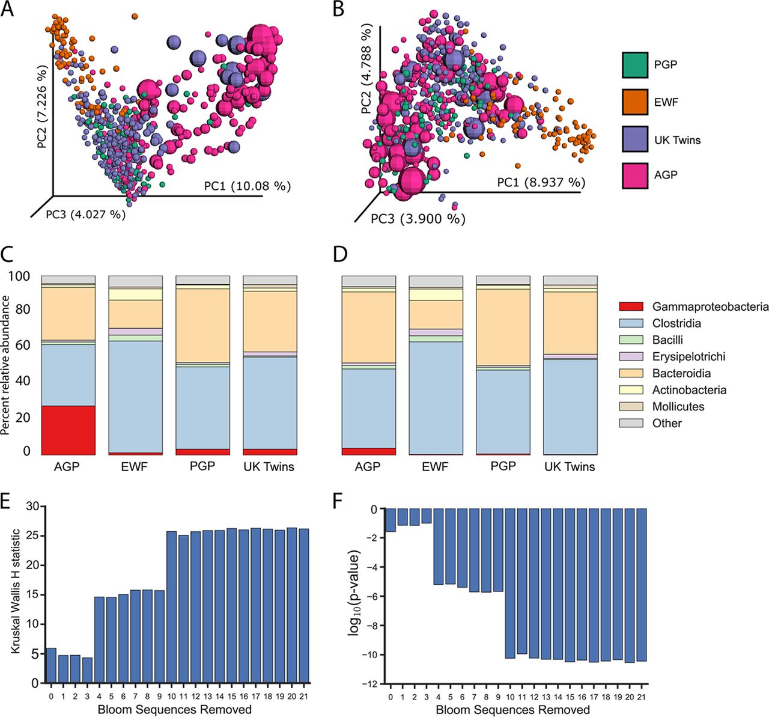
Removing sOTUs Restores Normal Community
Notes:
sOTUs = sub-operational OTUs

Slide 8
Class Level Breakdown Pre and Post Removal

Slide 9
Restoring Age and Diversity Correlation
Notes:
I actually find this graph redundant in the in the fact they are essentially the inverse of each other
X-axis is the number of cumulative bloom sequences removed
Y-axis is the significant correlation with age. 20, 30, 40, 50, 60

Slide 10
Impact of sOTUs Removal to Distance Comparisons

