Slide 1
Schloss Journal Club
Genetic Determinant of the Gut Microbiome in UK Twins
Marc Sze
July 14th, 2016

Slide 2
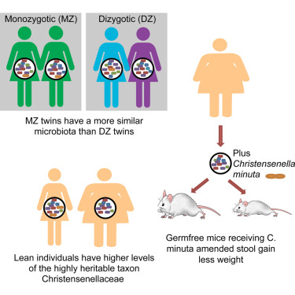
Introduction
 |  | P-value MZ more similar than DZ
Weighted UniFrac | All Bacteria | 0.094
 | Ruminococcaceae | 0.07
 | Lachnospiraceae | 0.016
 | Bacteroidaceae | 0.806
Unweighted UniFrac | All Bacteria | 0.032
 | Ruminococcaceae | 0.024
 | Lachnospiraceae | 0.39
 | Bacteroidaceae | 0.196
Bray Curtis | All Bacteria | 0.11
 | Ruminococcaceae | 0.097
 | Lachnospiraceae | 0.036
 | Bacteroidaceae | 0.448
*No mention of multiple
comparison correction

Slide 3
Introduction

