Slide 1
NON LINEAR CONTROL Collaborative Laboratory
097469 – NonLinear Control Course – A.Y. 2023/2024 – Semester I
Giuseppe Tosto 10934977
Marco Rositani 10937256
Guglielmo Chiereghin 10666842

Slide 2
NonLinear Control – Collaborative Laboratory
Introduction
State-Space
Dynamical Model
Simulation Scheme
Linear Tangent Approximation
Approximated Model
FeedBack Control
Simulations
FeedBack Linearization
Model
Pole Placement Controller
Simulations
Variable Structure Control
Controller Model
Simulations
High Frequency Switching Countermeasure

Slide 3
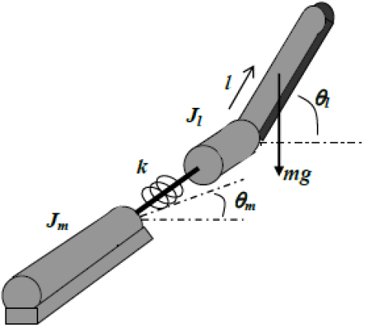
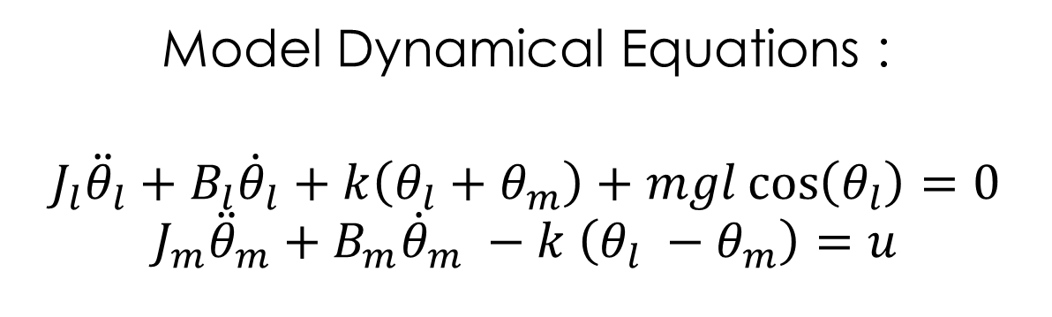
Introduction
Model Dynamical Equations :
$$J_{l}{\ddot{θ}}_{l}+B_{l}{\dot{θ}}_{l}+k\left(θ_{l}+θ_{m}\right)+mgl\cos\left(θ_{l}\right)=0$$
$$J_{m}{\ddot{θ}}_{m}+B_{m}{\dot{θ}}_{m} −k \left(θ_{l} −θ_{m}\right)=u$$
Parameters :
$$k$$ | $$J_{l}$$ | $$J_{m}$$ | $$B_{l}$$ | $$B_{m}$$ | $$m$$ | $$l$$
0.8 Nm/rad | 4e-4 Nms²/rad | 4e-4 Nms²/rad | 0 Nms/rad | 0 .015Nms/rad | 0.3 kg | 0.3 m

Slide 4
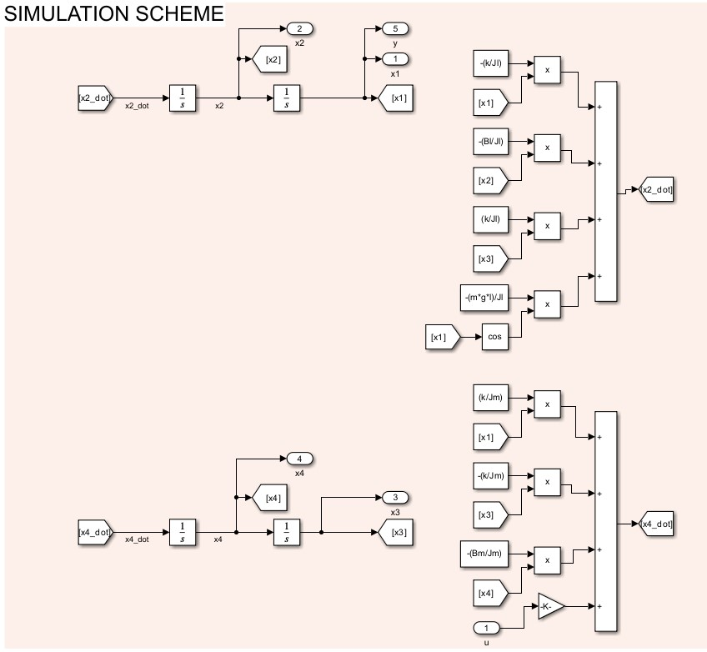
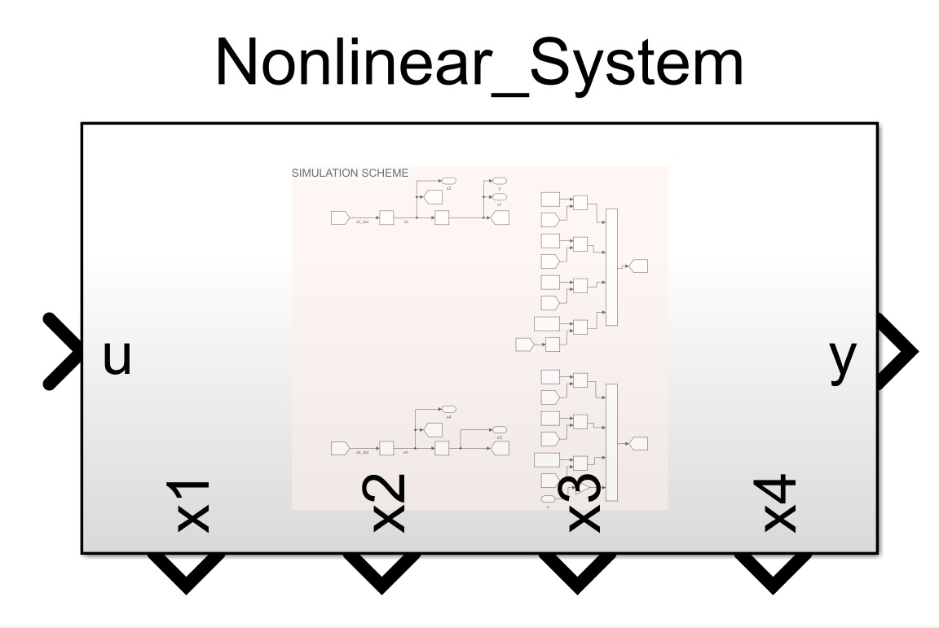
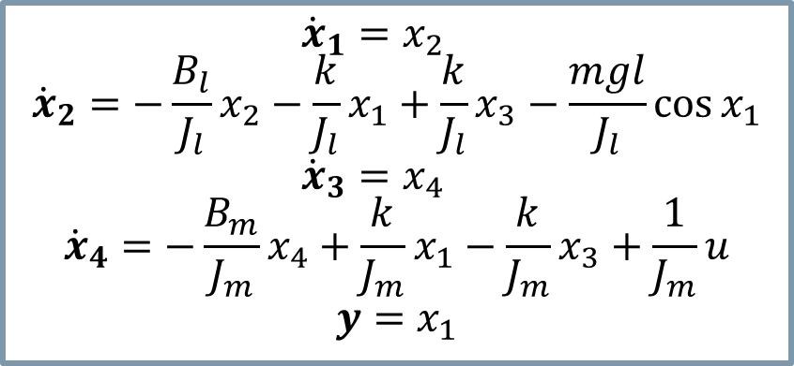
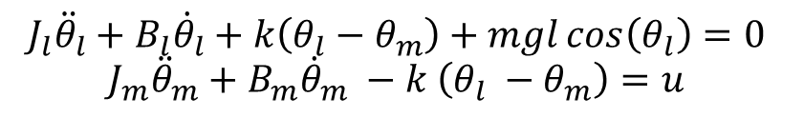
Model and Simulation scheme
State-Space Representation
Request 1 : Give a state space representation of the system and provide a related simulation scheme
State-Space Representation:
$$J_{l}{\ddot{θ}}_{l}+B_{l}{\dot{θ}}_{l}+k\left(θ_{l}−θ_{m}\right)+mgl\cos\left(θ_{l}\right)=0$$
$$J_{m}{\ddot{θ}}_{m}+B_{m}{\dot{θ}}_{m} −k \left(θ_{l} −θ_{m}\right)=u$$
$$x_{1}=θ_{l} ; x_{2}={\dot{θ}}_{l} ; x_{3}=θ_{m} ; x_{4}={\dot{θ}}_{m}$$
$${\dot{x}}_{1}=x_{2}$$
$${\dot{x}}_{2}=−\frac{B_{l}}{J_{l}}x_{2}−\frac{k}{J_{l}}x_{1}+\frac{k}{J_{l}}x_{3}−\frac{mgl}{J_{l}}\cos{x_{1}}$$
$${\dot{x}}_{3}=x_{4}$$
$${\dot{x}}_{4}=−\frac{B_{m}}{J_{m}}x_{4}+\frac{k}{J_{m}}x_{1}−\frac{k}{J_{m}}x_{3}+\frac{1}{J_{m}}u$$
$$y=x_{1}$$

Slide 5
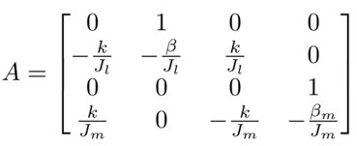
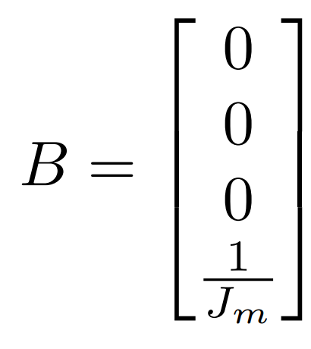


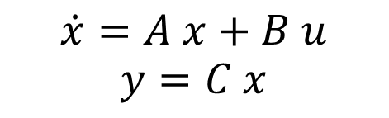
Linearized Model around the Equilibrium
Linear Tangent Approximation
Request 2 : Give Linear Tangent Approximation of the System at the point corresponding to $θ_{l}=\frac{π}{4}$ and propose a stabilizing feedback of this basis
Linear Tangent Approximation :
$$\dot{x}=A x+B u$$
$$y=C x$$

Slide 6
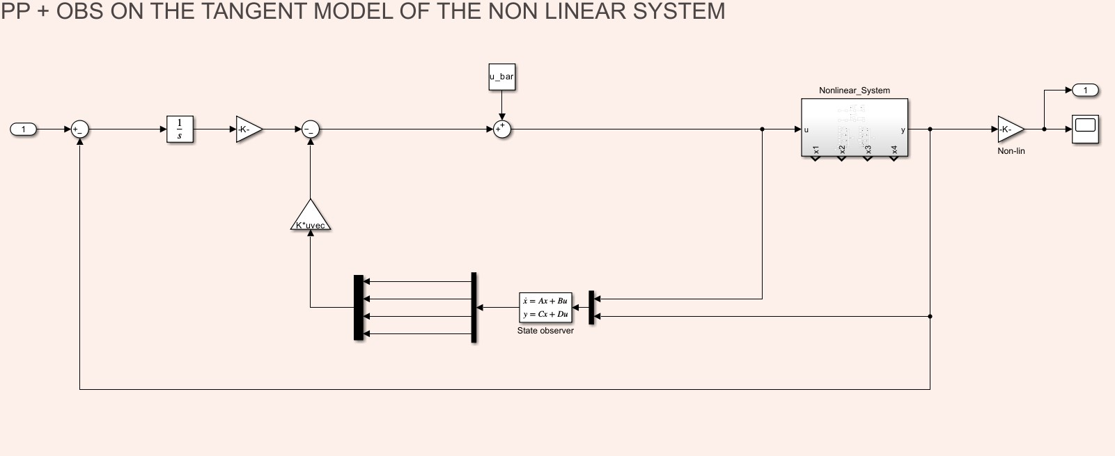
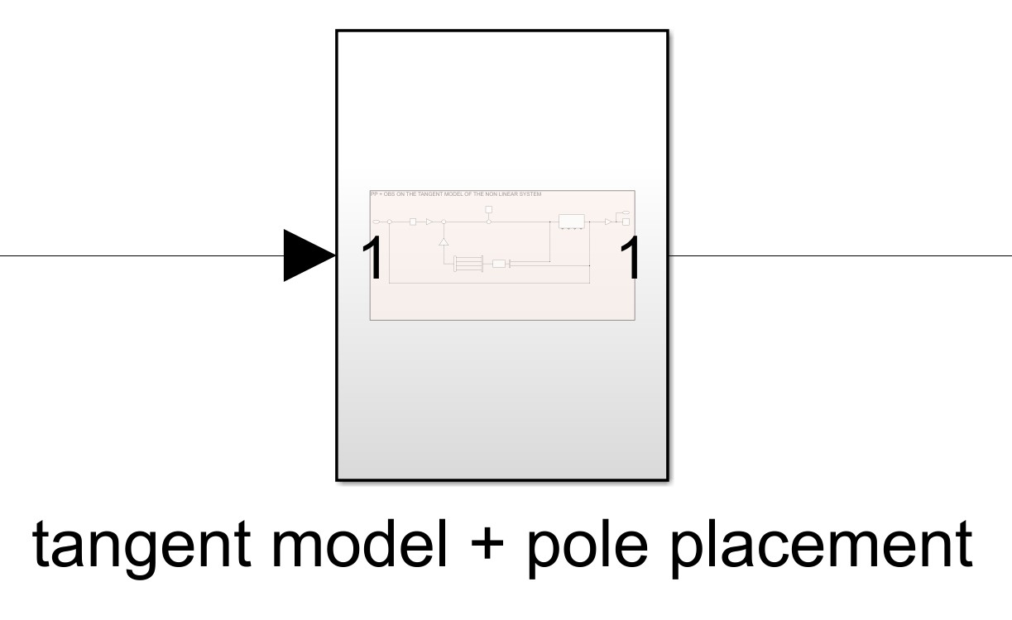
Stabilizing Control Law
Linear Tangent Approximation
As stabilizing control law we used a Pole Placement controller where we estimated the state through a Luenberger estimator and we enlarged the system with an integrator to track a reference on $θ_{l}$
Pole Placement Controller
POLES
p1 = -20 ; p2 = -25 ; p3 = -30 ; p4 = -35 ; p5 = -40
OBSERVER POLES
p1 = -200 ; p2 = -250 ; p3 = -300 ; p4 = -350

Slide 7
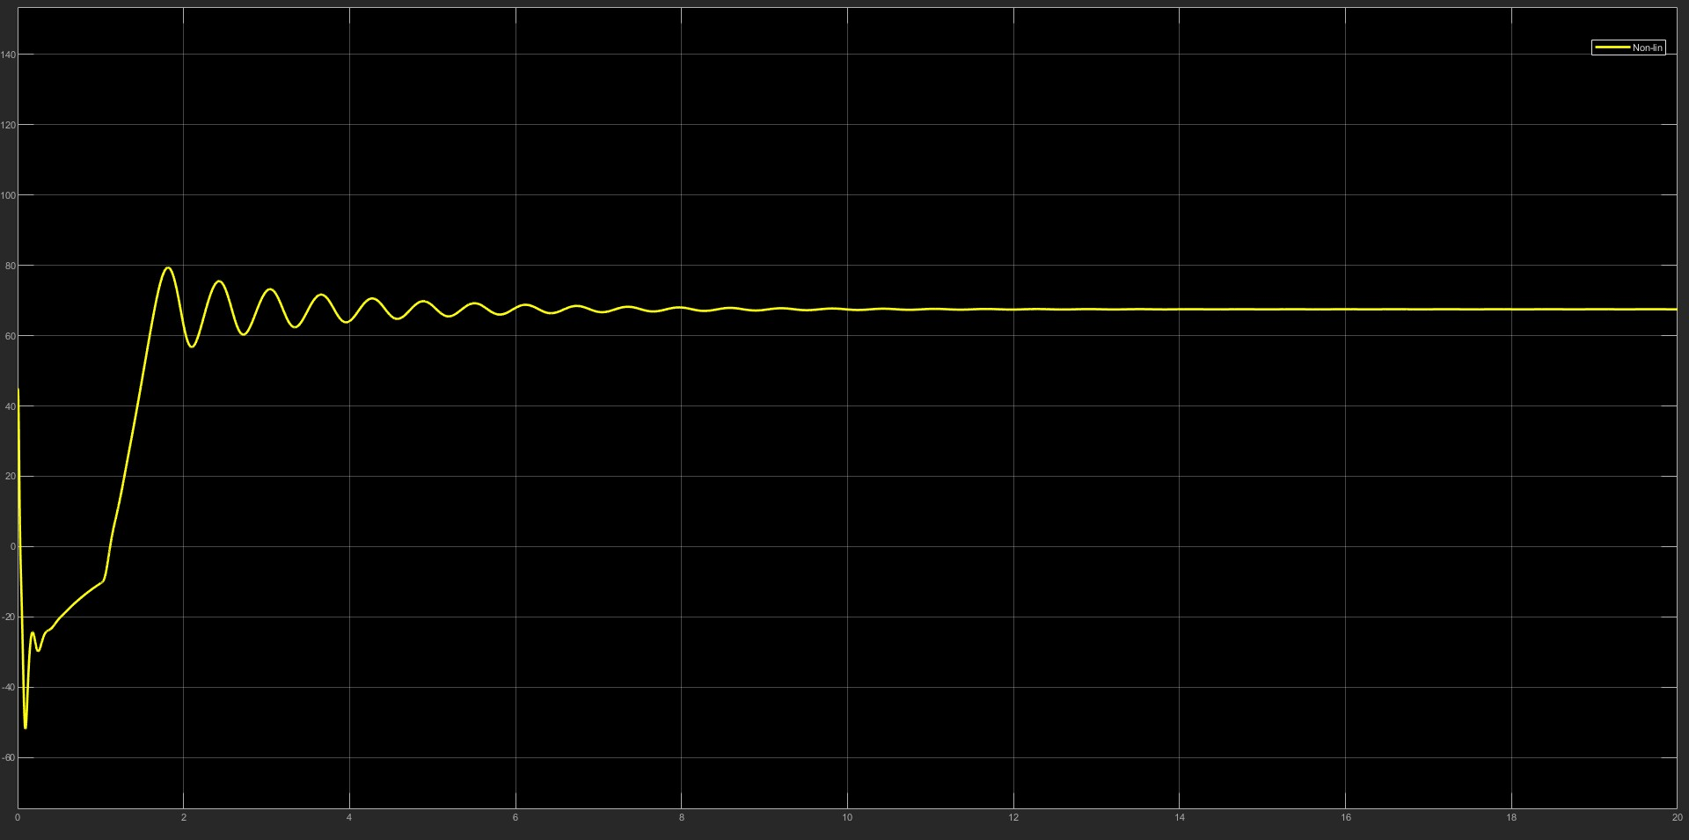
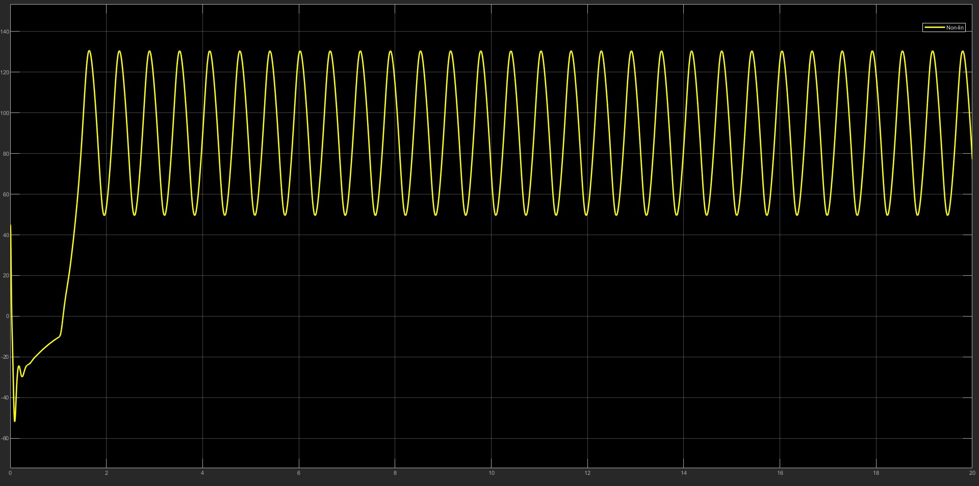
Simulation Performance
Linear Tangent Approximation
Request 3 : Implement the obtained control law in the simulation scheme and test its behavior
We run two different simulations to show the behaviour of this controller. In the first case (right image),we set a reference of π/4 + π/8, and as we can see the output tracks the reference after some initial small oscillations.
In the second case (left image) we used a reference of π/2 and from the plot we can see that the tracking performances are not so good as in the other case. This is due to the fact that the tangent model is accurate only in a neighborhood of the equilibrium point.

Slide 8


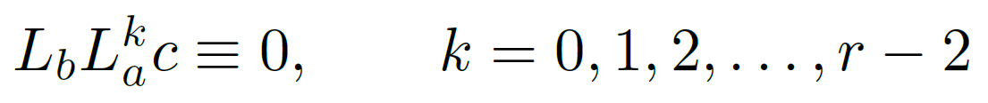
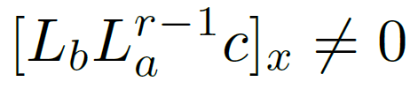


Fully Linearizability Condition
FeedBack Linearization
Request 4 : Check that the original nonlinear system is fully exactly I/O linearizable by diffeomorphism and state feedback, with $\frac{π}{4}−θ_{l}$ as the output, and propose a stabilizing state feedback law on this basis
First step is to check if our NonLinear, affine in the input, TI system is Fully Linearizable (Input/State Linearizable). This is equal to check that our system S has relative degree r in x°, equal to the grade of the system, n. Then we can obtain a (locally) linear system via state feedback :
System S has relative degree r in x° if, in a neighborhood of x° we got :
and
Then, to build the feedback linearization block we need to compute 2 functions :
In order to do so we define the Lie derivative operator along a vector field f as :
We have done all the other computations through a MatLab script
(results are on “symbolic_derivatives.m” file attached to the presentation)

Slide 9
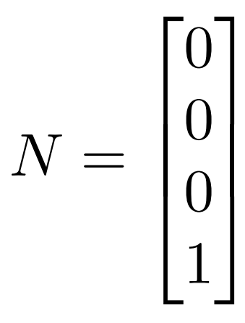
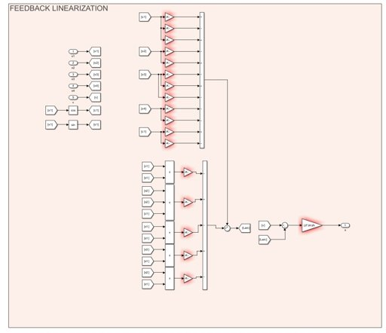
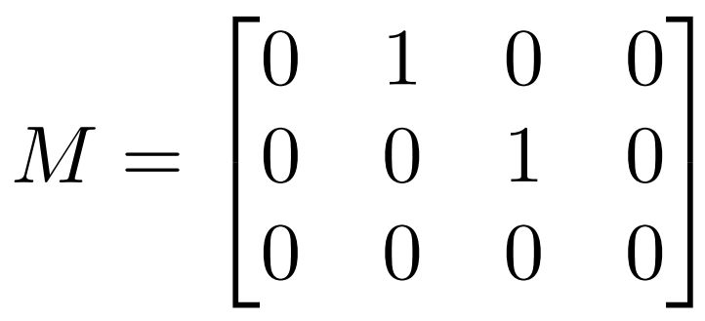
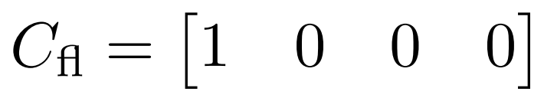
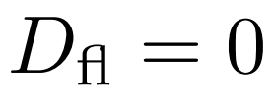
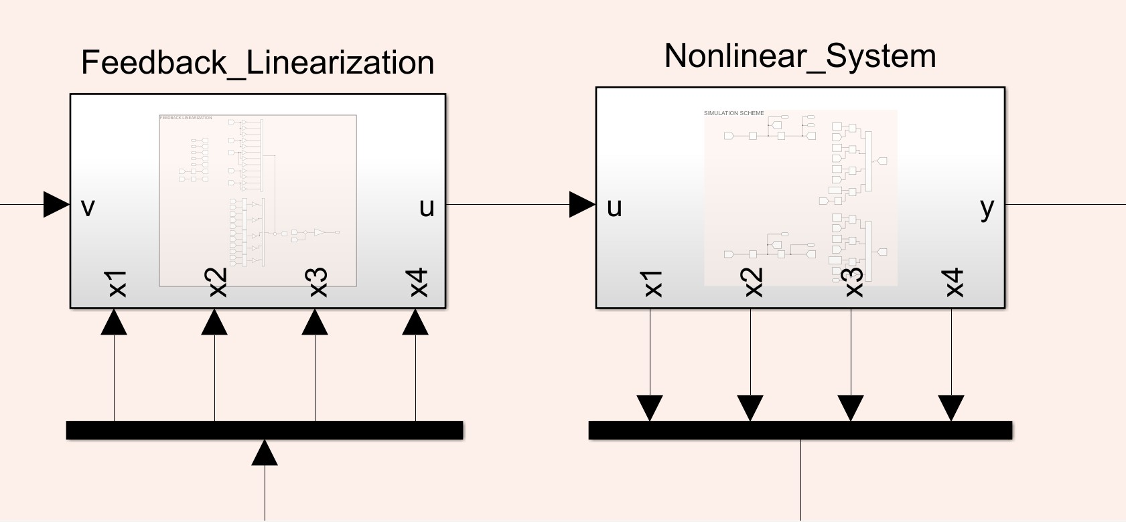
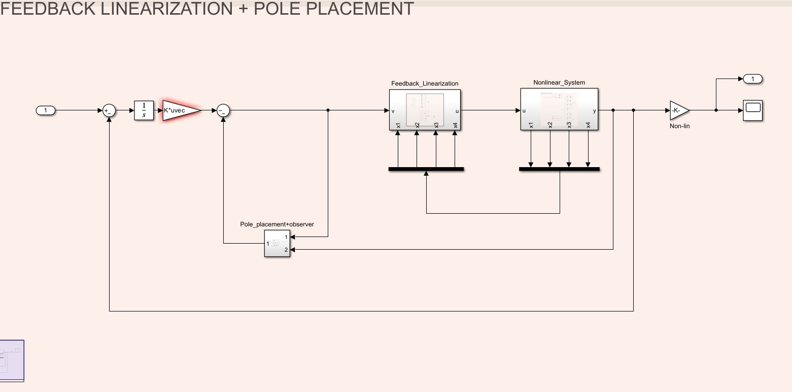
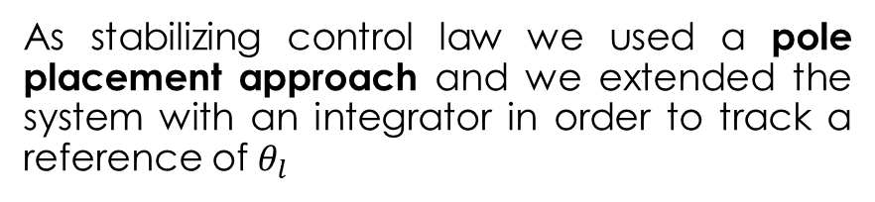
Model + Stabilizing State FeedBack Law
FeedBack Linearization
Pole Placement Controller
POLES
p1 = -20 ; p2 = -25 ; p3 = -30 ; p4 = -35 ; p5 = -40
OBSERVER POLES
p1 = -200 ; p2 = -250 ; p3 = -300 ; p4 = -350
As stabilizing control law we used a pole placement approach and we extended the system with an integrator in order to track a reference of $θ_{l}$

Slide 10
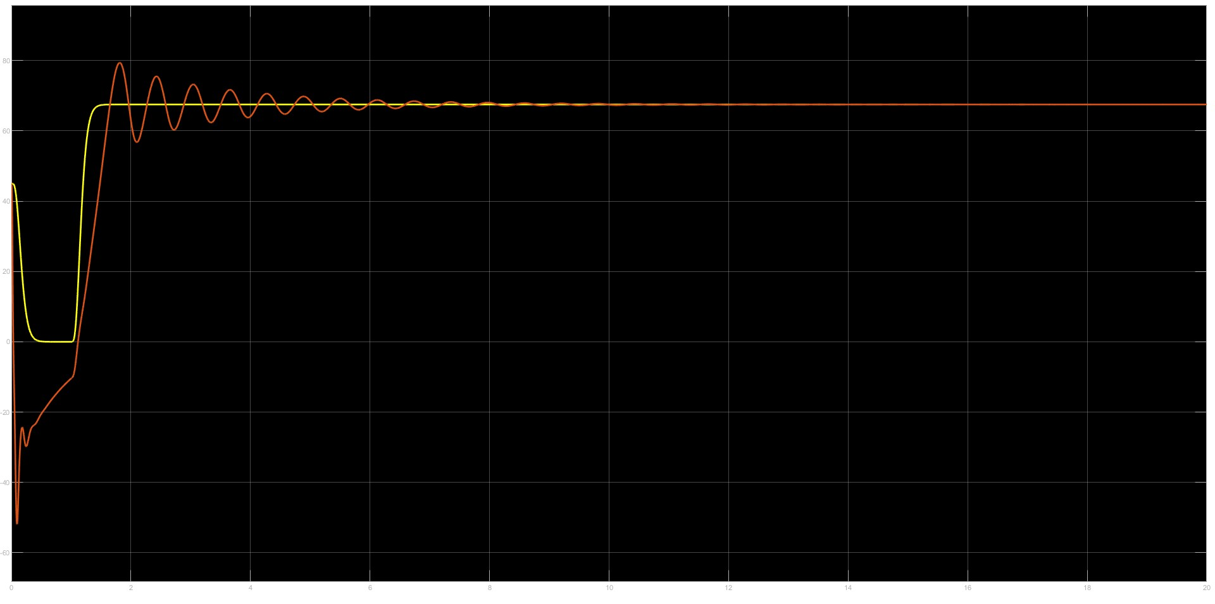
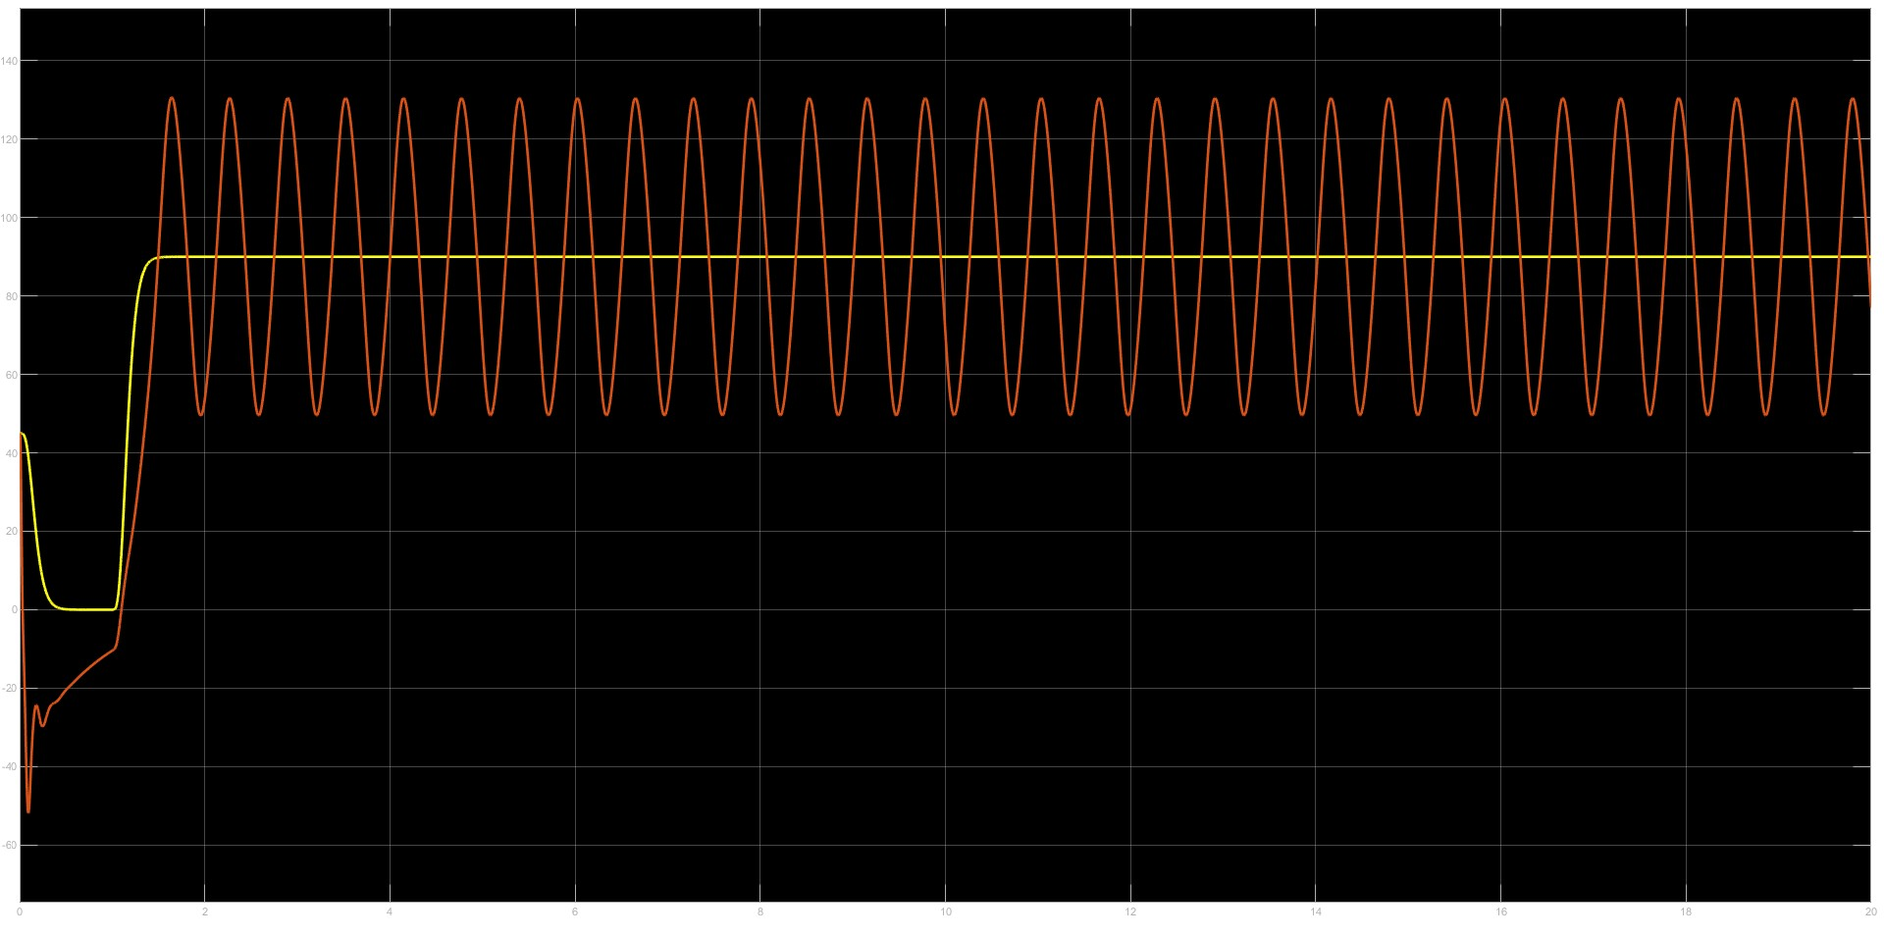
Simulation Performance
FeedBack Linearization
Request 5 : Verify the results in simulation and comment
We run two different simulations with the same reference values we used for the linear tangent approximation. As we can see the feedback linearization performs better than the linear tangent approximation model tracking the reference way faster without oscillations.
Moreover we can also see that the feedback linearized system can track a reference far from the equilibrium point in a more performant way with respect to the Linear Tangent Approximation.

Slide 11
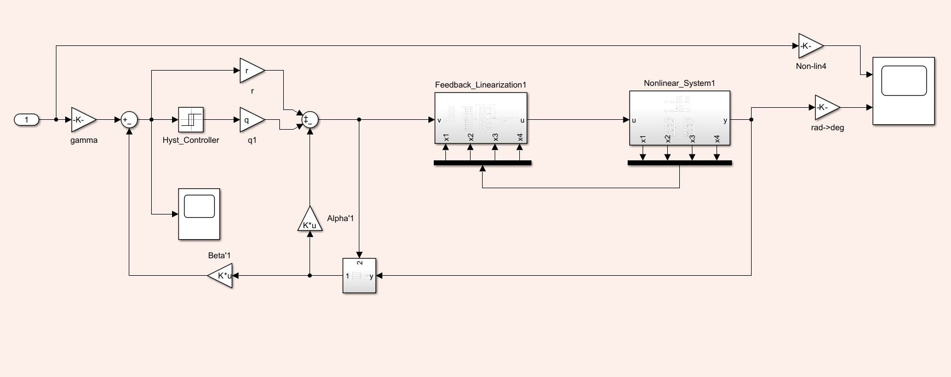
Model
Variable Structure Control
Request 6 : Propose a Variable Structure Controller for the system linearized via feedback linearization to make $y\left(t\right)=\frac{π}{4}−θ_{l}$ track some (constant) reference signal y°

Slide 12
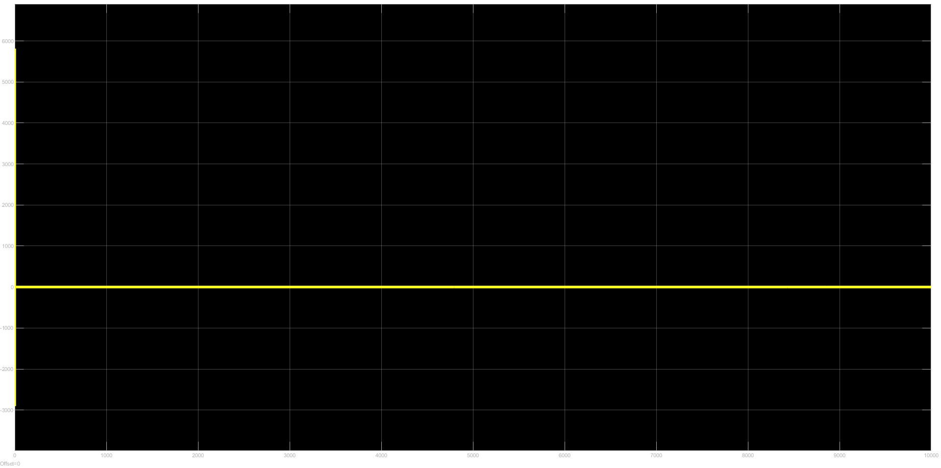
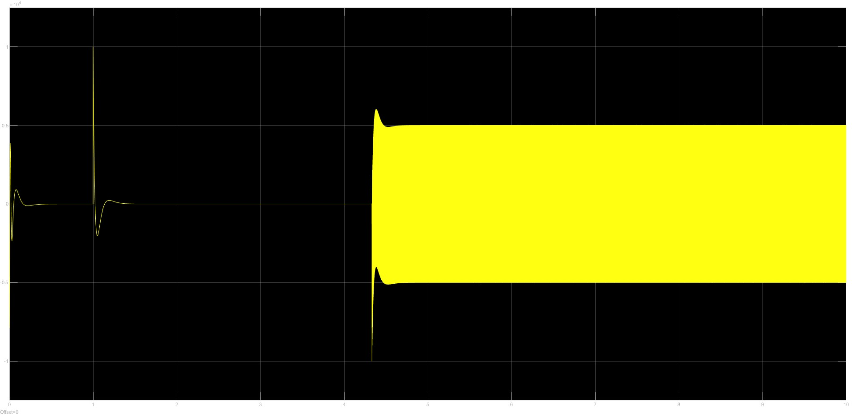
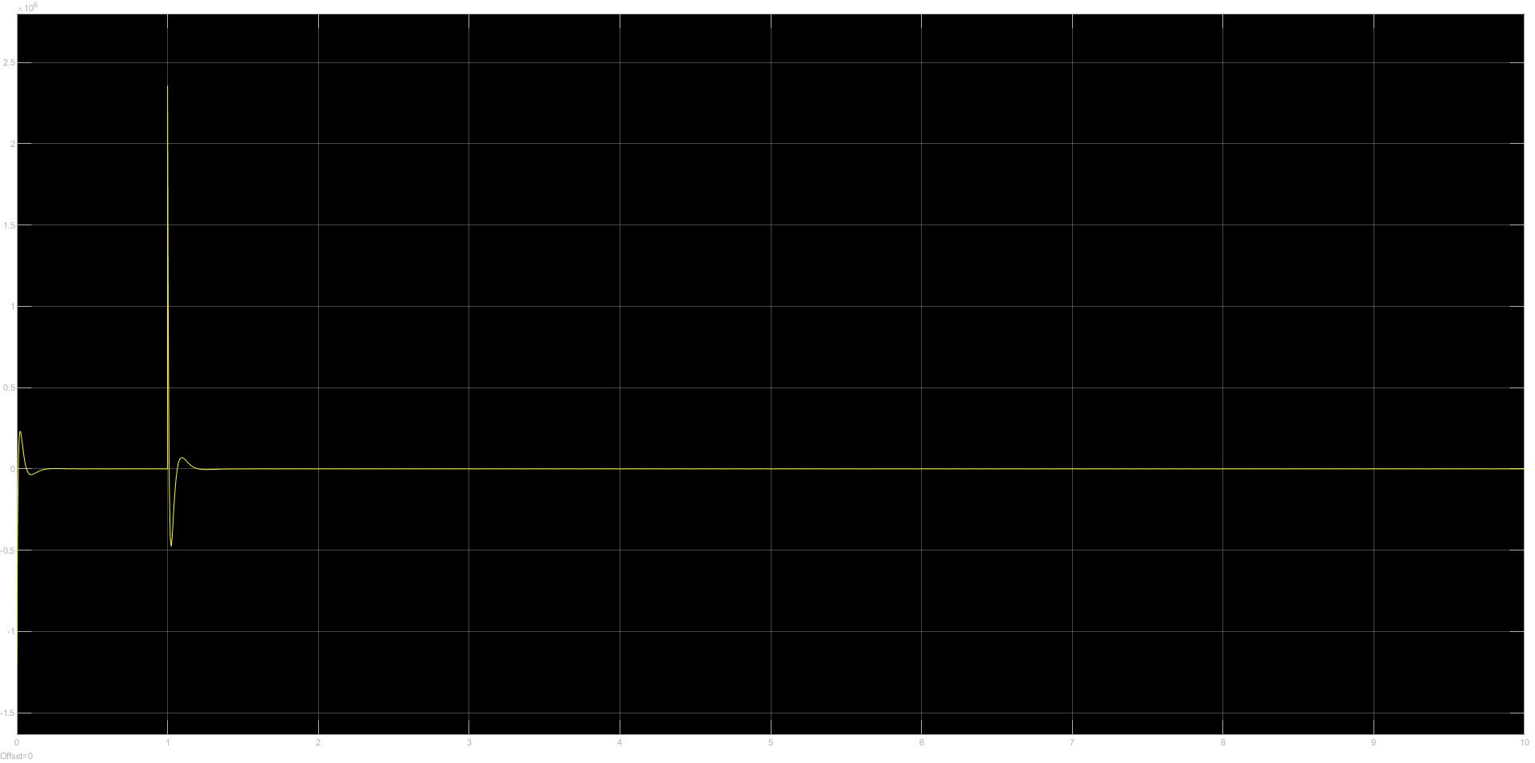
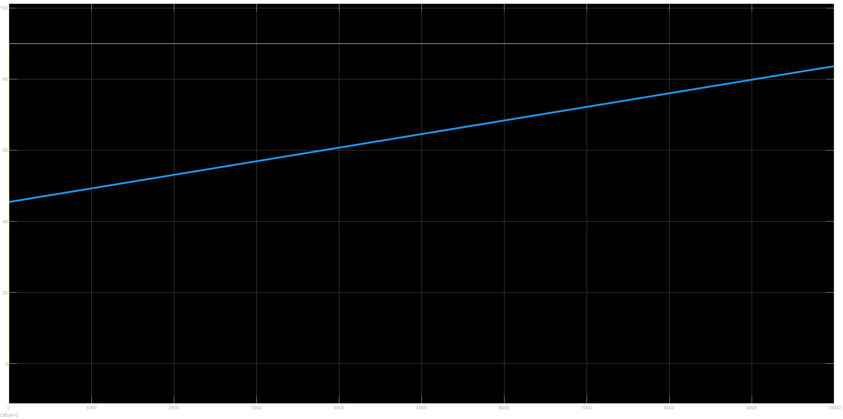
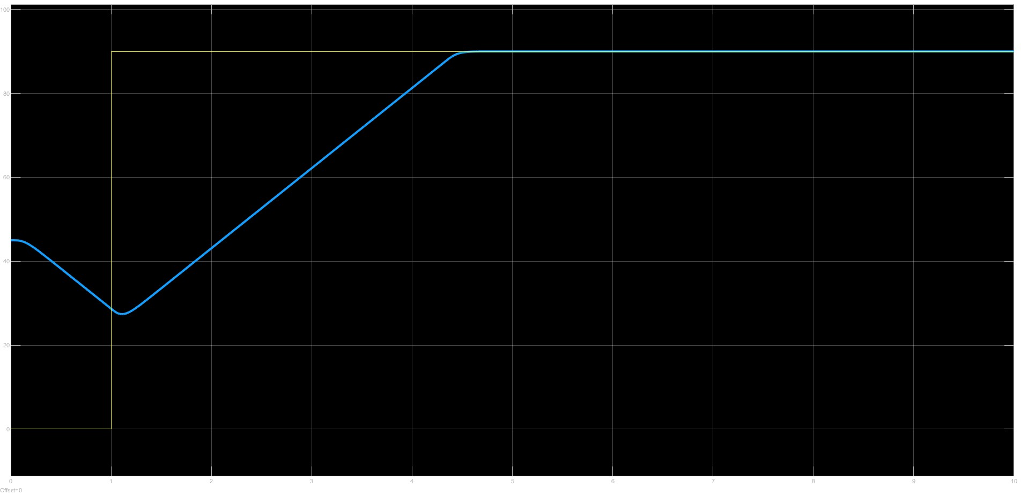
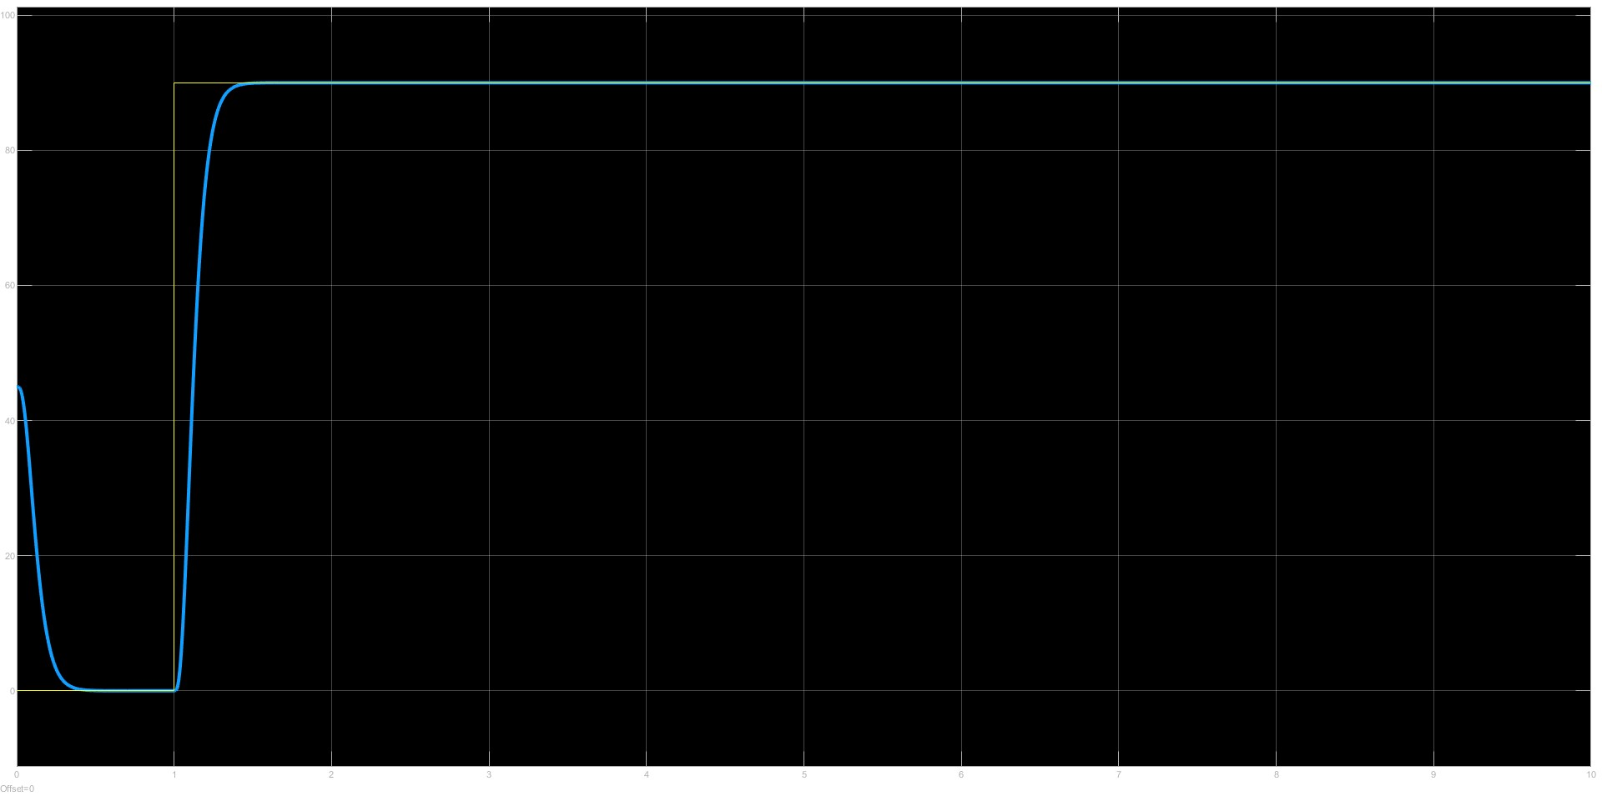
Simulation Performance
Variable Structure Control
Request 7 : Analyze the performance achieved by the variable structure controller devised in point 6 focusing on high frequency switching
q = 1 ; r = 0
q = 5000 ; r = 0
q = 10 ; r = 100

Slide 13
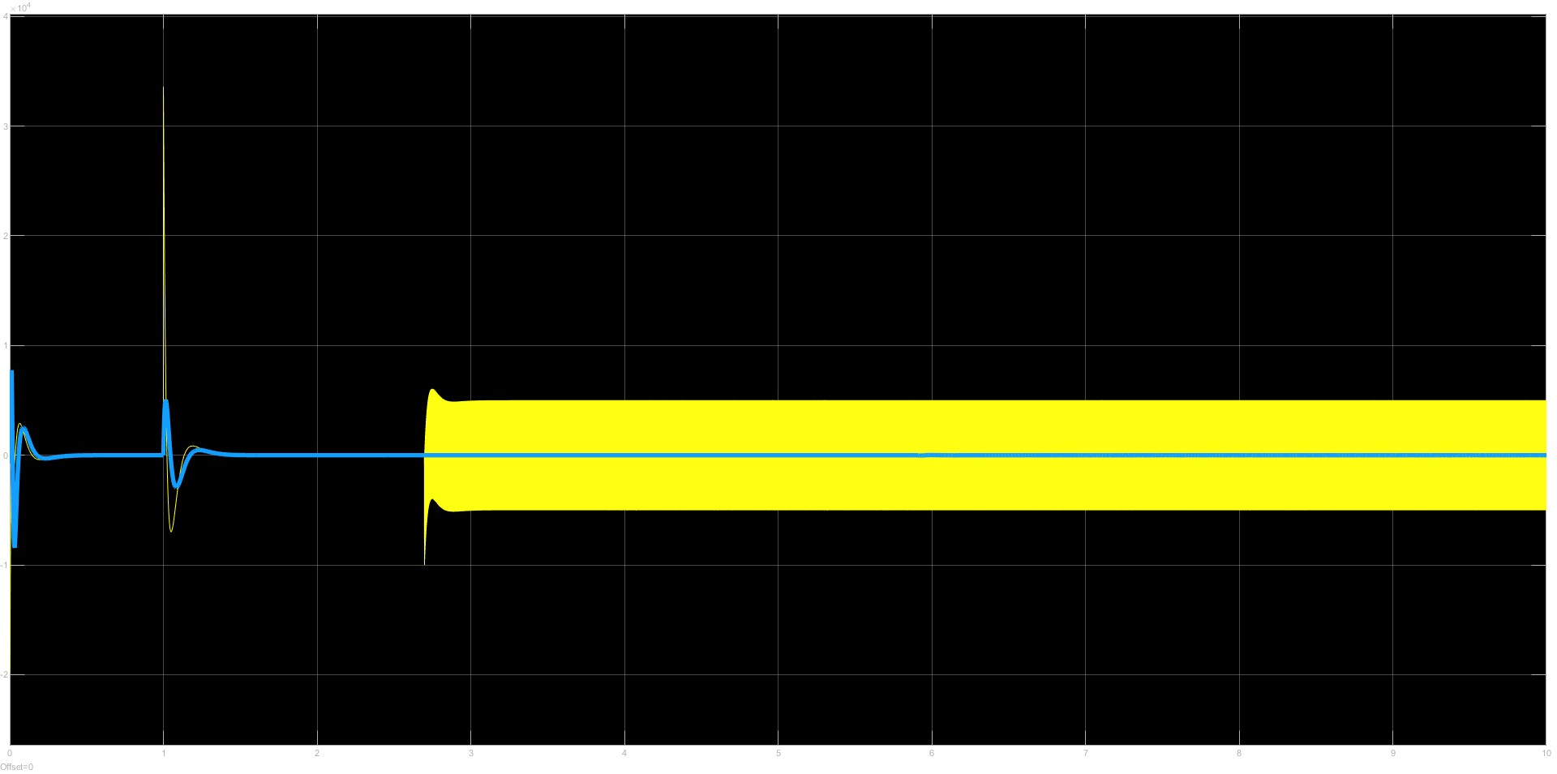
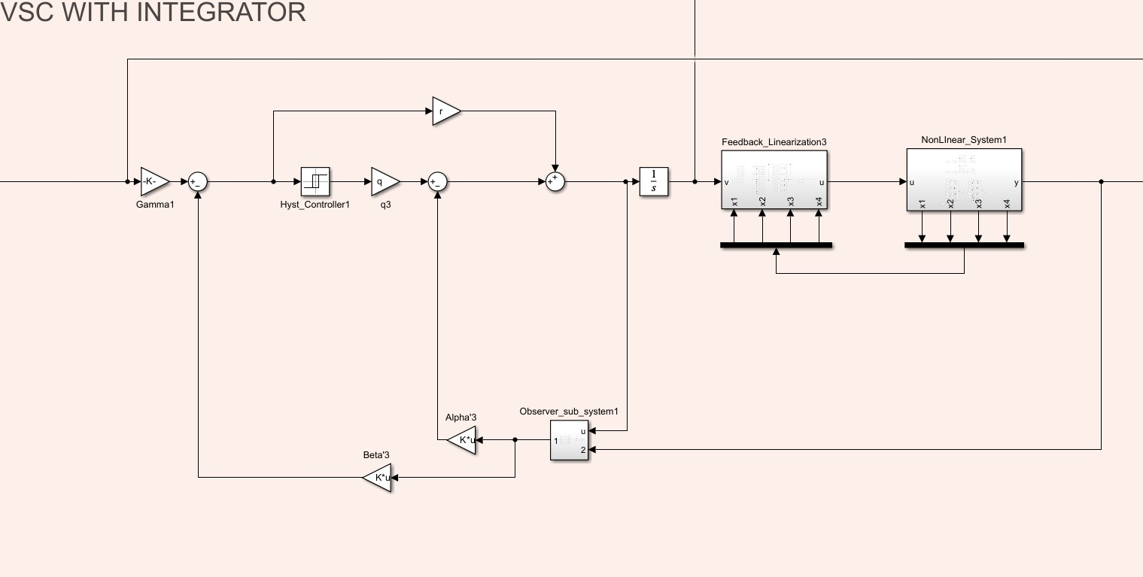
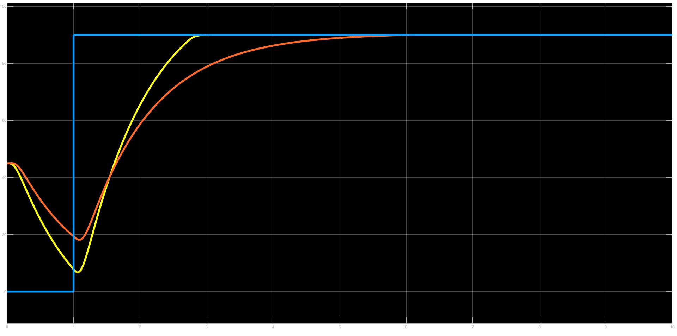
High Frequency Switching countermeasure + Simulation performance
Variable Structure Control
q = 5000 ; r = 1

