Slide 1
Subconscious behavioral patterns and
decision-making in three-dimensional
virtual environments
Author
Paul Marcu
Supervisor
Lect. Dr. Imre Zsigmond

Slide 2
Table of Contents
01
02
03
04
05
06
Motivation, Context and Objective
Previous Works in Related Fields
Proposed Solution and Methodology
Application Description
Maze Navigation Demo
Results, Analysis and Conclusions

Slide 3
Motivation
The evolution of the field of computer science over the last century has tended towards accessibility and empowering consumers, giving rise to hybrid disciplines such as UX design, social computing, and the most relevant to our study, human-computer interaction.
These fields use concepts from behavioral sciences — psychology, sociology et al.
Due to relative recency, some topics of study (3D interfacing) remain sparsely researched;
Rapid proliferation of powerful hardware and 3D applications in recent years justifies further research.

Slide 4
Context — Definition
On the field of human-computer interaction (HCI)
Studies and analyzes the relationship between users and systems;
Integrates concepts originating from cognitive psychology with applied computer science;
Critical in designing effective system interfaces;
Its multidisciplinary nature determines a broad and varied body of study.

Slide 5
Context — Evolution
1940s
1980s
1990s
2010s
HCI has its indistinct inception at the end of WWII
HCI begins to gain momentum as PCs become common
Leaps in hardware capacity enable 3D UI research
VR and AR devices spur various 3D interfacing studies

Slide 6
Objective
The scope of this thesis is to determine to what extent behavioral biases observed in psychology (such as the tendency to perceive certain colors more positively than others) may translate to 3D applications and virtual environments.

Slide 7
Previous Works
We have researched several academic works pertaining to the topic of our thesis. Of those, we have chosen to highlight three outstanding papers, relevant for their recency, methodology and results.
M. Flanagan — Critical play: Radical game design (2013)
This work highlights the ways in which HCI may be leveraged in the field of game design, a subcategory of software design that focuses on constructing recreational applications. It argues for the importance of enriching users’ experiences in three-dimensional games by leveraging psychological principles and understanding player behavior in the development process.

Slide 8
D.A. Bowman — Questioning naturalism in 3d user interfaces. (2012)
Bowman’s studies on the topic of 3D user interface design are all of great importance, but it is in this one that we find information most relevant for our thesis. Besides having a rigorous testing methodology which helped inspire the one utilized in the study, it affirms that a higher level of naturalism (direct interfacing) does not necessarily correlate with greater user control.

Slide 9
A. Muryy — Route selection in non-euclidean virtual environments. (2021)
Out of the studied psychological works, this paper’s usage of a virtual reality three-dimensional environment in its methodology affirms the validity of virtual spaces as analogues for their physical counterparts. Additionally, it concluded that the navigation of a space hinges on its established mental representation.

Slide 10
Proposed Solution
To reach our study’s objective, we opted for an empirical analysis of data collected from test subjects by:
Creating an interactive application depicting three sequentially accessible 3D labyrinths;
Having each of the labyrinths’ walls depict certain environmental traits;
Ensuring that the application can accurately record the user’s movement data;
Allowing test subjects to freely engage with the virtual testing environments;
Processing and modeling the resulting data;
Analyzing the modeled data and observing if it coincides with hypotheses from psychological articles.

Slide 11
Methodology
Participant Configuration
Fifteen students of the faculty (9 male, 6 female) were selected for participation;
It was confirmed ahead of the experiment that none of them had significant visual or motor impairments that could affect the outcome;
Additionally, each of them affirmed that they were familiar with the interfacing devices;
Subjects were unaware of the study’s scope.

Slide 12
External Configuration
The trials took place in empty classrooms, such as to avoid distractions;
Smartphones and smartwatches were left outside of the testing rooms, to mitigate the risk of interruptions;
Participants were seated at a desk, facing a laptop which was running the testing application, with no other background applications;
The only instructions given were to explore the mazes freely, as they contained no entrance nor exit;
Subjects were unaware of the study’s scope to prevent bias.

Slide 13
Stimulus Configuration
The experiment’s stimuli were visual, consisting of the three aforementioned labyrinths;
Each labyrinth presented the same corridor height and width, as well as identical white ceilings and grey floors;
The first maze had corridors of varying colors (red, green, blue, magenta);
The second maze had corridors depicting various geometric textures (circular, triangular, square);
The third maze had corridors of varying brightnesses (bright, dim, dimmer, dark);
Each maze had an allotted exploration time of sixty seconds.

Slide 14
Application Description
Design
The application uses the event-driven software architecture pattern;
The player, defined by the Player and Camera entities, acts as the “event emitter”;
The environment, defined by the Floor and Wall entities, acts as the “event consumer”, reacting to the player’s input;
This paradigm defines the experiment’s core interactive experience.

Slide 15
Structure
The program has a structure of four UI scenes and three 3D scenes;
“Scenes” are isolated environments specific to the Unity 3D game engine;
The seven scenes take place intermittently in the application’s flow, such that users will go from a UI scene (menu) to a 3D scene (labyrinth).

Slide 16
Implementation
The application was implemented in the Unity 3D game engine;
As such, physics and rendering systems are built-in;
The player and the environment are represented by scene entities;
Entity behavior and application logic is defined by C# scripts.

Slide 17
Results
The testing results were stored in three separate .txt files, each corresponding to one of the labyrinths.
The files contained the movement data of the user, stored as tuples of X and Y coordinates. In order to accurately determine the user’s path, the Player entity’s position in the maze was polled every 500ms.

Slide 18
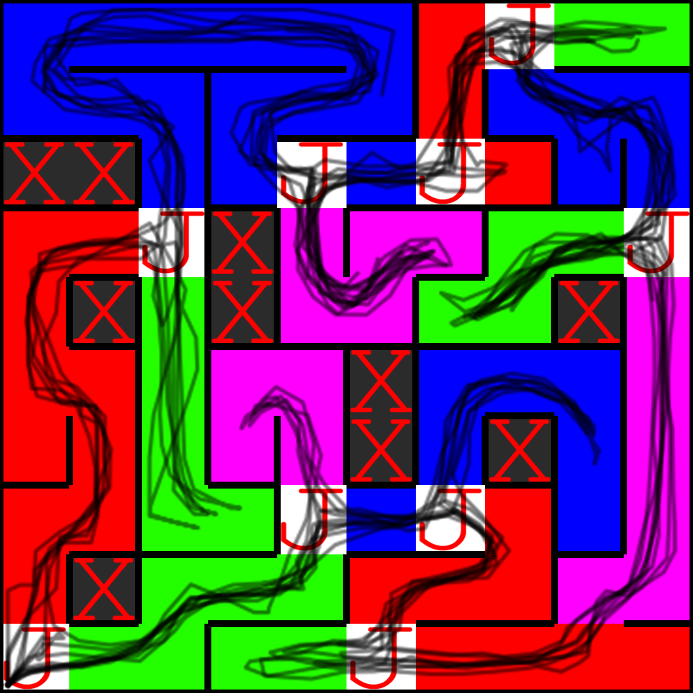
Results
To be able to analyze behavioral preferences based on movement, we chose to evaluate users’ choices at junctions — that is, the intersection of multiple corridors. As such, whenever a user selected a previously unexplored corridor, the specific trait (color, texture, brightness) of that corridor would gain a “favorability score” of (n - 1), where n is the number of unexplored corridors at that junction.
Top-down view of the color labyrinth.
The black lines are plotted movement data.
J is used for junction tiles, while X is used for inaccessible tiles.

Slide 19
Analysis
Through our previously established favorability scoring system, we have observed the following total values across all participants:
Color Labyrinth:
Red | Green | Blue | Magenta
19 | 33 | 20 | 13
Texture Labyrinth:
Circle | Triangle | Square
37 | 18 | 14
Brightness Labyrinth:
Bright | Dim | Dimmer | Dark
24 | 15 | 11 | 12

Slide 20
Analysis — Color
For the color analysis, our hypothesis was based on the psychological findings by Valdez et al. (1994), who determined a comprehensive mapping of colors to emotional states.
Given this precedent, it was expected that colors associated with calmer emotional states (green and blue) would attract more people than those associated with intensely anxious emotional states (red and magenta).

Slide 21
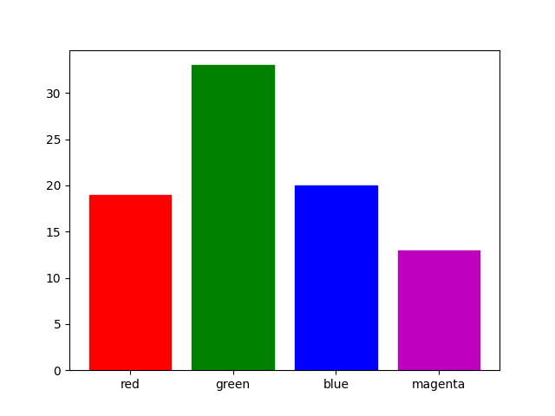
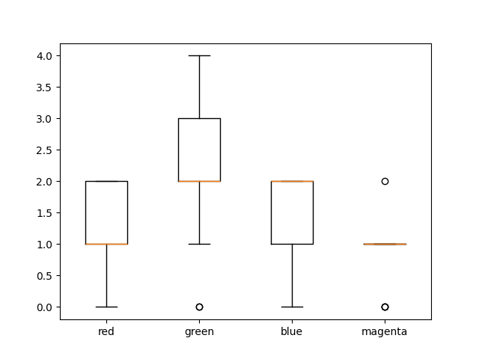
Analysis — Color
The results concurred with the hypothesis from a quantitative analysis (total score), as well as from a mean analysis (score per person) perspective.

Slide 22
Analysis — Texture
Our hypothesis for the texture analysis was modeled after Bar et al. (2006)’s findings, who empirically determined that curved shapes elicit positive emotions from humans, while jagged shapes elicit negative ones.
As such, we expected the smooth, circular geometric pattern to appeal to test subjects to a much larger degree than either the triangular or square pattern.

Slide 23
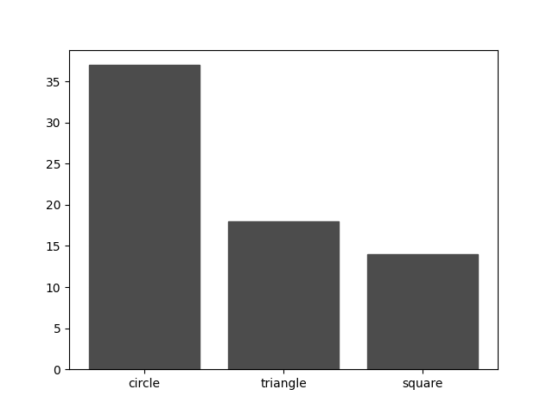
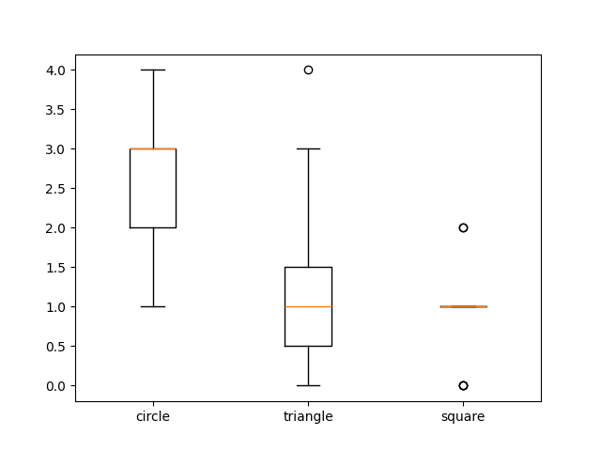
Analysis — Texture
Again, the results concurred with the hypothesis from a quantitative analysis (total score), as well as from a mean analysis (score per person) perspective.

Slide 24
Analysis — Brightness
In the case of brightness, our hypothesis was informed by Wilms (2018), whose conclusions highlighted the fact that, while emotional intensity seemed constant between different levels of monochrome brightness, emotional valence (positivity) increased.
As such, we expected the corridors to attract participants’ attention in a manner proportional to their respective brightnesses.

Slide 25
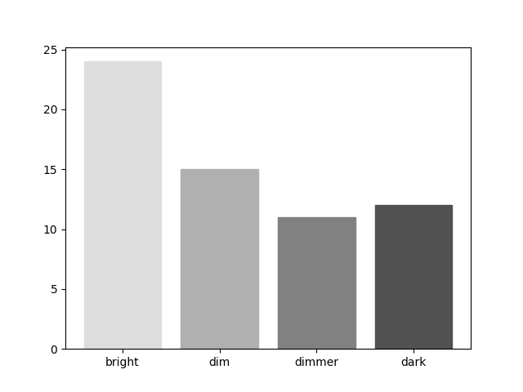
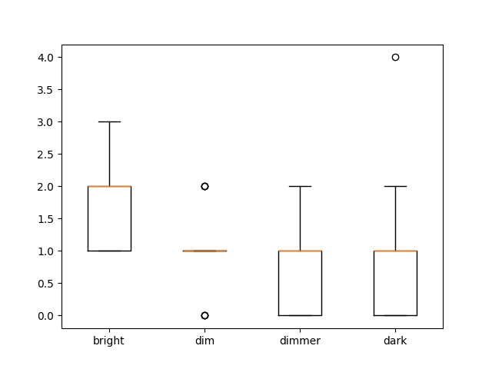
Analysis — Brightness
Once more, the results concurred with the hypothesis from a quantitative analysis (total score), as well as from a mean analysis (score per person) perspective.

Slide 26
Conclusion
The significant overlap between the results of our experiment and pre-established data from the field of psychology presents the strong possibility for applying more varied psychological data and principles in designing 3D software.

Slide 27
Thank you for your time!

