Slide 1
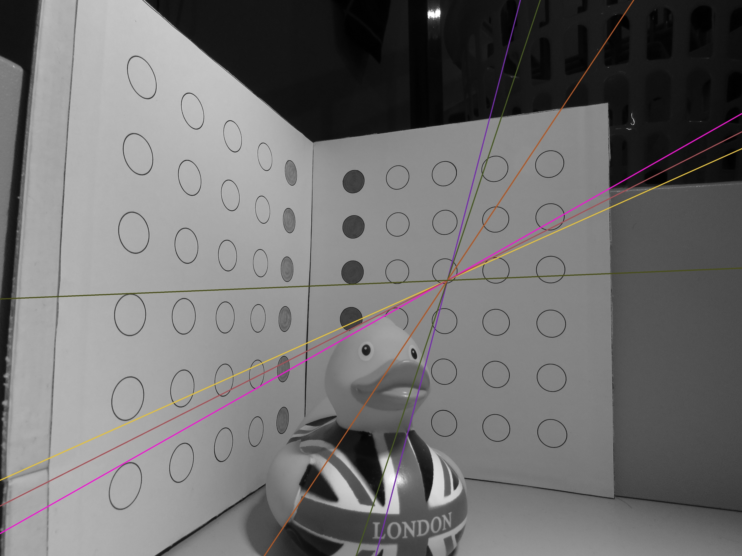
Vanishing Points
Perspective Lines
Horizon
Epipole
Epipolar Lines (All Other Coloured Lines)

Slide 2
