Slide 1
Thesis Project
Properties of pocket lining residues [PLRs] of transporter protein families in different Staphyllococcus aureus strains

Slide 2
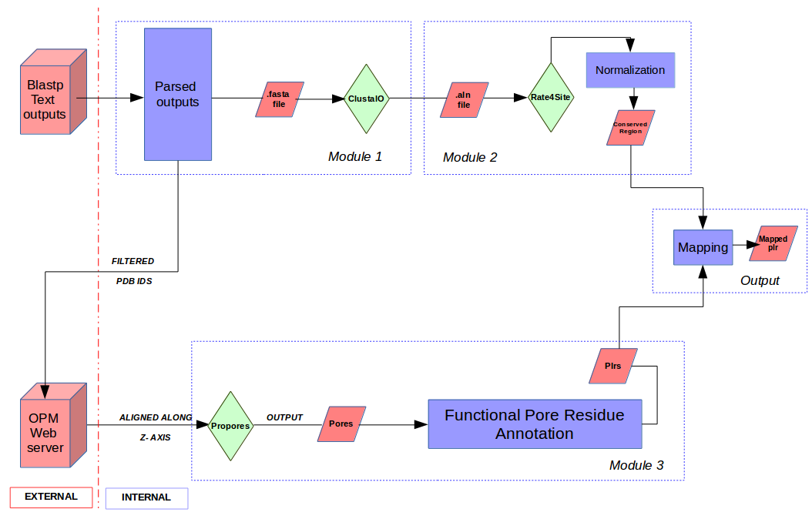
FPRA PIPELINE – Identify and map the conserved PLRs

Slide 3
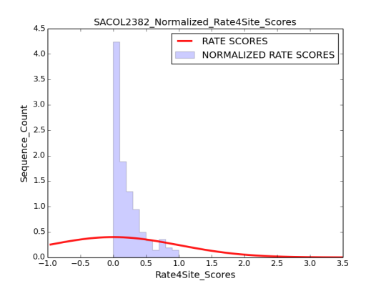
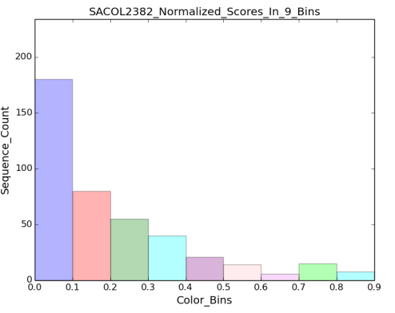
PROGRAMS and METHODS
MODULE 1
BLASTP
Sequence homology using Blast standalone program.
2 level parsing : level 1 - < = 500 homologs, level 2 - E-value < = 1e-10,Identity% > = 35%, Coverage% > = 75%
MODULE 2
RATE4SITE
MSA file is used to evaluate the evolutionary conservation (rate scores) of positions in protein sequence. Lower scores means more conservation.
NORMALIZATION
 | SACOL |  | SAN315
 | SEQ LIST | STR LIST | SEQ LIST | STR LIST
Level 1 | 30896 | 6421 | 49616 | 8449
Level 2 | 28010 | 352 | 45032 | 436
All scores which are generated are scaled to the range [0,1] (unity normalization).
Feature Scaling :
X’ = (X - Xmin) / (Xmax - Xmin)
Normalization the Rate scores for DAACS family
CLUSTALO
Input fasta file from blast and contains query sequence, sequence list and structure list.
Gives a better estimation of conservation.
Higher and lower values are assigned color grade from 1-9.
Highly conserved sequences fall in first 3 bins (conserved list).
Estimating the conserved residues

Slide 4
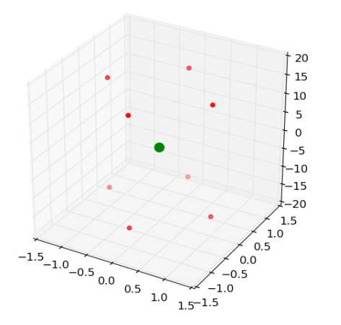
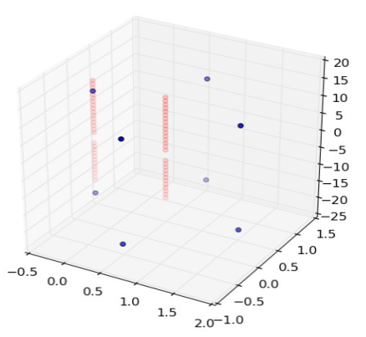
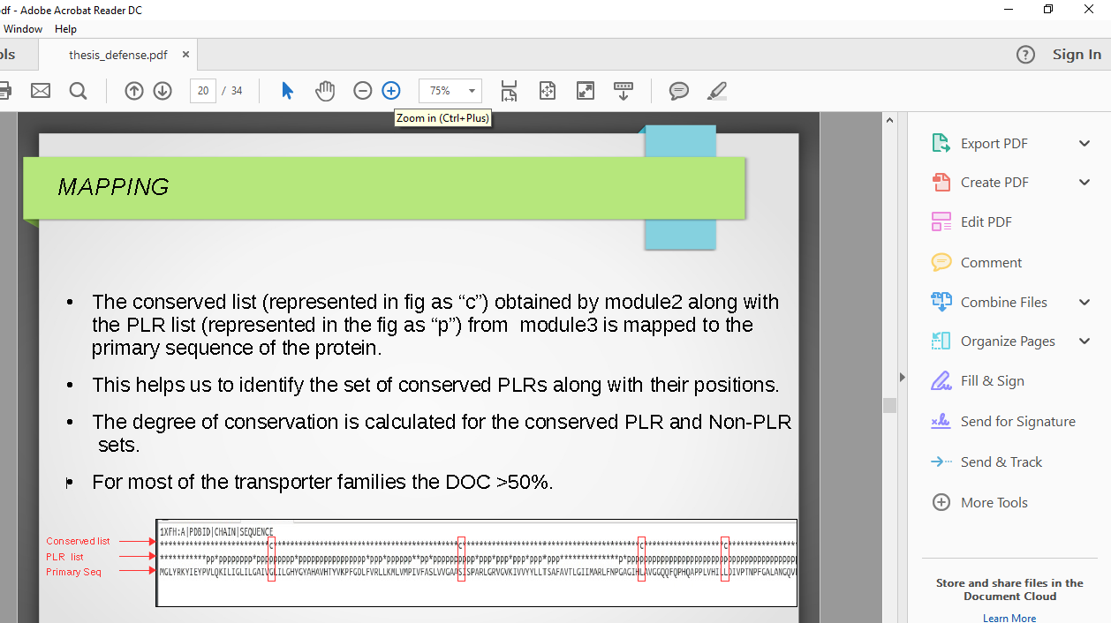
PROGRAMS and METHODS
MODULE 3
OPM DATABASE
He STR LIST is taken to predict the spatial arrangement of membrane proteins in the lipid bilayer.
The hydrophobic thickness is in the range of 21.1 - 45 A.
FPRAT
Extract the coordinates to a text file for each OPM output, eg. “1xfhATOM”.
Calculate the Center of mass (COM) of the coordinate file of the z-oriented OPM file.
Create a box with the COM as its centre and spanning -15.0 < = z < = 15.0, -1.0 < = x < = 1.0 and -1.0 < = y < = 1.0.
Filter out the pores.
The box generated or 1xfhout.pdb.
The green dot represents the COM.
The red dots represent the box coordinates.
The red dots in depict the filtering out of the coordinate points of the pores for 1xfhout.pdb.
The enclosed pore of these points is then identified.
The corresponding list files are then identified (PLR list).
MODULE 4
MAPPING

Slide 5
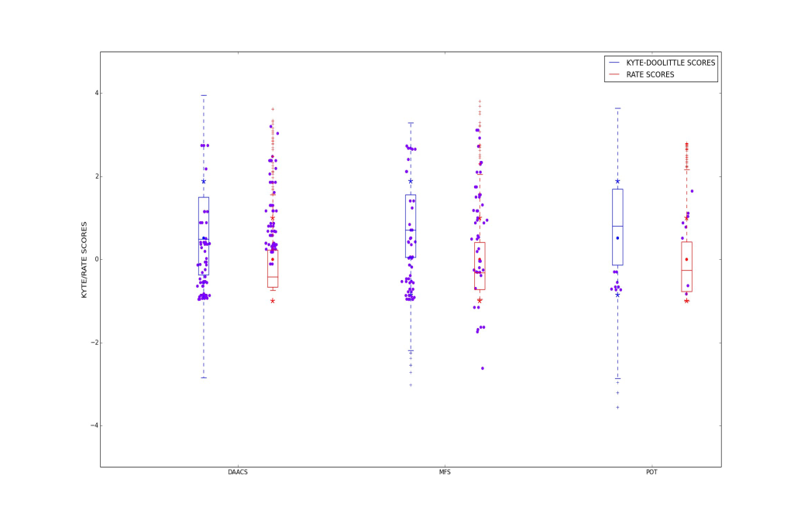
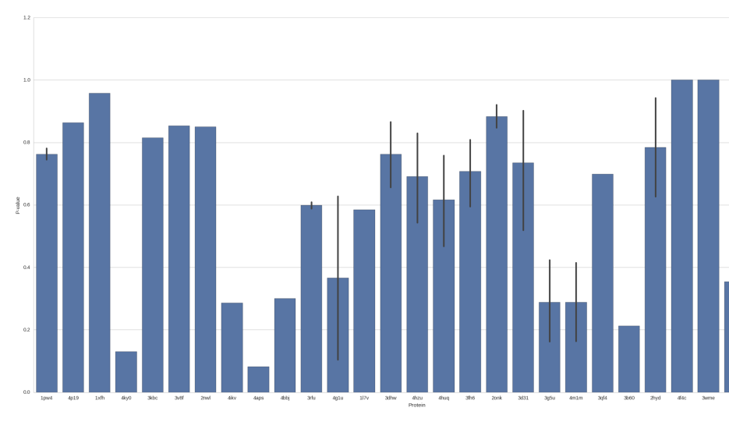
RESULTS
KYTE-DOOLITTLE SCORING
Quantitative measure of the degree of hydrophobicity (hydrophobicity scores on the residues).
It is useful to identify the possible domains of a protein structure.
Graph depicts the kyte vs rate scores on the PLRs.
HYPOTHESIS TESTING
Wilcoxon signed-ranked test : The P-value for conserved PLRS and conserved Non-PLRs(within the same set) is 3.45001e-10.
Hypergeometric test : We see that the P-values for each of the proteins are very high proving less significance in the test as p-value need to be a low value.
Redundant hits
More significant hits

