Slide 1
Dometic Workshop Assessment Report
10 Jun 2019 thru 20 Jun 2019

Slide 2
Workshop Summary
Objectives
Tasks Performed
Next Steps
To Understand the overall end to end system for developing Full Climate control app, Cloud Features for Marine and RV requirements
To understand the existing system of CFX App developed using React Native to Support IOS and Android platform
To Understand Cloud requirements for Marine Boat and RV( Recreational Vehicle)
To Provide Suggestion & Improvements for the Climate Control App & Cloud Features Implementation
Understanding of CFX App and Demo, Product supported by CFX App currently
New Products to be supported
CFX architecture Understanding
CFX source code walkthrough
Requirement Capturing for Climate control App - Skin
Cloud Requirement Capturing for Marine and RV
Workshop with Dometic IT Team to understand the complete End to End system
UI Design Requirements discussion with Design Team for Marine and RV Phase 1 - to design wireframes
Commercial Proposal
Climate Control App - Skin development
Cloud Features – Marine and RV Phase 1
Dometic Marine App Scope - Vancouver, Canada
Notes:
Content Slide

Slide 3

Generic System Diagram For Dometic Apps
Configuration & Services
Management
Future Scope -E-Commerce, Alexa, Google Home etc.
AWS Azure Cloud
Dometic Ecosystem - User and product registration
Cloud Communication
(MQTT and REST API)
MQTT Broker
Dometic Scope
Dometic Apps
Cloud Communication
(MQTT and REST API)
Gateway
Cooler Box( Single, Double, Triple + Icemaker)
Air Conditioner/Heater
GPS Track & Trail
Geo fencing with movement detection
Entry monitor
Micro services
React Native Framework Supporting iOS and Android Platforms
Wi-Fi or BLE Connectivity

Slide 4


DevOps
DevOps is a set of software development practices that combines software development (Dev) and information technology operations (Ops) to shorten the systems development life cycle while delivering features, fixes, and updates frequently in close alignment with business objectives
Benefits of DevOps:
Shorter Development Cycles, Faster Innovation
Reduce Implementation Failure, Reflections and Recovery Time
Better Communication and Cooperation
Increased Efficiencies
Version Control
Github repository
Auto Check –in trigger
Jenkins CI/CD
Manual/automated tests
Triggers Build
Build
Unit Test
Archive artifacts
Application Deployment
Release
Future plan

Slide 5
Scope
Climate Control App
Marine & RV
Marine App( Vancouver)
Analysis of Existing source code
Skin Development for Home Page, AC, Heater, Batteries etc..
CFX App Maintenance & Change Request
DevOps – Migration of Rubicon, Semcon and WSI repository to Dometic GitHub
Marine
Geo fencing with movement detection
GPS track & trail
Engine theft wire loop. Send alert to cloud if broken
Entry monitor
High Water Alert and repeating bilge pump alarm
Tank levels monitor (fresh/grey/black)
Intuitive HMI & GUI
Battery monitor-House, Cranking and Trolling Bank
24/7 access to your system
Remote load control (simple existing digital switching loads, low Hp climate control)
RV
System alert, diagnostic & predicted maintenance
Climate Control from Cloud (AC & Furnace)
24/7 access to your system
Intuitive HMI & GUI
Electrical Faults / alerts
Smoke detector / Alerts
Engine Faults / alerts
Battery Prediction from Cloud
Tank levels monitor (fresh/grey/black)
Lock Operations from Cloud
Awnings control from Cloud
GPS track & trail
LPG Gas Monitor from Cloud
Digital switching control
Digital switching monitor
Eskimo Ice (CAN)
Refrigeration (KRA Modbus)
Climate control and monitor
GPS track
Digital switching event log
Climate control event log
Anti-theft
Notes:
Content Slide

Slide 6
Dependencies
Dometic Interact Gateway
Centralized Database for User, product, parameter details
Data structure for sending and receiving data
Access to AWS Cloud
Access to AWS Cloud

Slide 7
Recommendations
POC for developing Local Alert Notification for CFX App
Lab Setup for System Testing – To be discussed and decided by Dometic

Slide 8
Tentative Plan
Milestones | Deliverable Dates | Dependency | Remarks | Status
Commercial Proposal for Full Climate control Skin Development | 29th June 2019 |  | Proposal shall have schedule and deliverables defined for the scope of work | In Progress
Cloud Features commercial proposal for Marine and RV | 29th June 2019 | LMC App access and AWS Cloud access | Proposal shall have schedule and deliverables defined for the scope of work | In Progress
Marine Features Mobile App commercial proposal for Vancouver, Canada | 5th July 2019 |  | Proposal shall have schedule and deliverables defined for the scope of work | Not Started

Slide 9
Best Practices

Slide 10


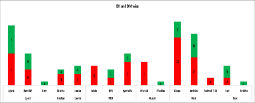
Delivery Quality Measure
Tests covers both development & bug fixing
Tasks can be written in different Languages (C#, Java, Python. .etc)
Toughness of the Task is classified as Elementary, Easy, Medium, Hard
Test completion & result notification to the candidates & admin
Codility result is based on correctness , performance , test case execution
Our Intake goes through technical online test
Customer Feedback
Process Compliance Index

Slide 11
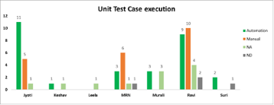
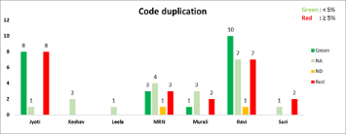
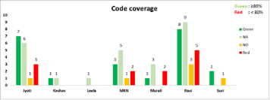
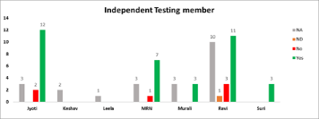
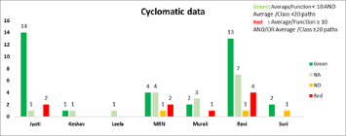
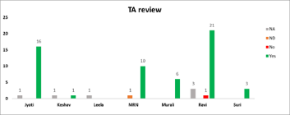
Delivery Quality Measure

Slide 12
Project Quality Dashboard
Project | Project Plan | Requirement Management | Code Review | Unit Testing | Static Analysis | DevOps | Bug Tracking
 | Excel | TFS |  | Jasmine & Karma | Sonar Qube, TS Lint | Docker | TFS
Project Planning | Requirement Management | Architecture Compliance | Code Quality | Unit Testing | System Testing | Project Release
Up to date Project Plan | Single Requirement Source | Defined Design Objective | Static Analysis | Unit Test Automation | Performance Testing | Regression Testing
Milestone Date Clarity | Requirement Changes / Updates | Regular Design Review | TA Review |  | Test Devices Availability | Build Stability
Overall Schedule Variance | Defined Acceptance Criteria |  | Design Pattern Compliance |  | Target Platform Availability | DevOps Implementation
Meeting Expectation
Watch out stage for action
Need Immediate action
Not Applicable

Slide 13
Thank You
Harish NV
Program Manager

