Slide 1
YouTube Presentation
Setting up
LittleBrotherTaskbar 0.1.9
on
Ubuntu 19.3
https://github.com/marcus67/little_brother_taskbar

Slide 2
What is LittleBrotherTaskbar?
Taskbar tool for the desktop tray
Reports the status for a specific user monitored by LittleBrother
Shows the remaining time
Plays back notifications
  Play time in session (upon login)
  Remaining play time
  Logout warnings
Support for several languages

Slide 3
Agenda
Describe Setup of Demo System
Install the PyPi Package
Start the App On the Command Line
Register the App as Desktop Service
Login into Desktop

Slide 4
Agenda
Describe Setup of Demo System
Install the PyPi Package
Start the App On the Command Line
Register the App as Desktop Service
Login into Desktop

Slide 5
Setup of the Demo System
My System
Gnome Boxes
Ubuntu Version 19.3 Virtual Machine
Ubuntu Packages
  mate (Desktop)
  lightdm (Desktop Manager)
  little-brother (0.3.1 Revision 68)
Two users „leon“ and „christoph“

Slide 6
Agenda
Describe Setup of Demo System
Install the PyPi Package
Start the App On the Command Line
Register the App as Desktop Service
Login into Desktop

Slide 7
Installing the PyPi Package
Available pypi.org:
https://pypi.org/project/little-brother-taskbar/
Preconditions (already done on demo system)
  apt-get install python-google-speak
  apt-get install libgtk-3-dev
  apt-get install libpulse-dev
  apt-get install mpg123
  pip3 install setuptools==40.8.0
Install package
pip3 install little-brother-taskbar

Slide 8
Agenda
Describe Setup of Demo System
Install the PyPi Package
Start the App On the Command Line
Register the App as Desktop Service
Login into Desktop

Slide 9
Starting the App on the
Command Line
Issue
run_little_brother_taskbar \
--server-url=http://localhost:5555 \
--username=leon \
--speech-engine=google
--username only required if USER is not set

Slide 10
Agenda
Describe Setup of Demo System
Install the PyPi Package
Start the App On the Command Line
Register the App as Desktop Service
Login into Desktop

Slide 11
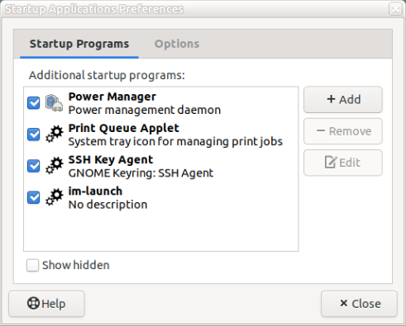
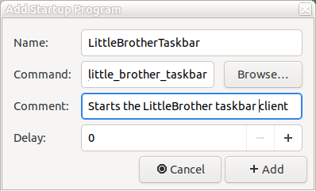

Register the App as a Desktop Service
Add app as a „Startup Application“
App will be started upon login into desktop
Notifications about blocked time will be played before user is automatically logged out

Slide 12
Agenda
Describe Setup of Demo System
Install the PyPi Package
Start the App On the Command Line
Register the App as Desktop Service
Login into Desktop

Slide 13
Thank You for Watching!
Visit LittleBrotherTaskbar at
  https://github.com/marcus67/little_brother_taskbar
  https://www.facebook.com/littlebrotherdebian
Send mail to
  little-brother@web.de

