Slide 1
YouTube Presentation
Setting up LittleBrother
on
Ubuntu 18.10
https://github.com/marcus67/little_brother

Slide 2
What is LittleBrother?
Debian Tool to monitor and limit login time of users on Linux Clusters (or single hosts)
Should run on most Debian-based distributions
Permitted login times can be set individually for each user according to schedules
Remote administration possible through web interface
International language support (EN, DE, IT)

Slide 3
Agenda
Describe Setup of Target System
Install the Debian Package
Describe Configuration File
Setup LittleBrother Database
Start the Application
Show Web Frontend

Slide 4
Agenda
Describe Setup of Target System
Install the Debian Package
Describe Configuration File
Setup LittleBrother Database
Start the Application
Show Web Frontend

Slide 5
Setup of the Target System 1/2
Your System
Package „mysql-server“
mysql Database Setup
  root password must be known
  allow TCP connections
  allow root login over TCP

Slide 6
Setup of the Target System 2/2
My System
Gnome Boxes
Ubuntu Version 18.10 Virtual Machine
Ubuntu Packages
  mysql-server
  mate
  lightdm
Two users „seth“ and „jennifer“
Already pre-installed:
  Popup message tool „zenity“

Slide 7
Agenda
Describe Setup of Target System
Install the Debian Package
Describe Configuration File
Setup LittleBrother Database
Start the Application
Show Web Frontend

Slide 8
Installing the Debian Package
Download from master directory on SourceForge:
https://sourceforge.net/projects/little-brother/files/master/
Install package
dpkg -i PACKAGE.deb
Fix dependencies
apt-get install -f

Slide 9
Agenda
Describe Setup of Target System
Install the Debian Package
Describe Configuration File
Setup LittleBrother Database
Start the Application
Show Web Frontend

Slide 10
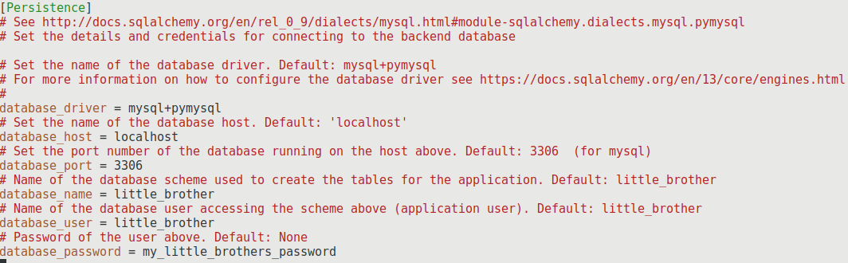
Configuration File 1/3
Section for the database connection

Slide 11
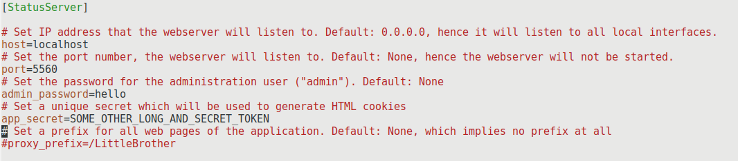
Configuration File 2/3
Section for the web server

Slide 12
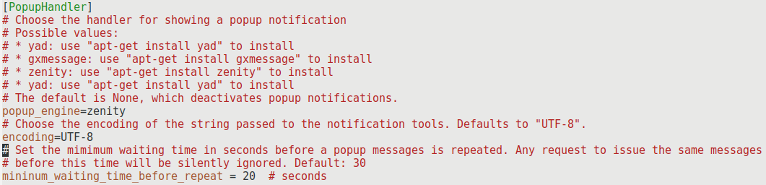
Configuration File 3/3
Section for the popup handler

Slide 13
Agenda
Describe Setup of Target System
Install the Debian Package
Describe Configuration File
Setup LittleBrother Database
Start the Application
Show Web Frontend

Slide 14
Setting up the Database 2/2
Run helper script (as root!)
run_little_brother.py \
--config /etc/little-brother/little-brother.config \ --create-databases \
--option \
Persistence.database_admin=root Persistence.database_admin_password=mypassword

Slide 15
Agenda
Describe Setup of Target System
Install the Debian Package
Take a Look at the Configuration File
Set Up LittleBrother Database
Start the Application
Show Web Frontend

Slide 16
Starting the Application
Start the service
systemctl start little-brother
Check the logfile
/var/log/little-brother/LittleBrother.log

Slide 17
Agenda
Describe Setup of Target System
Install the Debian Package
Describe Configuration File
Setup LittleBrother Database
Start the Application
Show Web Frontend

Slide 18
Showing the Web Frontend
Allow popup messages to be displayed:
xhost +SI:localuser:little-brother
Use browser to open web frontend
http://localhost:5560/

Slide 19
Thank You for Watching!
Visit LittleBrother at
  https://github.com/marcus67/little_brother
  https://www.facebook.com/littlebrotherdebian
Send mail to
  little-brother@web.de

