Slide 1
YouTube Presentation
Setting up
LittleBrother 0.3.1 (Rev 68)
on
Ubuntu 19.3
https://github.com/marcus67/little_brother

Slide 2
What is LittleBrother?
Debian Tool to monitor and limit login time of users on Linux Clusters (or single hosts)
Should run on most Debian-based distributions
Permitted login times can be set individually for each user according to schedules
Remote administration possible through web interface
Support for several languages

Slide 3
Agenda
Describe Setup of Demo System
Install the Debian Package
Take a Look at the Configuration File
Start the Application
Show Web Frontend

Slide 4
Agenda
Describe Setup of Demo System
Install the Debian Package
Take a Look at the Configuration File
Start the Application
Show Web Frontend

Slide 5
Setup of the Target System
My System
Gnome Boxes
Ubuntu Version 19.3 Virtual Machine
Ubuntu Packages
  mate (Desktop)
  lightdm (Desktop Manager)
Two users „leon“ and „christoph“

Slide 6
Agenda
Describe Setup of Demo System
Install the Debian Package
Take a Look at the Configuration File
Start the Application
Show Web Frontend

Slide 7
Installing the Debian Package
Download from master directory on SourceForge:
https://sourceforge.net/projects/little-brother/files/master/
Install package
dpkg -i PACKAGE.deb
Fix dependencies
apt-get install -f

Slide 8
Agenda
Describe Setup of Demo System
Install the Debian Package
Take a Look at the Configuration File
Start the Application
Show Web Frontend

Slide 9
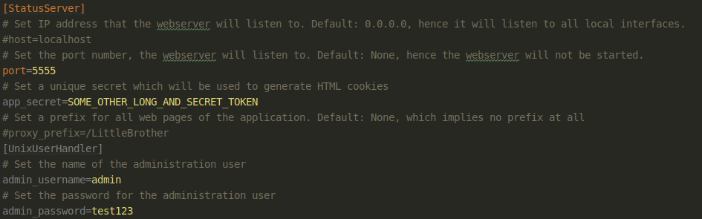
Configuration File
Location /etc/little-brother/little-brother.config
Relevant Section for the password setup:

Slide 10
Agenda
Describe Setup of Demo System
Install the Debian Package
Take a Look at the Configuration File
Start the Application
Show Web Frontend

Slide 11
Starting the Application
Start the service
systemctl start little-brother
Check the logfile
tail -f /var/log/little-brother/LittleBrother.log

Slide 12
Agenda
Describe Setup of Demo System
Install the Debian Package
Take a Look at the Configuration File
Start the Application
Show Web Frontend

Slide 13
Showing the Web Frontend
Use browser to open web frontend
http://localhost:5555/
Add a user
Define a rule for that user
Test if user is correctly logged out

Slide 14
Thank You for Watching!
Visit LittleBrother at
  https://github.com/marcus67/little_brother
  https://www.facebook.com/littlebrotherdebian
Send mail to
  little-brother@web.de

