Slide 1


Master’s Degree in
Health Data Science
MHEDAS
MHEDA: : Biomedical sensors and signal processing - 2025/2026

Slide 2











Laboratory 1 Report
Group E
Authors: Carmen Aznar Mathonneau; Kamela Xhengo;
Marco Russo; Yuxi Qiao.

Slide 3
Laboratory 1 Report
► Task 1 – Schematics of a mixed signal circuit.
► Task 2 – Programming the Arduino board.
► Task 3 – Introducing the LCD display.
► Task 4 – Conditioning circuit.
► Task 5 – Results.
<number>

Slide 4
Laboratory 1 Report
► Task 1 – Schematics of a mixed signal circuit.
► Task 2 – Programming the Arduino board.
► Task 3 – Introducing the LCD display.
► Task 4 – Conditioning circuit.
► Task 5 – Results.
<number>

Slide 5
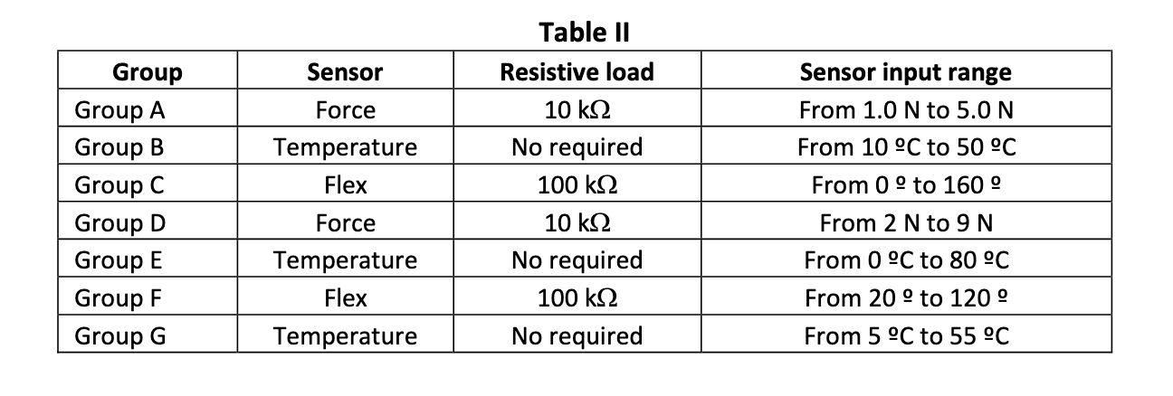
Lab1: Task 1
<number>

Slide 6
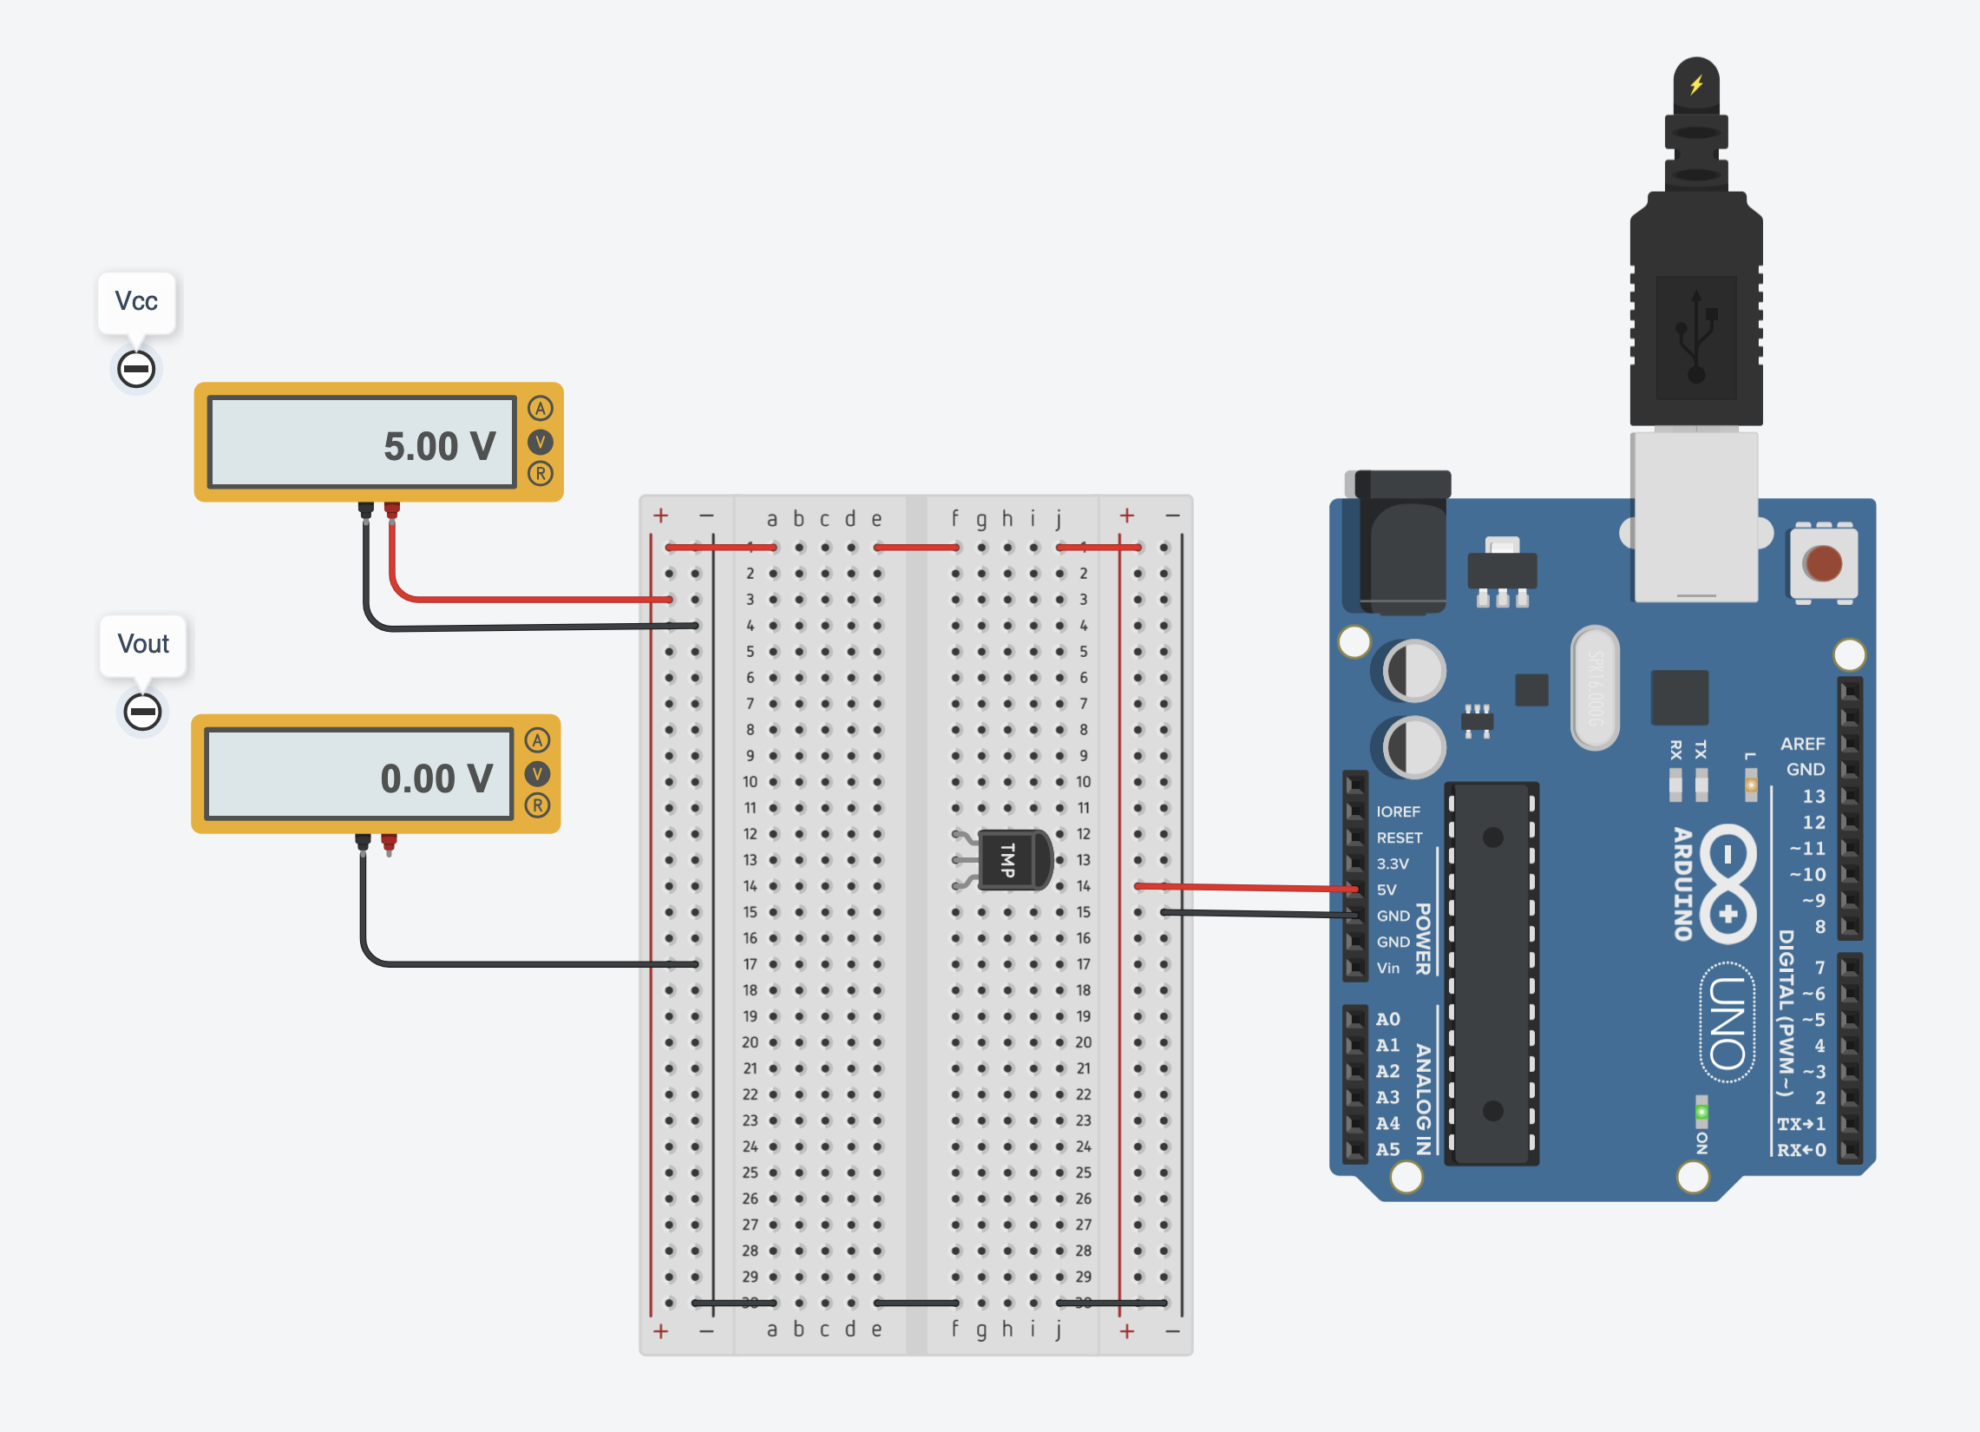
Lab1: Task 1. Introducing a mixed signal circuit design.
In the first task we introduce a simple circuit design with following components:
- 1x Arduino Uno board
- 1x Breadboard small
- 1x Temperature sensors TMP36
- 2x Multimeters
The temperature sensor using breadboard. The first voltmeter show the input voltage, 5V. The second one, is off, because the analog signal is simulated and not wired as well.
<number>

Slide 7
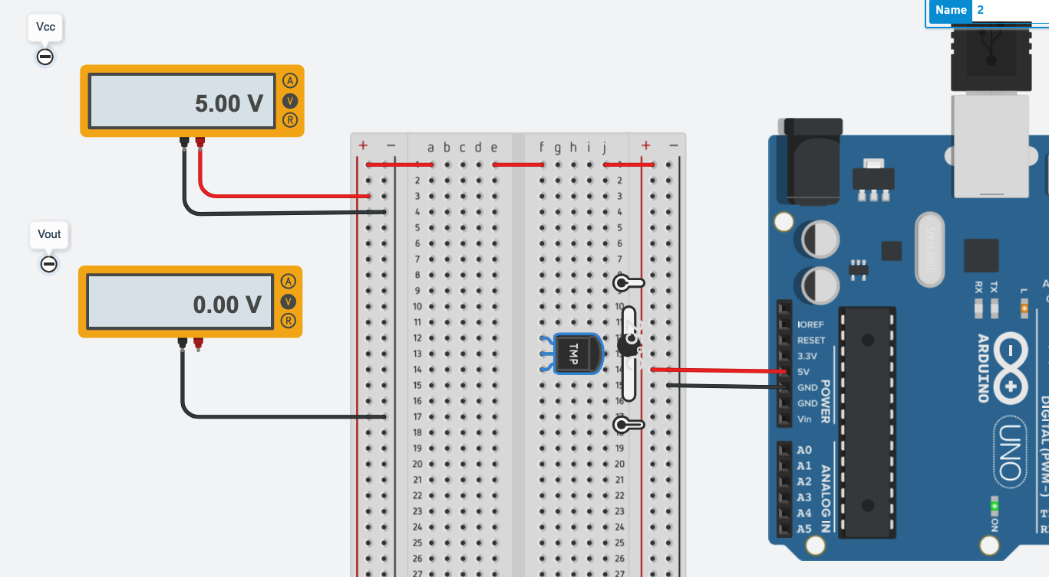
Lab1: Task 1. Introducing a mixed signal circuit design.
In this screenshot we show the temperature sensor set at 25ºC. The input voltmeter show 5V as expected, and Vout shows 0V.
In the next task, we are going to connect the voltmeter and the temperature sensors to get the output voltage.
<number>

Slide 8
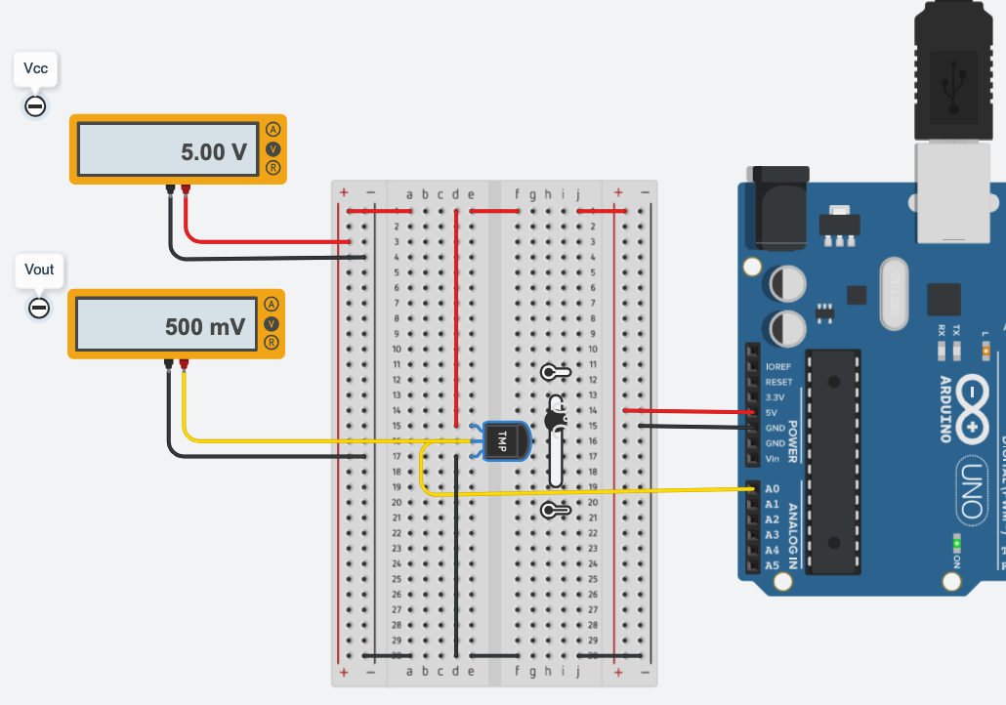
Lab1: Task 1. Introducing a mixed signal circuit design.
In this screenshot the temperature sensor for the minimum temperature configured at 0ºC, the Vout shows 500mV.
<number>

Slide 9
Lab1: Task 1. Introducing a mixed signal circuit design.
 | T (ºC) | Vin | Vout
Minimum Temp value | 0ºC | 5V | 0V
T0 | 25ºC | 5V | 0V
T1 | 25ºC | 5V | 0V
Maximum Temp value | 80ºC | 5V | 0V
Table 1.1 - The table shows the values with analog port simulated. That’s mean we show only the input value in the first multimeter. In the second one is null value because we don’t convert the analog value to digital from the temperature sensor.
<number>

Slide 10
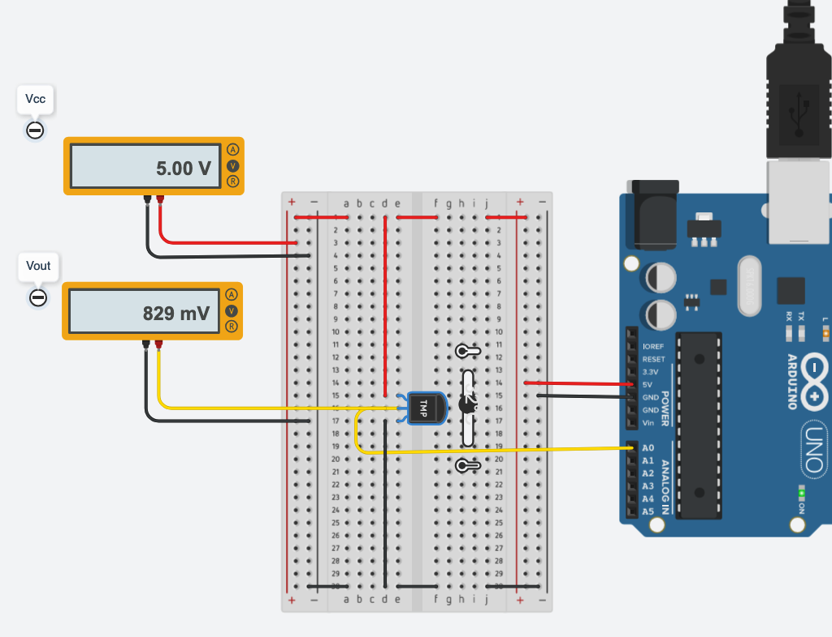
Lab1: Task 1. Introducing a mixed signal circuit design.
In this screenshot we see the temperature sensor set at 32ºC. The input voltmeter show 5V as expected, and Vout shows ~829mV.
<number>

Slide 11
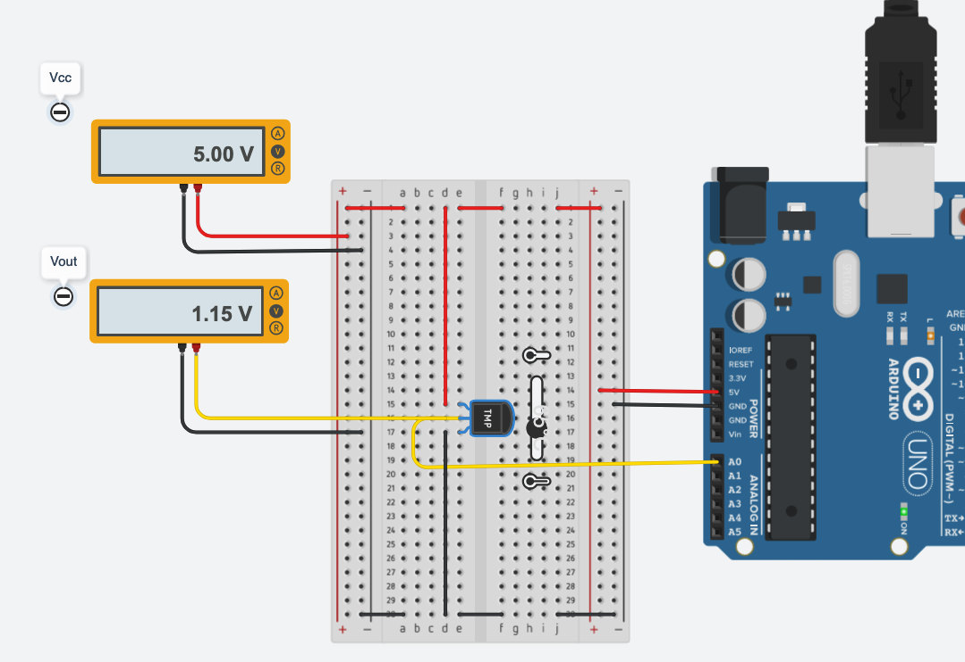
Lab1: Task 1. Introducing a mixed signal circuit design.
In this screenshot the temperature sensor has been configured at 65ºC, and voltmeter out shows the corresponding voltage, 1.15V
<number>

Slide 12

Lab1: Task 1. Introducing a mixed signal circuit design.
In this screenshot the temperature sensor has been configured at 80ºC, and voltmeter out shows the corresponding voltage, 1.30V
<number>

Slide 13
Lab1: Task 1. Introducing a mixed signal circuit design.
 | T (ºC) | Vin | Vout
Minimum Temp value | 0ºC | 5V | 500mV
T0 | 32ºC | 5V | 829mV
T1 | 65ºC | 5V | 1.15V
Maximum Temp value | 80ºC | 5V | 1.3V
Table 1.4 - The table shows the values with analog port wired. In the first voltmeter always shows the power supply voltage, 5V. In the second one, the values depends of the temperature sensors, which convert the analog value to digital.
<number>

Slide 14
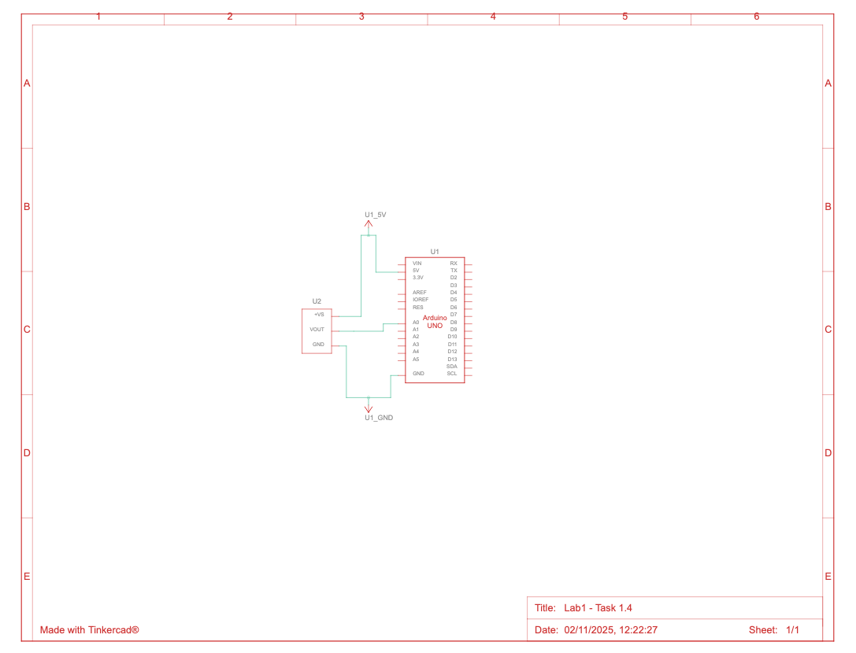
Lab1: Task 1. Introducing a mixed signal circuit design.
In the last screenshot of task 1.4, we will show the schematic view of the circuit.
So, me move forward to next step 2. We are going to remove breadboard and connect the temperature sensor by A0 analog port using coding to shows the output results by text.
<number>

Slide 15
Laboratory 1 Report
► Task 1 – Schematics of a mixed signal circuit.
► Task 2 – Programming the Arduino board.
► Task 3 – Introducing the LCD display.
► Task 4 – Conditioning circuit.
► Task 5 – Results.
<number>

Slide 16
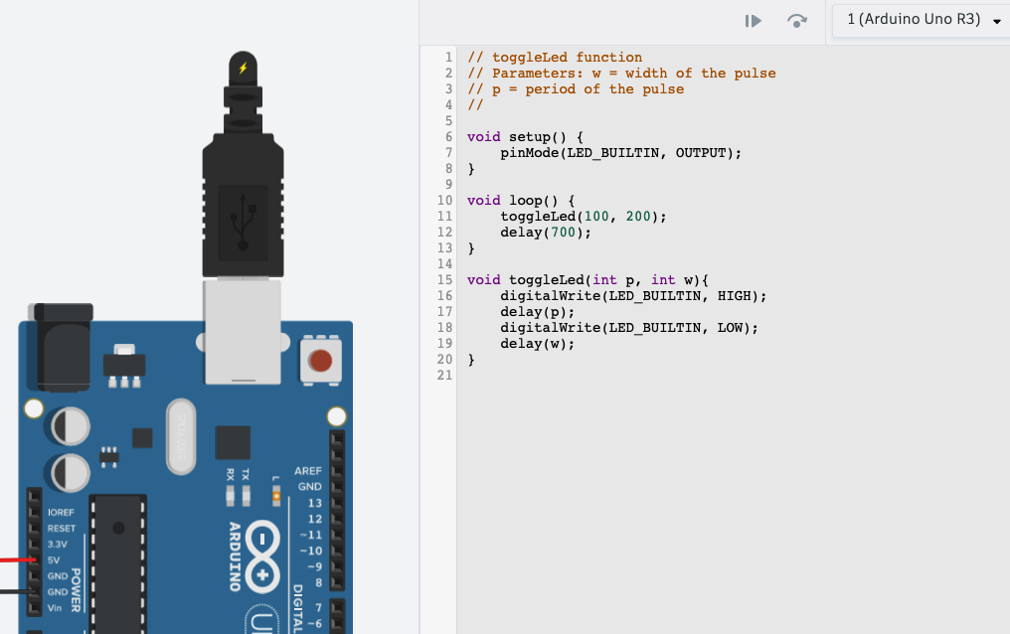
Lab1: Task 2. Programming the Arduino board
The following code used, we code on-board Led blink by specific C programming language within Arduino. In the screenshot we mark it with white circle as result.
Anyway, only for the first task 2.1, we set 100ms of lightening and 200ms off.
Basically, in the function setup we set how many milliseconds the led blinks and the delay duration, set to 700ms.
The function loop, read the main function toggleLed, with two arguments, p (pulse) and w (width) and assign the delay per each.
<number>

Slide 17
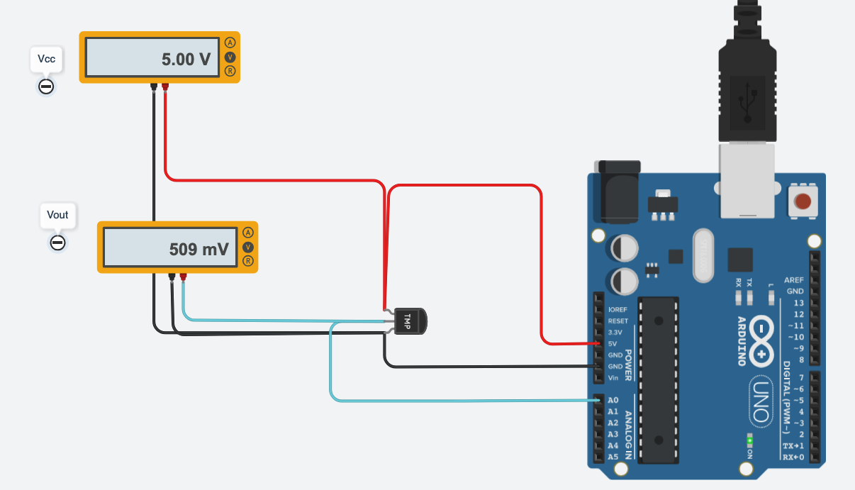
Lab1: Task 2. Programming the Arduino board
In the task 2.1 we show the best approach to programming on Arduino UNO Board, using the code section and interact with the all physical components. As group E, we have temperature sensor with a range 0ºC to 80ºC.
In this screenshot, we are able to show the temperature sensor connected via analog port, A0. In the first voltmeter, we still see the input voltage, 5V. In the second one, we show the output voltage of temperature sensor, the Vout. As the first task, we are going to show some basic function, such as how the on-board led blink works.
<number>

Slide 18
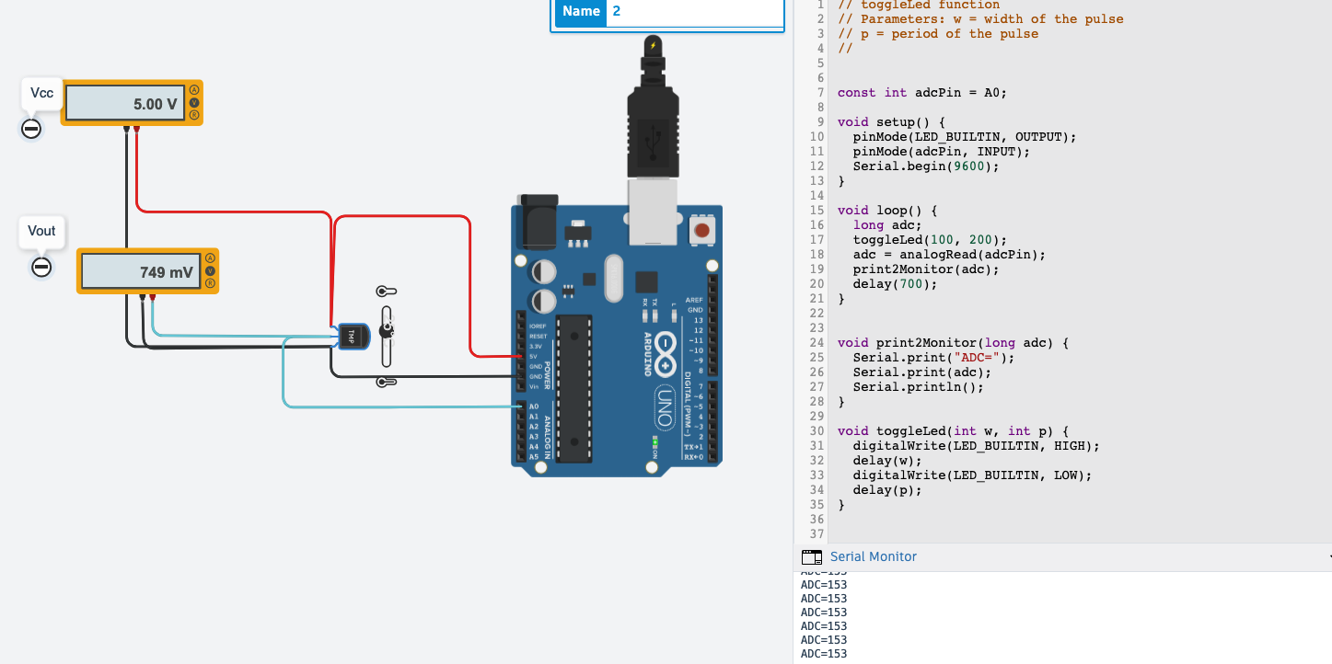
Lab1: Task 2. Programming the Arduino board
In the task 2.2, we add some functions more to show the analog to digital conversion in the serial monitor (the output text below the code section). The requirement is interact directly with the temperature sensor, using the slicer with the range 0ºC to 80ºC.
After set the input variable, the constant adcPin connected by A0 analog port, we add more functions in the main code. The first to convert the analog signal to digital. And the second function, to show the output text on the Serial Monitor.
So, the variable adcPin get from the port A0 the analog value from the temperature sensor, and the it shows in the serial monitor the digital value. It’s expressed as a number between 0 and 1023.
<number>

Slide 19
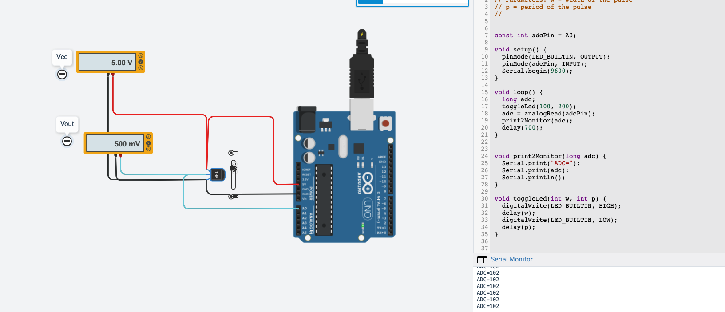
Lab1: Task 2. Programming the Arduino board
In this screenshot we show the temperature sensor set to minimum ~0ºC; the output voltage ~500mV and in the bottom-right the analog value converted to digital, ADC=~102.
<number>

Slide 20
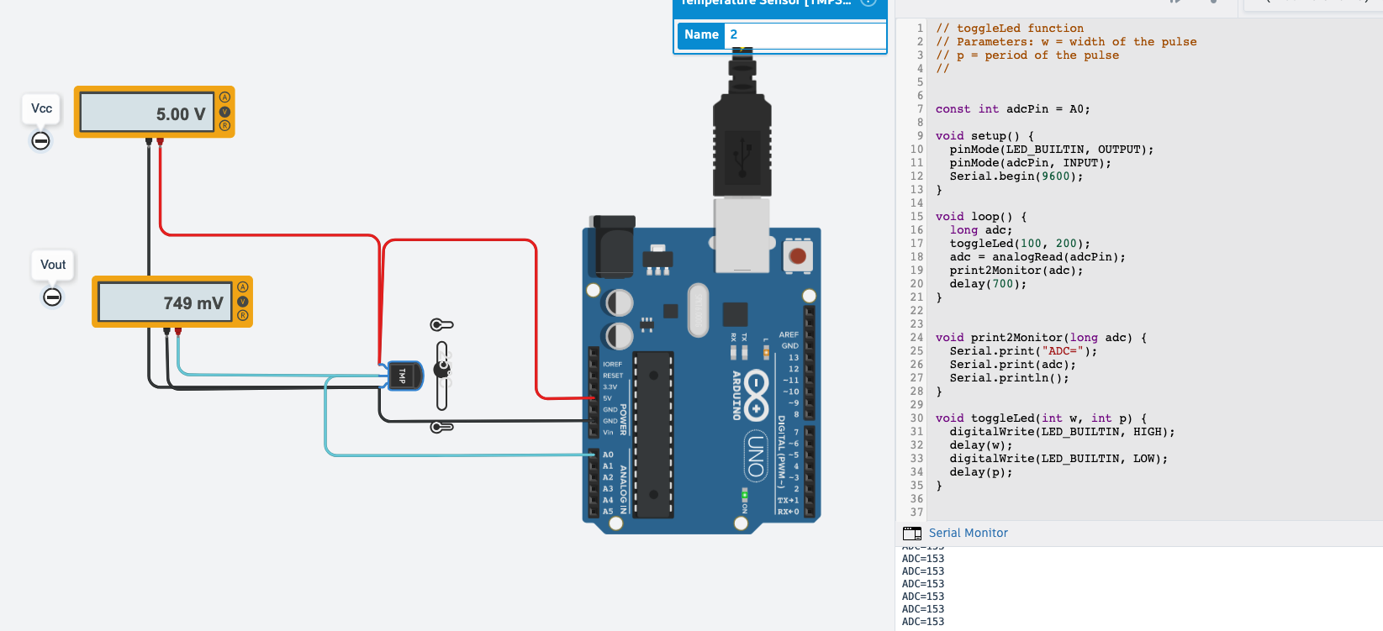
Lab1: Task 2. Programming the Arduino board
In this screenshot we show the temperature sensor set to 25ºC; the output voltage ~749mV and in the bottom-right the analog value converted to digital ADC=153.
<number>

Slide 21
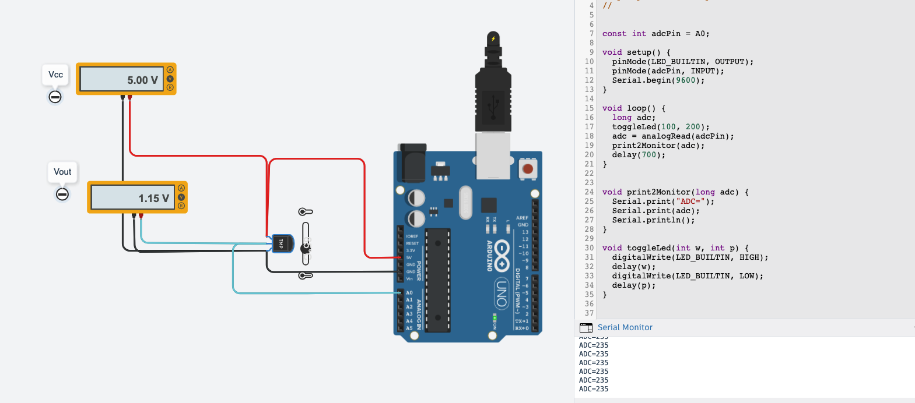
Lab1: Task 2. Programming the Arduino board
In this screenshot we show the temperature sensor set to 65ºC; the output voltage ~1.15V and in the bottom-right the analog value converted to digital ADC=235.
<number>

Slide 22
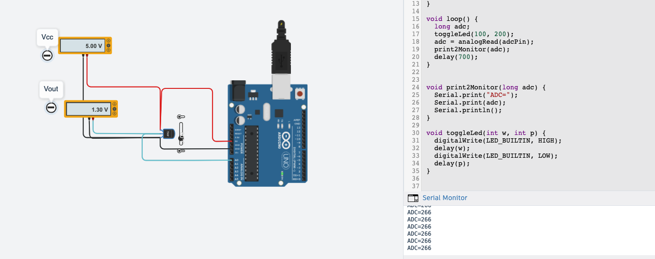
Lab1: Task 2. Programming the Arduino board
In this screenshot we show the temperature sensor set to maximum 80ºC; the output voltage ~1.30V and in the bottom-right the analog value converted to digital ADC=266.
<number>

Slide 23
Lab1: Task 2. Programming the Arduino board
 | T (ºC) | Vin | Vout | ADC value
Minimum Temp value | 0ºC | 5V | ~500mV | ~102
T0 | 25ºC | 5V | ~749mv | ~153
T1 | 65ºC | 5V | ~1.15V | ~235
Maximum Temp value | 80ºC | 5V | ~1.30V | ~266
Table III - The table shows the values with analog port connected with the temperature sensor. That’s mean we are able to show the output voltage and the original analog value in the Serial Monitor.
It’s important to remind that the output values are the approximation, due the oscillations of the input voltage, isn’t 5V precisely and the temperature sensor doesn’t set the decimal part.
<number>

Slide 24
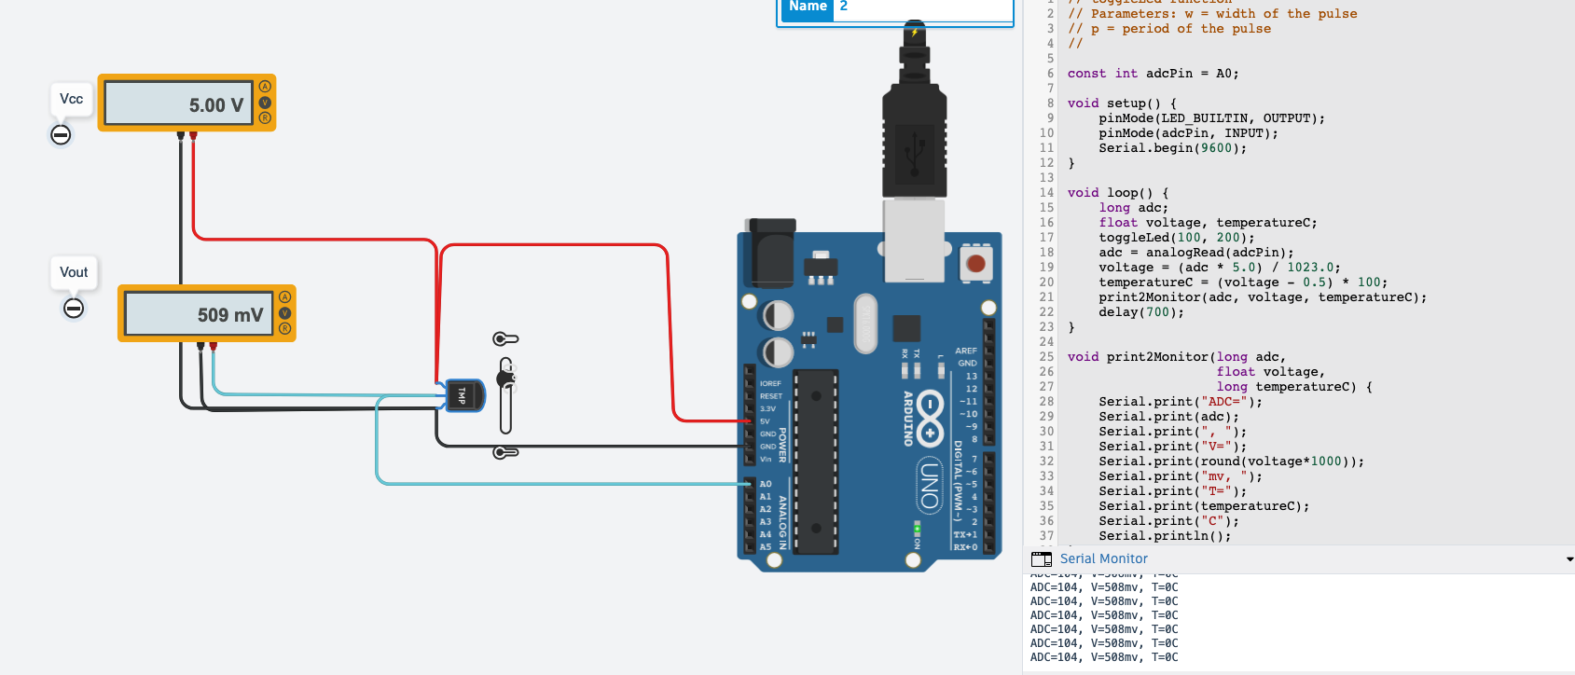
Lab1: Task 2. Programming the Arduino board
In this screenshot we show the output values in the Serial Monitor. In order, there are the analog value converted to digital ADC=104; the output voltage ~509mV and the temperature sensor set to minimum requested at 0ºC.
<number>

Slide 25
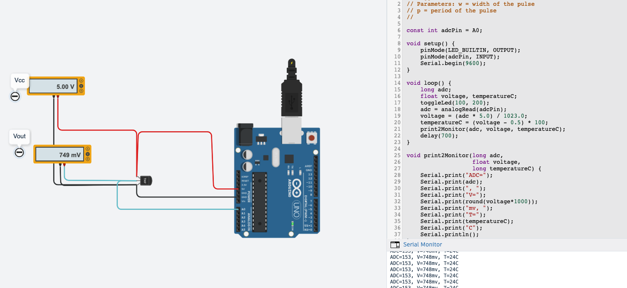
Lab1: Task 2. Programming the Arduino board
In the task 2.3, we improve the initial code with one more function to convert the analog value to digital. Additionally, we are able to show the corresponding converted value to mV as the output on the Serial Monitor.
In the screenshot we show the main code used, specially to convert the values for voltage and temperature.
<number>

Slide 26
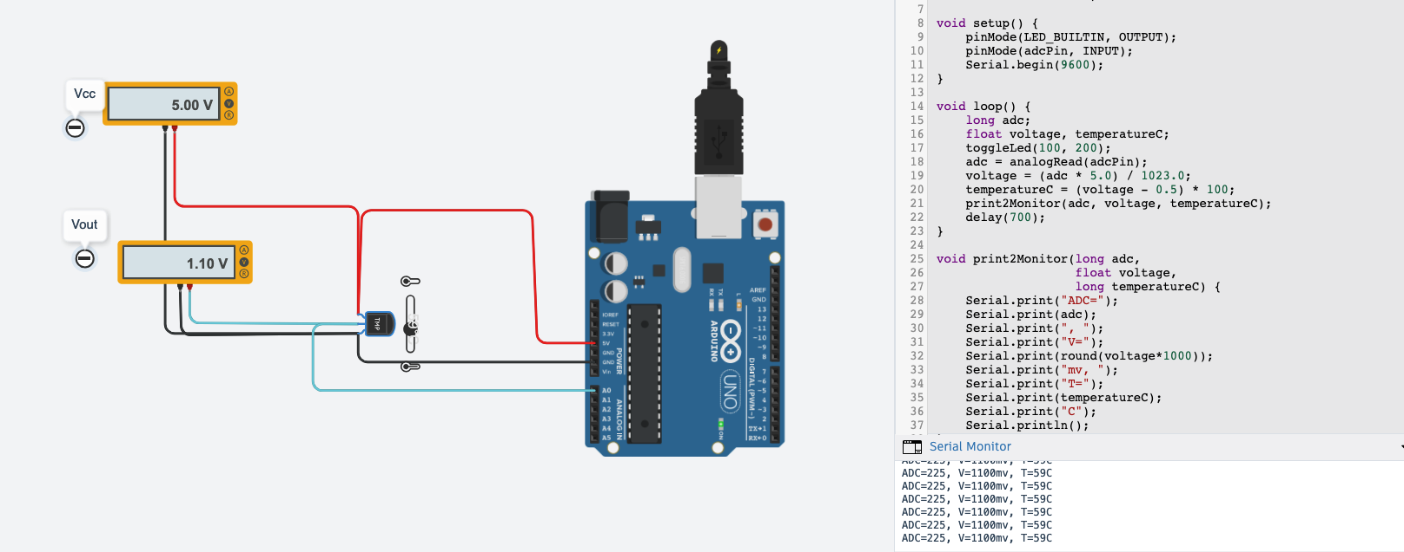
Lab1: Task 2. Programming the Arduino board
In this screenshot we show the output values in the Serial Monitor. In order, there are the analog value converted to digital ADC=225; the output voltage ~1100mV and the temperature sensor set to T2 requested at 59ºC.
<number>

Slide 27

Lab1: Task 2. Programming the Arduino board
In this screenshot we show the output values in the Serial Monitor. In order, there are the analog value converted to digital ADC=172; the output voltage ~839mV and the temperature sensor set to T1 requested at 34ºC.
<number>

Slide 28
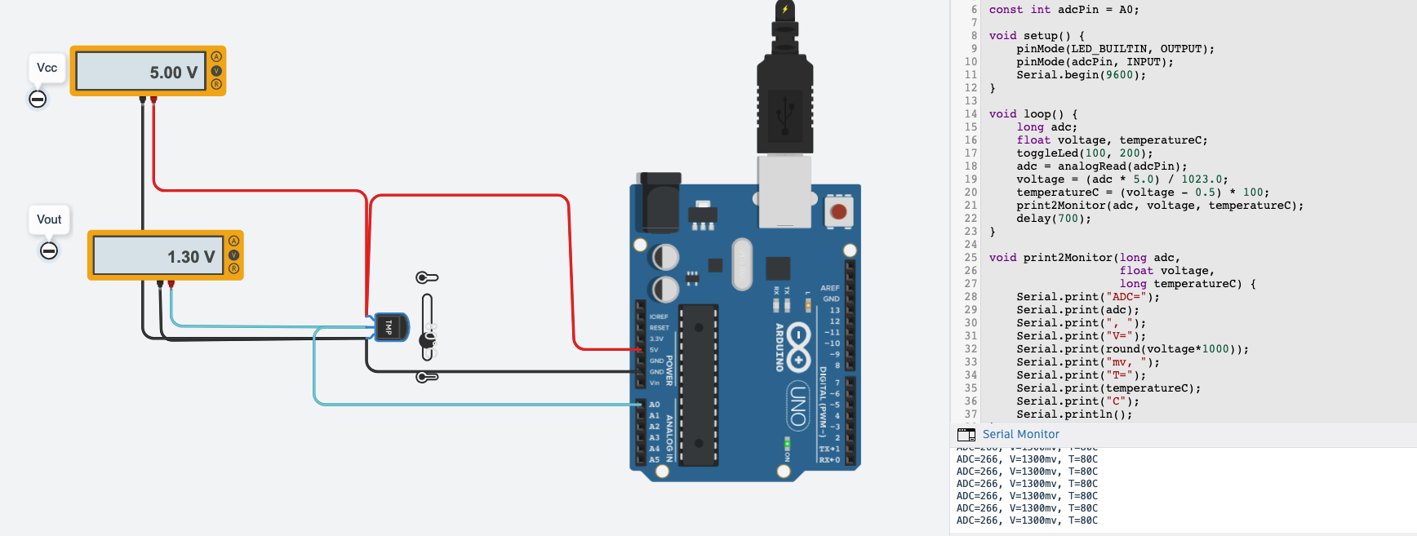
Lab1: Task 2. Programming the Arduino board
In this screenshot we show the output values in the Serial Monitor. In order, there are the analog value converted to digital ADC=266; the output voltage ~1300mV and the temperature sensor set to maximum requested at 80ºC.
<number>

Slide 29
Lab1: Task 2. Programming the Arduino board
 | T (ºC) | Vout (V) | ADC steps | Vinadc (mV) | Tarduino
Minimum Temp. value | 0ºC | 0V | 0 | 0mV | 0.0
T1 | 34ºC | 2.13V | 434 | 2124mV | 33.9
T2 | 59ºC | 3.69V | 754 | 3684mV | 58.9
Maximum Temp. value | 80ºC | 5.0V | 1023 | 5000mV | 80.0
Table IV – It’s a final table if we set the power voltage with a minimum temperature range. 0ºC = 0V and 80ºC = 5V. The T1 and T2 are calculated to return the corresponding values for ADC steps and Vinadc.
<number>

Slide 30
Laboratory 1 Report
► Task 1 – Schematics of a mixed signal circuit.
► Task 2 – Programming the Arduino board.
► Task 3 – Introducing the LCD display.
► Task 4 – Conditioning circuit.
► Task 5 – Results.
<number>

Slide 31
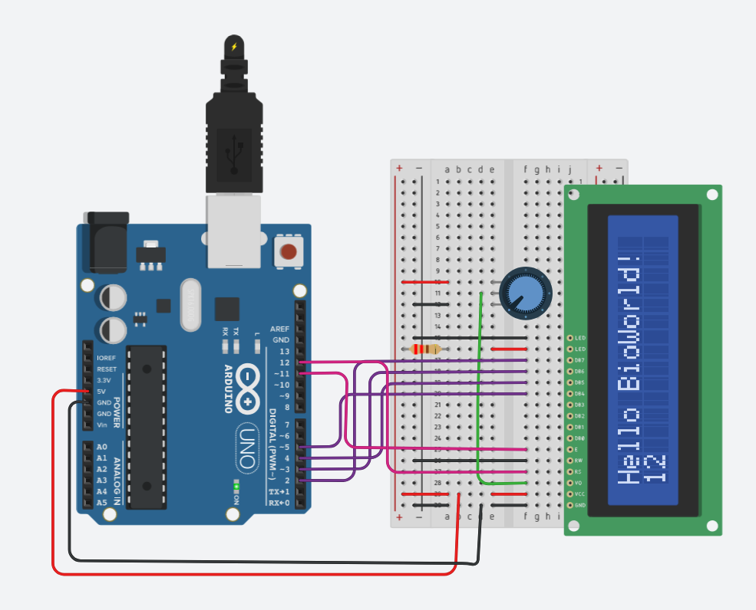
Lab1: Task 3. Introducing the LCD display.
In the task 3.1, we design a circuit to connect a potentiometer and a 16x2 LCD display. The following components are used to achieve it:
- 1x Arduino UNO board;
- 1x breadboard small;
- 1x 16x2 LCD display;
- 1x potentiometer configured at 10kΩ;
- 1x resistor with value at 220Ω;
- red wire to supply 5V; black wire at ground; pink and purple wires to connect the LCD display.
In the next two slides we are going to show the schematic view to understand how connect each pin between Arduino and LCD display. And the others, show the code used, import LCD display function from Arduino library.
<number>

Slide 32
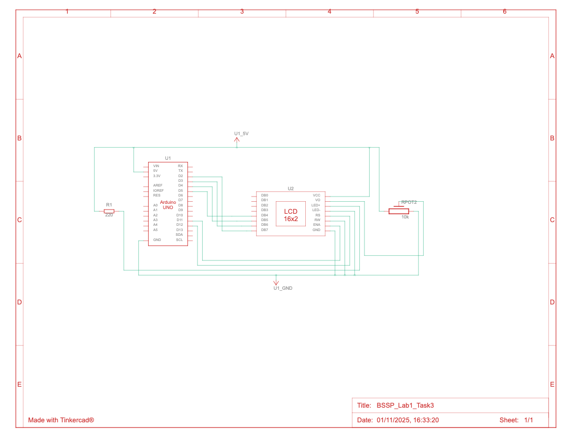
Lab1: Task 3. Introducing the LCD display.
The screenshot shows the schematic view of Arduino UNO, LCD display, resistor and the potentiometer connected all together.
<number>

Slide 33
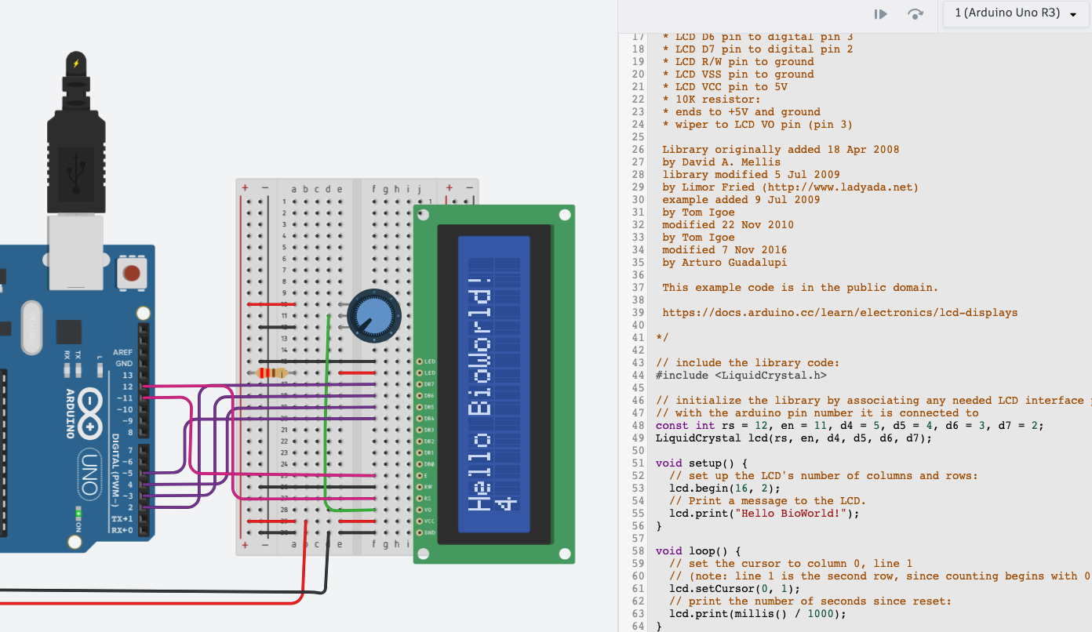
Lab1: Task 3. Introducing the LCD display.
<number>

Slide 34
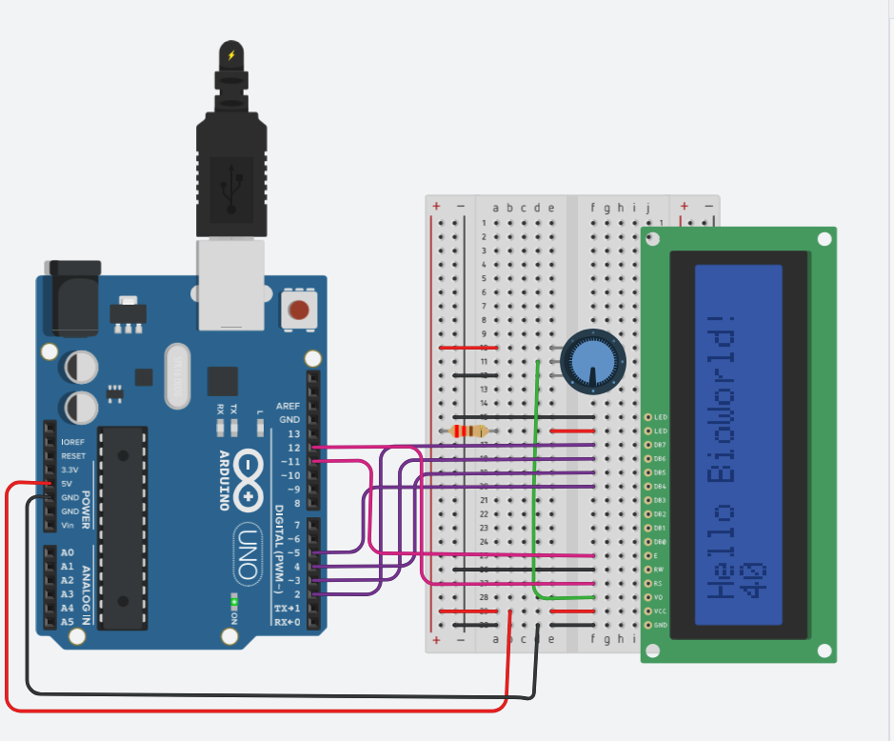
Lab1: Task 3. Introducing the LCD display.
That task help us to understand how potentiometer affects directly over LCD Display. In fact, if we turn down the potentiometer, the range is 5V to 0V, it means less voltage, the display fade out the output text until disappear completely.
In the next task, we will interact with the temperature sensor and show the values related on the LCD display.
Following the first instructions, we need to adapt the circuit design and the code to get analog temperature, convert in digital value and show in the only two rows on the LCD display instead of Serial Monitor only.
<number>

Slide 35
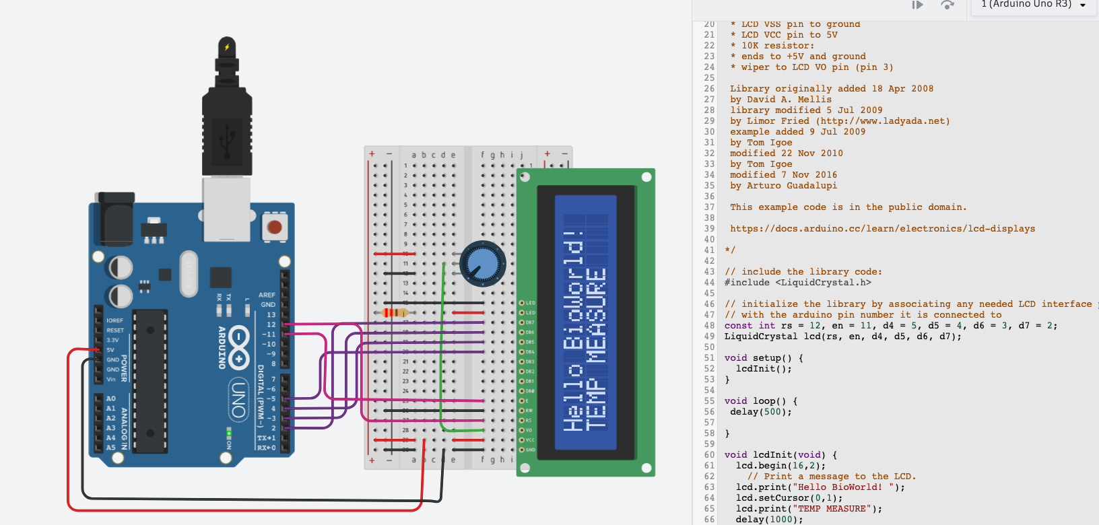
Lab1: Task 3. Introducing the LCD display.
In the task 3.2 we adapt the code to prepare the breadboard to join the temperature sensor and the LCD Display with welcoming message.
Then, we join the first task made before, with the temperature sensor in the left side and combine the code at once to show the values on LCD display instead on the Serial Monitor.
In this screenshot, we show the first adaption of the code.
<number>

Slide 36
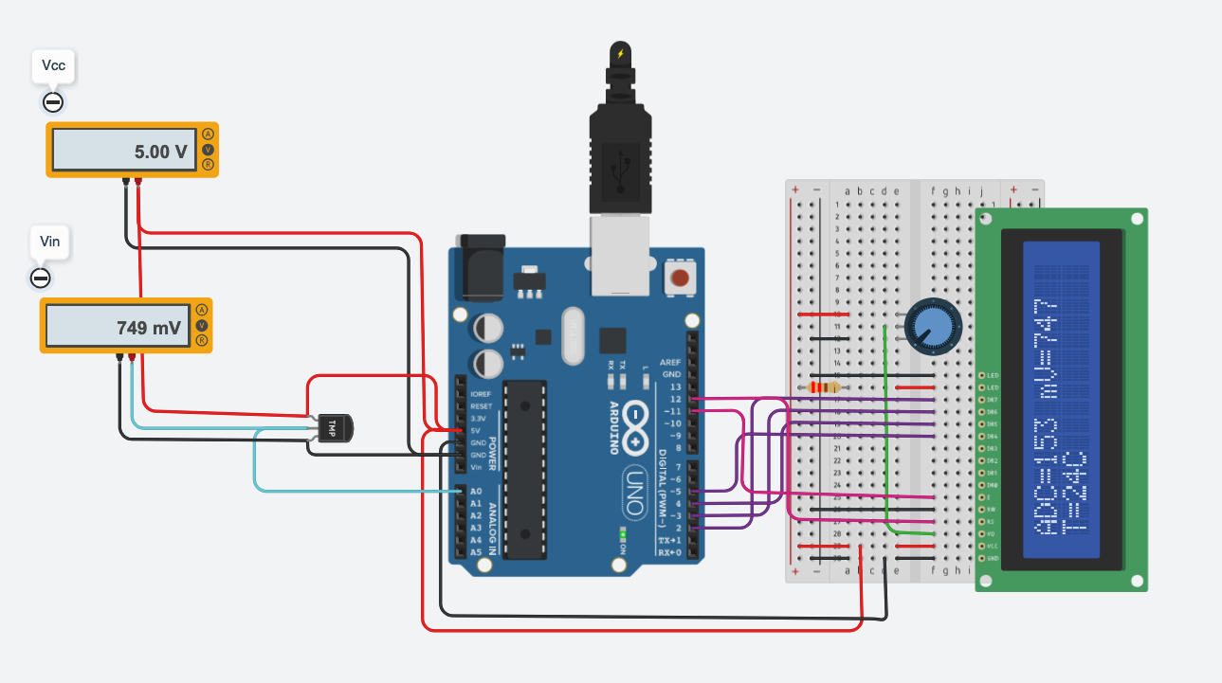
Lab1: Task 3. Introducing the LCD display.
Finally, the task 3.3 shows the values ADC; mV and T directly on LCD display instead on the Serial Monitor.
In the next slide we will show the final schematic view and the code used to achieve this task.
<number>

Slide 37
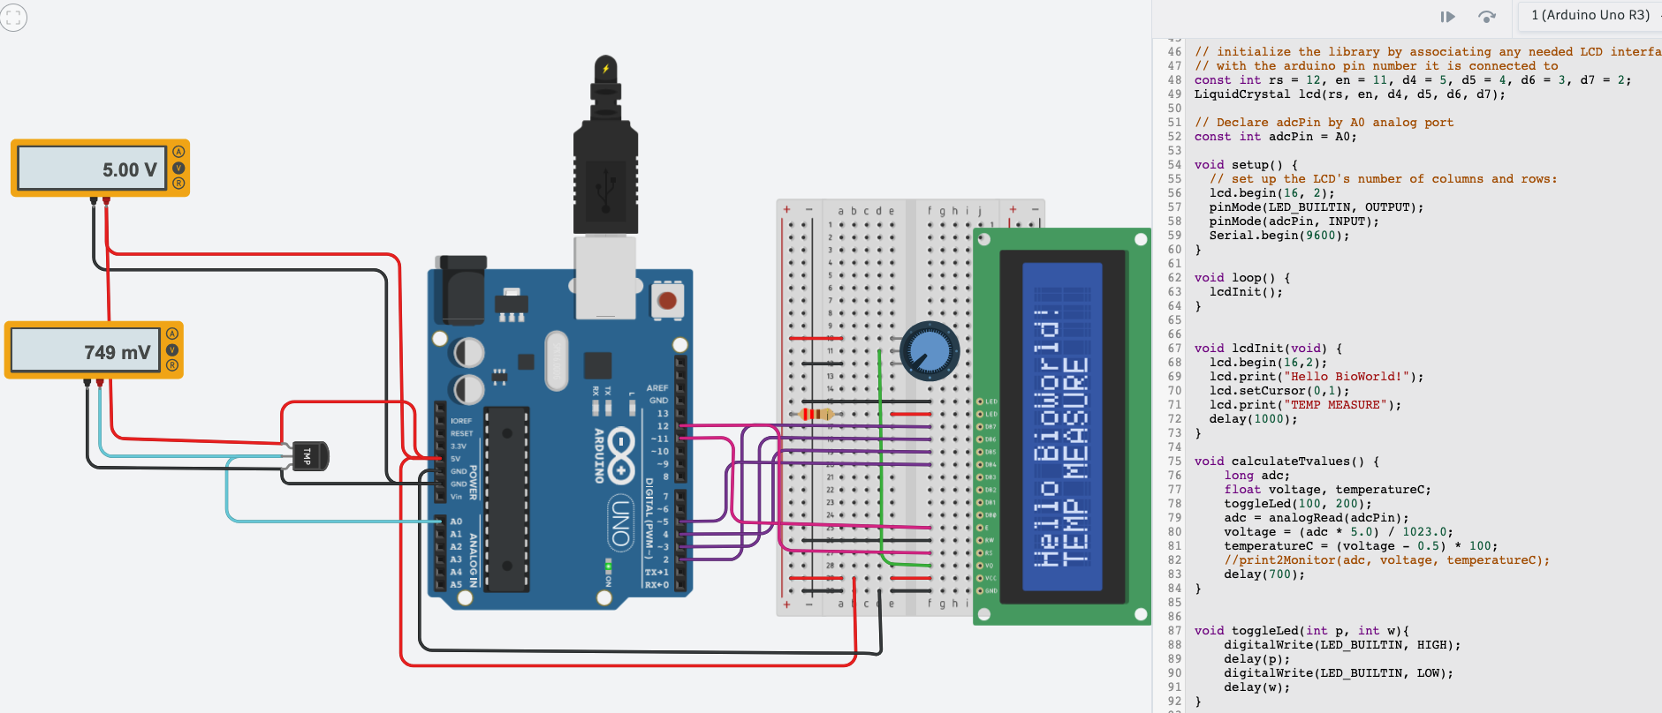
Lab1: Task 3. Introducing the LCD display.
In this screenshot we join the first part, the temperature sensor shown in the task 2, and the right side with the LCD display.
In the next task 3.3 we will adapt the code by the function calculateTvalues() and send those values in the new function lcdPrint()
<number>

Slide 38
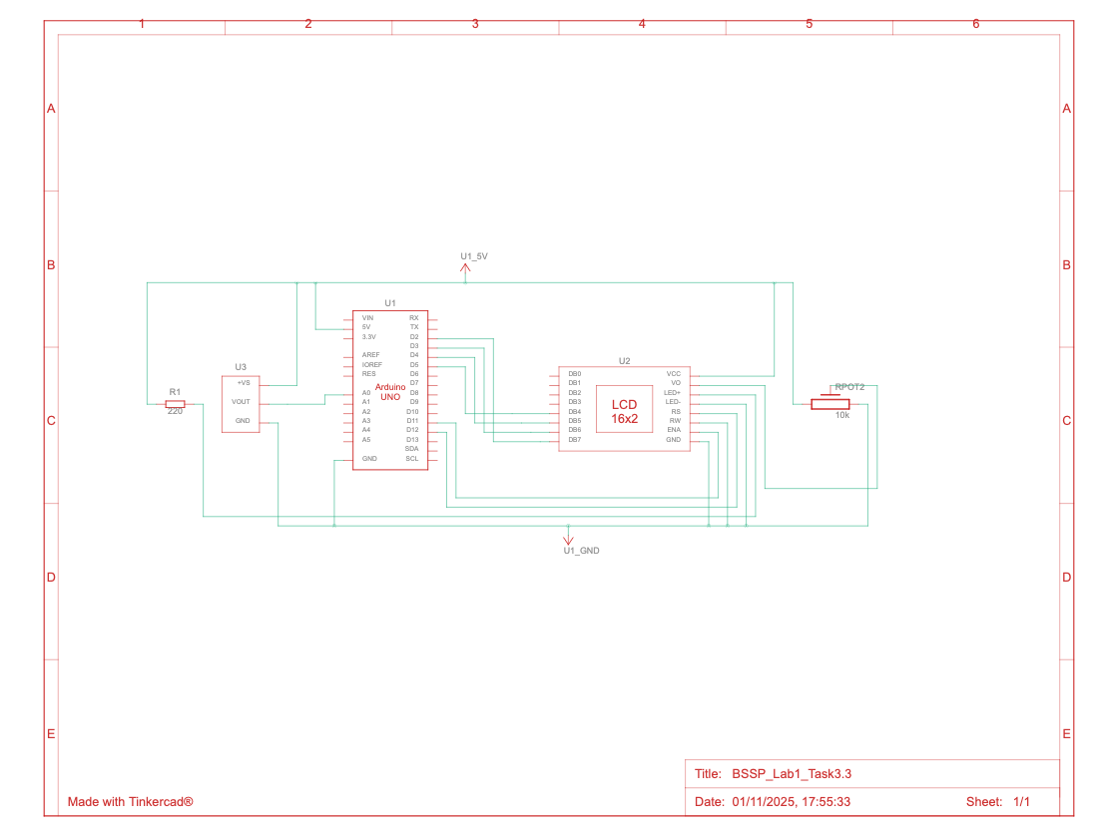
Lab1: Task 3. Introducing the LCD display.
<number>

Slide 39
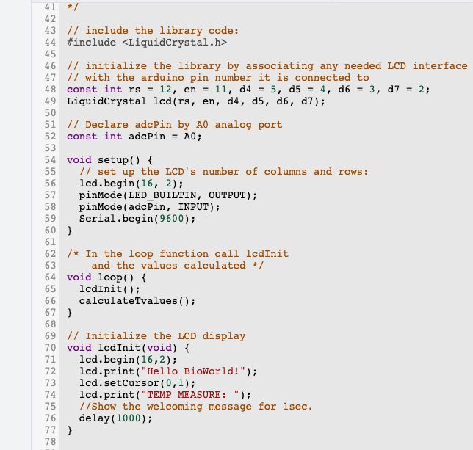
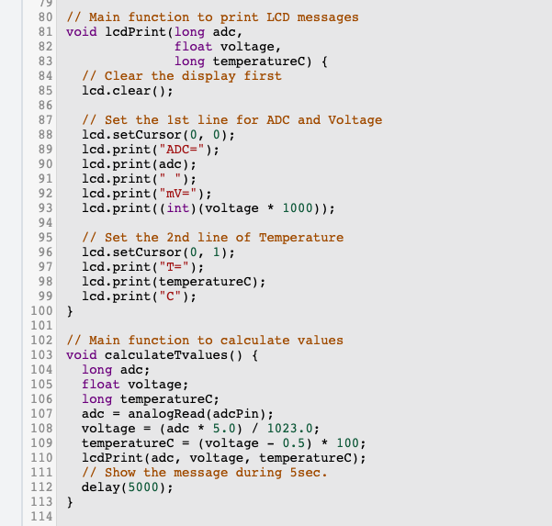
Lab1: Task 3. Introducing the LCD display.
<number>

Slide 40
Laboratory 1 Report
► Task 1 – Schematics of a mixed signal circuit.
► Task 2 – Programming the Arduino board.
► Task 3 – Introducing the LCD display.
► Task 4 – Conditioning circuit.
► Task 5 – Results.
<number>

Slide 41
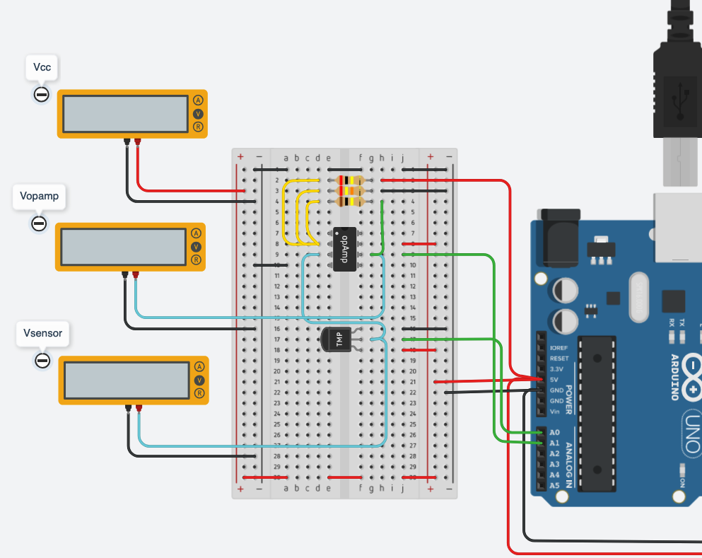
Lab1: Task 4. Conditioning circuit.
In the task 4.1 we are going to design the new circuit following the requirements to optimise the previous circuit. That optimisation involves the introduction of the thermistor. It maximizes the analogue input range into an ADC in order to maximize the resolution. In the same way, this task optimises the input of the ADC inside Arduino Uno from 0.25 to 4.75 V.
Taking the specifications of our Group E, the inlet temperatures to be considered are between 0 ºC and 80 ºC.
This input temperatures range must be converted by the non-inverting amplifier to an ADC voltage input between 0.25 V and 4.75 V.
<number>

Slide 42
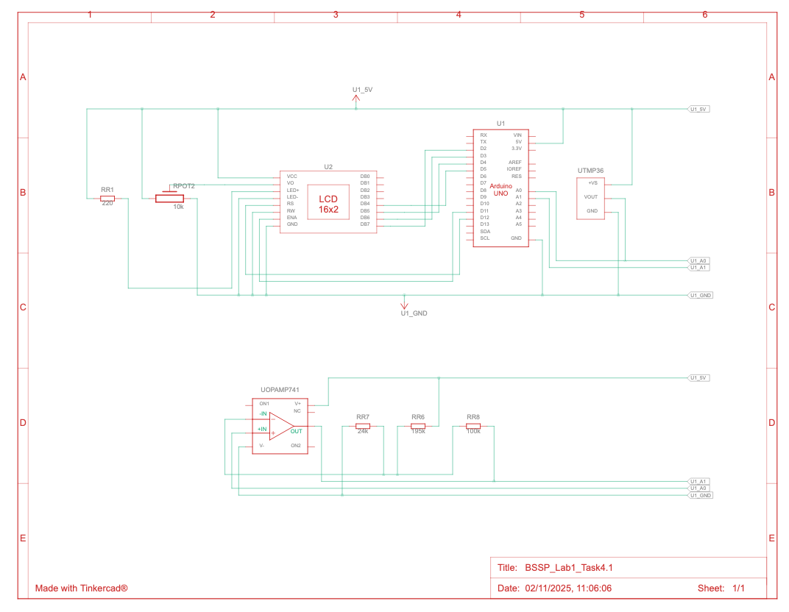
Lab1: Task 4. Conditioning circuit.
In the task 4.2 we show the schematic view with the solution corresponding the connections between the components.
To adjusting the frequency in the circuit, and re-create a thermistor, there are three resistors with default value assigned are 1kΩ. Resistors are used with a thermistor and Op-Amp to create a voltage divider, which converts the thermistor's resistance change into a voltage change. This voltage is then fed into the Op-Amp, which can be configured to amplify and linearise the signal, making the output proportional to temperature. Because of that, we need to calculate by the temperature range 0ºC and 80ºC and the power supply voltage, at 5V.
The second component is operation amplifier, opAmp741. It’s important understand the pins: IN+ and IN- used for connecting the signal to be amplified or filtered; Power+ and Power- , respectively the input voltage and the ground.
To assign the values, apart the available academic material, the Unit3, we have checked the Arduino official documentation for OpAmp741 https://www.electronicshub.org/ic-741-op-amp-basics/
<number>

Slide 43
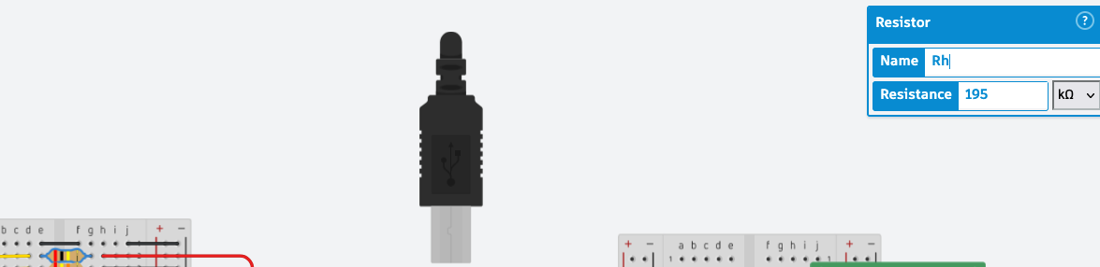
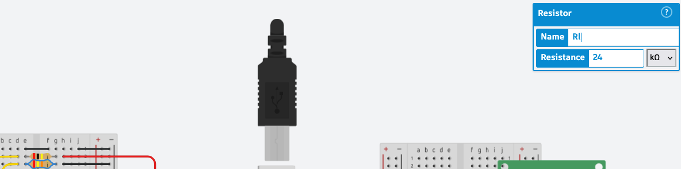
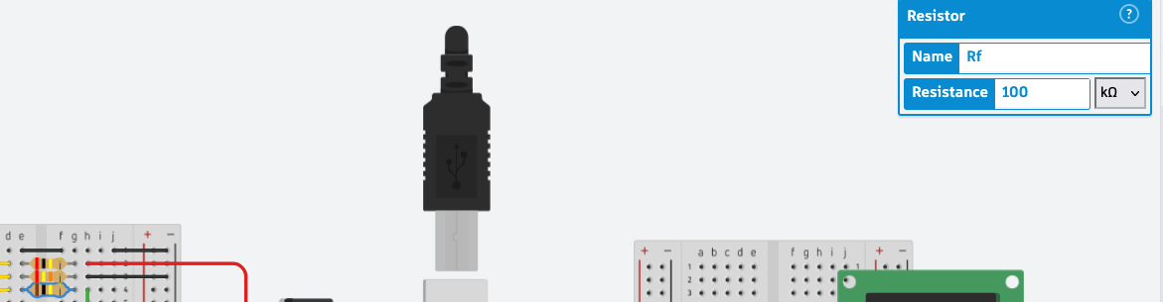
Lab1: Task 4. Conditioning circuit.
In the task 4.3 we are going to calculate the resistors values.
The first resistor, Rh which connect the inverting input, pin IN- from OpAmp and the power voltage 5V.
The second resistor, Rl connect between the inverting input pin IN- from OpAmp and the ground.
The third resistor, Rf connect between the inverting input pin IN- from OpAmp and the OpAmp ouput.
To calculate the resistor values, following the formula:
To calculate the offset, remember we have a temperature range from 0ºC to maximum 80ºC, the resultant values are:
- Rf = 100kΩ
- Rh = 195kΩ
- Rl = 24kΩ
<number>

Slide 44
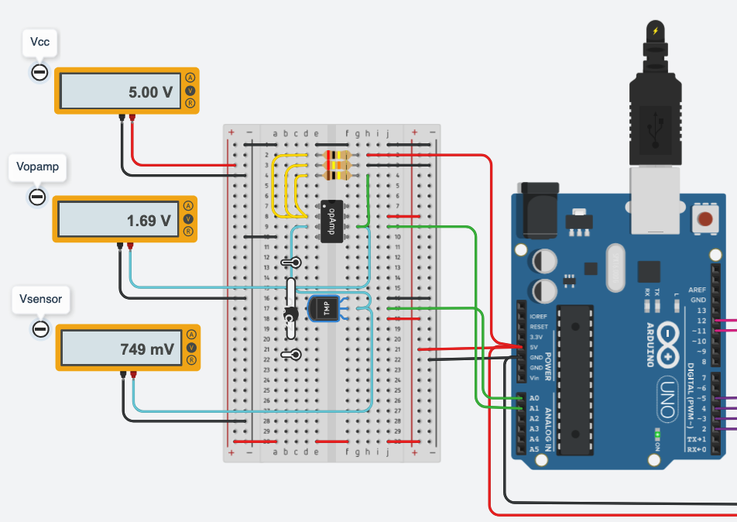
Lab1: Task 4. Conditioning circuit.
In the task 4.4 we show the values corresponding with the temperature set at 25ºC
The Operational Amplifier send the corresponding value converted to voltmeter Vopamp, it shows 1.69V.
As expected the voltmeter for the temperature sensor, Vsensor shows 749mV.
<number>

Slide 45
Laboratory 1 Report
► Task 1 – Schematics of a mixed signal circuit.
► Task 2 – Programming the Arduino board.
► Task 3 – Introducing the LCD display.
► Task 4 – Conditioning circuit.
► Task 5 – Results.
<number>

Slide 46
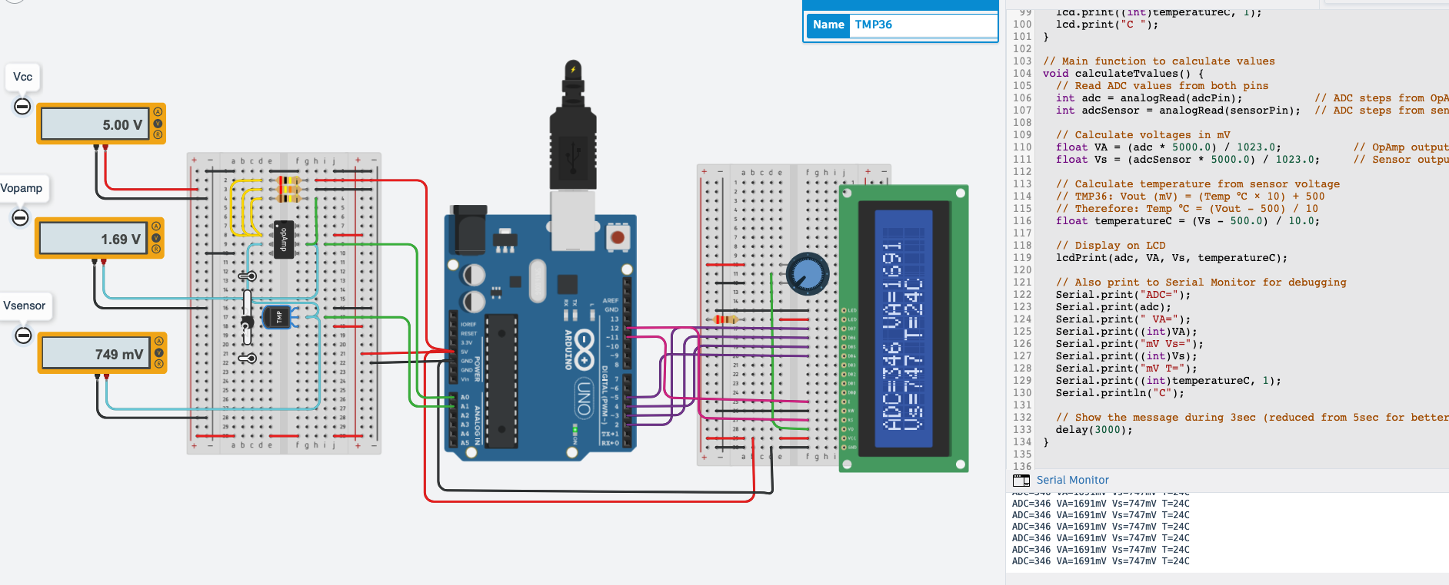
Lab1: Task 5. The sensor data acquisition system.
In the task 5 we will put all together and show the values requested on LCD display and on the Serial Monitor. In the next slides we will show the entire code used and the schematic view. Also, we fill the table V with the requested values.
<number>

Slide 47
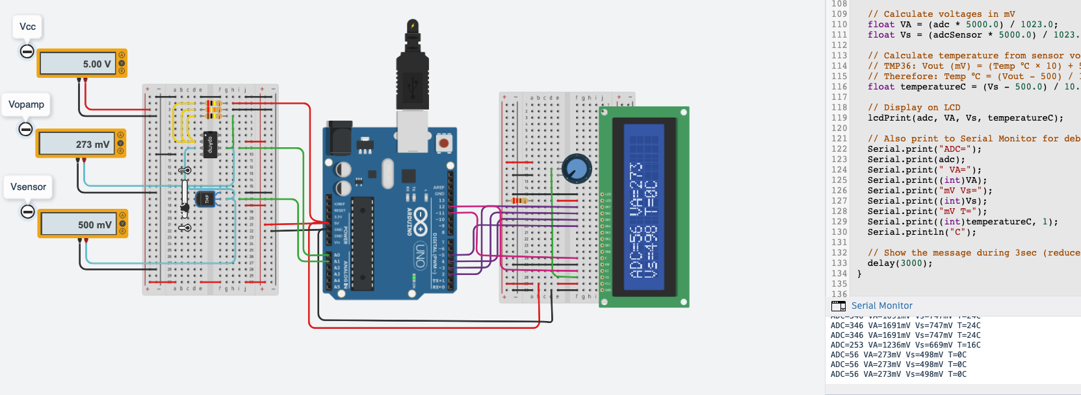
Lab1: Task 5. The sensor data acquisition system.
In the screenshot the temperature Tmin has been configured at 0ºC with the following values: ADC=56; VA=273mV; Vs=498mV.
<number>

Slide 48
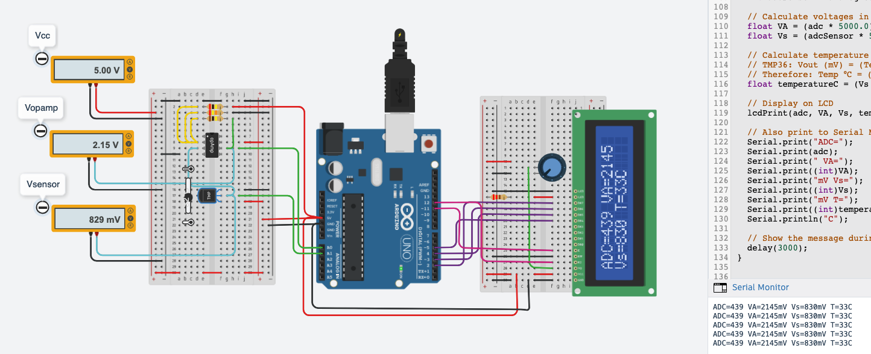
Lab1: Task 5. The sensor data acquisition system.
In the screenshot the temperature T1 has been configured at 33ºC with the following values: ADC=439; VA=2145mV; Vs=830mV.
<number>

Slide 49
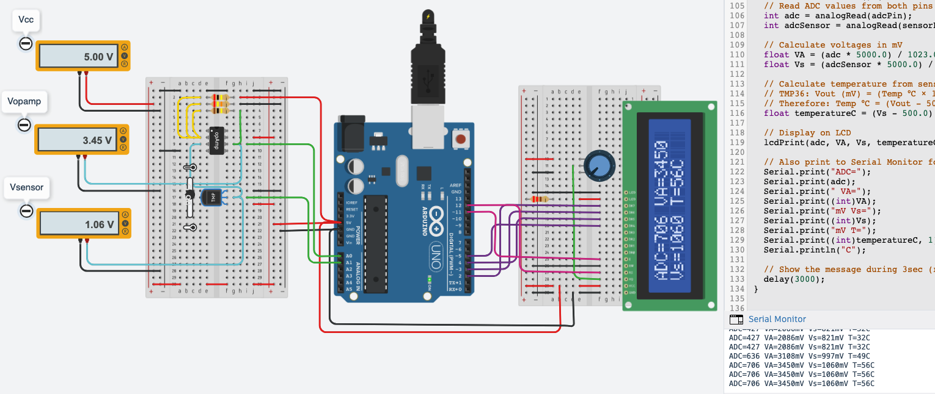
Lab1: Task 5. The sensor data acquisition system.
In the screenshot the temperature T2 has been configured at 56ºC with the following values: ADC=706; VA=3450mV; Vs=1060mV.
<number>

Slide 50
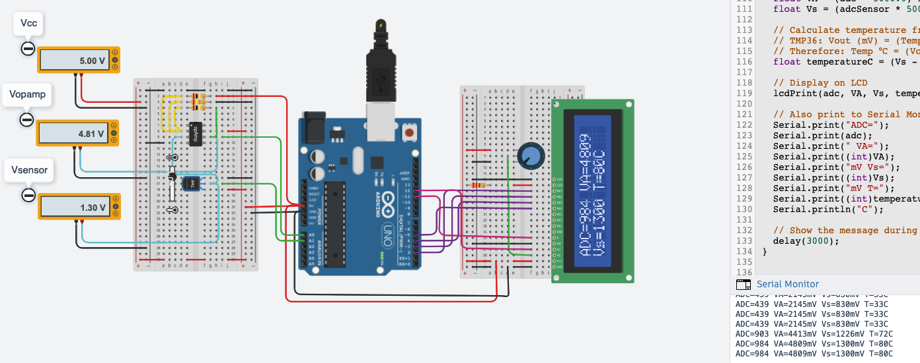
Lab1: Task 5. The sensor data acquisition system.
In the screenshot the temperature Tmax has been configured at 80ºC with the following values: ADC=984; VA=4809mV; Vs=1300mV.
<number>

Slide 51
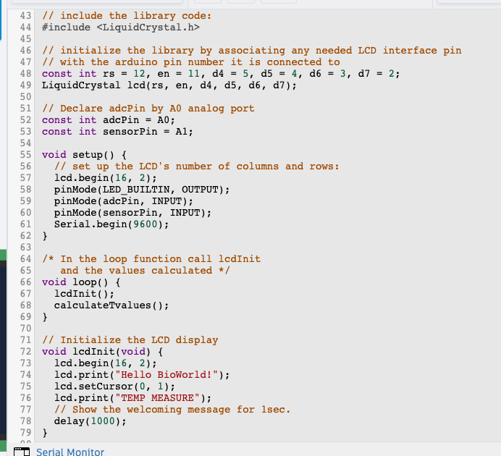
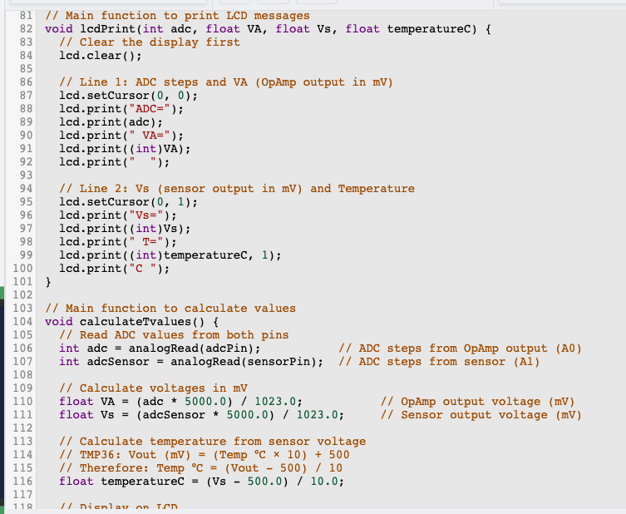
Lab1: Task 5. The sensor data acquisition system.
<number>

Slide 52
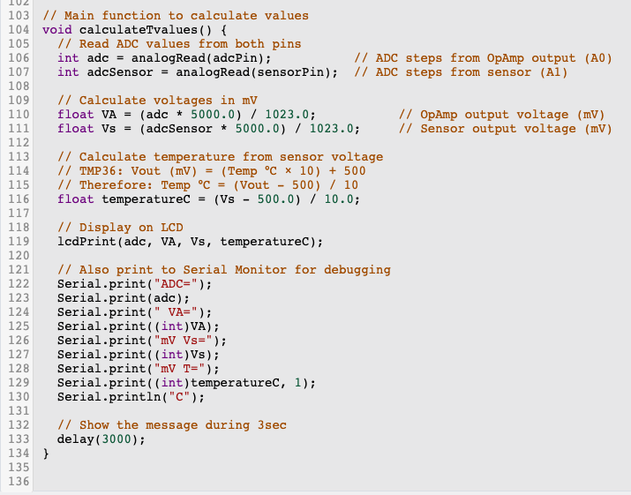
Lab1: Task 5. The sensor data acquisition system.
<number>

Slide 53
Lab1: Task 5. The sensor data acquisition system.
 | T (ºC) | Vout Sensor (V) | Vout OpAmp (V) | ADC counts (LCD) | OpAmp (LCD) | Sensor Out (LCD) | Measured T in LCD | Error %
Minimum Temp. value | 0ºC | 500mV | 273mV | 56 | 273mV | 498mV | 0ºC | 0.4%
T1 | 32ºC | 829mV | 2.15V | 439 | 2145mV | 830mV | 33ºC | -0.12%
T2 | 56ºC | 1.06V | 3.45V | 706 | 3450mV | 1060mV | 56ºC | 0%
Maximum Temp. value | 80ºC | 1.30V | 4.81V | 984 | 4809mV | 1300mV | 80ºC | 0%
Table V – It’s a final table where we consider the 8 values between the minimum and maximum input sensor range. Finally, we calculate the error% between sensor value and sensor output shown in LCD display value.
<number>

Slide 54
Final evaluation of Laboratory 1
This laboratory practice successfully demonstrated the implementation of a complete temperature sensing system, from the beginning using the simple potentiometer and show the output on the voltmeter. Calculating and convert the values using other components such as the TMP36 sensor, OpAmp 741 conditioning circuit, and Arduino Uno microcontroller.
Key achievements learnt:
- Designed and implemented a non-inverting amplifier circuit that optimised the ADC input range from 0.25V to 4.75V for the 0-80°C temperature range.
- Calculated optimal resistor values (Rf=100kΩ, Rl=24kΩ, Rh=195kΩ) achieving a gain of 5.6 and offset of 2.56V
- Successfully integrated LCD display to show ADC steps, amplified voltage (VA), sensor voltage (Vs), and calculated temperature
- Improved measurement resolution from 0.405°C/step to 0.15°C/step through proper signal conditioning
The practice reinforced understanding of analog signal conditioning, ADC conversion principles, and the importance of maximising input voltage span for better measurement accuracy. Finally, the hands-on experience with Tinkercad simulation validated theoretical calculations and demonstrated practical circuit design optimisation techniques essential in biomedical instrumentation.
Marco Russo marco.russo@estudiants.urv.cat

Slide 55
Final evaluation of Laboratory 1

Slide 56
Final evaluation of Laboratory 1

Slide 57
Final evaluation of Laboratory 1

Slide 58
Thank you for your attention!
► Contact
► Carmen Aznar Mathonneau
► Yuxi Qiao
► Marco Russo -
► Kamela Xhengo

