Slide 1
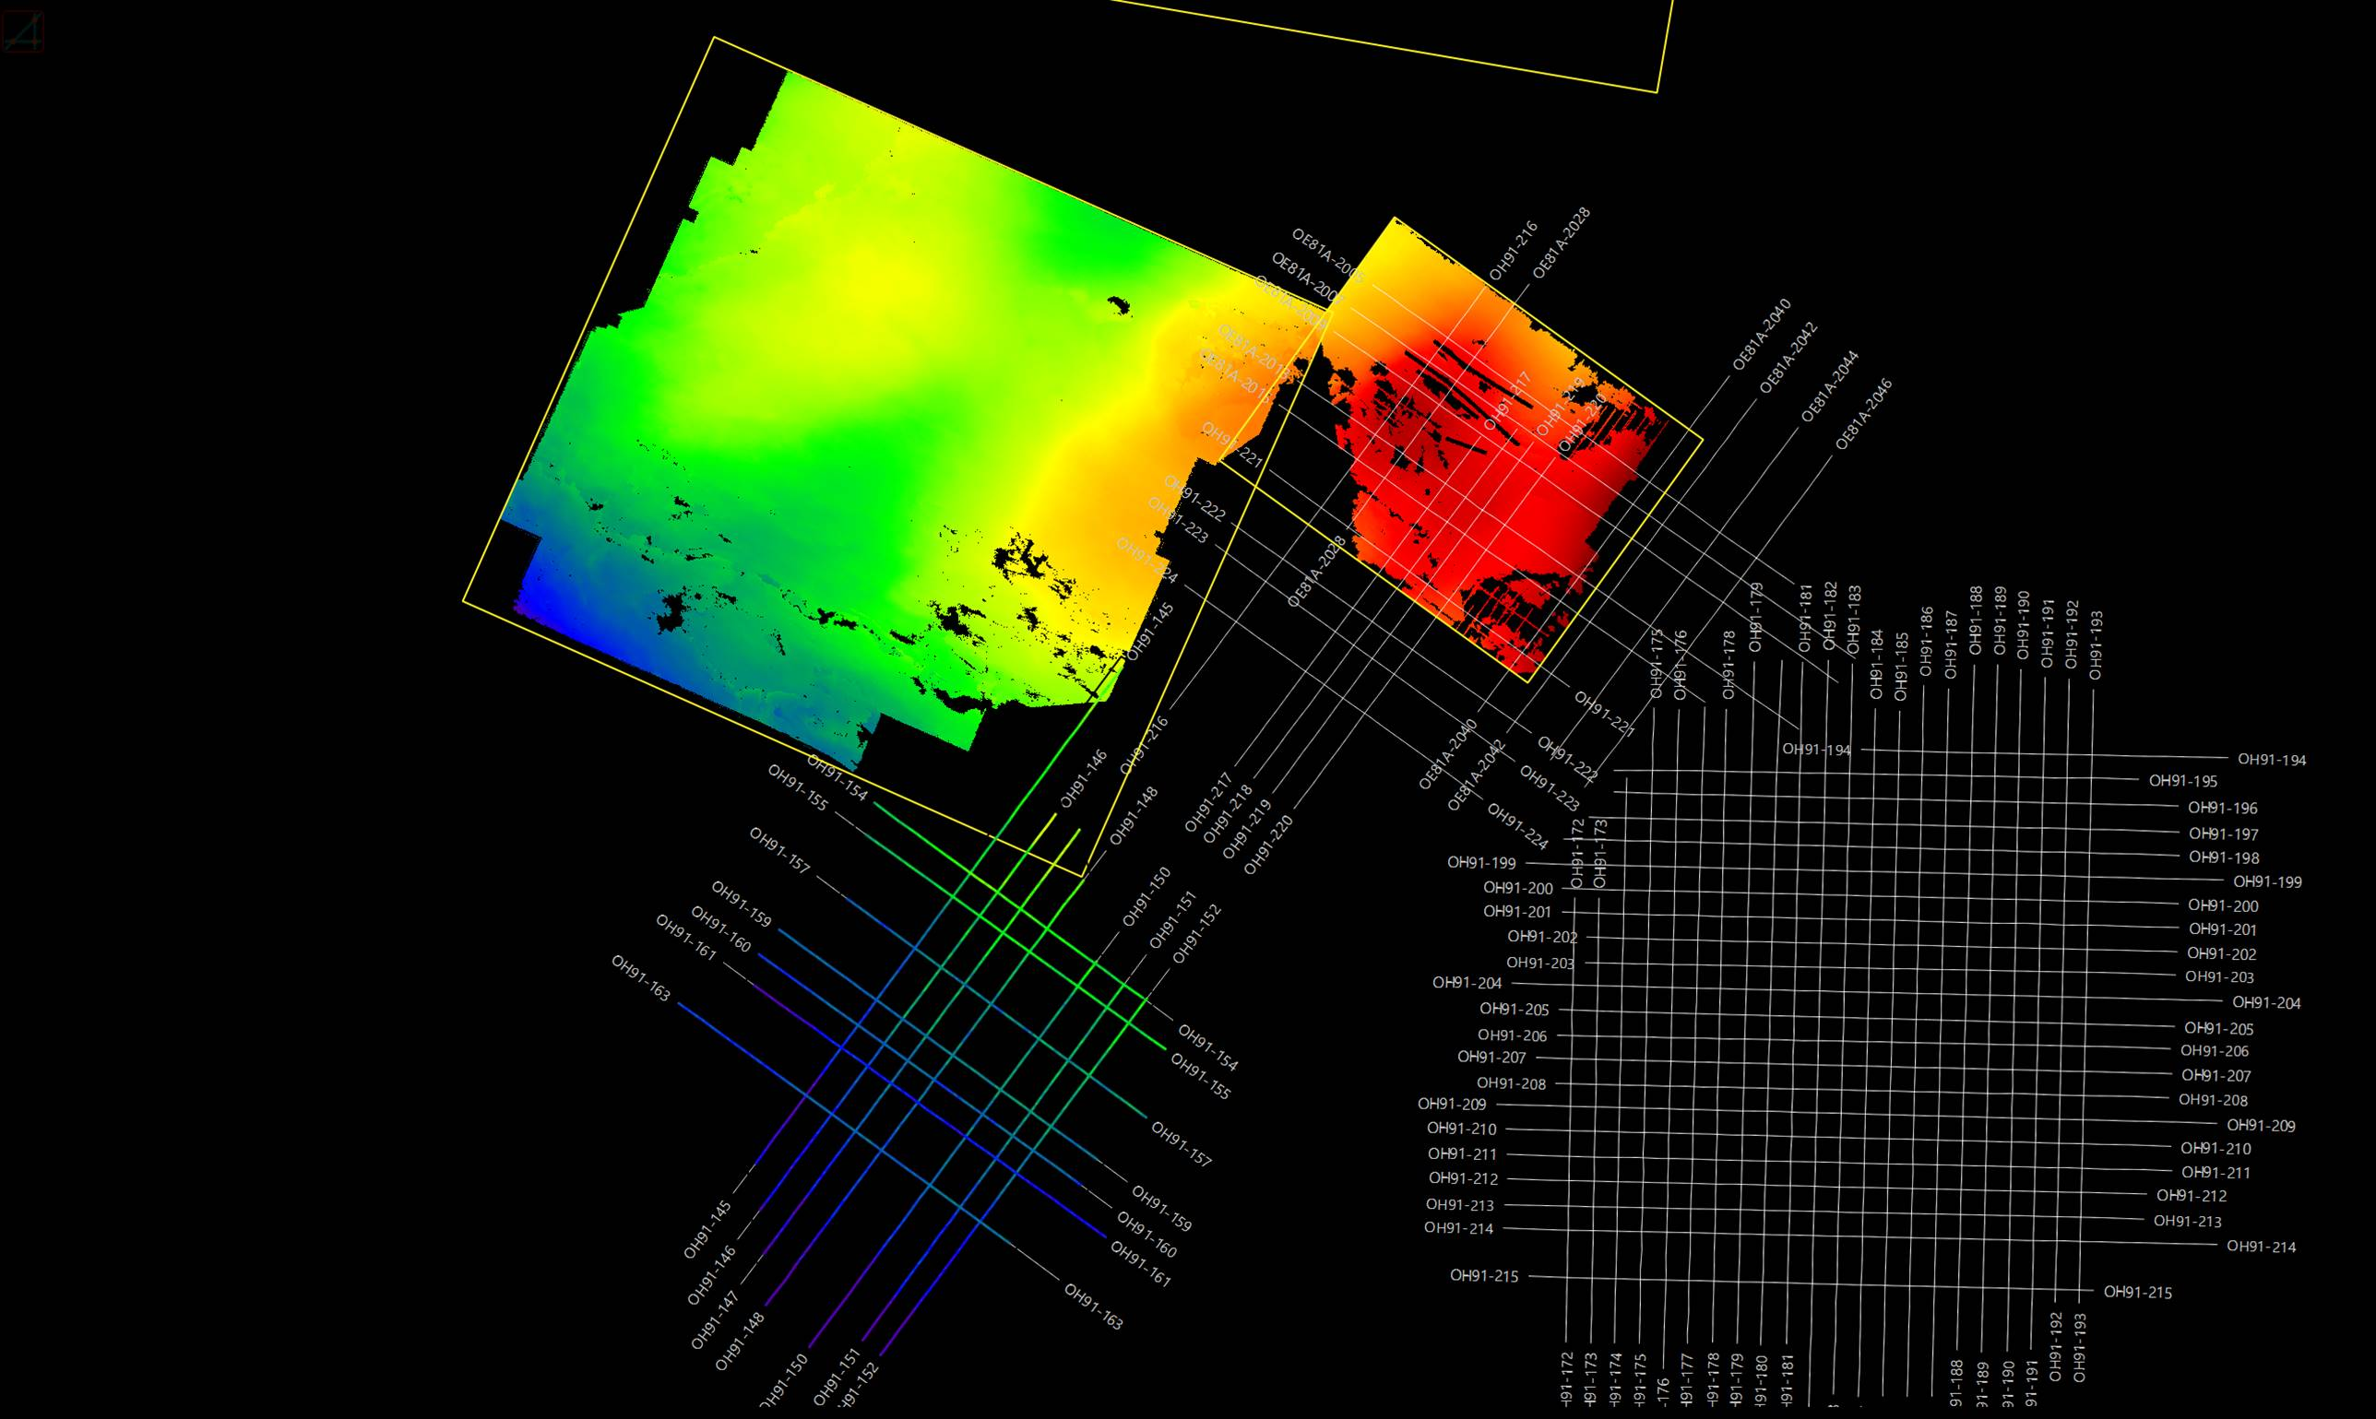
SeismicHorizon and HorizonInterpretation WPC ? which to use ? where to store

Slide 2
Reservoir Data Interoperability use case - details
Demonstration step | Product | API | Modeling Data types | Associated OSDU WPC in Manifest
1. Equinor Ingest data | Aspen RMS® | ETP Domain API Or Generate RESQML file and ingest through Open ETP SSL Client | Ingest: Horizon picks (2D Grids) Fault sticks Well picks and logs | LocalBoundaryFeature HorizonInterpretation FaultInterpretation GenericRepresentation
2. TotalEnergies Consume and Ingest data | Sismage-CIG | ETP Domain API | Consume: - Horizon picks (2D Grids) - Fault sticks Ingest Horizon triangulated surfaces Fault triangulated surfaces | LocalBoundaryFeature HorizonInterpretation FaultInterpretation GenericRepresentation
3. AspenTech Consume and Ingest data | Aspen SKUA® | ETP Domain API | Consume: Horizon triangulated surfaces Fault triangulated surfaces Well picks and logs Ingest 3D reservoir grid 3D reservoir grid static and dynamic properties | LocalBoundaryFeature HorizonInterpretation FaultInterpretation GenericRepresentation IjkGridRepresentation GenericProperty TimeSeries
4. Dynamic Graphics Consume data | Coviz 4D | ETP Domain API | Consume 3D Reservoir grid with dynamic properties | IjkGridRepresentation GenericProperty TimeSeries

Slide 3
Business Capability User Story – Actual (1)
Business Capability User Story:
What does the Business User want to do?
As a geophysicist, I need to interpret seismic volumes, picking the horizons and the faults based partially on pre-existing data, and save/store the results.
Why? (Business Goal)
To generate derivative products that assist with interpretation of the subsurface, to clarify geology & production opportunities (hotspots & areas of high potential).
Content Data Types Needed
SeismicTraceData content:
File/dataset
(e.g. SEGY, ZGY)
DDMS
SDDMS (Includes OVDS -- also others)
Seismic Horizon content
File/ødataset
RESQML
XYZ (csv, tab-delimited, etc.)
DDMS
RDDMS
Seismic Fault content
File/dataset
RESQML
XYZ (csv, tab-delimited, etc.)
DDMS
RDDMS
SeismicBinGrid
Metadata attributes capture the info needed
Files/dataset
P6/11
Csv
DDMS
SDDMS ?
RDDMS
SeismicLineGeometry
File/dataset
P1/11, P1/90
Csv - line name, shotpoint, X, Y, lat, lon
DDMS
SDDMS - 2D Seismic Line specific ?
RDDMS ?
Wellbore Trajectory
File/dataset
CSV, Excel, WITSML, P7
DDMS
WBDDMS
RDDMS
Well Logs (incl. Seismic to well ties)
File/dataset
LAS, DLIS, WITSML, JSON
DDMS
RDDMS
WBDDMS
Wellbore Markers
File/dataset
CSV, Excel
DDMS
WBDDMS
RDDMS
Generic Representation for 2D Polygons, Pointsets
File/dataset
SHP, RESQML, etc.
DDMS
RDDMS
OSDU WKS Data Types Needed (Master & Metadata)
Input
SeismicTraceData
SeismicBinGrid (for 3D)
SeismicLineGeometry (for 2D)
Well Header
Wellbore Trajectory
Well Logs
Wellbore Markers
Output
SeismicHorizon
SeismicFault
Seismic-well-ties (Well Log)
2D Polygons, Pointsets (GenericRepresentation)

Slide 4
Business Capability User Story – Actual (2)
OSDU Microservices Needed
(needs to be mapped to Functional & Non-Functional, Data Types/content)
Core Services – many
Reservoir DDMS
Wellbore DDMS
Seismic DDMS
Non-OSDU Components Likely Needed
Application adaptors to read/write to OSDU format(s)
Data ingestion tooling & process
Data mapping/transformation tooling & process
Data quality/technical assurance tooling & process
Functional Capabilities Needed Seismic
Allow access/retrieval only to a set of traces without retrieving the full seismic volume, e.g. a cube that is smaller than the full survey
Allow access to data specific to an inline, crossline, arbitrary line, or time slice, without retrieving the full seismic volume
Allow different storage tiers due to the storage cost of large seismic volumes; e.g. "cold storage" vs "warm storage"
Unified API for the Seismic DDMS - now present in API v.4. - An API that allows create, search, update of the major data types
NOT only allowing uploading bulk files
Allow ingestion of each catalog and content mentioned above
Allow legal tagging of each catalog and content mentioned above
Allow capture of data lineage of each catalog and content mentioned above
Allow a workspace that contains the interpreted data until the data is deemed worthy of publishing and sharing (P&WS + Technical Assurance)
Benefits: Reviewing these 2 slides for questions & gaps will identify…
Components of OSDU that are (thought to be) ready
Additional detail backlog/work tasks needed, in each category, which we then create and track…
In OSDU
Outside OSDU
Non-Functional Requirements
Performance, Security, Usability, Reliability, Scalability, Compliance, Documentation, and Privacy
Specifics TBD for each

Slide 5
Reservoir DDMS Solution
RDDMS API’s
Notes:
After February 1st. We set out on a new task. To share seismic interpretation data through RDDMS.
RDDMS is currently an experimental feature in the community version of OSDU, and not yet available in ADME. Therefore, Microsoft set up a standalone version of RDDMS, so that we could start on the functional testing.
This is when we onboarded AspenTech and set a new goal – share surfaces through RDDMS before April 1st. Did we make it?

Slide 6
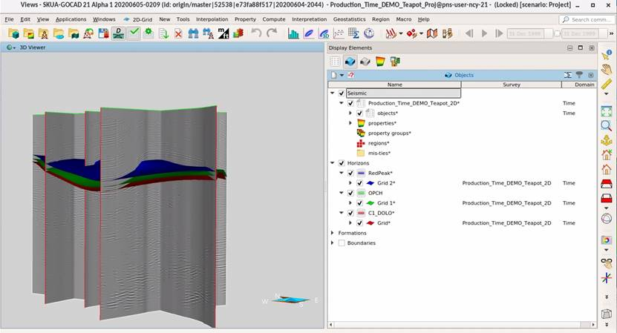
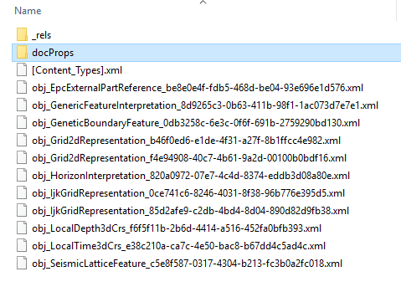
Example of seismic horizon
Horizon (Map)
Horizon (Pick)
Horizon Interpretation (C1Dolo)
CRS Depth
CRS Time
Seismic survey

Slide 7
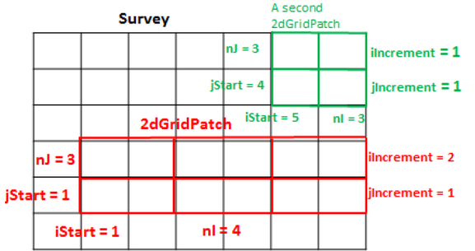
SeismicHorizon components - definitions
OSDU Seismic interpretation WPC’s
RESQML data objects
SeismicBinGrid: "A representation of the surface positions for each subsurface node in a set of processed trace data work product components with common positions. Different sampling (spacing) and extents (ranges) in the trace data may be handled by the same bin grid."
Seismic2DInterpretatationProject: "A collection of logical processed lines and trace datasets that represent an important and uniform set for interpretation. (…) Interpretation objects (horizons) are hung from an interpretation project to give context and to interpret spatial location.“
Seismic3DInterpretationProject: "A collection of trace datasets with a common bin grid that are important for interpretation. (…) Interpretation objects (horizons) are hung from an interpretation project to give context and to interpret spatial location.“
SeismicHorizon: “A set of picks related to seismic processing geometry which define a surface. The geometry used is referenced by the Interpretation Project.“
Seismic lattice: defines the seismic trace organization during a 3D acquisition. It is represented by a regular IJ 2D grid
Seismic line
Horizon Interpretation: An interpretation of a horizon, which optionally provides stratigraphic information.
Grid2dRepresentation: Representation based on a 2D grid.
Horizon geometry (pick): Z values array + link to supported seismic interpretation. The Z values are then combined with the geometry of a seismic survey to give XYZ points
BinGrid geometry (map): grid 2D representation where the geometry is provided by a 2D lattice
Seismic line and lattice sets

Slide 8
RESQML – a normalized view of SeismicHorizon
SeismicHorizon WPC
InlineMin
InlineMax
CrosslineMin
CrosslineMax
SeismicPickingTypeID
SeismicDomainTypeID
SeismicDomainUOM
VerticalDatumOffset
VerticalDatumUOM
VerticalMeasurementTypeID
ReplacementVelocity
ReplacementVelocityUOM
SeismicHorizonTypeID +
GeologicalUnitName
GeologicalUnitAgeYear
GeologicalUnitAgePeriod
PetroleumSystemElementTypeID *link to feature?
SeismicVelocityModelID +→ activity model
BinGridCoveragePercent+
Remark
Interpreter Creator
SeismicTraceDataID linked to Interpretation? SeismicLatticeFeature
GeoContexts ?
SeismicAttributes
3
1
BoundaryFeatureWPC
HorizonInterpretation WPC
StratigraphicColumn WPC
6
2
Grid2dRepresentation
(WPC GenericRepresentation)
SurfaceRole: pick Boundaries
SeismicHorizon
mapping
Grid2dPatch
seismicCoordinates
seismicSupport
Points
array of z
Point3dFromRepresentationLatticeArray
start
offsets
6
3
2
LocalDepthCrs or LocalTimeCrs
1
4
Property
5
Grid2dRepresentation
Citation (creation and last update info)
SurfaceRole: map
Boundaries
7
4
LocalDepthCrs
RepresentationSet
7
Seismic2DInterpretationProject
In master
SeismicLatticeFeature
CrosslineCount,
CrosslineIndexIncrement,
FirstCrosslineIndex,
irstInlineIndex,
InlineCount,
InlineIndexIncrement
SeismicBinGrid
5
SeismicBinGrid
CRS
….
P6Geometry
Generic Interpretation

Slide 9
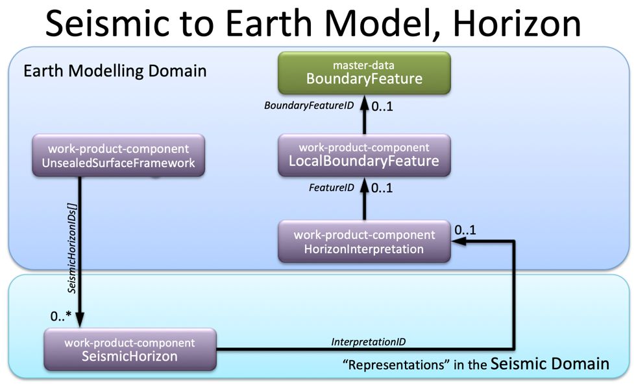

Slide 10
Demo Interoperability (F2F Edinburgh 2024)
Generated WPC SeismicHorizon manifest from RESQML 2.0.1 HorizonInterpretation, BinGrid data
{ …
"kind": "osdu:wks:work-product-component--SeismicHorizon:1.2.0",
"id": "npequinor-dev:work-product-component--SeismicHorizon:098bbfc0-d892-4fb8-b99d-994038a706d8",
"data": {
…
"Datasets": ["npequinor-dev:dataset--ETPDataspace:demo-volve-sh:"],
"DDMSDatasets": ["eml://reservoir-ddms1/dataspace('demo/volve-sh')/resqml20.obj_Grid2dRepresentation(098bbfc0-d892-4fb8-b99d-994038a706d8)«],
"IsDiscoverable": true,
…
"BinGridID": "npequinor-dev:work-product-component--SeismicBinGrid:975c6d8d-6eed-4025-a3a7-7078380f4695:",
"CrosslineMin": 0,
"CrosslineMax": 761,
"GeologicalUnitName": "TY",
"IndexableElementCount": [
{
"Count": 329513,
"IndexableElementID": "npequinor-dev:reference-data--IndexableElement:Nodes:"
}
],
"InlineMax": 433,
"InlineMin": 0,
"InterpretationID": "npequinor-dev:work-product-component--HorizonInterpretation:6dbd45f3-82cb-4b7b-a9dc-f9a671c8939f:",
"InterpretationName": «volve",
"LocalModelCompoundCrsID": "npequinor-dev:work-product-component--LocalModelCompoundCrs:aab87b9e-32c1-4949-811f-6b72a55462ea:"
}
},
…

Slide 11
Demo: SeismicHorizons in RDDMS, RESQML2.2 json, 3 options
Horizon defined as a set of Z values on top of a regular grid of X and Y values. But, the same flexibility of the Resqml data model applies to arbitrary set of points (with no XY structures), 2d lines. It also applies to faults and includes triangles, polyhedra, etc.
Horizon with inline X, Y, Z Values. The first file testHorizonEverythingIncluded.json contains an array of objects, the first object is the horizon itself, and the other ones are the objects this horizons may be referencing. Note that these objects (Coordinate Reference System, Interpretation and Features) are links so they are typically sent one time, then horizons can attach to them. Besides the coordinate system information, everything in references is optional. The horizon itself is a simple one, with a single patch. The patch is defined using two vectors for X and Y coordinates.
Horizon referencing a BinGrid The second file testHorizonReferencingBinGrid.json shows a horizon that references an external grid. Unlike the previous geometry where the X and Y are vector based, this defines the supporting geometry X an Y coordinates as a window inside an existing BinGrid. It contains just the horizon.
Horizon referencing data inside an Excel spreadsheet In order to demonstrate how we can reuse an existing file, the third file testHorizonReferencingXL.json shows a horizon that references an external Excel file. The Z coordinates are defined using a given column in a given sheet of a spreadsheet. Other file types can be used, such as CSV, SEGY but the principle is the same, we just need to define the rule of how to extract the data from the file (e.g sheet name, column and row indices, etc.)
Sources: https://gitlab.opengroup.org/osdu/subcommittees/data-def/projects/reservoir/docs/-/blob/e3200f7f453246a4fd7ab1caa6ae41fe6d5b507b/Presentations/Seismic%20Horizon%20presentations/testSeismicHorizonResqml.zip

Slide 12
Multi-survey picking
Example of multi-survey picking
In RESQML: in Grid2DRepresentation
Patch1 → 3D Survey1
Patch2 → 3D Survey2
Patch3 → 2D Survey
Example of attribute common to all picking is SeismicHorizonPickingTypeID
3D Survey 1
Horizon
TopCretaceous
3D Survey 2
2D Survey

Slide 13
Multi-survey picking and link to stratigraphic column
3D Survey 1
STRATIGRAPHIC COLUMN |  | StratigraphicColumn
RANK1 | RANK2 | StratigraphicColumnRankInterpretation
UNIT A | UNIT A | StratigraphicUnitInterpretation
UNIT B | UNIT B1 | StratigraphicUnitInterpretation
 | UNIT B2 | StratigraphicUnitInterpretation
TopB1
3D Survey 2
2D Survey

Slide 14
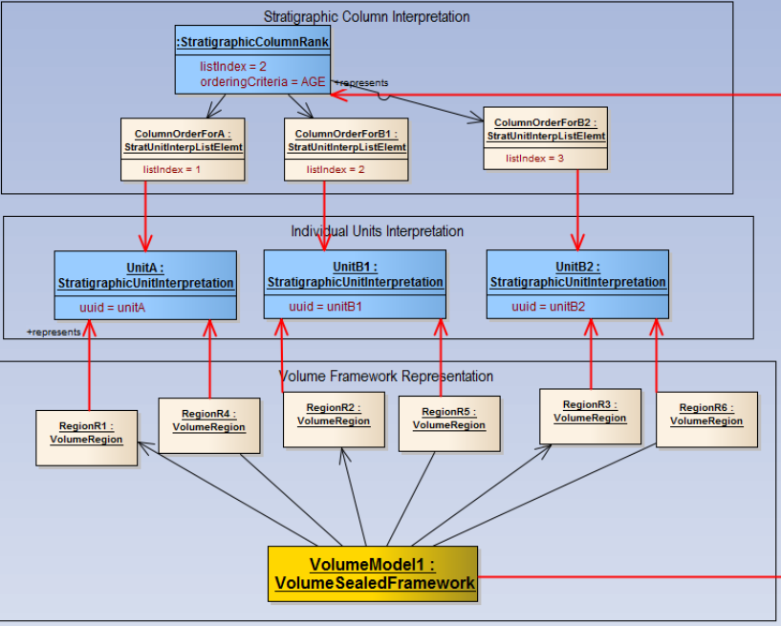
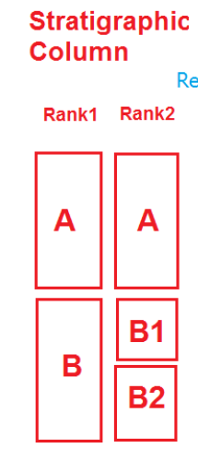

Slide 15
Remarks
OSDU SeismicHorizon is a single very specific object vs. RESQML equivalent is made of a composition of several generic parts
OSDU seismic attributes has no seismic specific attribute and is contained by horizon vs RESQML part is a generic property that can be added after horizon creation
SeismicInterpretationProject is intermediate step between Horizon and BinGrid vs RESQML RepresentationSet which is generic
OSDU SeismicHorizon is associated with a GeologicUnit while RESQML is associated to GeologicHorizon

Slide 16
Links
SeismicProjectsAndRelatedData.md#98-seismic-interpretation-representations
SeismicHorizon.2.0.0.md
HorizonInterpretation.1.2.0.md

