Slide 1


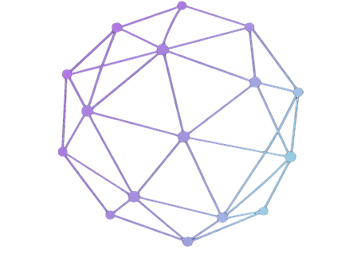
NetworkAI
Workshop
An introduction to Model Context Protocol
and Retrieval-Augmented Generation

Slide 2
NetworkAI
Workshop
01
Current Events
Today’s
Agenda
02
Intro to MCP
03
Real Examples
04
Demo & Applications
05
Intro to RAG & NotebookLM
06
Announcements

Slide 3
NetworkAI
Workshop
Current Events
What is happening around us?
Claude Design released by Anthropic
DeepSeek V4 dropped
OpenAI released GPT-5.5

Slide 4
NetworkAI
Activity
Let’s Discuss!
Turn and talk to the person your sitting next to about...
If AI can take actions (such as sending emails), at what point should it be required to stop and ask for human approval?
What is something you would like your preferred AI to do for you that it doesn’t do yet?
Is AI a bigger opportunity or threat for students entering the workforce?
Should companies disclose when content is created by AI?

Slide 5
NetworkAI
Workshop
Chatbots vs Agents with Tools
Many AI options like standard chatbots know things, but when given the proper tools, they can also DO things
We’ve seen this with things like agentic AI in coding (vibe coding)
How can we personalize and utilize these tools
with our LLMS for tasks?

Slide 6
NetworkAI
Workshop
The Problem

Slide 7
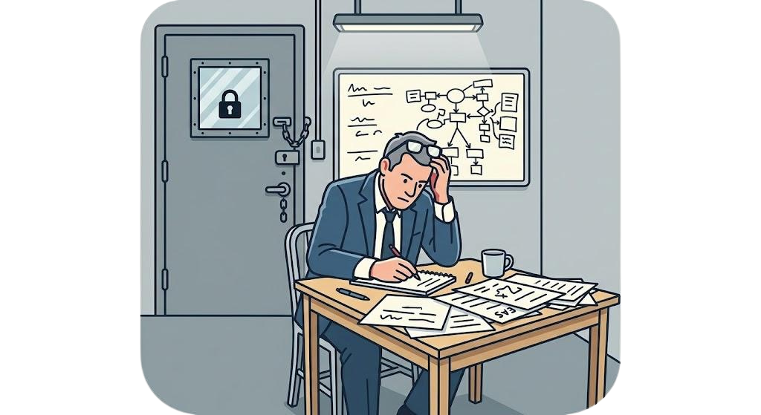

NetworkAI
Workshop
LLMs are powerful but isolated by default
They can't check your calendar, read your emails, update a spreadsheet, or browse a live website on their own
Like a very smart consultant locked in a room with no internet, no files, no tools

Slide 8

NetworkAI
Workshop
What is MCP?
Officially introduced by Anthropic in late 2024
Created as an open standard that allows AI models to connect to external tools and data sources.
USB standard but for AI
Any tool that has a MCP server can plug in
Not proprietary or specific to a single platform

Slide 9
NetworkAI
Workshop
Tool Calls vs MCP
Pre-MCP
Agent Skills
MCP
Tool calls were individually hardcoded for each AI
Custom built & hard to mass produce
Agents chain multiple tool calls together to complete a goal autonomously
Relied on custom, one-off tool definitions per platform
Instead of hardcoding individual tools, MCP standardizes how AI connects to any tool.
One protocol, any model, any server

Slide 10
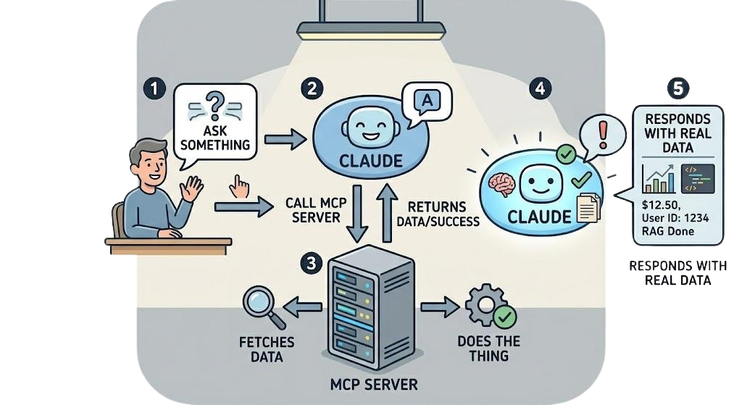
NetworkAI
Workshop
How does MCP work?
Host (Claude/ChatGPT)
Client (Bridge)
Server (The Tool)
Claude asks the google calendar MCP server for your schedule, gets it back, then answers your question
Notes:
how to effectively vibe code:
1. describe what you want
you don't want to be like what Andrej said in the post. you want to vibe with intention, and be confident that you understand the product/codebase and what's changing between each prompt.
If you're building a website, you have to outline the behavior of the website, what functions it serves, and what features it has.
terrible example: doesn't know what website you're thinking of , so it's a blank welcome page.

Slide 11
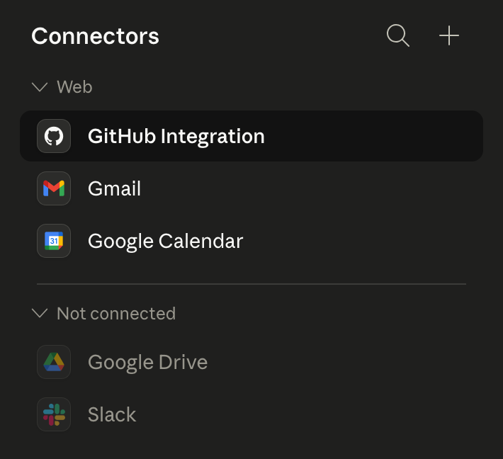
NetworkAI
Workshop
Real MCP
EXAMPLES
Claude + Gmail: summarize threads, draft replies
Claude + Google Drive: find and read documents
Claude + Slack: search messages, send updates, set up automations
Claude + GitHub: review code, open issues
Notes:
make sure everyone has:
- cursor
- github
- vercel

Slide 12
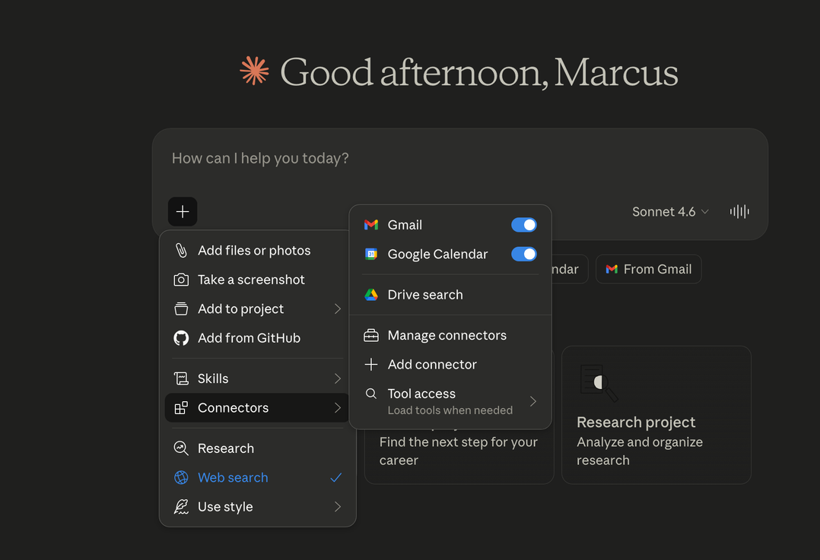
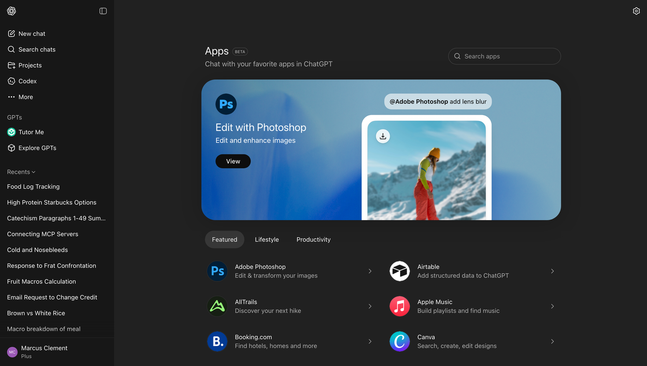
NetworkAI
Workshop
Live Demo
Apps and Connectors
on ChatGPT Settings
in Claude if you click on plus next to chatbar
Connectors

Slide 13
NetworkAI
Workshop
What you can create using MCP
The personal project ideas are endless with MCP.
It can easily be utilized to create a product or system that saves you time or offers convenience.

Slide 14
NetworkAI
Workshop
Bigger Picture of MCP
MCP is becoming the standard, not just Anthropic's thing
(other model providers adopting it)
Agentic AI: the next wave isn't chatbots, it's AI that acts autonomously across your tools
People who understand this layer and know how to utilize it will stand out

Slide 16
NetworkAI
Workshop
What is RAG?
Retrieval-Augmented
Generation
LLMs are trained on data up to a cutoff date and don't know your specific documents, company files, or private information
Asking ChatGPT about your company's internal policy manual? It has no idea.
Before the AI answers, it first retrieves relevant information from a document library you provide
Then it uses that retrieved context to generate a more accurate, grounded answer
Think of it like an open-book exam vs. a closed-book one → RAG lets the AI use the book
One-line summary: give the AI your documents so it can answer questions about your world, not just the general internet.
Everyday Use Cases
Customer support bot that actually knows your company's return policy
Asking questions over a 100-page research report
A study tool that answers questions based only on your class notes
Legal or HR teams querying internal policy documents

Slide 17
NetworkAI
Workshop
Use Cases
for Students
The RAG
Connection
NotebookLM
A Google product powered by Gemini, built entirely around RAG
You upload your own sources (PDFs, docs, YouTube links, websites, Google Drive files) and it becomes an AI that only answers based on what you gave it
Upload all your lecture slides and ask it to quiz you
Drop in a dense research paper and get a plain-English summary
Combine multiple sources and ask it to find connections across them
NotebookLM is essentially RAG with a clean UI built on top, no setup required
Great entry point for understanding what RAG feels like before you build anything
What Makes It Different?
No hallucinations from general training data, it cites the exact source for every answer
Generates study guides, FAQs, timelines, and briefing docs from your uploads automatically
Audio Overview feature: turns your documents into a podcast-style conversation between two AI hosts
Notes:
Vibe coding existed before the term was coined. It started in late 2024 but became popular after Andrej Karpathy called it "vibe coding".
Andrej -> founding member of OpenAI and the ex-Director of AI at Tesla
He described it as "fully giving into the vibes" and "forget that the code even exists", and letting agents write every line of code. He mentioned that Cursor Composer with Claude Sonnet was getting too good, but this was back in 2025, it's exponentially better now and easier for the average joe to build something.
The rest of the post explains his process of using the vibe coding tools.
TLDR: building software by describing what you want; not writing every line yourself.
If youre building a product, you'd want a clear goal of what you're building, iterate on the details the agent missed, and perform effective quality control before shipping the final product.

Slide 18
NetworkAI
Workshop
Hands On
Open Claude or ChatGPT on your laptop and play around with different connectors.
Once you get that working, try using two at once, for example: “Check my calendar and draft a Slack message about my availability”
Try giving multi-step tasks if your subscription allows.
*Also feel free to try out NotebookLM. Try pasting lecture
slides into it and ask it questions.

Slide 19
Announcements
Join the Discord if you haven’t already
Recruiter Event RSVP will be out soon
Upcoming events
NetworkAI x KTP Recruiter Event | Tuesday, May 5th @ 6-7:30 DEMP 004
Connect with recruiters and learn how AI shows up in hiring.
AI Ethics with Business Ethics Association | Monday, May 18th @6:30-7:30
Joint session on responsible AI in business contexts.

