Slide 1
ASH – Active Session History
Feel the Power
Kyle Hailey
Embarcadero Technologies
Kyle.hailey@embarcadero.com
http://Oraperf.sourceforge.net

Slide 2
Who is Kyle Hailey
1990 Oracle
  90 Oracle Unix support
  92 Ported v6 onto Dec Ultrix
  93 Oracle France
  94 Gold Support Specialist
  95 Performance Expert at Digital Europe
  98 Kernel Development California
2000 Dot.Com
2001 Quest
2002 Oracle OEM 10g
2005 Embarcadero
When not being being a Geek writing for the Oaktable etc
- windsurf
- gallivant around the world
- and wonder how I missed the dot.com millions

Slide 3
ASH
Whole New Paradigm in Technology
The Power of ASH lies in
Simplifying Performance Tuning
Totally new and exciting methodology
Cheaper, Quicker, Richer and better tasting too

Slide 4
Why should you care?
Because ASH can Change your life …
10g immediately Accessible
  For Geeks: Via scripts in SQL
  For non-geeks (ie Sales People) :
  Graphical EM
For those of you stuck on 7,8,9 , my apologies because 10g rocks
But no worries, the data is accessible for you too
  via PL/SQL data collection scripts
  Then the power of ASH is accessible via SQL

Slide 5
Here’s a piece of Personal history

Slide 6
This is the story of how
ASH changed my Life
Once upon a time I was stuck in dull tech support …
Finally I was promoted to head DBA, thinking my life was getting better…

Slide 7
But … It was then that I learned I needed to know what the databases were doing ALL the time
Because lives and more importantly my job depended on it

Slide 8
What could I do?!
Clearly a job for Stats Pack
Because stats pack showed me every hour
All the Stats!
All the top Bottlenecks
Almost all the top SQL

Slide 9
So why wasn’t I feeling better?
Hmmm … but … wait
What if my database hits a bottleneck 15 minutes after my last stats pack?!
What about that rouge coder who writes bad SQL … can I find his module gone mad?
Ok I found the top SQL but … now what?

Slide 10
If lives (and my job) depended on my databases
Was once an hour really enough ?
Could Stats Pack find that rogue coder?
Could Stats Pack tell me why an SQL bottlenecked?

Slide 11
Don’t tell anyone but …
SVRMGR>
SVRMGR> set charwidth 12
Charwidth 12
SVRMGR> set numwidth 10
Numwidth 10
SVRMGR> Rem Select Library cache statistics. The pin hit rate shoule be high.
SVRMGR> select namespace library,
2> gets,
3> round(decode(gethits,0,1,gethits)/decode(gets,0,1,gets),3)
4> gethitratio,
5> pins,
6> round(decode(pinhits,0,1,pinhits)/decode(pins,0,1,pins),3)
7> pinhitratio,
8> reloads, invalidations
9> from stats$lib;
LIBRARY GETS GETHITRATI PINS PINHITRATI RELOADS INVALIDATI
------------ ---------- ---------- ---------- ---------- ---------- ----------
BODY 40 .95 40 .4 0 0
CLUSTER 0 1 0 1 0 0
INDEX 0 1 0 1 0 0
OBJECT 0 1 0 1 0 0
PIPE 0 1 0 1 0 0
SQL AREA 835 .938 82110 .999 0 0
TABLE/PROCED 117 .778 485 .94 0 0
TRIGGER 0 1 0 1 0 0
8 rows selected.
SVRMGR>
I couldn’t even decipher Stats Pack half the time

Slide 12
Oh no … it’s 3am my manager calls
“why is the database hanging?!”
Who did it?
Where did the SQL get blocked?
What if the bottlenecked started 5 minutes after my last Stats Pack?

Slide 13
In that moment of crises Stats Pack couldn’t tell me
… but ASH can

Slide 14
The crises of my day have left the “ASHes” of today.
I didn’t have ASH but
You do

Slide 15
Introducing ASH my Friend ☺
A technology capable of saving lives …
(And your job)
Notes:
Size of Ash
--- Algorithm used to estimate ASH buffers size
memory_quota = max(2% of sga_target, 5% of shared_pool_size); /*
sga_target = 0 when AUTO SGA is OFF */
cpu_quota = 2MB * (# of CPUs);
ash_size = min( cpu_quota, memory_quota );
ash_size = max( 1MB, ash_size); /* atleast 1MB */
ash_size = min( 128MB, ash_size); /* atmost 128MB */
---

Slide 16
ASH
A Revolution in Monitoring
Active Session History
New 10g
Every Second it collects data
1 hour of history in Memory for immediate access at your fingertips
This an hour of data could change your life
Notes:
Size of Ash
--- Algorithm used to estimate ASH buffers size
memory_quota = max(2% of sga_target, 5% of shared_pool_size); /*
sga_target = 0 when AUTO SGA is OFF */
cpu_quota = 2MB * (# of CPUs);
ash_size = min( cpu_quota, memory_quota );
ash_size = max( 1MB, ash_size); /* atleast 1MB */
ash_size = min( 128MB, ash_size); /* atmost 128MB */
---

Slide 17
It’s a Revolution and it’s an Evolution
Oracle 6 … ie the dark ages … there was once the Cache Buffer Hit Ratio
Oracle 7 … turned the lights on … Wait Events … hallelujah I can see the light
Oracle 10g … ASH has landed
(like the wheels on the suitcases)

Slide 18
ASH – Intelligence for the new Millennium
Intelligently Collects Data
  It self adjusts for your needs
  More activity, more data collected
  Less activity, less data collected
Those old methods collected everything
  Obfuscated the problem, too many statistics too late
  Costly
  Too Granular – once an hour ?! Give me a break

Slide 19
ASH – In Memory
Collects active session data only
History v$session_wait + v$session + extras
Circular Buffer - 1M to 128M (~2% of SGA)
Flushed every hour to disk or when buffer 2/3 full (it protects itself so you can relax)
Notes:
Size of Ash
--- Algorithm used to estimate ASH buffers size
memory_quota = max(2% of sga_target, 5% of shared_pool_size); /*
sga_target = 0 when AUTO SGA is OFF */
cpu_quota = 2MB * (# of CPUs);
ash_size = min( cpu_quota, memory_quota );
ash_size = max( 1MB, ash_size); /* atleast 1MB */
ash_size = min( 128MB, ash_size); /* atmost 128MB */
---

Slide 20
ASH Sizing …
Avg row around 150bytes
3600 secs in an hour
~ ½ Meg per Active Session per hour
That’s generally over an hour of ASH

Slide 21
ASH Samples
What is Sampling?

Slide 22
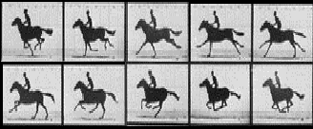

Sampling is like taking Pictures

Slide 23




ASH Samples Session State
Session 1
10:00:00
10:00:01
10:00:02
10:00:03
10:00:04
10:00:05
TIME
Sessions change but we want the main picture

Slide 24
ASH Samples Session State
Session 1
?
?
?
?
?
TIME
Sessions change a lot quicker but can get the main picture via sampling by sampling faster

Slide 25
If happens a lot or for long … we’ll catch it, guaranteed

Slide 26
Session States
IO
CPU
Wait
Idle

Slide 27
IDLE
Ex : SQL*Net Message from Client
All Idle Events:
select name from v$event_name where
wait_class='Idle‘;
58 Rows
Notes:
pmon timer
rdbms ipc message
wait for unread message on broadcast channel
wait for unread message on multiple broadcast channels
ges remote message
ges reconfiguration to start
gcs remote message
PX Deq: Par Recov Reply
PX Deq: Par Recov Execute
PX Deq: Par Recov Change Vector
wait for activate message
wakeup event for builder
wakeup event for preparer
wakeup event for reader
wait for transaction
parallel recovery coordinator waits for cleanup of slaves
smon timer
PX Deq: Txn Recovery Start
PX Deq: Txn Recovery Reply
statement suspended, wait error to be cleared
PX Deq: Index Merge Reply
PX Deq: Index Merge Execute
PX Deq: Index Merge Close
PX Deq: kdcph_mai
PX Deq: kdcphc_ack
virtual circuit status
dispatcher timer
jobq slave wait
pipe get
PX Deque wait
PX Idle Wait
PX Deq: Join ACK
PX Deq Credit: need buffer
PX Deq: Msg Fragment
PX Deq: Parse Reply
PX Deq: Execute Reply
PX Deq: Execution Msg
PX Deq: Table Q Normal
PX Deq: Table Q Sample
single-task message
SQL*Net message from client
SQL*Net message from dblink
PL/SQL lock timer
queue messages
wakeup time manager
AQ Proxy Cleanup Wait
Queue Monitor Wait
Queue Monitor Slave Wait
Queue Monitor Shutdown Wait
Queue Monitor IPC wait
STREAMS apply coord waiting for slave message
STREAMS fetch slave waiting for txns
STREAMS apply slave idle wait
STREAMS capture process filter callback wait for ruleset
waiting for subscribers to catch up
waiting for low memory condition to be resolved
HS message to agent
JS external job

Slide 28
CPU
ASH: SESSION_STATE = “ON CPU”
ASH: wait_time > 0

Slide 29
WAITING
ASH: SESSION_STATE=‘WAITING’
ASH: WAIT_TIME=0
WAIT_CLASS
  Administrative
  Application
  Cluster
  Commit
  Concurrency
  Configuration
  Network
  Other
  Scheduler
  System I/O
800+ WAIT

Slide 30
IO
ASH:
SESSION_STATE=‘WAITING’
and
WAIT_CLASS=‘User I/O’

Slide 31
Samples for all users
Session 1
Session 2
Session 3
Session 4
10:15:00
10:15:01
10:15:02
10:15:03
10:15:04
10:15:05
10:15:06
10:15:07
TIME

Slide 32
ASH Fields
SQL> v$active_session_history
Name Null? Type
----------------------------------------- -------- ----------------------------
SAMPLE_ID NUMBER
SAMPLE_TIME TIMESTAMP(3)
SESSION_ID NUMBER
SESSION_SERIAL# NUMBER
USER_ID NUMBER
SQL_ID VARCHAR2(13)
SQL_CHILD_NUMBER NUMBER
SQL_PLAN_HASH_VALUE NUMBER
SQL_OPCODE NUMBER
SERVICE_HASH NUMBER
SESSION_TYPE VARCHAR2(10)
SESSION_STATE VARCHAR2(7)
QC_SESSION_ID NUMBER
QC_INSTANCE_ID NUMBER
EVENT VARCHAR2(64)
EVENT_ID NUMBER
EVENT# NUMBER
SEQ# NUMBER
P1 NUMBER
P2 NUMBER
P3 NUMBER
WAIT_TIME NUMBER
TIME_WAITED NUMBER
CURRENT_OBJ# NUMBER
CURRENT_FILE# NUMBER
CURRENT_BLOCK# NUMBER
PROGRAM VARCHAR2(48)
MODULE VARCHAR2(48)
ACTION VARCHAR2(32)
CLIENT_ID VARCHAR2(64)

Slide 33
v$active_session_history
SAMPLE_ID NUMBER
SAMPLE_TIME TIMESTAMP(3)
When
Session
SESSION_ID NUMBER
SESSION_SERIAL# NUMBER
USER_ID NUMBER
SERVICE_HASH NUMBER
SESSION_TYPE VARCHAR2(10)
PROGRAM VARCHAR2(64)
MODULE VARCHAR2(48)
ACTION VARCHAR2(32)
CLIENT_ID VARCHAR2(64)
SESSION_STATE VARCHAR2(7)
WAIT_TIME NUMBER
State
Wait
EVENT VARCHAR2(64)
EVENT_ID NUMBER
EVENT# NUMBER
SEQ# NUMBER
P1 NUMBER
P2 NUMBER
P3 NUMBER
WAIT_TIME NUMBER
TIME_WAITED NUMBER
CURRENT_OBJ# NUMBER
CURRENT_FILE# NUMBER
CURRENT_BLOCK# NUMBER0
SQL
SQL_ID VARCHAR2(13)
SQL_CHILD_NUMBER NUMBER
SQL_PLAN_HASH_VALUE NUMBER
SQL_OPCODE NUMBER
QC_SESSION_ID NUMBER
QC_INSTANCE_ID NUMBER
Duration
TIME_WAITED NUMBER

Slide 34
Primary Fields of ASH
SAMPLE_TIME
When
SESSION_STATE
State
SESSION_ID
Session
SQL_ID
SQL
EVENT
Wait
Duration
TIME_WAITED

Slide 35
Amazing things YOU can do with ASH

Slide 36
Resource Consumers
Consumers
Top Session
Top User
Top SQL
Top Object
Top Module.Action
Top Program
Top Service
Top Client
Top Wait
Resources
CPU
Waits
  Event (800*)
I/O
  File
  Block
Time
X
(32 columns in ASH)

Slide 37
Consumer Columns
SAMPLE_ID NUMBER
SAMPLE_TIME TIMESTAMP(3)
When
*
Session
SESSION_ID NUMBER
SESSION_SERIAL# NUMBER
USER_ID NUMBER
SERVICE_HASH NUMBER
SESSION_TYPE VARCHAR2(10)
PROGRAM VARCHAR2(64)
MODULE VARCHAR2(48)
ACTION VARCHAR2(32)
CLIENT_ID VARCHAR2(64)
*
*
*
*
*
*
SESSION_STATE VARCHAR2(7)
WAIT_TIME NUMBER
State
Wait
*
EVENT VARCHAR2(64)
EVENT_ID NUMBER
EVENT# NUMBER
SEQ# NUMBER
P1 NUMBER
P2 NUMBER
P3 NUMBER
WAIT_TIME NUMBER
TIME_WAITED NUMBER
CURRENT_OBJ# NUMBER
CURRENT_FILE# NUMBER
CURRENT_BLOCK# NUMBER0
SQL
*
SQL_ID VARCHAR2(13)
SQL_CHILD_NUMBER NUMBER
SQL_PLAN_HASH_VALUE NUMBER
SQL_OPCODE NUMBER
QC_SESSION_ID NUMBER
QC_INSTANCE_ID NUMBER
Duration
TIME_WAITED NUMBER

Slide 38
Groupings – Top Consumer
SESSION_ID
SESSION_SERIAL# (signal SID reuse)
SESSION_TYPE (FOREGROUND,BACKGROUND)
USER_ID (SYS, SYSTEM, SCOTT etc)
SERVICE_HASH (OE,GL,HR)
MODULE.ACTION(PLSQL tagging)
CLIENT_ID (customers connecting via session pool)
PROGRAM (SQL, JDBC, Forms etc)
SQL_ID
QC_SESSION_ID - Query Coordinator
QC_INSTANCE_ID
EVENT + P1, P2, P3
CURRENT_OBJ#
CURRENT_FILE#
CURRENT_BLOCK#

Slide 39
Top CPU Session
Who is the rogue session ?
  Select
  session_id,
  count(*)
  from
  v$active_session_history
  where
  session_state= ‘ON CPU‘ and
  SAMPLE_TIME > sysdate – (5/(24*60))
  group by
  session_id
  order by
  count(*) desc;

Slide 40
Results Top CPU Session
SESSION_ID COUNT(*)
---------- ----------
265 256
264 15
257 12
271 12
276 1
Notes:
Select
session_id, session_serial# ,
count(*) ,
round((count(*)*100)/(5*60),0) "%",
lpad('*',round((count(*)*10)/(5*60),0),'*') "Bar"
from
v$active_session_history
where
session_state= 'ON CPU' and
SAMPLE_TIME > sysdate - (5/(24*60))
group by
session_id, session_serial#
order by
count(*) desc
/

Slide 41
CPU with Bars
SESSION_ID COUNT(*) % Bar
---------- ---------- ---------- ------------
257 75 25 |*** |
263 62 21 |** |
256 32 11 |* |
264 9 3 | |
277 3 1 | |
258 1 0 | |
280 1 0 | |
Notes:
Select
session_id, session_serial# ,
count(*) ,
round((count(*)*100)/(5*60),0) "%",
lpad('*',round((count(*)*10)/(5*60),0),'*') "Bar"
from
v$active_session_history
where
session_state= 'ON CPU' and
SAMPLE_TIME > sysdate - (5/(24*60))
group by
session_id, session_serial#
order by
count(*) desc
/

Slide 42
Top Waiting Session
Top Waiting Session in last 5 minutes
Select
session_id,
count(*)
from
v$active_session_history
where
session_state=‘WAITING’ and
SAMPLE_TIME > SYSDATE - (5/(24*60))
group by
session_id
order by
count(*) desc;

Slide 43
Top Waiting Session Results
SESSION_ID COUNT(*)
---------- ----------
272 224
254 8
249 5
276 5
277 4
270 1

Slide 44
Top SQL from ASH
Top Categories of Resource usage – IO, CPU, WAIT
select
ash.SQL_ID ,
sum(decode(ash.session_state,'ON CPU',1,0)) "CPU",
sum(decode(ash.session_state,'WAITING',1,0)) -
sum(decode(ash.session_state,'WAITING', decode(en.wait_class, 'User I/O',1,0),0)) "WAIT" ,
sum(decode(ash.session_state,'WAITING', decode(en.wait_class, 'User I/O',1,0),0)) "IO" ,
sum(decode(ash.session_state,'ON CPU',1,1)) "TOTAL"
from v$active_session_history ash,
v$event_name en
where SQL_ID is not NULL and en.event#=ash.event#
group by sql_id
order by sum(decode(session_state,'ON CPU',1,1)) desc

Slide 45
Top SQL from ASH Results
SQL_ID CPU WAITING IO TOTAL
------------- ---------- ---------- ---------- ----------
4c1xvq9ufwcjc 23386 0 0 23386
6wjw6rz5uvbp3 99 0 23 122
968dm8hr9qd03 97 0 22 119
938jp5gasmrah 90 0 25 115
cv8xnv81kf582 42 0 9 51
6p9bzu19v965k 21 0 0 21
5zu8pxnun66bu 15 0 0 15
db2jr13nup72v 9 0 0 9
7ks5gnj38hghv 8 0 0 8
38gfa1vpmwvx6 5 0 0 5
6zw21jfzjsunv 5 0 0 5
78s8yj36j2w1t 4 1 0 5
6769wyy3yf66f 4 0 0 4
aptc882suuy74 4 0 0 4

Slide 46
Top Session
select
ash.session_id,
ash.session_serial#,
ash.user_id,
ash.program,
sum(decode(ash.session_state,'ON CPU',1,0)) "CPU",
sum(decode(ash.session_state,'WAITING',1,0)) -
sum(decode(ash.session_state,'WAITING',
decode(en.wait_class,'User I/O',1, 0 ), 0)) "WAITING" ,
sum(decode(ash.session_state,'WAITING',
decode(en.wait_class,'User I/O',1, 0 ), 0)) "IO" ,
sum(decode(session_state,'ON CPU',1,1)) "TOTAL"
from v$active_session_history ash,
v$event_name en
where en.event# = ash.event#
group by session_id,user_id,session_serial#,program
order by sum(decode(session_state,'ON CPU',1,1))

Slide 47
Top Session Results
SESSION_ID SERIAL# USER_ID PROGRAM CPU WAITING IO
---------- ------- ---------- ------------------------- ------- ---------- ----------
247 61970 1 sqlplus 11698 0 0
277 1 0 oracle@labsfrh903 (LGWR) 14 21 0
276 1 0 oracle@labsfrh903 (CKPT) 19 10 0
278 1 0 oracle@labsfrh903 (DBW0) 29 0 0
280 1 0 oracle@labsfrh903 (PMON) 19 0 0
254 22617 5 Executor.exe 13 0 3
255 12877 5 Executor.exe 11 0 5
257 33729 5 Executor.exe 15 0 1
255 13417 5 Executor.exe 14 0 2

Slide 48
Top Session w/ Username
select
/* if sid not found in v$session then disconnected */
decode(nvl(to_char(s.sid),-1),-1,'DISCONNECTED','CONNECTED')
"STATUS",
topsession.session_id "SESSION_ID",
u.name "NAME",
topsession.program "PROGRAM",
max(topsession.CPU) "CPU",
max(topsession.WAITING) "WAITING",
max(topsession.IO) "IO",
max(topsession.TOTAL) "TOTAL"
from ( previous query ) topsession,
v$session s,
user$ u
where
u.user# =topsession.user_id and
/* outer join to v$session because the session might be disconnected */
topsession.session_id = s.sid (+) and
topsession.session_serial# = s.serial# (+)
group by topsession.session_id, topsession.session_serial#, topsession.user_id,
topsession.program, s.username,s.sid,s.paddr,u.name
order by max(topsession.TOTAL) desc

Slide 49
Top Session
Finding a Rogue User
STATUS SESSION_ID NAME PROGRAM CPU WAITING IO
--------------- ---------- ---------- ------------------------- ---------- ---------- ----------
CONNECTED 247 CPU_Monger ChMgr304.exe 11704 0 0
CONNECTED 277 SYS oracle@labsfrh903 (LGWR) 14 19 0
CONNECTED 278 SYS oracle@labsfrh903 (DBW0) 29 0 0
CONNECTED 276 SYS oracle@labsfrh903 (CKPT) 18 9 0
CONNECTED 280 SYS oracle@labsfrh903 (PMON) 20 0 0
DISCONNECTED 255 SYSTEM Executor.exe 11 4 5
DISCONNECTED 257 SYSTEM Executor.exe 13 0 3
DISCONNECTED 255 SYSTEM Executor.exe 14 0 2
DISCONNECTED 257 SYSTEM Executor.exe 13 0 3
DISCONNECTED 254 SYSTEM Executor.exe 12 0 3
DISCONNECTED 254 SYSTEM Executor.exe 13 0 2
DISCONNECTED 256 SYSTEM Executor.exe 11 0 4
DISCONNECTED 256 SYSTEM Executor.exe 12 0 3
DISCONNECTED 256 SYSTEM Executor.exe 13 0 2
DISCONNECTED 255 SYSTEM Executor.exe 14 0 1
DISCONNECTED 254 SYSTEM Executor.exe 11 0 4
DISCONNECTED 246 SYSTEM Executor.exe 11 0 3
DISCONNECTED 246 SYSTEM Executor.exe 13 0 1

Slide 50
Top Wait
How to Attack the problem?
Top SQL?
  Top wait for that SQL?
Top Waiting Session ?
  Top Waits for that Session
Top Waits for Database?
  Top Session waiting for that wait
  Top SQL for that wait
With Ash you can attack the problem all these ways

Slide 51
Graphical ASH
Session 1
Session 2
Session 3
Session 4
TIME

Slide 52
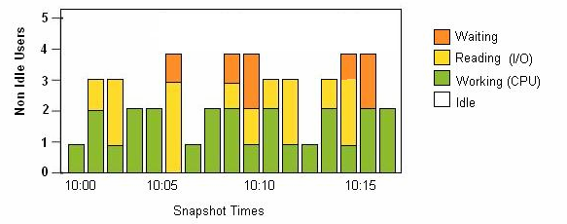
Graph of User States

Slide 53
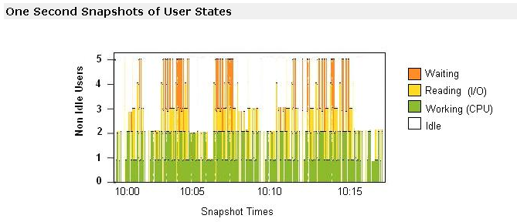
One Second Graph

Slide 54
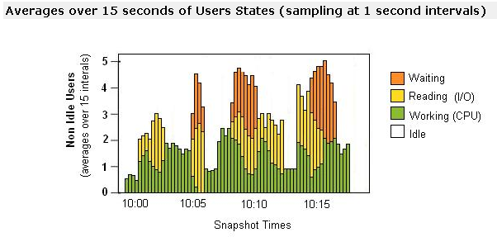
15 Second Averages

Slide 55
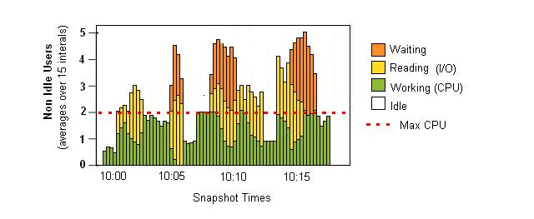
Maximum CPU Line

Slide 56
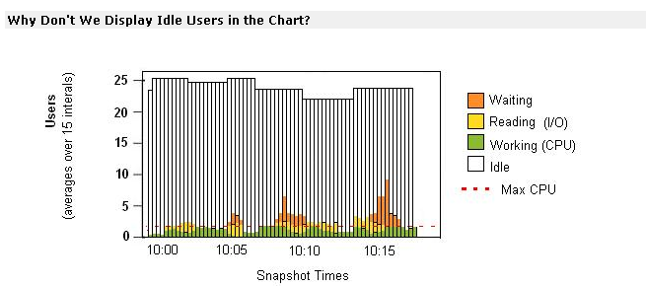
Idle Users

Slide 57
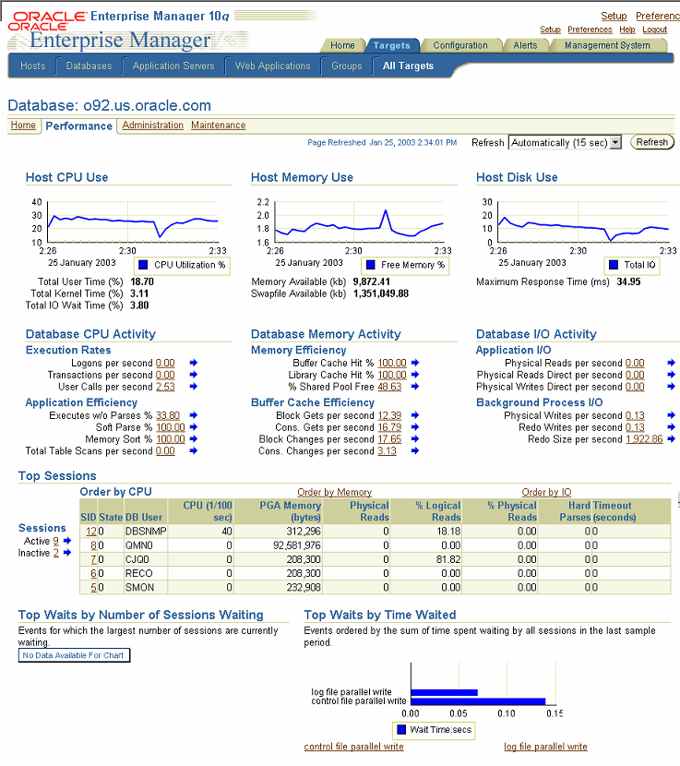
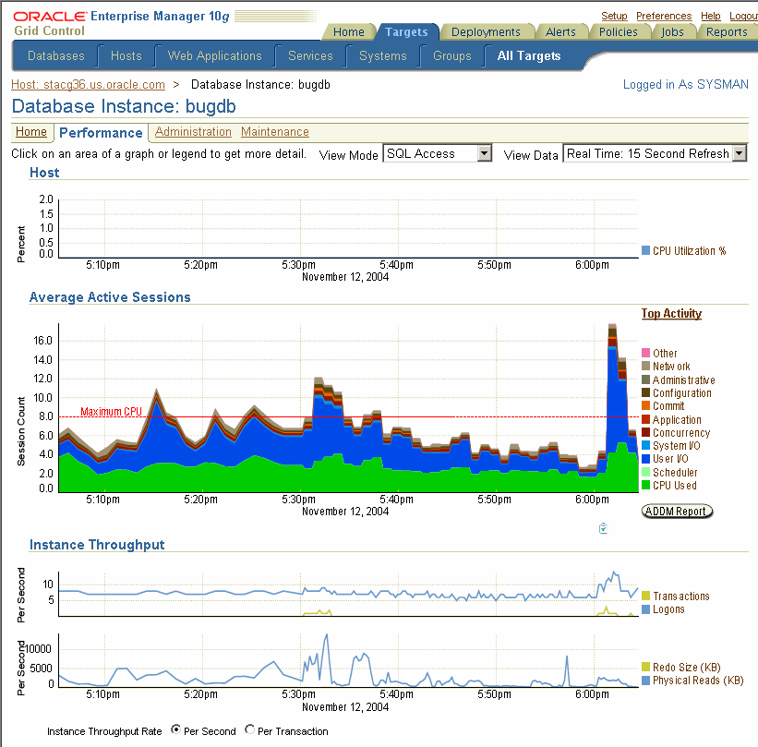
OEM Perf Page

Slide 58
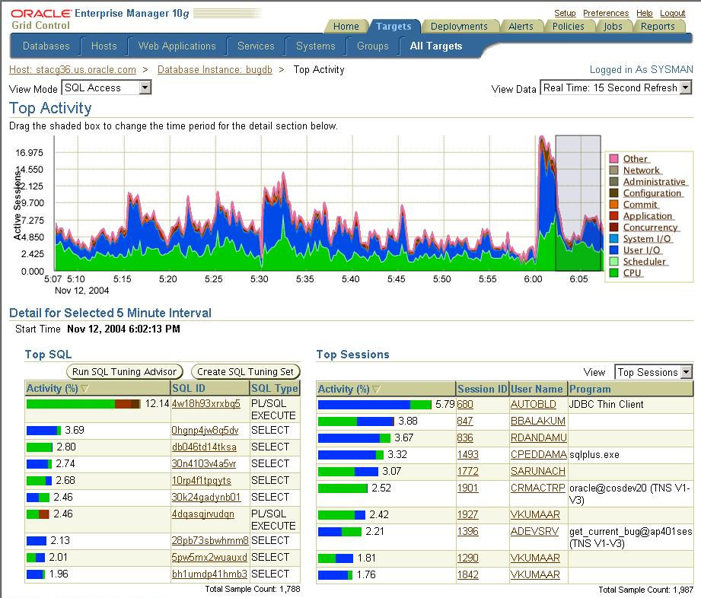
OEM Perf Page

Slide 59
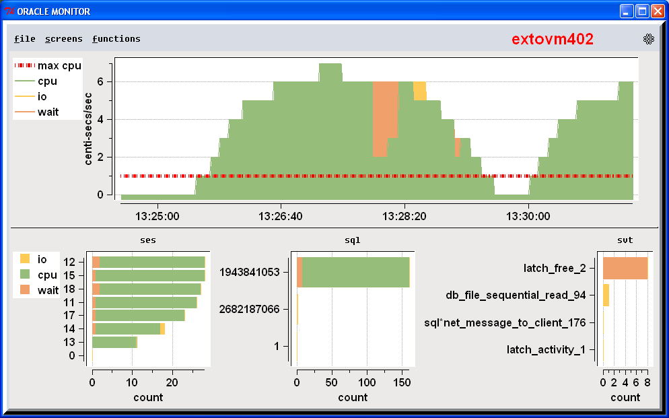
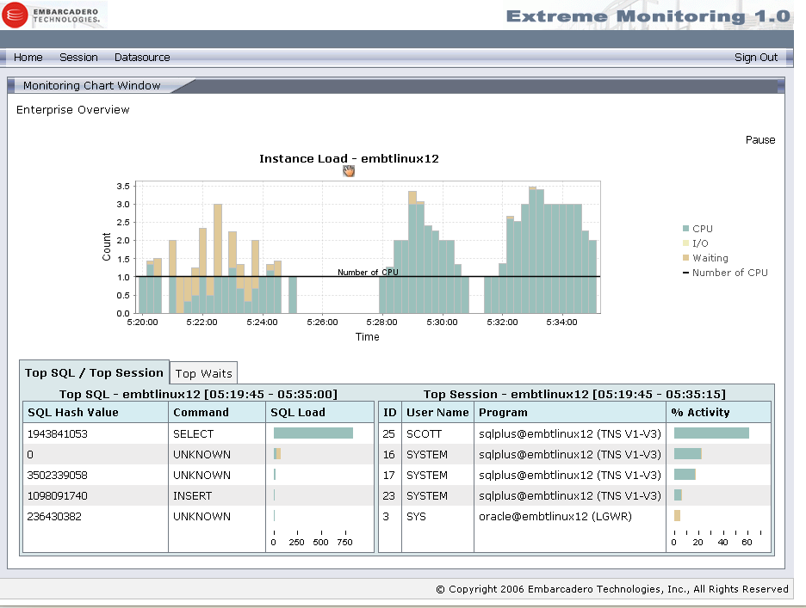
TCL CPU

Slide 60
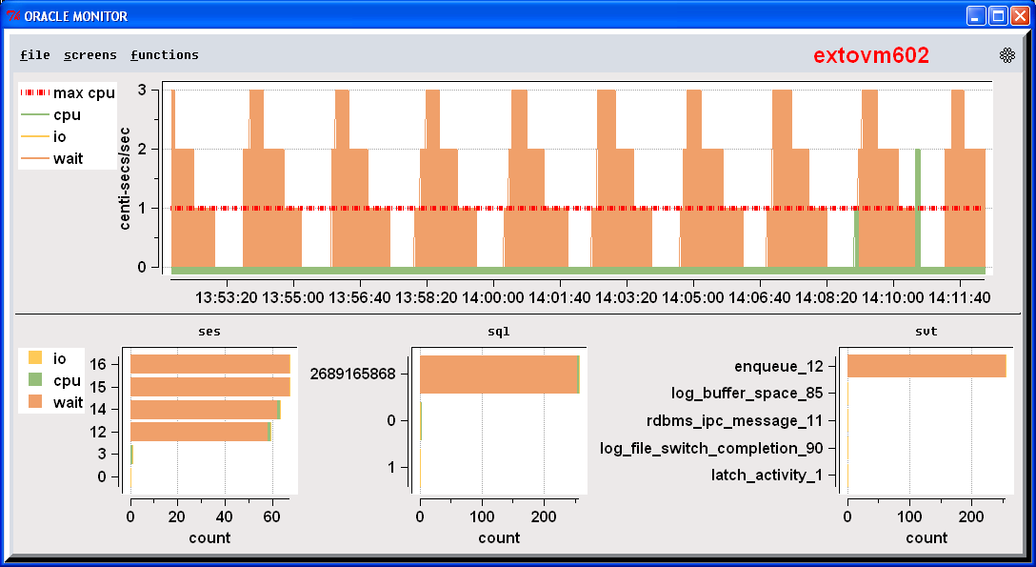
TCL Blocked Users (lock)

Slide 61
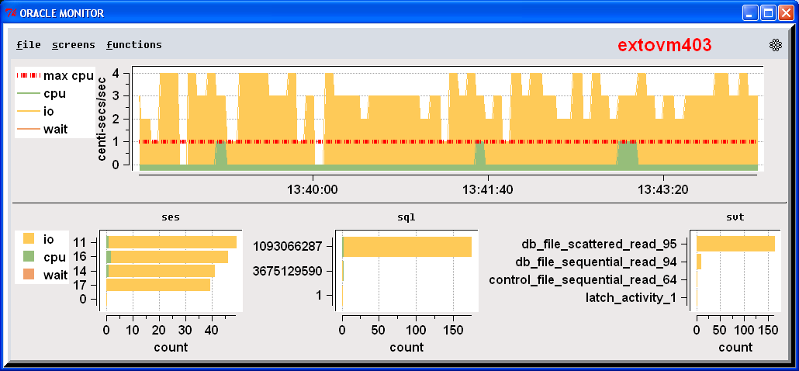
IO

Slide 62
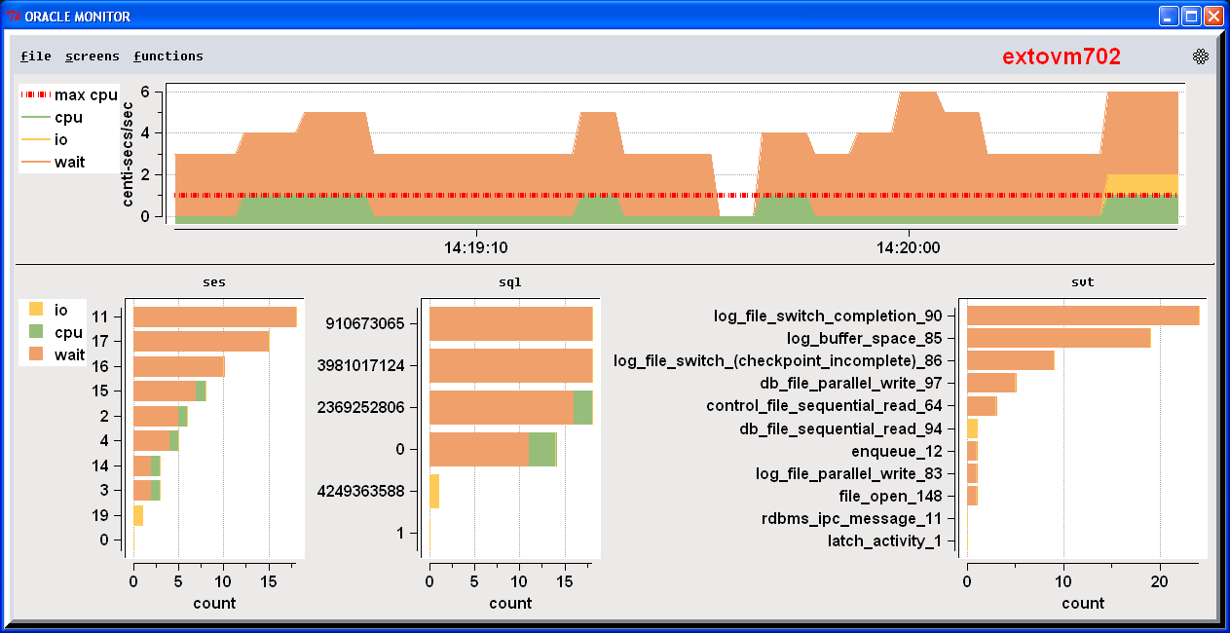
Redo Log Problems

Slide 63
Statistics vs Waits
Cache Buffer Hit vs IO Waits
Why group around in the dark – just turn the lights on

Slide 64
CPU problem
CPU is only updated at the end of the call.
Long calls look deceiving like no CPU is being used

Slide 65
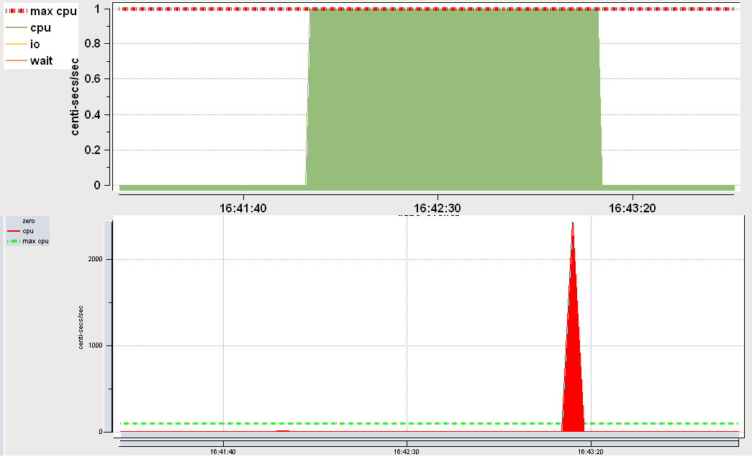
CPU in ASH vs Stats

Slide 66
Monitoring Waits can be Expensive
Rows queried =
  # of sessions x # of waits
  In 10g there are over 800 waits.
  For example 100 user x 800 waits = 80,000 rows

Slide 67
Sampling Cheap
With PL/SQL it’s less that 1 % CPU with 10 average active sessions
ASH in 10g even cheaper than SQL
ASH via Memory Scraping , 200x cheaper

Slide 68
ASH is Rich Data
On top of being Cheap the data is multi-dimensional – you can cut it up in many different ways
  Top Session
  Top SQL
  Top Module
  Top Action
  Top Program
  Top Client
  Top Service
All ranked by CPU, IO, or any of 800 waits or time spent in wait, or by file accessed, or object accessed
(instead of accessing 10s or 100s of tables or screens its all in one)

Slide 69
Alert on Blocked Sessions
Any session that is on a wait 15/15 samples can be called blocked whether or not they are on a row lock

Slide 70
ASH easily enables Drilldown Investigation
If a spike in System Load
Then find out which SQL
Then out what that SQL blocked on
  CPU then tune statement
  Wait
    Which wait
      Tune database
      Tune SQL

Slide 71
Simulating ASH
ASH is new in 10g
Need Diagnostic Pack License ☹
ASH data exist since V7
Collect it yourself ☺
  - Join v$session_wait & v$session
  - Save in a table
Consumes < 1% CPU for 10 active sessions (a lot)

Slide 72
Description of v$session_wait
Session
SID NUMBER
SEQ# NUMBER
WAIT_TIME NUMBER
State
EVENT VARCHAR2(64)
P1TEXT VARCHAR2(64)
P1 NUMBER
P1RAW RAW(4)
P2TEXT VARCHAR2(64)
P2 NUMBER
P2RAW RAW(4)
P3TEXT VARCHAR2(64)
P3 NUMBER
P3RAW RAW(4)
WAIT_TIME NUMBER
SECONDS_IN_WAIT NUMBER
STATE VARCHAR2(19)
Wait

Slide 73
Description of v$active_session_history
Calculated
SAMPLE_ID NUMBER
SAMPLE_TIME TIMESTAMP(3)
Time
Session
SESSION_ID NUMBER
SESSION_SERIAL# NUMBER
USER_ID NUMBER
SERVICE_HASH NUMBER
SESSION_TYPE VARCHAR2(10)
QC_SESSION_ID NUMBER
QC_INSTANCE_ID NUMBER
PROGRAM VARCHAR2(64)
MODULE VARCHAR2(48)
ACTION VARCHAR2(32)
CLIENT_ID VARCHAR2(64)
v$session
SESSION_STATE VARCHAR2(7)
State
Wait
EVENT VARCHAR2(64)
EVENT_ID NUMBER
EVENT# NUMBER
SEQ# NUMBER
P1 NUMBER
P2 NUMBER
P3 NUMBER
WAIT_TIME NUMBER
TIME_WAITED NUMBER
CURRENT_OBJ# NUMBER
CURRENT_FILE# NUMBER
CURRENT_BLOCK# NUMBER
SQL
SQL_ID VARCHAR2(13)
SQL_CHILD_NUMBER NUMBER
SQL_PLAN_HASH_VALUE NUMBER
SQL_OPCODE NUMBER
v$session

Slide 74
Create a Package and Insert
Create Package
  Query v$session & v$session_wait joined
  Sample 1 a second
  Collect into a GTT
  Insert into local or remote every 15 seconds
  voila

Slide 75
Create ASH Storage Table
drop table ash_data;
create table ash_data (
target_id number,
sample_id number,
sample_time date,
sid number,
state varchar2(20),
serial# number,
user# number,
sql_address# varchar2(20),
sql_hash number,
command number,
session_type number,
event# number,
seq# number,
p1 number,
p2 number,
p3 number,
wait_time number,
row_wait_obj# number,
row_wait_file# number,
row_wait_block# number,
program varchar2(64),
module_hash number,
action_hash number
);

Slide 76
Simulation Optimizations
Partition ASH_DATA for efficient deletion of old data
Run compaction routines to save history
  Load
  Top Session
  Top sql
  Top waits

Slide 77
How ASH works
V$session_wait+ v$session + extras
MMON/MMNL
v$active_session_history
Only writes out 1 in 10 rows via direct path inserts
wrh$_active_session_history

Slide 78
ASH buffer
Insert one direction
- Touch up wait times
Select reads backwards
No latching
No read consistency
Index on time
Insert point

Slide 79
Family of ASH Tables
v$session_wait
v$active_session_history
V$session_wait_history
wrh$active_session_history

Slide 80
ASH Tables
current
10 samples
hour
7 days (disk)
1 in 10
v$session_wait
SID
SEQ#
EVENT
P1TEXT
P1
P1RAW
P2TEXT
P2
P2RAW
P3TEXT
P3
P3RAW
WAIT_CLASS_ID
WAIT_CLASS#
WAIT_CLASS
WAIT_TIME
SECONDS_IN_WAIT
STATE
v$session_wait_history
SID
SEQ#
EVENT#
EVENT
P1TEXT
P1
P2TEXT
P2
P3TEXT
P3
WAIT_TIME
v$active_session_history
SAMPLE_ID
SAMPLE_TIME
SESSION_ID
SESSION_SERIAL#
USER_ID
SQL_ID
SQL_CHILD_NUMBER
SQL_PLAN_HASH_VALUE
SQL_OPCODE
SERVICE_HASH
SESSION_TYPE
SESSION_STATE
QC_SESSION_ID
QC_INSTANCE_ID
SEQ#
EVENT#
P1
P2
P3
WAIT_TIME
TIME_WAITED
CURRENT_OBJ#
CURRENT_FILE#
CURRENT_BLOCK#
PROGRAM
MODULE
ACTION
CLIENT_ID
wrh$active_session_history
SNAP_D
DBID
INSTANCE_NUMBER
SAMPLE_ID
SAMPLE_TIME
SESSION_ID
SESSION_SERIAL#
USER_ID
SQL_ID
SQL_CHILD_NUMBER
SQL_PLAN_HASH_VALUE
SQL_OPCODE
SERVICE_HASH
SESSION_TYPE
SESSION_STATE
QC_SESSION_ID
QC_INSTANCE_ID
SEQ#
EVENT_ID
P1
P2
P3
WAIT_TIME
TIME_WAITED
CURRENT_OBJ#
CURRENT_FILE#
CURRENT_BLOCK#
PROGRAM
MODULE
ACTION
CLIENT_ID
v$event_name
EVENT_ID
EVENT#
EVENT_ID
NAME
PARAMETER1
PARAMETER2
PARAMETER3
WAIT_CLASS_ID
WAIT_CLASS#
WAIT_CLASS

Slide 81
Wait Time vs Time Waited
SESSION_STATE
  Waiting, on CPU
  Based on WAIT_TIME
WAIT_TIME
  0 => waiting
  >0 => CPU (value is time of last wait)
TIME_WAITED
  Actual time waited for event
  0 until wait finishes
  Fix up values (no one else can do this)

Slide 82
Oradebug
Dump to trace file
  SQL> oradebug dump ash 5
  SQL> Alter session set events ‘immediate
  tracename ashdump level 5’;
  level 5 = # of minutes
  loader file rdbms/demo/ashldr.ctl

Slide 83
INIT.ORA
ASH
statistics_level = Typical (default)
_active_session_history =TRUE (default)
_ash_sampling_interval = 1000 (default, milliseconds)
_ash_enable = false; ( A dynamic parameter will turn off ASH sampling, flushing and the V$ views on ASH )
Notes:
ASH
_ash_enable = false; [ A dynamic parameter will turn off ASH sampling, flushing and the V$ views on ASH ]
ADDM
_addm_auto_enable = false; [ A dynamic parameter to turn off automatic ADDM runs after every AWR snapshot ]
AWR
"_swrf_mmon_flush" = FALSE ; AWR
metrics
"_swrf_mmon_metrics" = FALSE ; METRICS
DB Feature Usage
"_swrf_mmon_dbfus" = FALSE ; DB Feature Usage
"_swrf_on_disk_enabled" = FALSE ; disable all (on disk, including manual) AWR operations:

Slide 84
Client Id
Setting Client ID
dbms_session.set_identifier(client_id);
Enabling trace for a client ID
dbms_monitor.client_id_trace_enable(client_id, TRUE, FALSE);
arguments are trace waits, trace bind variables
Enabling statistics aggregation by client id
dbms_monitor.client_id_stat_enable (client_id);
Script to Extract Client Trace
  trcsess

Slide 85
Session Dedicated
Scott
John
Sue
Mike
Randy
Tim
Mary
Oracle
Sessions
S1
S2
S3
S4
S4
S5
S6
Oracle Database Host

Slide 86
Session Dedicated trace
Scott
John
Sue
Mike
Randy
Tim
Mary
SQL_TRACE=TRUE
Oracle
Sessions
S1
S2
S3
S4
S4
S5
S6
Oracle Database Host

Slide 87
Session Pooling trace
Scott
John
Sue
Mike
Randy
Tim
Mary
APP Server 1
S1, sql_trace=true
Oracle
Sessions
S1
S2
S3
S4
S4
S5
S6
S7
Oracle Database Host

Slide 88
Session Pooling
Scott
John
Sue
Mike
Randy
Tim
Mary
Set client_id = SCOTT
APP Server 1
dbms_session.set_identifier
(client_id);
Oracle
Sessions
S1
S2
S3
S4
S4
S5
S6
S7
Oracle Database Host

Slide 89
Extras
10gR2 add fields to ASH
  Blocking Session Id, serial# and state
  XID, transaction ID
  RAC event Fixup
  Plan Hash Fix up
    10gR1 - during parsing no plan, good way to find parsing problems
    10gR2 – get plan hash fixup – good but loose some ability to find parsing problems
  Wait Class, needed this for grouping

Slide 90
How Many Active Sessions?
How much data does ASH Collect ?
1 CPU means max 1 Avg Active Session unless there is a bottleneck

Slide 91
Active Sessions at Big Sites
Oracle 4 way RAC internal apps
  10,000 connected, 200 active
One Site
  3000 connected, 30 Active
Site
  12,000 connected, 100 active

Slide 92
ASH – OS and other DBs
SQL Server
Linux
DB2
Sybase

Slide 93
The Challenger Incident
Thanks to Edward Tufte

Slide 94
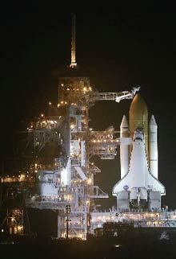
Launch: Pressure
Midnight before
January 28, 1986
Lives are on the line

Slide 95
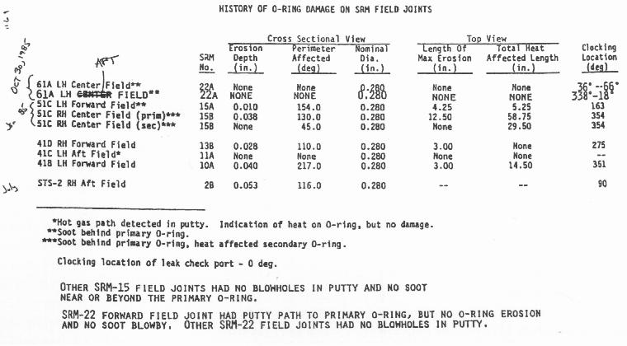
List of Past Problems

Slide 96
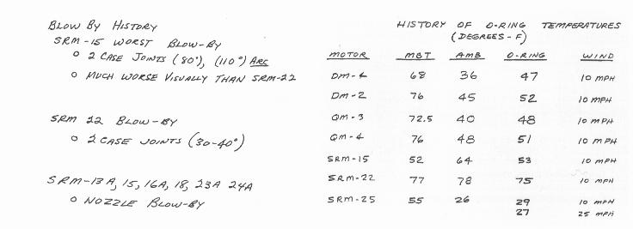
Correlated with Temperatures

Slide 97
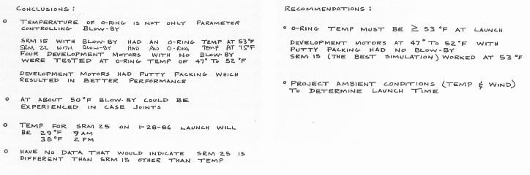
Trying to Show data an Analysis

Slide 98
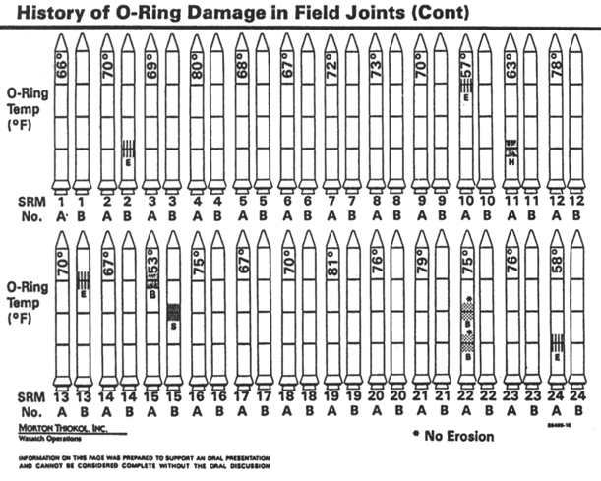
Congressional Hearings Evidence

Slide 99
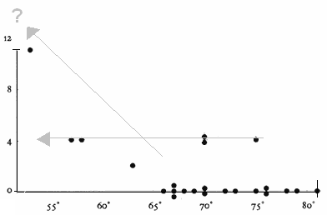
Engineers Tried to Communicate

Slide 100
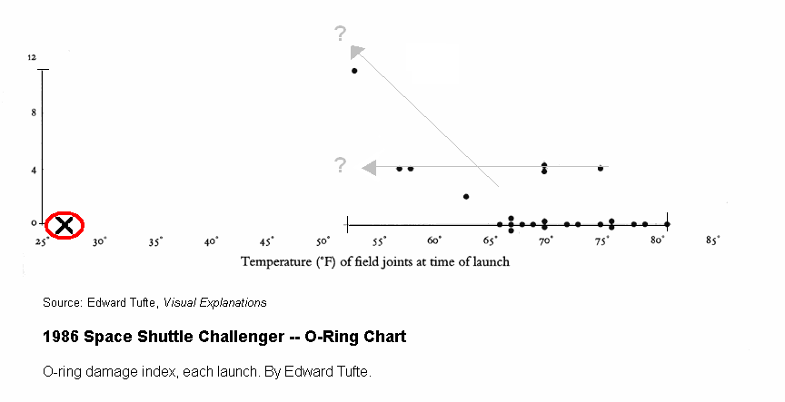
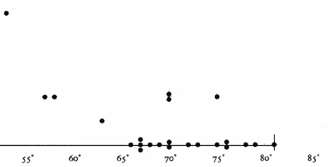
Even Clearer

Slide 101
Difficult
NASA Engineers Fail
Congressional Investigators Fail
Data is Difficult
But …
Lack of Clarity can be devastating

Slide 102
Imagine Trying to Drive your Car if you Dashboard looked like:
SVRMGR>
SVRMGR> set charwidth 12
Charwidth 12
SVRMGR> set numwidth 10
Numwidth 10
SVRMGR> Rem Select Library cache statistics. The pin hit rate shoule be high.
SVRMGR> select namespace library,
2> gets,
3> round(decode(gethits,0,1,gethits)/decode(gets,0,1,gets),3)
4> gethitratio,
5> pins,
6> round(decode(pinhits,0,1,pinhits)/decode(pins,0,1,pins),3)
7> pinhitratio,
8> reloads, invalidations
9> from stats$lib;
LIBRARY GETS GETHITRATI PINS PINHITRATI RELOADS INVALIDATI
------------ ---------- ---------- ---------- ---------- ---------- ----------
BODY 40 .95 40 .4 0 0
CLUSTER 0 1 0 1 0 0
INDEX 0 1 0 1 0 0
OBJECT 0 1 0 1 0 0
PIPE 0 1 0 1 0 0
SQL AREA 835 .938 82110 .999 0 0
TABLE/PROCED 117 .778 485 .94 0 0
TRIGGER 0 1 0 1 0 0
8 rows selected.
SVRMGR>
And is updated once and hour

Slide 103
Or This?
SVRMGR>
SVRMGR> set charwidth 12
Charwidth 12
SVRMGR> set numwidth 10
Numwidth 10
SVRMGR> Rem Select Library cache statistics. The pin hit rate shoule be high.
SVRMGR> select namespace library,
2> gets,
3> round(decode(gethits,0,1,gethits)/decode(gets,0,1,gets),3)
4> gethitratio,
5> pins,
6> round(decode(pinhits,0,1,pinhits)/decode(pins,0,1,pins),3)
7> pinhitratio,
8> reloads, invalidations
9> from stats$lib;
LIBRARY GETS GETHITRATI PINS PINHITRATI RELOADS INVALIDATI
------------ ---------- ---------- ---------- ---------- ---------- ----------
BODY 40 .95 40 .4 0 0
CLUSTER 0 1 0 1 0 0
INDEX 0 1 0 1 0 0
OBJECT 0 1 0 1 0 0
PIPE 0 1 0 1 0 0
SQL AREA 835 .938 82110 .999 0 0
TABLE/PROCED 117 .778 485 .94 0 0
TRIGGER 0 1 0 1 0 0
8 rows selected.
SVRMGR>

Slide 105
3 Types of Collecting
Cumulative
Current
Sampling Current

Slide 106
Cumulative
Cumulative Counters
  v$sysstat
  v$system_event
  Electric meter

Slide 107
Cumulative Need Deltas
Delta
Time
Delta = value_time_B – value_time_A
Rate = Delta/time

Slide 108
Counters and Rates
Statistics - good
  Transactions/sec
  Commits/sec
  Watts/month
Waits – weird, either
  Delta = Seconds spend over time period
  Rate = Centi-secs/sec

Slide 109
Statistics & Waits are Counters
v$sysstat
V$system_event
Electricity meter
physical_reads
buffer busy wait
Watts
Statistics just keep growing
Notes:
If we charted the a statistics value

Slide 110
Current
Current
  v$session_wait
  Current Stats (logons current,opened cursors current)
  temperature

Slide 111
Sampling
Sampling
  ASH
  Sunny days a year per city

